Slide 1
Final project
Linda Nguyen
Intro to Web Development
NYU School of Engineering
Spring 2016

Slide 2
Motivation
I love birds
I want to share pictures of birds I find
My friends and I share bird photos over instant messaging
We should have a site dedicated to just sharing bird photos

Slide 3
Project Statement
Anyone can upload a photo and apply a filter
The site will identify if it is a bird by reverse image searching or machine learning.
  The image will not be uploaded if it is not a bird.
Anyone can give likes
Anyone can comment
Goal: Have a forum with exclusively bird photos with filter options
Like Instagram, but only birds

Slide 4
Target Audience
Americans
Curious outdoor people
Hikers
Birdwatchers
Memers
For any ages

Slide 5
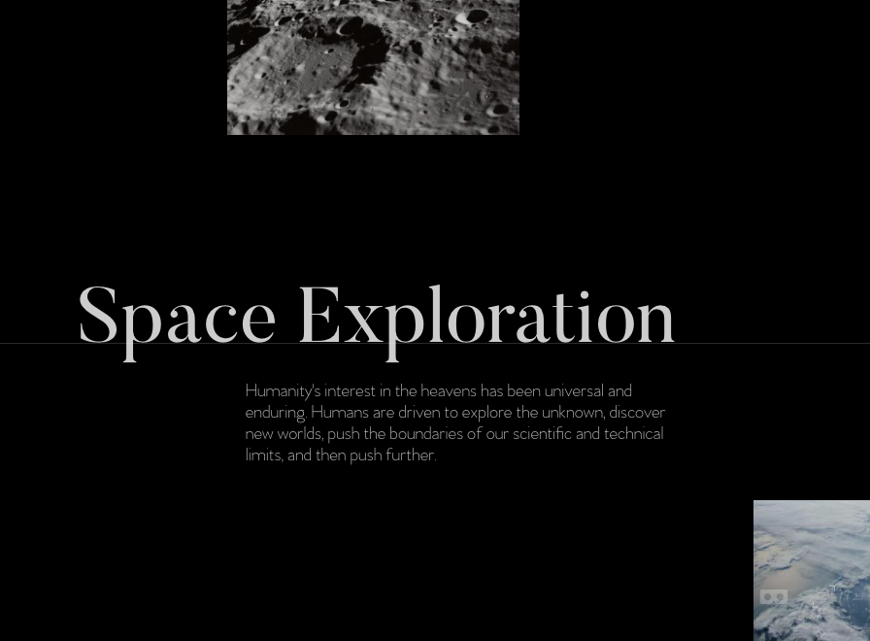
Creative Brief
Minimalistic
Earthy color scheme
Sleek like http://space.vanderlanth.io/

Slide 6
Functionality
Upload photos
Sort by likes
Give likes
Leave comments
Bird identification

Slide 7
Concepts/Skills
React as a framework for the front-end
  JavaScript library for building user interfaces
Node.js for the API server
  JavaScript run-time environment for executing JavaScript code server-side
Redux to keep track of state
  predictable state container for JavaScript app
Filestack to upload photos and add filters
  file toolkit with a file uploading API, image processing engine
Moment.js to process time
  parse, validate, manipulate, and display dates and times in JavaScript

Slide 8
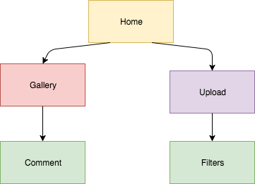
Site Map

Slide 9
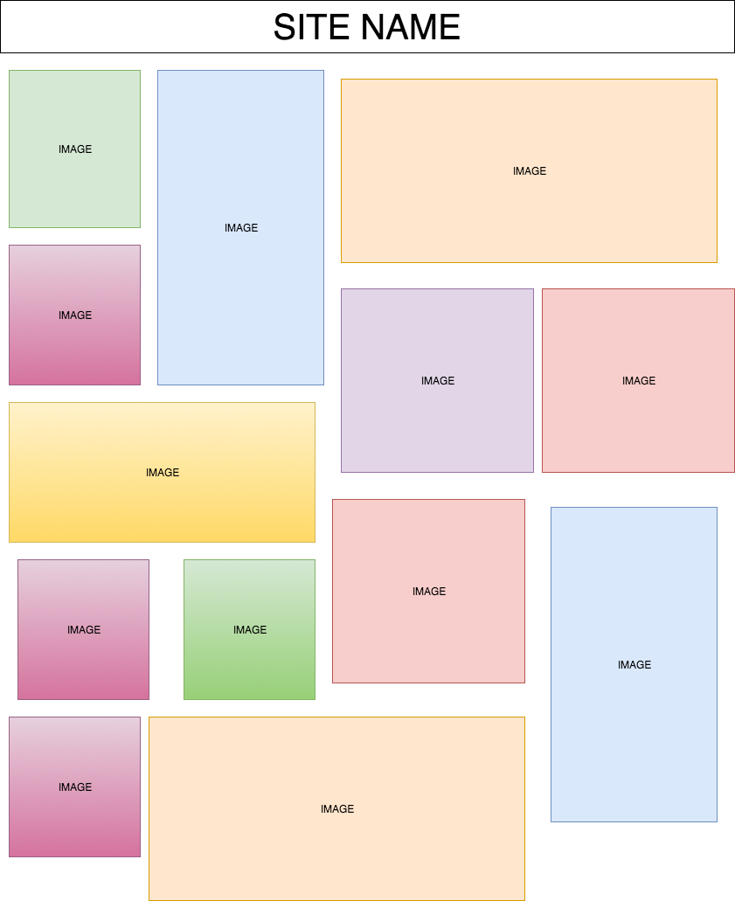
Wireframes: Gallery

Slide 10
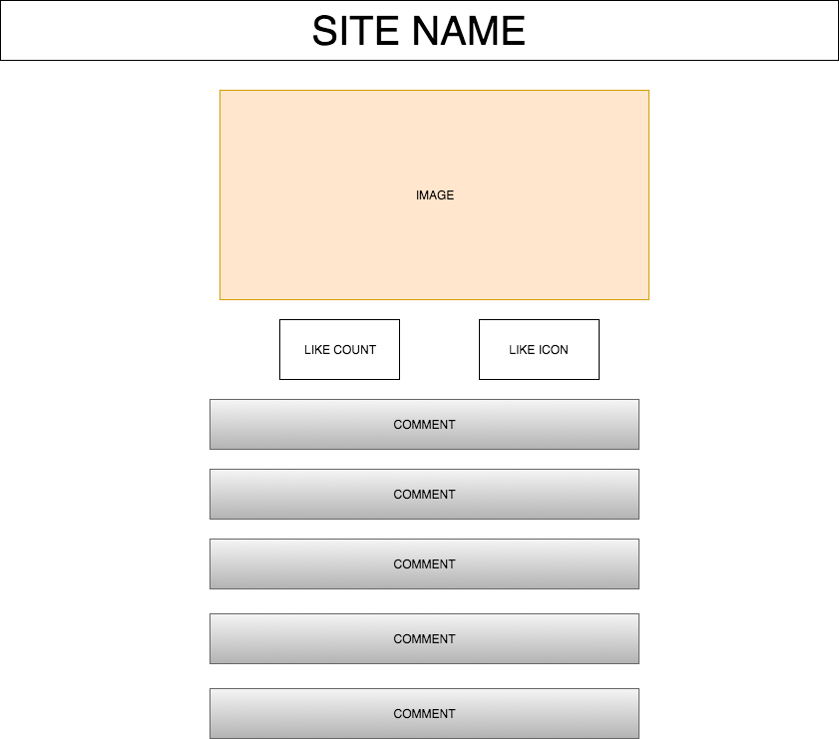
Wireframes: Image/comment/like

Slide 11
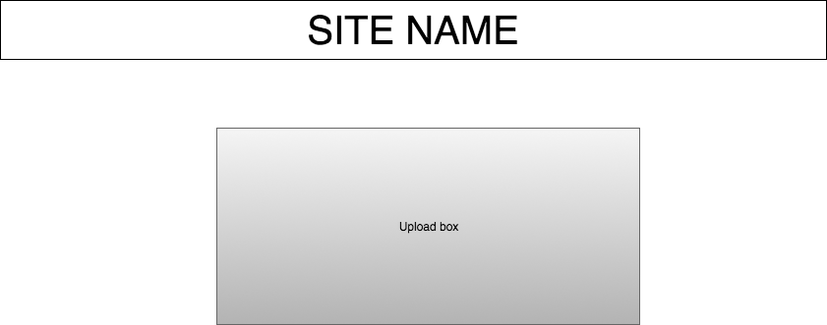
Wireframes: Upload

Slide 12
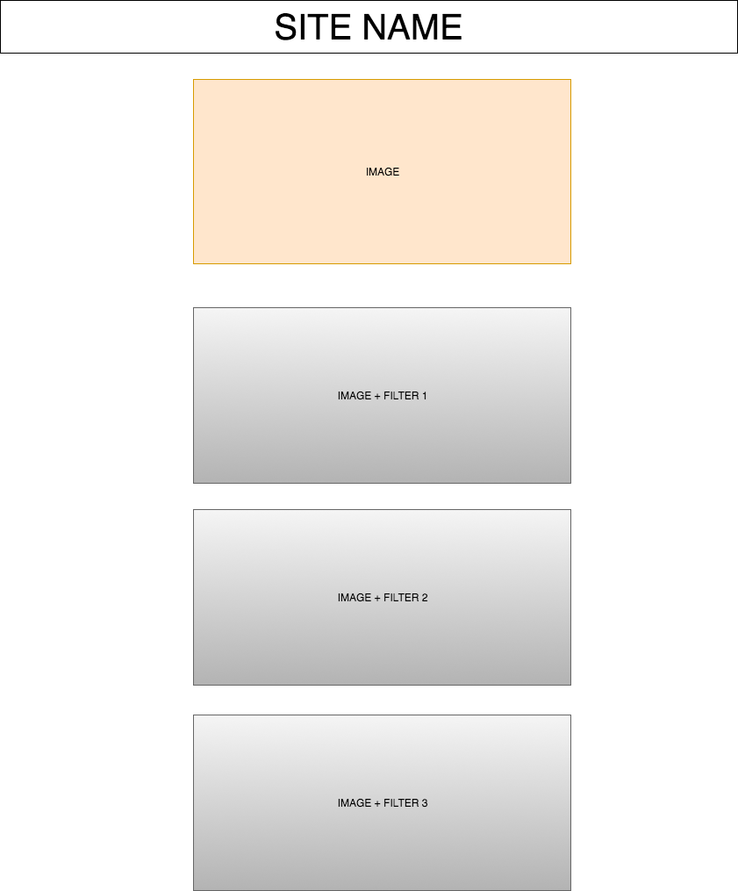
Wireframes: Filters

Slide 13
Questions/Feedback?
???

