Slide 1


AI MARKETING & WHATSAPP SELLING
Your AI marketing team.
Selling on WhatsApp.
Send photos, get a shop link, and let your AI team help you post and reply. Built for South Africa.
Prepared for [[PROSPECT NAME]]
[[DATE]] · Thabo Malebadi, founder
Notes:
Open warmly and make it about them. "Thanks for your time. FluxMuse is an AI marketing team that lives in WhatsApp: send product photos, get a shop link, and get help posting and replying." Say the session takes about 20 minutes plus questions. Ask one opening question: "Where do most of your sales conversations happen today?" Their answer tells you which slides to lean on. Swap guide: owner-operators get the Solo deck, businesses with staff get the SME deck, agencies get the Partner Programme deck. Facts in this deck follow CURRENT_OFFER.md.

Slide 2
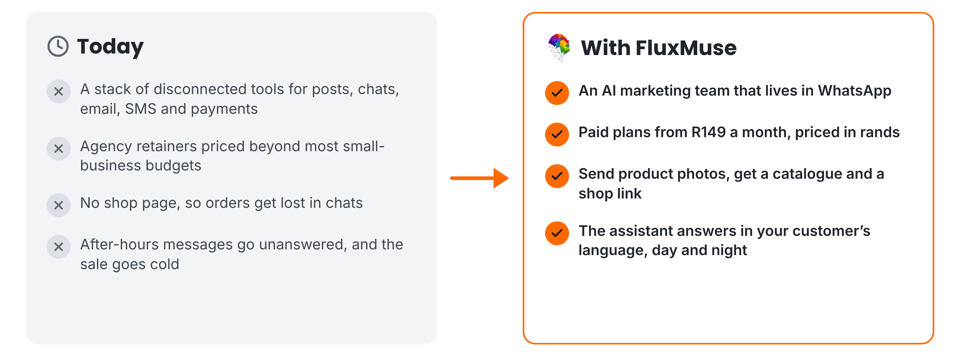
THE PROBLEM WE SOLVE
Marketing and selling, without the patchwork
FluxMuse · fluxmuse.ai
2
Notes:
Describe the day-to-day reality without numbers we can't back up. Most small businesses juggle separate tools for posts, chats and payments. Agency retainers are out of reach for many. Without a shop page, orders get lost in chats, and after-hours messages go unanswered. On the right is what changes: an AI marketing team that lives in WhatsApp, paid plans from R149 a month, a catalogue and shop link built from product photos, and replies in the customer's language. All of these are newly launched (CURRENT_OFFER.md §3). Ask which problem hurts most.

Slide 3


MEET FLUXMUSE
One AI team for marketing and sales
LIVE, NEWLY LAUNCHED
BEING SWITCHED ON
Photos to catalogue
Checkout
Shop link
Facebook & Instagram
Order alerts
AI Voice (beta)
AI marketing and a WhatsApp shop, for South African businesses.
AI posts & clips
Set up by hand
TikTok video
FluxMuse · fluxmuse.ai
3
Notes:
Here's FluxMuse in one line: an AI marketing team and WhatsApp shop for South African businesses. Be precise about what's live. Live and newly launched: photos to catalogue on WhatsApp, a hosted shop link, order alerts with SOLD, AI captions, images and short clips, and TikTok video posting. Being switched on: checkout through FluxMuse, Facebook and Instagram auto-posting, and AI Voice in beta. Newly launched means built and deployed, but no business has run it end to end yet, so we set you up by hand (CURRENT_OFFER.md §3). Ask whether they already use WhatsApp Business.

Slide 4
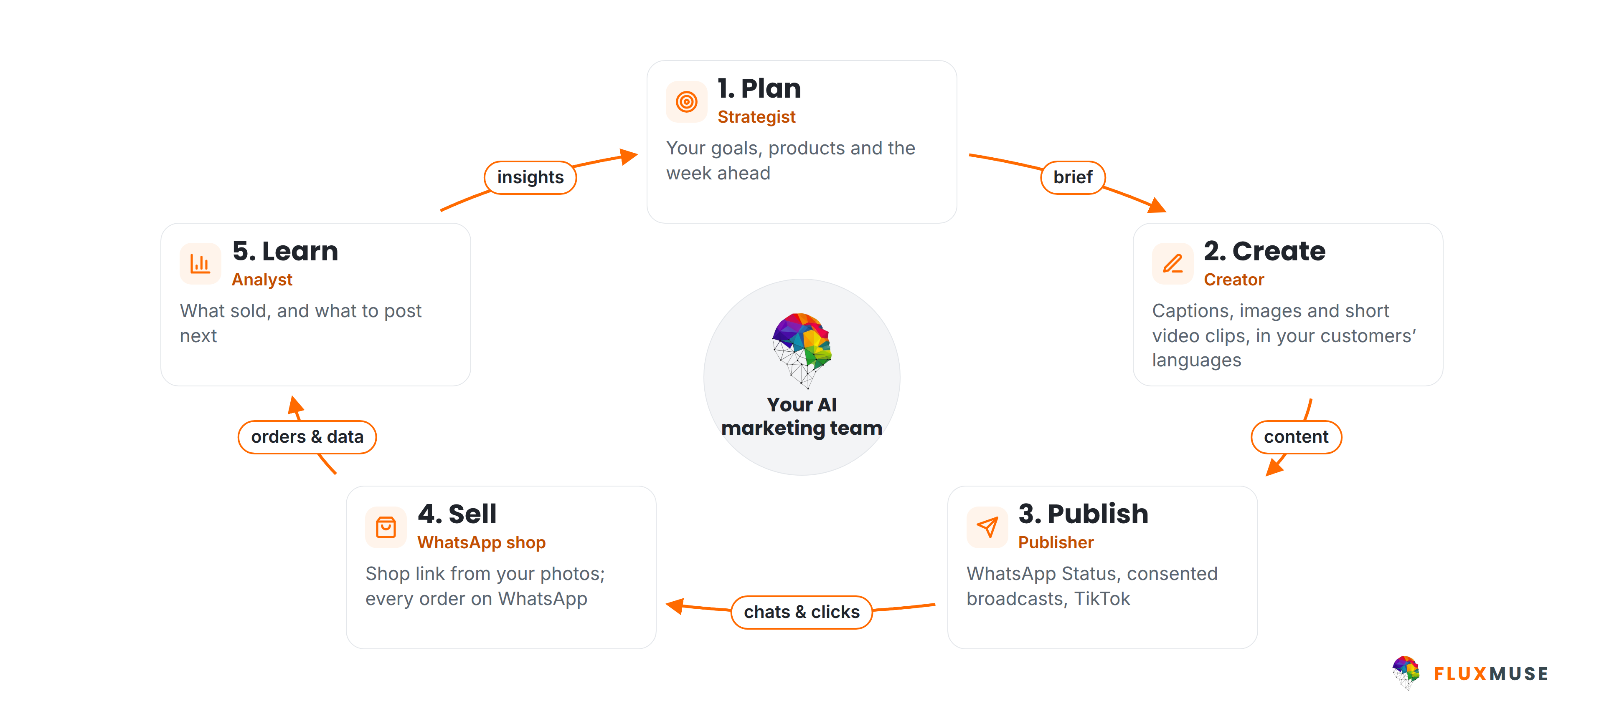
HOW FLUXMUSE WORKS
One loop, run by your AI marketing team
FluxMuse · fluxmuse.ai
4
Notes:
FluxMuse works as a loop. Plan: your goals, products and the week ahead. Create: captions, images and short video clips, in your customers' languages. Publish: forward to WhatsApp Status, send broadcasts to contacts who have opted in, and post video to TikTok. Sell: a shop link built from your photos, with every order landing on WhatsApp. Learn: what sold, and what to post next. Facebook and Instagram auto-posting is being switched on, so don't promise it yet (CURRENT_OFFER.md §3). The point is that marketing and selling stop living in separate tools.

Slide 5
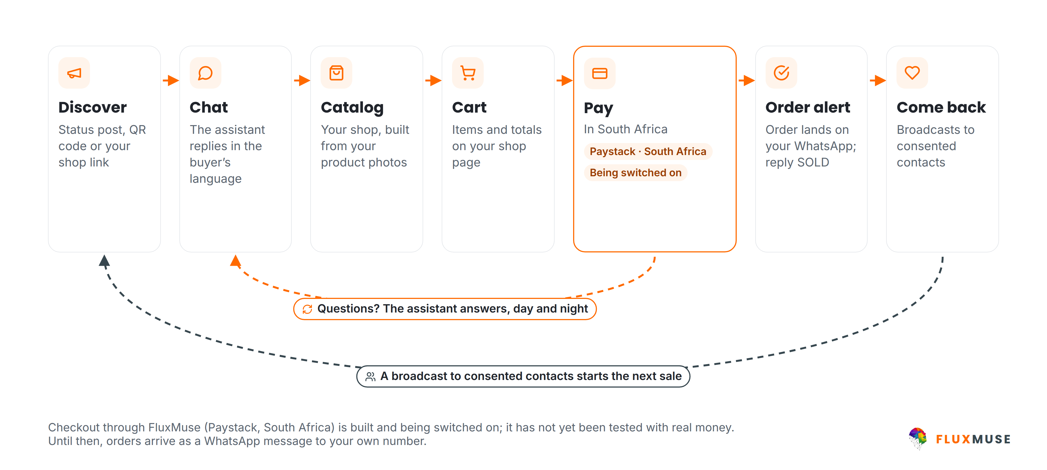
WHATSAPP SELLING
From first tap to repeat order, on WhatsApp
FluxMuse · fluxmuse.ai
5
Notes:
This is the heart of the pitch. A buyer finds you through a Status post, a QR code or your shop link. The assistant replies in their language. They browse a catalogue built from your photos, fill a cart, and the order lands on your WhatsApp; you reply SOLD to keep track. Be honest about payment: checkout through FluxMuse on Paystack is built but being switched on, because it hasn't been tested end to end with real money. Until then, orders arrive as a WhatsApp message and you take payment your usual way (CURRENT_OFFER.md §3). Broadcasts go only to consented contacts.

Slide 6
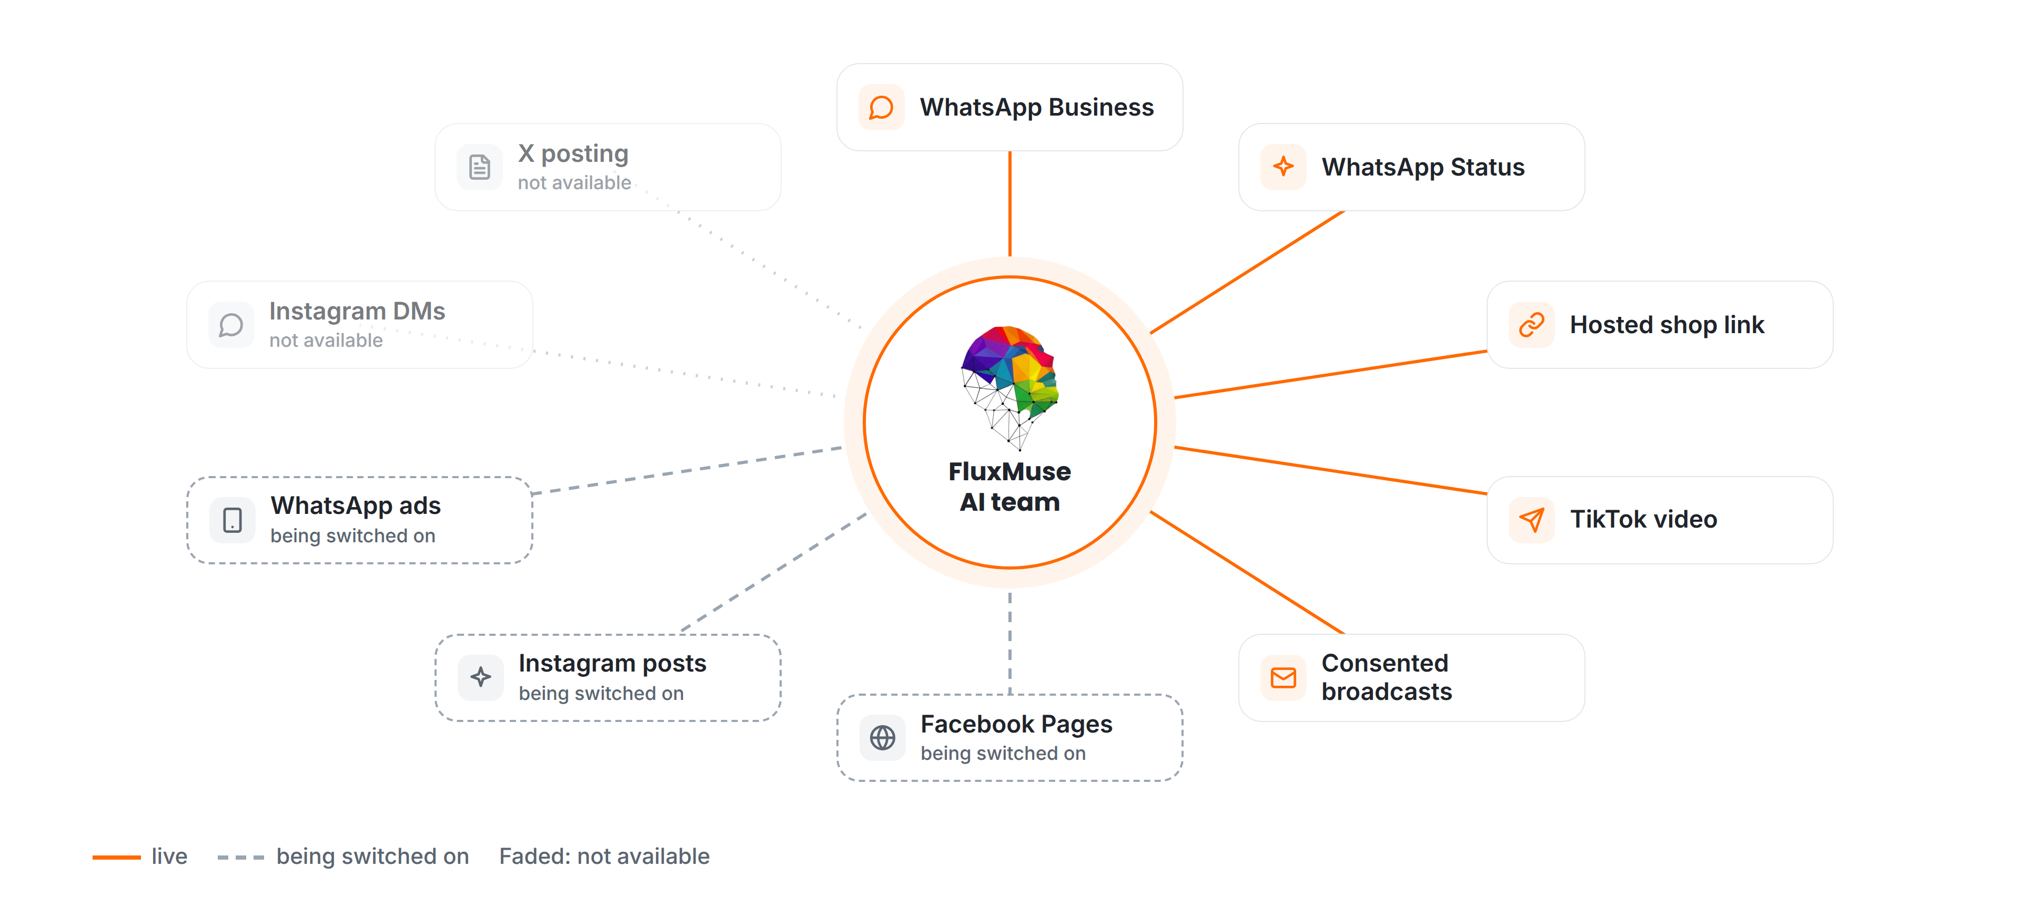
CHANNELS
Where FluxMuse works today
FluxMuse · fluxmuse.ai
6
Notes:
Be precise about channels. Live today: WhatsApp Business, WhatsApp Status, the hosted shop link, TikTok video posting and broadcasts to consented contacts. Being switched on: Facebook Pages and Instagram posting, because Meta hasn't approved those permissions yet, and click-to-WhatsApp ads, which we run on our own account first. Not available: Instagram DMs and comments, and X posting. If Instagram is their main channel, say so honestly: until Meta approves it, the value is forwarding posts to WhatsApp Status (CURRENT_OFFER.md §3).

Slide 7
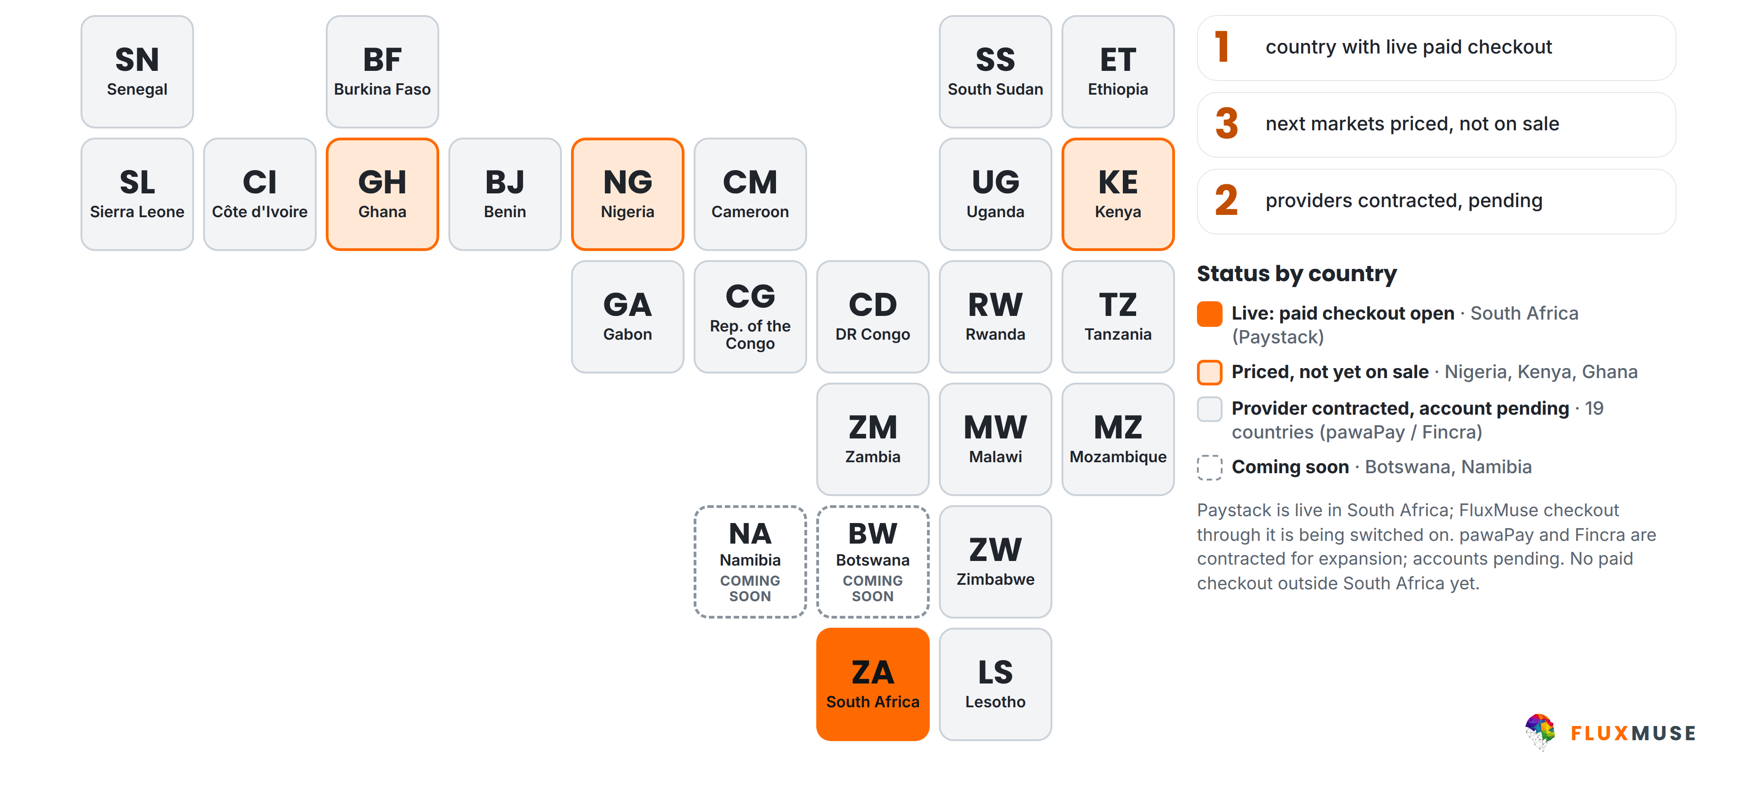
PAYMENTS COVERAGE
Live in South Africa. The rest is pending.
FluxMuse · fluxmuse.ai
7
Notes:
Be straight about payments. FluxMuse is open for paid sign-up in South Africa only, where Paystack is live. Checkout through FluxMuse for your buyers is built and being switched on; it hasn't been tested end to end with real money yet. Nigeria, Kenya and Ghana are priced but not on sale, because the provider accounts are still pending. pawaPay and Fincra are contracted for expansion, with accounts pending, so the other countries on the map are not open. Botswana and Namibia are coming soon. Source: CURRENT_OFFER.md §3 and §4; 00_FACTS §3.

Slide 8



BUILT FOR YOU
Built for businesses like yours
South Africa first.
Solo entrepreneurs
SMEs
Agencies & partners
Founder-run, 1–5 people
5–200 staff
Managing 5–50 clients
Nano · R149/mo
Growth · R1,999/mo
Partner · R6,999/mo
FluxMuse · fluxmuse.ai
8
Notes:
FluxMuse is built for three kinds of business, starting in South Africa, the only market open for paid sign-up today. Solo entrepreneurs run founder-led businesses of one to five people and usually start on Nano at R149 a month, or Micro at R289 for a WhatsApp number. SMEs have five to 200 staff and typically run Growth at R1,999, or Starter at R499 for one brand. Agencies managing five to 50 clients join the partner programme at a wholesale R6,999 a month. Prices: CURRENT_OFFER.md §1. Ask which fits, then go to that slide.

Slide 9
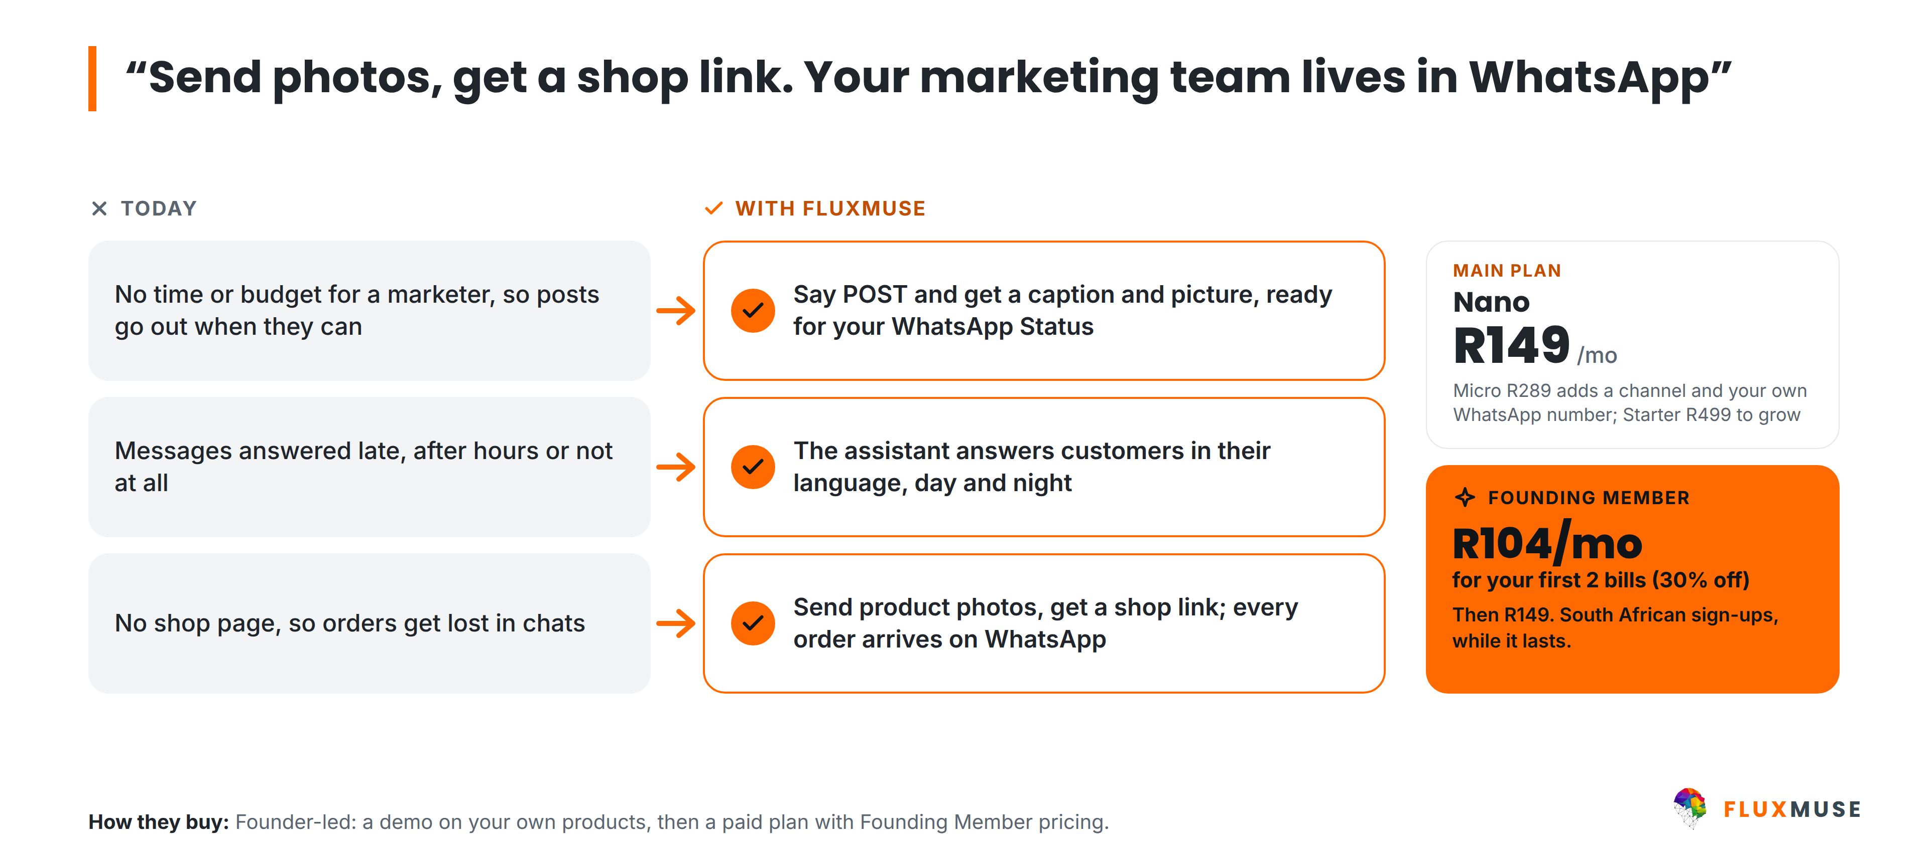
LAUNCH SEGMENT · SOLO ENTREPRENEURS
Solo entrepreneurs: 1–5 people
FluxMuse · fluxmuse.ai
9
Notes:
Solo entrepreneurs are braiders and beauty studios, fashion resellers, home bakers, coaches and informal retailers. Their pains are simple: no time or budget for a marketer, messages answered late, and no shop page, so orders get lost in chats. FluxMuse answers each one with newly launched features: say POST to get a caption and picture, the assistant answers in the customer's language, and product photos become a shop link. Nano is R149 a month; Founding Members pay R104 for the first two bills. Micro at R289 adds a channel and their own WhatsApp number (CURRENT_OFFER.md §1).

Slide 10
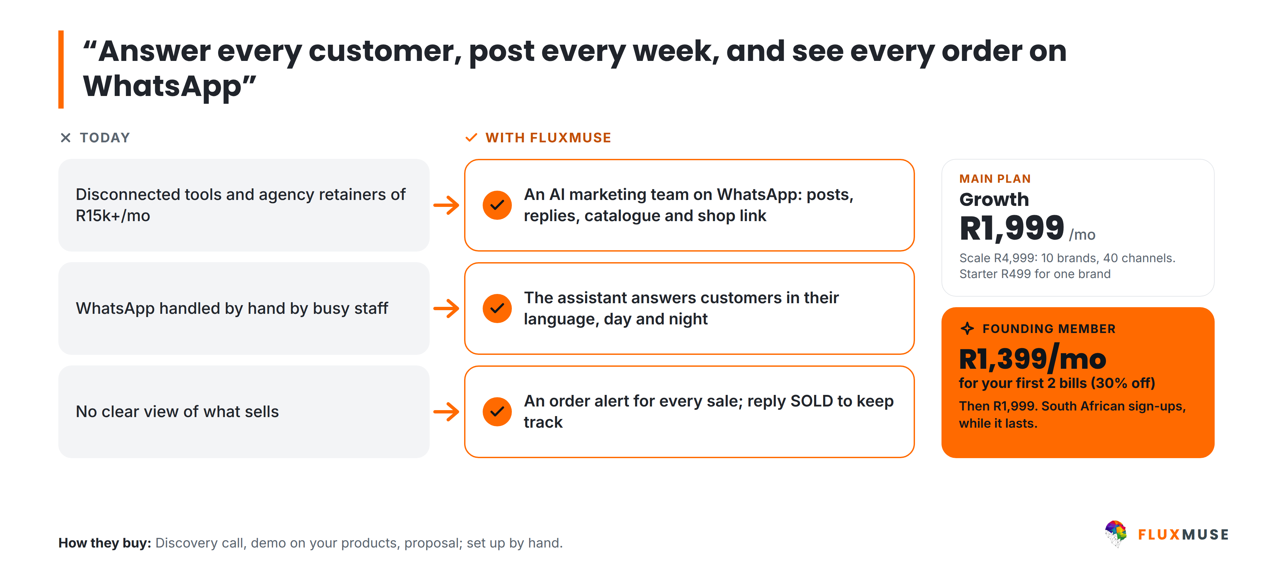
LAUNCH SEGMENT · SMES
SMEs: 5–200 staff
FluxMuse · fluxmuse.ai
10
Notes:
SMEs are retailers, restaurants, e-commerce brands, clinics, property, auto and education businesses with five to 200 staff. The usual story: disconnected tools and agency retainers, WhatsApp handled by hand by busy staff, and no clear view of what sells. FluxMuse puts an AI marketing team on WhatsApp, answers customers in their language, and sends an order alert for every sale. Growth at R1,999 a month is the usual start: three brands and 15 channels. Scale at R4,999 suits multi-brand groups. Founding Members pay R1,399 for the first two Growth bills (CURRENT_OFFER.md §1).

Slide 11
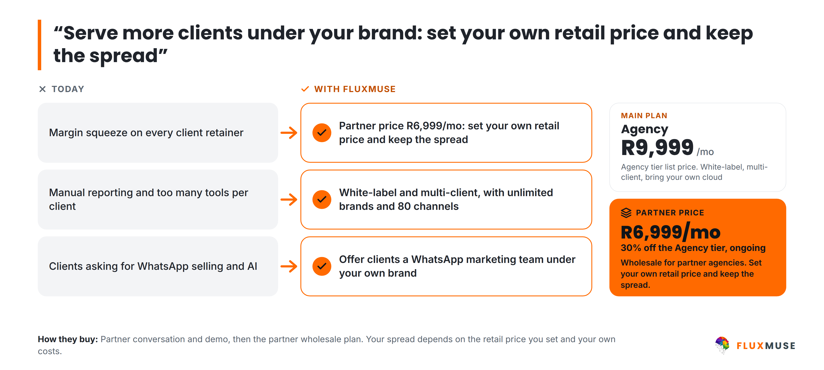
LAUNCH SEGMENT · AGENCIES & PARTNERS
Agencies: serve more clients, your brand
FluxMuse · fluxmuse.ai
11
Notes:
Agencies and freelancers managing five to 50 small-business clients feel a margin squeeze, spend hours on reporting and tools per client, and have clients asking for WhatsApp selling and AI. FluxMuse gives them one white-label, multi-client platform with unlimited brands and 80 channels. Partners buy the Agency tier at a wholesale price of R6,999 a month, 30% off the R9,999 list price, and set their own retail price. Don't quote a fixed margin: it depends on the agency's pricing and delivery costs (00_FACTS §2 "Partner wholesale").

Slide 12
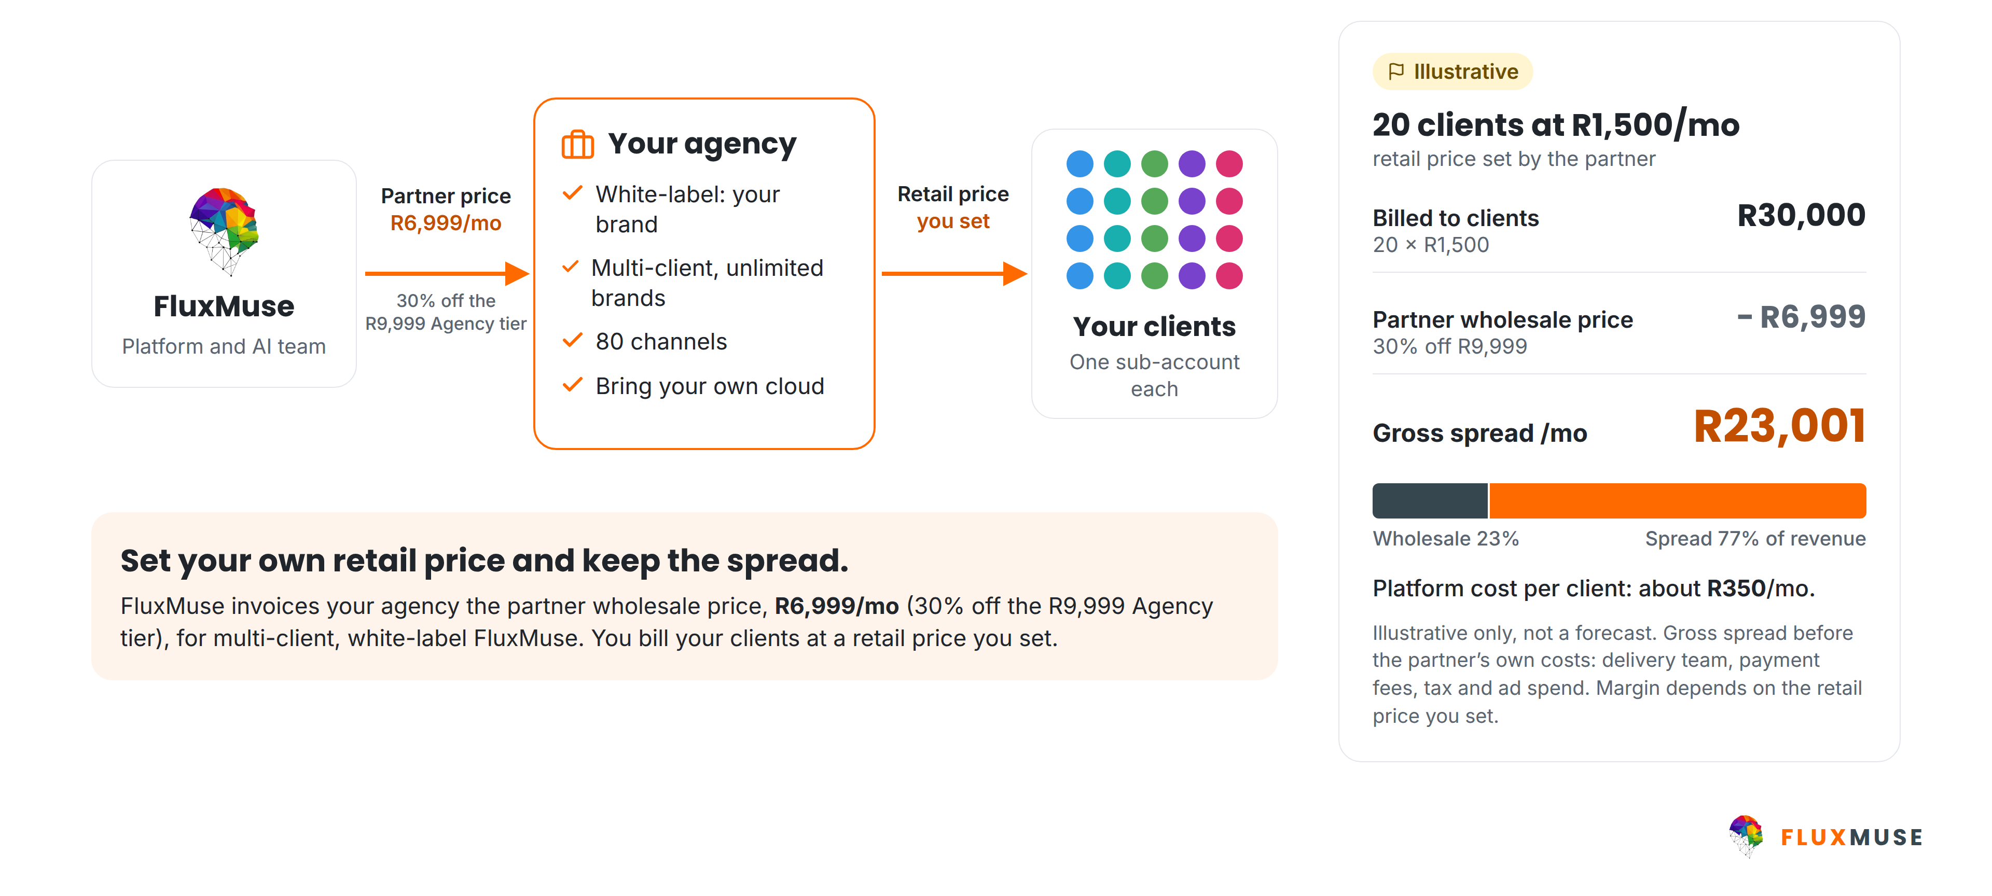
AGENCY PARTNER MODEL · ILLUSTRATIVE ECONOMICS
Resell FluxMuse under your own brand
FluxMuse · fluxmuse.ai
12
Notes:
Here's how the partner model works. FluxMuse invoices the agency the partner wholesale price of R6,999 a month, 30% off the R9,999 Agency list price. The agency serves its clients under its own brand and bills them a retail price it sets. The example is illustrative only, not a forecast: 20 clients at R1,500 a month bills R30,000, and after R6,999 the agency keeps a gross spread of R23,001 a month, before its own costs. Encourage them to run their own numbers. Referral commission is still to be decided (00_FACTS §2 "Partner wholesale").

Slide 13
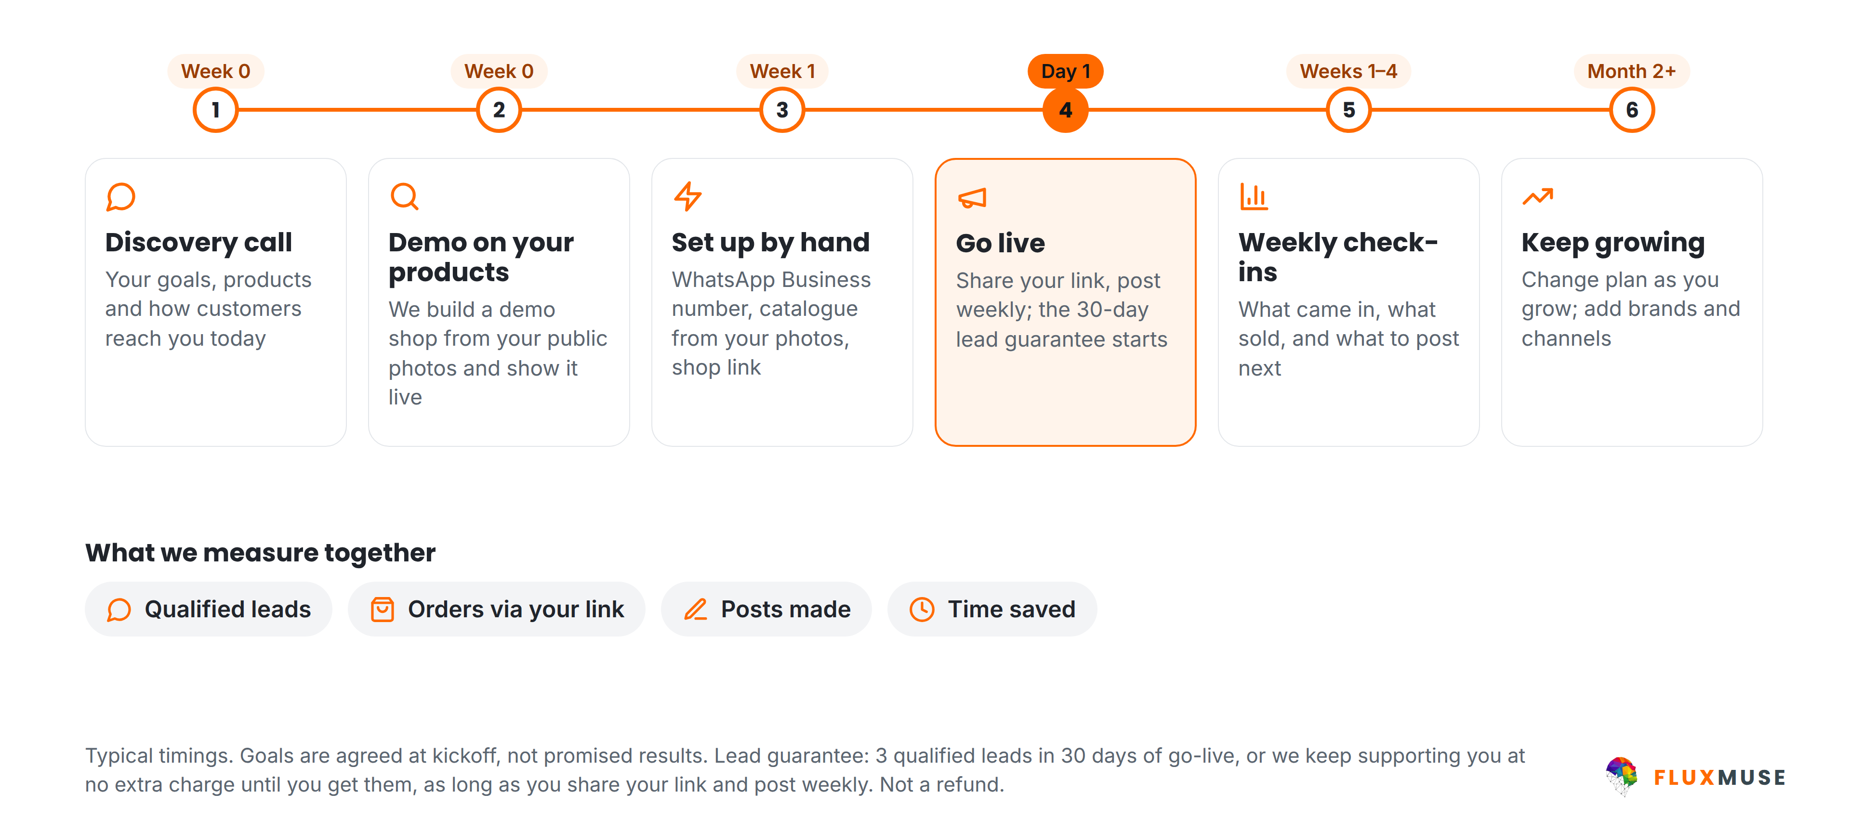
WORKING WITH FLUXMUSE
From first call to your first orders
FluxMuse · fluxmuse.ai
13
Notes:
This is how we work together. First a discovery call about your goals and products. Then a demo shop built from your own public photos, shown live; that's a demo, not a trial. Once you choose a paid plan, we set you up by hand: WhatsApp Business number, catalogue and shop link. On go-live day the lead guarantee starts: three qualified leads in 30 days, as long as you share your link and post weekly; if not, we keep supporting you at no extra charge. Then weekly check-ins. Goals are agreed together, not promised results (CURRENT_OFFER.md §2).

Slide 14





OUR FIRST GROUP OF BUSINESSES
Starting small, set up by hand
A small first group
LEAD GUARANTEE
3 qualified leads in 30 days of go-live
We set you up by hand
Weekly founder check-ins
A qualified lead is a new WhatsApp number that messages you through your FluxMuse link. If fewer than 3 arrive in 30 days, and you shared your link and posted at least weekly, we keep supporting you at no extra charge until you reach 3. Extra support, not a payout.
You tell us what to fix first
Your story shared only with consent
FluxMuse · fluxmuse.ai
14
Notes:
Be honest about where we are. FluxMuse is newly launched and has no paying customers or case studies yet. We're opening with a small first group of South African businesses, and we set each one up by hand, with weekly check-ins. That's the offer: close attention, not social proof. It's backed by the lead guarantee: three qualified leads in 30 days of go-live. If fewer arrive, and the business shared its link and posted at least weekly, we keep supporting them at no extra charge until three arrive. It is extra support, never cash back (CURRENT_OFFER.md §2 and §4).

Slide 15
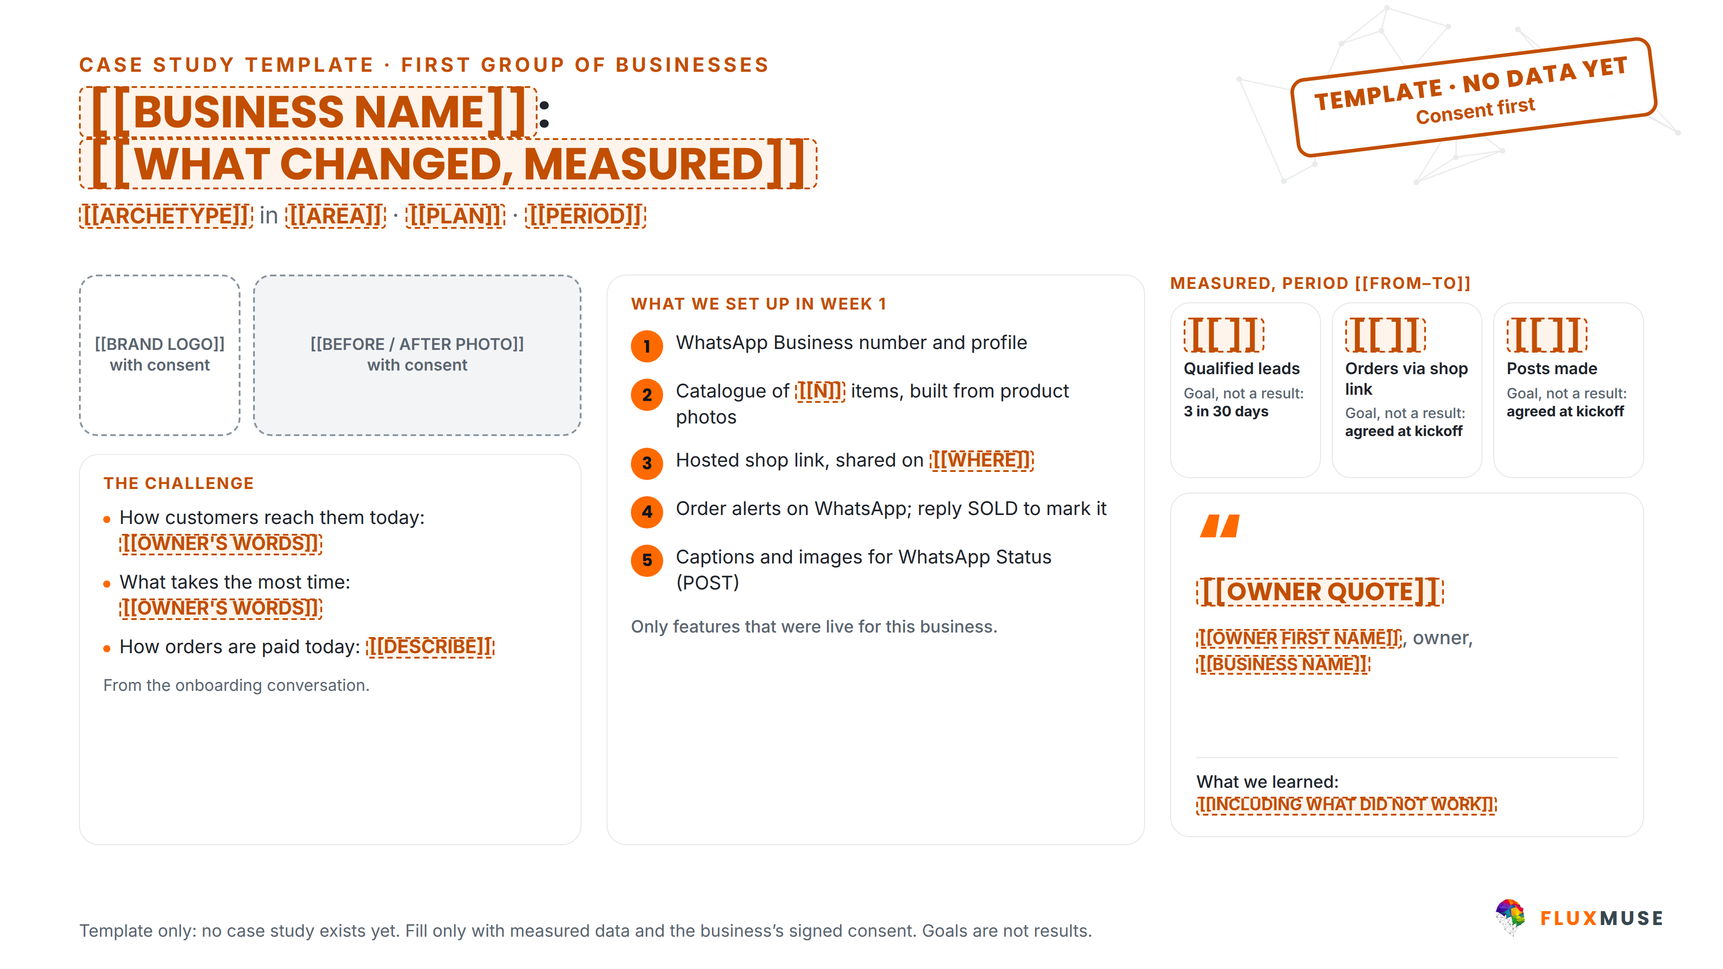
CASE STUDY TEMPLATE · NO DATA YET
What we'll measure, with your consent
FluxMuse · fluxmuse.ai
15
Notes:
This is a template, not a case study. No case study exists yet, and we never show projected results. When a business in our first group agrees, we record what we set up in week one, using live features only, and track three measures: qualified leads, with the lead guarantee's three in 30 days as the goal (if the business shares its link and posts weekly), orders through the shop link, and posts made. Each is a goal agreed at kickoff, not a result. We fill it only with measured data and the business's signed consent (07_Case_Studies/First_Group_Case_Studies.md; 00_FACTS §6). Hide this slide if time is short.

Slide 16
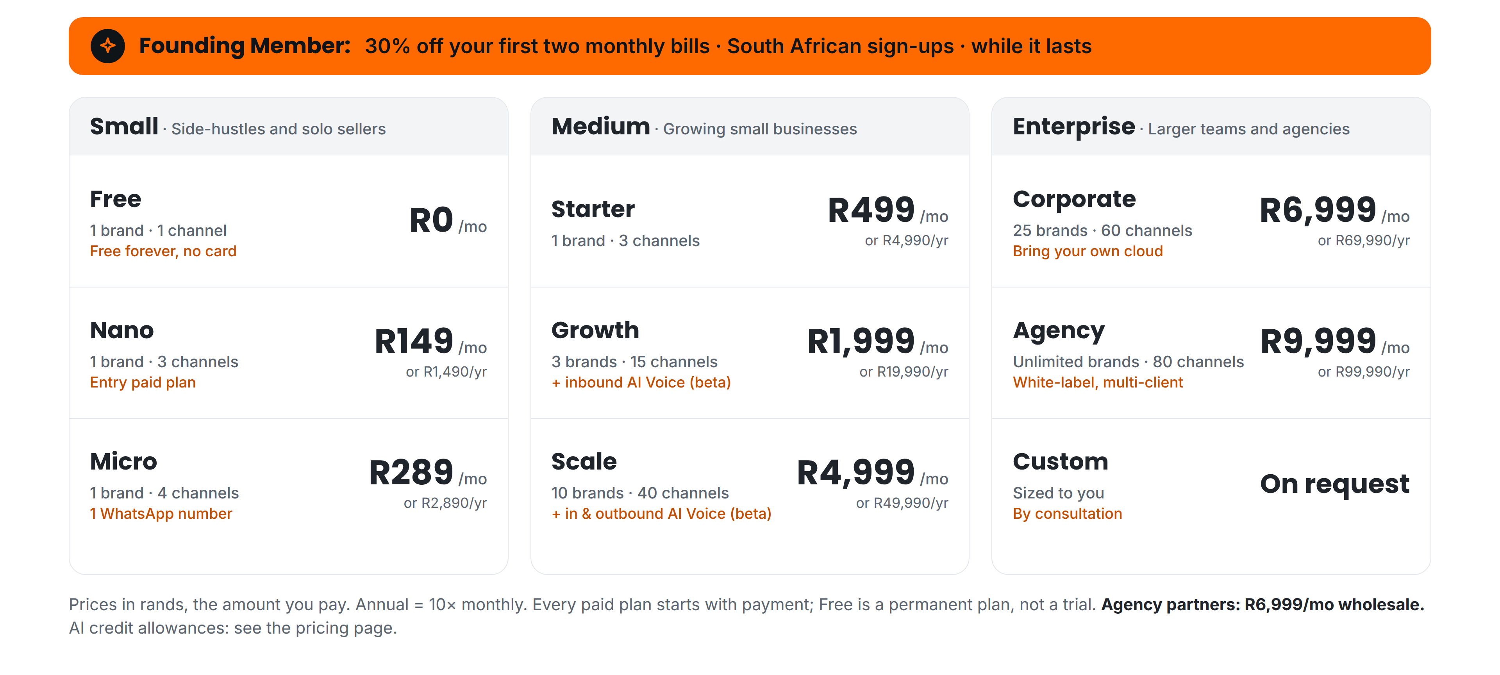
PRICING (ZAR) · EVERY PAID PLAN STARTS WITH PAYMENT
Nine plans in three bands, priced in rands
FluxMuse · fluxmuse.ai
16
Notes:
Nine plans in three bands, priced in rands, and the price shown is what you pay. Small: Nano at R149 and Micro at R289 for side-hustles and solo sellers. Medium: Starter R499, Growth R1,999 with inbound AI Voice in beta, and Scale R4,999 with inbound and outbound AI Voice in beta. Enterprise: Corporate R6,999, Agency R9,999, and Custom by consultation. Annual billing is ten times monthly. There are no trials: every paid plan starts with payment. Free is a permanent plan, so don't lead with it. Don't quote AI credit allowances; point to the pricing page (CURRENT_OFFER.md §1).

Slide 17
PRICING (ZAR) · EDITABLE
Plans at a glance
Band | Plan | Monthly | Annual | Brands · channels | Founding Member, first 2 bills
Small | Free | R0 | R0 | 1 · 1 | Free forever, no card
 | Nano | R149 | R1,490 | 1 · 3 | R104
 | Micro | R289 | R2,890 | 1 · 4 | R202
Medium | Starter | R499 | R4,990 | 1 · 3 | R349
 | Growth | R1,999 | R19,990 | 3 · 15 | R1,399
 | Scale | R4,999 | R49,990 | 10 · 40 | R3,499
Enterprise | Corporate | R6,999 | R69,990 | 25 · 60 | Talk to us
 | Agency | R9,999 | R99,990 | Unlimited · 80 | Partner price R6,999
 | Custom | On request |  | By consultation
Prices are what you pay. No trials: every paid plan starts with payment; Free is a permanent plan. AI credit allowances: see fluxmuse.ai/pricing. Paid sign-up is open in South Africa.
FluxMuse · fluxmuse.ai
17
Notes:
This is the same pricing as an editable table, useful when you tailor the deck. It shows all nine plans with monthly and annual prices, where annual is ten times monthly, plus brands and channels. The Founding Member column is 30% off the first two monthly bills for South African sign-ups, rounded down to whole rands. Agencies don't get Founding Member pricing; point them to the R6,999 partner price instead. Corporate launch pricing is by conversation. If you edit a price, check it against CURRENT_OFFER.md §1 first, and never add per-plan AI credit numbers.

Slide 18
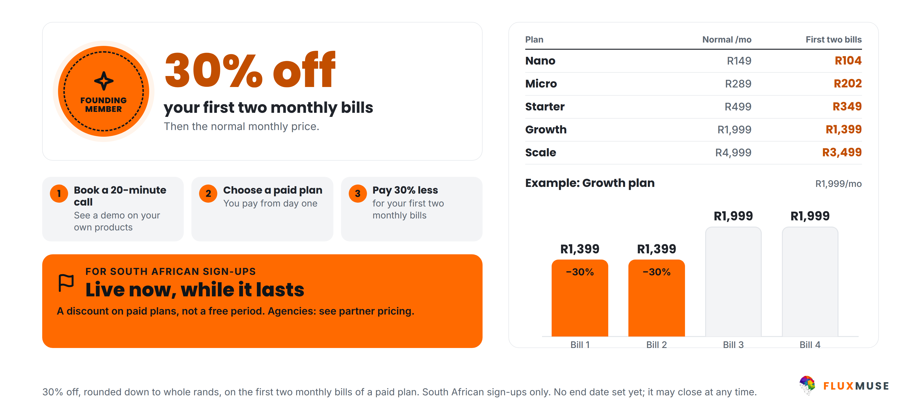
LAUNCH OFFER · SOUTH AFRICA · LIVE NOW
Become a Founding Member
FluxMuse · fluxmuse.ai
18
Notes:
Our launch offer is Founding Member, and it's live now. South African sign-ups get 30% off their first two monthly bills on a paid plan: R104 on Nano, R202 on Micro, R349 on Starter, R1,399 on Growth or R3,499 on Scale, then the normal monthly price. It's a discount, not a free period. There's no set end date, so say "while it lasts" and never quote a closing date. Agencies get the partner price instead. Don't offer annual bonus months or other perks; they aren't confirmed (00_FACTS §2 "Founding Member").

Slide 19




TRUST & COMPLIANCE
Built to protect your customers' data
Meta Tech Provider
Official WhatsApp API
POPIA-aligned
Verified by Meta
Meta Cloud API
Consented broadcasts only
Row-level security
Encrypted tokens
Data export & deletion
Your data kept separate
Connected accounts
Export data, delete account
FluxMuse · fluxmuse.ai
19
Notes:
Trust matters when you're handling customer chats. Fluxmuse (Pty) Ltd is a verified Meta Tech Provider, with business and access verification, and WhatsApp runs on Meta's official Cloud API. Broadcasts go only to contacts who have opted in, in line with POPIA. Under the hood there's row-level security, encrypted tokens for connected accounts, and data export and account deletion. If they ask for a data processing agreement, a security questionnaire or certifications, don't improvise: note the request and follow up in writing (CURRENT_OFFER.md §4; 00_FACTS §1).

Slide 20
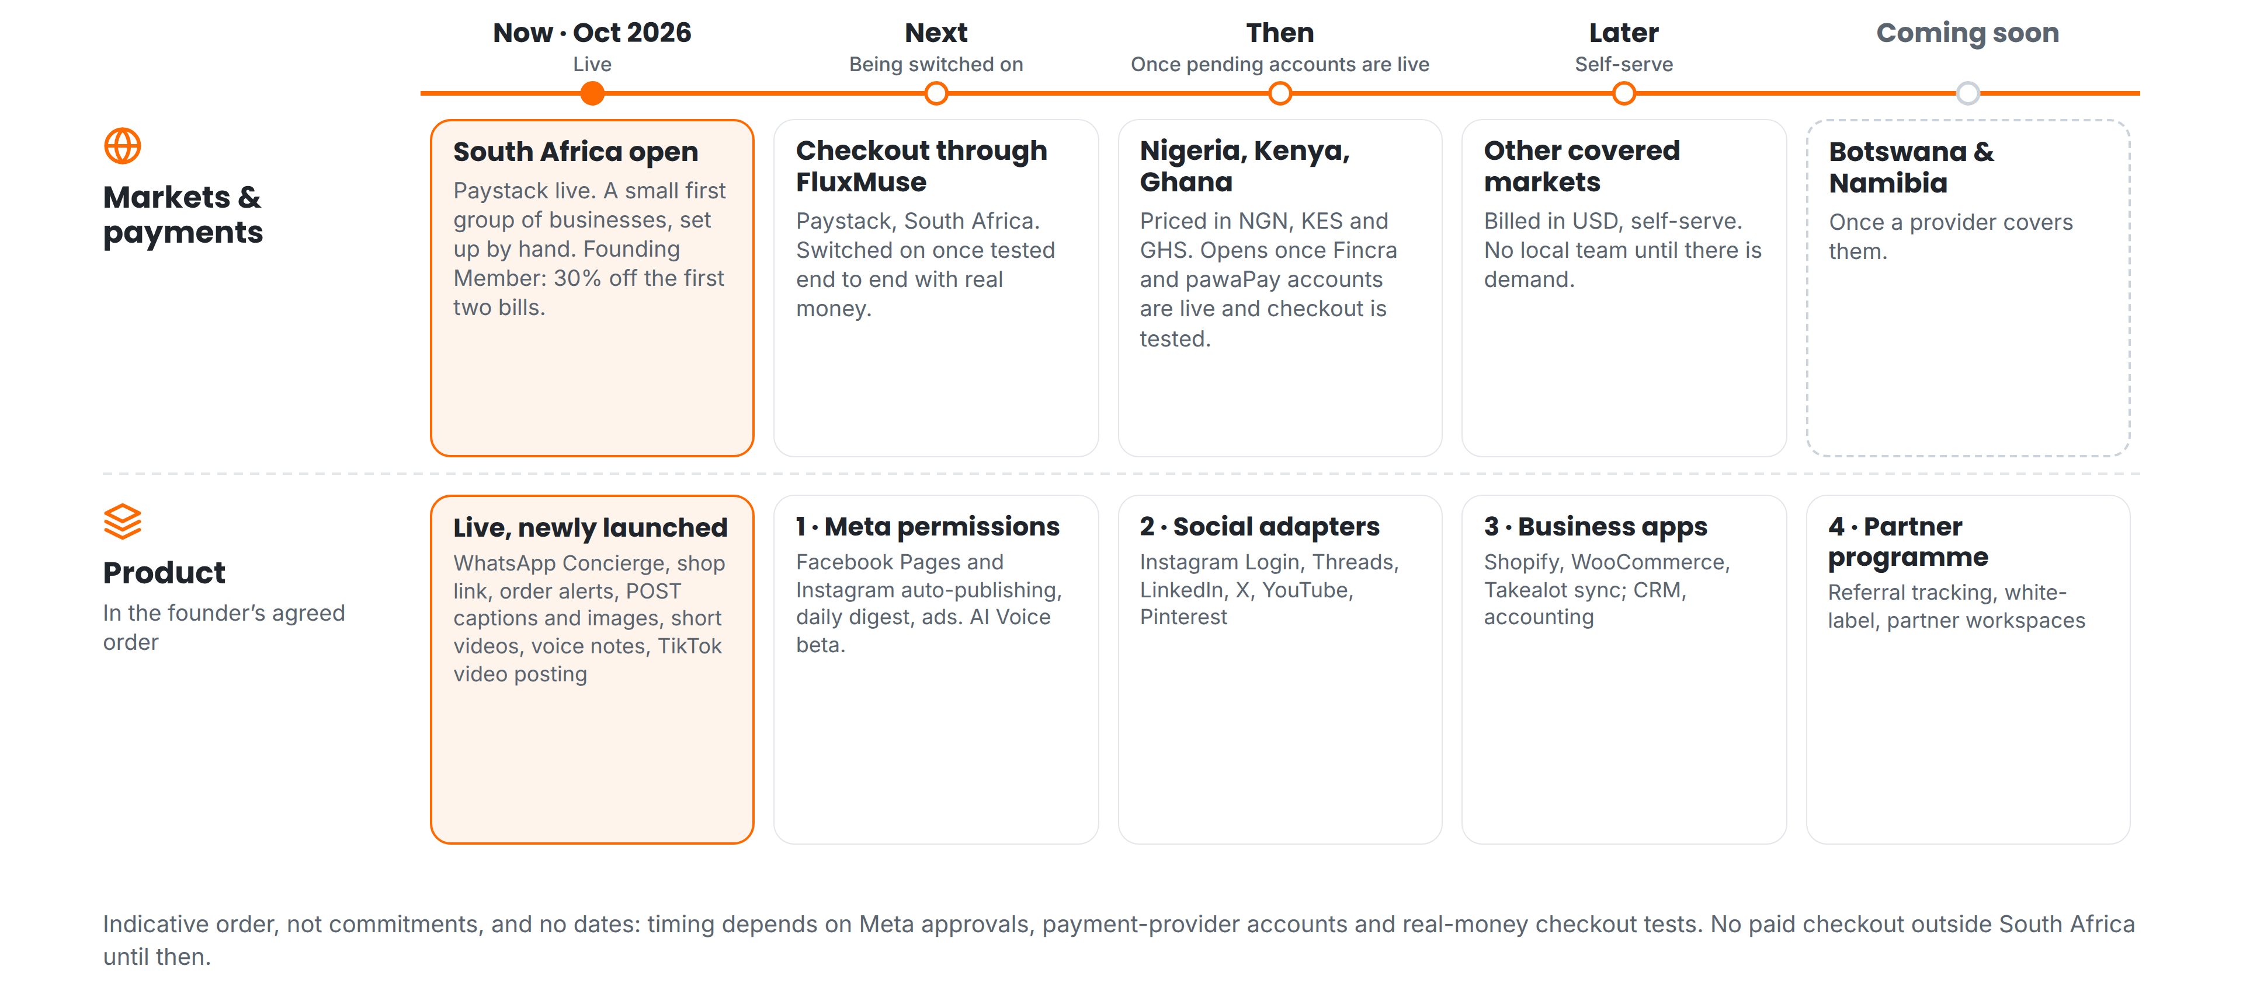
ROADMAP · INDICATIVE, NO DATES
What comes next, in order
FluxMuse · fluxmuse.ai
20
Notes:
Here's what comes next, in order, with no dates. On markets: South Africa is open now, with Paystack live. Next, checkout through FluxMuse, switched on once it's tested end to end with real money. Then Nigeria, Kenya and Ghana, once the pawaPay and Fincra accounts are live. Later, other markets in US dollars; Botswana and Namibia are coming soon. On product: Meta permissions for Facebook and Instagram posting, then social adapters, business app integrations, and the partner programme. Timing depends on approvals, so don't give dates (00_FACTS §1 "Roadmap").

Slide 21
NEXT STEPS
Let's get you selling on WhatsApp
1
Book a 20-minute call
TALK TO US
Goals, channels, products.
Thabo Malebadi
Founder
thabo@fluxmuse.com
fluxmuse.ai
2
See a demo on your products
Built from your own photos.
[[wa.me QR CODE]]
Scan to chat on WhatsApp
wa.me/
[[NUMBER]]
3
Choose a plan, we set you up
Paid plans from R149/mo.
FluxMuse · fluxmuse.ai
21
Notes:
Close with one clear next step, and agree it before the call ends. Option one: book a 20-minute call to map goals, channels and products. Option two: see a demo shop built from their own public product photos; it's a demo, not a trial, with nothing to sign up for. Option three: choose a paid plan, and we set them up by hand. Contact is Thabo Malebadi, thabo@fluxmuse.com. Follow up within 24 hours with this deck and a short summary (CURRENT_OFFER.md §2).

Slide 22
APPENDIX
Reference slides
A1
Payment status by country
A2
Partner wholesale pricing
A3
Frequently asked questions
FluxMuse · fluxmuse.ai
22
Notes:
The appendix is for questions and follow-up, not the main talk track. It covers payment status by country, partner wholesale pricing where relevant, and the questions prospects ask most. Paid sign-up is open in South Africa only. Nigeria, Kenya and Ghana are priced but not on sale, so don't show local prices or offer checkout there; anyone outside South Africa, including Botswana and Namibia, gets the waitlist link instead: [[WAITLIST LINK]]. Regional price sheets are internal only and are not in customer decks (00_FACTS §2 "Market gating").

Slide 23
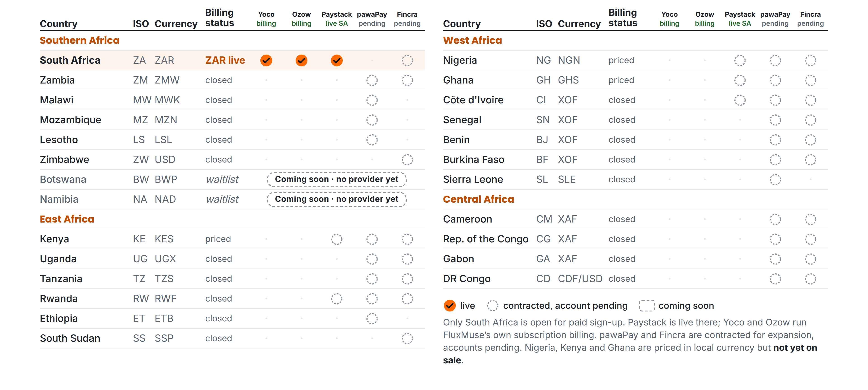
APPENDIX A1 · PAYMENT STATUS
What is live, and what is still pending
FluxMuse · fluxmuse.ai
23
Notes:
This matrix shows payment status by country. Only South Africa is open for paid sign-up: Paystack is live there, and Yoco and Ozow run FluxMuse's own subscription billing. Checkout through FluxMuse for a business's buyers is still being switched on. pawaPay and Fincra are contracted for expansion, but the accounts are pending, so none of those countries is open. Nigeria, Kenya and Ghana are priced in local currency but not on sale. Botswana and Namibia are coming soon with no provider yet. Source: CURRENT_OFFER.md §3; 00_FACTS §3.

Slide 24
APPENDIX A2 · PARTNER WHOLESALE
Partner wholesale pricing
ZAR | Per month | Per year (10×)
Agency list price | R9,999 | R99,990
Partner wholesale (−30%) | R6,999 | R69,990
ILLUSTRATIVE ONLY · NOT A FORECAST
You set your retail price.
Paid sign-up is South Africa only for now.
Local-currency partner prices: not set yet.
20 clients × R1,500/mo = R30,000 billed
− R6,999 wholesale = R23,001/mo gross spread, before your own costs
FluxMuse · fluxmuse.ai
24
Notes:
Partner wholesale pricing is the Agency tier at 30% off list: R6,999 a month instead of R9,999, or R69,990 a year, in rands. Paid sign-up is open in South Africa only for now, so there are no local-currency partner prices yet. Launch offers don't stack with partner pricing. The example is illustrative only, not a forecast: 20 clients at R1,500 bills R30,000; minus R6,999 leaves a R23,001 gross spread before the partner's own costs. Don't quote a fixed margin. Referral commission is still a founder decision (00_FACTS §2 "Partner wholesale").

Slide 25
APPENDIX A3 · FAQ (1 OF 2)
Questions prospects ask
Is my customers' data safe?
Can I use my own WhatsApp number?
Row-level security, encrypted tokens, broadcasts only to consented contacts, and data export and account deletion. Fluxmuse is a verified Meta Tech Provider.
Yes. We connect your WhatsApp Business number through Meta's official Cloud API setup, with you, by hand.
How do my customers pay?
Is there a trial? Can I cancel?
Today, orders arrive as a WhatsApp message and you take payment your usual way. Checkout through FluxMuse (Paystack, South Africa) is being switched on.
No trials: every paid plan starts with payment, monthly or annual (10× monthly). Free is a permanent plan. Cancellation terms: [[CONFIRM TERMS]].
FluxMuse · fluxmuse.ai
25
Notes:
Use these answers as written; they follow CURRENT_OFFER.md. On data, stick to the controls listed and don't claim certifications we haven't confirmed. On WhatsApp numbers, a number already used in the WhatsApp Business app may need extra steps, so check it together during setup. On payments, be clear that checkout through FluxMuse is being switched on and hasn't been tested with real money yet. There are no trials, and cancellation terms are still to be confirmed, so promise a written answer rather than improvising.

Slide 26
APPENDIX A3 · FAQ (2 OF 2)
Questions prospects ask
Is there a guarantee?
How long does setup take?
A lead guarantee: 3 qualified leads in 30 days of go-live. If fewer, and you shared your link and posted weekly, we keep supporting you free until you reach 3.
We set you up by hand: WhatsApp number, catalogue from your photos, shop link. We aim for your first week; Meta approvals can stretch it.
I already use Shopify or WooCommerce.
Where can I buy FluxMuse?
Keep them. Sync from Shopify, WooCommerce and Takealot is being switched on. Until then, we build your catalogue from product photos.
South Africa, today. Nigeria, Kenya and Ghana are priced but not yet on sale. Other countries can join the waitlist.
FluxMuse · fluxmuse.ai
26
Notes:
The lead guarantee always comes with its conditions: three qualified leads in 30 days of go-live; if fewer, and the business shared its link and posted at least weekly, we extend support at no extra charge until three arrive. It is never cash back. Setup is by hand, but Meta approvals and catalogue size can stretch it, so set expectations honestly. Store sync is being switched on, so don't promise it. Outside South Africa, share the waitlist link, never prices (CURRENT_OFFER.md §2 and §3).

