Slide 1


AI MARKETING & WHATSAPP SELLING
Your AI marketing team.
Selling on WhatsApp.
Send photos, get a shop link, and let your AI team help you post and reply. Built for South Africa.
Prepared for [[PROSPECT NAME]]
[[DATE]] · Thabo Malebadi, founder
Notes:
Frame this as a conversation about time and control. "FluxMuse gives your team an AI marketing team inside WhatsApp: a shop link built from your photos, an order alert for every sale, and help posting and replying." Confirm who's in the room: owner, marketing, operations. Ask: "Which tools do you use today for social, WhatsApp and orders, and who runs each one?" If they manage brands for clients, they're an agency: use the Partner deck. Facts follow CURRENT_OFFER.md.

Slide 2
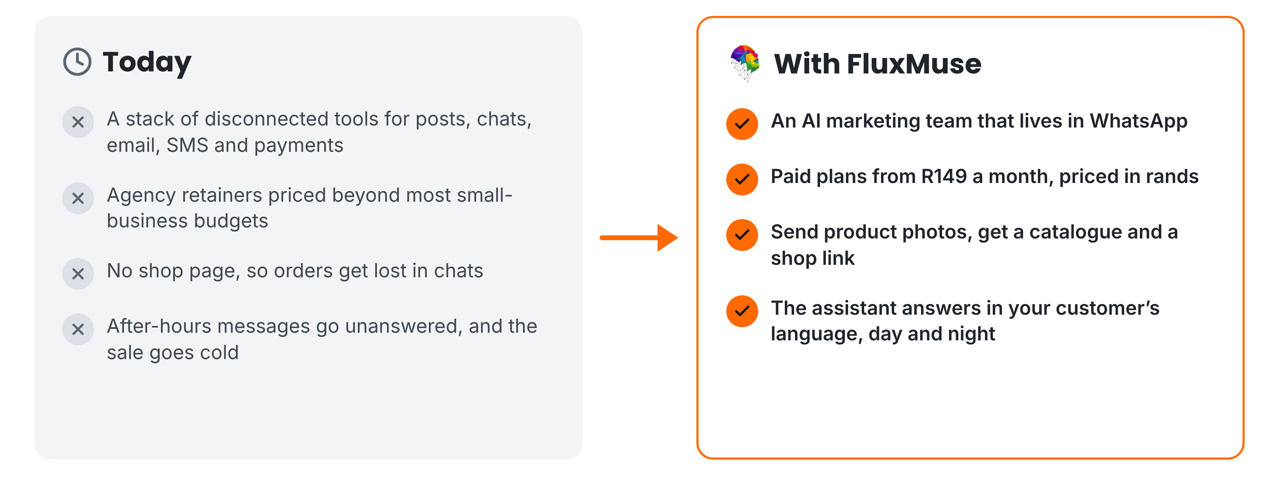
THE PROBLEM WE SOLVE
Marketing and selling, without the patchwork
FluxMuse · fluxmuse.ai
2
Notes:
For a business with staff, the problem is usually fragmentation. Posts, chats and orders sit in separate tools, often run by different people. Agency retainers are hard to justify, staff answer WhatsApp by hand, and nobody has a clear view of what sells. On the right is the FluxMuse answer: an AI marketing team in WhatsApp, a catalogue and shop link from product photos, and replies in the customer's language. These features are newly launched (CURRENT_OFFER.md §3). Ask how many tools they pay for today, and who owns each one.

Slide 3


MEET FLUXMUSE
One AI team for marketing and sales
LIVE, NEWLY LAUNCHED
BEING SWITCHED ON
Photos to catalogue
Checkout
Shop link
Facebook & Instagram
Order alerts
AI Voice (beta)
AI marketing and a WhatsApp shop, for South African businesses.
AI posts & clips
Set up by hand
TikTok video
FluxMuse · fluxmuse.ai
3
Notes:
Here's FluxMuse in one line: an AI marketing team and WhatsApp shop for South African businesses. Be precise about what's live. Live and newly launched: photos to catalogue on WhatsApp, a hosted shop link, order alerts with SOLD, AI captions, images and short clips, and TikTok video posting. Being switched on: checkout through FluxMuse, Facebook and Instagram auto-posting, and AI Voice in beta. Newly launched means built and deployed, but no business has run it end to end yet, so we set you up by hand (CURRENT_OFFER.md §3). Ask whether they already use WhatsApp Business.

Slide 4
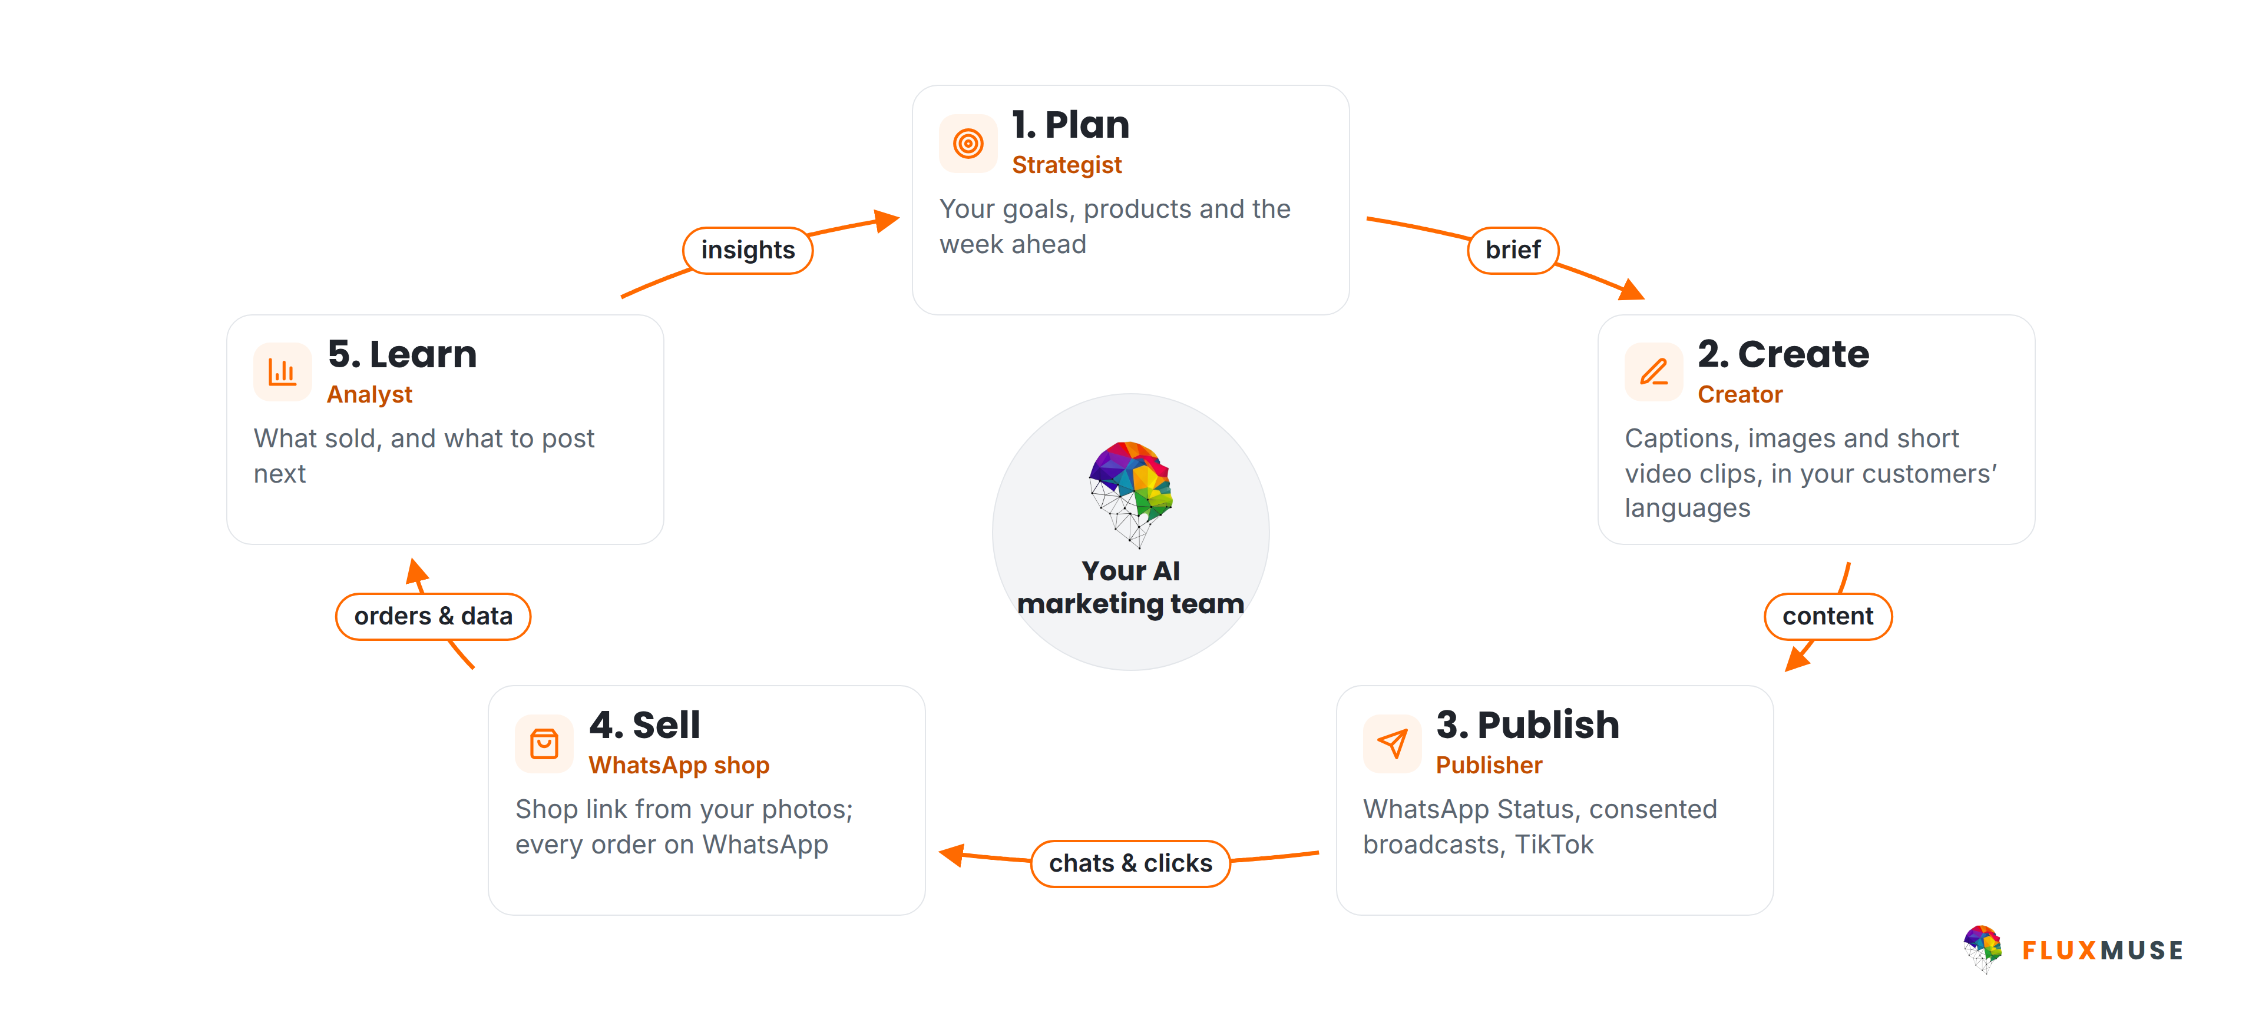
HOW FLUXMUSE WORKS
One loop, run by your AI marketing team
FluxMuse · fluxmuse.ai
4
Notes:
FluxMuse works as a loop. Plan: your goals, products and the week ahead. Create: captions, images and short video clips, in your customers' languages. Publish: forward to WhatsApp Status, send broadcasts to contacts who have opted in, and post video to TikTok. Sell: a shop link built from your photos, with every order landing on WhatsApp. Learn: what sold, and what to post next. Facebook and Instagram auto-posting is being switched on, so don't promise it yet (CURRENT_OFFER.md §3). The point is that marketing and selling stop living in separate tools.

Slide 5
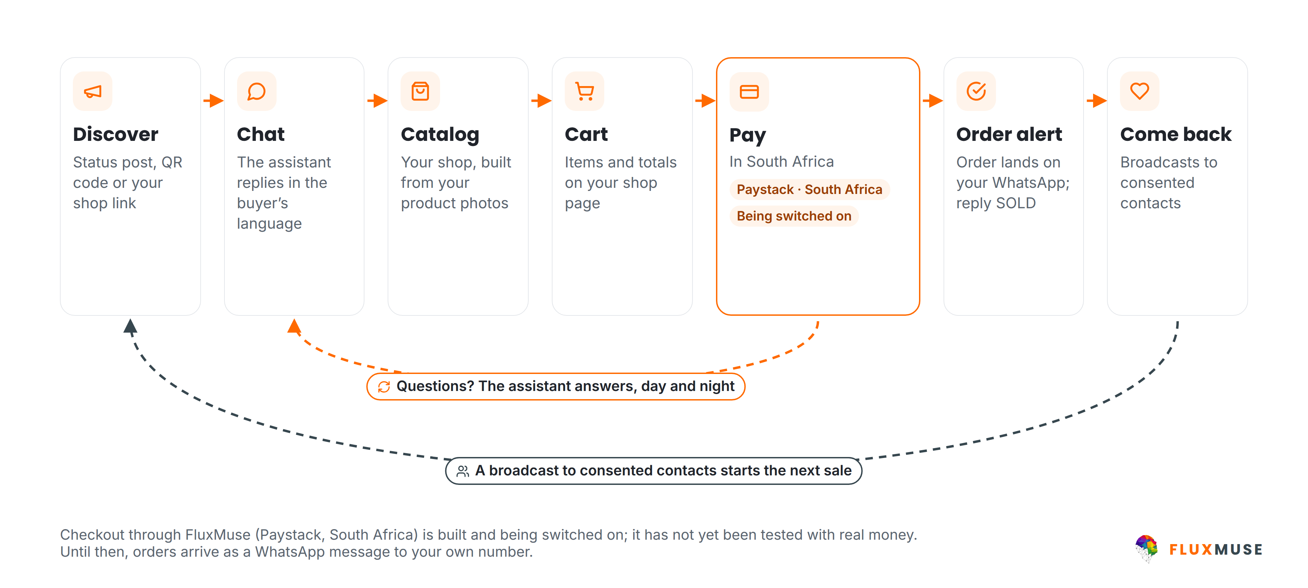
WHATSAPP SELLING
From first tap to repeat order, on WhatsApp
FluxMuse · fluxmuse.ai
5
Notes:
This is the heart of the pitch. A buyer finds you through a Status post, a QR code or your shop link. The assistant replies in their language. They browse a catalogue built from your photos, fill a cart, and the order lands on your WhatsApp; you reply SOLD to keep track. Be honest about payment: checkout through FluxMuse on Paystack is built but being switched on, because it hasn't been tested end to end with real money. Until then, orders arrive as a WhatsApp message and you take payment your usual way (CURRENT_OFFER.md §3). Broadcasts go only to consented contacts.

Slide 6
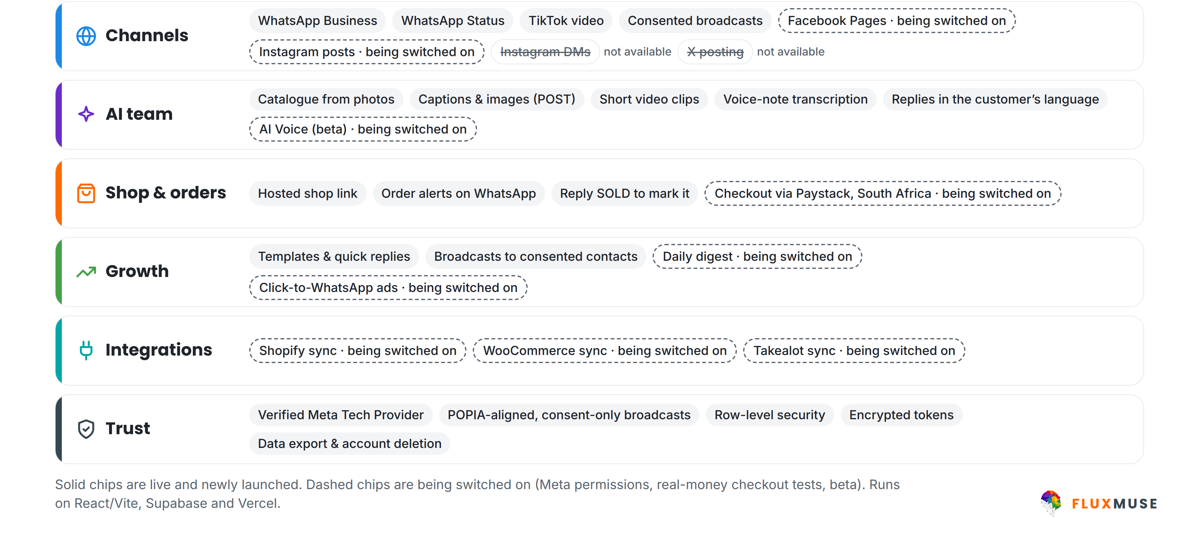
PLATFORM
Live today, and being switched on
FluxMuse · fluxmuse.ai
6
Notes:
This is the whole platform, with every piece labelled. Solid chips are live and newly launched: WhatsApp Business, Status, TikTok video, consented broadcasts, catalogue from photos, captions, images, clips, voice-note transcription, the shop link and order alerts. Dashed chips are being switched on: Facebook and Instagram posting, AI Voice in beta, Paystack checkout, the daily digest, click-to-WhatsApp ads and Shopify, WooCommerce and Takealot sync. Instagram DMs and X posting are not available. Labels follow CURRENT_OFFER.md §3. Ask which piece matters most to them.

Slide 7







YOUR TOOLS & YOUR TEAM
Fits how your team already works
Being switched on
Live now
Shopify sync
WooCommerce sync
Templates & quick replies
Takealot sync
FB/Instagram posts
10 brands (Scale)
AI Voice (beta)
Daily digest
Order alerts
Consented broadcasts
Until sync is on, we build your catalogue from product photos.
Replies in their language
FluxMuse · fluxmuse.ai
7
Notes:
SMEs rarely start from zero, so be honest about what connects today. On the left is what's being switched on: sync from Shopify, WooCommerce and Takealot, which is only partly built, so don't promise it, plus Facebook and Instagram posting, AI Voice in beta and the daily digest. Until sync is on, we build the catalogue from product photos. On the right is what a team can use now: WhatsApp templates and quick replies, several brands on one account, order alerts, consented broadcasts and replies in the customer's language. AI Voice is beta, evaluated together (CURRENT_OFFER.md §3).

Slide 8
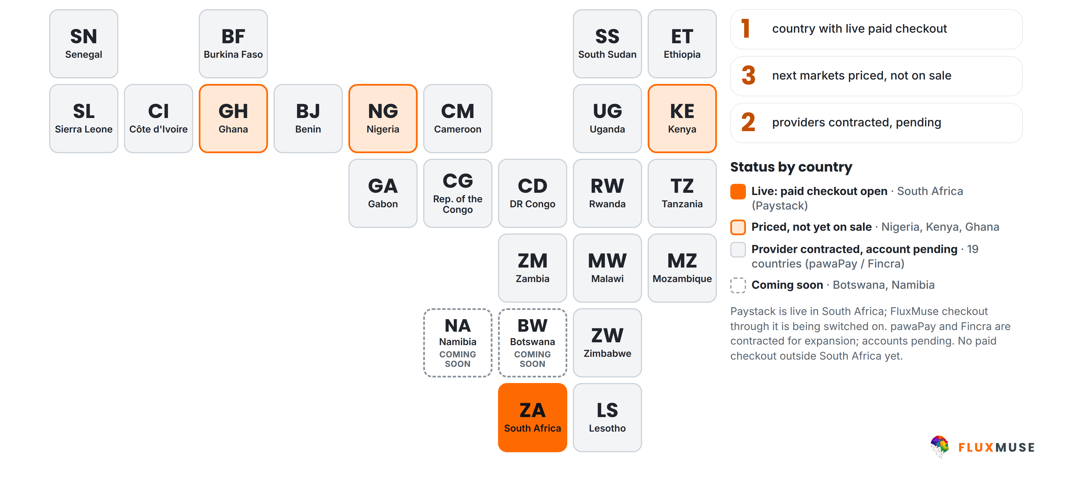
PAYMENTS COVERAGE
Live in South Africa. The rest is pending.
FluxMuse · fluxmuse.ai
8
Notes:
Be straight about payments. FluxMuse is open for paid sign-up in South Africa only, where Paystack is live. Checkout through FluxMuse for your buyers is built and being switched on; it hasn't been tested end to end with real money yet. Nigeria, Kenya and Ghana are priced but not on sale, because the provider accounts are still pending. pawaPay and Fincra are contracted for expansion, with accounts pending, so the other countries on the map are not open. Botswana and Namibia are coming soon. Source: CURRENT_OFFER.md §3 and §4; 00_FACTS §3.

Slide 9
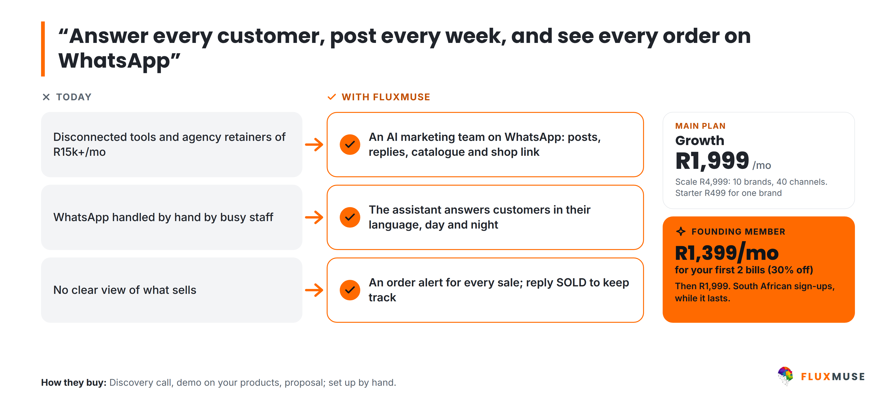
LAUNCH SEGMENT · SMES
SMEs: 5–200 staff
FluxMuse · fluxmuse.ai
9
Notes:
SMEs are retailers, restaurants, e-commerce brands, clinics, property, auto and education businesses with five to 200 staff. The usual story: disconnected tools and agency retainers, WhatsApp handled by hand by busy staff, and no clear view of what sells. FluxMuse puts an AI marketing team on WhatsApp, answers customers in their language, and sends an order alert for every sale. Growth at R1,999 a month is the usual start: three brands and 15 channels. Scale at R4,999 suits multi-brand groups. Founding Members pay R1,399 for the first two Growth bills (CURRENT_OFFER.md §1).

Slide 10
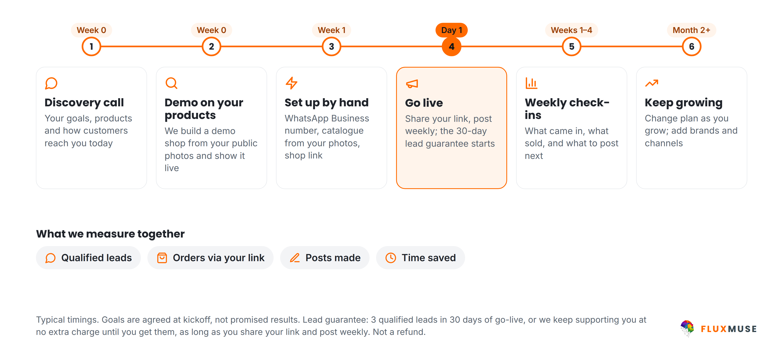
WORKING WITH FLUXMUSE
From first call to your first orders
FluxMuse · fluxmuse.ai
10
Notes:
This is how we work together. First a discovery call about your goals and products. Then a demo shop built from your own public photos, shown live; that's a demo, not a trial. Once you choose a paid plan, we set you up by hand: WhatsApp Business number, catalogue and shop link. On go-live day the lead guarantee starts: three qualified leads in 30 days, as long as you share your link and post weekly; if not, we keep supporting you at no extra charge. Then weekly check-ins. Goals are agreed together, not promised results (CURRENT_OFFER.md §2).

Slide 11



OUR FIRST GROUP OF BUSINESSES
Starting small, set up by hand
A small first group
LEAD GUARANTEE
3 qualified leads in 30 days of go-live
We set you up by hand
Weekly founder check-ins
A qualified lead is a new WhatsApp number that messages you through your FluxMuse link. If fewer than 3 arrive in 30 days, and you shared your link and posted at least weekly, we keep supporting you at no extra charge until you reach 3. Extra support, not a payout.
You tell us what to fix first
Your story shared only with consent
FluxMuse · fluxmuse.ai
11
Notes:
Be honest about where we are. FluxMuse is newly launched and has no paying customers or case studies yet. We're opening with a small first group of South African businesses, and we set each one up by hand, with weekly check-ins. That's the offer: close attention, not social proof. It's backed by the lead guarantee: three qualified leads in 30 days of go-live. If fewer arrive, and the business shared its link and posted at least weekly, we keep supporting them at no extra charge until three arrive. It is extra support, never cash back (CURRENT_OFFER.md §2 and §4).

Slide 12
PRICING (ZAR) · YOUR PLANS
Plans for a growing team
Starter
Growth
Scale
R499/mo
R1,999/mo
R4,999/mo
or R4,990/yr
or R19,990/yr
or R49,990/yr
1 brand · 3 channels
3 brands · 15 channels
10 brands · 40 channels
One brand
+ AI Voice (beta)
+ outbound Voice (beta)
FOUNDING MEMBER
R349 for your first 2 bills
FOUNDING MEMBER
R1,399 for your first 2 bills
FOUNDING MEMBER
R3,499 for your first 2 bills
Prices in rands are what you pay. Every paid plan starts with payment; no trials. Annual = 10× monthly. AI credit allowances: see fluxmuse.ai/pricing.
Founding Member: 30% off your first two monthly bills, South African sign-ups, while it lasts.
FluxMuse · fluxmuse.ai
12
Notes:
Most SMEs start on Growth at R1,999 a month: three brands, 15 channels and inbound AI Voice in beta. Single-brand businesses can start on Starter at R499. Multi-brand groups should look at Scale at R4,999: ten brands, 40 channels, and inbound and outbound AI Voice in beta, which we evaluate together. Annual billing is ten times monthly. No trials: every paid plan starts with payment. Founding Members in South Africa pay 30% less for the first two bills: R1,399 on Growth. Larger groups: Corporate or Custom (CURRENT_OFFER.md §1).

Slide 13
PRICING (ZAR) · EDITABLE
Plans at a glance
Band | Plan | Monthly | Annual | Brands · channels | Founding Member, first 2 bills
Small | Free | R0 | R0 | 1 · 1 | Free forever, no card
 | Nano | R149 | R1,490 | 1 · 3 | R104
 | Micro | R289 | R2,890 | 1 · 4 | R202
Medium | Starter | R499 | R4,990 | 1 · 3 | R349
 | Growth | R1,999 | R19,990 | 3 · 15 | R1,399
 | Scale | R4,999 | R49,990 | 10 · 40 | R3,499
Enterprise | Corporate | R6,999 | R69,990 | 25 · 60 | Talk to us
 | Agency | R9,999 | R99,990 | Unlimited · 80 | Partner price R6,999
 | Custom | On request |  | By consultation
Prices are what you pay. No trials: every paid plan starts with payment; Free is a permanent plan. AI credit allowances: see fluxmuse.ai/pricing. Paid sign-up is open in South Africa.
FluxMuse · fluxmuse.ai
13
Notes:
This is the same pricing as an editable table, useful when you tailor the deck. It shows all nine plans with monthly and annual prices, where annual is ten times monthly, plus brands and channels. The Founding Member column is 30% off the first two monthly bills for South African sign-ups, rounded down to whole rands. Agencies don't get Founding Member pricing; point them to the R6,999 partner price instead. Corporate launch pricing is by conversation. If you edit a price, check it against CURRENT_OFFER.md §1 first, and never add per-plan AI credit numbers.

Slide 14
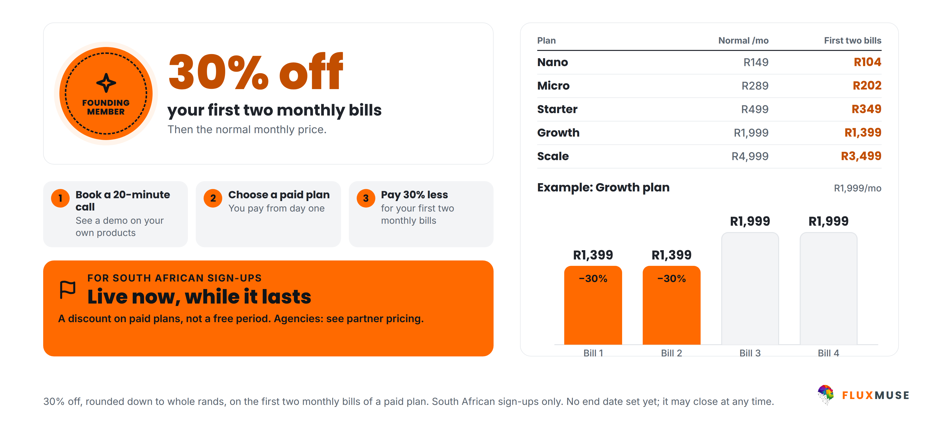
LAUNCH OFFER · SOUTH AFRICA · LIVE NOW
Become a Founding Member
FluxMuse · fluxmuse.ai
14
Notes:
Founding Member is live now for South African sign-ups: 30% off the first two monthly bills. On Growth that's R1,399 instead of R1,999 for two months; on Scale R3,499 instead of R4,999; on Starter R349. Then the normal price. It's a discount, not a free period, and there's no set end date, so say "while it lasts". Don't offer bonus months on annual plans or other perks; only the discount is confirmed. Larger groups on Corporate: talk to us (00_FACTS §2 "Founding Member").

Slide 15


TRUST & COMPLIANCE
Built to protect your customers' data
Meta Tech Provider
Official WhatsApp API
POPIA-aligned
Verified by Meta
Meta Cloud API
Consented broadcasts only
Row-level security
Encrypted tokens
Data export & deletion
Your data kept separate
Connected accounts
Export data, delete account
FluxMuse · fluxmuse.ai
15
Notes:
Trust matters when you're handling customer chats. Fluxmuse (Pty) Ltd is a verified Meta Tech Provider, with business and access verification, and WhatsApp runs on Meta's official Cloud API. Broadcasts go only to contacts who have opted in, in line with POPIA. Under the hood there's row-level security, encrypted tokens for connected accounts, and data export and account deletion. If they ask for a data processing agreement, a security questionnaire or certifications, don't improvise: note the request and follow up in writing (CURRENT_OFFER.md §4; 00_FACTS §1).

Slide 16
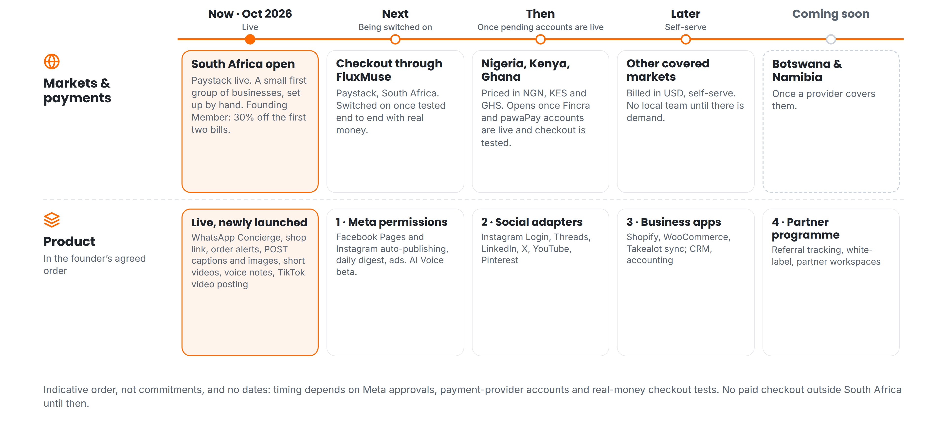
ROADMAP · INDICATIVE, NO DATES
What comes next, in order
FluxMuse · fluxmuse.ai
16
Notes:
Here's what comes next, in order, with no dates. On markets: South Africa is open now, with Paystack live. Next, checkout through FluxMuse, switched on once it's tested end to end with real money. Then Nigeria, Kenya and Ghana, once the pawaPay and Fincra accounts are live. Later, other markets in US dollars; Botswana and Namibia are coming soon. On product: Meta permissions for Facebook and Instagram posting, then social adapters, business app integrations, and the partner programme. Timing depends on approvals, so don't give dates (00_FACTS §1 "Roadmap").

Slide 17
NEXT STEPS
Let's get you selling on WhatsApp
1
Book a 20-minute call
TALK TO US
Goals, channels, tools and team.
Thabo Malebadi
Founder
thabo@fluxmuse.com
fluxmuse.ai
2
See a demo on your products
Built from your own photos.
[[wa.me QR CODE]]
Scan to chat on WhatsApp
wa.me/
[[NUMBER]]
3
Get a tailored proposal
Starter, Growth, Scale or Corporate.
FluxMuse · fluxmuse.ai
17
Notes:
Close with one agreed next step and an owner for it. Option one: a 20-minute call with the people who run marketing, sales and operations, to map goals, channels, tools and team. Option two: a demo shop built from their own public photos, shown live. Option three: a tailored proposal for Starter, Growth, Scale or Corporate. Contact is Thabo Malebadi, thabo@fluxmuse.com. Follow up within 24 hours with the deck and a short written summary (CURRENT_OFFER.md §2).

Slide 18
APPENDIX
Reference slides
A1
Payment status by country
A2
Frequently asked questions
FluxMuse · fluxmuse.ai
18
Notes:
The appendix is for questions and follow-up, not the main talk track. It covers payment status by country, partner wholesale pricing where relevant, and the questions prospects ask most. Paid sign-up is open in South Africa only. Nigeria, Kenya and Ghana are priced but not on sale, so don't show local prices or offer checkout there; anyone outside South Africa, including Botswana and Namibia, gets the waitlist link instead: [[WAITLIST LINK]]. Regional price sheets are internal only and are not in customer decks (00_FACTS §2 "Market gating").

Slide 19
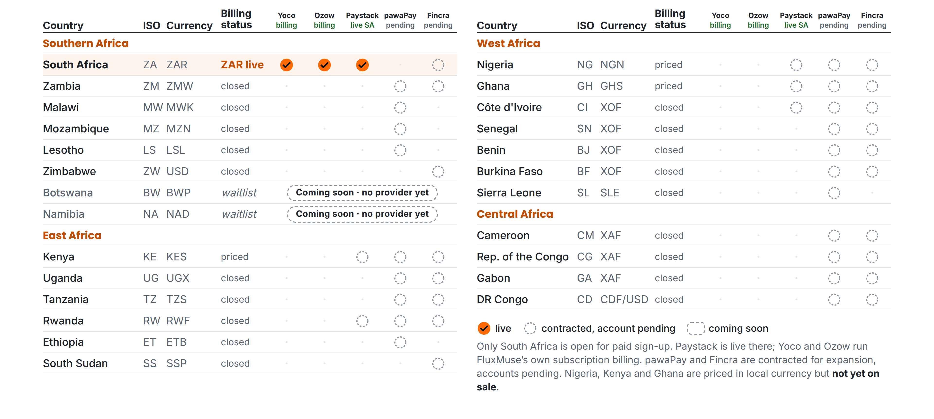
APPENDIX A1 · PAYMENT STATUS
What is live, and what is still pending
FluxMuse · fluxmuse.ai
19
Notes:
This matrix shows payment status by country. Only South Africa is open for paid sign-up: Paystack is live there, and Yoco and Ozow run FluxMuse's own subscription billing. Checkout through FluxMuse for a business's buyers is still being switched on. pawaPay and Fincra are contracted for expansion, but the accounts are pending, so none of those countries is open. Nigeria, Kenya and Ghana are priced in local currency but not on sale. Botswana and Namibia are coming soon with no provider yet. Source: CURRENT_OFFER.md §3; 00_FACTS §3.

Slide 20
APPENDIX A2 · FAQ (1 OF 2)
Questions prospects ask
Is my customers' data safe?
Can I use my own WhatsApp number?
Row-level security, encrypted tokens, broadcasts only to consented contacts, and data export and account deletion. Fluxmuse is a verified Meta Tech Provider.
Yes. We connect your WhatsApp Business number through Meta's official Cloud API setup, with you, by hand.
How do my customers pay?
Is there a trial? Can I cancel?
Today, orders arrive as a WhatsApp message and you take payment your usual way. Checkout through FluxMuse (Paystack, South Africa) is being switched on.
No trials: every paid plan starts with payment, monthly or annual (10× monthly). Free is a permanent plan. Cancellation terms: [[CONFIRM TERMS]].
FluxMuse · fluxmuse.ai
20
Notes:
Use these answers as written; they follow CURRENT_OFFER.md. On data, stick to the controls listed and don't claim certifications we haven't confirmed. On WhatsApp numbers, a number already used in the WhatsApp Business app may need extra steps, so check it together during setup. On payments, be clear that checkout through FluxMuse is being switched on and hasn't been tested with real money yet. There are no trials, and cancellation terms are still to be confirmed, so promise a written answer rather than improvising.

Slide 21
APPENDIX A2 · FAQ (2 OF 2)
Questions prospects ask
Is there a guarantee?
How long does setup take?
A lead guarantee: 3 qualified leads in 30 days of go-live. If fewer, and you shared your link and posted weekly, we keep supporting you free until you reach 3.
We set you up by hand: WhatsApp number, catalogue from your photos, shop link. We aim for your first week; Meta approvals can stretch it.
I already use Shopify or WooCommerce.
Where can I buy FluxMuse?
Keep them. Sync from Shopify, WooCommerce and Takealot is being switched on. Until then, we build your catalogue from product photos.
South Africa, today. Nigeria, Kenya and Ghana are priced but not yet on sale. Other countries can join the waitlist.
FluxMuse · fluxmuse.ai
21
Notes:
The lead guarantee always comes with its conditions: three qualified leads in 30 days of go-live; if fewer, and the business shared its link and posted at least weekly, we extend support at no extra charge until three arrive. It is never cash back. Setup is by hand, but Meta approvals and catalogue size can stretch it, so set expectations honestly. Store sync is being switched on, so don't promise it. Outside South Africa, share the waitlist link, never prices (CURRENT_OFFER.md §2 and §3).

