Slide 1


AI MARKETING & WHATSAPP SELLING
Your AI marketing team.
Selling on WhatsApp.
Send photos, get a shop link, and let your AI team help you post and reply. Built for South Africa.
Prepared for [[PROSPECT NAME]]
[[DATE]] · Thabo Malebadi, founder
Notes:
Keep it personal and short. "You're running the business, the marketing and the WhatsApp inbox yourself. FluxMuse is an AI marketing team that lives in WhatsApp, with paid plans from R149 a month." Promise about 15 minutes. Ask: "How do customers find you, and how do they order today?" Listen for lost messages, late replies and no shop page; you'll come back to each one. If they have staff or several brands, switch to the SME deck. Prices follow CURRENT_OFFER.md §1.

Slide 2
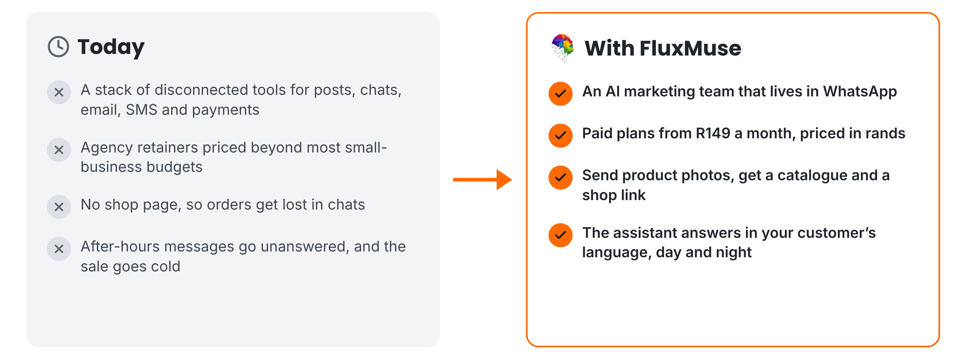
THE PROBLEM WE SOLVE
Marketing and selling, without the patchwork
FluxMuse · fluxmuse.ai
2
Notes:
Talk about their week, not the market. You post when you find time, answer messages late at night, and orders get lost in chats because there's no shop page. Paying a marketer or an agency isn't realistic yet. On the right: FluxMuse is an AI marketing team in WhatsApp from R149 a month. Send product photos and you get a catalogue and a shop link, and the assistant answers in your customer's language. These are newly launched, not long-tested (CURRENT_OFFER.md §3). Ask which of these costs them the most sales.

Slide 3


MEET FLUXMUSE
One AI team for marketing and sales
LIVE, NEWLY LAUNCHED
BEING SWITCHED ON
Photos to catalogue
Checkout
Shop link
Facebook & Instagram
Order alerts
AI Voice (beta)
AI marketing and a WhatsApp shop, for South African businesses.
AI posts & clips
Set up by hand
TikTok video
FluxMuse · fluxmuse.ai
3
Notes:
Here's FluxMuse in one line: an AI marketing team and WhatsApp shop for South African businesses. Be precise about what's live. Live and newly launched: photos to catalogue on WhatsApp, a hosted shop link, order alerts with SOLD, AI captions, images and short clips, and TikTok video posting. Being switched on: checkout through FluxMuse, Facebook and Instagram auto-posting, and AI Voice in beta. Newly launched means built and deployed, but no business has run it end to end yet, so we set you up by hand (CURRENT_OFFER.md §3). Ask whether they already use WhatsApp Business.

Slide 4
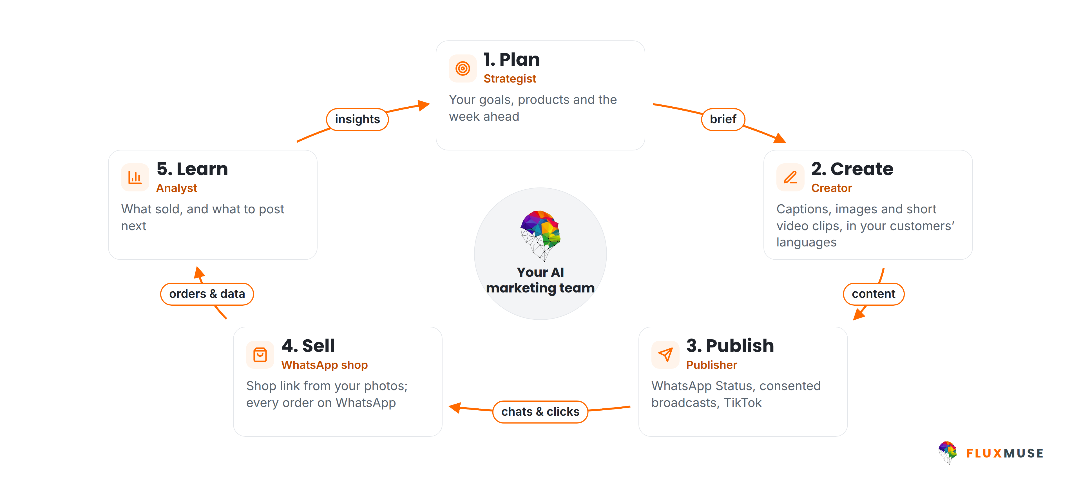
HOW FLUXMUSE WORKS
One loop, run by your AI marketing team
FluxMuse · fluxmuse.ai
4
Notes:
FluxMuse works as a loop. Plan: your goals, products and the week ahead. Create: captions, images and short video clips, in your customers' languages. Publish: forward to WhatsApp Status, send broadcasts to contacts who have opted in, and post video to TikTok. Sell: a shop link built from your photos, with every order landing on WhatsApp. Learn: what sold, and what to post next. Facebook and Instagram auto-posting is being switched on, so don't promise it yet (CURRENT_OFFER.md §3). The point is that marketing and selling stop living in separate tools.

Slide 5
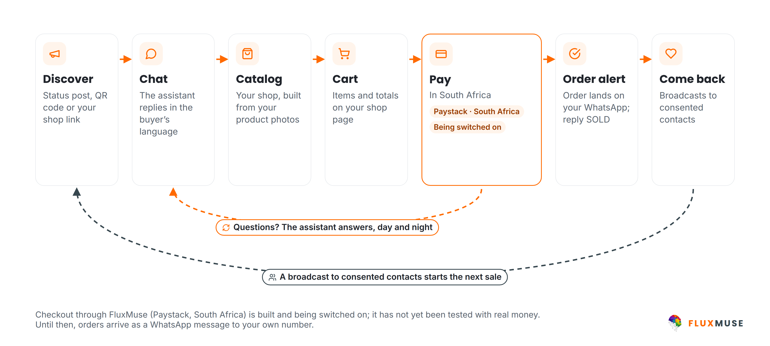
WHATSAPP SELLING
From first tap to repeat order, on WhatsApp
FluxMuse · fluxmuse.ai
5
Notes:
This is the heart of the pitch. A buyer finds you through a Status post, a QR code or your shop link. The assistant replies in their language. They browse a catalogue built from your photos, fill a cart, and the order lands on your WhatsApp; you reply SOLD to keep track. Be honest about payment: checkout through FluxMuse on Paystack is built but being switched on, because it hasn't been tested end to end with real money. Until then, orders arrive as a WhatsApp message and you take payment your usual way (CURRENT_OFFER.md §3). Broadcasts go only to consented contacts.

Slide 6
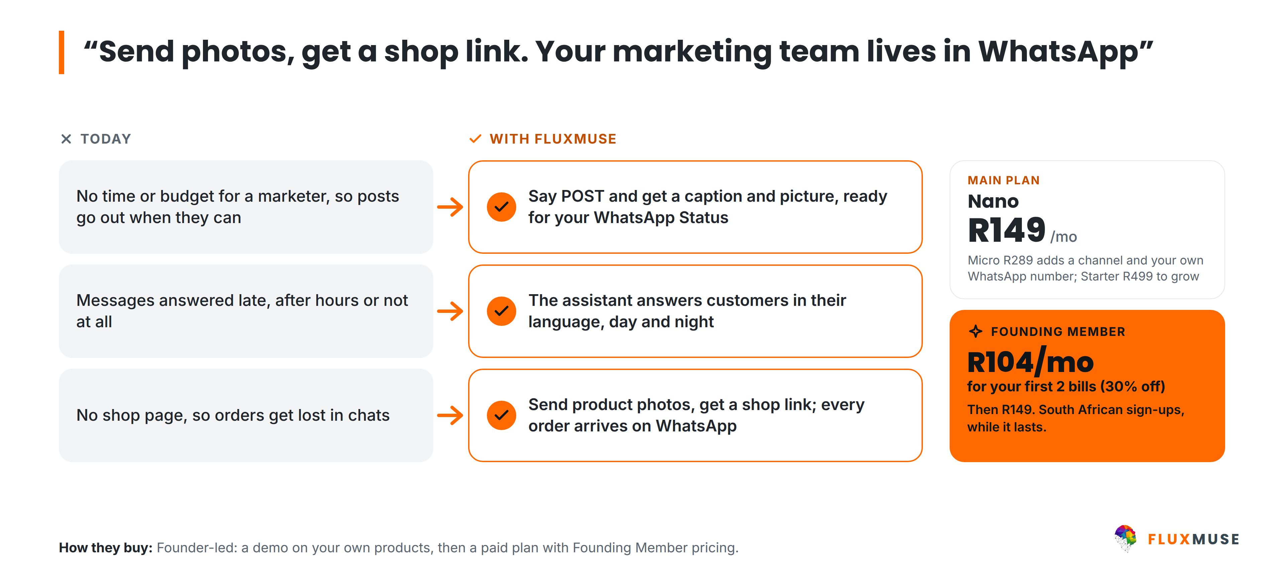
LAUNCH SEGMENT · SOLO ENTREPRENEURS
Solo entrepreneurs: 1–5 people
FluxMuse · fluxmuse.ai
6
Notes:
Solo entrepreneurs are braiders and beauty studios, fashion resellers, home bakers, coaches and informal retailers. Their pains are simple: no time or budget for a marketer, messages answered late, and no shop page, so orders get lost in chats. FluxMuse answers each one with newly launched features: say POST to get a caption and picture, the assistant answers in the customer's language, and product photos become a shop link. Nano is R149 a month; Founding Members pay R104 for the first two bills. Micro at R289 adds a channel and their own WhatsApp number (CURRENT_OFFER.md §1).

Slide 7
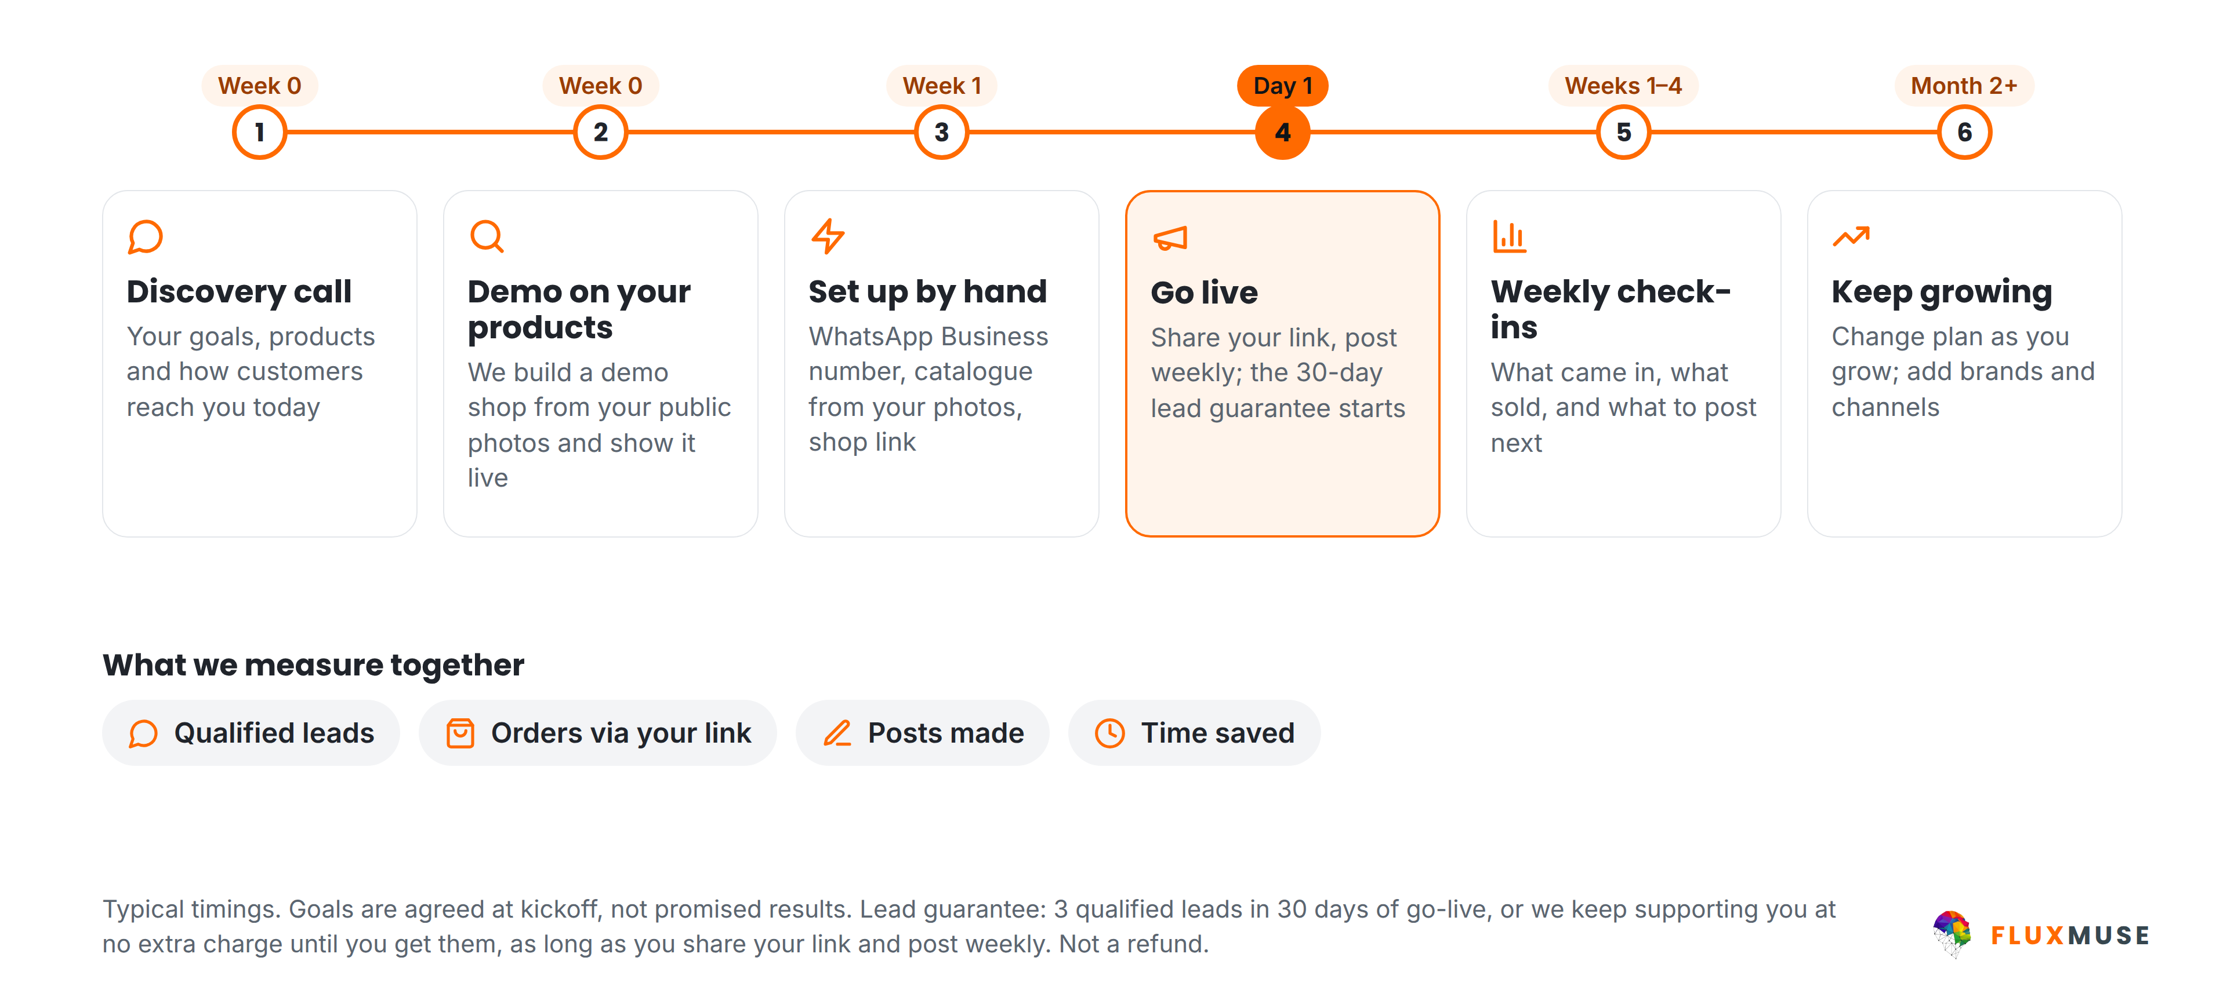
WORKING WITH FLUXMUSE
From first call to your first orders
FluxMuse · fluxmuse.ai
7
Notes:
This is how we work together. First a discovery call about your goals and products. Then a demo shop built from your own public photos, shown live; that's a demo, not a trial. Once you choose a paid plan, we set you up by hand: WhatsApp Business number, catalogue and shop link. On go-live day the lead guarantee starts: three qualified leads in 30 days, as long as you share your link and post weekly; if not, we keep supporting you at no extra charge. Then weekly check-ins. Goals are agreed together, not promised results (CURRENT_OFFER.md §2).

Slide 8





OUR FIRST GROUP OF BUSINESSES
Starting small, set up by hand
A small first group
LEAD GUARANTEE
3 qualified leads in 30 days of go-live
We set you up by hand
Weekly founder check-ins
A qualified lead is a new WhatsApp number that messages you through your FluxMuse link. If fewer than 3 arrive in 30 days, and you shared your link and posted at least weekly, we keep supporting you at no extra charge until you reach 3. Extra support, not a payout.
You tell us what to fix first
Your story shared only with consent
FluxMuse · fluxmuse.ai
8
Notes:
Be honest about where we are. FluxMuse is newly launched and has no paying customers or case studies yet. We're opening with a small first group of South African businesses, and we set each one up by hand, with weekly check-ins. That's the offer: close attention, not social proof. It's backed by the lead guarantee: three qualified leads in 30 days of go-live. If fewer arrive, and the business shared its link and posted at least weekly, we keep supporting them at no extra charge until three arrive. It is extra support, never cash back (CURRENT_OFFER.md §2 and §4).

Slide 9
PRICING (ZAR) · YOUR PLANS
Plans that fit a small business
Nano
Micro
Starter
R149/mo
R289/mo
R499/mo
or R1,490/yr
or R2,890/yr
or R4,990/yr
1 brand · 3 channels
1 brand · 4 channels
1 brand · 3 channels
Entry plan
Own WhatsApp number
Room to grow
FOUNDING MEMBER
R104 for your first 2 bills
FOUNDING MEMBER
R202 for your first 2 bills
FOUNDING MEMBER
R349 for your first 2 bills
Prices in rands are what you pay. Every paid plan starts with payment; no trials. Annual = 10× monthly. AI credit allowances: see fluxmuse.ai/pricing.
Founding Member: 30% off your first two monthly bills, South African sign-ups, while it lasts.
FluxMuse · fluxmuse.ai
9
Notes:
Most solo businesses start on Nano: R149 a month for one brand and three channels. Micro at R289 adds a fourth channel and connects their own WhatsApp number. Starter at R499 is the step up as they grow. Annual billing is ten times monthly. There's no trial: every paid plan starts with payment. As a Founding Member, a South African sign-up pays 30% less for the first two monthly bills: R104 on Nano, R202 on Micro. It's a discount, not a free period, and it has no set end date. Don't quote AI credit numbers (CURRENT_OFFER.md §1).

Slide 10
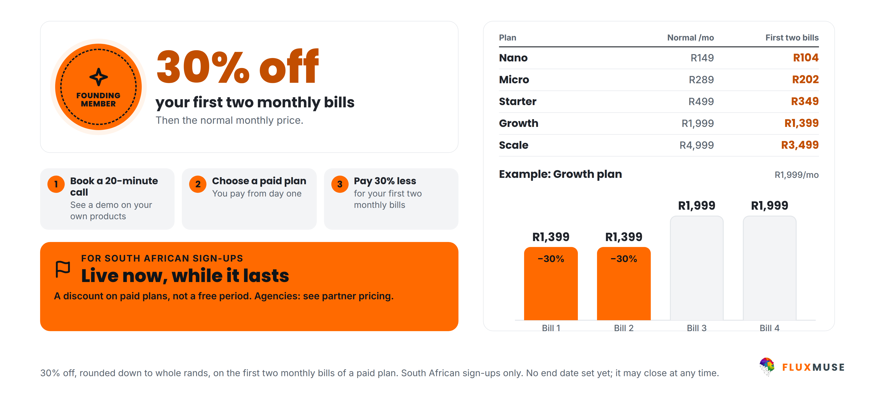
LAUNCH OFFER · SOUTH AFRICA · LIVE NOW
Become a Founding Member
FluxMuse · fluxmuse.ai
10
Notes:
Here's the easiest yes. Join as a Founding Member and your first two Nano bills are R104 instead of R149, or R202 instead of R289 on Micro. After that it's the normal monthly price. It's a discount on a paid plan, not a free period, and it's for South African sign-ups while it lasts; there's no closing date to quote. Don't promise extra perks like badges or bonus months; only the discount is confirmed. Then offer the demo on their own products (00_FACTS §2 "Founding Member").

Slide 11




TRUST & COMPLIANCE
Built to protect your customers' data
Meta Tech Provider
Official WhatsApp API
POPIA-aligned
Verified by Meta
Meta Cloud API
Consented broadcasts only
Row-level security
Encrypted tokens
Data export & deletion
Your data kept separate
Connected accounts
Export data, delete account
FluxMuse · fluxmuse.ai
11
Notes:
Trust matters when you're handling customer chats. Fluxmuse (Pty) Ltd is a verified Meta Tech Provider, with business and access verification, and WhatsApp runs on Meta's official Cloud API. Broadcasts go only to contacts who have opted in, in line with POPIA. Under the hood there's row-level security, encrypted tokens for connected accounts, and data export and account deletion. If they ask for a data processing agreement, a security questionnaire or certifications, don't improvise: note the request and follow up in writing (CURRENT_OFFER.md §4; 00_FACTS §1).

Slide 12
NEXT STEPS
Let's get you selling on WhatsApp
1
Book a 20-minute call
TALK TO US
Goals, products, customers.
Thabo Malebadi
Founder
thabo@fluxmuse.com
fluxmuse.ai
2
See a demo on your products
Built from your own photos.
[[wa.me QR CODE]]
Scan to chat on WhatsApp
wa.me/
[[NUMBER]]
3
Join as a Founding Member
First 2 Nano bills at R104.
FluxMuse · fluxmuse.ai
12
Notes:
Close with one clear next step. The simplest is a demo shop built from their own public product photos, shown live; it's a demo, not a trial. If they're ready, they join as a Founding Member on Nano: R104 for each of the first two bills, then R149, and we set them up by hand. If they want to think first, book a 20-minute call. Contact is Thabo Malebadi, thabo@fluxmuse.com. Follow up within 24 hours with a short summary (CURRENT_OFFER.md §1 and §2).

Slide 13
APPENDIX A1 · FAQ (1 OF 2)
Questions prospects ask
Is my customers' data safe?
Can I use my own WhatsApp number?
Row-level security, encrypted tokens, broadcasts only to consented contacts, and data export and account deletion. Fluxmuse is a verified Meta Tech Provider.
Yes. We connect your WhatsApp Business number through Meta's official Cloud API setup, with you, by hand.
How do my customers pay?
Is there a trial? Can I cancel?
Today, orders arrive as a WhatsApp message and you take payment your usual way. Checkout through FluxMuse (Paystack, South Africa) is being switched on.
No trials: every paid plan starts with payment, monthly or annual (10× monthly). Free is a permanent plan. Cancellation terms: [[CONFIRM TERMS]].
FluxMuse · fluxmuse.ai
13
Notes:
Use these answers as written; they follow CURRENT_OFFER.md. On data, stick to the controls listed and don't claim certifications we haven't confirmed. On WhatsApp numbers, a number already used in the WhatsApp Business app may need extra steps, so check it together during setup. On payments, be clear that checkout through FluxMuse is being switched on and hasn't been tested with real money yet. There are no trials, and cancellation terms are still to be confirmed, so promise a written answer rather than improvising.

Slide 14
APPENDIX A1 · FAQ (2 OF 2)
Questions prospects ask
Is there a guarantee?
How long does setup take?
A lead guarantee: 3 qualified leads in 30 days of go-live. If fewer, and you shared your link and posted weekly, we keep supporting you free until you reach 3.
We set you up by hand: WhatsApp number, catalogue from your photos, shop link. We aim for your first week; Meta approvals can stretch it.
I already use Shopify or WooCommerce.
Where can I buy FluxMuse?
Keep them. Sync from Shopify, WooCommerce and Takealot is being switched on. Until then, we build your catalogue from product photos.
South Africa, today. Nigeria, Kenya and Ghana are priced but not yet on sale. Other countries can join the waitlist.
FluxMuse · fluxmuse.ai
14
Notes:
The lead guarantee always comes with its conditions: three qualified leads in 30 days of go-live; if fewer, and the business shared its link and posted at least weekly, we extend support at no extra charge until three arrive. It is never cash back. Setup is by hand, but Meta approvals and catalogue size can stretch it, so set expectations honestly. Store sync is being switched on, so don't promise it. Outside South Africa, share the waitlist link, never prices (CURRENT_OFFER.md §2 and §3).

