Slide 1

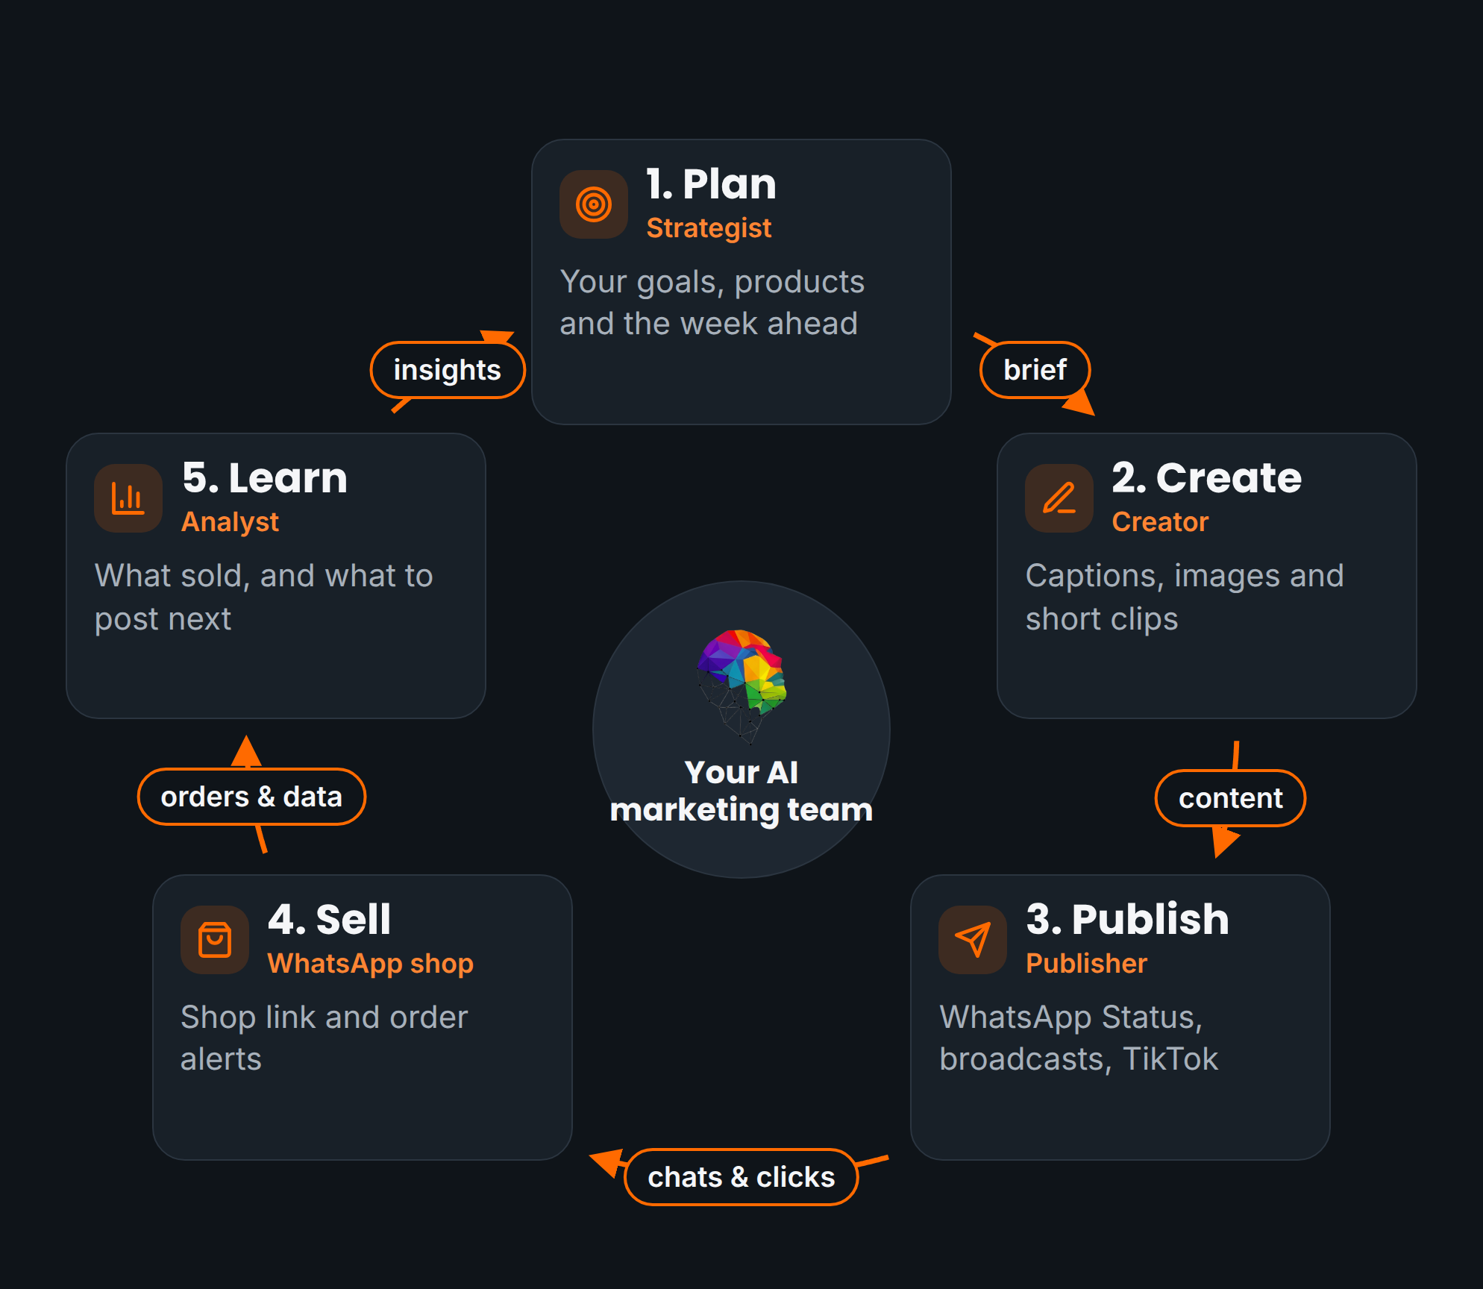
FLUXMUSE · INVESTOR PRESENTATION
An AI marketing team and a WhatsApp shop for African small businesses
Seed round · R46M
[[DATE]] · Confidential
Fluxmuse (Pty) Ltd · South Africa · fluxmuse.ai
Notes:
Thank you for your time. FluxMuse, built by Fluxmuse (Pty) Ltd in South Africa, gives small businesses an AI marketing team and a shop that runs on WhatsApp. The product is newly launched in South Africa. We have no paying customers yet, and we say so up front. We are raising a R46M seed, about US$2.49M. In the base case of our model this round carries the company to profitability with no Series A; the upside case passes too, the conservative case does not, and the headroom is thin. Every figure is from financial model v3, dated 2026-10-05. Sources: 00_FACTS_AND_ASSUMPTIONS.md; 08_Prospects/CURRENT_OFFER.md; 06_Financial_Model/Financial_Model_Notes.md. Replace [[DATE]] before sending.

Slide 2




THE PROBLEM
Sales happen in chat. The tools don't.
Buyers already shop in chats
No marketing capacity
Selling is still manual
They find a business on social or a WhatsApp Status, then ask, order and pay in chat, answered by hand.
Owners post when they find time. A marketer or agency retainer is out of reach for many.
Catalogues, prices and orders live in photo albums and chat threads, not in a shop.
FluxMuse works where the owner already works: on WhatsApp, turning photos into a shop and posts, and orders into alerts.
FluxMuse · Confidential
2
Notes:
Start with how small businesses in South Africa actually sell. Buyers find them on Facebook, Instagram, TikTok or a WhatsApp Status, then ask questions, order and pay in chat, and the owner handles every message by hand. Owners rarely have the time or budget for marketing, so posting is patchy and agency retainers are out of reach. The catalogue is a photo album and the order book is a chat thread. We show no market statistics here on purpose: this framing comes from our segment work, and we will measure it with the first group of businesses we set up by hand. Sources: 00_FACTS_AND_ASSUMPTIONS.md; CURRENT_OFFER.md §3 and §4.

Slide 3
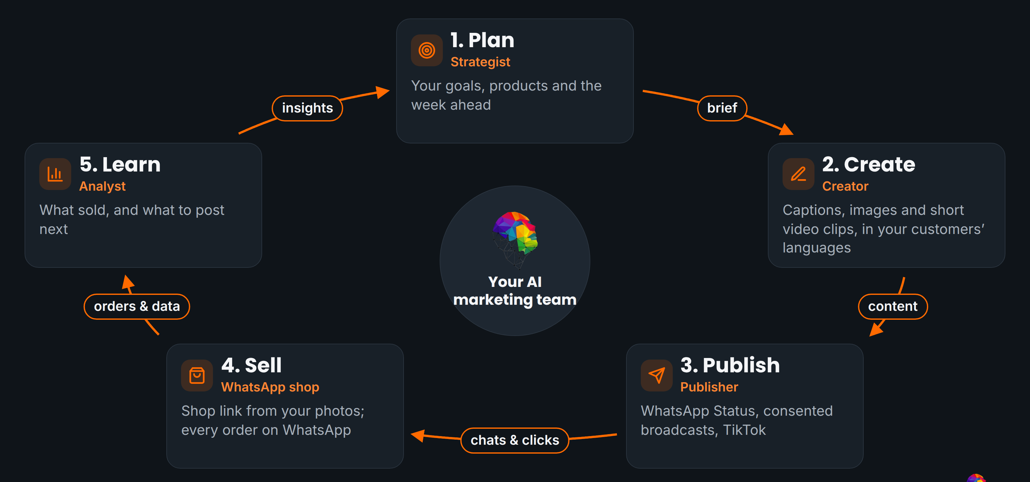
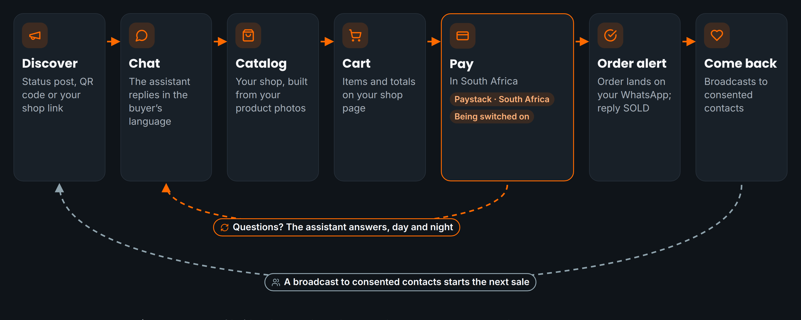

THE SOLUTION
An AI team that markets and sells on WhatsApp
AI captions, images, short video clips and voice-note transcription, on WhatsApp
Newly launched in South Africa. Facebook and Instagram auto-publishing and checkout through FluxMuse are being switched on.
WhatsApp Concierge: send photos, get a catalogue and a hosted shop link
FluxMuse · Confidential
3
Notes:
FluxMuse is one loop, run from WhatsApp. The owner sends product photos; the Concierge drafts the catalogue entry and the owner replies yes, no or edit. A hosted shop link sends each order to the owner's own WhatsApp, and they reply SOLD. The POST keyword returns a caption and image ready for WhatsApp Status; short video clips, voice-note transcription and answers in the customer's language are live too. All of this is newly launched, and no merchant has run it end to end yet. Facebook and Instagram auto-publishing wait on Meta permissions. Sources: CURRENT_OFFER.md §3; 00_FACTS_AND_ASSUMPTIONS.md.

Slide 4
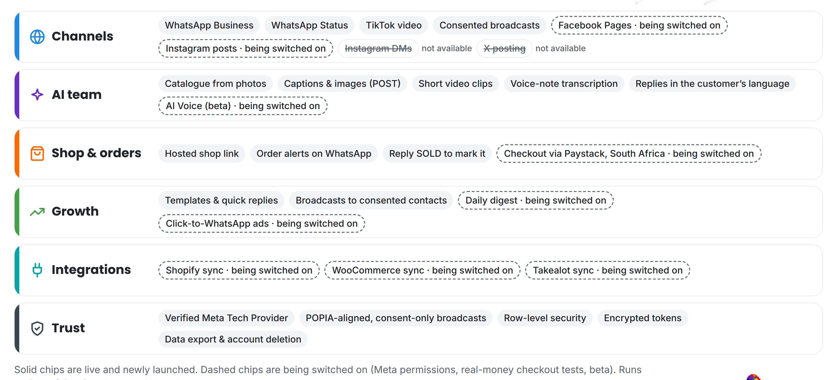
PRODUCT
What is live, in setup and not yet available
Layer | What's included | Status
WhatsApp shop | Concierge, shop link, order alerts, SOLD | Live
AI content | Captions, images, short video, voice notes | Live
WhatsApp Business | Setup, templates, broadcast to consented contacts | Live
TikTok | Video posting (approved) | Live
Facebook / Instagram | Auto-publishing (Meta permissions pending) | In setup
Checkout, AI Voice | FluxMuse checkout; AI Voice beta; daily digest | In setup
Not yet | Instagram DMs, X, checkout outside SA | Not available
Solid chips are live and newly launched; dashed chips are being switched on.
9
R149
ZA
plans in three bands
entry paid plan
live market
FluxMuse · Confidential
4
Notes:
This is the product as it stands, with an honest status column taken from the current offer. Live and newly launched: the WhatsApp Concierge, hosted shop link, order alerts and SOLD, AI captions, images, short video and voice-note transcription, WhatsApp Business setup and consented broadcasts, and TikTok video posting. Being switched on: Facebook and Instagram auto-publishing, which waits on Meta permissions, checkout through FluxMuse, which is built but not yet tested with real money, AI Voice in beta, and the daily digest. Not available: Instagram DMs and comments, X posting, and checkout outside South Africa. Sources: CURRENT_OFFER.md §3; infographic platform-stack.

Slide 5
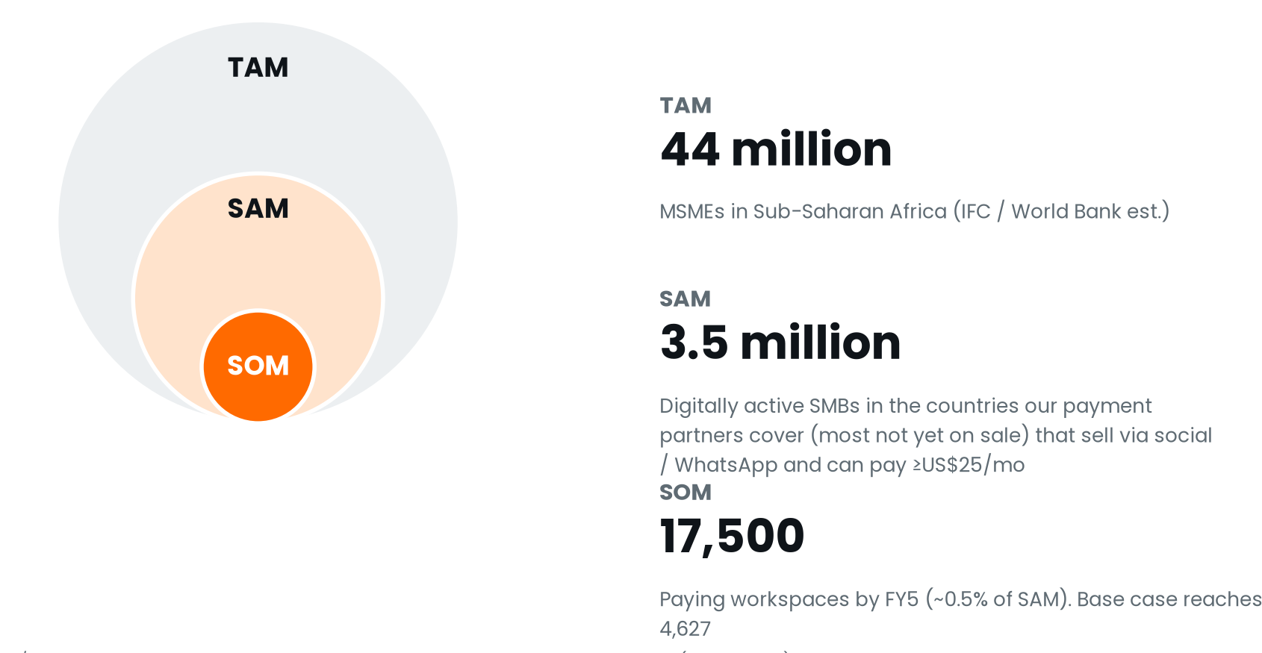
WHY AFRICA, WHY NOW · MARKET ESTIMATES
Small businesses already sell on mobile
>90%
of internet users in SA and Nigeria use WhatsApp
DataReportal 2025 est.
~70%
of global mobile money value is in Sub-Saharan Africa
GSMA State of the Industry 2025 est.
~44M
MSMEs in Sub-Saharan Africa
IFC / World Bank est.
~39M
MSMEs in Nigeria; ~7.4M in Kenya; ~2.5–3M SMMEs in South Africa
TAM: IFC / World Bank est. SAM and SOM: FluxMuse planning estimates. The base case reaches 4,627 paying workspaces in FY5, 26.4% of SOM (projection (model v3, base case)). Verify all estimates before external use.
SMEDAN, KNBS, SEDA / Stats SA est.
FluxMuse · Confidential
5
Notes:
Why Africa, and why now. WhatsApp is where commerce already happens: more than 90% of internet users in South Africa and Nigeria use it (DataReportal 2025 est.), and Sub-Saharan Africa handles about 70% of global mobile money value (GSMA est.). There are roughly 44 million MSMEs in the region. We size a serviceable market of about 3.5 million digitally active small businesses across the African markets our payment partners can reach, and an obtainable share of 0.5%, or 17,500 paying workspaces. The base case needs 4,627. These are estimates to verify before external use. Sources: 00_FACTS_AND_ASSUMPTIONS.md §5; model_summary.json → market_sizing.

Slide 6
BUSINESS MODEL · PRICED IN RANDS
Nine plans in three bands
Band | Plan | Monthly | Annual
Small | Free | R0 | R0
 | Nano | R149 | R1,490
 | Micro | R289 | R2,890
Medium | Starter | R499 | R4,990
 | Growth | R1,999 | R19,990
 | Scale | R4,999 | R49,990
Enterprise | Corporate | R6,999 | R69,990
 | Agency | R9,999 | R99,990
 | Custom | By consultation | –
REVENUE STREAMS · FY5
Projection (model v3, base case)
Subscriptions (net)
R84.7M
WhatsApp messaging
R7.9M
AI-credit packs
R0.9M
Custom setup fees
R0.1M
FluxMuse checkout fee
R0
Total revenue
R93.5M
Annual = 10× monthly
Paid plans start with payment
No VAT added
Paystack card and EFT fees pass through to the merchant. FluxMuse adds no fee on checkout in any scenario.
Founding Member, live now: 30% off the first two monthly bills for South African sign-ups (Nano R104, Growth R1,399). Partner wholesale R6,999.
FluxMuse · Confidential
6
Notes:
Revenue is mainly subscriptions, priced in rands in three bands. Small: a permanent Free plan, Nano at R149 and Micro at R289. Medium: Starter R499, Growth R1,999 and Scale R4,999. Enterprise: Corporate R6,999, Agency R9,999 and Custom by consultation. Annual is ten times monthly, and every paid plan starts with payment. Agencies resell at partner wholesale of R6,999. In FY5 the model books R84.7M of net subscriptions out of R93.5M of total revenue. Sources: CURRENT_OFFER.md §1; model_summary.json → price_tables; Financial_Model_Notes.md §4.

Slide 7




GO-TO-MARKET · SOUTH AFRICA NOW
Three segments, one partner channel
Solo sellers
SMEs
Agency partners
Side-hustles, solo shops
Growing small businesses
Managing many SMB clients
Nano R149 → Micro → Starter
Starter R499 → Scale
Partner wholesale R6,999
Self-serve; Free plan as the on-ramp
Guided onboarding call
Live demo on a client's public catalogue
Opening with a small first group, set up by hand: about 4 businesses a month, Oct ’26–Jan ’27 (model input). Founding Member is live.
1 · NOW
2 · WAVE 1, PENDING
3 · LATER
4 · COMING SOON
South Africa
Nigeria, Kenya, Ghana
19 more countries
Botswana & Namibia
Billed in ZAR · Paystack live
Priced, not on sale · Oct ’28–Apr ’29
USD, self-serve · model Nov 2029
No payment provider yet
Expansion waits for Fincra and pawaPay accounts to go live and for each MRR gate. Launch months: projection (model v3, base case).
FluxMuse · Confidential
7
Notes:
We sell in South Africa now, to three segments. Solo sellers start self-serve on Nano or Micro, with the Free plan as an on-ramp, not a trial. SMEs start on Starter or Growth with a guided call. Agencies are our partner channel at wholesale, and we demo on a client's own public catalogue. We are opening with a small first group of businesses and setting each one up by hand. Nigeria, Kenya and Ghana are priced but not on sale: checkout there waits for the Fincra and pawaPay accounts. The model opens them in Oct 2028, Jan 2029 and Apr 2029. Sources: CURRENT_OFFER.md §3 and §4; model_summary.json → markets.

Slide 8
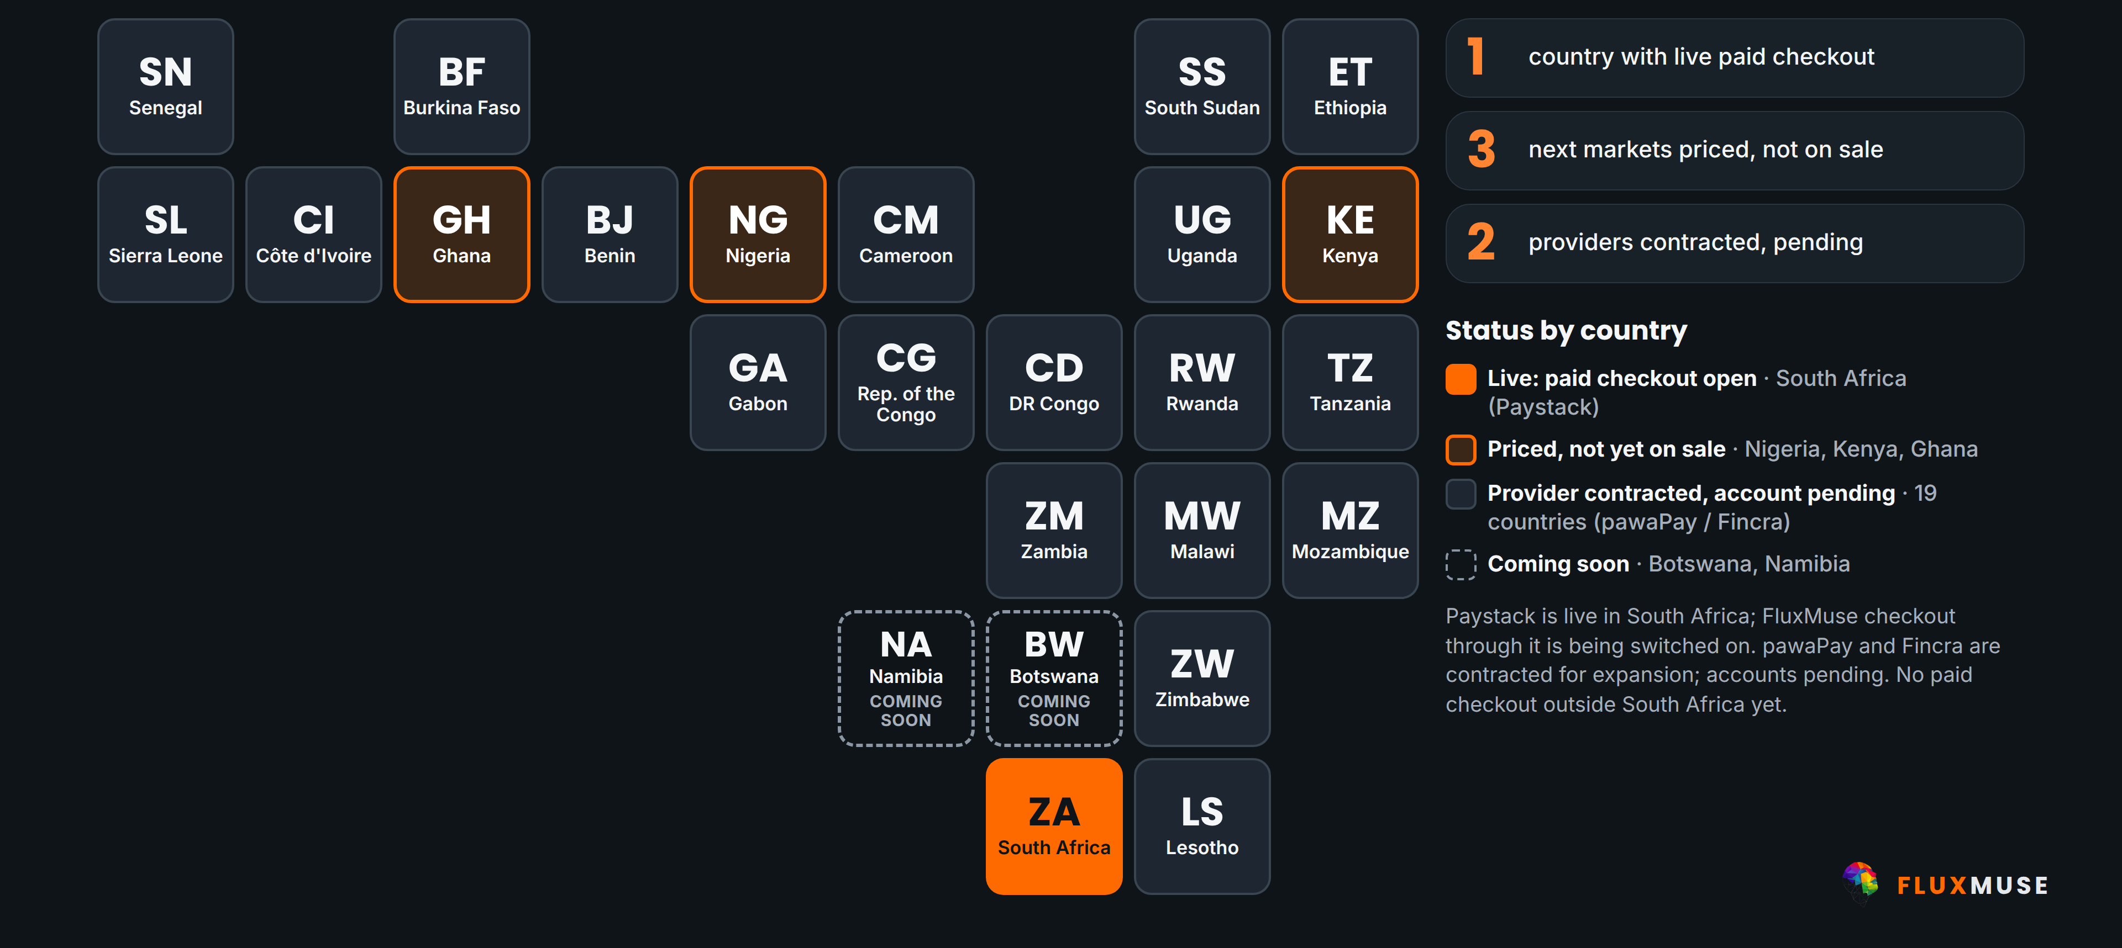
PAYMENTS
Live in South Africa. The rest is pending.
Live today
Paystack in SA; Yoco and Ozow for our billing
Being switched on
FluxMuse checkout, not yet tested with real money
Pending
pawaPay, Fincra signed; accounts pending
Paystack
Yoco
Ozow
pawaPay
Fincra
No paid checkout outside South Africa yet. Card fees are Paystack's, passed through; no FluxMuse fee.
FluxMuse · Confidential
8
Notes:
Payments, stated plainly. Paystack is live in South Africa, and Yoco and Ozow run FluxMuse's own subscription billing. Checkout through FluxMuse for merchants is built but not yet tested end to end with real money, so we describe it as being switched on. pawaPay and Fincra are contracted for expansion, but the accounts are pending, so there is no paid checkout in Nigeria, Kenya, Ghana or anywhere outside South Africa yet. Card fees are Paystack's standard fee, passed through, with no FluxMuse fee on top. Getting these rails live is part of what the expansion money buys. Sources: CURRENT_OFFER.md §2 to §4; infographic payment-coverage-map_dark.

Slide 9


WHERE WE ARE · NO CUSTOMERS YET
Live, verified, and opening by hand
Verified Meta Tech Provider
Live in South Africa
Paystack live
TikTok posting approved
Business and access verification
Newly launched on WhatsApp
South Africa; others pending
Meta publishing in setup
FIRST GROUP · BEING SET UP
LEAD GUARANTEE
A small first group of businesses, set up by hand
3 qualified leads in 30 days of go-live. If fewer, we extend support at no extra charge until 3 arrive.
Oct 2026
Selling opens in SA
Jan 2027
First group done (model)
Feb 2027
Seed closes (model)
Conditions: the merchant shares the link and posts weekly.
FluxMuse · Confidential
9
Notes:
Here is what is real today. Fluxmuse (Pty) Ltd is a verified Meta Tech Provider. The product is live in South Africa and newly launched, and Paystack is live there. TikTok video posting is approved; Facebook and Instagram publishing wait on Meta. We have no paying customers, no pilot and no results, and we do not show any. We are opening with a small first group of businesses and setting each up by hand. The offer is backed by a lead guarantee: three qualified leads in 30 days of go-live, or extended support at no extra charge until they arrive. It is support, never cash. Sources: CURRENT_OFFER.md §2 to §4; 07_Case_Studies/ First_Group_Case_Studies.md.

Slide 10
COMPETITION & POSITIONING · QUALITATIVE VIEW
Where FluxMuse sits
↑ WhatsApp-first, priced in rands
Global social media tools
Strong at publishing and analytics. FluxMuse runs from WhatsApp and builds the shop, priced in rands.
Local agencies
FluxMuse
WhatsApp BSPs & chatbot vendors
E-commerce platforms
Strong at messaging infrastructure. FluxMuse adds the AI team that creates the marketing.
WhatsApp BSPs & chatbot vendors
E-commerce platforms
Strong at storefronts. FluxMuse builds the shop from photos sent on WhatsApp.
Global social media tools
Local agencies
Local knowledge and service. FluxMuse makes them partners, white-label at R6,999/mo wholesale.
AI marketing + selling in one product →
FluxMuse · Confidential
10
Notes:
We position against categories, not named companies, and this map is our qualitative view, not measured data. Global social media tools are strong at publishing and analytics. WhatsApp business solution providers and chatbot vendors are strong at messaging infrastructure. E-commerce platforms are strong at storefronts. Local agencies bring service and local knowledge. FluxMuse aims for the top right: WhatsApp-first and priced in rands, with AI marketing and selling in one product. We treat agencies as a channel: they resell FluxMuse at the R6,999 partner wholesale price. Sources: 00_FACTS_AND_ASSUMPTIONS.md; CURRENT_OFFER.md §1.

Slide 11
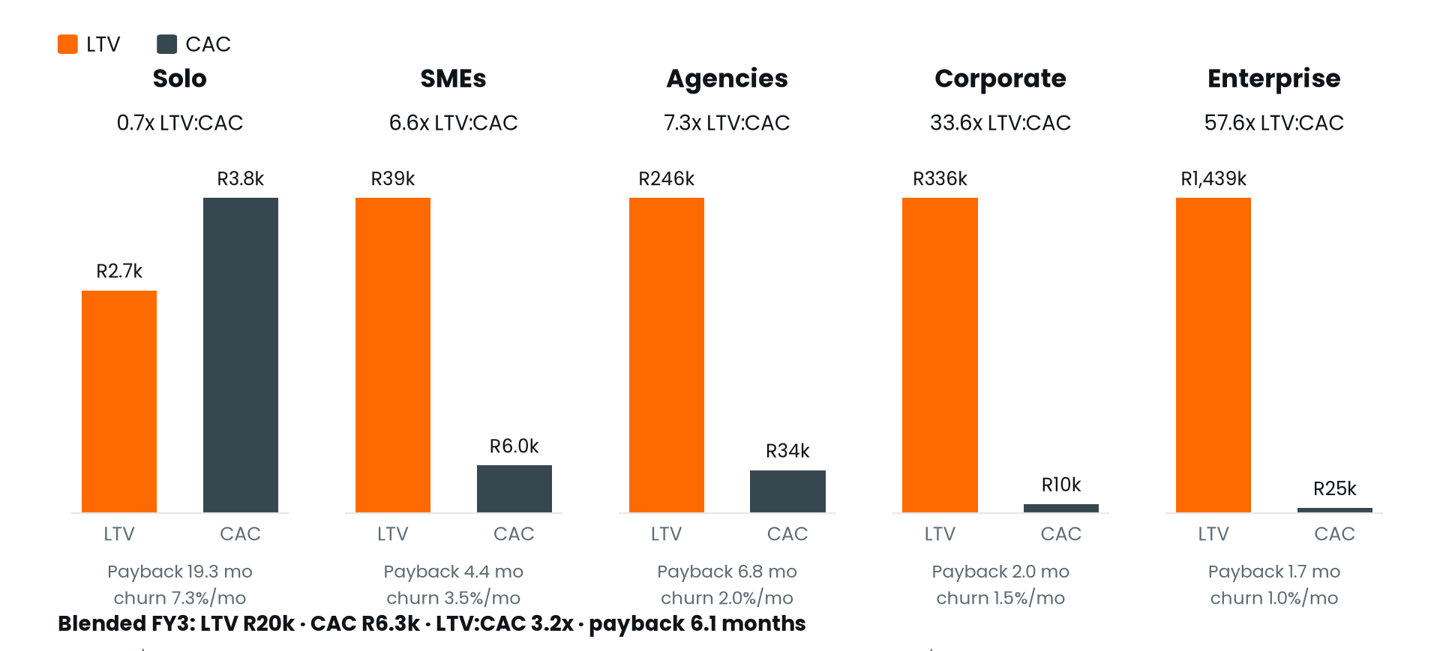
UNIT ECONOMICS · FY3 · PROJECTION (MODEL V3, BASE CASE)
Blended LTV:CAC 3.2x, payback 6.1 months
R19,908
R6,272
Blended LTV
Blended CAC
3.2x
6.1 mo
LTV:CAC
CAC payback
Blended | FY1 | FY3 | FY5
LTV:CAC | 0.8x | 3.2x | 4.7x
Payback (mo) | 25.0 | 6.1 | 4.1
Software GM | 23% | 67% | 76%
Solo does not pay back on fully loaded CAC (0.7x): it earns its place through the Free plan and upgrades, not paid ads. SMEs (6.6x) and agencies (7.3x) carry the blend.
LTV = ARPA × software GM (66.8%) ÷ churn
FluxMuse · Confidential
11
Notes:
Unit economics in FY3, all projections. Blended LTV is R19,908 against a blended CAC of R6,272, so LTV to CAC is 3.2 times and CAC pays back in 6.1 months. The honest weak spot is Solo: with shared marketing costs loaded, it is 0.7 times, so we grow Solo through the Free plan and upgrades rather than paid acquisition at scale. SMEs are 6.6 times and agencies 7.3. Every one of these figures is a projection (model v3, base case). Sources: model_summary.json → unit_economics_fy3; Financial_Model_Notes.md §7.

Slide 12
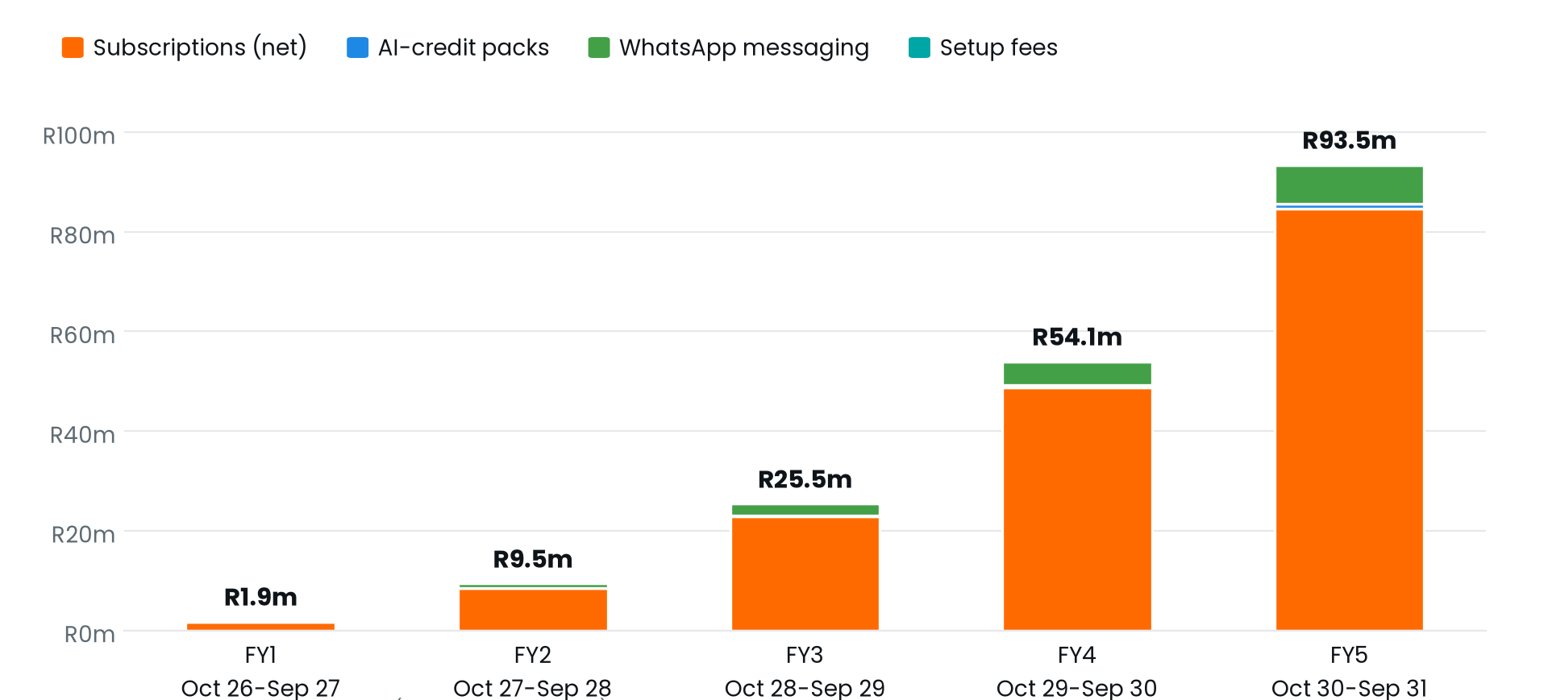
FINANCIAL PROJECTIONS · PROJECTION (MODEL V3, BASE CASE)
FY5: R93.5M revenue, 4.8% EBITDA margin
R93.5M
R4.5M
4,627
FY5 revenue
FY5 EBITDA
paying workspaces
≈US$5.06M
4.8% margin
70 people in FY5
Base case (FY = Oct–Sep) | FY1 | FY2 | FY3 | FY4 | FY5
Revenue | R1.9M | R9.5M | R25.5M | R54.1M | R93.5M
Gross margin | 22% | 54% | 62% | 66% | 71%
EBITDA | −R7.0M | −R11.7M | −R16.9M | −R10.6M | R4.5M
EBITDA margin | n/m | −124% | −66% | −20% | 5%
Paying workspaces (Sep) | 238 | 728 | 1,734 | 3,147 | 4,627
Subscription ARR | R3.9M | R12.7M | R32.0M | R63.0M | R99.9M
FluxMuse · Confidential
12
Notes:
This is the five-year base case, net of the Founding Member discount, with no VAT. Revenue grows R1.9M, R9.5M, R25.5M, R54.1M, R93.5M from FY1 to FY5, about US$5.06M in the final year. Gross margin rises from 22% to 71% as AI cost per workspace falls. EBITDA is negative for 4 years, with the deepest loss of −R16.9M, and turns positive at R4.5M in FY5. Paying workspaces grow from 238 to 4,627. Every volume is an assumption: there are no customers yet. Sources: model_summary.json → annual; Financial_Model_Notes.md §1.

Slide 13
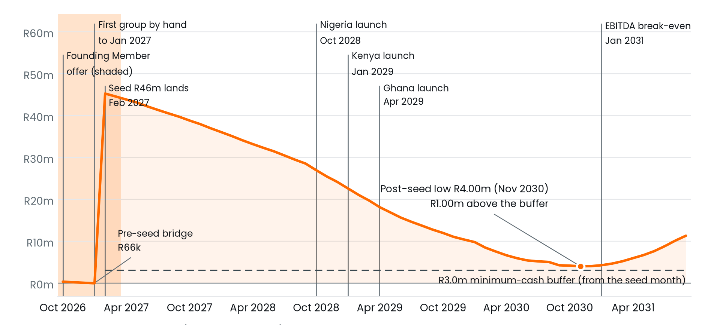
PATH TO PROFITABILITY · PROJECTION (MODEL V3, BASE CASE)
Base case: profitable on the R46M seed, no Series A
Jan 2031
EBITDA break-even; sustained from Jan 2031
Dec 2030
Operating cash flow positive; sustained Dec 2030
R4.00M
Cash low (Nov 2030), R1.0M above the buffer
MILESTONE GATING PROTECTS THE BUFFER
Every hire waits for its MRR milestone
NG / KE / GH launch at R0.9M / R1.2M / R1.5M MRR
Paid spend capped at R40k + 35% of MRR
Thin headroom
Base and Upside pass; Conservative does not
FluxMuse · Confidential
13
Notes:
The seed is sized to the model: R46M is the smallest passing seed of R45.1M, rounded up. It lands in Feb 2027. In the base case cash falls to R4.00M in Nov 2030, only R1.00M above our R3.0M buffer. Operating cash flow turns positive in Dec 2030 and EBITDA breaks even in Jan 2031. That is a long road and thin headroom. Gating protects it: hires and launches wait for MRR, and paid spend is capped. A pre-seed bridge of R66.3k is needed before close. Sources: model_summary.json → cash, seed_sizing; Financial_Model_Notes.md §1 and §3.

Slide 14
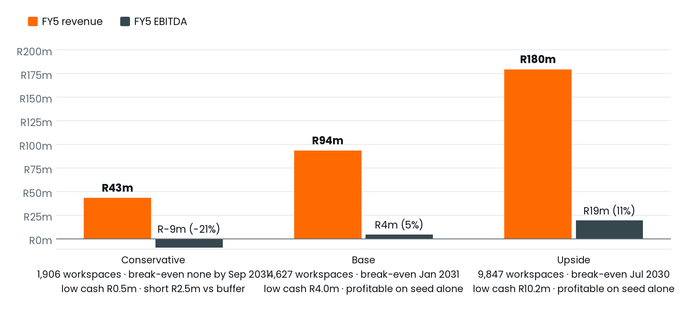
SCENARIOS & SENSITIVITIES · MODEL V3
Base and Upside pass on R46M; Conservative fails
Scenario | FY5 revenue | FY5 EBITDA | Cash low | Pass
Conservative | R43.4M | −R9.2M | R0.53M | No
Base | R93.5M | R4.5M | R4.00M | Yes
Upside | R179.6M | R19.4M | R10.16M | Yes
Conservative falls below the R3.0M buffer from May 2031 and does not break even by Sep 2031.
FX SHOCK · ZAR 15% STRONGER
THIN HEADROOM
With quarterly repricing it passes (low R4.53M). Without repricing it fails: cash low R0.92M, FY5 EBITDA −R0.9M.
Free upgrades at 0.25% a month: cash low −R0.72M, fails. Sign-ups at 0.85x plan: low R0.80M, below the buffer.
FluxMuse · Confidential
14
Notes:
We are plain about this slide. On R46M, base and upside pass our test; conservative does not. Conservative reaches R43.4M revenue in FY5, stays above zero, but drops below the buffer from May 2031 and never breaks even within the horizon. The base case headroom is thin: Free users upgrading at 0.25% a month instead of 0.5% breaks it, and so do sign-ups 15% below plan. A 15% stronger rand passes only if we reprice quarterly. Our response is to measure conversion from the first month and slow hiring gates early if it lags. Sources: model_summary.json → scenarios, constraint_checks, sensitivity_base, free_conversion_sensitivity, fx_shock; Financial_Model_Notes.md §2, §3, §6 and §10.

Slide 15




KEY RISKS
What could go wrong, and how we manage it
Demand is unproven
Thin headroom
Meta dependency
No paying customers yet; every volume is an assumption.
Upgrades at 0.25%/mo take the cash low to −R0.72M.
Facebook and Instagram publishing wait on Meta approval.
Measure sign-ups and Free upgrades from month 1; slow hiring if they lag.
Gated hiring; raise gates early. Conservative case still fails.
Verified Tech Provider; WhatsApp Status and TikTok work today.
Payment rails
FX
Execution & hiring
Only South Africa has live checkout.
NGN, KES and GHS can weaken against the rand.
From 2 founders to 41 people by the end of FY3.
pawaPay and Fincra contracted; no expansion until they are live.
Quarterly repricing; without it a ZAR +15% shock fails.
Every hire waits for an MRR milestone.
FluxMuse · Confidential
15
Notes:
These are the risks we would want an investor to probe. Demand is unproven: there are no paying customers, so conversion and sign-up volume are guesses until we measure them. Headroom is thin: a lower Free upgrade rate alone breaks the base case, and the conservative case fails on this seed. Meta has not yet approved Facebook and Instagram publishing. Only South Africa has live checkout, and expansion waits for pawaPay and Fincra. FX needs repricing discipline. Execution risk is managed by MRR-gated hiring. Sources: Financial_Model_Notes.md §6 and §10; CURRENT_OFFER.md §3; model_summary.json → free_conversion_sensitivity.

Slide 16
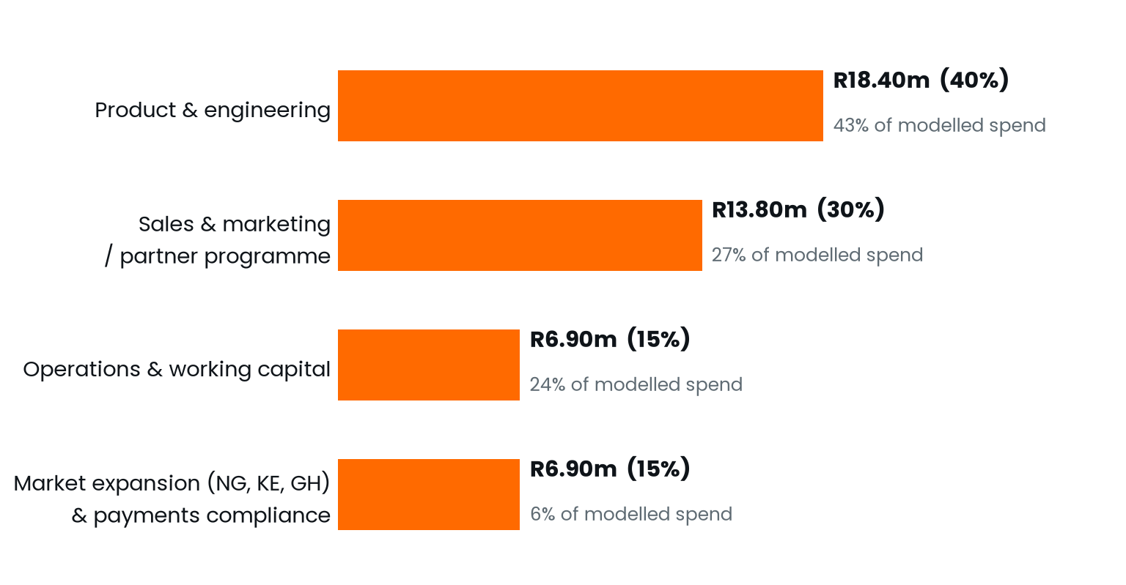
THE ASK
R46M seed to reach profitability
R46M
Seed round · ≈US$2.49M
Instrument [[TBC]] · valuation [[TBC]]
Close Feb 2027 · pre-seed bridge R66.3k
WHY THIS SIZE
R45.1M is the smallest seed at which the base case passes. R23.36M is used in the first 24 months; the rest carries the long loss-making stretch to the Nov 2030 low.
R18.4M product & engineering: engineers, AI/ML, design, integrations, hosting
R13.8M sales & marketing: growth team, partnerships, capped paid acquisition
R6.9M expansion: NG/KE/GH rails, teams, compliance
R6.9M operations: customer success, finance, cash buffer
FluxMuse · Confidential
16
Notes:
We are raising R46M, about US$2.49M, with instrument and valuation to be confirmed. It splits 40% product and engineering, R18.4M; 30% sales, marketing and partners, R13.8M; 15% Nigeria, Kenya and Ghana expansion with payments compliance; and 15% operations and working capital. The size is set by the model, not by appetite: it is the smallest seed at which the base case stays above our buffer, rounded up. In the base case the round carries us to profitability with no Series A; in the conservative case it does not. Sources: model_summary.json → use_of_funds, seed_sizing; 00_FACTS_AND_ASSUMPTIONS.md §7.

Slide 17
MILESTONES THIS ROUND BUYS
From a first group to break-even
Sept 2026
Oct 2026
Oct ’26–Jan ’27
[[TARGET]]
Feb 2027
Verified Meta Tech Provider
Selling in South Africa; Founding Member live
First group set up by hand (model input)
FluxMuse checkout and Meta publishing switched on
Seed closes (model input); first hires
Pending
Oct ’28–Apr ’29
Nov 2029
Dec 2030
Jan 2031
Fincra and pawaPay accounts live
Nigeria, Kenya and Ghana open (MRR-gated)
19 USD markets, self-serve
Operating cash flow positive
EBITDA break-even, no Series A
Orange cards: projection (model v3, base case) (Base); dates move with MRR gates and with the payment accounts.
FluxMuse · Confidential
17
Notes:
This is what the round buys, in order. We are a verified Meta Tech Provider, and selling opened in South Africa in October with Founding Member live. The model sets up a first group by hand from Oct 2026 - Jan 2027. Checkout through FluxMuse and Meta publishing are being switched on; the founder will set a target date. The seed closes in Feb 2027 in the model. Expansion needs the Fincra and pawaPay accounts live first; the model then opens Nigeria, Kenya and Ghana from Oct 2028 to Apr 2029, reaches operating cash flow positive in Dec 2030 and EBITDA break-even in Jan 2031. Sources: CURRENT_OFFER.md §3; model_summary.json → markets, cash.

Slide 18
TEAM · HEADCOUNT 13 → 23 → 70 (FY1, FY2, FY5; MODEL V3)
The team, and who the seed hires
[[FOUNDER NAME, TITLE, BIO]]
[[CO-FOUNDER]]
[[ADVISORS]]
Model role: Founder & CEO
Model role: CTO / founding engineer
Advisory board
Month (base) | Key hires (MRR-gated) | MRR gate (last month)
Feb 2027 | 2 senior full-stack engineers, Head of Growth, partnerships manager, customer success lead | At seed close
Mar 2027–Jun 2027 | AI/ML engineer, performance marketer, product designer, finance & compliance manager | Up to R0.15M
Aug 2028–Feb 2029 | Country leads for Nigeria, Kenya and Ghana, 2 months before each launch | Launch gates R0.9M–R1.5M
Oct 2028 | 2 integrations engineers: social adapters, commerce, CRM | R1.0M
Sep 2030–Sep 2031 | Head of Sales & Partnerships, VP Engineering, CFO | R5.0M to R8.0M
FluxMuse · Confidential
18
Notes:
Introduce the founding team here: fill in the founder, co-founder and advisors, with one line on why each is right for this problem. The model runs lean before the seed, with two founders on reduced salaries. The seed then funds the hires in the table, each waiting for a monthly recurring revenue milestone: engineers, a Head of Growth, a partnerships manager and a customer success lead at close; design, AI and finance through 2027; country leads before each wave-1 launch; and senior leaders only once MRR supports them. Headcount reaches 13 by the end of FY1, 23 in FY2 and 70 in FY5. Sources: hiring plan in _build/fm_inputs.py (ROLES) applied to model_summary.json → monthly_base.subscription_mrr_net_zar, reconciled to monthly_base.headcount; annual[].headcount_end_fy.

Slide 19



THANK YOU
Join the FluxMuse seed round
CONTACT
Thabo Malebadi
thabo@fluxmuse.com
[[PHONE]]
Data room: [[LINK]]
R46M to reach profitability with no Series A in the base case (projection (model v3, base case)).
Verified Meta Tech Provider
Live in South Africa · Paystack
First group being set up by hand
FluxMuse · Confidential
19
Notes:
Close with the ask and a clear next step. FluxMuse gives small businesses an AI marketing team and a shop on WhatsApp, newly launched in South Africa. In the model the R46M seed carries the base case to profitability with no Series A; upside passes, conservative does not, and we have shown why. Offer data-room access: the financial model and notes, Meta verification evidence and payment contracts. Agree a follow-up date before the meeting ends. Fill in [[PHONE]] and the data-room [[LINK]] before sending. Sources: model_summary.json → profitable_on_seed_alone (Conservative False, Base True, Upside True); CURRENT_OFFER.md §2 and §4; Investor_Deck_Guide.md.

Slide 20
APPENDIX
Reference slides
A1
Key model assumptions
A2
Paying workspaces by segment and market
A3
Pricing: nine plans in rands; local prices, not yet on sale
A4
Payment rails by country: live and pending
A5
FX shock sensitivity
A6
Founding Member discount cost
A7
Founder confirmations (internal: hide before sending)
FluxMuse · Confidential
20
Notes:
The appendix supports questions and diligence; it is not part of the main talk track. A1 lists the model's key assumptions word for word from the model summary. A2 shows paying workspaces by segment and by market. A3 has the nine plans in rands, then local-currency prices for markets that are priced but not yet on sale. A4 shows payment rails by country, live and pending. A5 is the FX shock, and A6 the Founding Member discount cost. A7 lists founder confirmations still open: it is internal, so hide or delete it before the deck goes to any investor. Sources: model_summary.json; 00_FACTS_AND_ASSUMPTIONS.md; CURRENT_OFFER.md.

Slide 21
APPENDIX A1 · KEY ASSUMPTIONS (1 OF 3) · MODEL V3
Key model assumptions
Topic | Assumption (model_summary.json → key_assumptions)
Timing & cash | Month 1 = Oct 2026. Opening cash R500,000 [[CONFIRM]]. Lean pre-seed mode until the R46M seed lands in Feb 2027: two founders on reduced salaries, lean hosting and overheads, the first-group set-up cost; no paid marketing or hires.
First group | No trials and no pilot. South Africa sells from Oct 2026. A first group of 4 paying businesses a month is set up by hand from Oct 2026 to Jan 2027 (50% Solo, the rest SMEs) [[CONFIRM]].
Sign-ups & Free plan | Self-serve sign-ups (Free + paid): South Africa 150 in Oct 2026 [[CONFIRM]], growing 12% a month in FY1 (Base). 5% of Solo and 8% of SME sign-ups pay at once [[CONFIRM]]; the rest join Free. Active Free users upgrade at 0.5% a month and go dormant at 10% a month [[CONFIRM]].
Founding Member | Founding Member: 30% off the first 2 monthly bills for South African Solo and SME sign-ups, live from Oct 2026; proposed end Mar 2027 [[CONFIRM]]. Not modelled on Agency, Corporate, Custom or annual plans. +20% paying sign-ups while it runs [[CONFIRM]]. No NG/KE/GH launch windows.
Pricing | Pricing (ZAR / month): Free R0, Nano R149, Micro R289, Starter R499, Growth R1,999, Scale R4,999, Corporate R6,999, Agency R9,999, Custom from R19,999 [[CONFIRM]]. NG/KE/GH/USD use the live tier_regional_prices at FX parity. Annual = 10x monthly, 25% of subscriptions on annual billing; +6% list escalator each October. No VAT (not VAT-registered).
FluxMuse · Confidential
21
Notes:
These assumptions are copied word for word from the model summary, so they always match the workbook. This page covers timing & cash, first group, sign-ups & free plan, founding member, pricing. Items marked [[CONFIRM]] still wait for founder sign-off and are listed again in appendix A7. When an investor challenges a number in the deck, trace it here first, then to the Assumptions sheet in FluxMuse_Financial_Model.xlsx, where each input sits in its own cell with the Conservative, Base and Upside values side by side. The inputs to replace with live data first are the pay-at-sign-up rates, the Free upgrade rate and sign-up volume. Source: model_summary.json → key_assumptions[0–4]; Financial_Model_Notes.md §4 and §11.

Slide 22
APPENDIX A1 · KEY ASSUMPTIONS (2 OF 3) · MODEL V3
Key model assumptions
Topic | Assumption (model_summary.json → key_assumptions)
Partner wholesale | Partner wholesale: agency-segment customers (100%) pay R6,999 a month (Agency list -30%); local wholesale at the Corporate local price points [[CONFIRM]]. Partner referral commission undecided and not modelled.
Segments | Segment tier mix: Solo 45% Nano / 40% Micro / 15% Starter; SMEs 40% Starter / 50% Growth / 10% Scale. Upgrades a month: Nano->Micro 1.5%, Micro->Starter 0.8%, Starter->Growth 1.0%, Growth->Scale 0.6% [[CONFIRM]]. Agencies: 0.5 inbound a month in SA plus 1.5 per partnerships manager; 0.4 per NG/KE/GH country lead. Corporate inbound 1/3/6/9/12 deals a year; Custom 0/1/2/3/4 [[CONFIRM]].
Churn | Monthly churn: Nano 8.0%, Micro 7.0%, Solo Starter 6.0%, SME Starter 4.5%, SME Growth 3.0%, SME Scale 2.2%, Agency 2.0%, Corporate 1.5%, Custom 1.0% (Base; NG/KE/GH/Rest churn indices 1.05-1.25x).
Markets | Markets: South Africa only until NG/KE/GH checkout is live (Fincra/pawaPay pending). Planned earliest launches Nigeria Apr 2028, Kenya Jul 2028, Ghana Oct 2028, Rest of Africa (USD) May 2029 [[CONFIRM]], each also behind an MRR gate (R0.9M / R1.2M / R1.5M / R2.5M x scenario gate multiplier). Botswana & Namibia off; gated countries zero.
Cost discipline | Cost discipline: every non-founder hire waits for its earliest month, the seed, and an MRR gate x scenario multiplier (Conservative 1.4x, Base 1.0x, Upside 0.8x); paid acquisition = MIN(desired, R40,000 + 35% of last month's MRR in Base) and off where CAC payback > 12 months. Paid CAC Solo R1,500 [[CONFIRM]], SME R6,500.
FluxMuse · Confidential
22
Notes:
These assumptions are copied word for word from the model summary, so they always match the workbook. This page covers partner wholesale, segments, churn, markets, cost discipline. Items marked [[CONFIRM]] still wait for founder sign-off and are listed again in appendix A7. When an investor challenges a number in the deck, trace it here first, then to the Assumptions sheet in FluxMuse_Financial_Model.xlsx, where each input sits in its own cell with the Conservative, Base and Upside values side by side. The inputs to replace with live data first are the pay-at-sign-up rates, the Free upgrade rate and sign-up volume. Source: model_summary.json → key_assumptions[5–9]; Financial_Model_Notes.md §4 and §11.

Slide 23
APPENDIX A1 · KEY ASSUMPTIONS (3 OF 3) · MODEL V3
Key model assumptions
Topic | Assumption (model_summary.json → key_assumptions)
Other revenue | Other revenue: AI-credit packs (R300 for 1,000 credits, 5% of metered workspaces a month [[CONFIRM]]), WhatsApp messages resold at Meta cost +25%, R25,000 Custom setup fee [[CONFIRM]]. No agency setup fee. No FluxMuse checkout fee: Paystack fees pass through to the merchant (0% in every scenario). Campaign Financing excluded.
COGS | COGS: AI at R0.15 of provider cost per credit (ai-credit-math.ts and platform_billing_config), falling 10% a year, 40% utilisation of the live allowances; Corporate, Agency and Custom use their own AI keys. Free users cost 60 credits a month at 40% use plus R3 hosting. Hosting R30k/month + R35 per workspace after the seed, 3.0% processing + 1.5% mobile-money/FX on non-SA revenue, R50 per workspace support, customer success team in COGS.
Funding & tax | Funding & tax: R46M seed only; Series A input kept at R0. Tax 27% only once cumulative EBITDA is positive; D&A, interest and VAT ignored (not VAT-registered).
FluxMuse · Confidential
23
Notes:
These assumptions are copied word for word from the model summary, so they always match the workbook. This page covers other revenue, cogs, funding & tax. Items marked [[CONFIRM]] still wait for founder sign-off and are listed again in appendix A7. When an investor challenges a number in the deck, trace it here first, then to the Assumptions sheet in FluxMuse_Financial_Model.xlsx, where each input sits in its own cell with the Conservative, Base and Upside values side by side. The inputs to replace with live data first are the pay-at-sign-up rates, the Free upgrade rate and sign-up volume. Source: model_summary.json → key_assumptions[10–12]; Financial_Model_Notes.md §4 and §11.

Slide 24
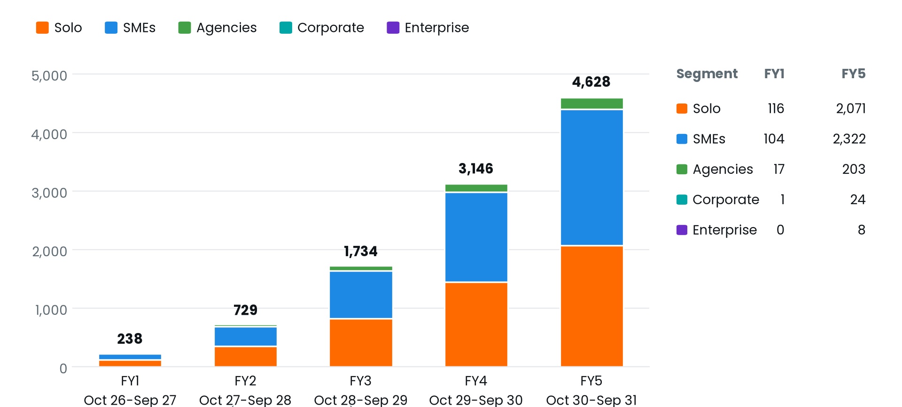
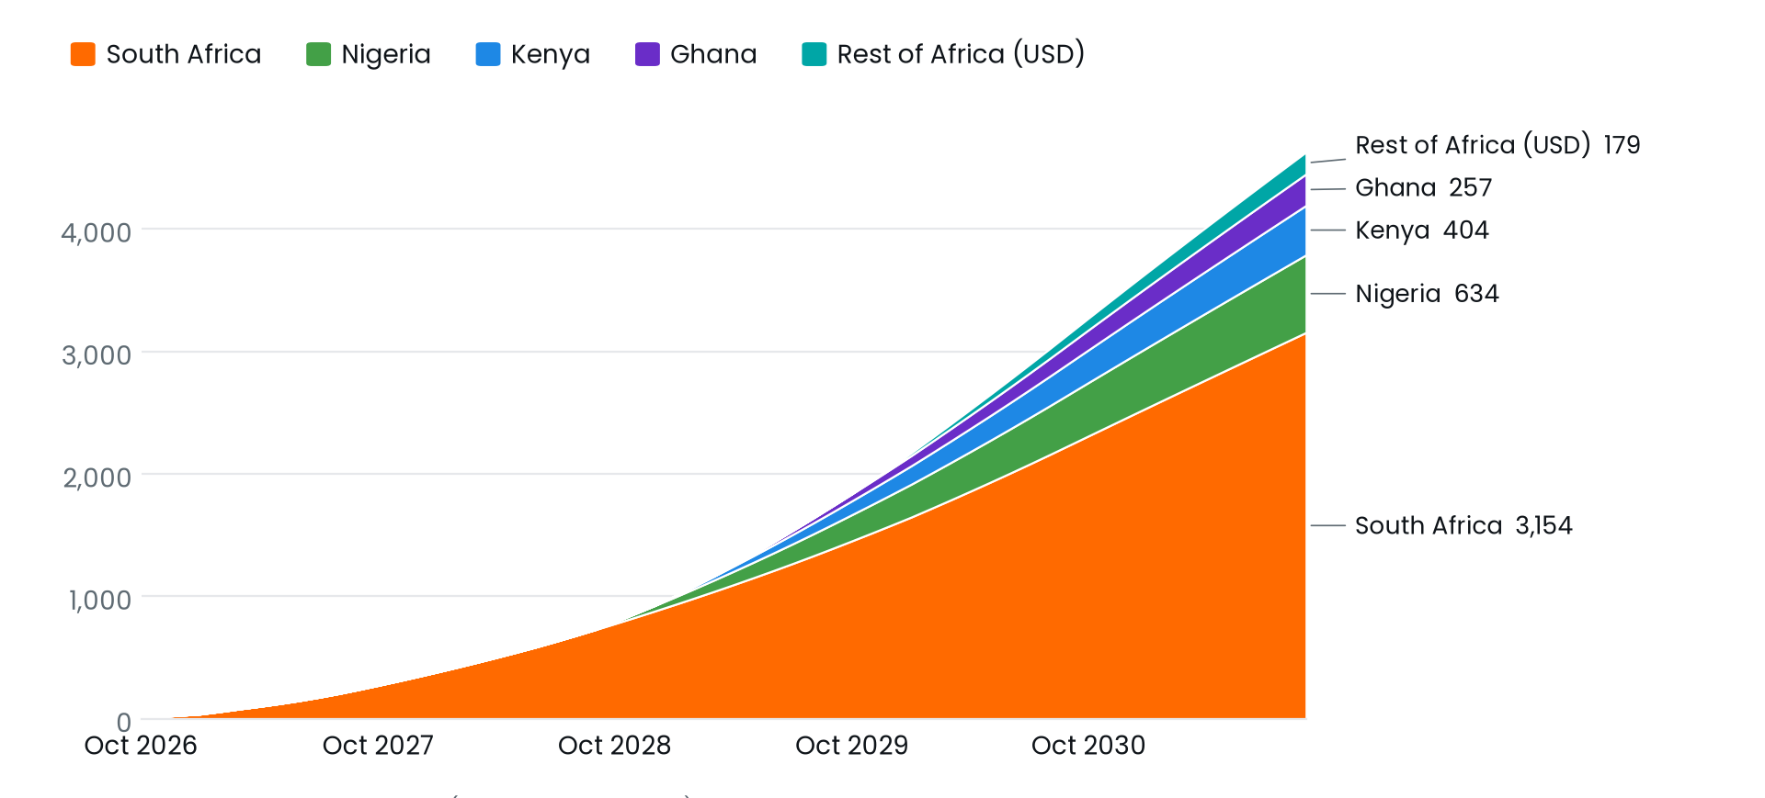
APPENDIX A2 · PROJECTION (MODEL V3, BASE CASE)
Paying workspaces by segment and market
By segment, FY5: Solo 2,071 · SMEs 2,322 · Agencies 203 · Corporate 24 · Enterprise (Custom) 8. Total 4,627.
By market, Sep 2031: South Africa 3,154 · Nigeria 634 · Kenya 404 · Ghana 257 · 19 USD markets 179. Outside South Africa, all pending payment accounts.
FluxMuse · Confidential
24
Notes:
Two views of the same projected customer base. By segment, solo sellers and SMEs make up almost all workspaces, with 203 agency partners, 24 Corporate customers and 8 Custom customers by FY5. By market, South Africa stays the core with 3,154 workspaces at the end of FY5. Every other market waits for its payment accounts and MRR gate, starting with Nigeria in Oct 2028 in the base case. There are no customers today; these are projections. Sources: model_summary.json → annual[].ending_customers_by_segment and ending_customers_by_market; Financial_Model_Notes.md §1.

Slide 25
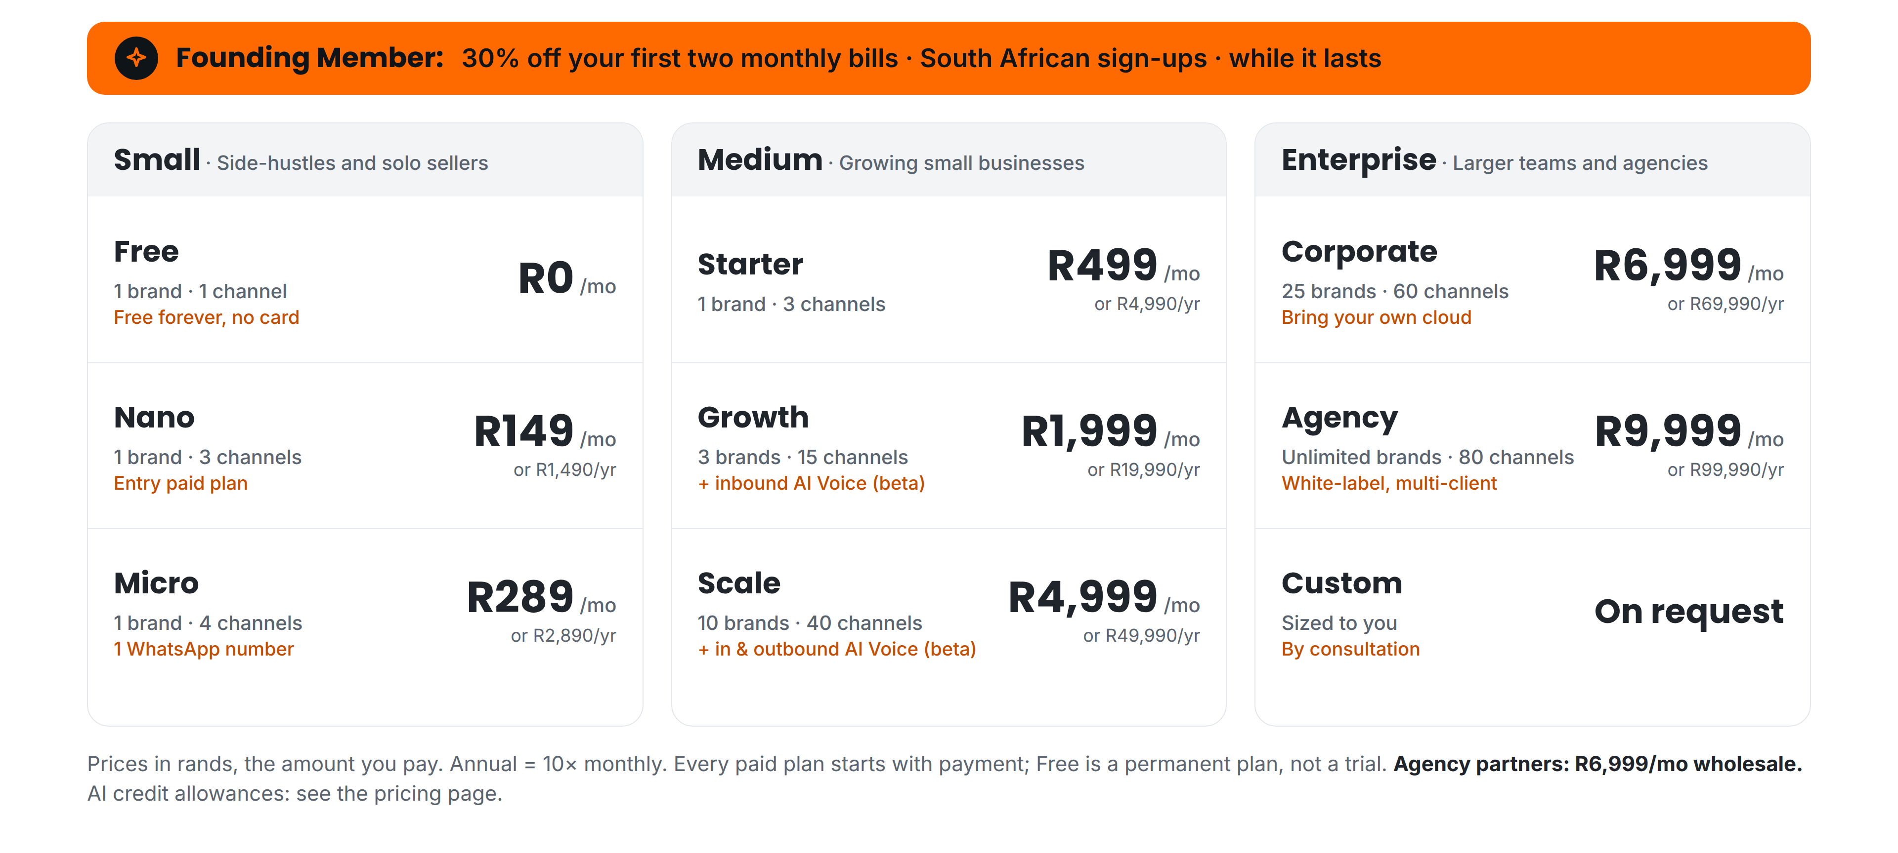
APPENDIX A3 · PRICING (1 OF 2) · ZAR
Nine plans in three bands, in rands
FluxMuse · Confidential
25
Notes:
The full rand price list as live in the product. Small: Free, a permanent plan with no card, Nano R149 and Micro R289. Medium: Starter R499, Growth R1,999 and Scale R4,999. Enterprise: Corporate R6,999, Agency R9,999 and Custom by consultation, which the model books from R19,999. Annual is ten times monthly. Founding Members in South Africa pay, for example, R104 or R1,399 for their first two monthly bills. Agencies resell at partner wholesale of R6,999. We never quote AI credit allowances per plan. Sources: CURRENT_OFFER.md §1; model_summary.json → price_tables.

Slide 26
APPENDIX A3 · PRICING (2 OF 2) · PRICED, NOT YET ON SALE
Local-currency and USD prices
Plan / month | NGN | KES | GHS | USD
Nano | ₦12,000 | KSh 1,199 | GH₵ 99 | $8
Micro | ₦24,000 | KSh 2,299 | GH₵ 199 | $16
Starter | ₦41,000 | KSh 3,999 | GH₵ 339 | $27
Growth | ₦165,000 | KSh 15,999 | GH₵ 1,359 | $109
Scale | ₦413,000 | KSh 39,999 | GH₵ 3,399 | $269
Corporate | ₦579,000 | KSh 56,999 | GH₵ 4,799 | $379
Agency | ₦829,000 | KSh 80,999 | GH₵ 6,799 | $539
Custom (from) | ₦1,650,000 | KSh 161,000 | GH₵ 13,600 | $1,099
Partner wholesale | ₦579,000 | KSh 56,999 | GH₵ 4,799 | $379
Not on sale: checkout outside South Africa waits for the Fincra and pawaPay accounts. Prices at FX parity with the rand, annual = 10× monthly, reviewed quarterly. Botswana and Namibia: coming soon, no prices.
FluxMuse · Confidential
26
Notes:
Local-currency prices for Nigeria, Kenya and Ghana, and USD for the 19 other markets our payment partners can reach. These are set in the product but not on sale: there is no paid checkout outside South Africa until the Fincra and pawaPay accounts are live. Prices were set at parity with the rand, using 1 ZAR = ₦82.83, KSh 8.07 and GH₵ 0.68. The product has no regional wholesale rows, so the model uses the Corporate local prices for partner wholesale, a point still to confirm. Prices are reviewed quarterly, which is the main FX control in appendix A5. Sources: CURRENT_OFFER.md §3; model_summary.json → price_tables; Financial_Model_Notes.md §4.

Slide 27
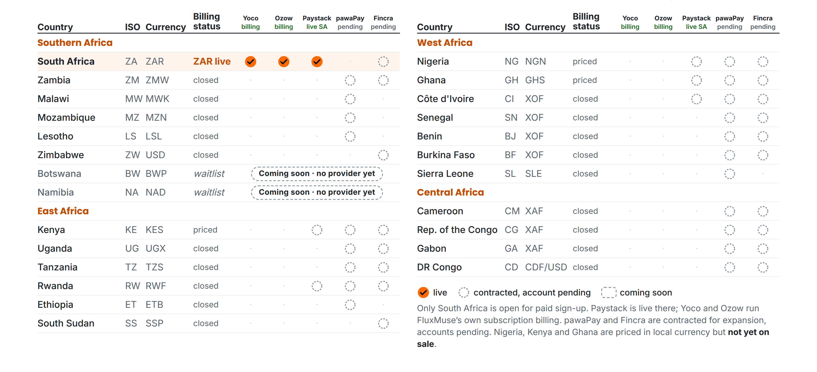
APPENDIX A4 · PAYMENT RAILS
What is live, and what is still pending
FluxMuse · Confidential
27
Notes:
This matrix shows payment status by country, live and pending. South Africa is the only country open for paid sign-up: Paystack is live there, and Yoco and Ozow run FluxMuse's own subscription billing. Nigeria, Kenya and Ghana are priced in local currency but not yet on sale. pawaPay and Fincra are contracted for expansion, with accounts pending, and would cover most of the other countries shown. Botswana and Namibia have no provider yet. We do not claim coverage that is not live. Contracts and account status belong in the data room. Sources: CURRENT_OFFER.md §3 and §4; infographic payment-rails-matrix.

Slide 28
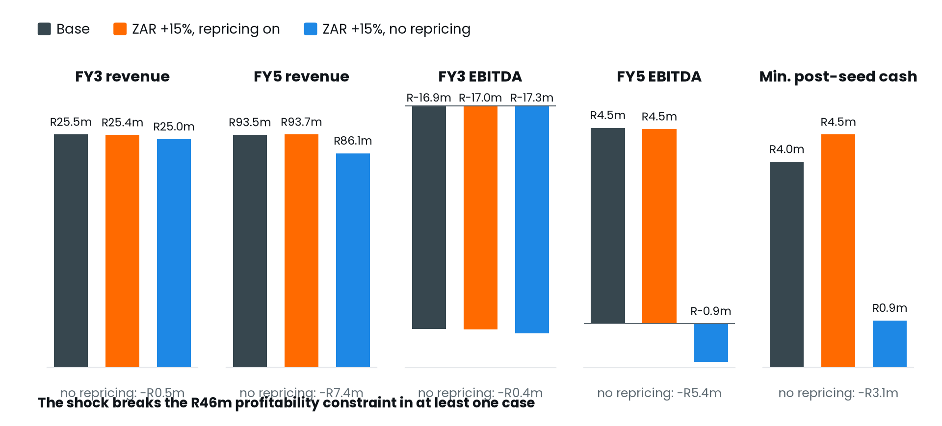
APPENDIX A5 · FX SHOCK · MODEL V3
ZAR 15% stronger vs NGN, KES, GHS and USD
Base case | Base | +15%, repricing | +15%, none
FY3 revenue | R25.5M | R25.4M | R25.0M
FY5 revenue | R93.5M | R93.7M | R86.1M
FY3 EBITDA | −R16.9M | −R17.0M | −R17.3M
FY5 EBITDA | R4.5M | R4.5M | −R0.9M
Cash low | R4.00M Nov 2030 | R4.53M Nov 2030 | R0.92M Mar 2031
Passes on R46M | Yes | Yes | No
The shock starts in Apr 2029, after Nigeria, Kenya and Ghana open in the model. With repricing the plan passes. Without it, FY5 EBITDA falls to −R0.9M and cash drops below the R3.0M buffer.
FluxMuse · Confidential
28
Notes:
This is the currency stress test. From April 2029 the rand is assumed 15% stronger against the naira, shilling, cedi and dollar, so every local price is worth less in rand. With quarterly repricing the cash low is R4.53M and the plan still passes. Without repricing, FY5 revenue moves −R7.4M, FY5 EBITDA turns negative and the cash low of R0.92M breaks the buffer, so the plan fails. Repricing discipline is the main FX control. Sources: model_summary.json → fx_shock; Financial_Model_Notes.md §6.

Slide 29
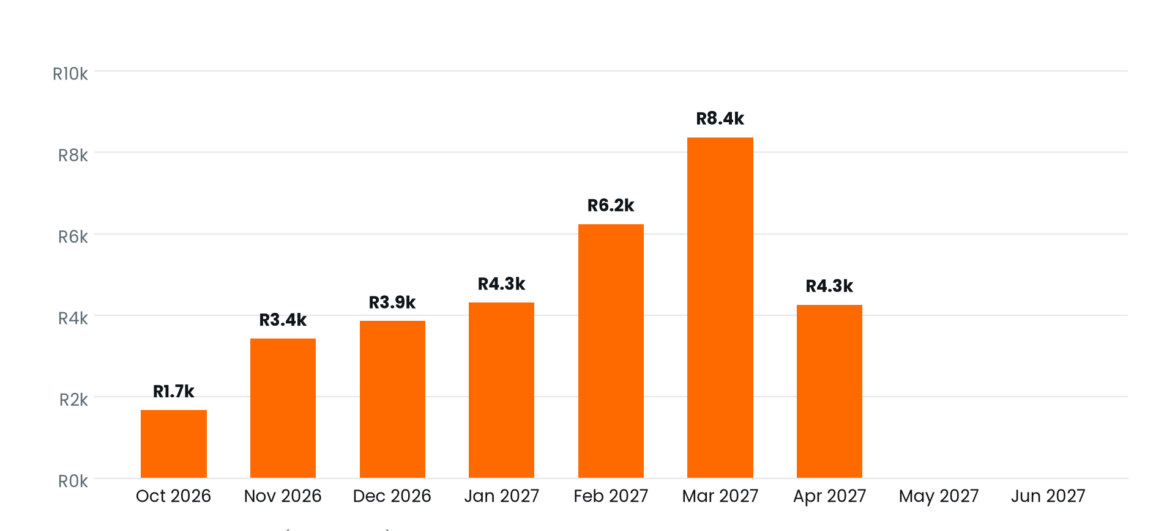
APPENDIX A6 · LAUNCH DISCOUNT COST · PROJECTION (MODEL V3, BASE CASE)
Founding Member costs little
Launch offer | FY1–FY3 cost | Cash low
Founding Member | R32.1k | R4.00M
No offer | R0 | R3.95M
Live since 1 Oct for South African sign-ups. The model ends it in Mar 2027, a proposed date the founder has not set.
Founding Member costs R32k in FY1 and nothing after. The +20% sign-up uplift while it runs is an assumption to measure.
FluxMuse · Confidential
29
Notes:
Investors often ask whether the launch discount hurts the plan. It does not. Founding Member is 30% off the first two monthly bills for South African Solo and SME sign-ups. It is a discount, not a free period. It costs R32k of revenue, all in FY1. Because the model assumes a 20% sign-up uplift while it runs, it leaves slightly more cash than no offer. That uplift is unproven, so we will measure it. No offer is modelled for Nigeria, Kenya or Ghana. Sources: model_summary.json → founding_member; CURRENT_OFFER.md §1; Financial_Model_Notes.md §4.

Slide 30
APPENDIX A7 · INTERNAL ONLY · HIDE BEFORE SENDING
Founder confirmations still open
1 | Opening cash at 1 Oct 2026 (default R500,000) and how to cover the R66,279 pre-seed bridge if the seed lands Feb 2027.
2 | Seed close month (Feb 2027) and instrument (SAFE vs priced equity).
3 | First group set up by hand: 4 a month, Oct 2026 to Jan 2027, 50% Solo; R10,000 a month set-up cost.
4 | South African sign-ups at launch (150 a month) and the pay-at-sign-up rates (Solo 5%, SME 8%).
5 | Free plan: 0.5% a month upgrade, 10% a month dormancy, R3 hosting per active Free user. Free allowance is 60 credits in the product (100 in older copy).
6 | Segment tier mixes, the upgrade rates and the new churn rates for Nano, Micro, SME Starter and Corporate.
7 | Founding Member end date (proposed Mar 2027), whether it applies to Corporate or annual plans, and the +20% sign-up uplift. Whether NG/KE/GH get a launch offer (none modelled).
8 | New NG/KE/GH and Rest-of-Africa plan months (Apr 2028 / Jul 2028 / Oct 2028 / May 2029) and their dependence on Fincra/pawaPay going live.
9 | Corporate and Custom inbound deal volumes, Custom modelled at R19,999, Custom setup fee R25,000, Corporate handling cost.
10 | Local partner wholesale prices (modelled at the Corporate local prices) and whether 100% of agency customers buy at wholesale.
11 | AI-credit pack attach rate (5%) and the R1,500 paid CAC for Solo.
12 | FX depreciation assumptions vs ZAR (NGN -10%, GHS -8%, KES -3%, USD 0% a year) and the quarterly repricing policy.
13 | Cost-discipline rules: MRR gates per hire and launch, the scenario gate multipliers, the paid-acquisition cap (35% of MRR in Base) and the 12-month CAC payback limit.
14 | Salaries and hiring plan (cost-to-company per role), including founders' reduced salaries.
15 | Market-sizing estimates (TAM/SAM/SOM) before external use.
FluxMuse · Confidential
30
Notes:
Internal slide: hide or delete it before the deck goes to any investor. These are the model inputs and decisions the founder still has to confirm, copied from the model summary. The most urgent are opening cash and the pre-seed bridge, the seed close month and instrument, the pay-at-sign-up and Free upgrade rates, and the Founding Member end date. Market sizing must be verified before external use. Once a decision is made, update the Assumptions sheet, rebuild the model, rebuild this deck with build_investor_deck.py and rerun the QA script. Source: model_summary.json → founder_confirmations_needed; Financial_Model_Notes.md §12.

