Slide 1


FLUXMUSE PARTNER PROGRAMME
Serve more clients.
Under your brand.
White-label AI marketing and WhatsApp selling for agencies and resellers.
Prepared for [[PROSPECT NAME]]
[[DATE]] · Thabo Malebadi, founder
Notes:
This deck is for agencies, freelancers and resellers. "FluxMuse lets you offer an AI marketing team and WhatsApp selling to your clients under your own brand, on a partner wholesale plan, and keep the spread." Ask two questions early: "How many clients do you manage?" and "What do you charge them per month?" Those numbers drive the illustrative economics later. Be clear from the start that partner obligations and referral commission are still being finalised (CURRENT_OFFER.md; 00_FACTS §2 "Partner wholesale").

Slide 2


THE AGENCY SQUEEZE
What agencies are up against
TODAY
Margin squeeze on retainers
Manual reporting
Too many tools per client
WITH FLUXMUSE
Partner price, your retail price
White-label, multi-client
WhatsApp selling + AI, your brand
FluxMuse · fluxmuse.ai
2
Notes:
Start with the agency's reality. Clients expect more every month, from content to WhatsApp selling to AI, while retainers stay flat. Reporting eats hours, and every new client adds another set of tools and logins. FluxMuse changes that. Partners buy the Agency tier at the partner price and set their own retail price. They run clients from one white-label, multi-client platform with unlimited brands. And they offer an AI marketing team on WhatsApp under their own brand. Ask how many tools they pay for per client, and how long reporting takes them.

Slide 3


MEET FLUXMUSE
One AI team for marketing and sales
LIVE, NEWLY LAUNCHED
BEING SWITCHED ON
Photos to catalogue
Checkout
Shop link
Facebook & Instagram
Order alerts
AI Voice (beta)
AI marketing and a WhatsApp shop, for South African businesses.
AI posts & clips
Set up by hand
TikTok video
FluxMuse · fluxmuse.ai
3
Notes:
Here's FluxMuse in one line: an AI marketing team and WhatsApp shop for South African businesses. Be precise about what's live. Live and newly launched: photos to catalogue on WhatsApp, a hosted shop link, order alerts with SOLD, AI captions, images and short clips, and TikTok video posting. Being switched on: checkout through FluxMuse, Facebook and Instagram auto-posting, and AI Voice in beta. Newly launched means built and deployed, but no business has run it end to end yet, so we set you up by hand (CURRENT_OFFER.md §3). Ask whether they already use WhatsApp Business.

Slide 4
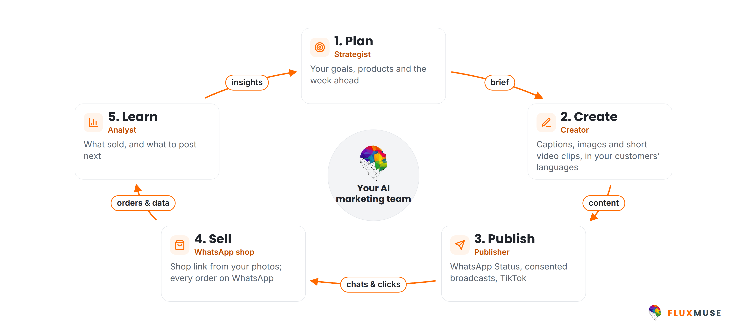
HOW FLUXMUSE WORKS
One loop, run by your AI marketing team
FluxMuse · fluxmuse.ai
4
Notes:
FluxMuse works as a loop. Plan: your goals, products and the week ahead. Create: captions, images and short video clips, in your customers' languages. Publish: forward to WhatsApp Status, send broadcasts to contacts who have opted in, and post video to TikTok. Sell: a shop link built from your photos, with every order landing on WhatsApp. Learn: what sold, and what to post next. Facebook and Instagram auto-posting is being switched on, so don't promise it yet (CURRENT_OFFER.md §3). The point is that marketing and selling stop living in separate tools.

Slide 5
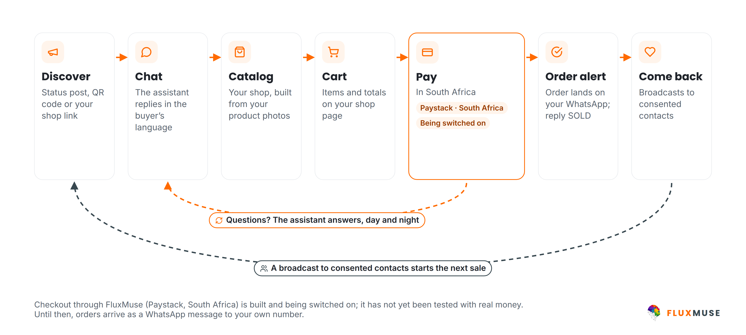
WHATSAPP SELLING
From first tap to repeat order, on WhatsApp
FluxMuse · fluxmuse.ai
5
Notes:
This is the heart of the pitch. A buyer finds you through a Status post, a QR code or your shop link. The assistant replies in their language. They browse a catalogue built from your photos, fill a cart, and the order lands on your WhatsApp; you reply SOLD to keep track. Be honest about payment: checkout through FluxMuse on Paystack is built but being switched on, because it hasn't been tested end to end with real money. Until then, orders arrive as a WhatsApp message and you take payment your usual way (CURRENT_OFFER.md §3). Broadcasts go only to consented contacts.

Slide 6
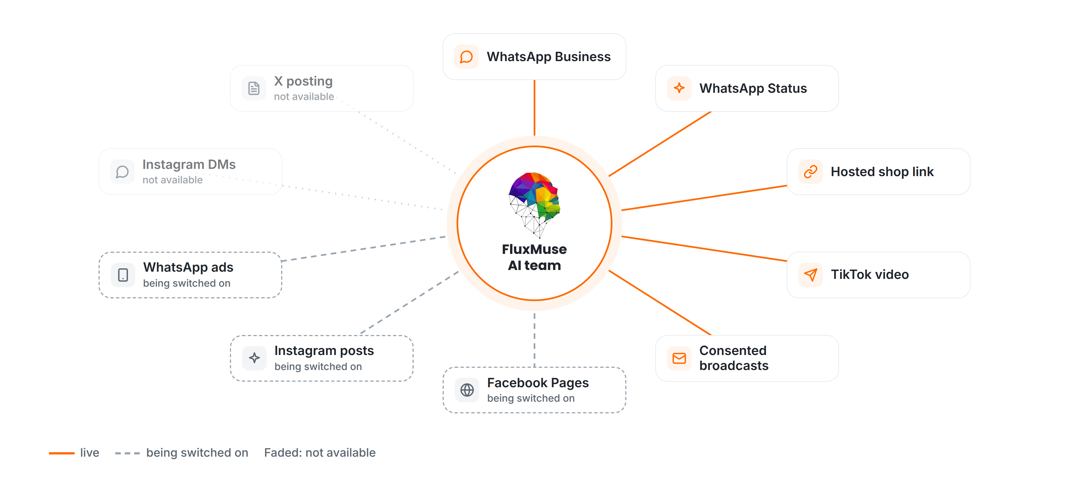
CHANNELS
Where FluxMuse works today
FluxMuse · fluxmuse.ai
6
Notes:
Be precise about channels. Live today: WhatsApp Business, WhatsApp Status, the hosted shop link, TikTok video posting and broadcasts to consented contacts. Being switched on: Facebook Pages and Instagram posting, because Meta hasn't approved those permissions yet, and click-to-WhatsApp ads, which we run on our own account first. Not available: Instagram DMs and comments, and X posting. If Instagram is their main channel, say so honestly: until Meta approves it, the value is forwarding posts to WhatsApp Status (CURRENT_OFFER.md §3).

Slide 7
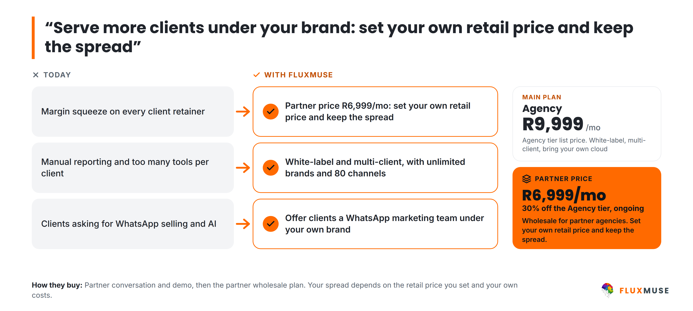
LAUNCH SEGMENT · AGENCIES & PARTNERS
Agencies: serve more clients, your brand
FluxMuse · fluxmuse.ai
7
Notes:
Agencies and freelancers managing five to 50 small-business clients feel a margin squeeze, spend hours on reporting and tools per client, and have clients asking for WhatsApp selling and AI. FluxMuse gives them one white-label, multi-client platform with unlimited brands and 80 channels. Partners buy the Agency tier at a wholesale price of R6,999 a month, 30% off the R9,999 list price, and set their own retail price. Don't quote a fixed margin: it depends on the agency's pricing and delivery costs (00_FACTS §2 "Partner wholesale").

Slide 8
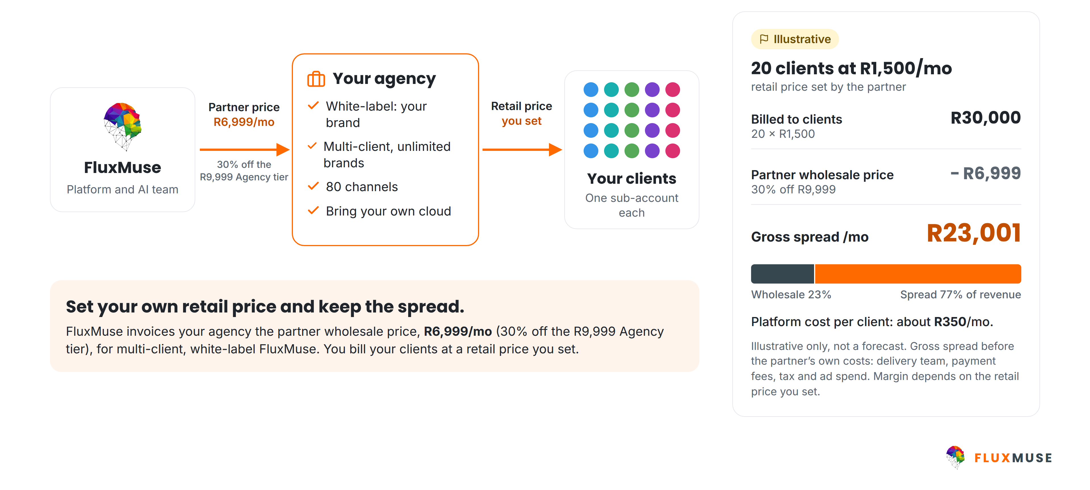
AGENCY PARTNER MODEL · ILLUSTRATIVE ECONOMICS
Resell FluxMuse under your own brand
FluxMuse · fluxmuse.ai
8
Notes:
Here's how the partner model works. FluxMuse invoices the agency the partner wholesale price of R6,999 a month, 30% off the R9,999 Agency list price. The agency serves its clients under its own brand and bills them a retail price it sets. The example is illustrative only, not a forecast: 20 clients at R1,500 a month bills R30,000, and after R6,999 the agency keeps a gross spread of R23,001 a month, before its own costs. Encourage them to run their own numbers. Referral commission is still to be decided (00_FACTS §2 "Partner wholesale").

Slide 9






PARTNER PLAN · AGENCY TIER AT WHOLESALE
Everything you need to resell
PARTNER WHOLESALE
Full white-label
Multi-client workspaces
R6,999
per month
Unlimited brands
80 channels
30% off the R9,999 Agency list price
R69,990 a year. Launch offers don't stack.
Bring your own cloud
Set up with you by hand
FluxMuse · fluxmuse.ai
9
Notes:
This is what a partner gets on the Agency tier at the partner price: R6,999 a month, 30% off the R9,999 list price, or R69,990 a year. Full white-label, so clients see the agency's brand. Multi-client workspaces with unlimited brands and 80 channels. Bring your own cloud. And we set the first client up with them by hand. Clients get the same product as direct sign-ups: the live, newly launched WhatsApp features. Launch offers don't stack with partner pricing. Don't quote AI credit numbers (00_FACTS §2 "Partner wholesale"; CURRENT_OFFER.md §1).

Slide 10
30% OFF THE AGENCY LIST PRICE
Partner wholesale pricing
ZAR | Per month | Per year (10×)
Agency list price | R9,999 | R99,990
Partner wholesale (−30%) | R6,999 | R69,990
ILLUSTRATIVE ONLY · NOT A FORECAST
You set your retail price.
Paid sign-up is South Africa only for now.
Local-currency partner prices: not set yet.
20 clients × R1,500/mo = R30,000 billed
− R6,999 wholesale = R23,001/mo gross spread, before your own costs
FluxMuse · fluxmuse.ai
10
Notes:
Partner wholesale pricing is the Agency tier at 30% off list: R6,999 a month instead of R9,999, or R69,990 a year, in rands. Paid sign-up is open in South Africa only for now, so there are no local-currency partner prices yet. Launch offers don't stack with partner pricing. The example is illustrative only, not a forecast: 20 clients at R1,500 bills R30,000; minus R6,999 leaves a R23,001 gross spread before the partner's own costs. Don't quote a fixed margin. Referral commission is still a founder decision (00_FACTS §2 "Partner wholesale").

Slide 11




BECOMING A PARTNER
From first call to first client
1
2
3
4
5
Intro call
White-label demo
First client
Go wholesale
Roll out
Clients, services, pricing
FluxMuse under your brand
Set up together, by hand
Agency tier at R6,999/mo
Onboard more clients
Timings depend on your team. Partner terms and co-marketing: [[TBC]].
FluxMuse · fluxmuse.ai
11
Notes:
Becoming a partner follows a simple path. It starts with an intro call about your clients, services and pricing. Then a white-label demo so you can see the platform under your brand. Next, pick one first client and we set them up together, by hand, so you learn the workflow on a real account; the lead guarantee applies to that client's go-live, with its conditions. Once that's working, move onto the Agency tier at R6,999 a month and roll out to more clients. We don't quote fixed timings, and formal partner terms are still being confirmed.

Slide 12

CO-MARKETING & COMMITMENTS
What we bring, and what we ask
FluxMuse provides
Partners commit to
Hands-on setup of your first client
Partner obligations: [[TBC]]
This deck and proposal templates
Minimum active clients: [[TBC]]
Consented case studies, once they exist
Brand and POPIA standards: [[TBC]]
Co-marketing support: [[TBC]]
Referral commission: [[FOUNDER DECISION: referral commission %]]
FluxMuse · fluxmuse.ai
12
Notes:
Be transparent about what's defined and what isn't. FluxMuse provides hands-on setup of the partner's first client, sales material such as this deck and proposal templates, and case studies only once they exist and the business has consented; there are none yet. Co-marketing specifics are still being finalised. Partner obligations, such as minimum active clients, brand standards and data-protection responsibilities under POPIA, are to be confirmed. Referral commission is a founder decision that hasn't been made. Don't promise terms; take questions and follow up in writing.

Slide 13
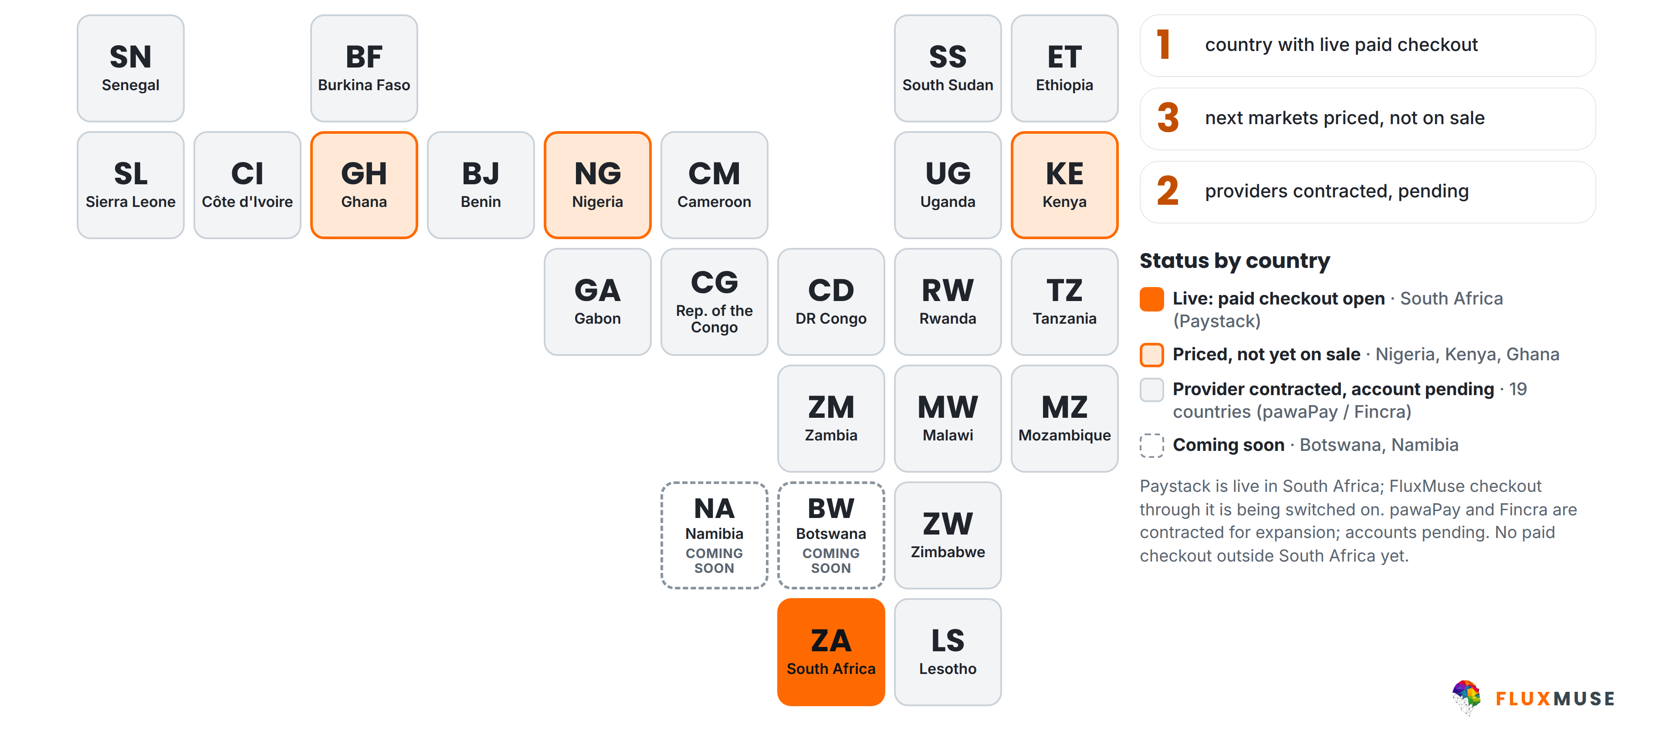
PAYMENTS COVERAGE
Live in South Africa. The rest is pending.
FluxMuse · fluxmuse.ai
13
Notes:
Be straight about payments. FluxMuse is open for paid sign-up in South Africa only, where Paystack is live. Checkout through FluxMuse for your buyers is built and being switched on; it hasn't been tested end to end with real money yet. Nigeria, Kenya and Ghana are priced but not on sale, because the provider accounts are still pending. pawaPay and Fincra are contracted for expansion, with accounts pending, so the other countries on the map are not open. Botswana and Namibia are coming soon. Source: CURRENT_OFFER.md §3 and §4; 00_FACTS §3.

Slide 14


OUR FIRST GROUP OF BUSINESSES
Starting small, set up by hand
A small first group
LEAD GUARANTEE
3 qualified leads in 30 days of go-live
We set you up by hand
Weekly founder check-ins
A qualified lead is a new WhatsApp number that messages you through your FluxMuse link. If fewer than 3 arrive in 30 days, and you shared your link and posted at least weekly, we keep supporting you at no extra charge until you reach 3. Extra support, not a payout.
You tell us what to fix first
Your story shared only with consent
FluxMuse · fluxmuse.ai
14
Notes:
Be honest about where we are. FluxMuse is newly launched and has no paying customers or case studies yet. We're opening with a small first group of South African businesses, and we set each one up by hand, with weekly check-ins. That's the offer: close attention, not social proof. It's backed by the lead guarantee: three qualified leads in 30 days of go-live. If fewer arrive, and the business shared its link and posted at least weekly, we keep supporting them at no extra charge until three arrive. It is extra support, never cash back (CURRENT_OFFER.md §2 and §4).

Slide 15


TRUST & COMPLIANCE
Built to protect your customers' data
Meta Tech Provider
Official WhatsApp API
POPIA-aligned
Verified by Meta
Meta Cloud API
Consented broadcasts only
Row-level security
Encrypted tokens
Data export & deletion
Your data kept separate
Connected accounts
Export data, delete account
FluxMuse · fluxmuse.ai
15
Notes:
Trust matters when you're handling customer chats. Fluxmuse (Pty) Ltd is a verified Meta Tech Provider, with business and access verification, and WhatsApp runs on Meta's official Cloud API. Broadcasts go only to contacts who have opted in, in line with POPIA. Under the hood there's row-level security, encrypted tokens for connected accounts, and data export and account deletion. If they ask for a data processing agreement, a security questionnaire or certifications, don't improvise: note the request and follow up in writing (CURRENT_OFFER.md §4; 00_FACTS §1).

Slide 16
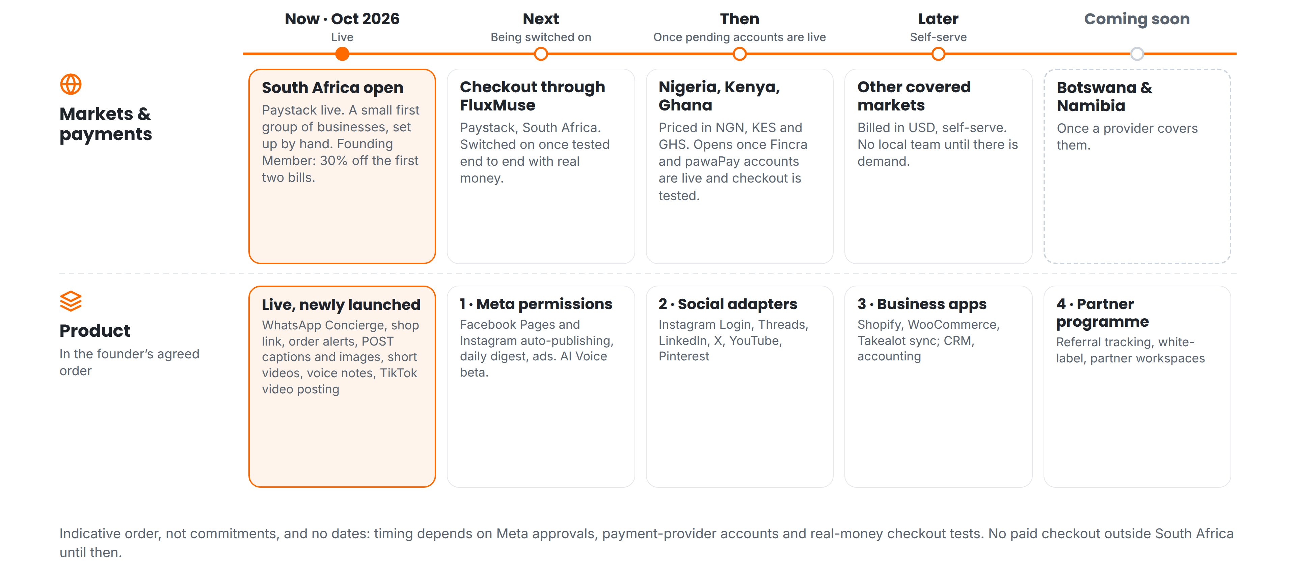
ROADMAP · INDICATIVE, NO DATES
What comes next, in order
FluxMuse · fluxmuse.ai
16
Notes:
Here's what comes next, in order, with no dates. On markets: South Africa is open now. Next, checkout through FluxMuse once it's tested with real money. Then Nigeria, Kenya and Ghana, once provider accounts are live, and later other markets in US dollars. On product: Meta permissions for Facebook and Instagram posting, then social adapters, business apps, then the partner programme layer with referral tracking and partner-managed workspaces. White-label and multi-client are on the Agency tier today; the programme layer comes later (00_FACTS §1 "Roadmap").

Slide 17
NEXT STEPS
Let's build your partner practice
1
Book a 30-minute partner call
TALK TO US
Your clients, services and pricing.
Thabo Malebadi
Founder
thabo@fluxmuse.com
fluxmuse.ai
2
See a white-label demo
FluxMuse under your brand.
[[wa.me QR CODE]]
Scan to chat on WhatsApp
wa.me/
[[NUMBER]]
3
Apply to become a partner
Agency tier at R6,999/mo wholesale.
FluxMuse · fluxmuse.ai
17
Notes:
Close with a concrete partner next step. Option one: a 30-minute partner call to go through their clients, services and pricing. Option two: a white-label demo so they can see FluxMuse under their brand. Option three: apply to become a partner on the Agency tier at R6,999 a month wholesale, starting with one first client we set up together. Contact is Thabo Malebadi, thabo@fluxmuse.com. Don't commit to commission or obligations that are still to be confirmed.

Slide 18
APPENDIX
Reference slides
A1
Payment status by country
A2
Frequently asked questions
FluxMuse · fluxmuse.ai
18
Notes:
The appendix is for questions and follow-up, not the main talk track. It covers payment status by country, partner wholesale pricing where relevant, and the questions prospects ask most. Paid sign-up is open in South Africa only. Nigeria, Kenya and Ghana are priced but not on sale, so don't show local prices or offer checkout there; anyone outside South Africa, including Botswana and Namibia, gets the waitlist link instead: [[WAITLIST LINK]]. Regional price sheets are internal only and are not in customer decks (00_FACTS §2 "Market gating").

Slide 19
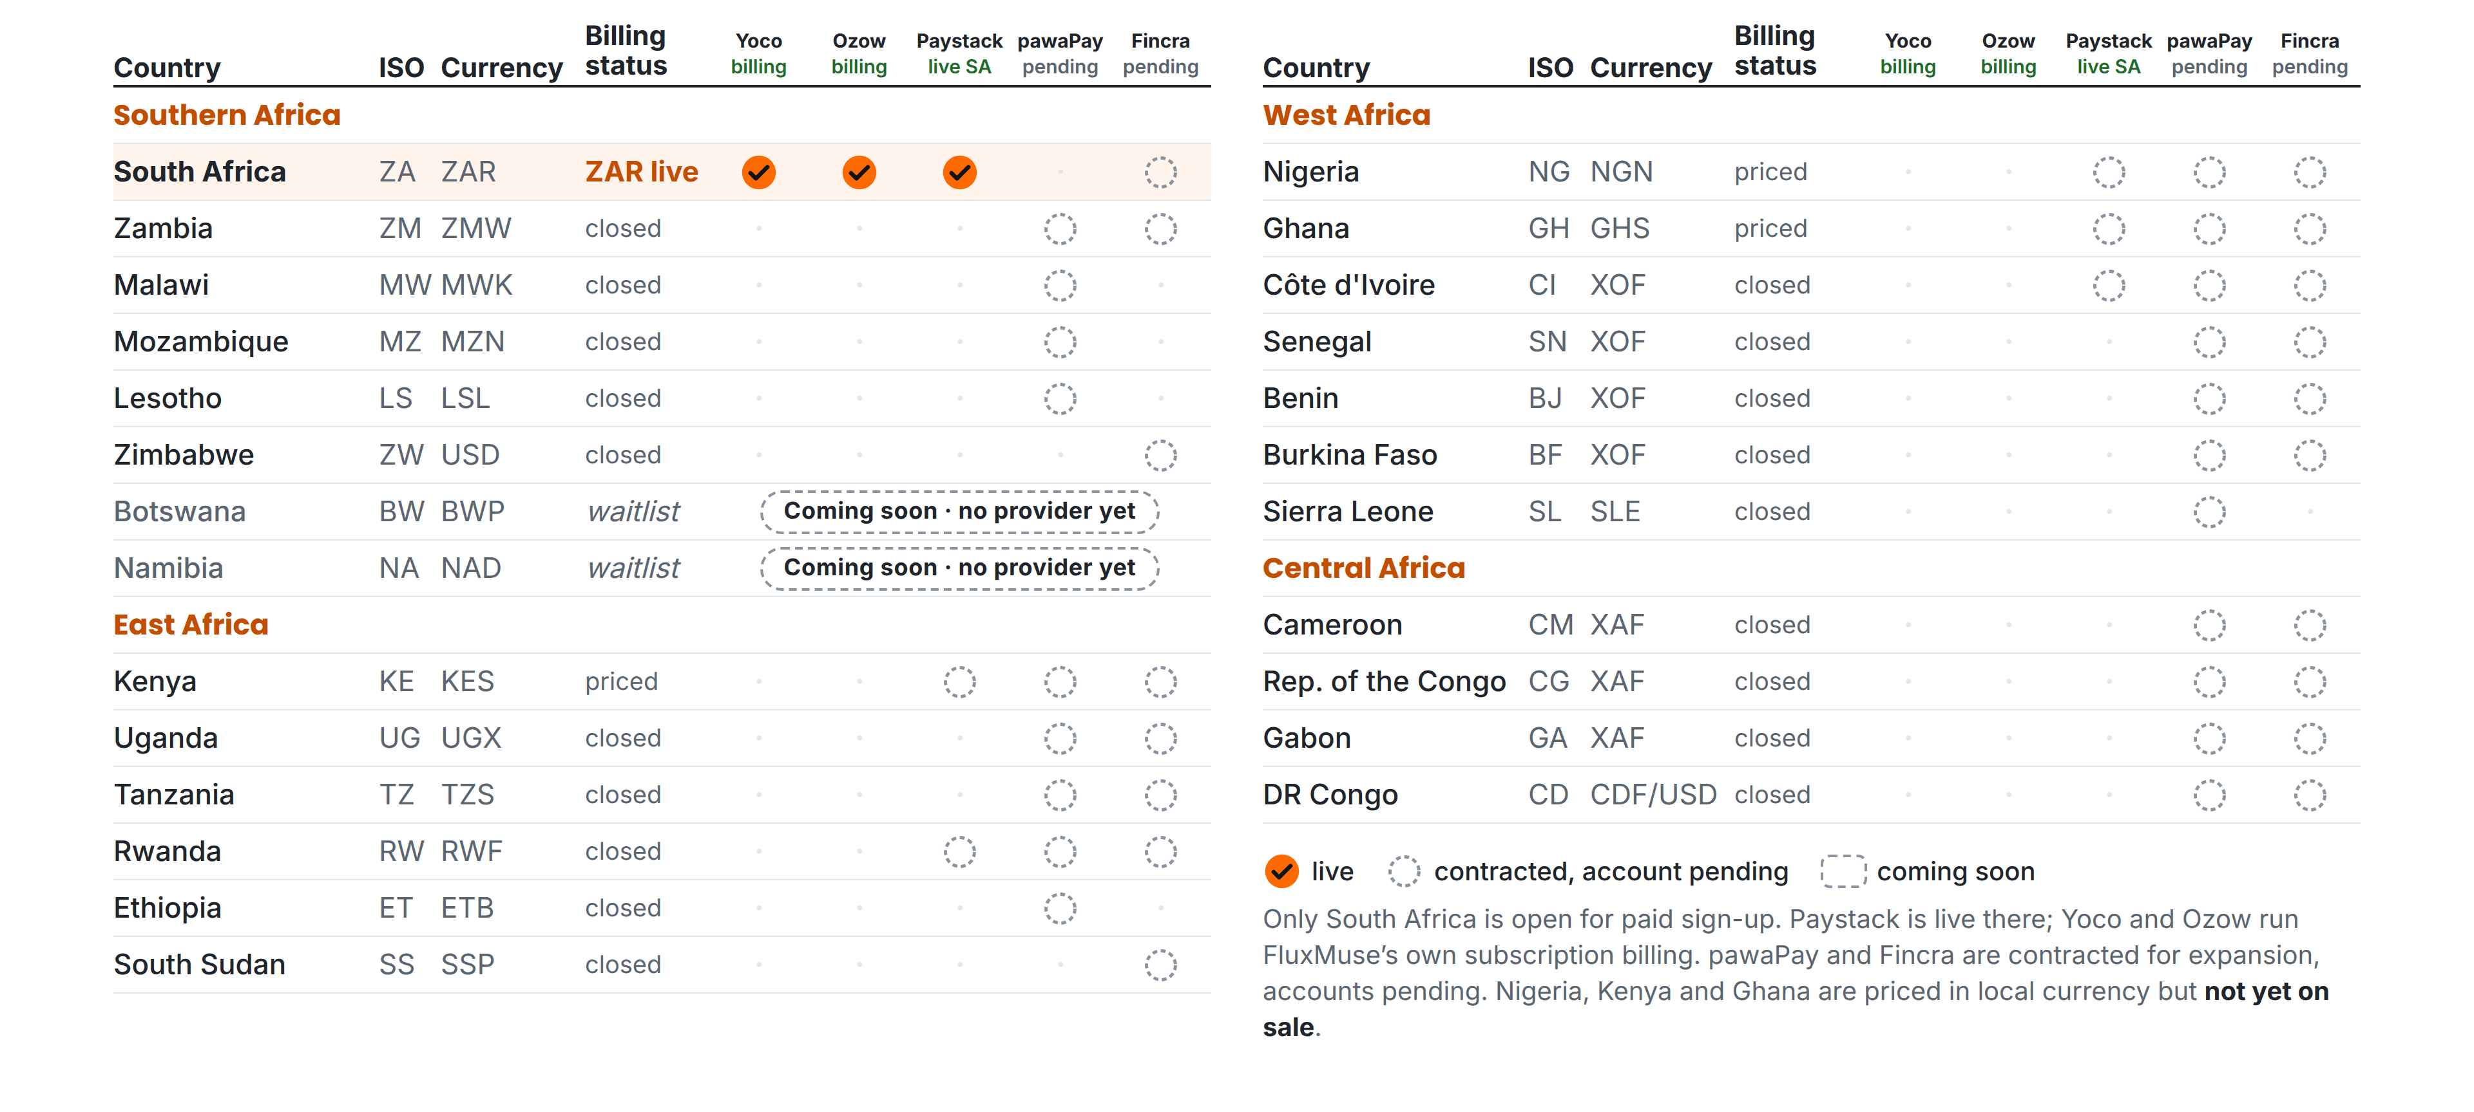
APPENDIX A1 · PAYMENT STATUS
What is live, and what is still pending
FluxMuse · fluxmuse.ai
19
Notes:
This matrix shows payment status by country. Only South Africa is open for paid sign-up: Paystack is live there, and Yoco and Ozow run FluxMuse's own subscription billing. Checkout through FluxMuse for a business's buyers is still being switched on. pawaPay and Fincra are contracted for expansion, but the accounts are pending, so none of those countries is open. Nigeria, Kenya and Ghana are priced in local currency but not on sale. Botswana and Namibia are coming soon with no provider yet. Source: CURRENT_OFFER.md §3; 00_FACTS §3.

Slide 20
APPENDIX A2 · FAQ (1 OF 2)
Questions prospects ask
Is my customers' data safe?
Can I use my own WhatsApp number?
Row-level security, encrypted tokens, broadcasts only to consented contacts, and data export and account deletion. Fluxmuse is a verified Meta Tech Provider.
Yes. We connect your WhatsApp Business number through Meta's official Cloud API setup, with you, by hand.
How do my customers pay?
Is there a trial? Can I cancel?
Today, orders arrive as a WhatsApp message and you take payment your usual way. Checkout through FluxMuse (Paystack, South Africa) is being switched on.
No trials: every paid plan starts with payment, monthly or annual (10× monthly). Free is a permanent plan. Cancellation terms: [[CONFIRM TERMS]].
FluxMuse · fluxmuse.ai
20
Notes:
Use these answers as written; they follow CURRENT_OFFER.md. On data, stick to the controls listed and don't claim certifications we haven't confirmed. On WhatsApp numbers, a number already used in the WhatsApp Business app may need extra steps, so check it together during setup. On payments, be clear that checkout through FluxMuse is being switched on and hasn't been tested with real money yet. There are no trials, and cancellation terms are still to be confirmed, so promise a written answer rather than improvising.

Slide 21
APPENDIX A2 · FAQ (2 OF 2)
Questions prospects ask
Is there a guarantee?
How long does setup take?
A lead guarantee: 3 qualified leads in 30 days of go-live. If fewer, and you shared your link and posted weekly, we keep supporting you free until you reach 3.
We set you up by hand: WhatsApp number, catalogue from your photos, shop link. We aim for your first week; Meta approvals can stretch it.
I already use Shopify or WooCommerce.
Where can I buy FluxMuse?
Keep them. Sync from Shopify, WooCommerce and Takealot is being switched on. Until then, we build your catalogue from product photos.
South Africa, today. Nigeria, Kenya and Ghana are priced but not yet on sale. Other countries can join the waitlist.
FluxMuse · fluxmuse.ai
21
Notes:
The lead guarantee always comes with its conditions: three qualified leads in 30 days of go-live; if fewer, and the business shared its link and posted at least weekly, we extend support at no extra charge until three arrive. It is never cash back. Setup is by hand, but Meta approvals and catalogue size can stretch it, so set expectations honestly. Store sync is being switched on, so don't promise it. Outside South Africa, share the waitlist link, never prices (CURRENT_OFFER.md §2 and §3).

