Slide 1
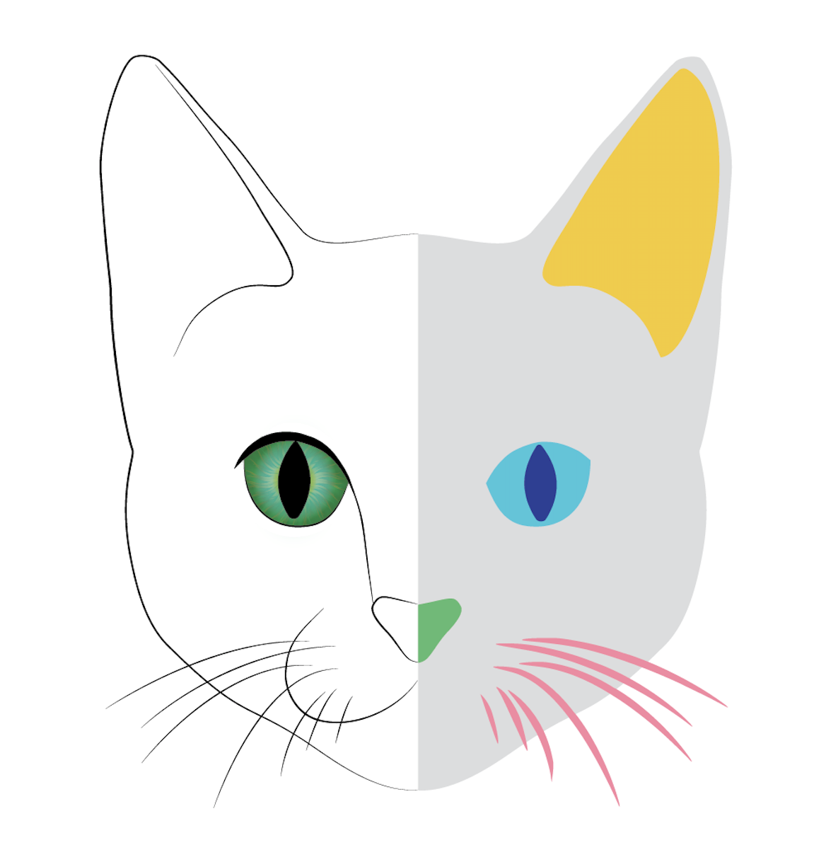
CATS
Content Aware Trainable Segmentation
in Java/Fiji

