Slide 1
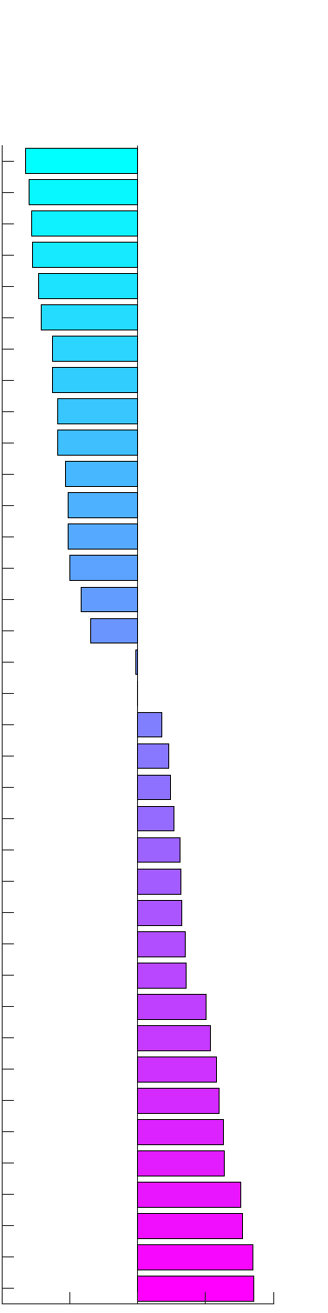
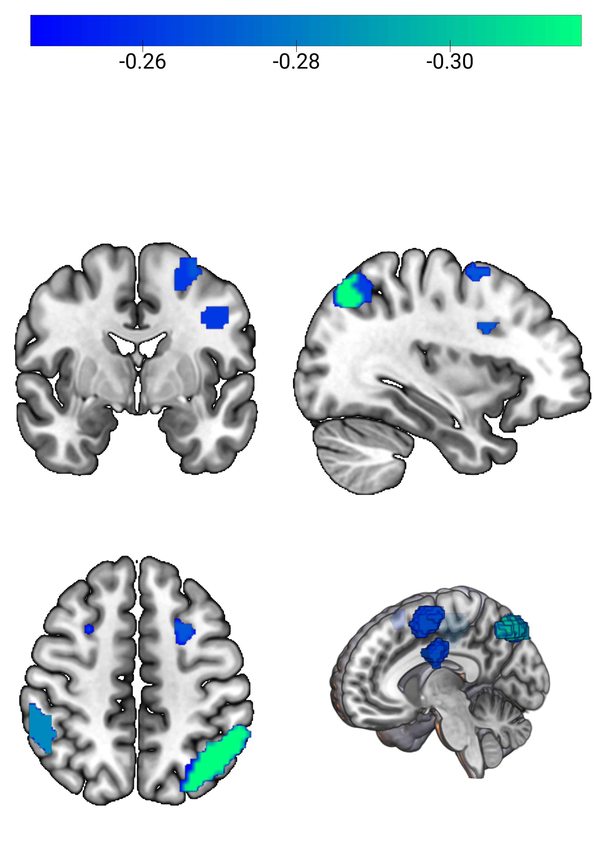

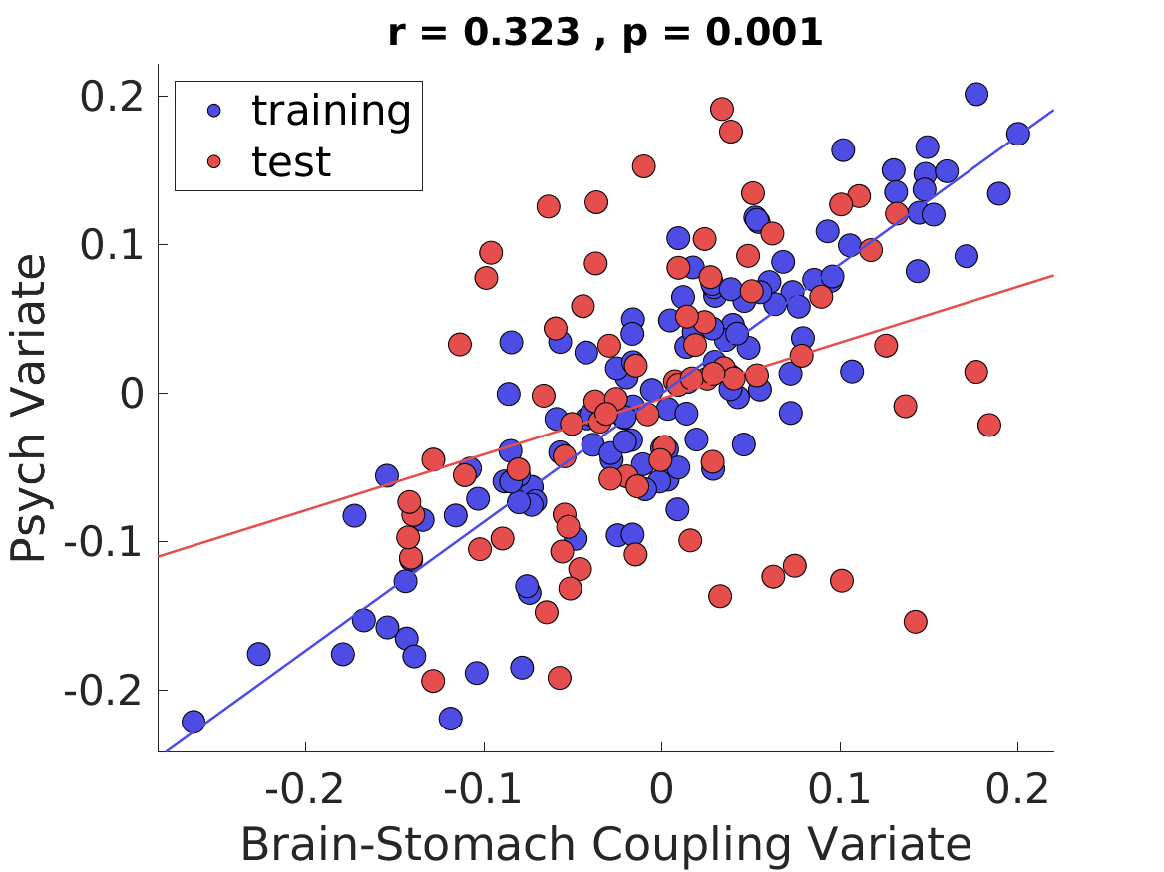
Psychiatric Signature of Stomach-Brain Coupling
CCA loadings (structure correlations)
CCA variate
r = 0.323, p = .001
Anxiety Trait
Depression A
Depression B
Stress
General Fatigue
Reduced Activity
Physical Fatigue
Mental Fatigue
ADHD A
Social Anxiety
Somatic Symptoms
Insomnia
ADHD B
Reduced Motivation
Empathy Distress
Autism
Empathy Fantasy
Empathy Concern
Intero Noticing
Intero Emotion Aware
Empathy Perspective
Intero Self Regulation
Intero Not Distracting
Intero Not Worrying
Intero Body Listening
Support Significant Other
Support Family
Intero Attention Regulation
Support Friend
Intero Trusting
Quality Life Social
Quality Life General
Quality Life Environment
Quality Life Physical
Mental Well-Being
Quality Life Psychological
Well-Being
Psych CCA Variate
Brain-Stomach Coupling CCA Variate
R
L
-1 -0.5 0 0.5 1
Psych CCA Loading
Brain-Stomach Coupling CCA Loading

