Slide 1
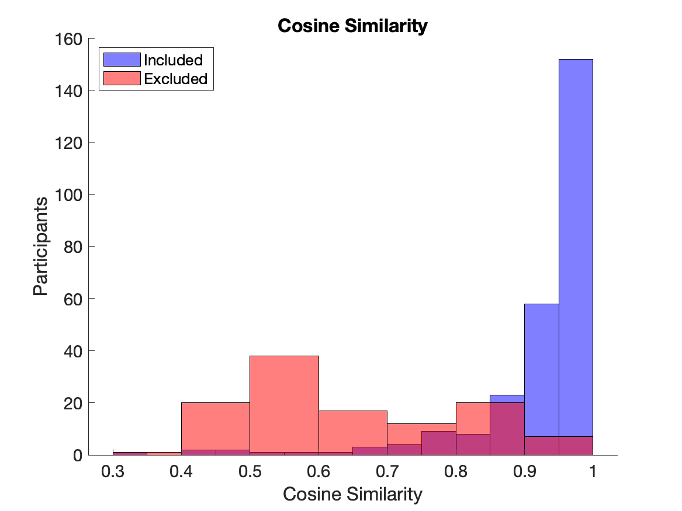
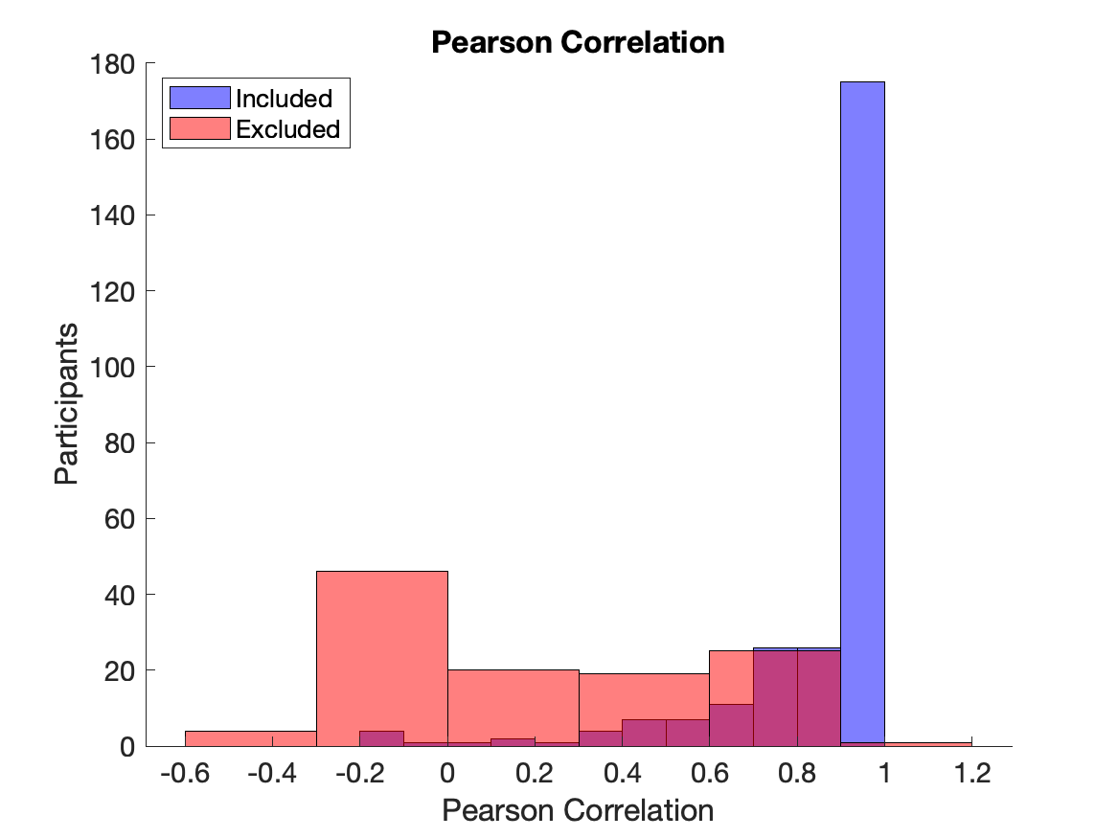


Rated Excellent/Good Quality
Rated Poor Quality
Rated Excellent/Good Quality
Rated Poor Quality

