Slide 1
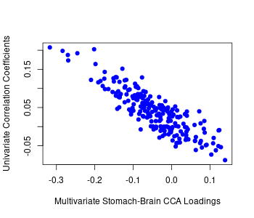
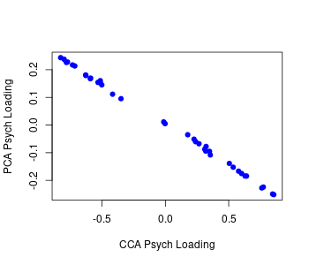
r = -0.999, p < .001
r = -0.870, p < .001

