Slide 1
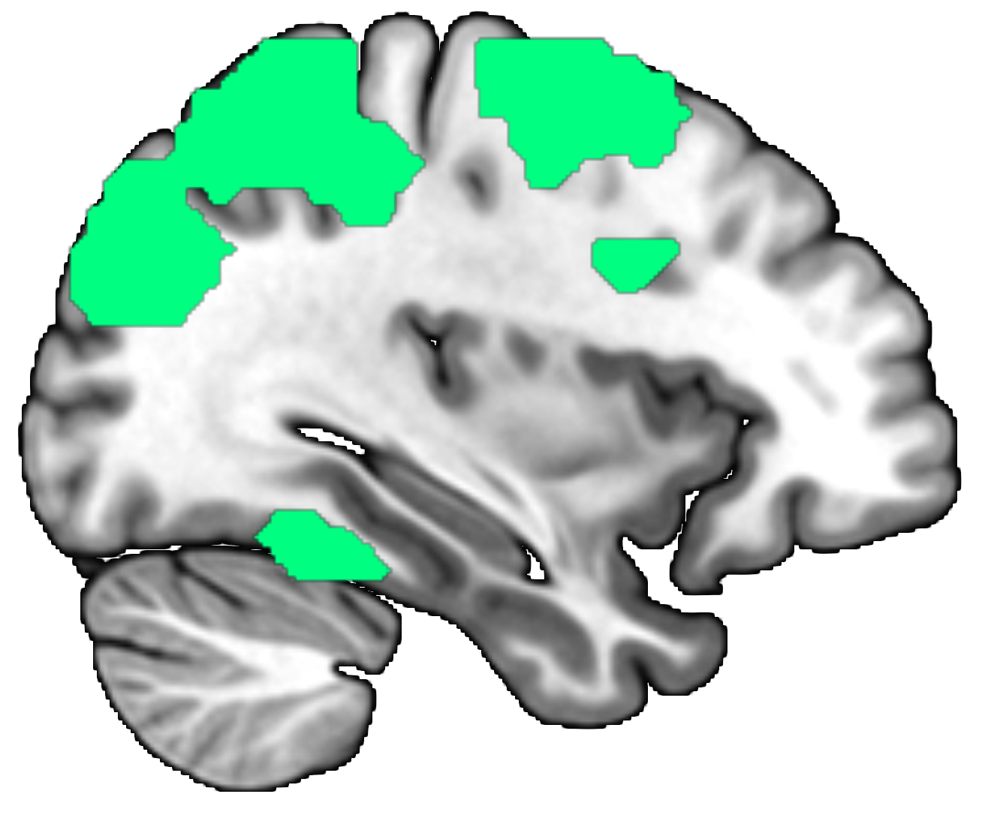
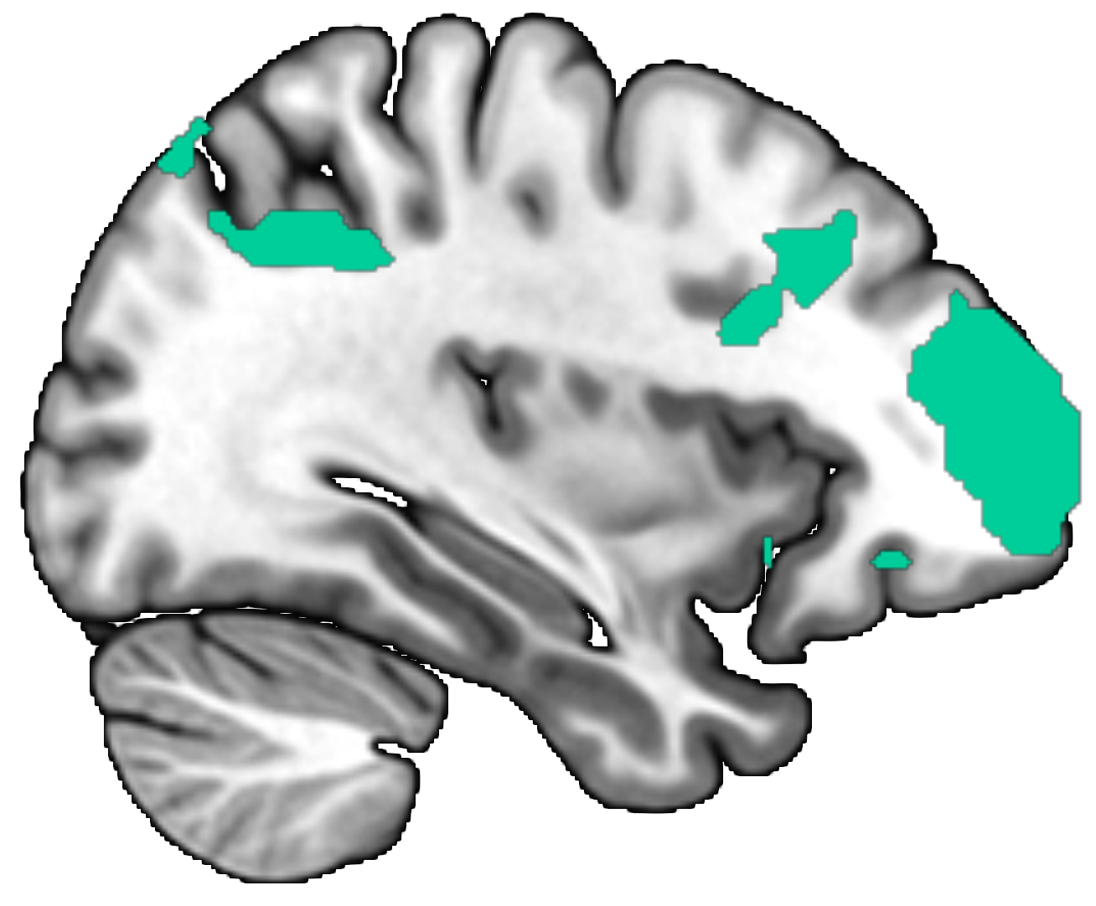
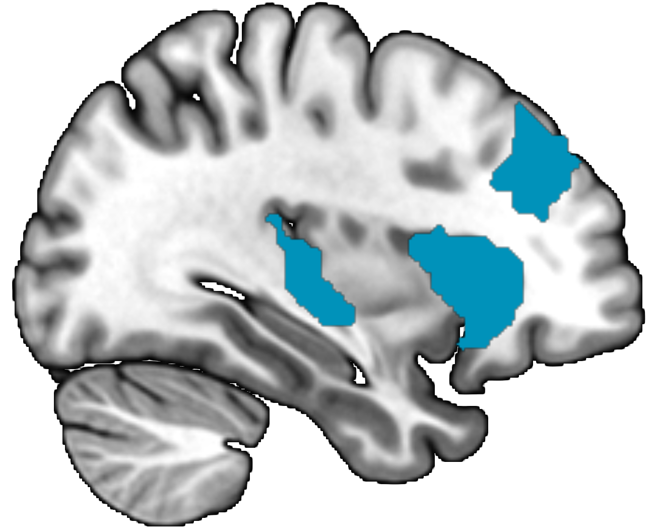
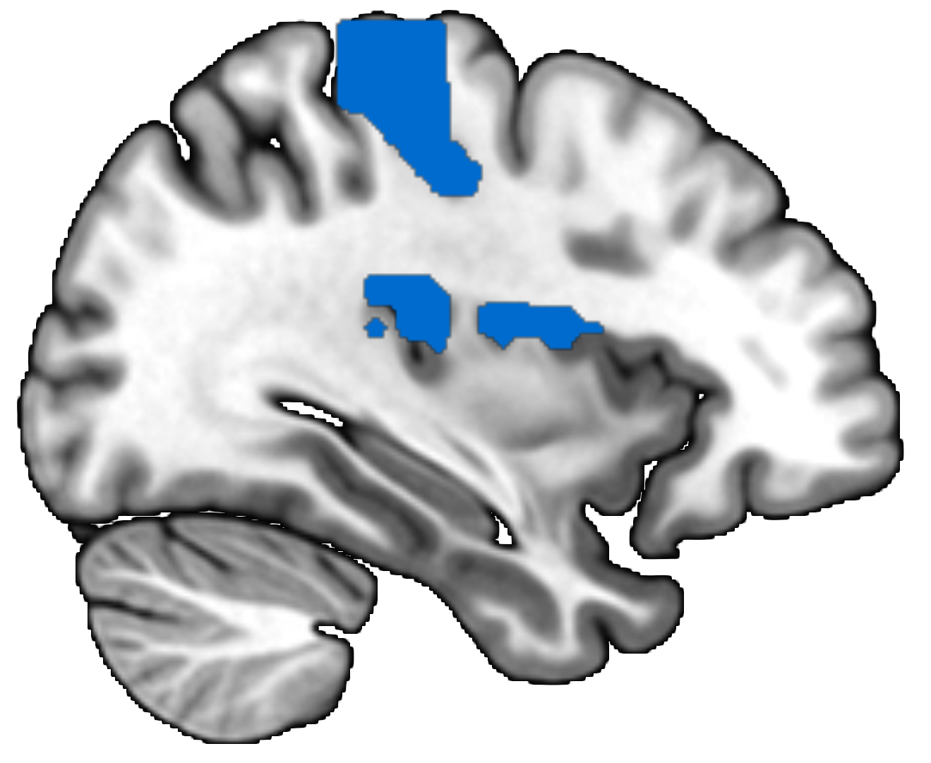
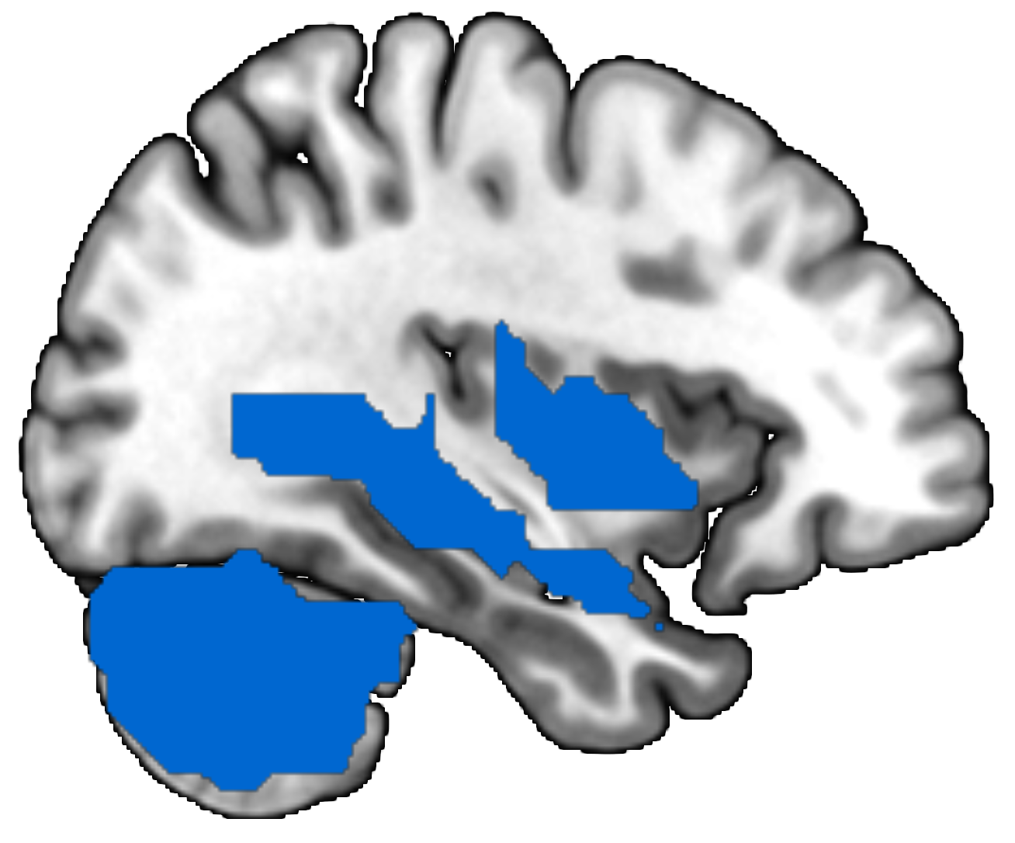
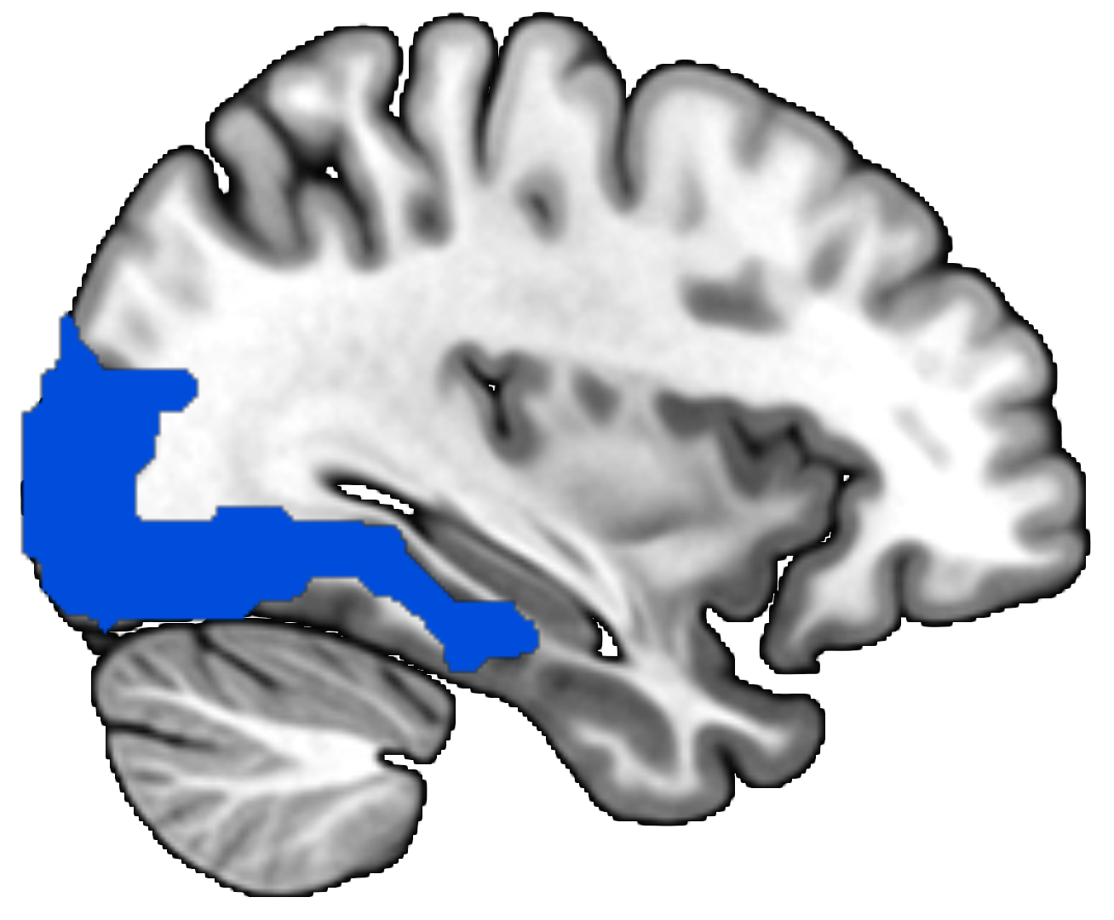
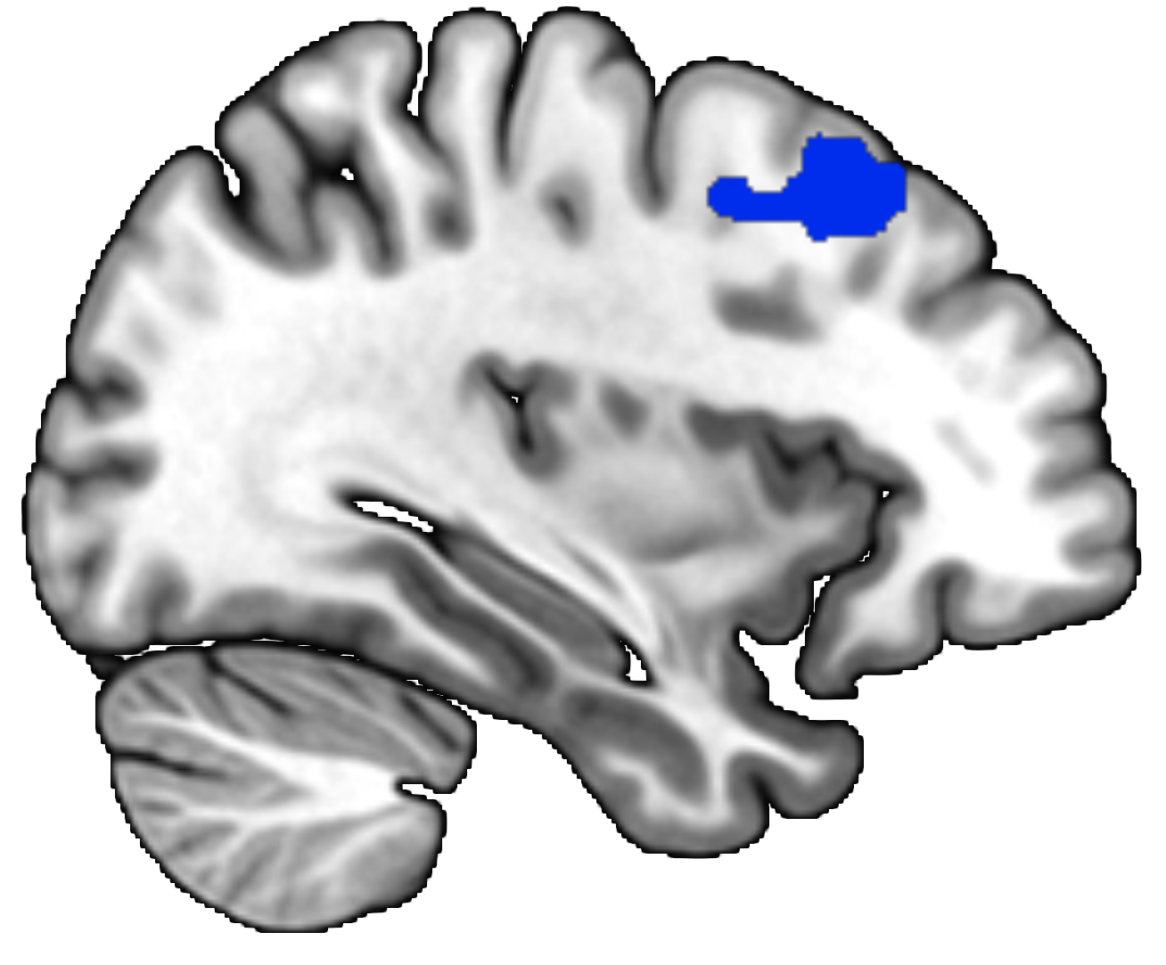
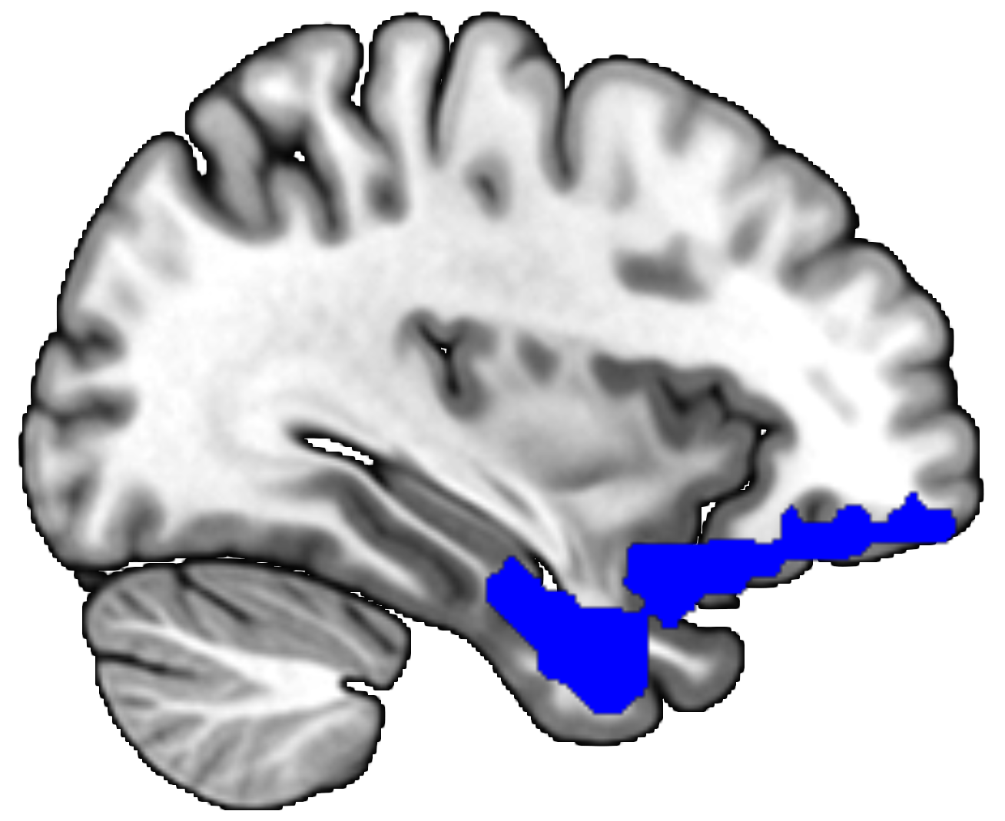
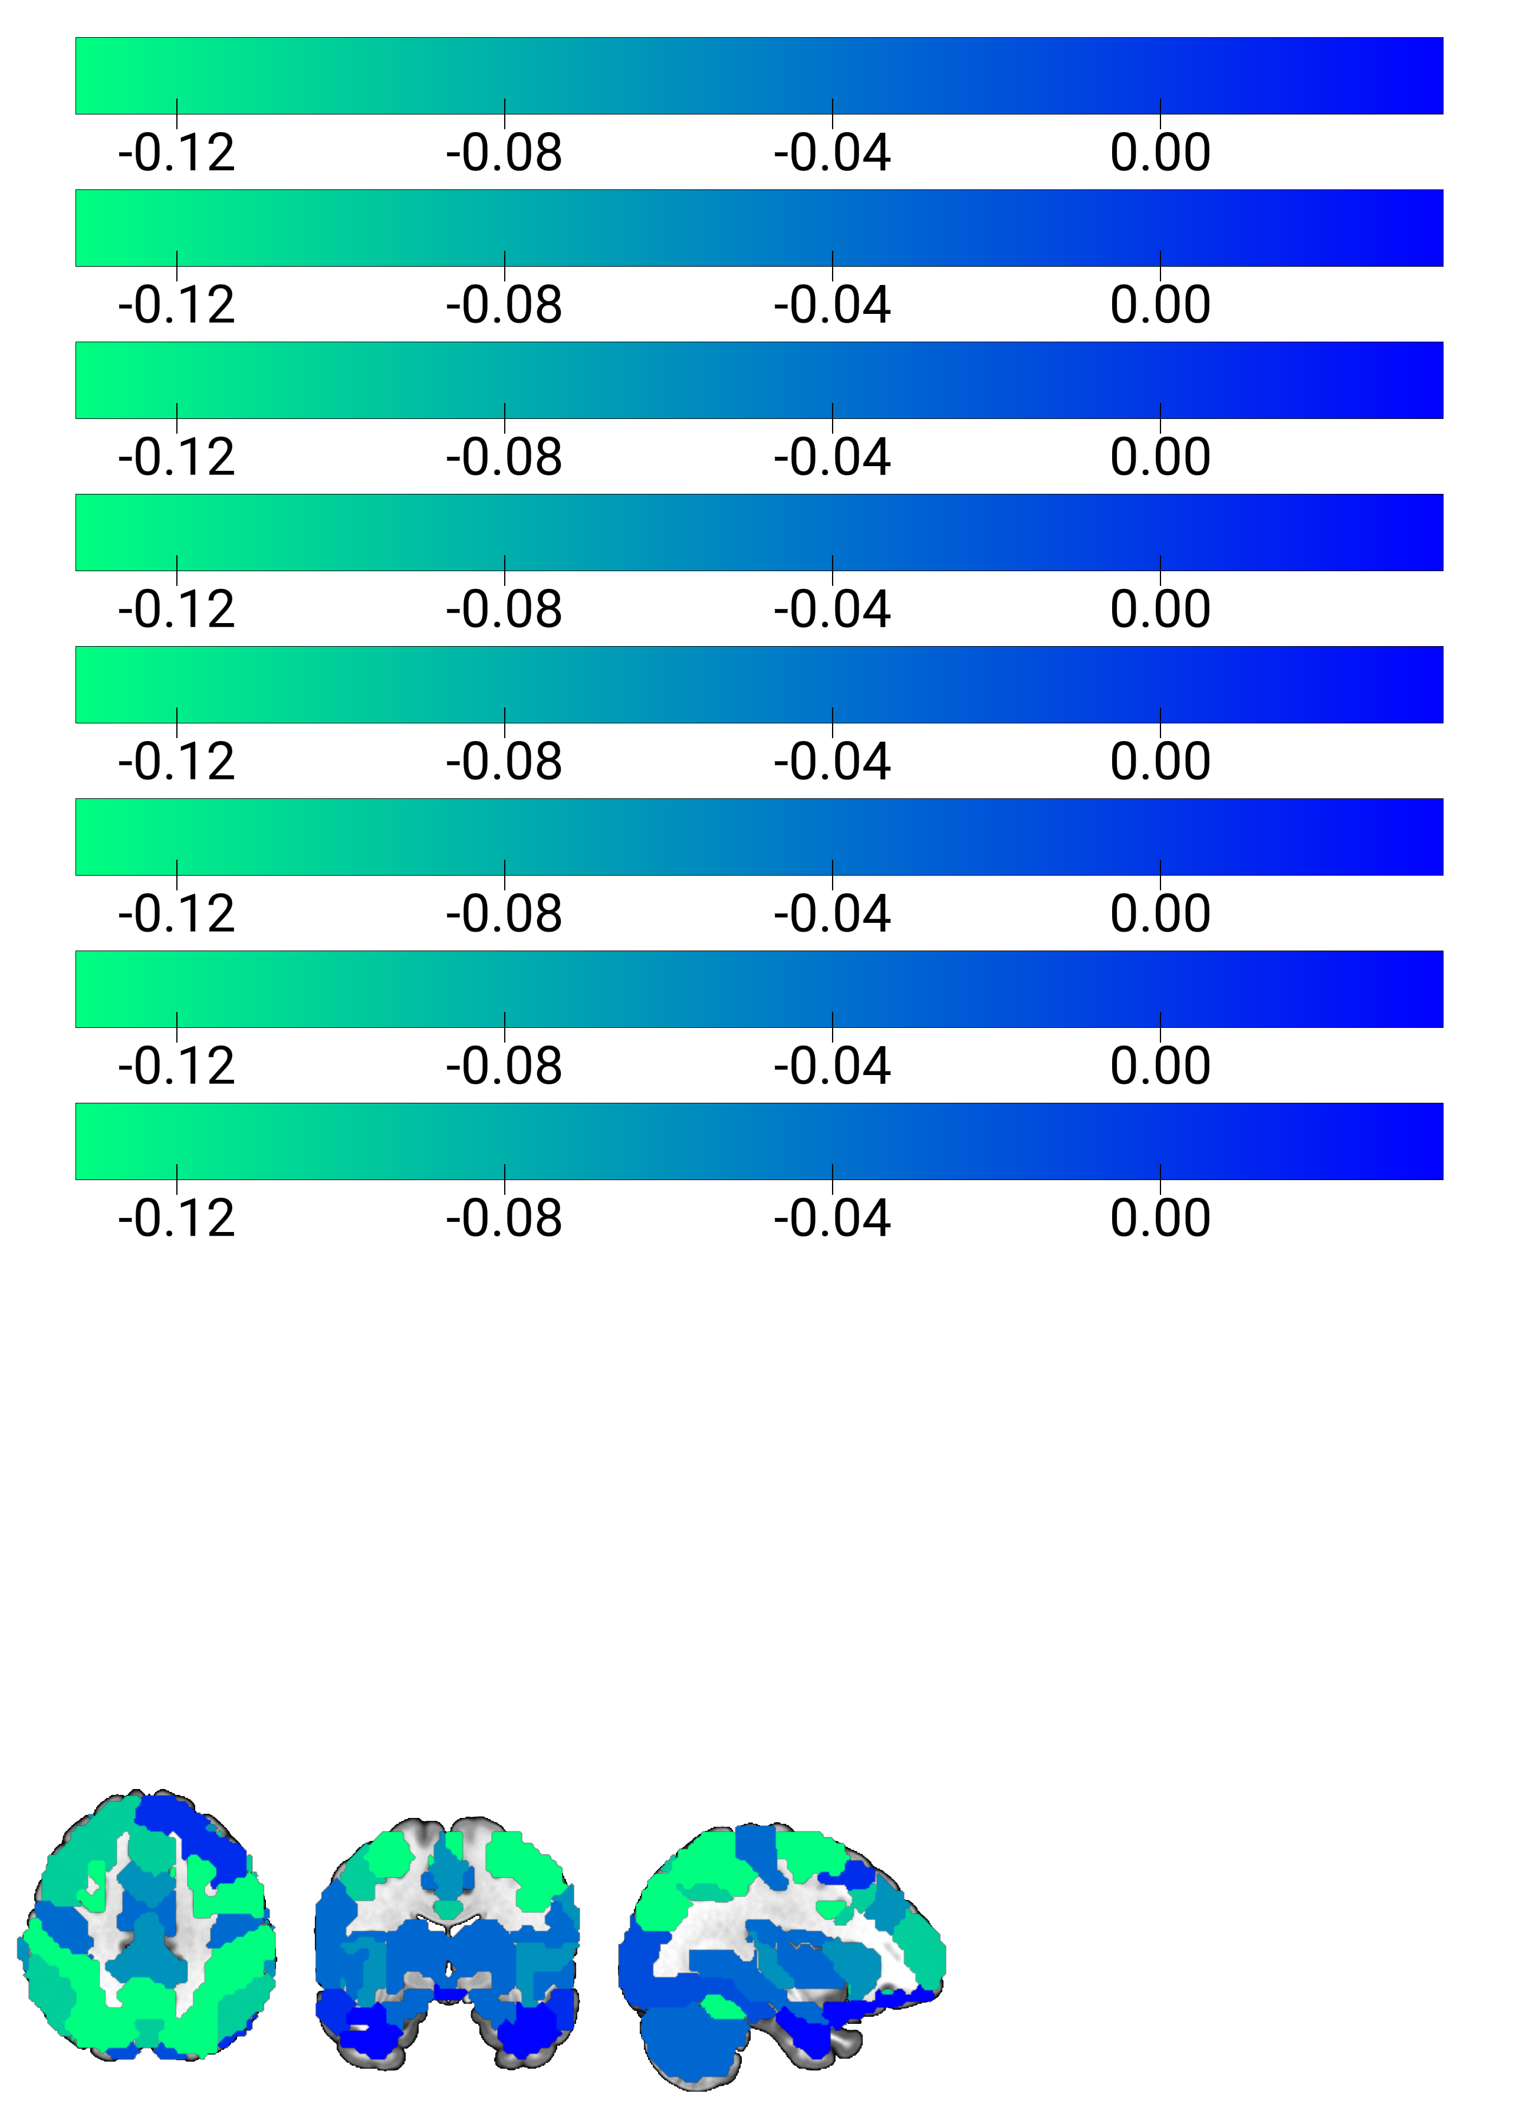
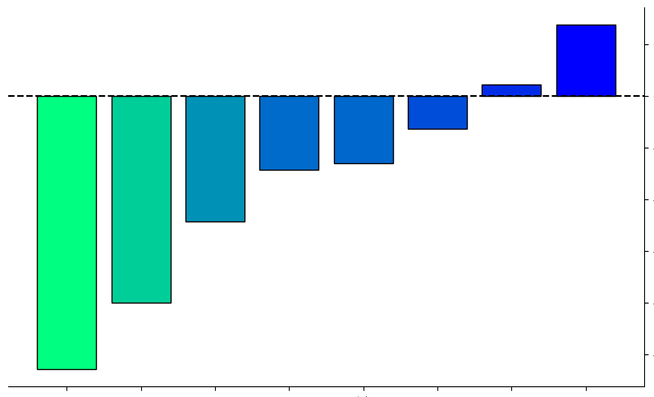
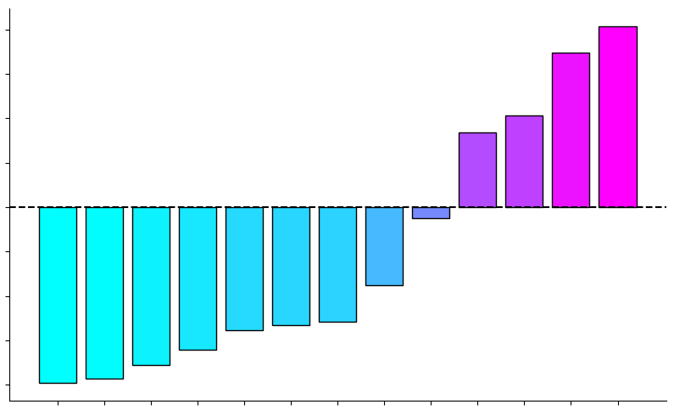
CCA Loadings Summary
DorsAttnB
ContA
SalVentAttnA
SomMotA
Unassigned
VisCent
DefaultB
LimbicA
0
-0.04
-0.08
-0.12
CCA Loading
0.8
0.6
0.4
0.2
0
-0.2
-0.4
-0.6
-0.8
0.025
0
-0.025
-0.050
-0.075
-0.100
-0.125
DorsAttnB
ContA
SalVentAttnA
SomMotA
Unassigned
VisCent
DefaultB
LimbicA
CCA Loadings
Depression
Stress
Anxiety
Fatigue
ADHD
Somatic
Insomnia
Autism
Empathy
Interoception
Social Support
Quality of Life
Well-Being
Stomach-Brain Coupling Networks
Mental Health Categories

