Slide 1
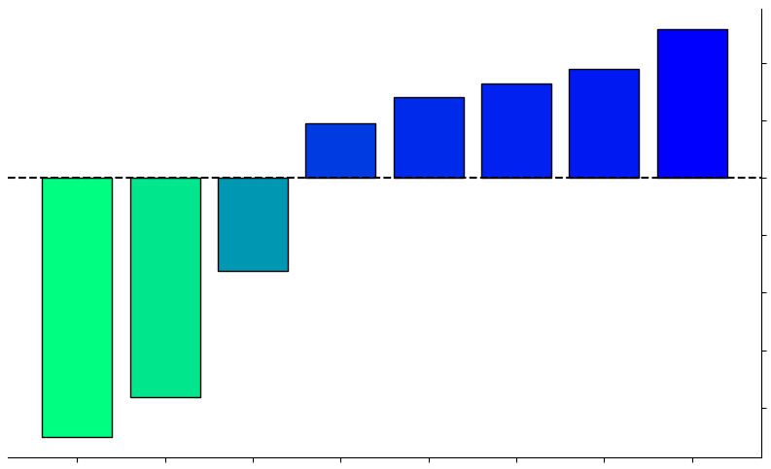
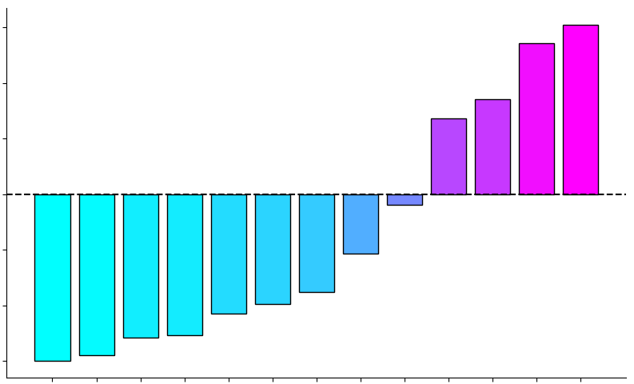
CCA Weights Summary
0.006
0.004
0.002
0
-0.002
-0.004
-0.006
0.0010
0.0005
0
-0.0005
-0.0010
-0.0015
-0.0020
CCA Weights
Depression
Stress
Anxiety
Fatigue
ADHD
Insomnia
Somatic
Autism
Empathy
Interoception
Social Support
Quality of Life
Well-Being
DorsAttnB
SomMotA
SalVentAttnA
ContA
NoNetwork
VisCent
LimbicA
DefaultB
Stomach-Brain Coupling Networks
Psychiatric Symptom Categories

