Slide 1
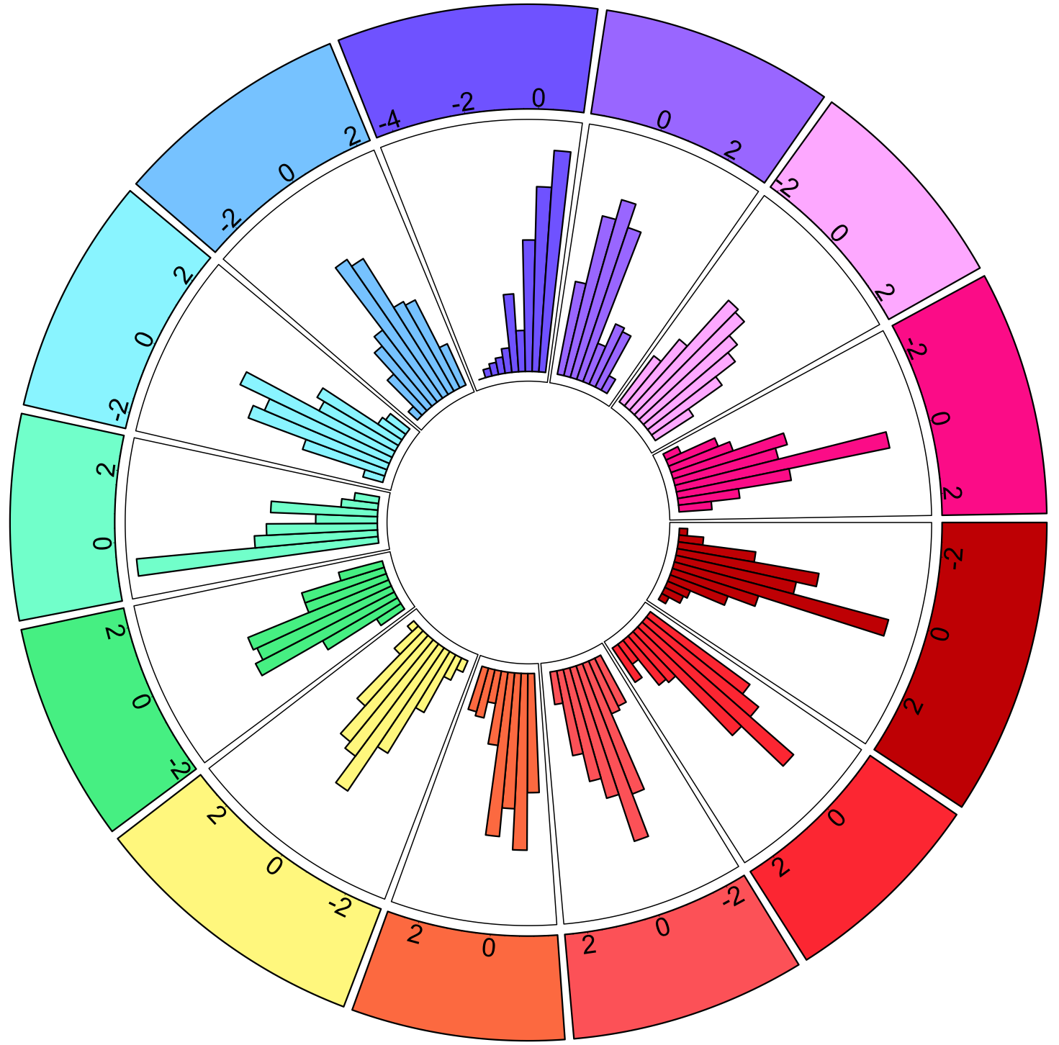
Social Support
-2
Somatic
Quality of Life
Stress
Interoception
Well-Being
Psychiatric
Symptoms
Insomnia
ADHD
Fatigue
-2
Anxiety
Empathy
-2
Autism
Depression

