Slide 1
Sponsorship Gate
Wave 2: we found a privacy leak in our own contract, fixed it, and proved it on a real chain
Anonymous, rate-limited fee sponsorship for Midnight
70 automated checks
real devnet transactions
web console, no wallet needed
Status: SIMULATED (34 contract tests) · LOCAL real devnet (deploy + 3 sponsored txs) · LIVE (Preprod) not yet

Slide 2
RECAP
The problem, in one line
A new user has no funds, so someone must pay their first fee. On a transparent chain that payment is a permanent public record of who funded whom.
Privacy
Abuse resistance
Sponsor safety
The sponsor should never learn who they sponsored, and nobody should be able to group one person's requests.
Anonymous plus free is an open drain. Each identity must cost something, and each request must be bounded.
The sponsor pays real fees. It must only ever pay for exactly the call it agreed to.
SPONSORSHIP GATE
2 / 12

Slide 3
WAVE 1 → WAVE 2
What changed, and what we got wrong
Wave 1
Contract + 16 simulated tests. Deployment never completed. No UI. A sponsor service that was only specified.
Found
authorize() published the caller's commitment in the public transcript, linking every request a member ever made. Our own tests could not see it.
Fixed
Merkle-membership proof. Only the root is disclosed. A transcript-level regression test plus a Wave 1 control contract prove the leak is gone.
Shipped
Quota slots · on-chain budget cap + topUp · sponsor-side inspector · real two-party flow on a devnet · in-browser console · pinned devnet stack.
SPONSORSHIP GATE
3 / 12

Slide 4
THE FINDING
A ledger query is not a state write, and it is public
Wave 1 checked membership with registered.member(commitment). The compiler happily accepted it, because the commitment is a hash, not raw witness data. But a query argument goes into the public transcript.
WAVE 1 · authorize() transcript
WAVE 2 · authorize() transcript
1. 9b06f1f30ce4370f682bb2f3f2aa0622…243b64ebf2b7ec3
← the member's commitment, in public
2. 0707070707070707…
3. f882a3549828bf46…
Anyone can group all of one member's requests.
1. 3fc0b14abfa80c56800411444747e9c5…
← a Merkle root (shared by all members)
2. 0707070707070707…
3. dedcc12bf176573055ec369a53db82a5…
← a fresh nullifier, unlinkable
The member is one of N, indistinguishable.
How we know the test can fail: the same check, run on the preserved Wave 1 contract, finds the commitment. Run on Wave 2, it does not. Both are in the suite.
SPONSORSHIP GATE
4 / 12

Slide 5
THE FIX
Prove membership without saying where
root (public)
register
Disclose your commitment once. Inserted into a Set (duplicate check) and a Merkle tree (membership).
hash
hash
authorize
Prove path → root, disclose only the root. Spend nullifier H(pool, epoch, slot, secret).
member
you
member
member
Historic roots
Older roots stay valid, so registering later never locks an earlier member out.
Your path to the root is private witness data. The circuit hashes it up and discloses only the root.
Honest limit
The anonymity set is the pool's size. A one-member pool hides nothing.
SPONSORSHIP GATE
5 / 12

Slide 6
CONTRACT
Four circuits, three new guarantees
Quota slots
On-chain budget
topUp (owner)
authorize(epoch, slot). A pool grants N authorizations per member per epoch. Each slot is its own nullifier, single-use, refreshed every epoch.
The contract cannot read DUST, so the sponsor commits to a ceiling it can enforce: maxAuthorizations + a counter. A pool-wide stop that holds even if every member cheats.
The budget can only go up, never down. Members are never promised capacity that is then taken back. Closing is deactivate().
CIRCUITS
register(nonce) PoW-gated, one-time commitment insert (Set + Merkle tree)
authorize(epoch, slot) Merkle membership + epoch window + quota + budget + nullifier
topUp(newMax) owner-only, increase-only deactivate() owner-only
SPONSORSHIP GATE
6 / 12

Slide 7
REAL TWO-PARTY FLOW
An unfunded wallet, paid for by someone else
Sponsee
no NIGHT, no DUST, no wallet
Builds + proves
register / authorize, locally
Sponsor inspects
exactly one sponsored call?
Balances with DUST
balanceUnboundTransaction
On-chain
block + indexer
What happened on the devnet
A byte-level privacy check, on the real chain
Pool deployed, then the unfunded sponsee registered and authorized two slots. Each transaction was balanced and submitted by the sponsor.
Fees paid by the sponsor: 900,000,020,153,862 DUST-units across 3 transactions.
Fees paid by the sponsee: 0.
We search each submitted transaction's actual bytes for the sponsee's commitment.
register: found (the positive control, proving the check can see it).
authorize x2: not found.
The Wave 2 contract does not leak the commitment on a real network, not only in simulation.
SPONSORSHIP GATE
7 / 12

Slide 8
SPONSOR SAFETY
The sponsor pays only for exactly what it agreed to
A nullifier says nothing about the transaction it travels in. So before spending DUST, the sponsor inspects the candidate itself. Same function in the devnet service, the unit tests, and the browser.
REFUSAL
ATTACK
EVIDENCE
NOT_A_CALL
A smuggled contract deploy or maintenance update
refused on a real ContractDeploy
TOO_MANY_ACTIONS
Five authorize calls bundled to inflate the fee
unit-tested
WRONG_CONTRACT
A valid-looking call to some other contract
unit-tested
ENTRY_POINT_NOT_SPONSORED
topUp / deactivate: owner-only, never a stranger's
unit-tested
HAS_ZSWAP_MOVEMENT
Shielded value moving; a sponsor pays fees, not transfers
unit-tested
NULLIFIER_ALREADY_SPENT
A replay that would fail on-chain after the sponsor paid
unit-tested
Also on a real chain: a sponsor with no DUST fails with Wallet.InsufficientFunds and leaves no trace in the pool.
SPONSORSHIP GATE
8 / 12

Slide 9
EVIDENCE
Real transactions, reproducible by anyone
STEP
BLOCK
TRANSACTION
34
24
deploy
358
00c96c5bcd…21fe0559e5
register (sponsored)
366
contract tests
inspector tests
00a8e444a8…6ada7001bd
authorize epoch 0 slot 0 (sponsored)
372
0027b2ab20…026097098d
12
1
authorize epoch 0 slot 1 (sponsored)
382
009e9efd4d…d381482f15
Pool 092752298f…2b46d29497 on a local devnet (node 0.22.3, indexer 4.0.0, proof-server 8.1.0). Reproduce: docker compose up, npm run compact, npm run flow.
browser e2e checks
wave-1 control
NOT YET LIVE
No Preprod or mainnet deployment yet. Everything above ran on a local devnet. We say so plainly.
SPONSORSHIP GATE
9 / 12

Slide 10
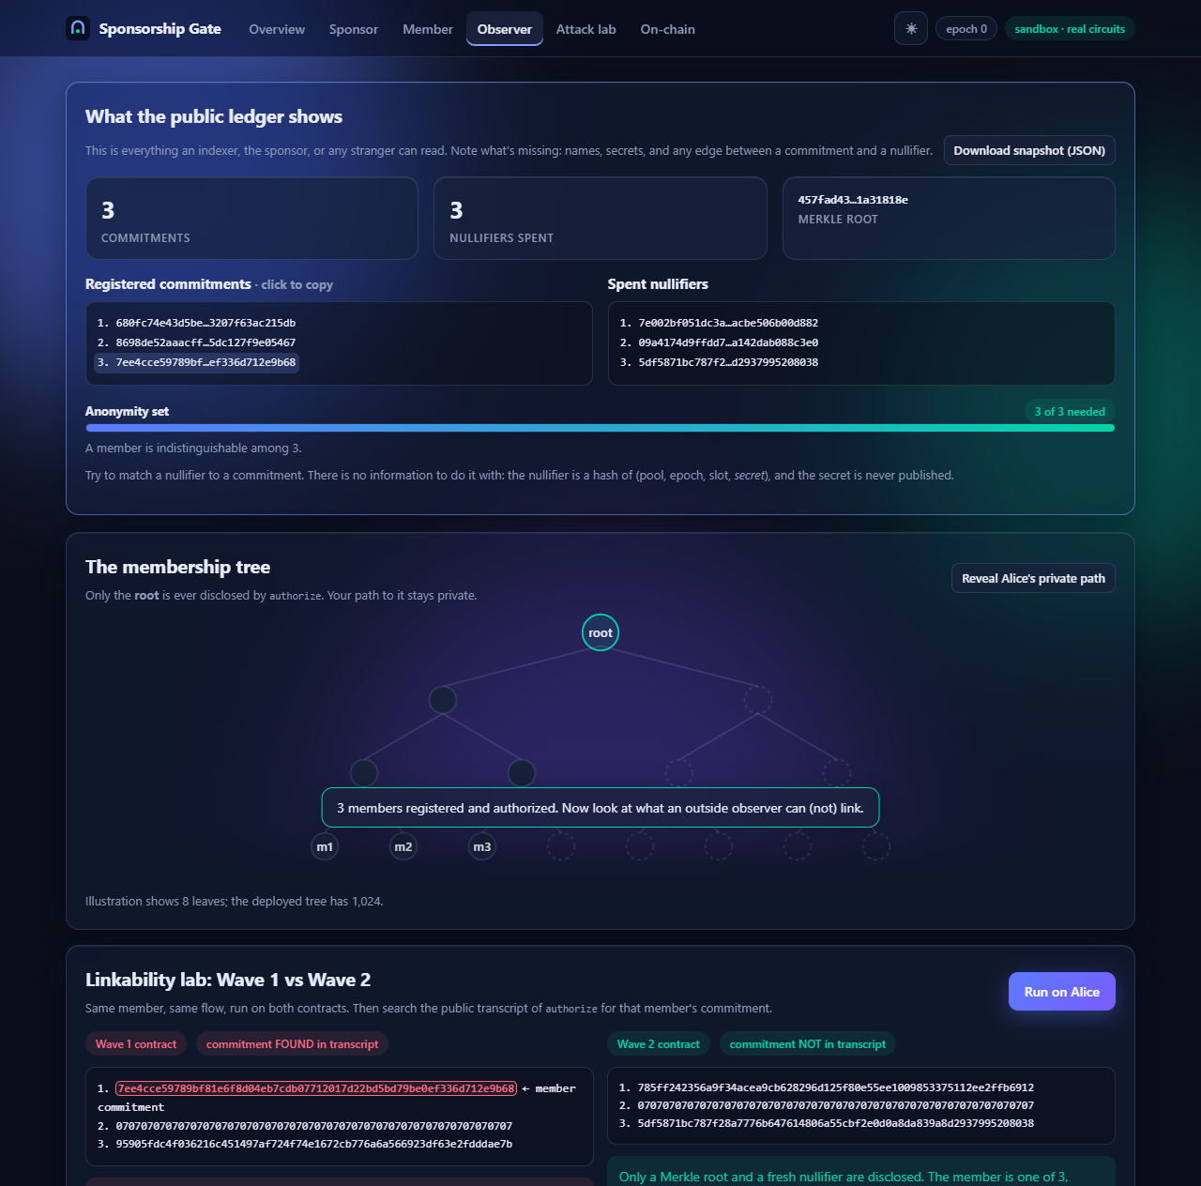
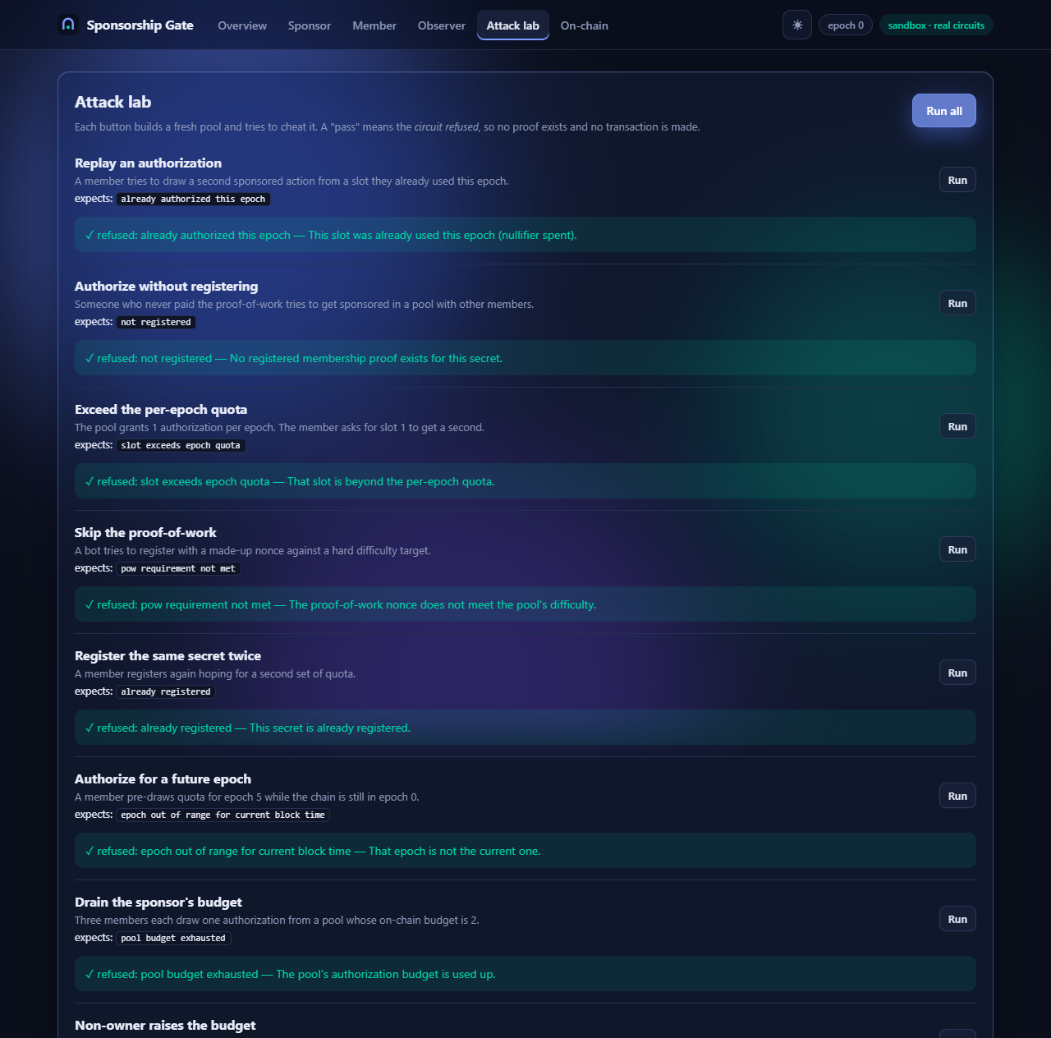
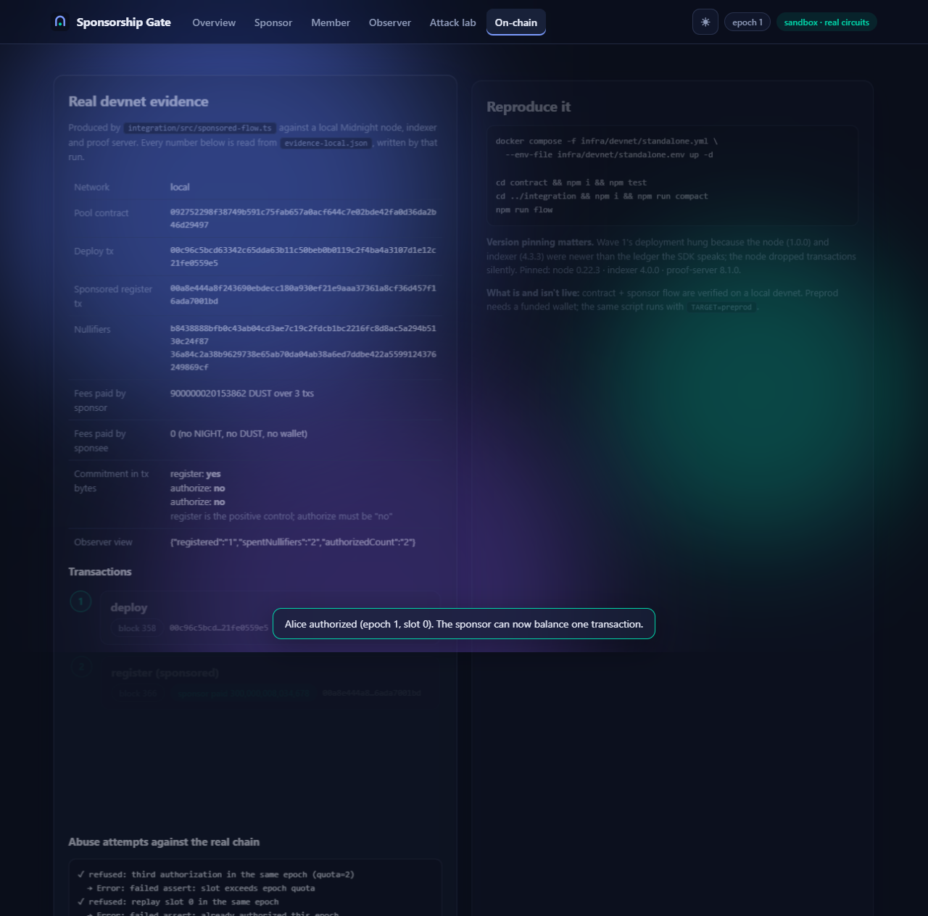
THE CONSOLE
Try to link a member. Try to break the pool.
Linkability lab
Attack lab
On-chain tab
Same member, both contracts. Search the public transcript for their commitment.
Ten attacks on fresh pools. A pass means the circuit refused.
The devnet transactions, fees and byte-level check, read from the evidence file.
SPONSORSHIP GATE
10 / 12

Slide 11
WHY WAVE 1 NEVER DEPLOYED
A silent version mismatch, found by comparing a working stack
Wave 1 stack
Wave 2 stack (pinned)
node 1.0.0 · indexer 4.3.3 · proof-server 8.1.0
Proofs generated, wallet balanced, transaction submitted. Then nothing: no error, no block. The node dropped it silently.
node 0.22.3 · indexer 4.0.0 · proof-server 8.1.0
The set the stable SDK line (midnight-js 4.1.1, ledger-v8 8.1.2) was validated against. Deploy lands in about 20 seconds.
WHY THIS MATTERS TO OTHER BUILDERS
Newer node/indexer tags do not mean newer-is-better for the current SDK line. A mismatch fails silently, at submission.
infra/devnet/standalone.yml pins the working set, with the reason written next to it, so the next team does not lose a wave to it.
SPONSORSHIP GATE
11 / 12

Slide 12
WHO IT'S FOR, AND WHAT'S NEXT
From a proven primitive to a service
Who uses it
How it sustains
Wallets and dApps that must onboard users with zero balance.
Communities and DAOs sponsoring members without a membership list.
Any app where "who funded whom" is itself sensitive.
Sponsors pay fees they choose to cover; the on-chain budget caps exposure. A hosted reference sponsor service (pool-as-a-service) is the natural paid layer. The contract and inspector stay open.
WAVE 3
Preprod deployment with the same script, and a funded wallet.
Reference sponsor service as running code, with rate limits and per-pool budgets.
Epoch-partitioned nullifiers so the spent set stops growing without bound.
Browser wallet (DApp connector) so the console can drive a live pool, not just the sandbox.
SPONSORSHIP GATE
12 / 12

