Slide 1

ANALYSIS AND INSIGHTS ON PARCH AND POSEY
coredataengineers
By Goup 15: Edmond Nathan
Emenike Nyema-Amadi
Surajudeen Abodunrin

Slide 2
INTRODUCTION
This is an exploratory analysis on the database of Parch and Posey

Slide 3
BRIEF HISTORY OF PARCH AND POSEY
Parch and Posey is a hypothetical paper company's sales data of different types of paper (standard, gloss, poster).
They have branches in different regions across the world.

Slide 4
Proposed Analysis
What is the total revenue generated by each sales channel (Direct Vs. Indirect), and how does the revenue distribution vary across different regions?
Top performing sales rep by revenue?
What is the total revenue generated by each region?
What is the average order amount for each of the top two product categories.

Slide 5
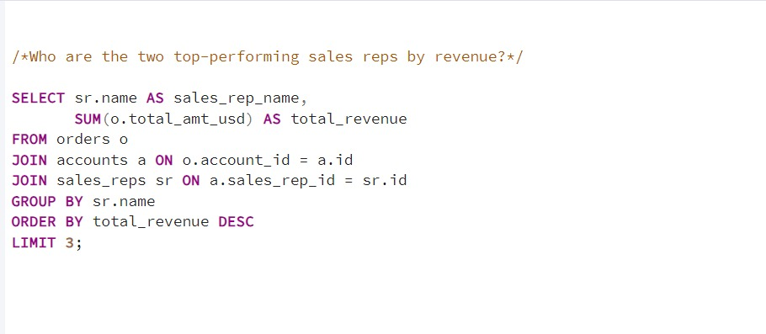
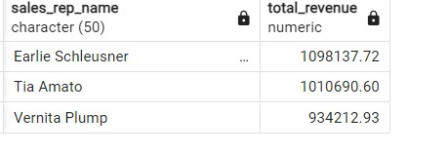

Slide 6
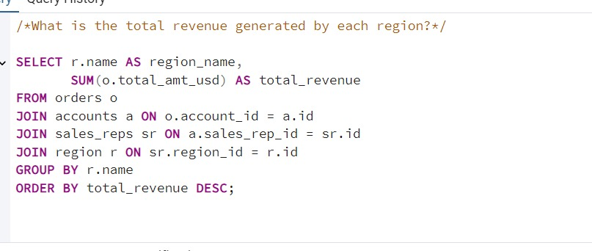
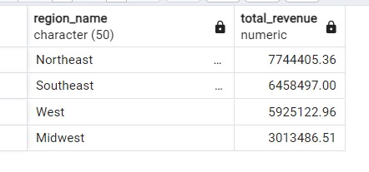

Slide 7
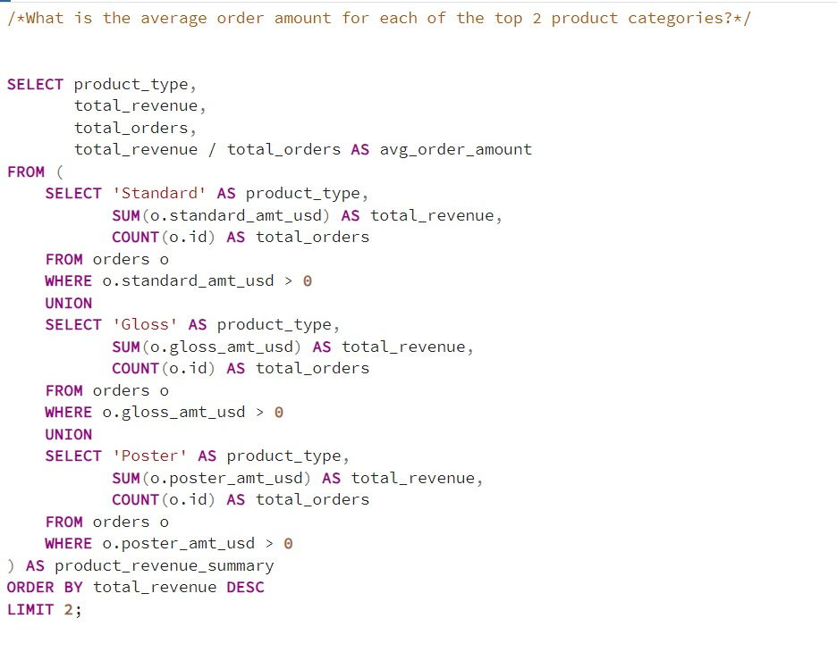
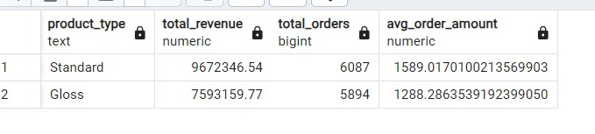

Slide 8
ANALYSIS
The Northeast region leads in revenue, generating $7.74 million, making it the most lucrative region for the business. Southeast follows closely with $6.45 million, indicating strong sales activity there.
The West region, while still substantial at $5.92 million, trails behind the top two regions. Midwest shows the lowest revenue at $3.01 million, suggesting potential for improvement or targeted growth strategies.

Slide 9
Analysis (Cont’d)
The Standard product category is the top performer, generating $9.67 million in revenue with an average order amount of $1,589, indicating high demand and value per order.
The Gloss category follows with $7.59 million in revenue and a lower average order amount of $1,288. While both categories perform well, the higher average order value for Standard suggests it could be prioritized in marketing and sales efforts.
Increasing focus on Gloss may help close the gap in revenue potential. Both categories are key revenue drivers for the business.

Slide 10
Analysis (Cont’d)
Earlie Schleusner leads as the top-performing sales rep with over $1 million in revenue, showcasing strong sales skills and potential for mentoring others.
Tia Amato, close behind, has also crossed the $1 million mark, with opportunities for further growth through client retention and upselling. Vernita Plump, generating $934K, is a strong contributor and has the potential to exceed $1 million with targeted strategies.

Slide 11
Recommendation
All three reps are crucial to the business’s success, and focusing on their key accounts can unlock even more revenue. They should also be rewarded with bonuses for motivation an morale boost.
The low revenue yield in the Midwest should guide resource allocation and marketing focus to maximize revenue across all regions.

Slide 12
THANK YOU

