Slide 1

MONGOOSE 2.0

Slide 2
WHAT IS mONGOOSE
Mongoose is a benchmarking tool initially designed for cloud storage performance testing
1M of concurrent connections
1M of operations per second
1M of items which may be processed multiple times in the circular load mode
1M of items which may be stored in the storage mock

Slide 3
TOP 10 features
Distributed Mode
Rich Metrics Reporting
Different operation types
(Create, Update, Append, Read, Delete)
Abstract Load Engine
(load with objects, files, containers, directories, etc)
Cloud Storages support
(S3, Atmos, Swift)
Flexible Load Limitation
(by count, time, rate)
Custom Content Generation and Verification
Circular Load Mode
Dynamic Configuration Parameters
Custom Item Naming Schemes

Slide 4
Distributed mode
Start the load servers
java -jar mongoose.jar server
Start the load client
java -Dload.server.addrs=<A>,<B>,<C> ... -jar mongoose.jar client

Slide 5
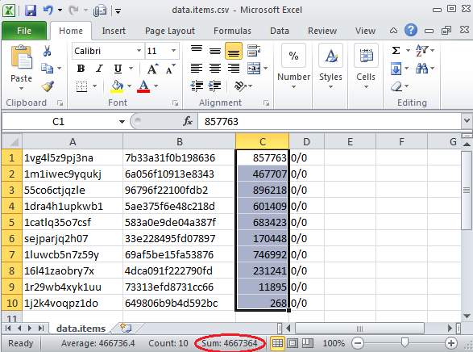
Reporting
Key log files:
  items.csv
  perf.avg.csv
  perf.trace.csv
  perf.sum.csv

Slide 6
Write and read example
Write some data
java -Ditem.data.size=4KB-16KB -Ditem.dst.container=foo -Ditem.dst.file=items.csv -jar mongoose.jar -f scenario/default.json
Read back
java -Dload.type=read -Ditem.dst.container=foo -Ditem.src.file=items.csv -jar mongoose.jar -f scenario/default.json

Slide 7
Where to go next
Refer to the Mongoose Wiki:
https://asdwiki.isus.emc.com:8443/display/ECS/Mongoose
Ask via email:
Mongoose.Support@emc.com

Slide 8
Q & A

Slide 9
Thank you

