Slide 1
Speed Dating Analysis
Eric Culbertson

Slide 2
Primary Goals
How do preferences for partners differ between genders?
Provided data set is equipped with numerous attributes that we could test
We can try to determine gender based on attribute preference
We can also try to rank attribute importance for each gender when predicting a match
As an additional study, I performed a sentiment analysis on Tinder for two different cities
Is Tinder better received in other areas?

Slide 3
Data Cleaning
In our dataset, there was a bunch of missing data that needed to be accounted for
I first removed all columns that had more than 10% NA’s
Then, I used the mice package to remove NA’s
Mice uses PMM for numeric variables, and polyreg for categorical data

Slide 4
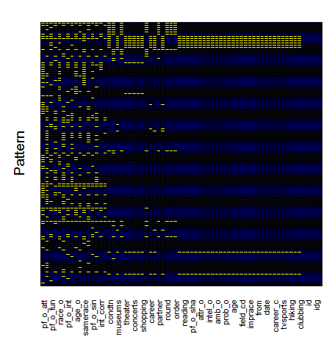
Data Cleaning
Mice assumes that the missing values are randomly distributed
As shown in the plot to the right, this isn’t always the case
Yellow clusters appear when certain waves are missing attributes for all participants
I chose to ignore these attributes

Slide 5
Normalization
Most numerical attributes were simply normalized such that they span from 0 to 1
For some attributes, however, certain waves defined attributes in different ways (eg. attr4_1, sinc4_1, …)
These attributes where sometimes on a scale from 0-10, and other times 100 points were allotted among the 5-6 attributes
To handle this, I added up the values of all attributes in the grouping and then divided each attribute by the sum

Slide 6
Added Variables
“age_diff” = participant’s age – date’s age
“confidence” = sum of how highly the participant rated him/herself
“similarity” = a “distance” between the rating of the participant and the rating of the date in attractiveness, fun, ambition, etc.

Slide 7
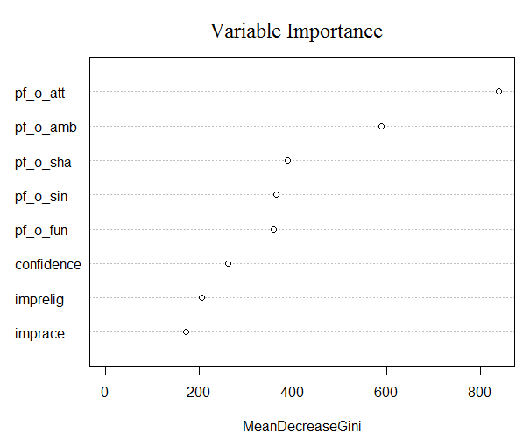
Classifying gender
I wanted to see if I could predict gender based on stated partner preference
It seems easiest to determine gender based on how much they prefer attractiveness
Variable importance done with random forest, and prediction done with C5.0
 | Predicted: Female | Predicted: Male
Actual: Female | 744 | 39
Actual: Male | 38 | 757

Slide 8
Ranking variable importance for each gender
To test this, I split up the data set into halves to separate the genders
Using the random forest package, I determined which attributes were most important in determining a match
Variables chosen: samerace, attr_o, sinc_o, intel_o, fun_o, amb_o, race, career_c,age_diff, int_corr, similarity, confidence, date, field_cd

Slide 9
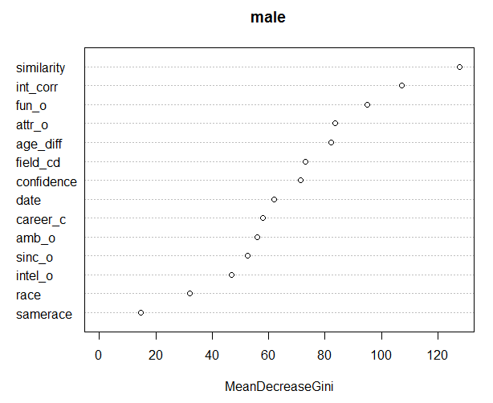
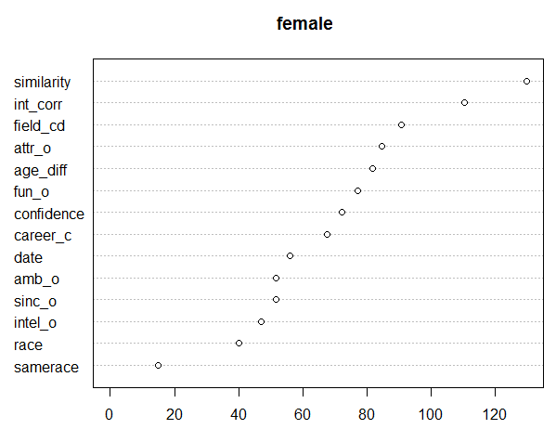
Ranking Variable Importance
 | Predicted: 0 | Predicted:1
Actual:0 | 559 | 79
Actual: 1 | 28 | 28
 | Predicted: 0 | Predicted: 1
Actual: 0 | 580 | 97
Actual: 1 | 6 | 1

Slide 10
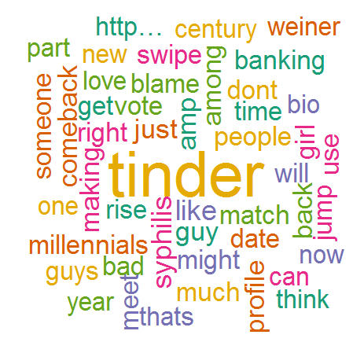
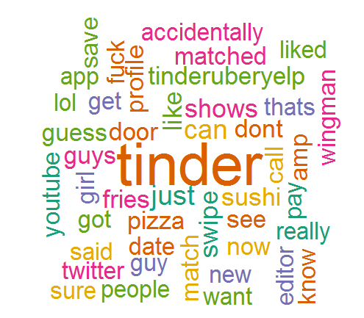
Extra Project: Sentiment analysis of Tinder dating app
I grabbed a collection of tweets from New York and the LA area
I wanted to see if attitudes on tinder differed between these locations

Slide 11
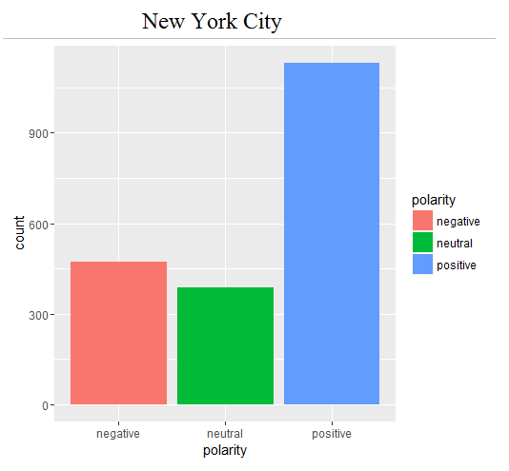
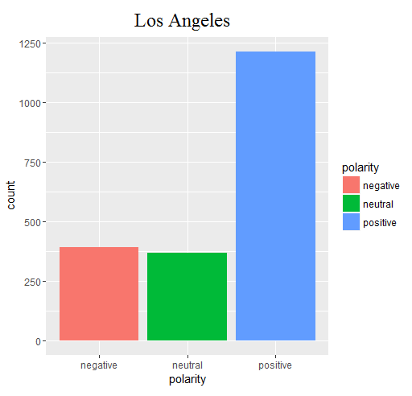
Polarity
Tweets from LA are overall more positive and less negative than tweets from New York

Slide 12
Conclusions
Predicting a gender based on preferences is much easier than determining a match
Preference for attractiveness is a good indicator of gender (playing into our stereotypes)
Because models for determining matches were not great, we should be suspicious of the variable importance they show
Different areas do seem to show different attitudes towards Tinder
It might be more interesting to compare two cities from different countries

