Slide 1
Assignment
Emilija Petreska

Slide 2
Case:
Create a useful dashboard regarding stock levels, average number of weeks in stock etc. Use attributes as e.g. Purchasing Manager, Warehouse, Product Category.
The attached files contain the data that is needed. A data model and some simple metrics need to be built.
The results are preferably presented via Power BI and a PBIX file, but other alternatives are also available.
However, this requires a documentation that shows the results and that we then go through the solution during an interview.

Slide 3
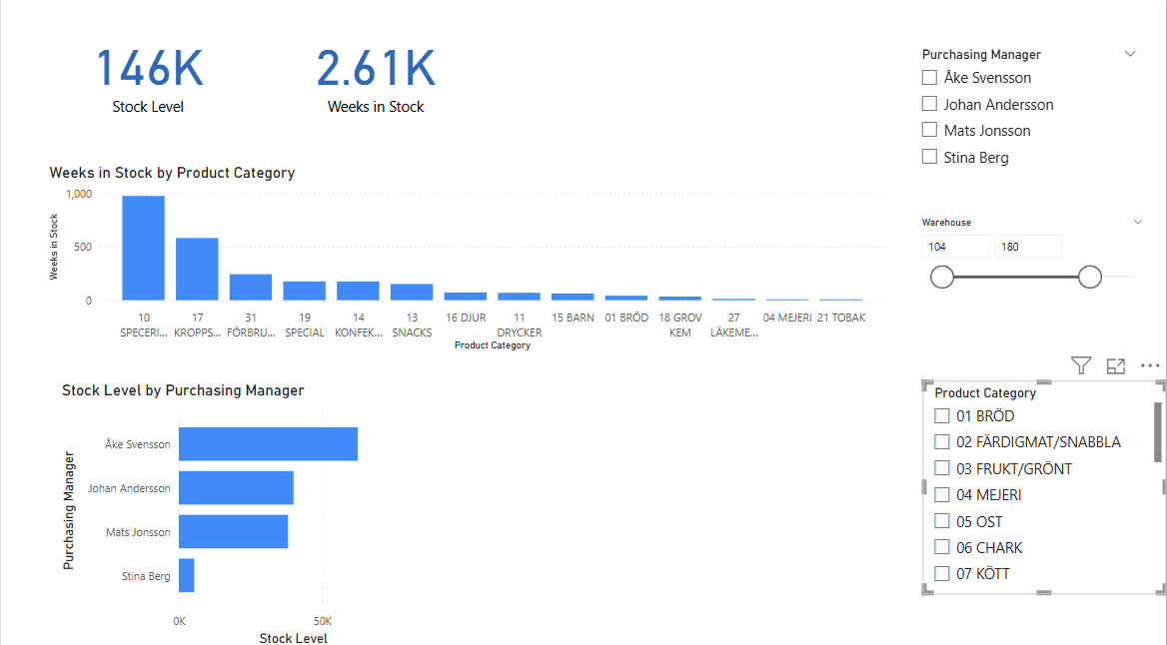
Dashboard

Slide 4
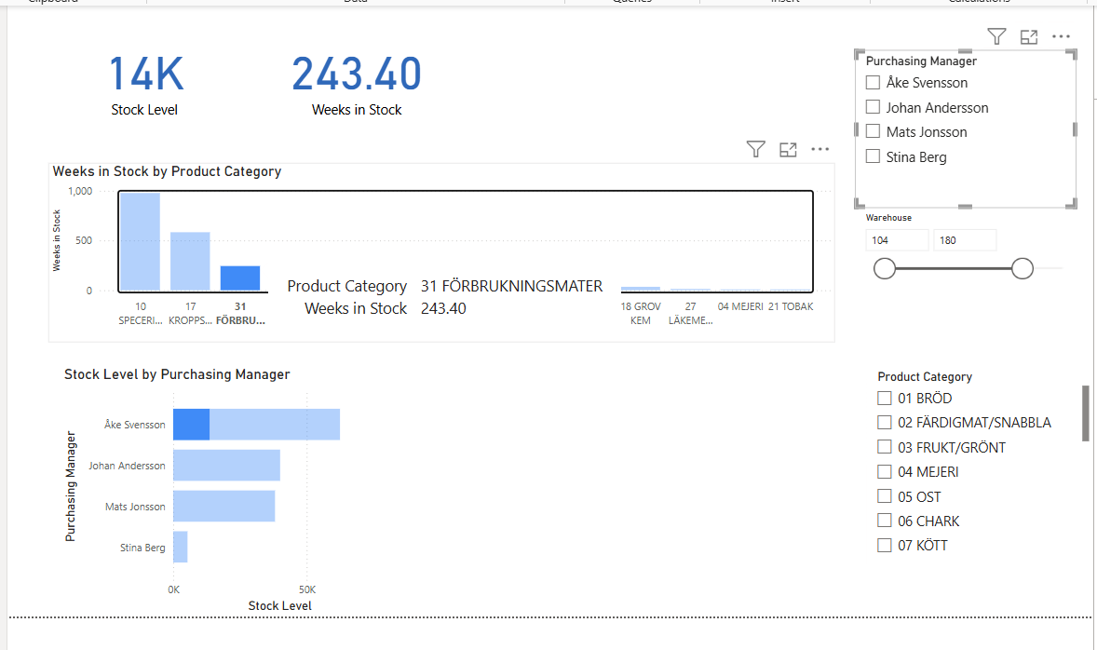
Interaction on the dashboard

Slide 5
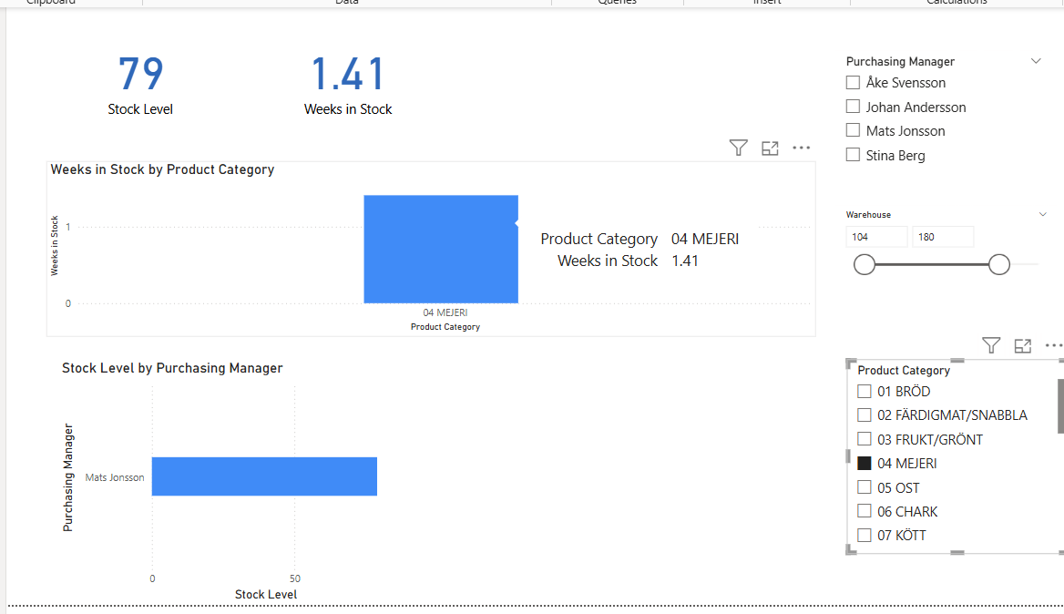
Product Category - Majeri

Slide 6
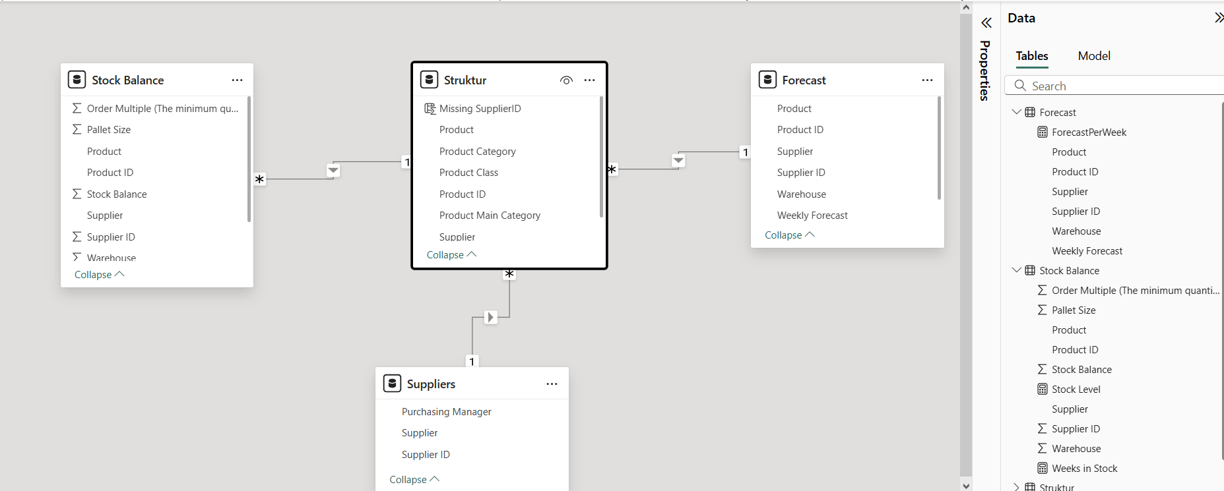
Data Model with created metrics

Slide 7
Documentation
Github repo:
P

