Slide 1
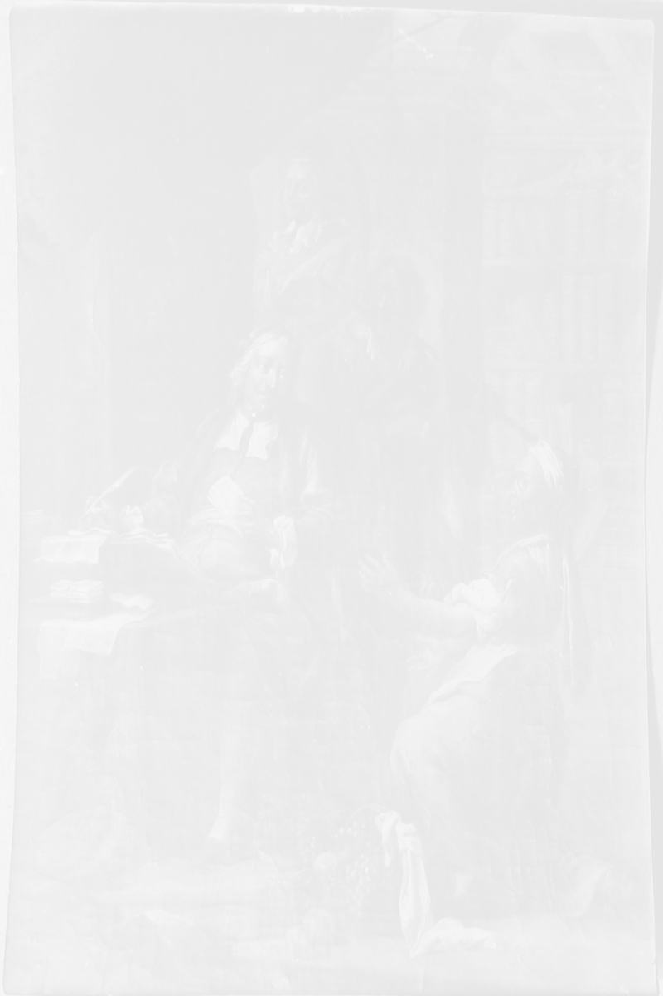
Polish Looted Art Discovery Engine
Recovering Cultural Heritage Through Technology
Polish Looted Art Discovery Engine
1 | 5

Slide 2
Challenge & Mission
Hundreds of thousands of Polish works looted in WWII still circulate online.
Recovery today is manual and slow.
We use technology to find where looted art appears—auctions, marketplaces, galleries—and surface leads for experts and restitution.
Polish Looted Art Discovery Engine
2 | 5

Slide 3
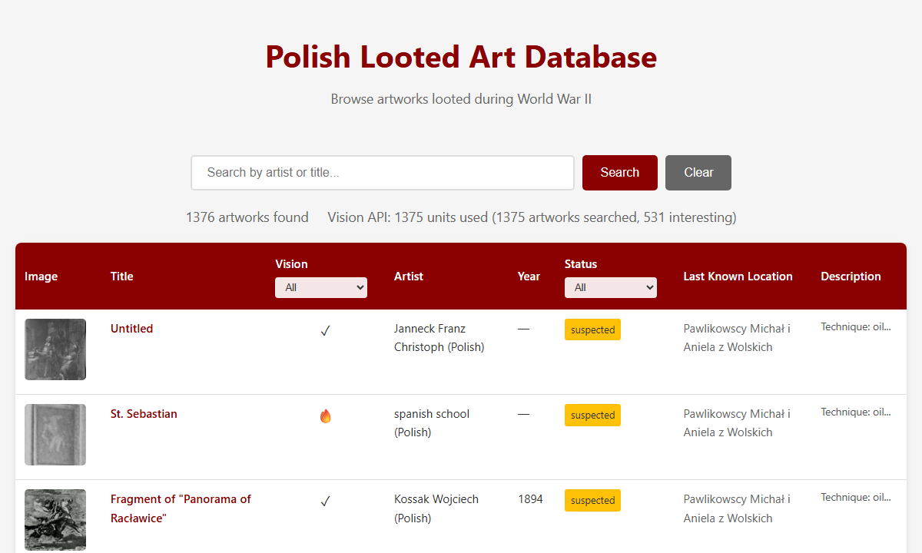
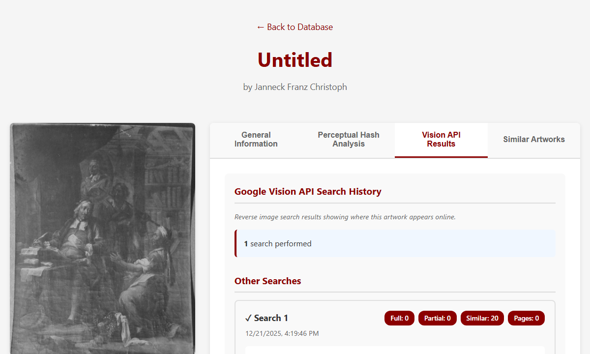
The Platform
Reference database from official sources (e.g. Division for Looted Art).
Reverse image search at scale; prioritizes auction and marketplace hits.
Web UI for curators to browse, search, and review leads.
Polish Looted Art Discovery Engine
3 | 5

Slide 4
Impact & Next Steps
Prioritized leads, low cost, scalable to tens of thousands of artworks.
Pilot with ministry or museum partners; secure funding for API and capacity.
Extend: public reporting, official DB integration, stronger restitution workflows.
Polish Looted Art Discovery Engine
4 | 5

Slide 5
Thank You
We seek partners in museums, government, and cultural institutions to scale impact and accelerate restitution.
Polish Looted Art Discovery Engine
5 | 5

