Slide 1
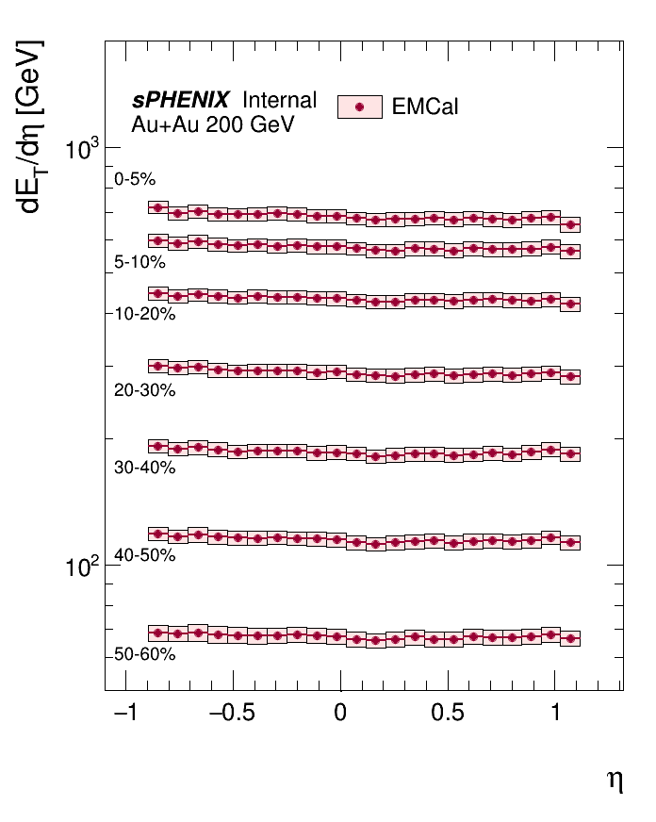
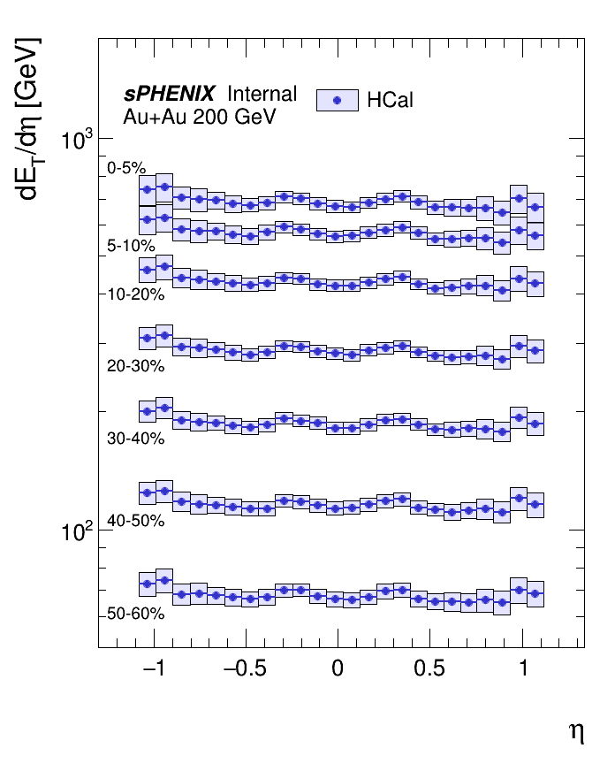
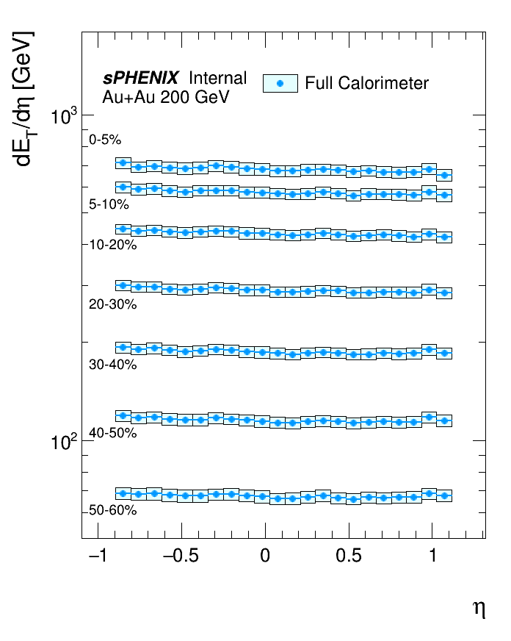
Comparison of EMCal-only, HCal-only and full calorimeter $dE_{T}/dη$ measurements

Slide 2
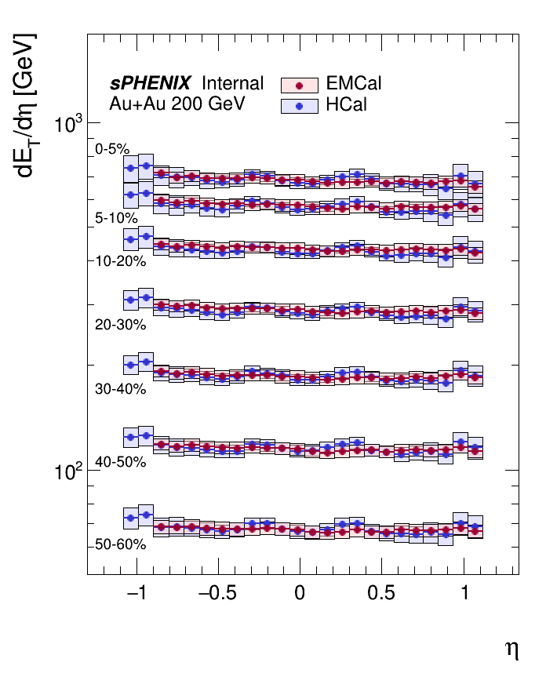
Comparison overlay of EMCal-only and HCal-only $dE_{T}/dη$ measurements

Slide 3
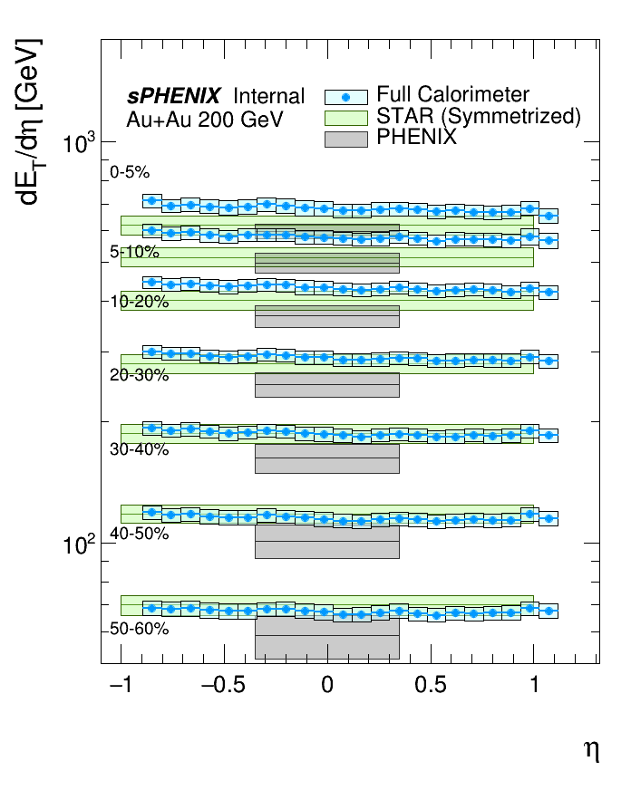
Comparison overlay of sPHENIX full calorimeter, STAR and PHENIX $dE_{T}/dη$ measurements

Slide 4
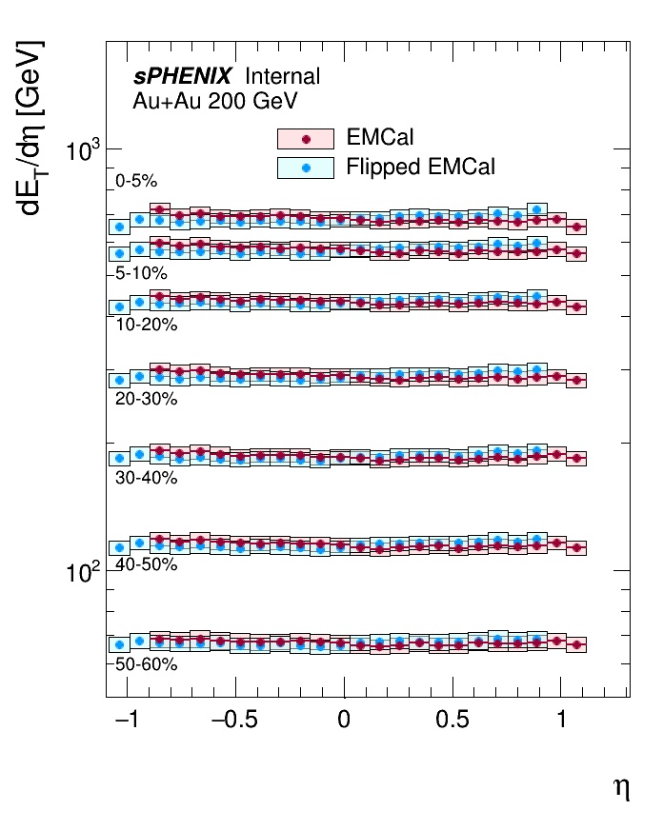
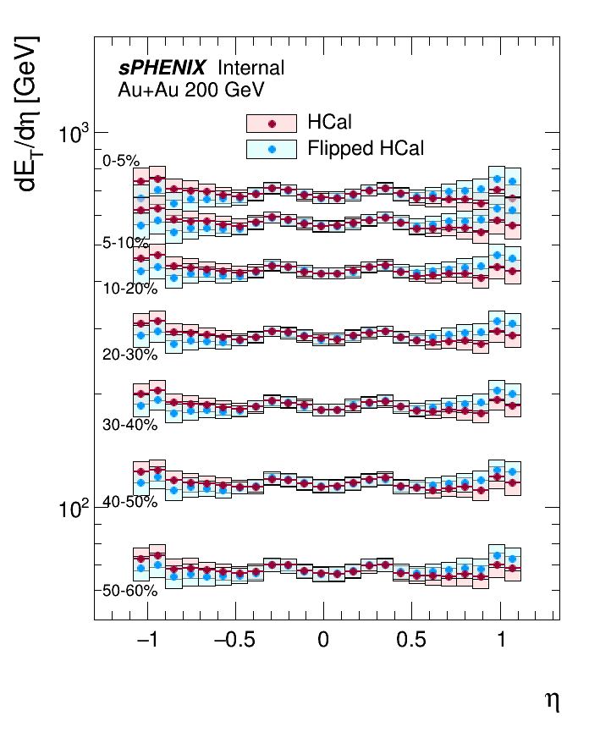
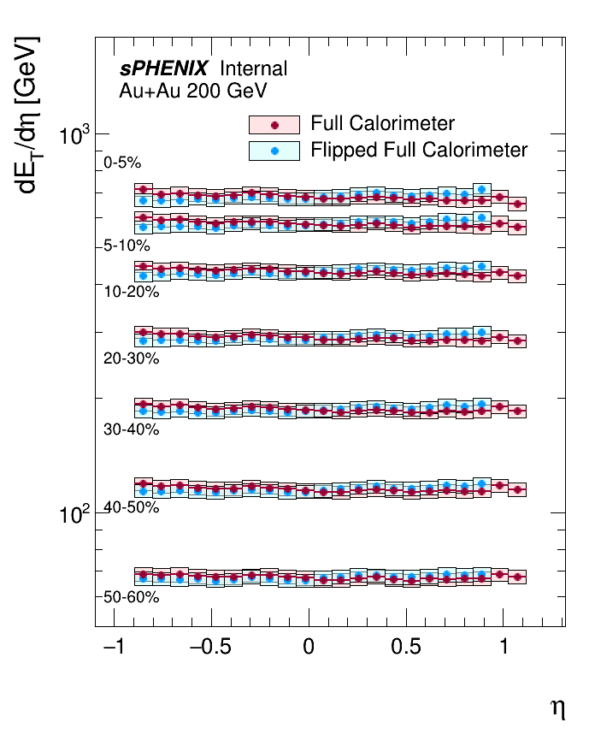
Comparison of EMCal-only, HCal-only and full calorimeter $dE_{T}/dη$ measurements to $dE_{T}/dη$ measurements flipped about $η=0$

