Slide 1
College Event Website
Group 10
By: Corey Holsey, Troyle Thomas, Navid Fanian

Slide 2
ER Diagram

Slide 3
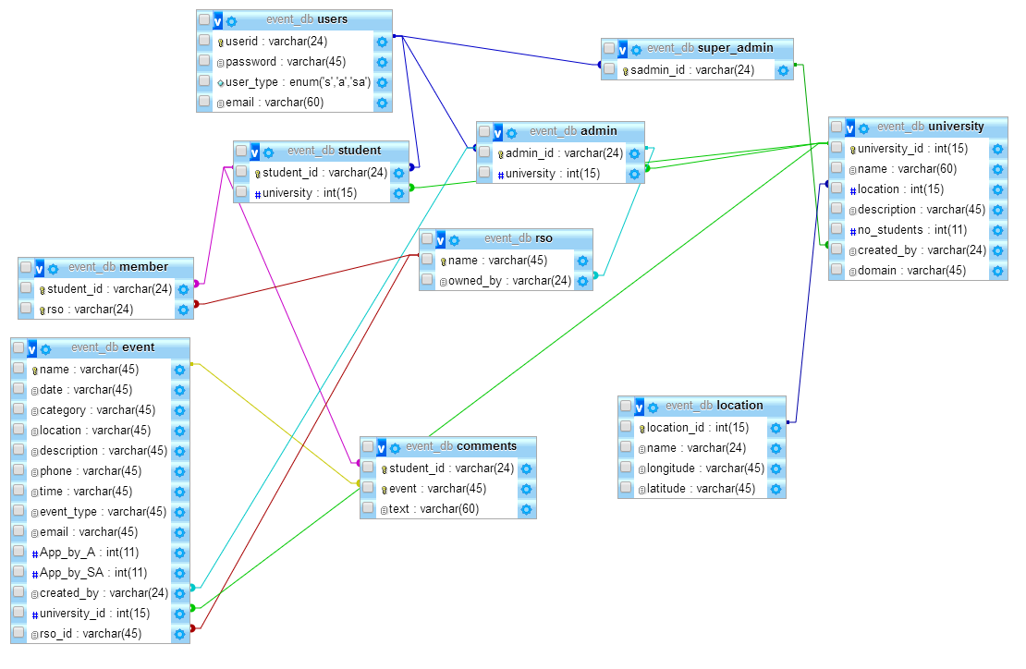
SQL ER Diagram

Slide 4
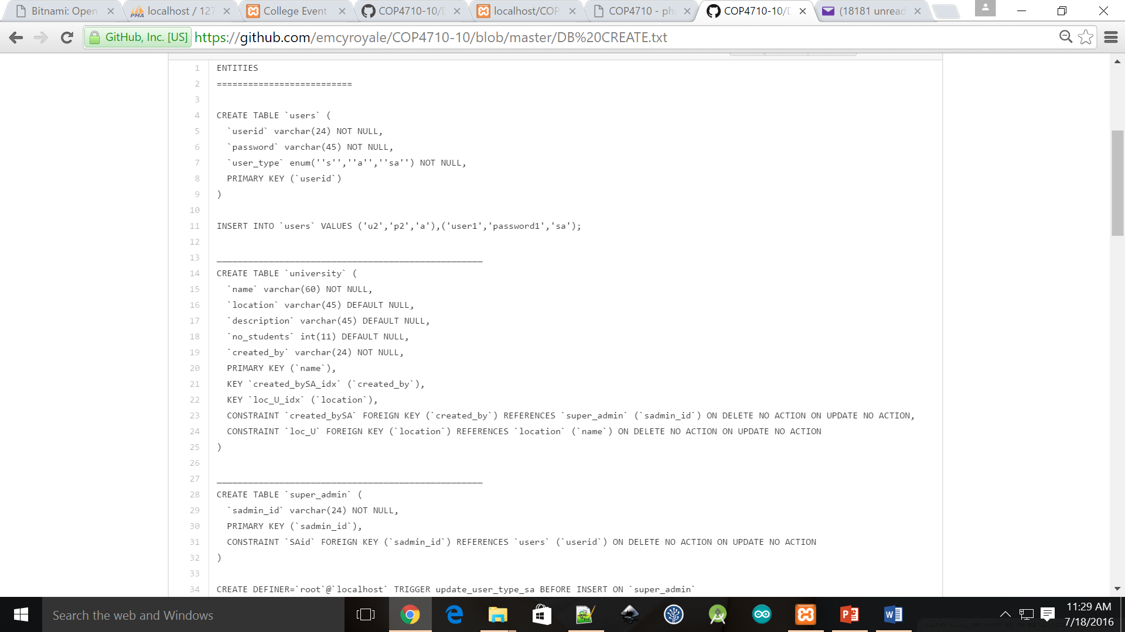
DB Tables

Slide 5
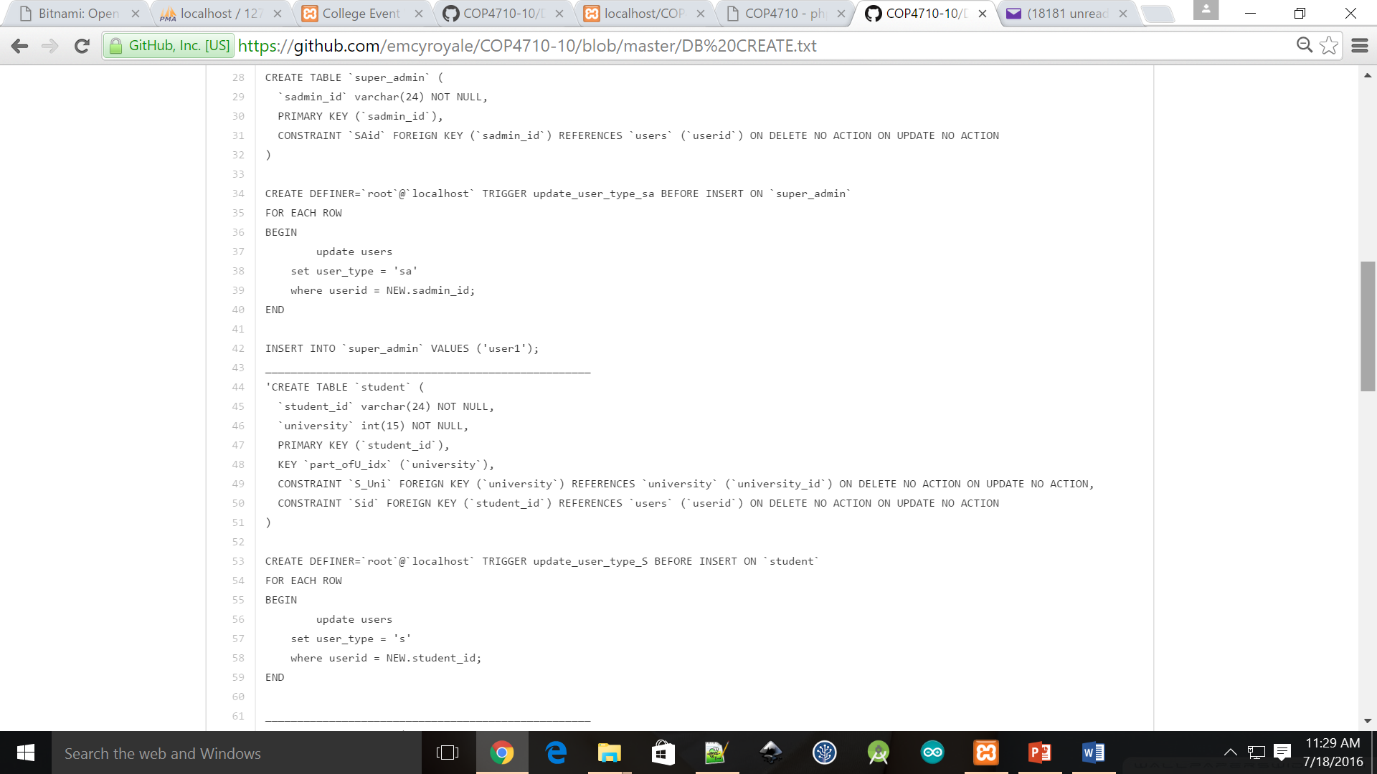
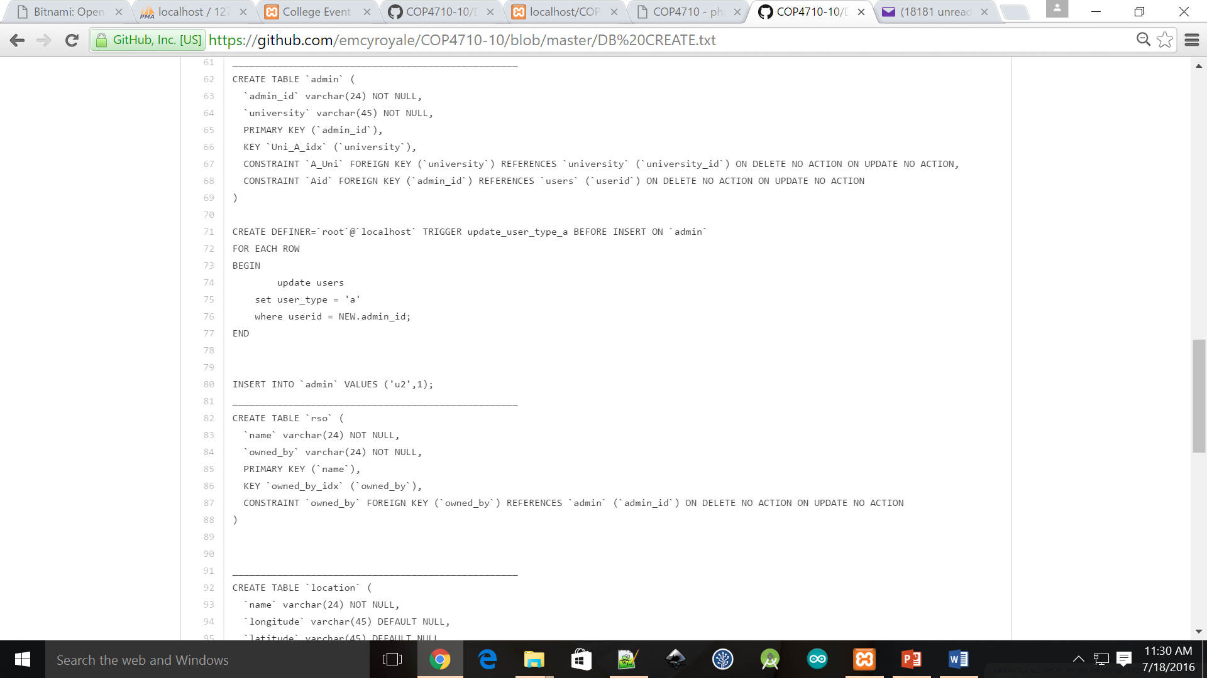
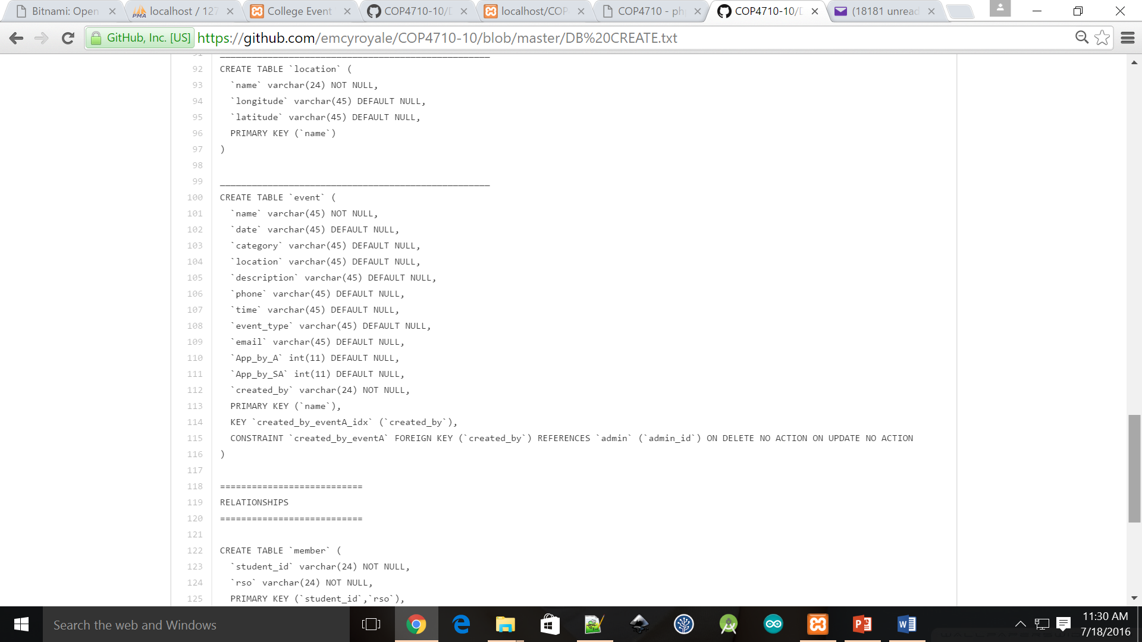

Slide 6
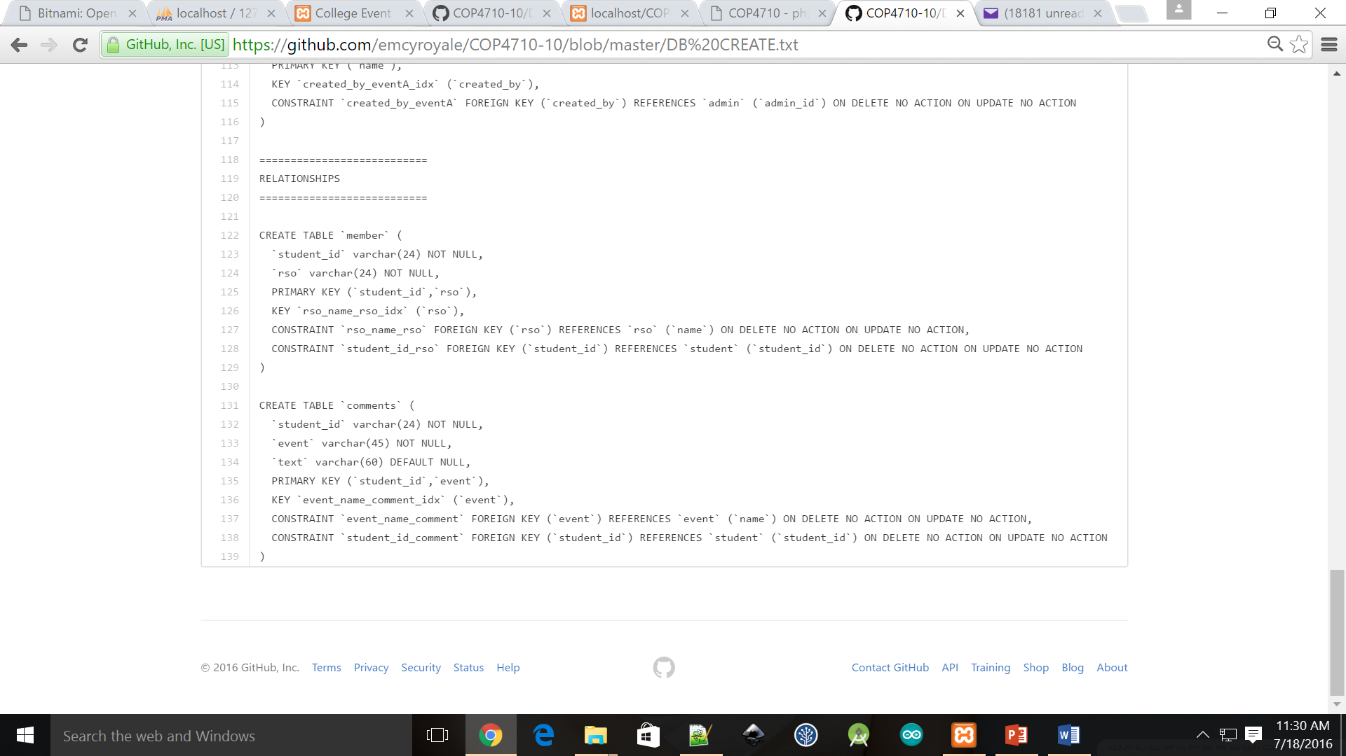

Slide 7
Questions?

