Slide 1
College Event Website
Group 10
By: Corey Holsey, Troyle Thomas, Navid Fanian

Slide 2
ER Diagram

Slide 3
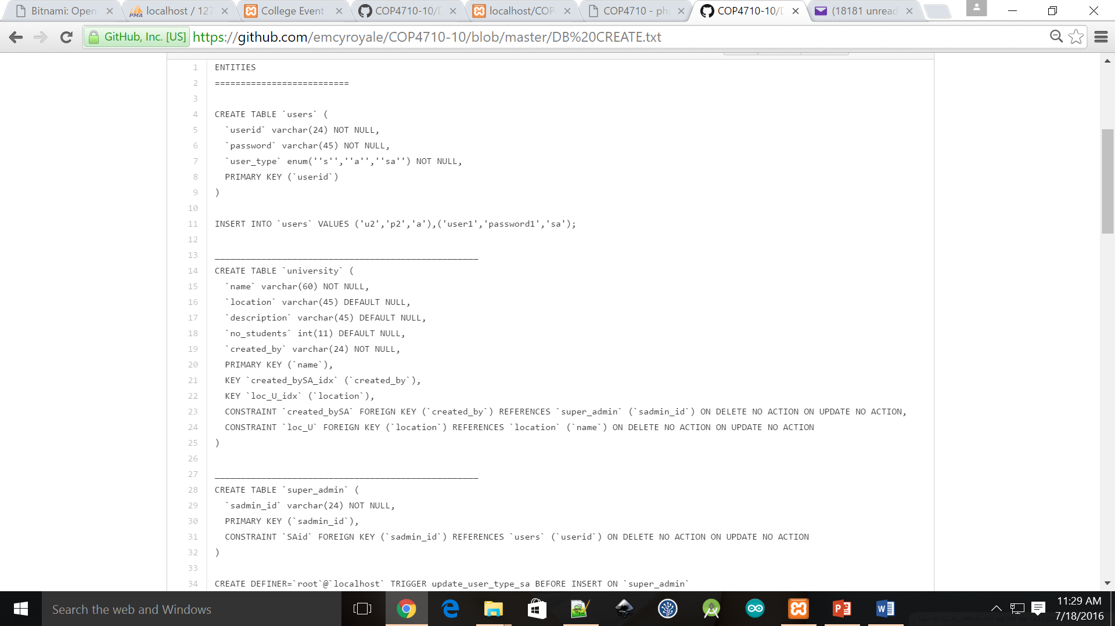
DB Tables

Slide 4
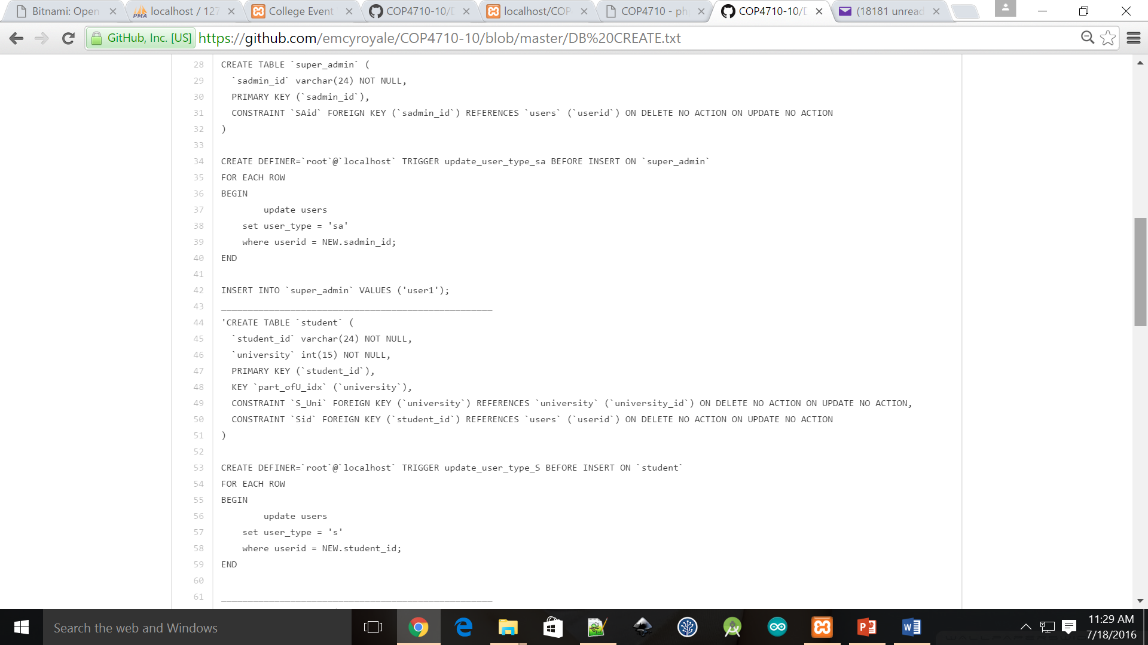
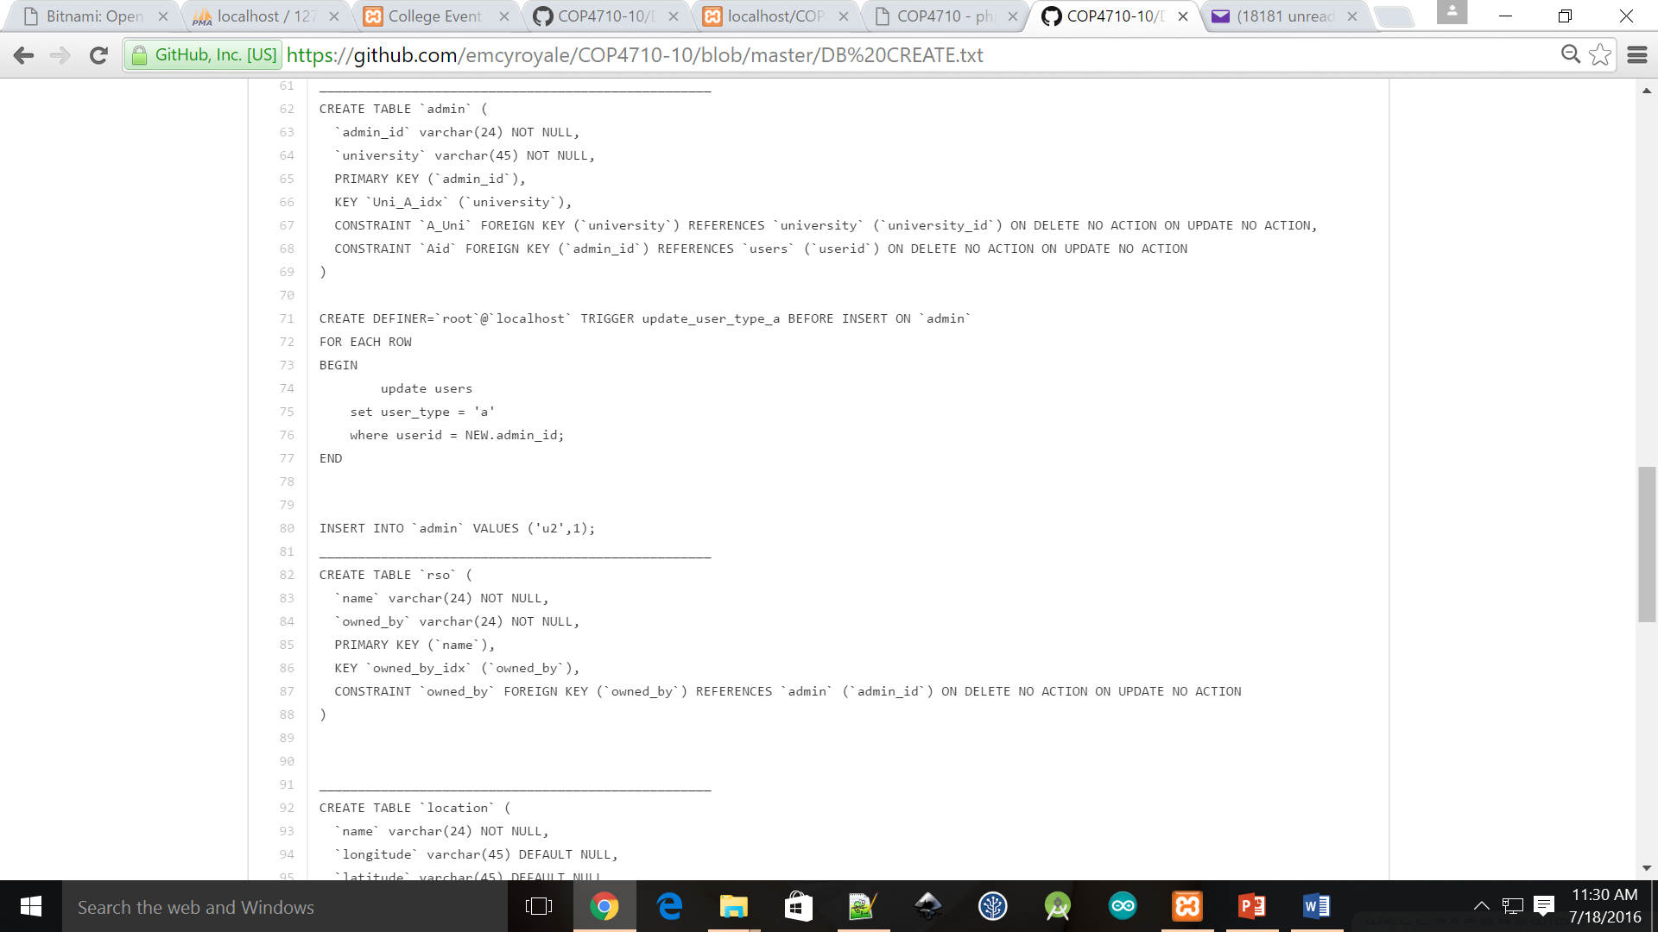
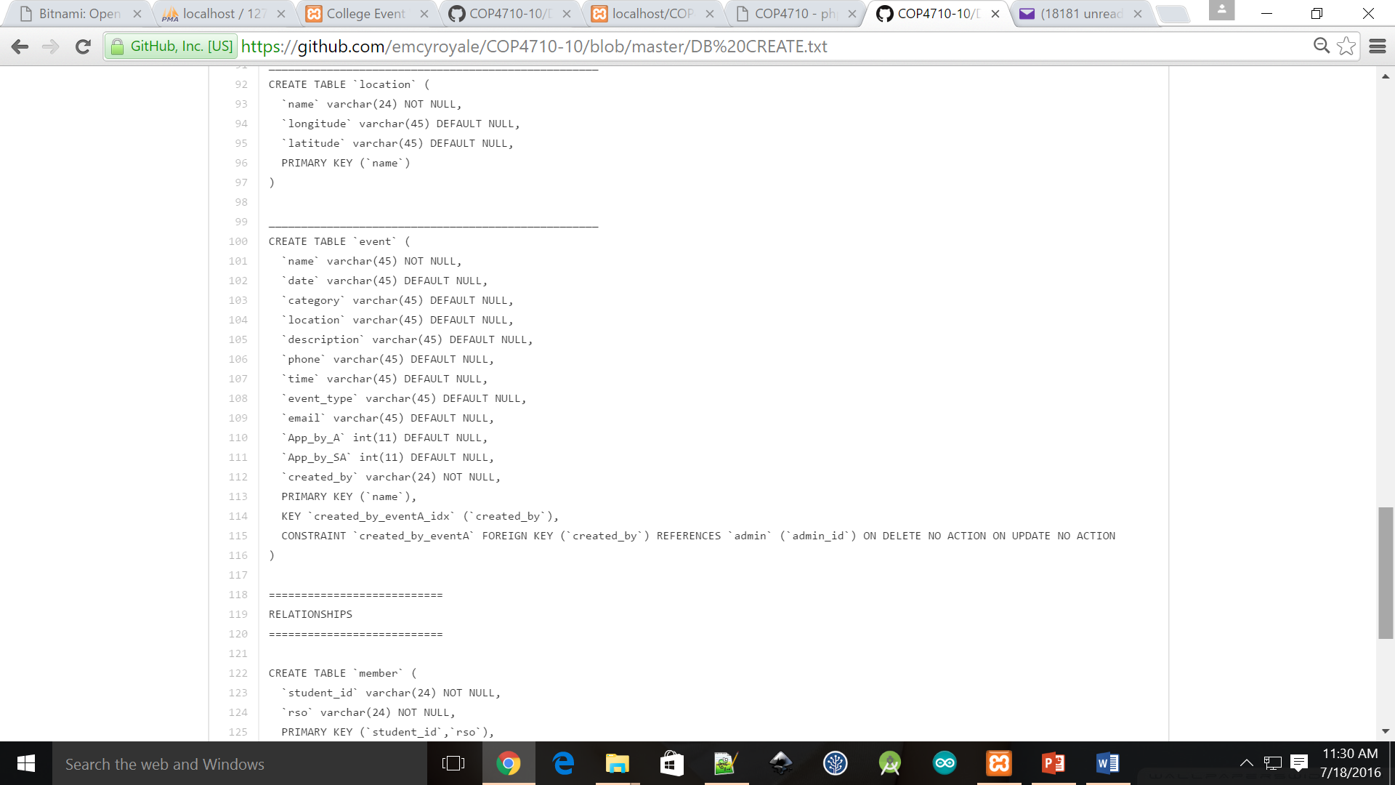

Slide 5
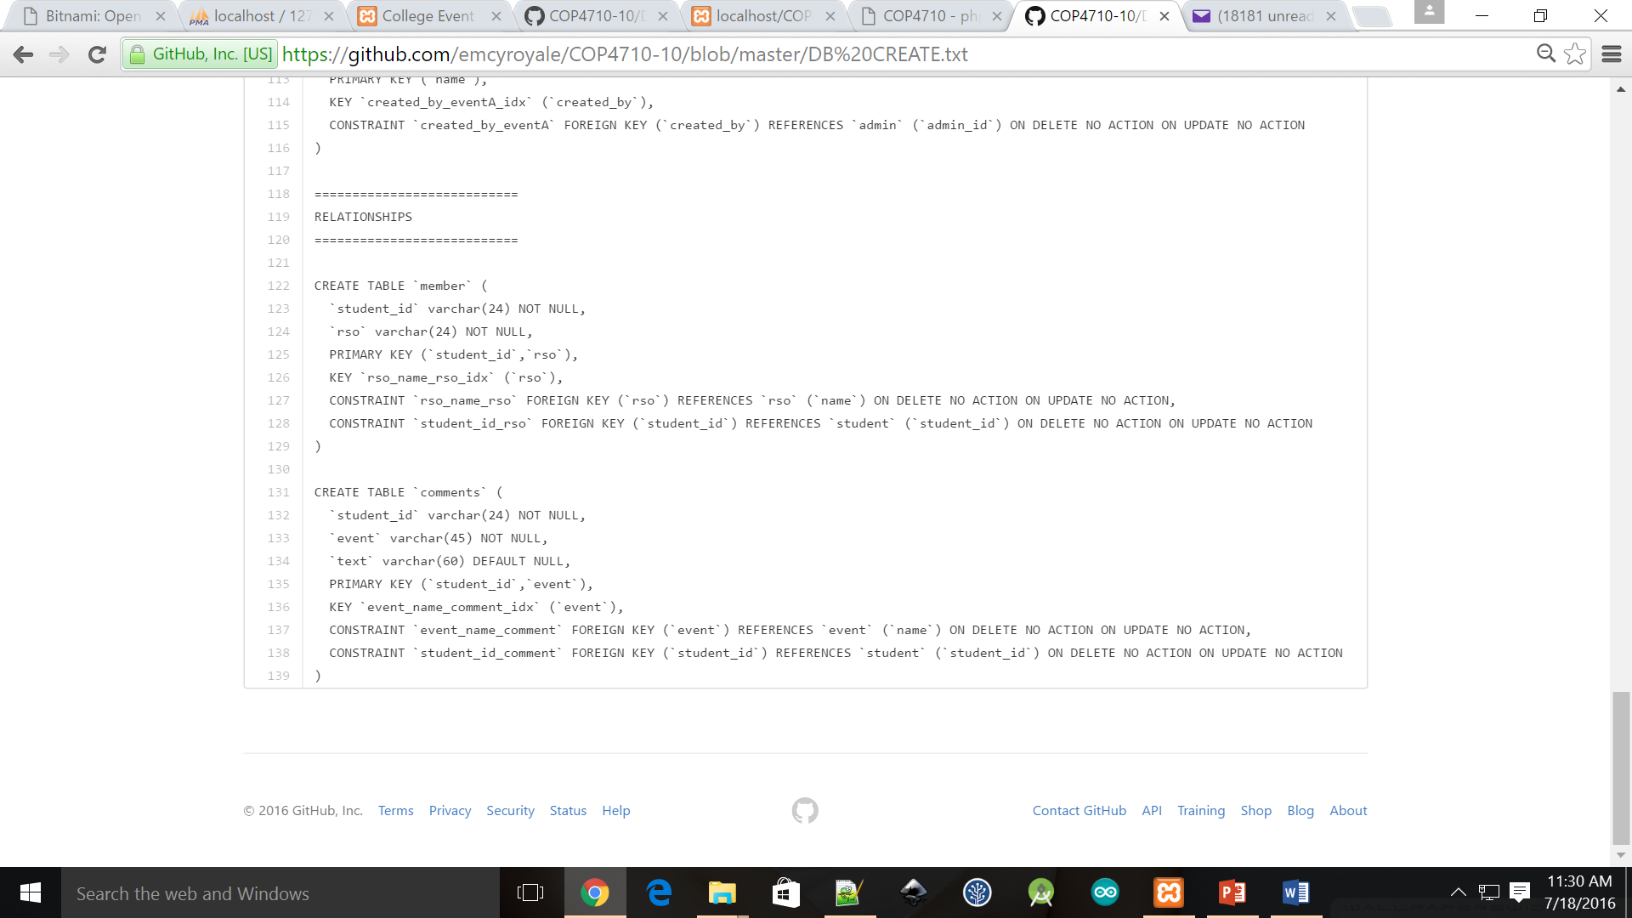

Slide 6
Questions?

