Slide 1
SPHERICAL SAMPLING
Edward John Domingo

Slide 2
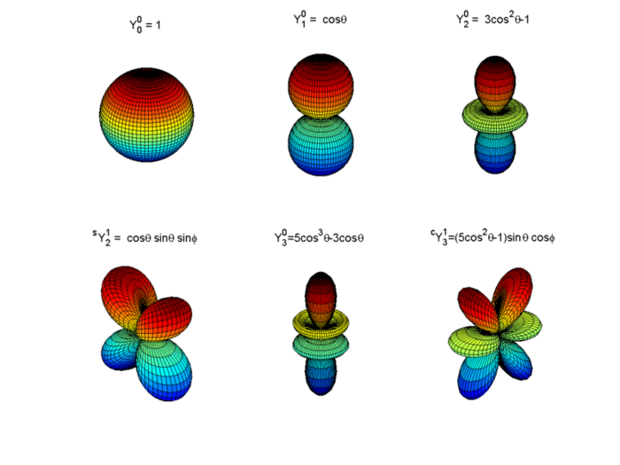
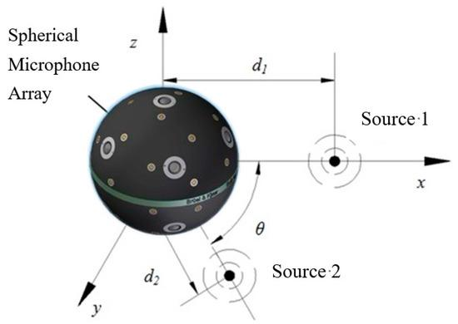
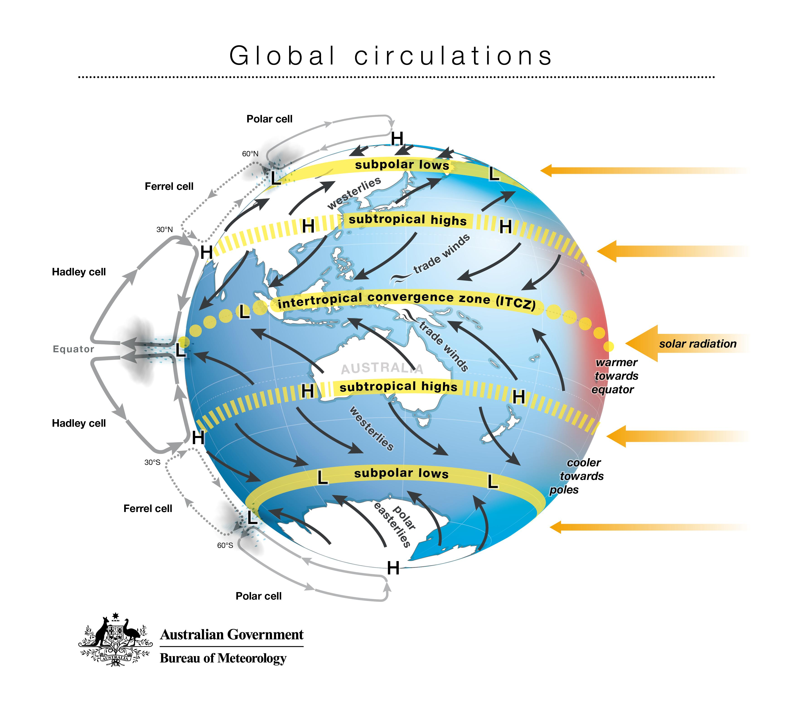
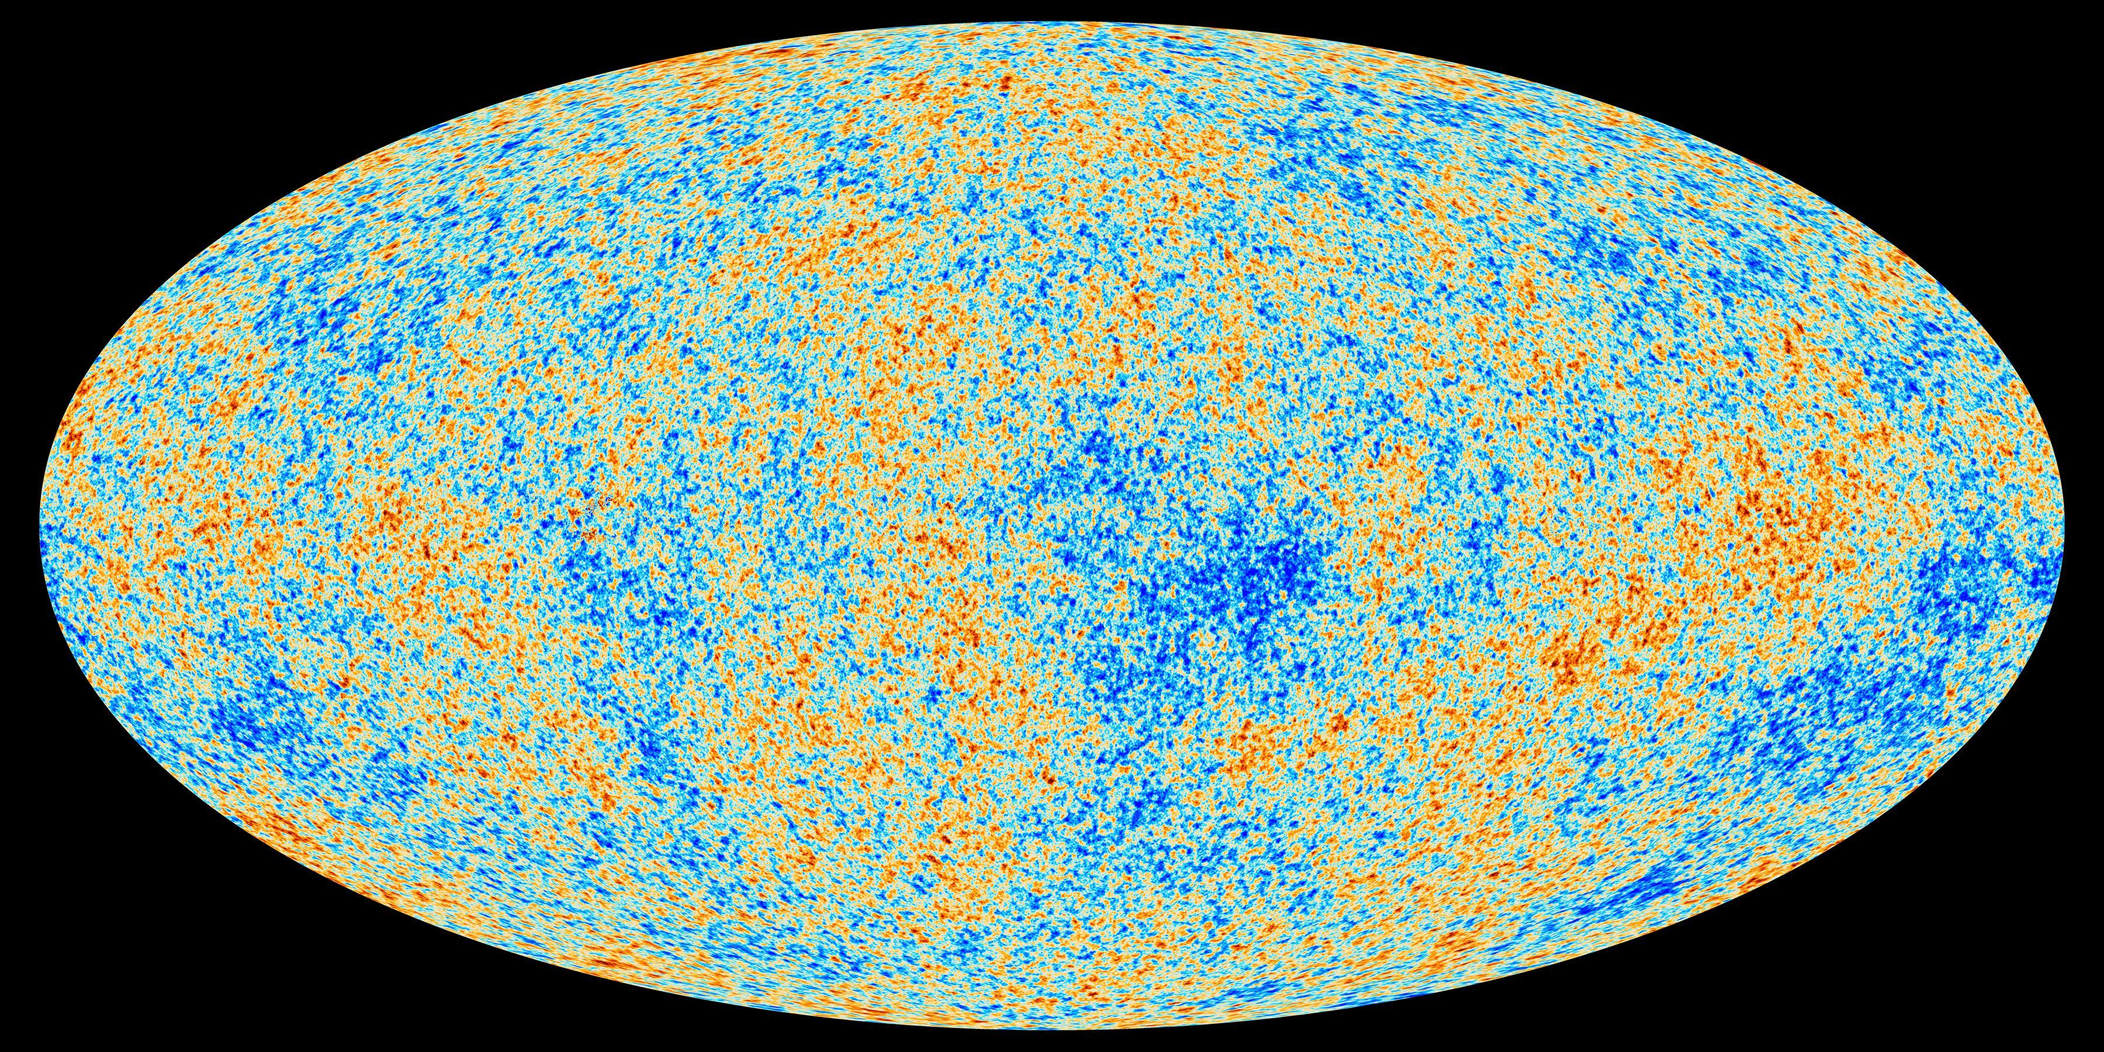
Spherical Sampling

Slide 3
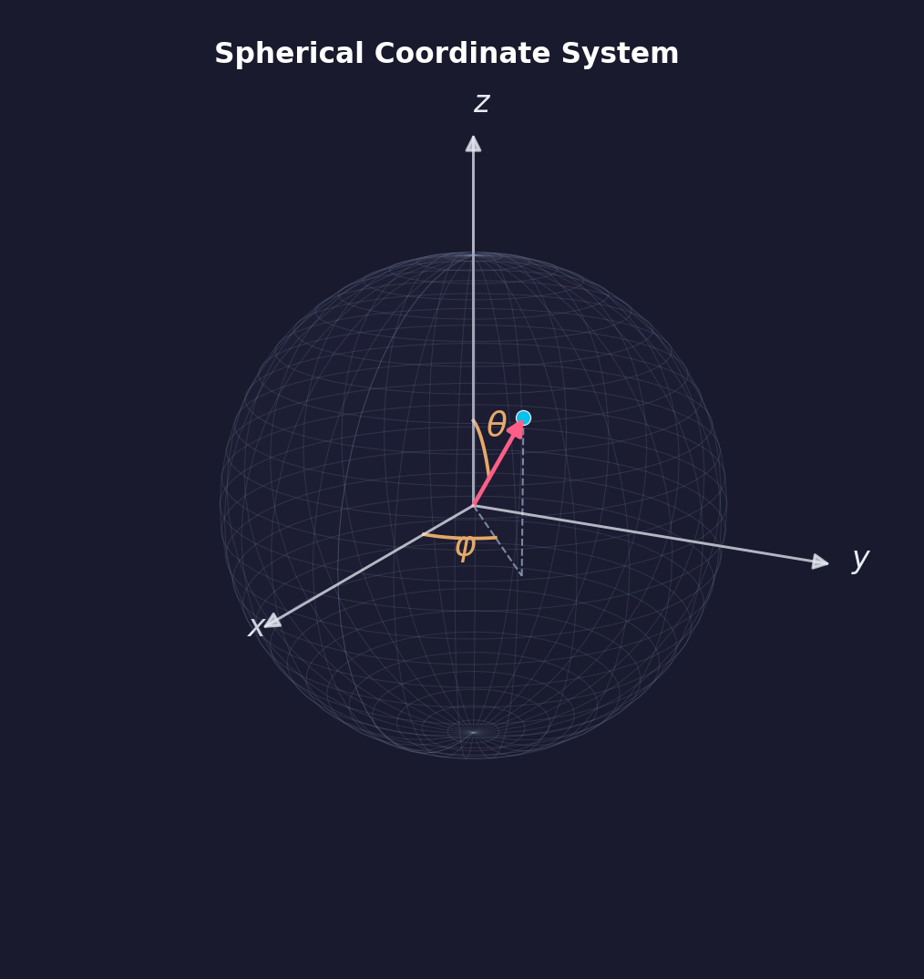
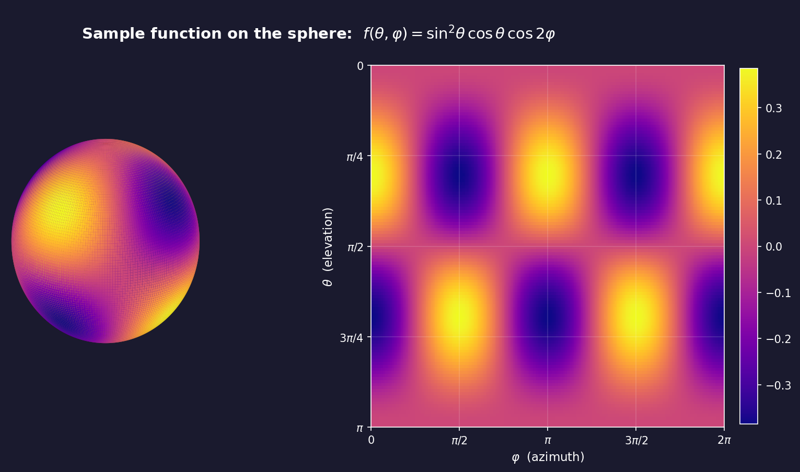



Spherical Functions
asds
Elevation/Colatitude:
Azimuth:
$$θ∈\left[0,π\right]$$
$$φ∈\left[0,2π\right]$$
$$f:S^{2}→ℝ \text{or} ℂ, f∈L^{2}\left(S^{2}\right)$$
Notes:
how do we represent and transform these functions efficiently? And to answer that, we'll borrow a very familiar idea from one dimension.

Slide 4
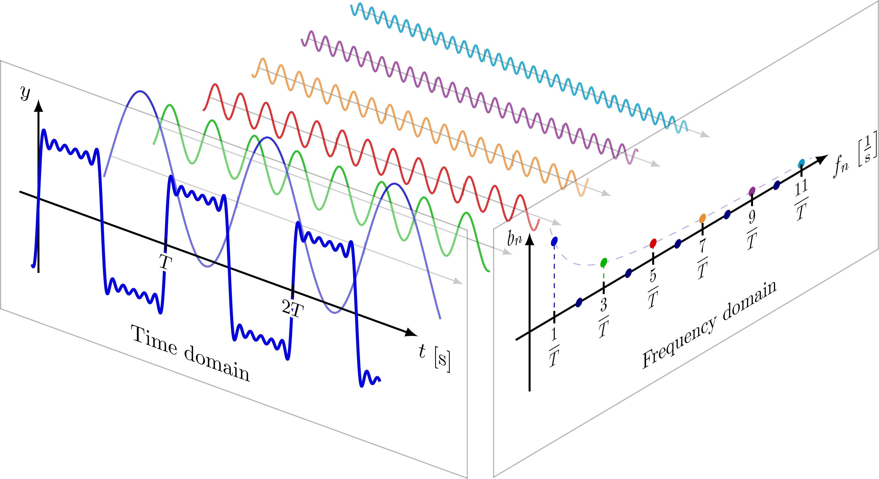
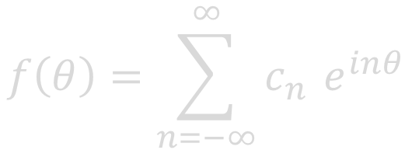
From 1D to 2D
$$f\left(θ\right)=\sum_{n=−∞}^{∞}{c_{n}} e^{inθ}$$
Fourier Series Decomposition
of a 1D Signal
Decomposing a periodic signal (Source: Neutelings, I., “Fourier series & synthesis,” TikZ.net).
Notes:
Motivation: Show the familiar 1D format
"Just as any periodic 1D signal can be broken down into a sum of simple sines and cosines — each weighted by a coefficient — the same idea extends to the sphere. Instead of complex exponentials indexed by a single frequency, we use spherical harmonics indexed by degree and order. The coefficients play the same role: they tell you how much of each 'frequency shape' is present in your signal."

Slide 5
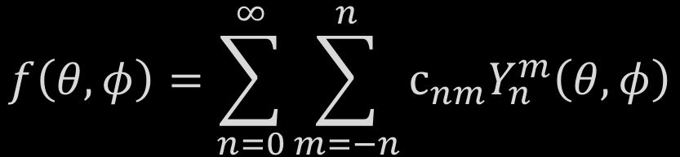
From 1D to 2D
$$f\left(θ\right)=\sum_{n=−∞}^{∞}{c_{n}} e^{inθ}$$
$$f\left(θ,φ\right)=\sum_{n=0}^{∞}{\sum_{m=−n}^{n}{c_{nm}Y_{n}^{m}\left(θ,φ\right)}}$$
Fourier Series Decomposition
of a 1D Signal
Spherical Harmonic Decomposition
of a Function on the Sphere
Notes:
spherical harmonics are to the sphere what complex exponentials are to the circle

Slide 6
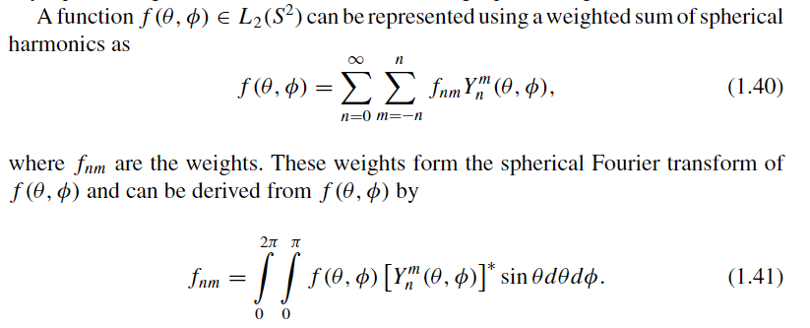

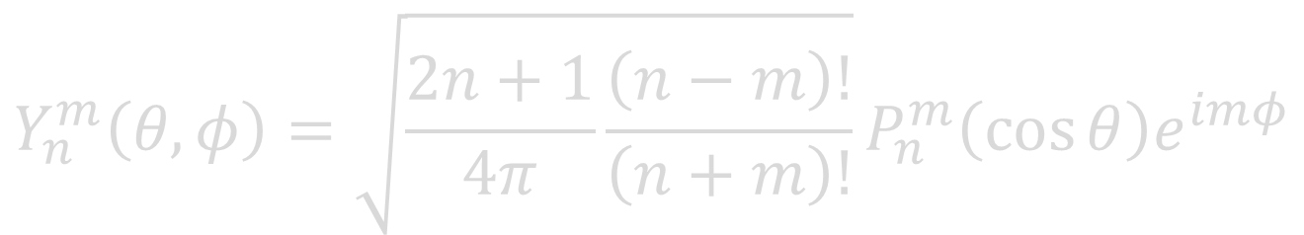
Spherical Harmonics
$$Y_{n}^{m}\left(θ,φ\right)=\sqrt{\frac{2n+1}{4π}\frac{\left(n−m\right)!}{\left(n+m\right)!}}P_{n}^{m}\left(\cos{θ}\right)e^{imφ}$$

Slide 7
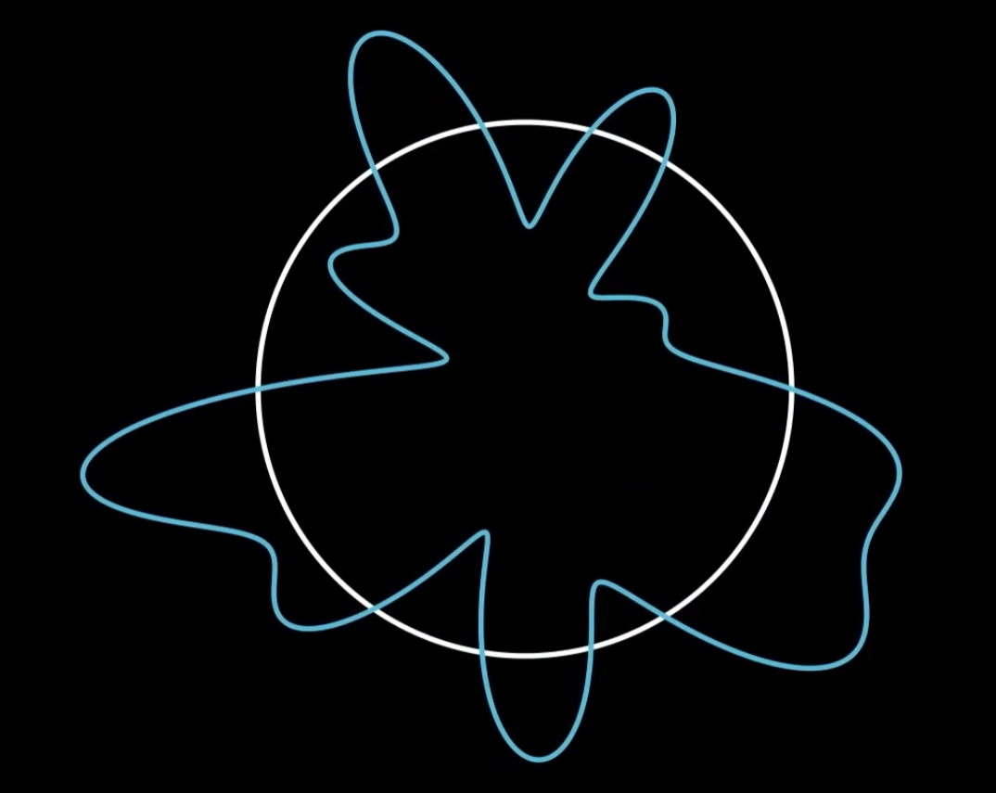
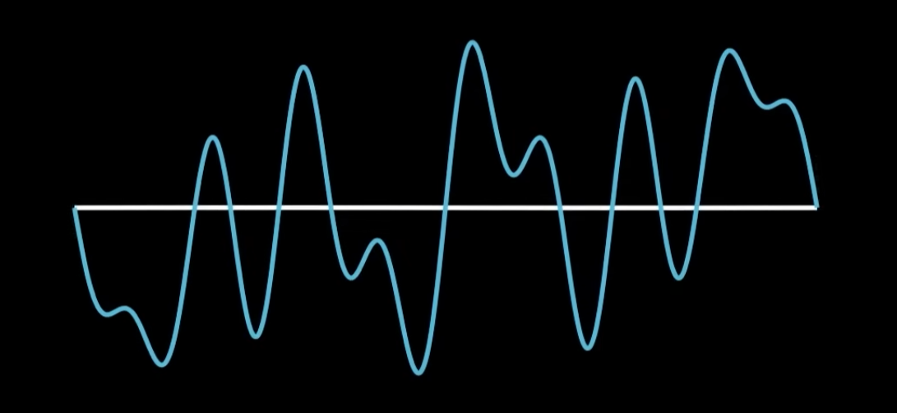
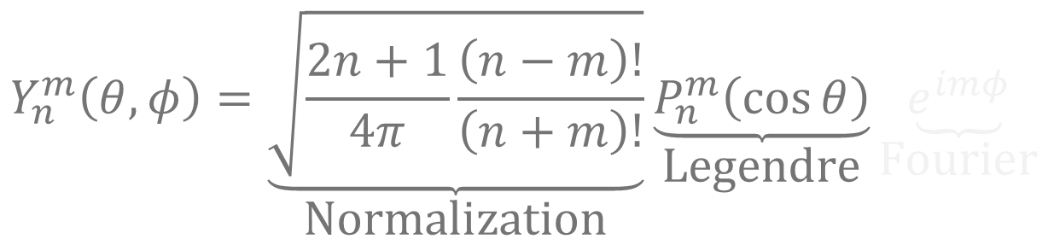
The Complex Exponential
$$Y_{n}^{m}\left(θ,φ\right)=\underset{\text{Normalization}}{\underbrace{\sqrt{\frac{2n+1}{4π}\frac{\left(n−m\right)!}{\left(n+m\right)!}}}}\underset{\text{Legendre}}{\underbrace{P_{n}^{m}\left(\cos{θ}\right)}}\underset{\text{Fourier}}{\underbrace{e^{imφ}}}$$
$$e^{imφ}=\cos\left(mφ\right)+i\sin\left(mφ\right)$$
Notes:
handling the azimuthal direction. The order m handles how many oscillations occur as we go through the equator.

Slide 8
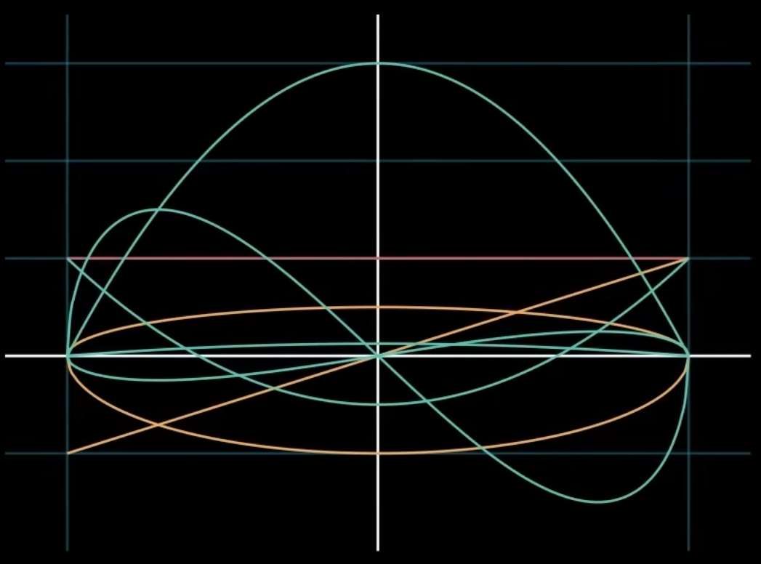

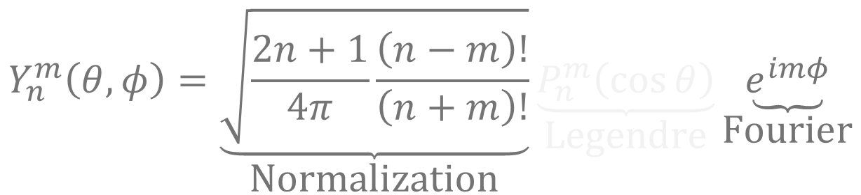
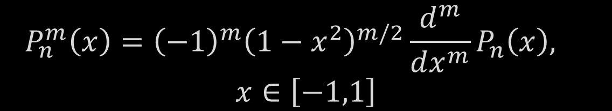
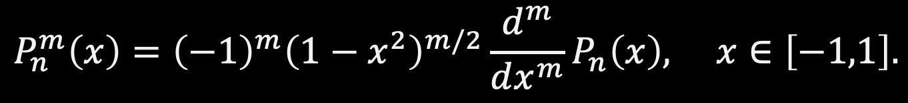
The Associated Legendre Polynomials
$$Y_{n}^{m}\left(θ,φ\right)=\underset{\text{Normalization}}{\underbrace{\sqrt{\frac{2n+1}{4π}\frac{\left(n−m\right)!}{\left(n+m\right)!}}}}\underset{\text{Legendre}}{\underbrace{P_{n}^{m}\left(\cos{θ}\right)}}\underset{\text{Fourier}}{\underbrace{e^{imφ}}}$$
$$P_{n}^{m}\left(x\right)={\left(−1\right)}^{m}{\left(1−x^{2}\right)}^{m/2}\frac{d^{m}}{dx^{m}}P_{n}\left(x\right), x∈\left[−1,1\right].$$
$$P_{n}^{m}\left(x\right)={\left(−1\right)}^{m}{\left(1−x^{2}\right)}^{m/2}\frac{d^{m}}{dx^{m}}P_{n}\left(x\right),$$
$$x∈\left[−1,1\right]$$
Notes:
These handle the colatitudinal direction — they control how the function varies from pole to equator.

Slide 9
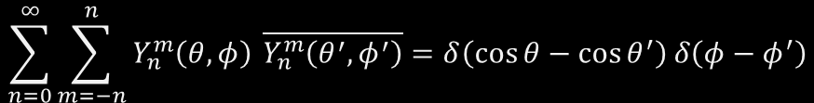
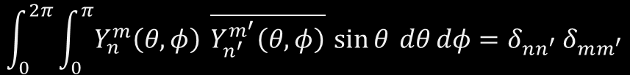
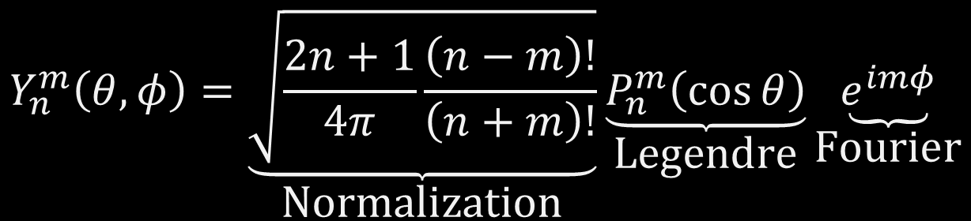
Spherical Harmonics
$$Y_{n}^{m}\left(θ,φ\right)=\underset{\text{Normalization}}{\underbrace{\sqrt{\frac{2n+1}{4π}\frac{\left(n−m\right)!}{\left(n+m\right)!}}}}\underset{\text{Legendre}}{\underbrace{P_{n}^{m}\left(\cos{θ}\right)}}\underset{\text{Fourier}}{\underbrace{e^{imφ}}}$$
Orthogonal:
Complete:
$$\int_{0}^{2π}{\int_{0}^{π}{Y_{n}^{m}\left(θ,φ\right)}} \overline{Y_{n^{′}}^{m^{′}}\left(θ,φ\right)} \sin{θ} dθ dφ=δ_{nn^{′}} δ_{mm^{′}}$$
$$\sum_{n=0}^{∞}{\sum_{m=−n}^{n}{Y_{n}^{m}\left(θ,φ\right)}} \overline{Y_{n}^{m}\left(θ^{′},φ^{′}\right)}=δ\left(\cos{θ}−\cos{θ^{′}}\right) δ\left(φ−φ^{′}\right)$$
Notes:
The Spherical Harmonics forms the orthonormal and complete basis for functions that live on the sphere
Assoc Legendre Functions for n = 0, 1, and 2

Slide 10
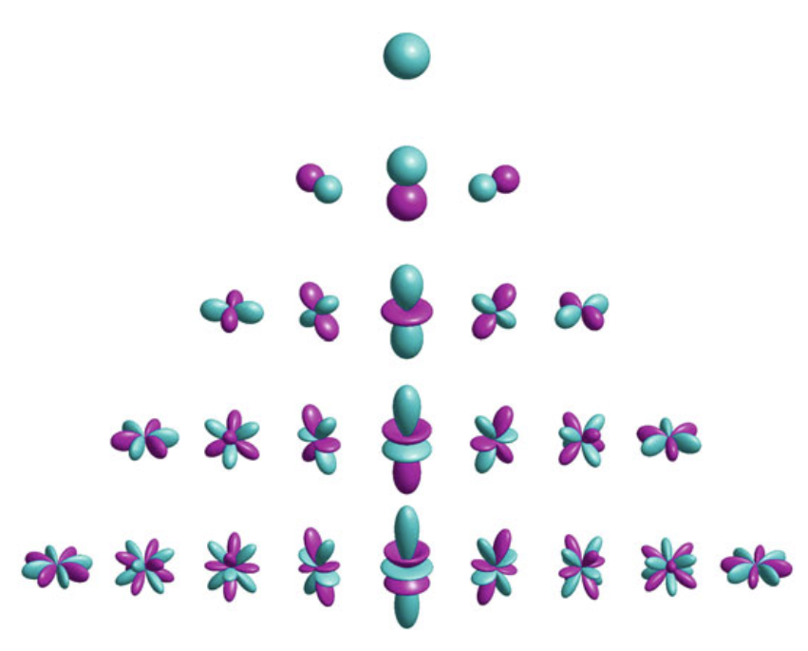
Spherical Harmonics Pyramid
$$Y_{n}^{m}\left(θ,φ\right), n=0,1,2,…, m=−n,…,n$$
0
Y₀⁰
1
Y₁⁻¹
Y₁⁰
Y₁¹
degree n
2
Y₂⁻²
Y₂⁻¹
Y₂⁰
Y₂¹
Y₂²
3
Y₃⁻³
Y₃⁻²
Y₃⁻¹
Y₃⁰
Y₃¹
Y₃²
Y₃³
▼
−3
−2
−1
0
1
2
3
order m
Notes:
As we go down this pyramid, we increase the number of terms by 2N+1 so for a degree N we get a total number of terms

Slide 11
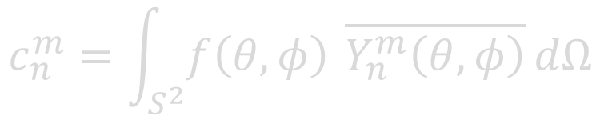


Forward and Inverse SHT
Forward SHT:
$$c_{n}^{m}=\int_{S^{2}}{f\left(θ,φ\right)} \overline{Y_{n}^{m}\left(θ,φ\right)} dΩ$$
$$c_{n}^{m}=\left\langle f,Y_{n}^{m}\right\rangle$$
Inverse SHT:
$$f\left(θ,φ\right)=\sum_{n=0}^{∞}{\sum_{m=−n}^{n}{c_{nm}Y_{n}^{m}\left(θ,φ\right)}}$$
Notes:
What happens when we only have access to the function at a finite number of sample points?
The forward SHT takes a spherical function $f\left(θ , φ\right)$and computes its spectral coefficients $f_{n}^{m}$via an integral of the function multiplied by the conjugate of each spherical harmonic over the sphere.

Slide 12


Bandlimited Functions
For a function bandlimited to degree N:
0
Y₀⁰
$$c_{n}^{m}=0 \text{for} n>N$$
1
Y₁⁻¹
Y₁⁰
Y₁¹
degree n
2
Y₂⁻²
Y₂⁻¹
Y₂⁰
Y₂¹
Y₂²
$${number of coefficients: (N+1)}^{2}$$
3
0
0
0
0
0
0
0
▼
−3
−2
−1
0
1
2
3
order m
Example: Function bandlimited to degree 2
Notes:
Thus for a band limited function of degree N, we only deal with X coefficients.

Slide 13
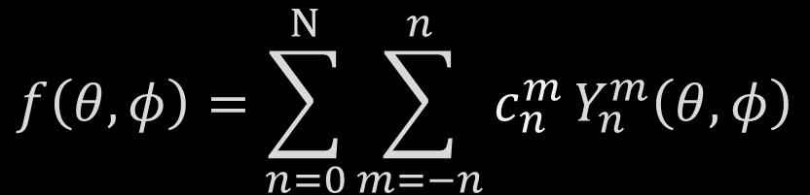
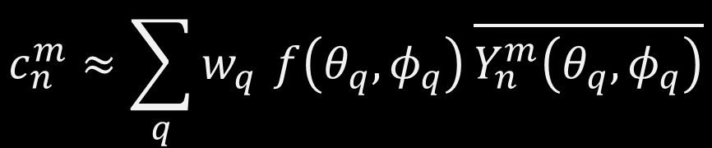
Discrete Spherical Harmonic Transform
$$f\left(θ,φ\right)=\sum_{n=0}^{N}{\sum_{m=−n}^{n}{c_{n}^{m }Y_{n}^{m}\left(θ,φ\right)}}$$
$$c_{n}^{m}≈\sum_{q}{w_{q}} f\left(θ_{q},φ_{q}\right) \overline{Y_{n}^{m}\left(θ_{q},φ_{q}\right)}$$
How do we choose sample points and weights so that the discrete SHT is accurate or exact for bandlimited functions?
Notes:
Instead of integrating over the entire sphere, we approximate that integral as a weighted sum over a finite set of sample points.

Slide 14
Spherical Sampling Schemes
Determines where and how we weight each of the samples
Sampling affects:
  Exactness
  Implementation complexity
  Computational efficiency and cost
  Numerical stability
Notes:
There are multiple ways to discretize the sphere.

Slide 15
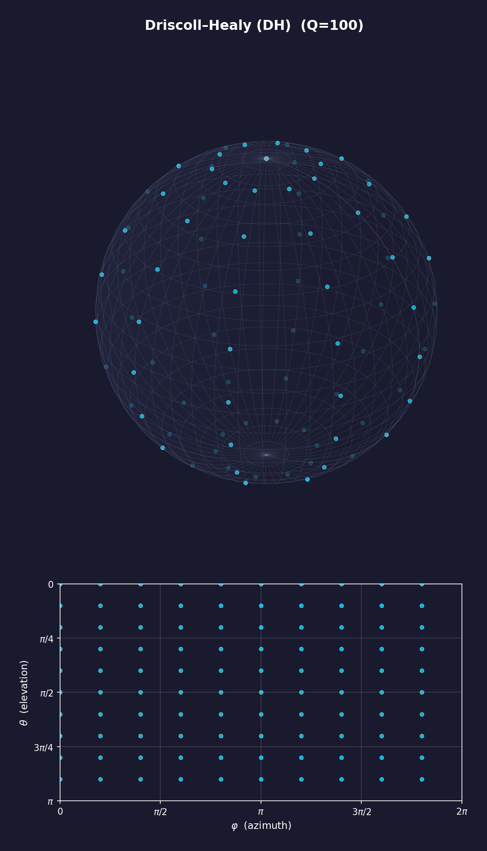
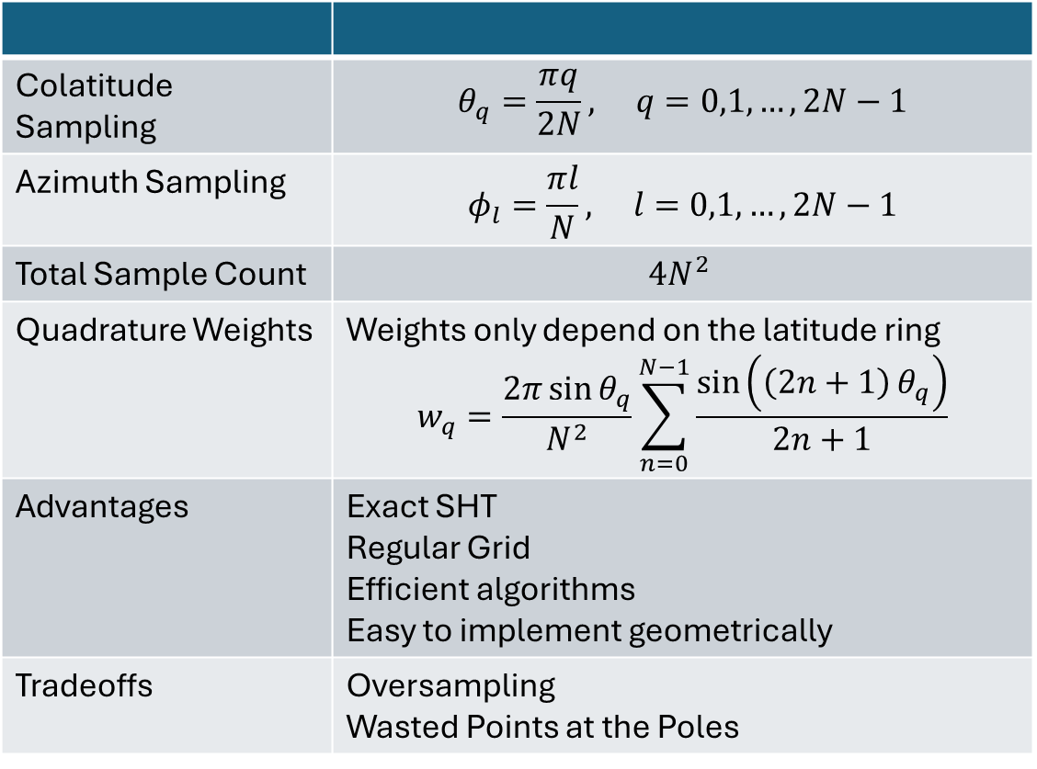
Driscoll-Healy
Equiangular Grid, Symmetric Spacing
Q = 100 for N = 5
Colatitude Sampling | $$θ_{q}=\frac{πq}{2N}, q=0,1,…,2N−1$$
Azimuth Sampling | $$φ_{l}=\frac{πl}{N}, l=0,1,…,2N−1$$
Total Sample Count | $$4N^{2}$$
Quadrature Weights | Weights only depend on the latitude ring $$w_{q}=\frac{2π\sin{θ_{q}}}{N^{2}}\sum_{n=0}^{N−1}{\frac{\sin\left(\left(2n+1\right) θ_{q}\right)}{2n+1}}$$
Advantages | Exact SHT Regular Grid Efficient algorithms Easy to implement geometrically
Tradeoffs | Oversampling Wasted Points at the Poles

Slide 16
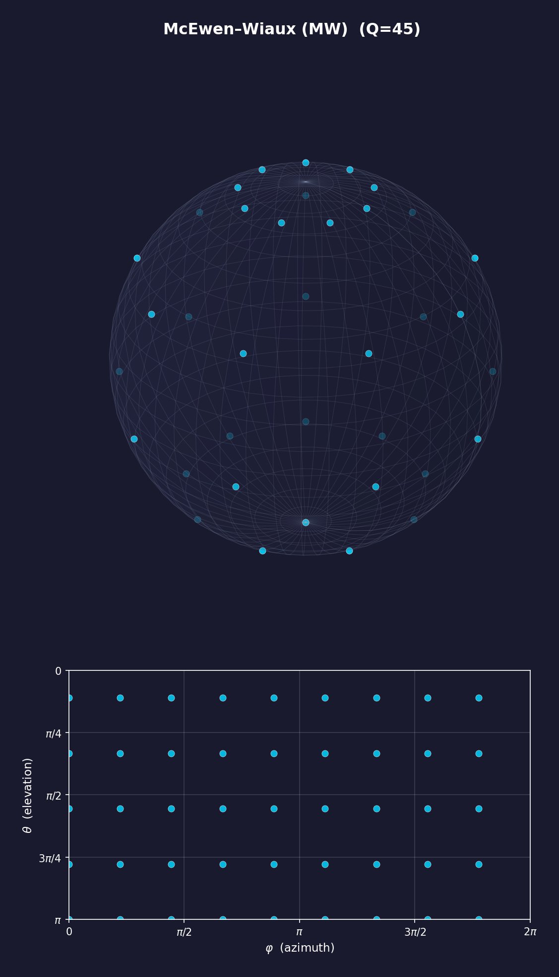
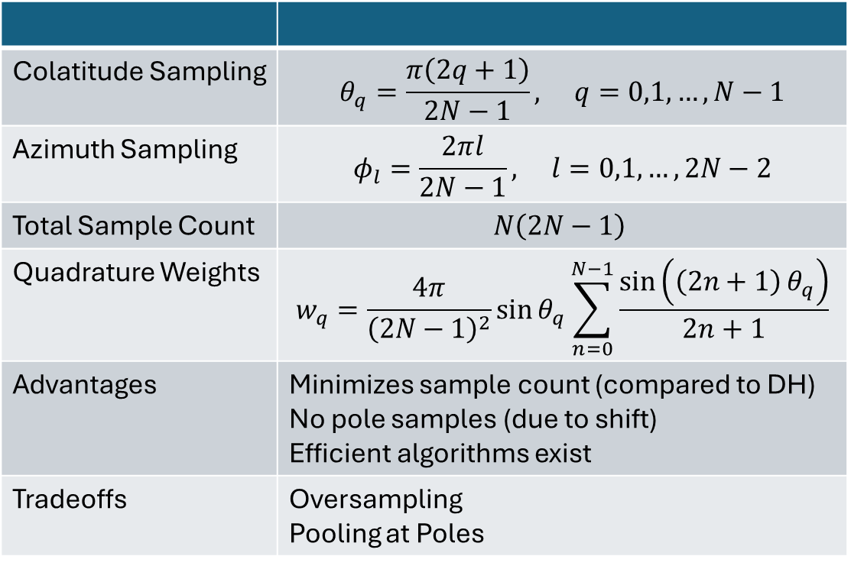
McEwen-Wiaux
Shifted poles; Minimal Sampling
Q = 45 for N = 5
Colatitude Sampling | $$θ_{q}=\frac{π\left(2q+1\right)}{2N−1}, q=0,1,…,N−1$$
Azimuth Sampling | $$φ_{l}=\frac{2πl}{2N−1}, l=0,1,…,2N−2$$
Total Sample Count | $$N\left(2N−1\right)$$
Quadrature Weights | $$w_{q}=\frac{4π}{{\left(2N−1\right)}^{2}}\sin{θ_{q}\sum_{n=0}^{N−1}{\frac{\sin\left(\left(2n+1\right) θ_{q}\right)}{2n+1}}}$$
Advantages | Minimizes sample count (compared to DH) No pole samples (due to shift) Efficient algorithms exist
Tradeoffs | Oversampling Pooling at Poles

Slide 17
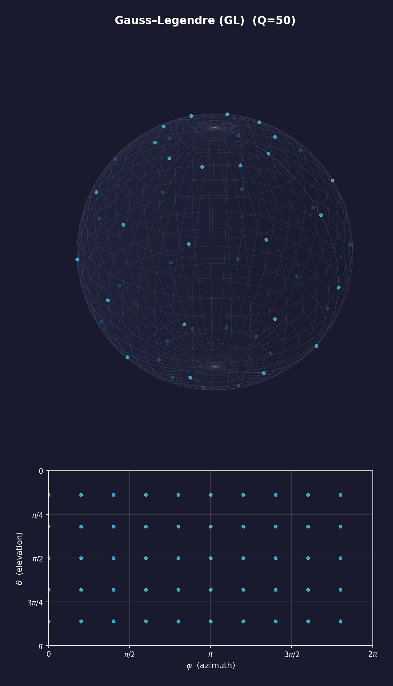
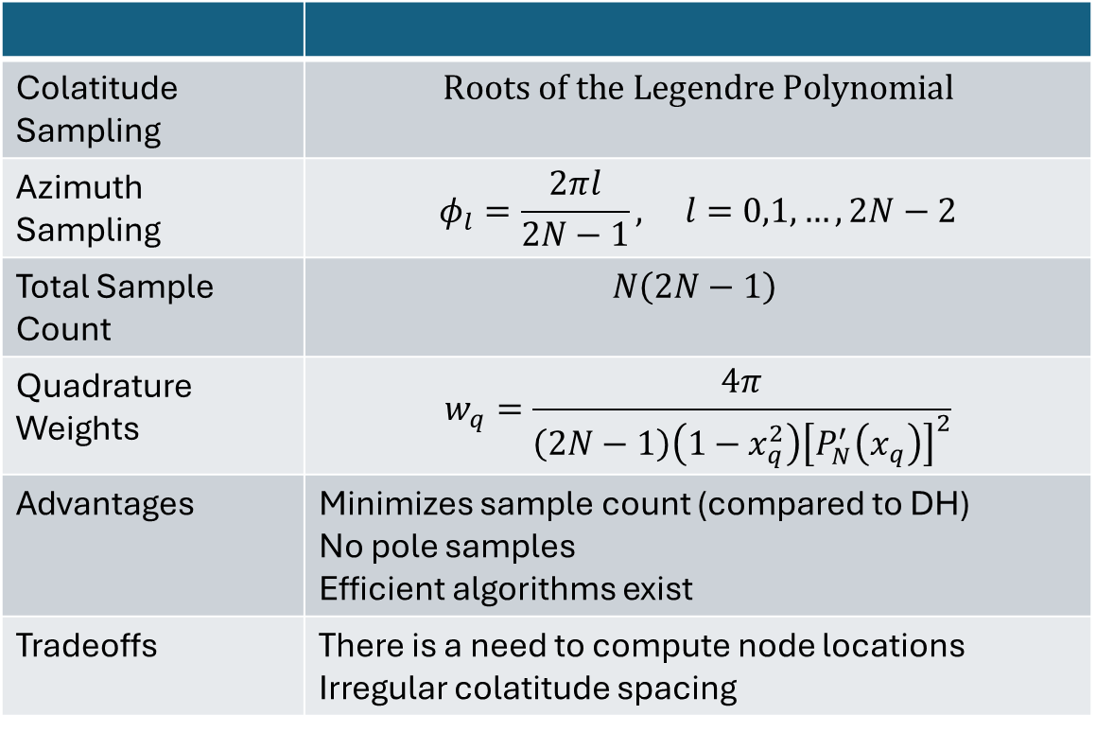
Gauss-Legendre
Q = 50 for N = 5
Colatitude Sampling | $$Roots of the Legendre Polynomial$$
Azimuth Sampling | $$φ_{l}=\frac{2πl}{2N−1}, l=0,1,…,2N−2$$
Total Sample Count | $$N\left(2N−1\right)$$
Quadrature Weights | $$w_{q}=\frac{4π}{\left(2N−1\right)\left(1−x_{q}^{2}\right){\left[P_{N}^{′}\left(x_{q}\right)\right]}^{2}}$$
Advantages | Minimizes sample count (compared to DH) No pole samples Efficient algorithms exist
Tradeoffs | There is a need to compute node locations Irregular colatitude spacing

Slide 18
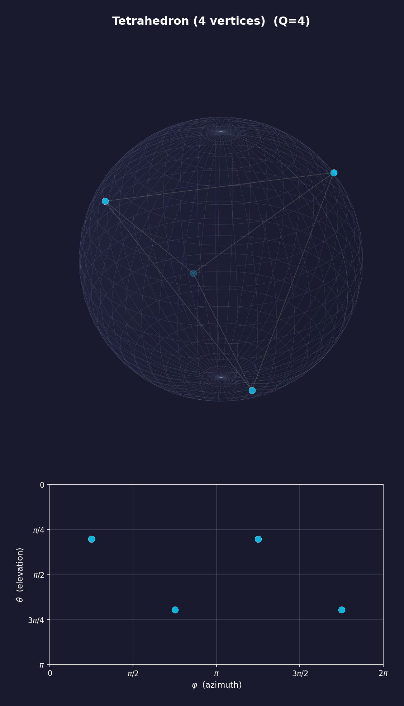
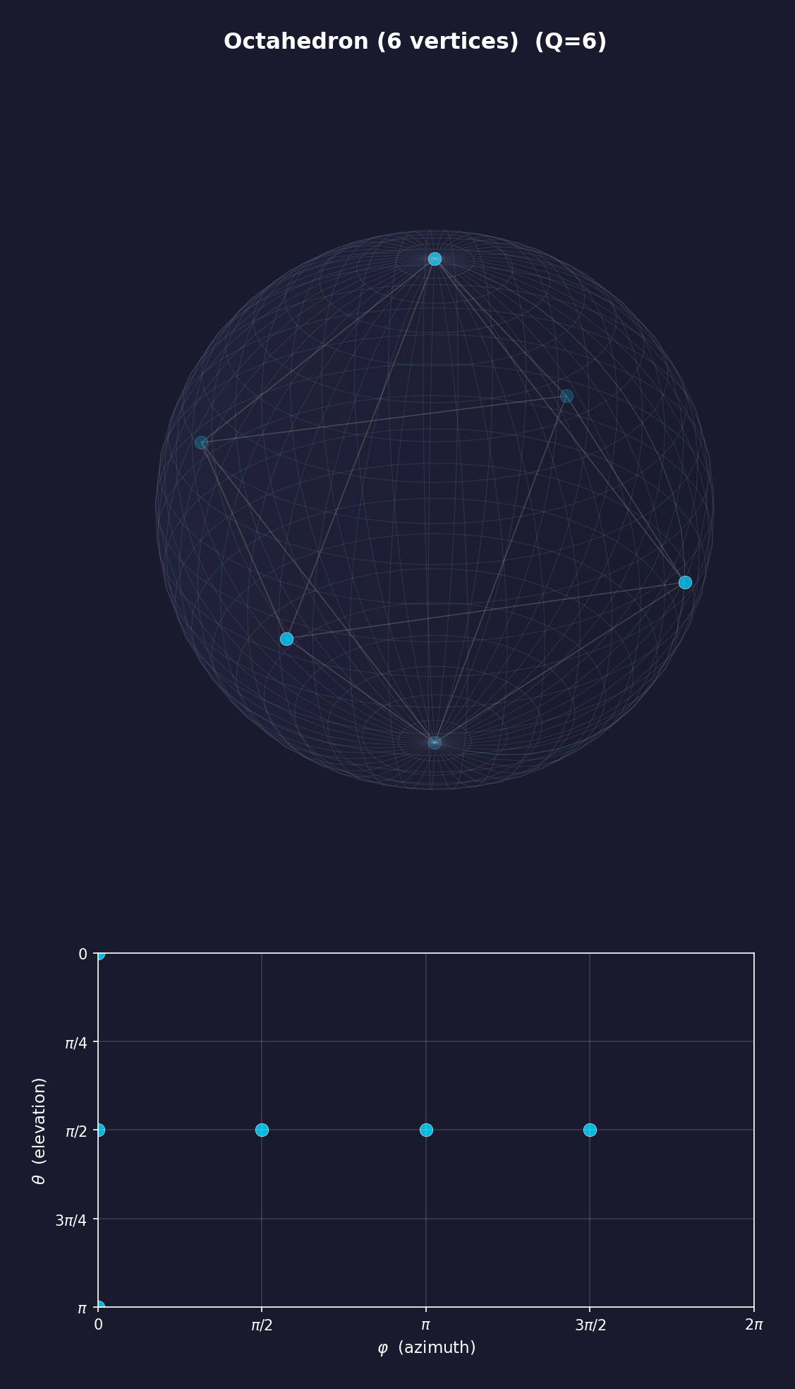
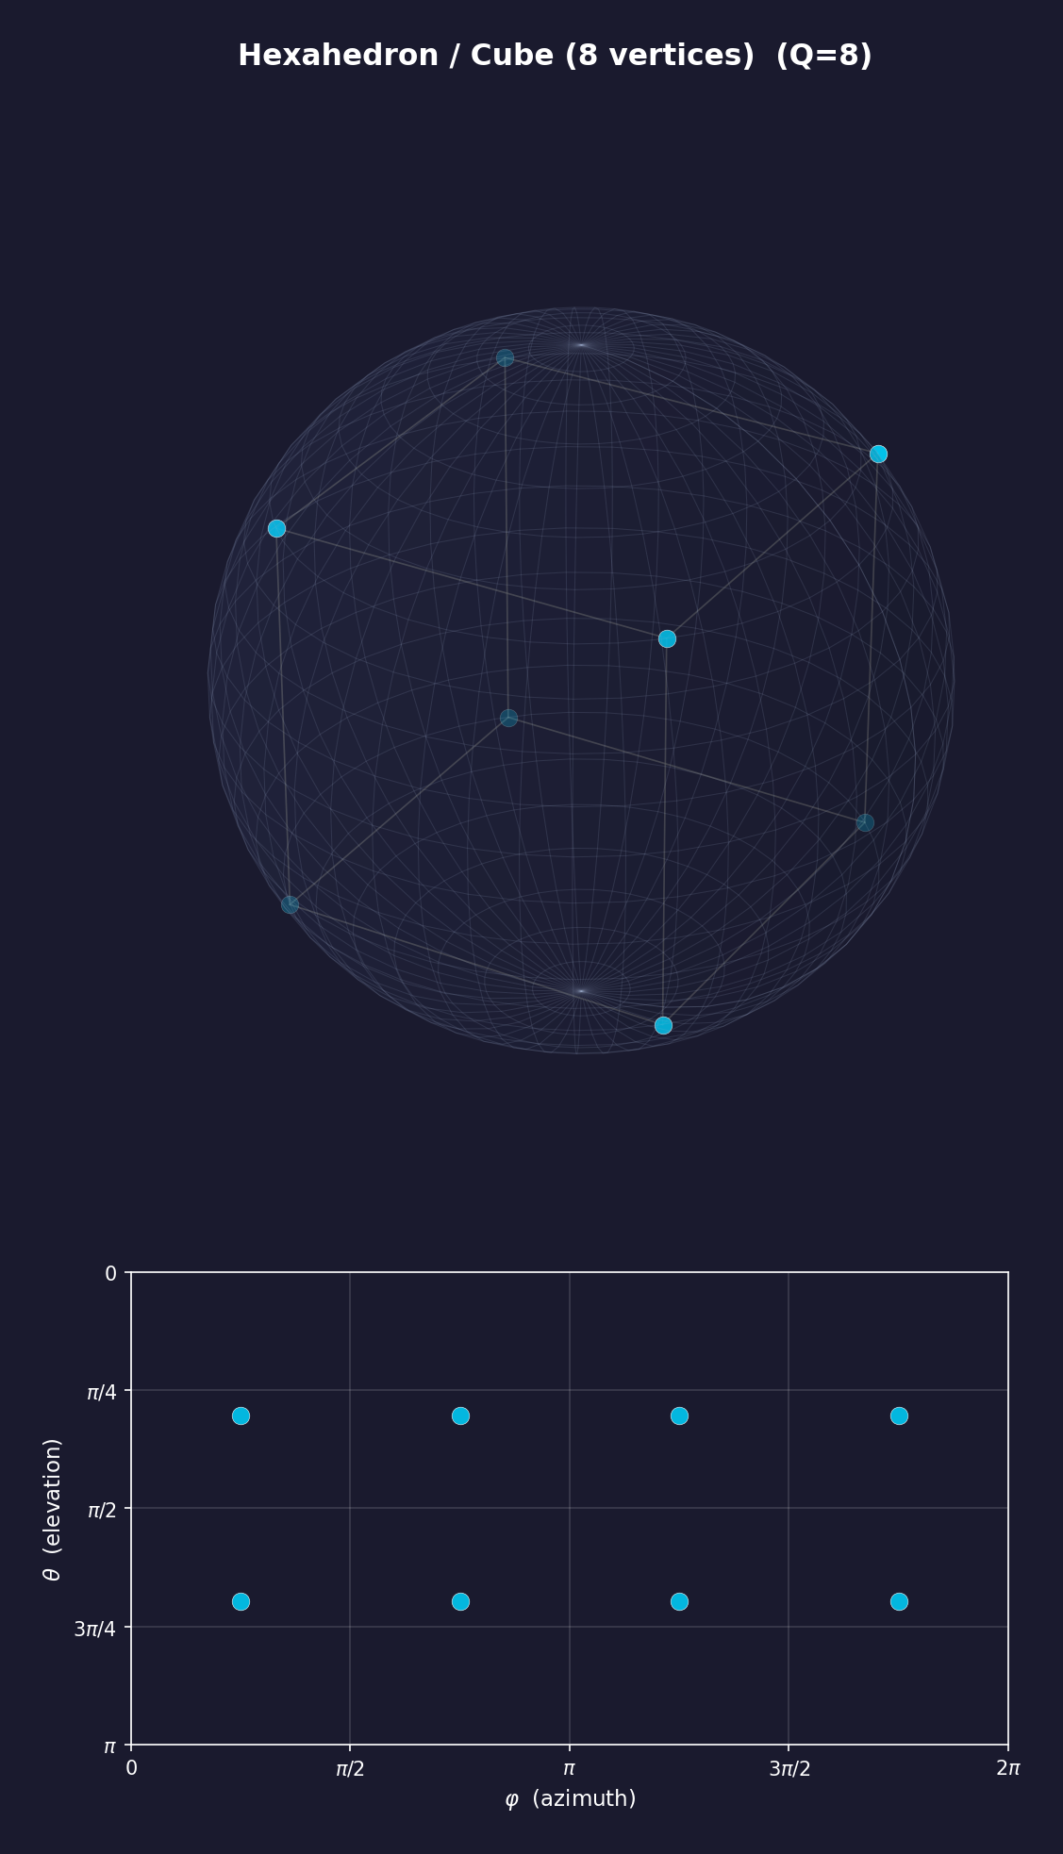
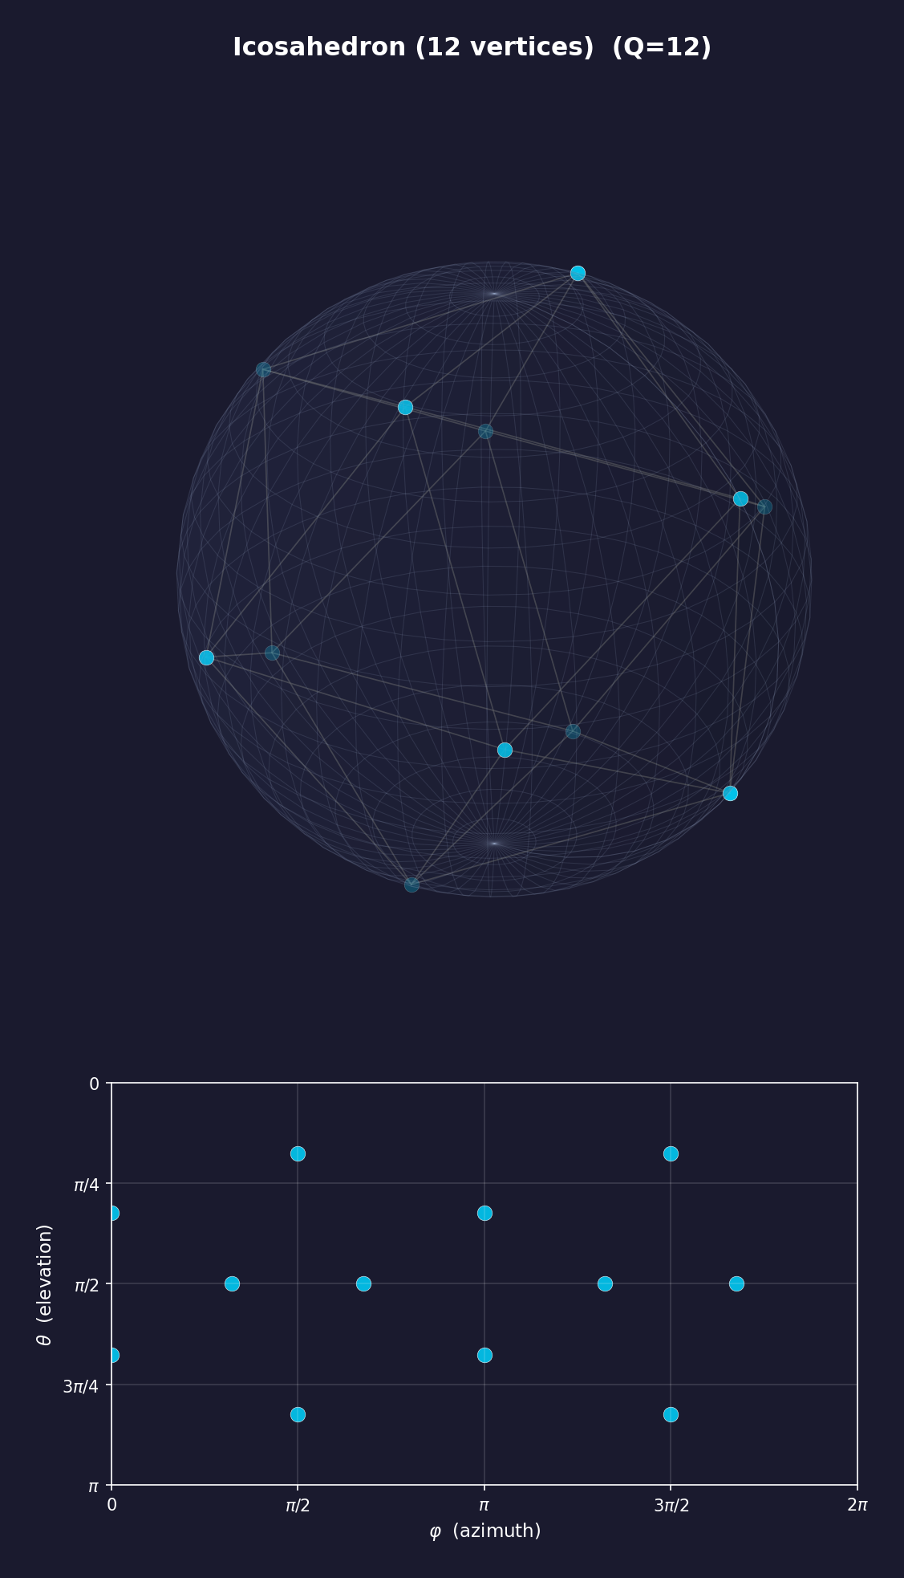
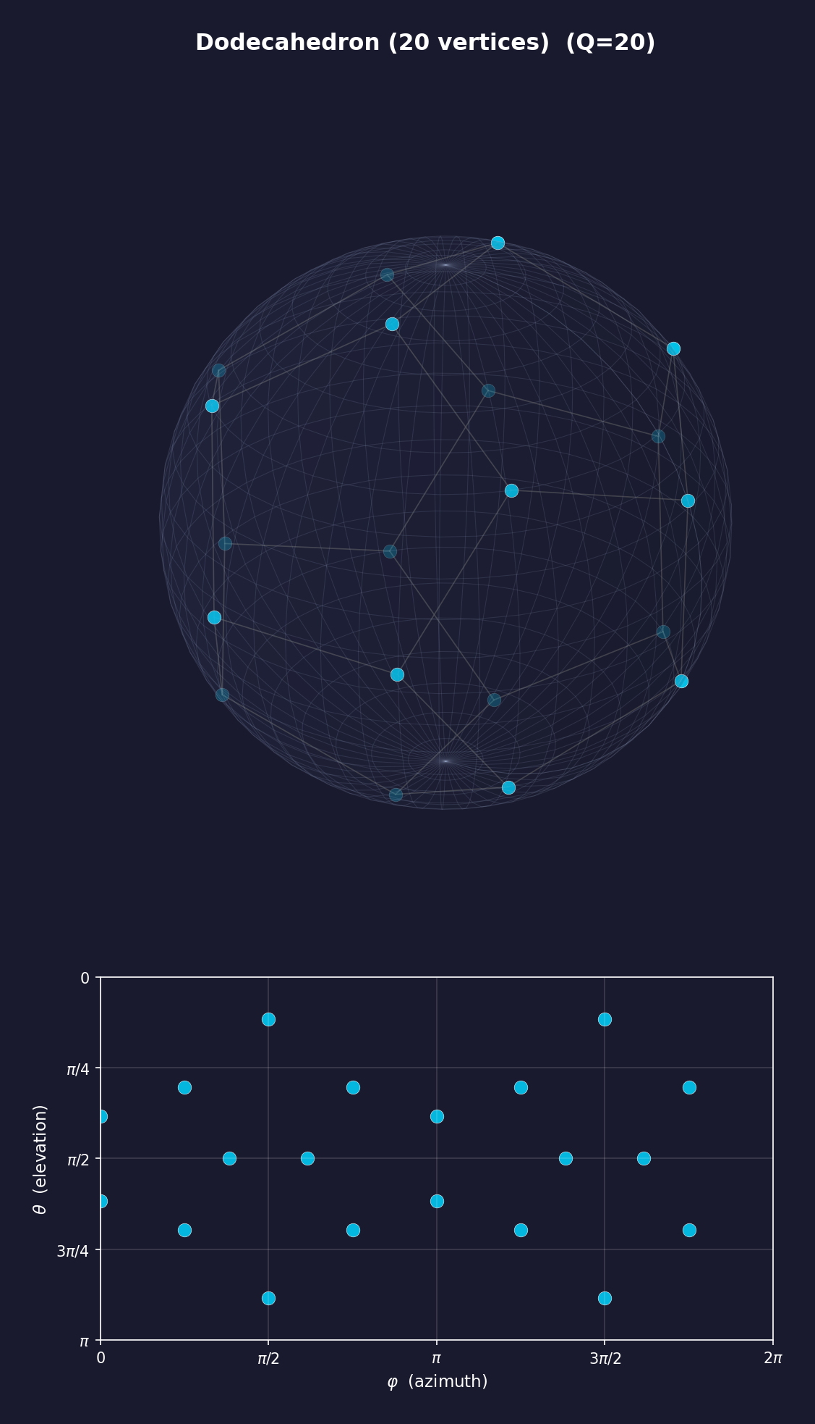
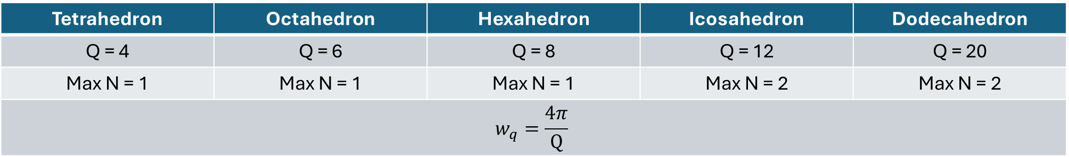
Polyhedral Grids
Polyhedron inscribed in a sphere (Vertices as Sample Points)
Tetrahedron | Octahedron | Hexahedron | Icosahedron | Dodecahedron
Q = 4 | Q = 6 | Q = 8 | Q = 12 | Q = 20
Max N = 1 | Max N = 1 | Max N = 1 | Max N = 2 | Max N = 2
$$w_{q}=\frac{4π}{Q}$$
Notes:
Platonic Solids

Slide 19
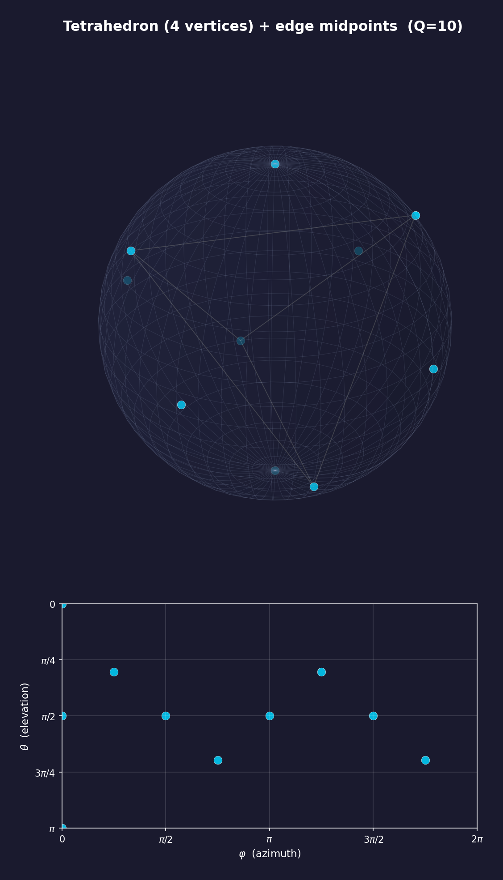
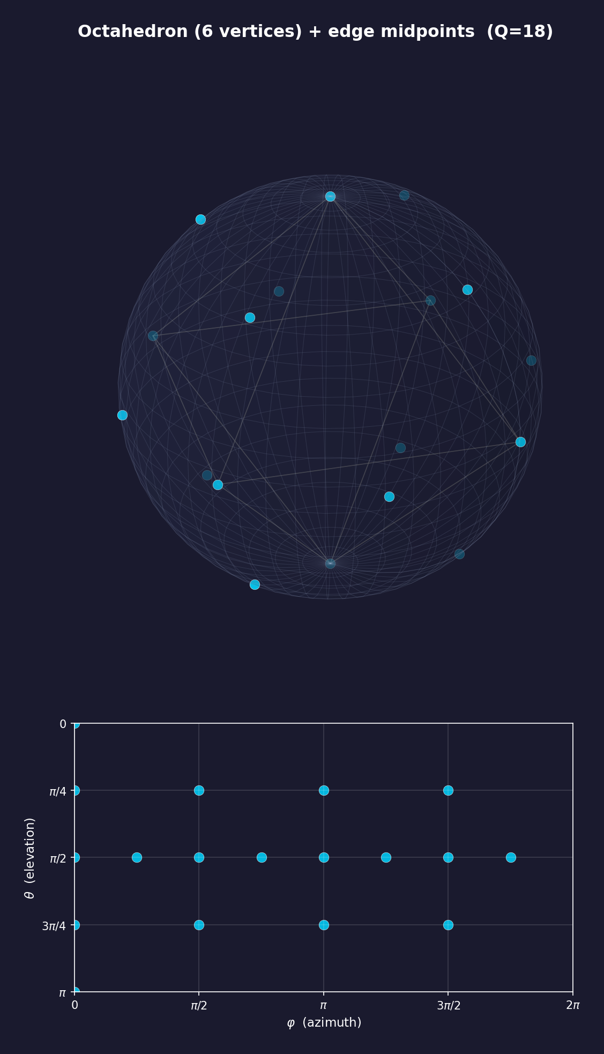
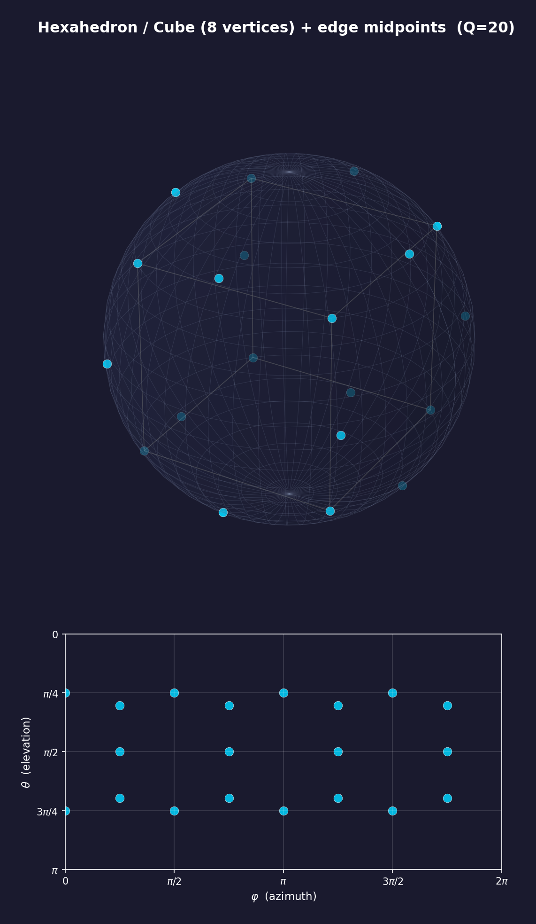
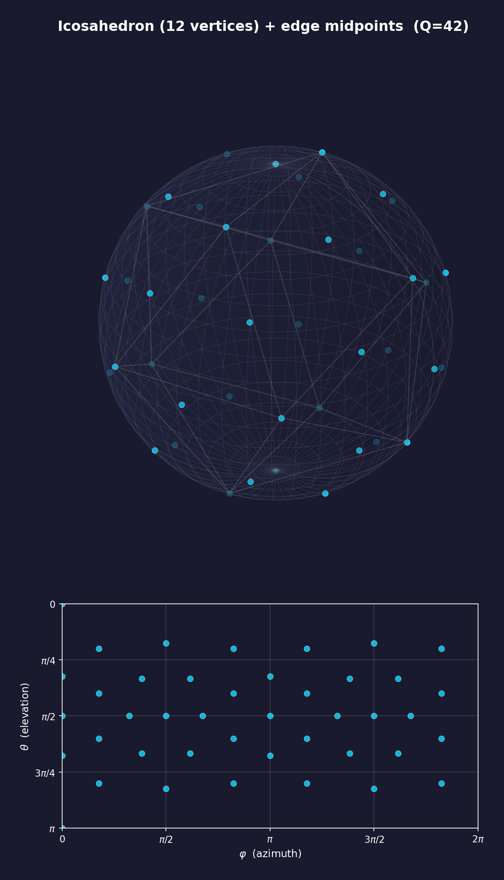
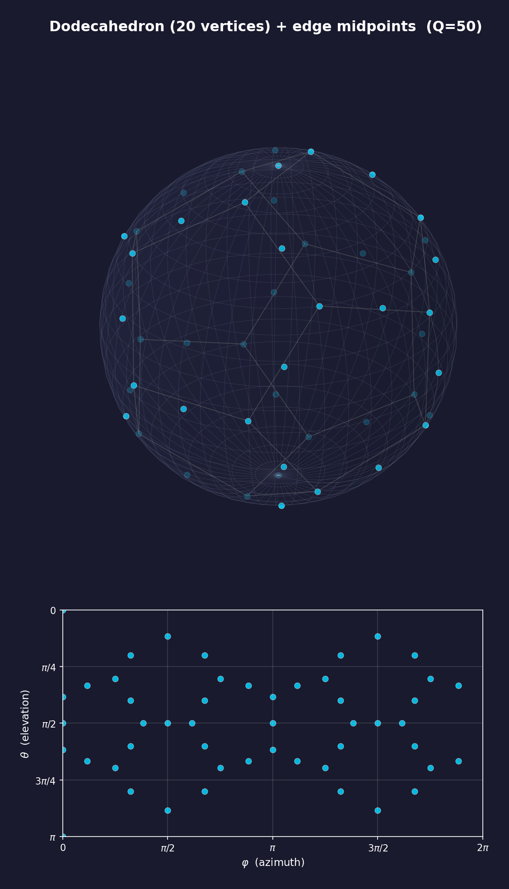
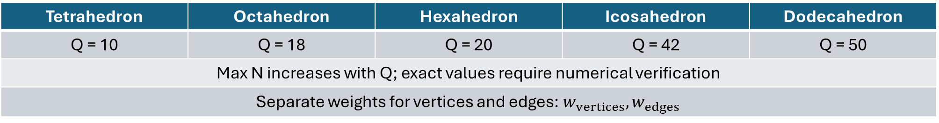
Polyhedral Grids
Vertices + Midpoints of Edges
Tetrahedron | Octahedron | Hexahedron | Icosahedron | Dodecahedron
Q = 10 | Q = 18 | Q = 20 | Q = 42 | Q = 50
Max N increases with Q; exact values require numerical verification
Separate weights for vertices and edges: $w_{vertices}, w_{edges}$

Slide 20
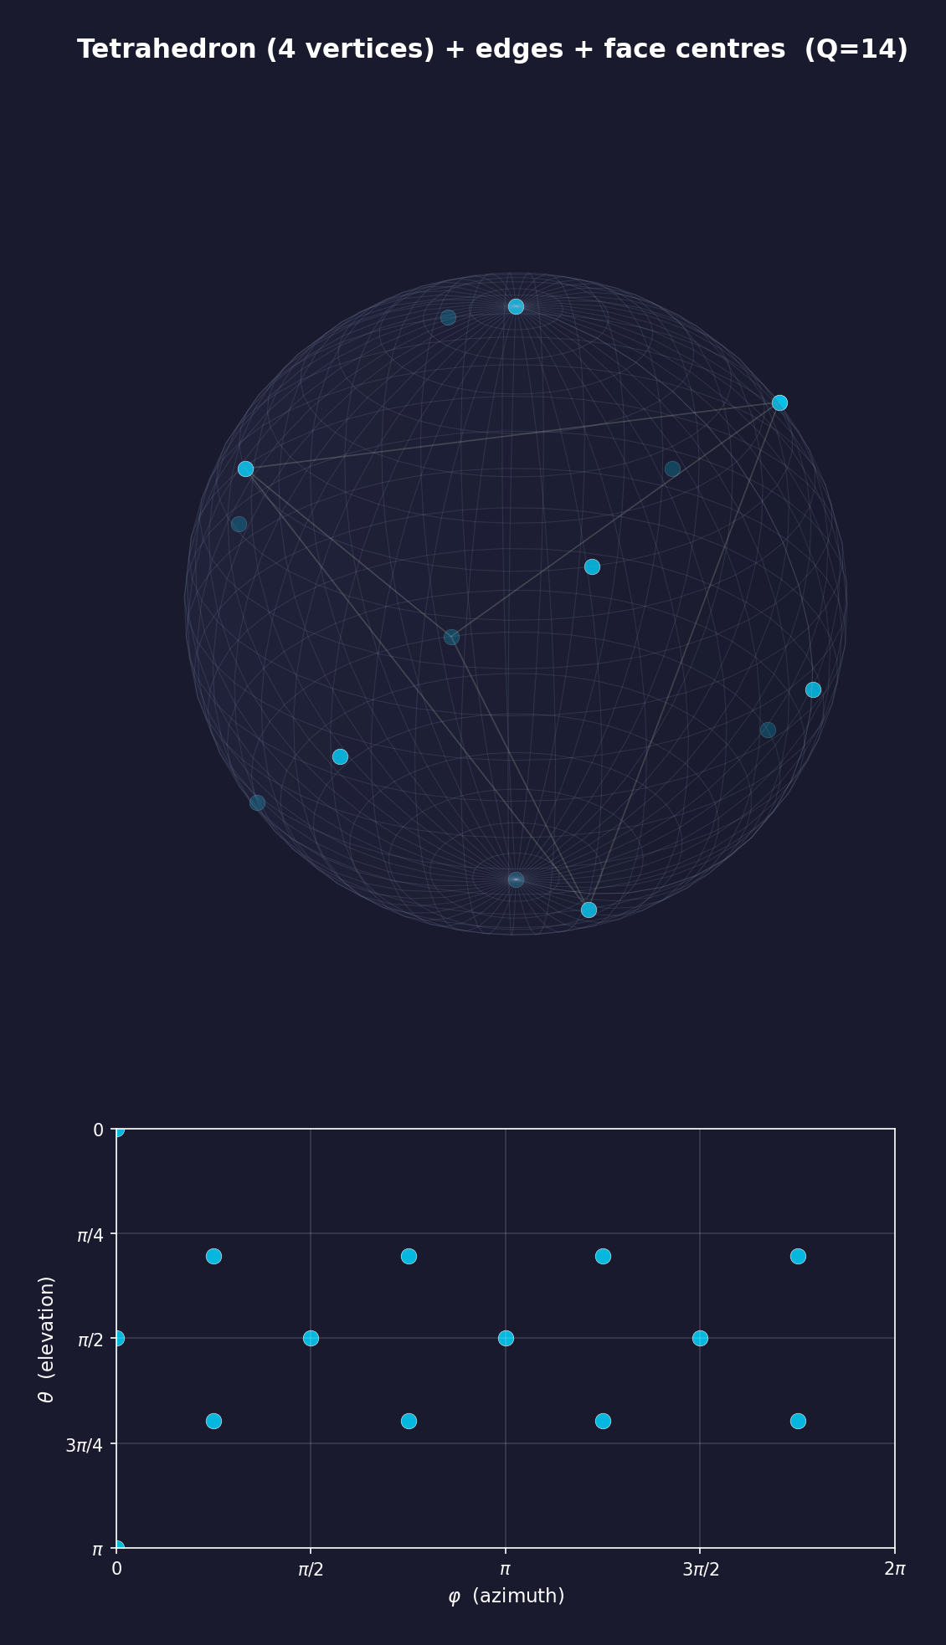
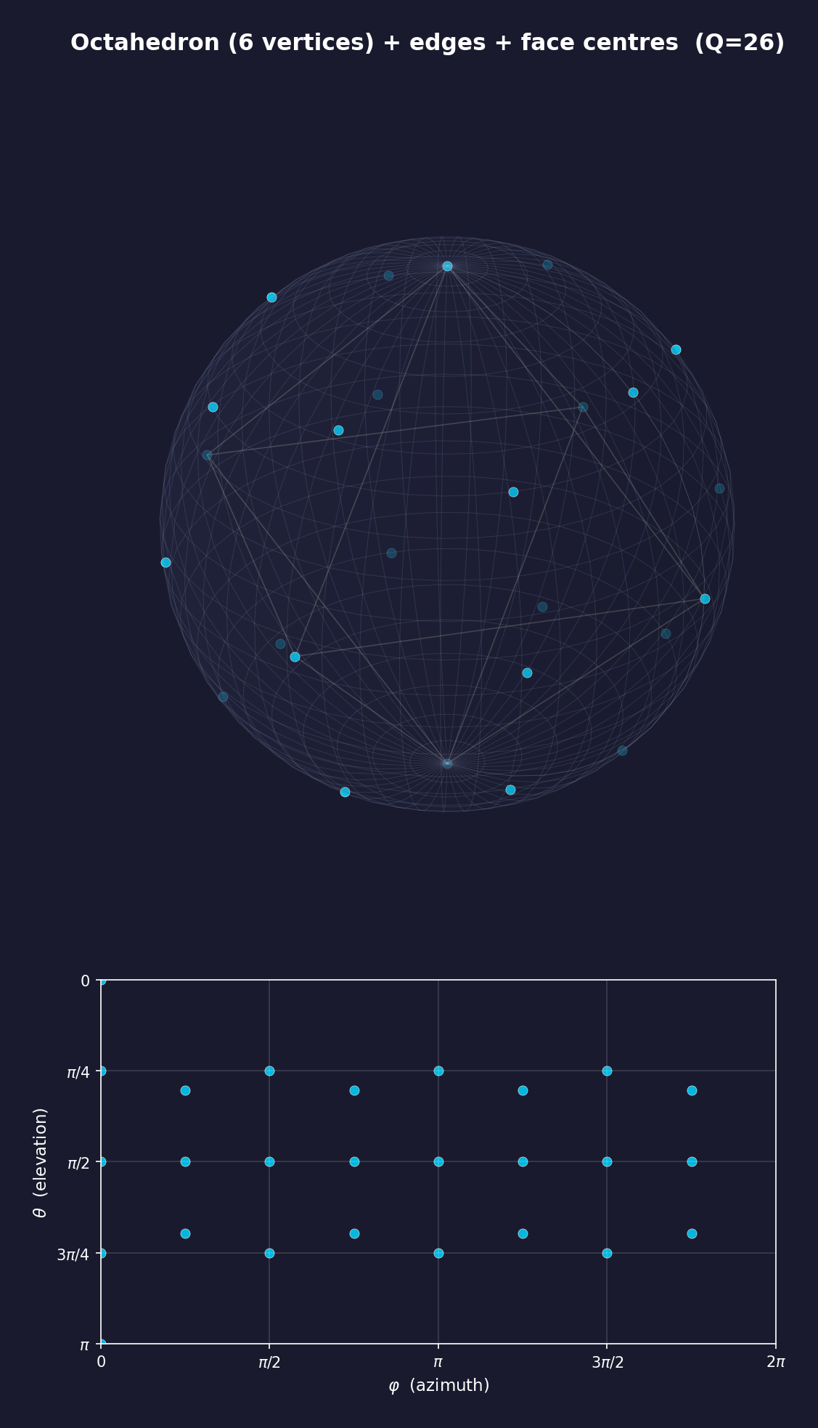
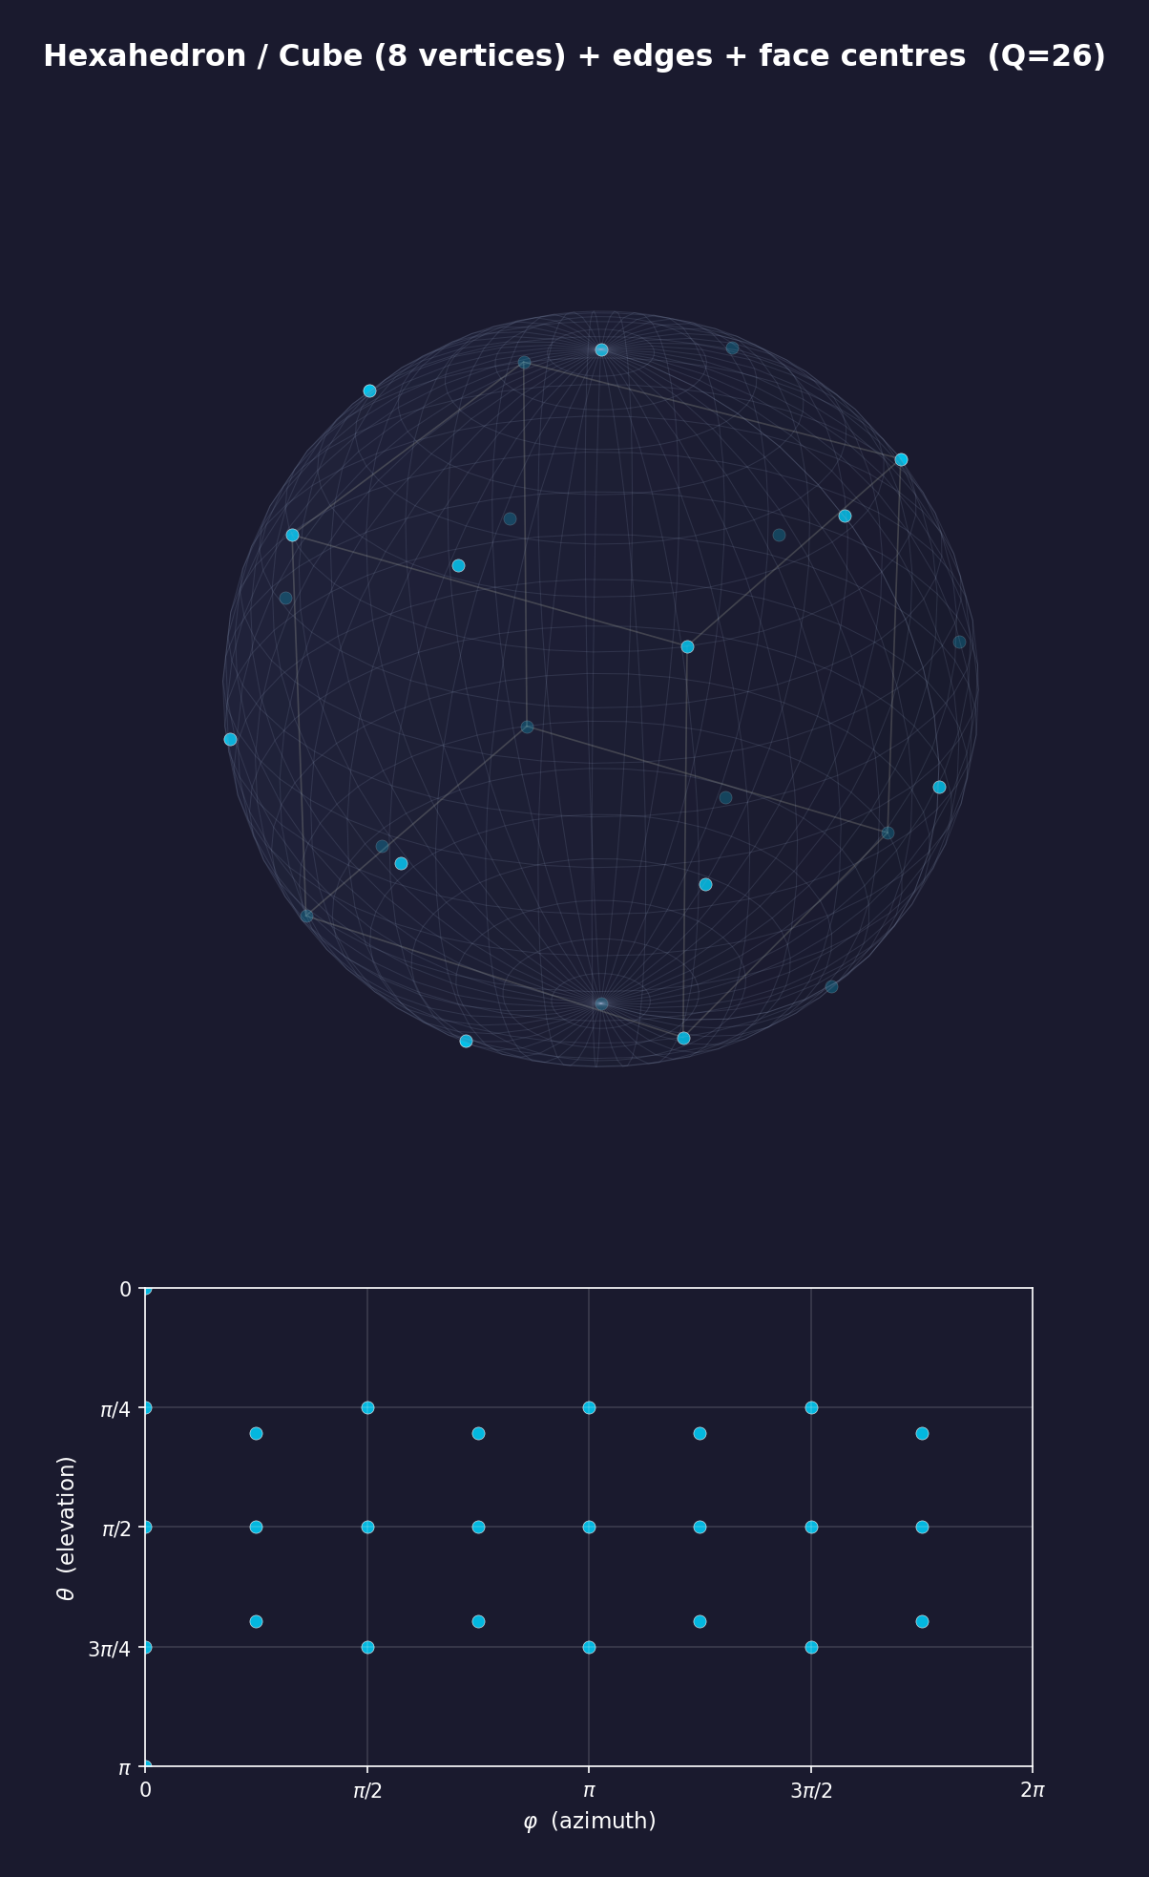
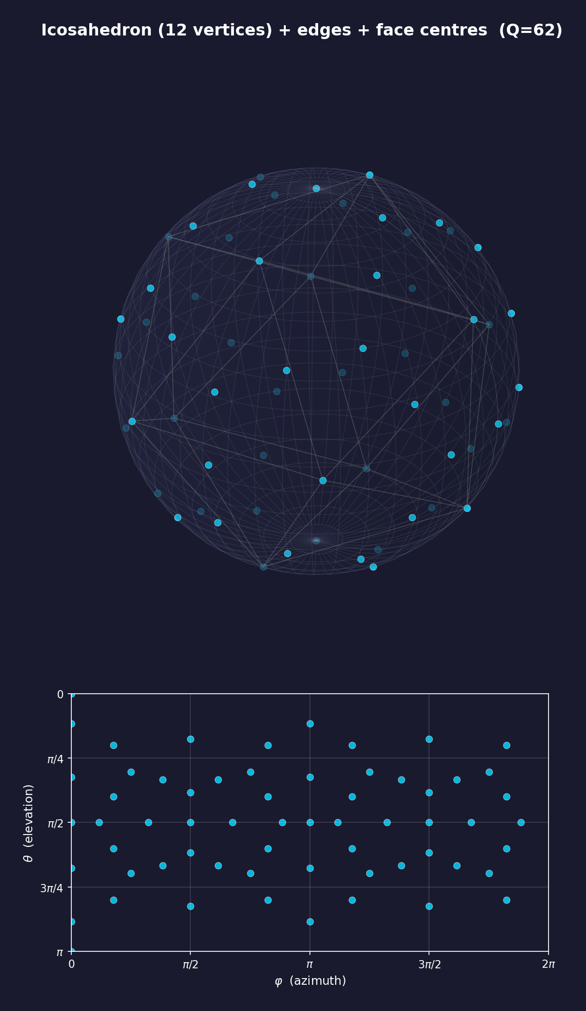
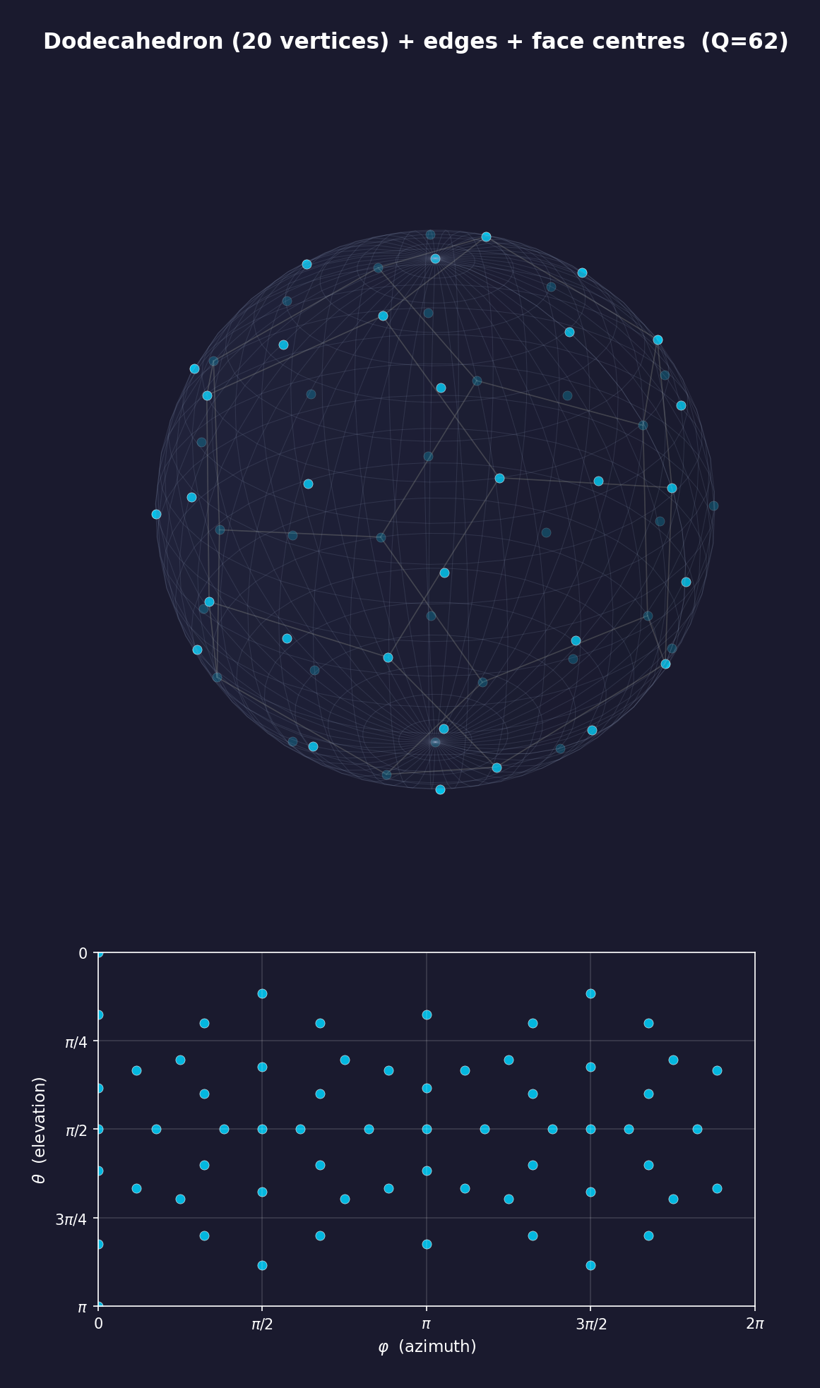
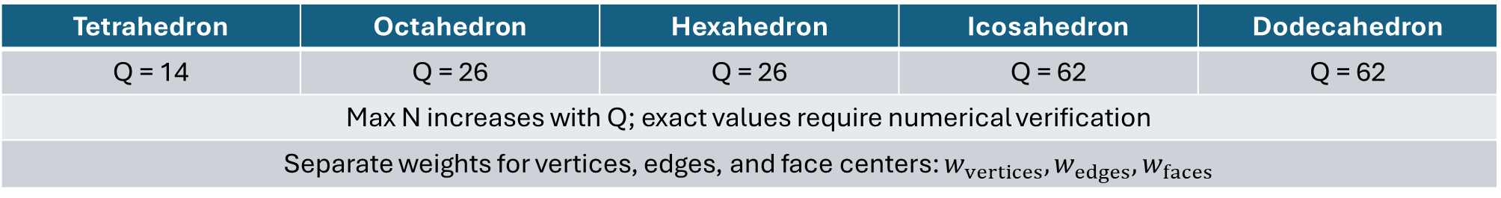
Polyhedral Grids
Vertices + Midpoints of Edges + Centers of Faces
Tetrahedron | Octahedron | Hexahedron | Icosahedron | Dodecahedron
Q = 14 | Q = 26 | Q = 26 | Q = 62 | Q = 62
Max N increases with Q; exact values require numerical verification
Separate weights for vertices, edges, and face centers: $w_{vertices}, w_{edges}, w_{faces}$

Slide 21
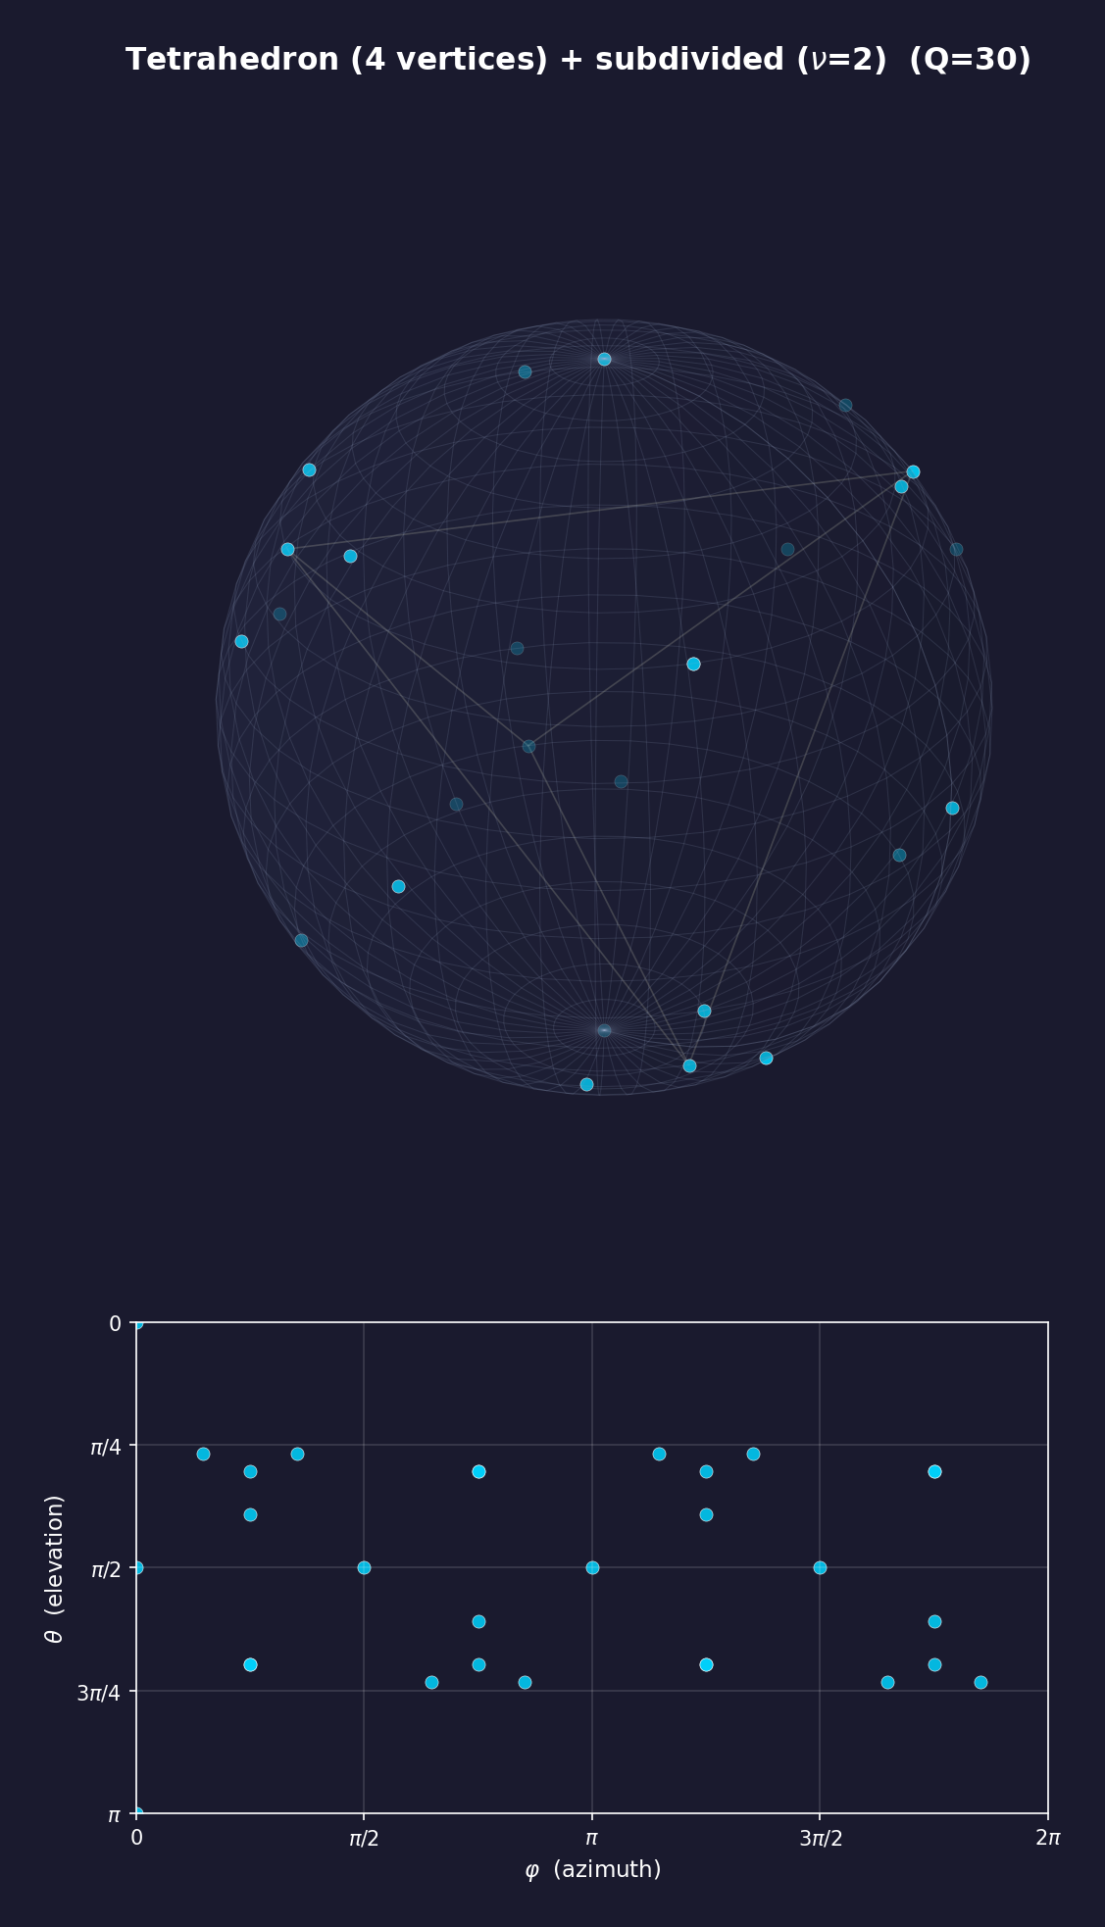




Polyhedral Grids
Vertices + Midpoints of Edges + Subdivided Faces
Tetrahedron | Octahedron | Hexahedron | Icosahedron | Dodecahedron
Q = 30 | Q = 58 | Q = 74 | Q = 142 | Q = 206
Max N increases with Q; exact values require numerical verification
Weights are determined numerically

Slide 22
Polyhedral Grids
Advantages and Trade-offs
Inherit the symmetry of the parent polyhedron
Fewer nodes needed for an SHT degree compared to equiangular grids
More uniform coverage over the sphere
Quadrature weights need to be determined numerically
More difficult to implement geometrically and complexity grows with each tier
Less compatible with fast algorithms

Slide 23
Which Sampling Scheme Should We Use?
It depends on the goal
For a simpler implementation and if oversampling is fine:
  Use one of the classical equiangular schemes
If rotational symmetry and geometric uniformity matters:
  Use a polyhedral grid

Slide 24
Spherical Sampling Pipeline
1
2
3
4
5
6
7
Function
on the Sphere
Choose
Bandlimit
Choose
Sampling Grid
Sample
the Sphere
Apply
Quadrature
Weights
Compute
SHT
Coefficients
Analyse or
Reconstruct
Function

Slide 25
Symmetries of the Sphere
Next Steps
The sphere is acted on by the group of rotations SO(3)
Finite subgroups of SO(3):
  Cyclic
  Dihedral
  Tetrahedral
  Octahedral
  Icosahedral
How can these symmetries guide the design of spherical sampling grids?

Slide 26
THANK YOU

