Slide 1
Evaluating Depth Fusion
for Instance Segmentation
in Fruit Harvesting Robots
Edward John Domingo
Supervisor: Yi Guo

Slide 2
BACKGROUND
Vision
Localisation
Path Planning
Grasping
Harvest
Notes:
Work on fruit harvesting robots have been done over the past decade
It’s composed of different submodules.
Vision is a key one, downstream dependency.
Before a robot can go and harvest fruit, it must first learn what and where

Slide 3
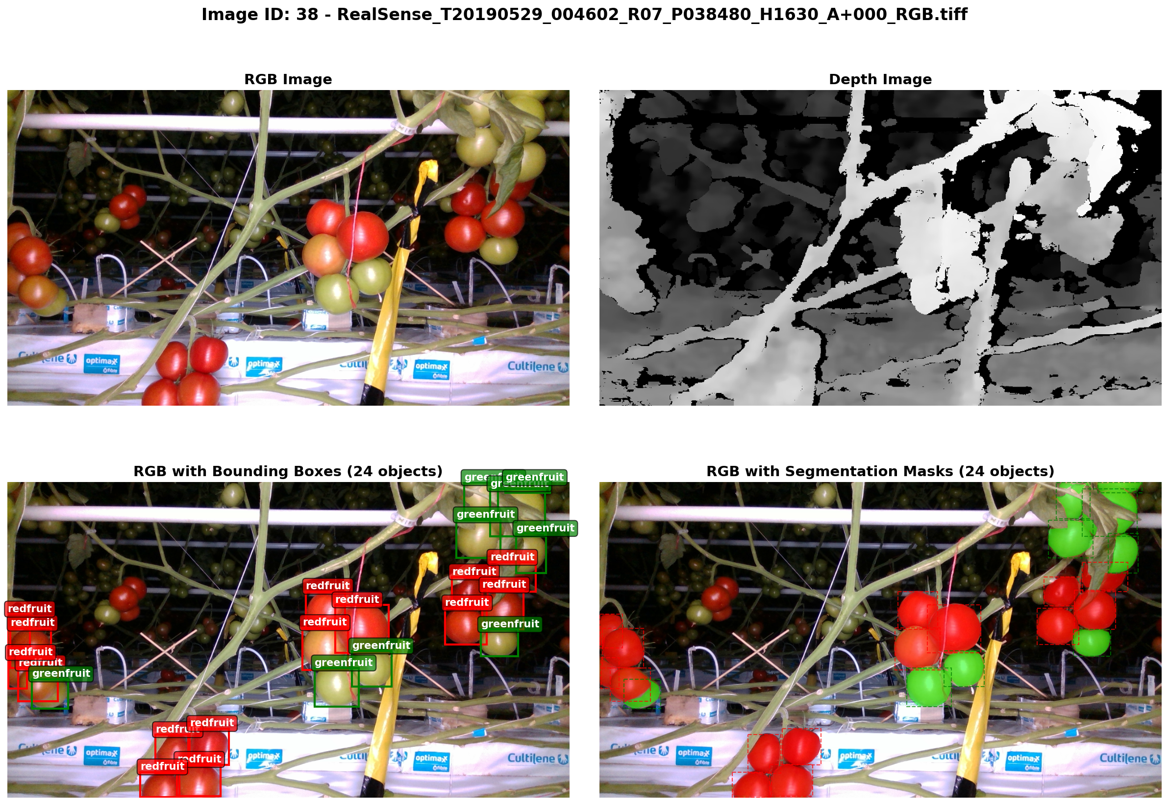
INSTANCE SEGMENTATION
Instance Segmentation:
• detects objects
• assigns a class
• pixel level mask per instance
Existing architectures take RGB inputs:
• YOLO
• Mask-RCNN
• Mask2Former (used in this project)
Notes:
Instance segmentation is the computer vision task used
It goes beyond just detecting that fruit exists
For every individual object instance:
It detects it, assigns a class and produces a pixel level mask

Slide 4
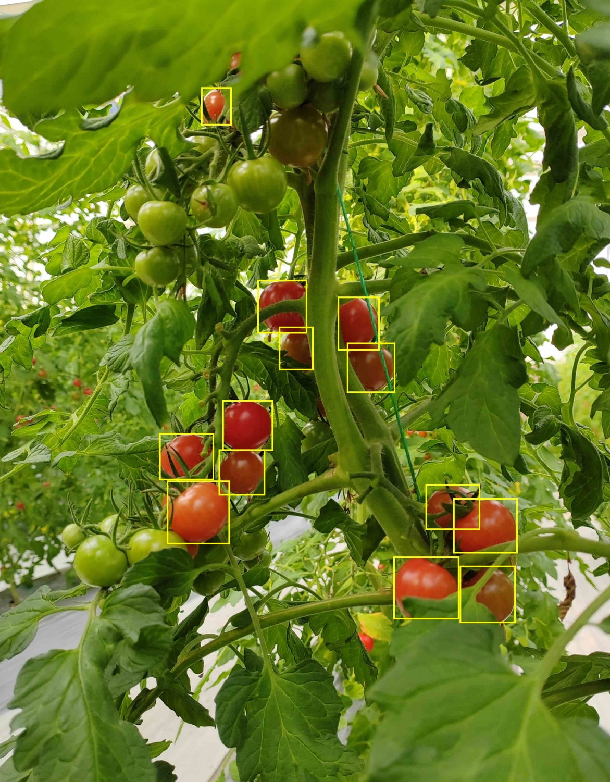
WHY ADD DEPTH?
RGB-only segmentation struggles with:
• Occluded fruits
• Colour blending
Depth is a complementary modality. It carries geometric information colour lacks.
Would adding depth improve segmentation accuracy?
Tomato Detection. Source: Hou et al., (2023)
Notes:
Across the literature, RGB-only segmentation has two failure modes:
Occlusion:
Colour blending: ambiguousness in
Both are limitations of colour input
Harvesting robots carry depth sensors anyways for 3D localisation

Slide 5
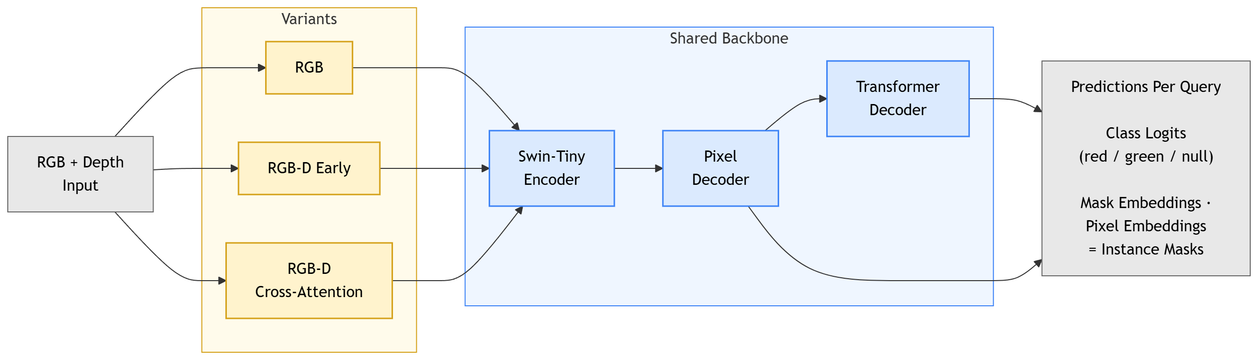
RESEARCH DESIGN
Base Architecture
Controlled Comparison
Mask2Former + Swin-Tiny backbone
Only the patch-embedding stage differs
Notes:
The setup is a controlled comparison (one base model)
"One model, one training recipe — the only variable is how depth enters at the input. That's the whole experiment.”
Three variants that branch from the same RGB+depth input
Everything downstream is shared
That isolates the effect of depth

Slide 6
RGB
Baseline (no depth)
  • Standard 3-channel input
  • No modifications
  • Carries no depth
R
G
B
Patch Embedding (X_{rgb})
Instance Segmentation Model
Notes:
Perception is a key module

Slide 7
RGB-D (Early)
Input-level Fusion
R
G
B
D
• Depth concatenated to RGB
• First convolution layer widened (3 -> 4)
• Problem: RGB and depth are different signals
Patch Embedding (X_{RGBD})
Instance Segmentation Model
Notes:
Perception is a key module

Slide 8

RGB-D (Cross-Attention)
Attention-based Fusion
Cross-modal Attention:
R
G
B
D
$$\text{Let} S\left(⋅\right)=\text{softmax}​\left(\frac{⋅}{\sqrt{C}}\right) \text{row}\text{−}\text{wise}$$
$$X_{I}^{\left(0\right)}=X_{I}+S\left(\left(W_{D1}X_{D}\right){\left(W_{D2}X_{D}\right)}^{⊤}\right)W_{I1}X_{I}$$
For $k=1,2,…,K$:
$$X_{D}^{\left(k\right)}=X_{D}^{\left(k−1\right)}+S\left(\left(W_{Iq}^{\left(k\right)}X_{I}^{\left(k−1\right)}\right){\left(W_{Ik}^{\left(k\right)}X_{I}^{\left(k−1\right)}\right)}^{⊤}\right)W_{Dv}^{\left(k\right)}X_{D}^{\left(k−1\right)}$$
$$X_{I}^{\left(k\right)}=X_{I}^{\left(k−1\right)}+S\left(\left(W_{Dq}^{\left(k\right)}X_{D}^{\left(k\right)}\right){\left(W_{Dk}^{\left(k\right)}X_{D}^{\left(k\right)}\right)}^{⊤}\right)W_{Iv}^{\left(k\right)}X_{I}^{\left(k−1\right)}$$
Patch Embedding
(X_{I})
Patch Embedding
(X_{D})
Cross-Modal Attention
Instance Segmentation Model
Notes:
- Unlike early fusion, depth gets its own processing path
- The two streams are combined by learned attention, not concatenation
- It works in two stages
K is the knob I sweep
Only the refined RGB stream continues into the backbone
Designed to start identical to RGB
Each line is an attention block — a similarity matrix between two streams that decides which patches inform which. The initial step lets depth reorganise RGB; the K cycles are the two modalities taking turns refining each other. And because every update is a zero-initialised residual, the block starts as the identity and equals plain RGB until it learns otherwise.

Slide 9
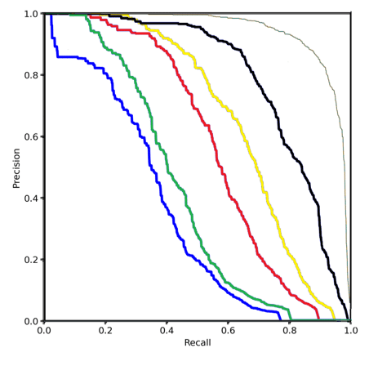
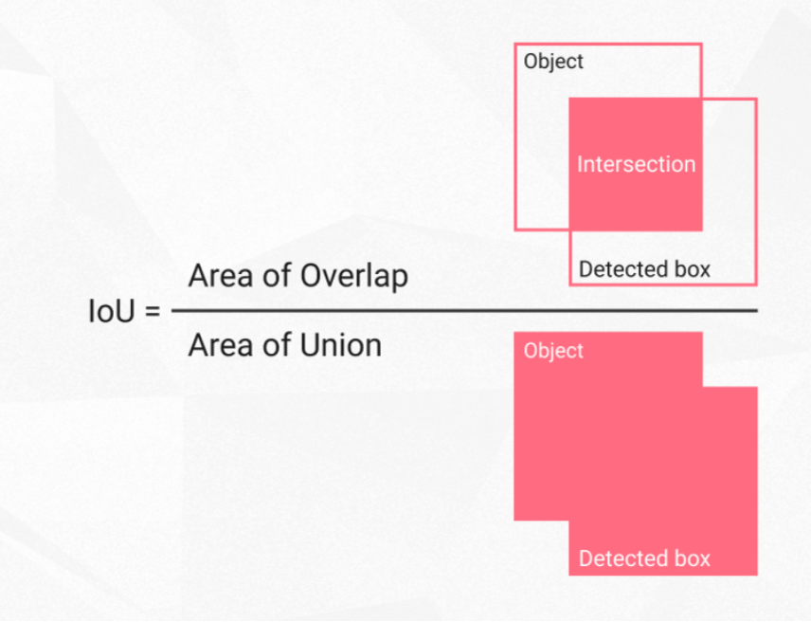
METRICS
Intersection over Union (IoU)
Measures how closely a predicted mask overlaps the ground-truth mask.
Average Precision (AP)
Area under precision-recall curve at a given IoU threshold
Metric | IoU Threshold
AP | [0.50, 0.95] step size 0.05
AP50 | 0.5
AP75 | 0.75
AP (green) | [0.50, 0.95] step size 0.05
AP (red) | [0.50, 0.95] step size 0.05
Notes:
Two building blocks: IoU and AP — IoU measures quality of a single mask, AP summarises overall detection performance IoU = intersection over union — overlap between the predicted mask and the ground truth, divided by their combined area; 0 means no overlap, 1 means perfect match A prediction counts as correct if its IoU clears a threshold — and that threshold is the dial that sets how strict the metric is AP is the area under the precision-recall curve — at a given IoU threshold, sweeping the confidence cutoff traces precision against recall, and AP is the area underneath Three AP variants, increasing strictness — AP50 uses a lenient 0.5 threshold (rough overlap is enough), AP75 uses a strict 0.75 (needs a tight mask), and AP (0.50–0.95) averages across the range Per-class AP — computed separately for red and green fruit, since the two classes have different difficulty

Slide 10
DATASET
Rob2Pheno
RGB Image
Depth Mask
Annotations
 | Train | Test
Images | 83 | 40
Instances | 1,074 | 538
- redfruit | 365 | 176
- greenfruit | 709 | 362
• 123 images total 720×1280 RGB-D pairs
• 2 classes: redfruit (ripe), greenfruit (unripe)
• Source: Afonso et al. (2020)
Notes:
Perception is a key module

Slide 11
TRAINING REGIME
Setting | Value
Initialisation | COCO-pretrained weights
Cross-validation | 5-fold (fixed seed)
Optimiser | AdamW
LR schedule | Cosine
Depth-path LR | 5× (DCA only)
Setting | Value
Epochs | 200
Batch size | 2
Augmentations | Geometric-only
Pre-processing | Mean-filled invalid depth
Notes:
Perception is a key module

Slide 12
RESULTS
5-fold cross-validation segmentation AP (mean ± std).
Variant | AP | AP50 | AP75 | AP (red) | AP (green)
RGB | 70.22 ± 1.84 | 94.93 ± 0.78 | 82.55 ± 1.18 | 70.84 ± 4.46 | 69.61 ± 2.89
RGB-D Early | 67.37 ± 2.32 | 93.89 ± 2.33 | 78.67 ± 3.28 | 68.63 ± 3.79 | 66.11 ± 3.75
RGB-D DCA (K=0) | 68.19 ± 2.12 | 94.15 ± 2.52 | 79.80 ± 1.66 | 69.06 ± 3.85 | 67.33 ± 2.81
RGB-D DCA (K=1) | 67.43 ± 1.31 | 94.49 ± 1.58 | 77.95 ± 2.68 | 68.46 ± 3.42 | 66.40 ± 2.54
RGB-D DCA (K=2) | 67.48 ± 2.02 | 93.90 ± 1.35 | 77.43 ± 1.93 | 68.02 ± 4.18 | 66.95 ± 3.68
Notes:
Perception is a key module

Slide 13
RESULTS
5-fold cross-validation segmentation AP (mean ± std).
Variant | AP | AP50 | AP75 | AP (red) | AP (green)
RGB | 70.22 ± 1.84 | 94.93 ± 0.78 | 82.55 ± 1.18 | 70.84 ± 4.46 | 69.61 ± 2.89
RGB-D Early | 67.37 ± 2.32 | 93.89 ± 2.33 | 78.67 ± 3.28 | 68.63 ± 3.79 | 66.11 ± 3.75
RGB-D DCA (K=0) | 68.19 ± 2.12 | 94.15 ± 2.52 | 79.80 ± 1.66 | 69.06 ± 3.85 | 67.33 ± 2.81
RGB-D DCA (K=1) | 67.43 ± 1.31 | 94.49 ± 1.58 | 77.95 ± 2.68 | 68.46 ± 3.42 | 66.40 ± 2.54
RGB-D DCA (K=2) | 67.48 ± 2.02 | 93.90 ± 1.35 | 77.43 ± 1.93 | 68.02 ± 4.18 | 66.95 ± 3.68
Contrary to hypothesis, RGB outperforms all variants.
Notes:
Perception is a key module

Slide 14
RESULTS
5-fold cross-validation segmentation AP (mean ± std).
Variant | AP | AP50 | AP75 | AP (red) | AP (green)
RGB | 70.22 ± 1.84 | 94.93 ± 0.78 | 82.55 ± 1.18 | 70.84 ± 4.46 | 69.61 ± 2.89
RGB-D Early | 67.37 ± 2.32 | 93.89 ± 2.33 | 78.67 ± 3.28 | 68.63 ± 3.79 | 66.11 ± 3.75
RGB-D DCA (K=0) | 68.19 ± 2.12 | 94.15 ± 2.52 | 79.80 ± 1.66 | 69.06 ± 3.85 | 67.33 ± 2.81
RGB-D DCA (K=1) | 67.43 ± 1.31 | 94.49 ± 1.58 | 77.95 ± 2.68 | 68.46 ± 3.42 | 66.40 ± 2.54
RGB-D DCA (K=2) | 67.48 ± 2.02 | 93.90 ± 1.35 | 77.43 ± 1.93 | 68.02 ± 4.18 | 66.95 ± 3.68
At AP50, the variants are effectively tied.
Notes:
Perception is a key module

Slide 15
RESULTS
5-fold cross-validation segmentation AP (mean ± std).
Variant | AP | AP50 | AP75 | AP (red) | AP (green)
RGB | 70.22 ± 1.84 | 94.93 ± 0.78 | 82.55 ± 1.18 | 70.84 ± 4.46 | 69.61 ± 2.89
RGB-D Early | 67.37 ± 2.32 | 93.89 ± 2.33 | 78.67 ± 3.28 | 68.63 ± 3.79 | 66.11 ± 3.75
RGB-D DCA (K=0) | 68.19 ± 2.12 | 94.15 ± 2.52 | 79.80 ± 1.66 | 69.06 ± 3.85 | 67.33 ± 2.81
RGB-D DCA (K=1) | 67.43 ± 1.31 | 94.49 ± 1.58 | 77.95 ± 2.68 | 68.46 ± 3.42 | 66.40 ± 2.54
RGB-D DCA (K=2) | 67.48 ± 2.02 | 93.90 ± 1.35 | 77.43 ± 1.93 | 68.02 ± 4.18 | 66.95 ± 3.68
Gap shows at AP75.
Notes:
Perception is a key module

Slide 16
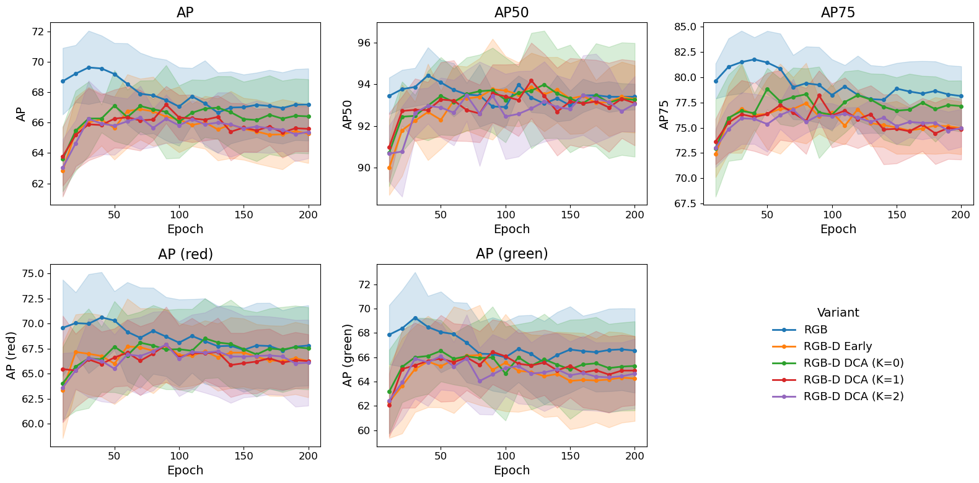
AP TRAINING CURVES
Two failure modes:
Heavily occluded
Notes:
RGB (blue) leads from the start and holds it the whole way
AP50 is the exception — everyone collapses into one band
The contrast between AP50 and AP75 is the whole story
No depth variant ever overtakes RGB and stays there — if depth were helping even intermittently, you'd expect a crossover somewhere; none happens Be honest about the shaded bands — these are ±1 std over folds and they overlap heavily, so the curves alone don't prove significance; that's exactly why the paired test (RGB wins 5/5 folds) is needed to back the trend

Slide 17
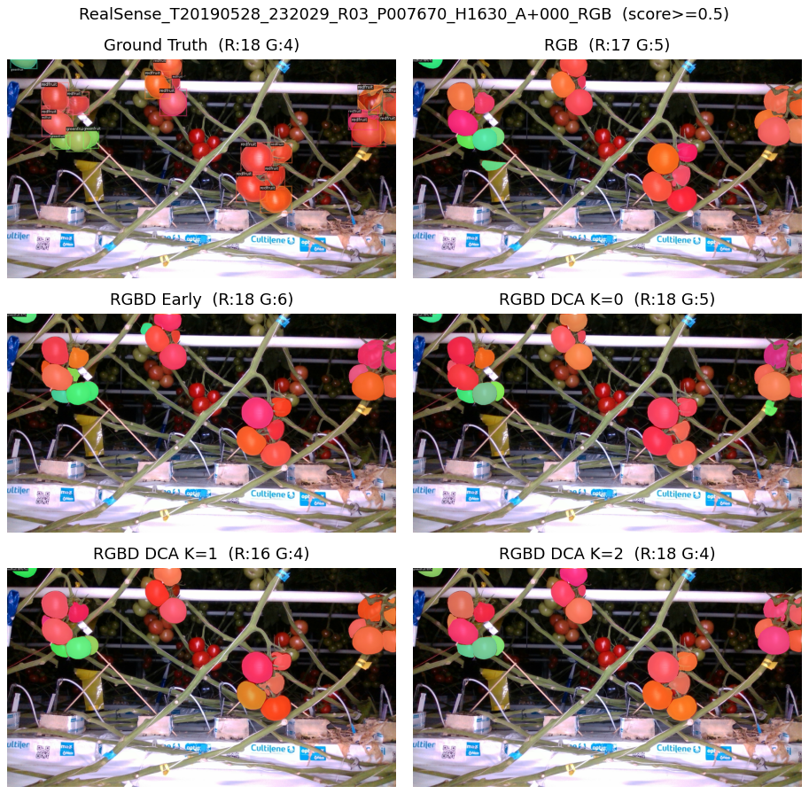
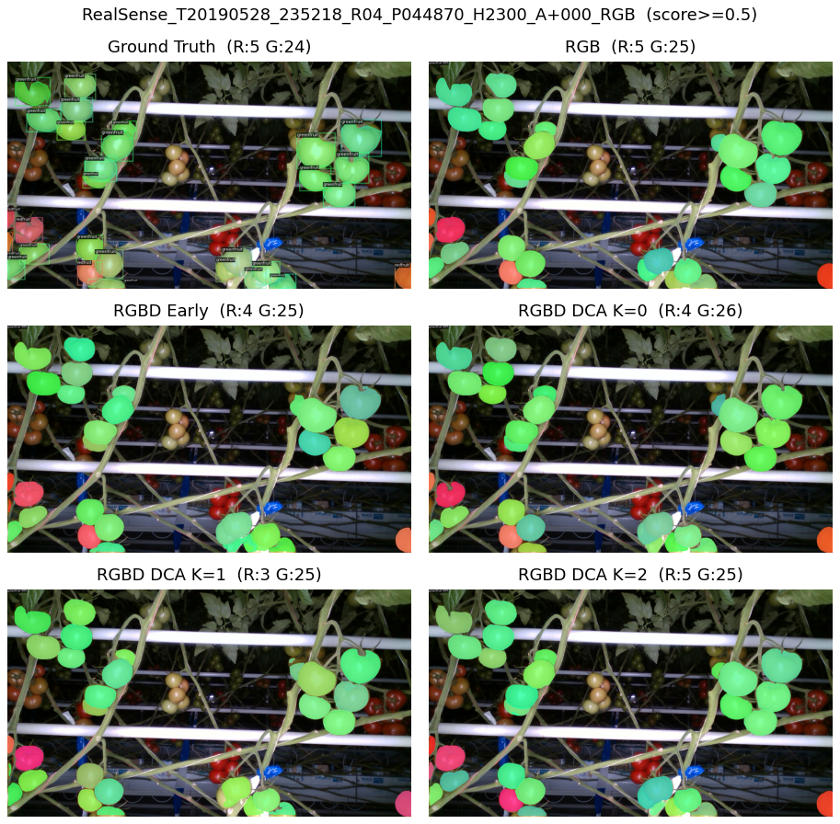
SAMPLE INFERENCE
Perception is a key module for fruit harvesting robots
Notes:
These are predictions on the held-out test set — images excluded from every cross-validation fold, using the median-performing fold per variant, so it's a fair qualitative look Two scenes chosen to cover both classes — the left panel is red-dominated (ground truth R:18 G:4), the right is green-dominated (R:5 G:24), so you can see each variant on both fruit types The counts let you compare against ground truth directly — e.g. left scene ground truth is R:18 G:4, and the variants land close (RGB R:17 G:5, others R:16–18) — all in the right ballpark, none dramatically off The headline: all variants look basically the same — this is the qualitative version of the quantitative result; no variant is visibly better or worse, masks are comparable across the board Individual images may slightly favour one variant, but nothing is consistent — flip through the full set and no variant pulls ahead reliably, which matches the metrics
depth isn't fixing or breaking anything.

Slide 18
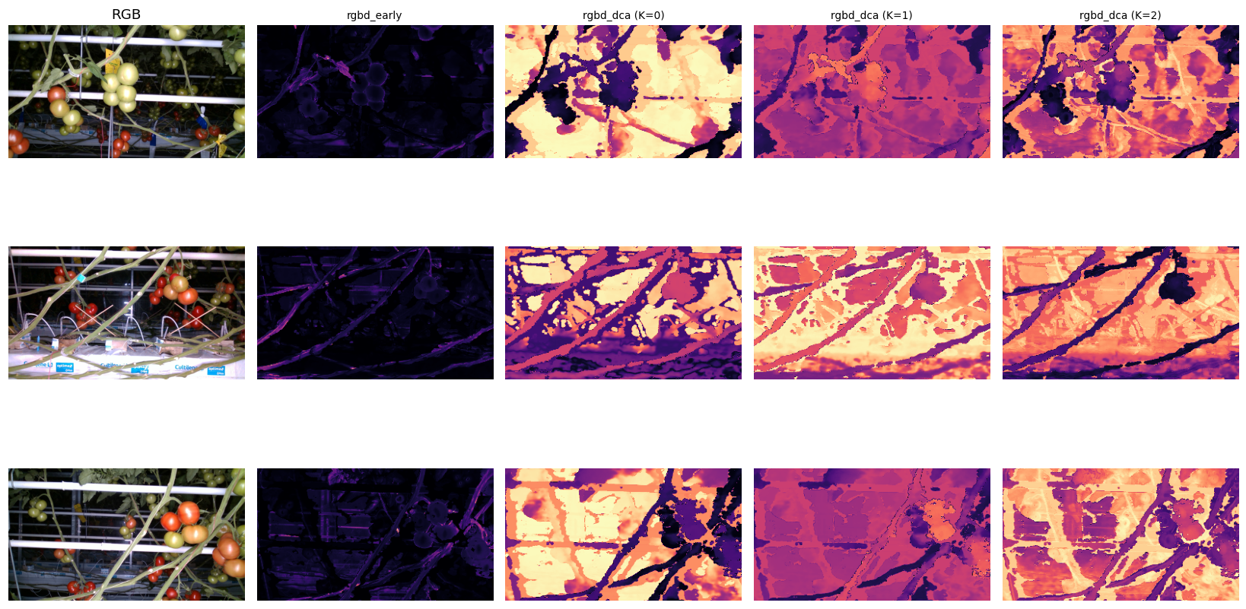
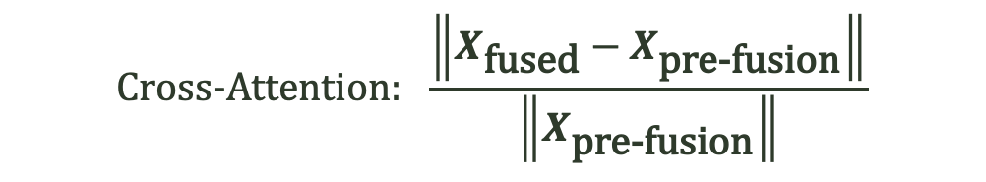

DEPTH CONTRIBUTION
$$\text{Cross}\text{-}\text{Attention}\text{:} \frac{\left\|X_{\text{fused}}−X_{\text{pre}\text{-}\text{fusion}}\right\|}{\left\|X_{\text{pre}\text{-}\text{fusion}}\right\|}$$
$$\text{Early}\text{:} \frac{\left\|\operatorname{conv}\left(\text{depth}\right)\right\|}{\left\|\operatorname{conv}\left(\text{RGB}\right)\right\|}$$
Per-patch depth contribution. Brighter = stronger depth influence.
Colour scale comparable within each variant only.
Notes:
How depth influenced the learned representations
Early: ratio of the convolutions of depth to the convolutions of rgb
DCA: how far the fusion step pushes each RGB token off its pre-fusion
e measure its influence on the learned representations directly Two measurements, one per fusion type — for early fusion, the patch-embed conv is linear, so depth's contribution can be isolated exactly (the ratio of conv(depth) to conv(RGB)); for cross-attention, we measure how far the fusion step pushes each RGB token off its pre-fusion value Brighter = stronger depth influence, and the colour scale is only comparable within a variant, not across columns Early fusion (second column) is almost entirely dark — depth contributes close to nothing; the model converged to essentially the RGB solution and ignores the extra channel Cross-attention is the more interesting failure — there's plenty of brightness, so depth is being used, but look at where: the bright regions sit on the background — bars, gaps, structure — while the fruit clusters stay comparatively dark That's exactly backwards — depth should help most where fruits overlap, to separate them; instead the model applies it where it matters least The unifying takeaway: early fusion ignores depth, cross-attention misplaces it — either way depth never reaches the problem it was meant to solve, which is why no variant beat RGB

Slide 19
CONCLUSION
- No RGB-D fusion variant beat the RGB baseline.
- Variants tie at AP50; gap shows at AP75.
- Small dataset where vision transformers are data hungry
Notes:
Perception is a key module

Slide 20
FUTURE RECOMMENDATIONS
Replace the backbone ViT
Increase dataset size.
Investigate if noise affects accuracy.
Change the way we apply depth.
Notes:
Perception is a key module

Slide 21
THANK YOU
Notes:
Perception is a key module

Slide 22
Colour palette
Light scheme · hex values for copy
Background
Panel / Card
Primary Ink
Tomato Red
#EDE6D6
#FFFFFF
#2E3A2B
#C8492E
Leaf Green
Steel Blue
Muted Text
Divider
#6B8E4E
#5A7184
#7A7666
#D4C9B0
7

