Slide 1
UNLIMITED SAMPLING
An exploration of the paper “Unlimited Sampling Beyond Modulo” by Azar, Mulleti & Eldar (2025)
DOMINGO, EDWARD JOHN

Slide 2
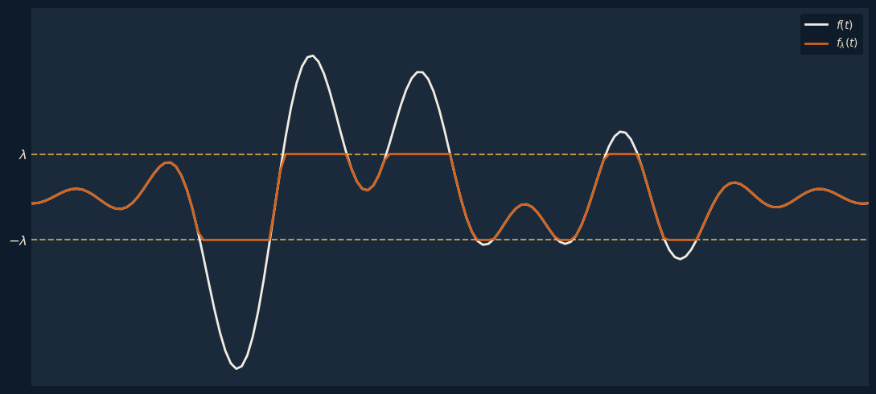
The Dynamic Range Problem
Signals have finite energy
Analog-to-Digital Converters (ADCs) have a finite Dynamic Range.
Notes:
ADCs turn a continuous signal into discrete samples that a computer can process.
SR: how often it measures the signal. Sample too slowly and you lose detail - the Nyquist rate sets the minimum needed to capture a bandlimited signal faithfully.
DR: the amplitude window the ADC can actually represent, say $\left[− , λλ\right]$.
When a signal exceeds that range, a conventional ADC clips it — flattening everything past $λ$and permanently losing that information.
The usual fixes all cost something. You can crank up the sampling rate, but that's expensive in power and hardware. So the question is: can we recover the full signal without paying that price?
In this presentation we explore the B²R² algorithm by Azar, Mulleti, and Eldar — an unlimited sampling framework that recovers the signal perfectly while sampling just barely above the Nyquist rate.

Slide 3
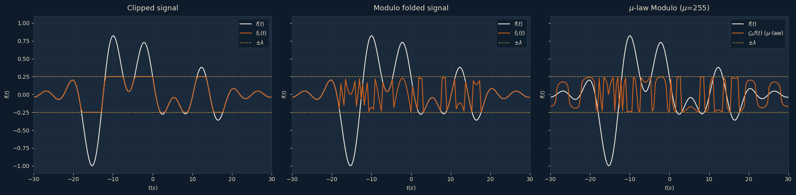
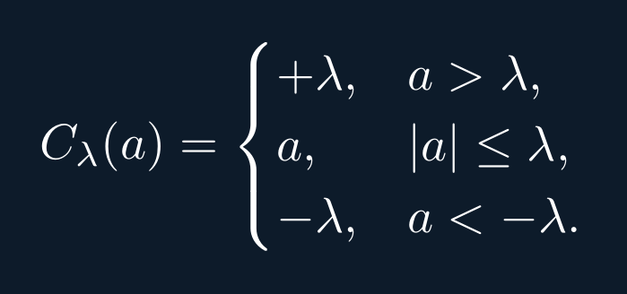
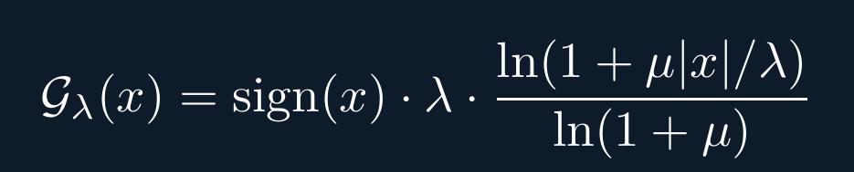
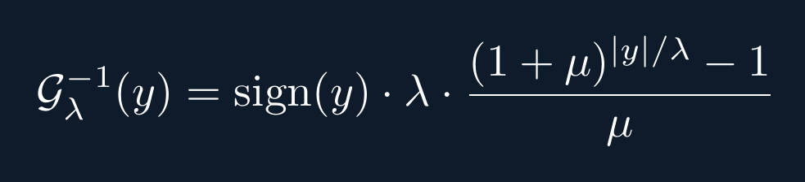
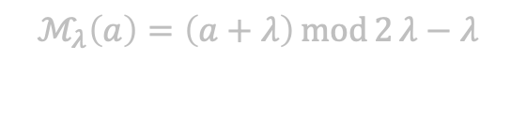
Operators
Different ways of processing signals
$$ℳ_{λ}\left(a\right)=\left(a+λ\right)\operatorname{mod}{2}λ−λ$$
Notes:
So how do we deal with a signal that exceeds the dynamic range?
Instead of just clipping it, we apply a nonlinear operator before sampling.
Clipping is the conventional one — anything above $λ$gets pinned to $λ$, anything below $−λ$to $−λ$. Simple, but it throws information away.
**Modulo** is the one we'll focus on. Instead of flattening the signal, it *folds* it back into the range — every time the signal crosses $λ$, it wraps around to $−λ$and keeps going. Notice nothing gets clipped flat; the orange signal still uses the full range. The information isn't destroyed, just disguised — and that's what lets us recover it later.
μ-law modulo adds a companding step after folding, boosting small amplitudes so they sit better above the noise floor. It's a generalization — and that's the key insight of the paper: clipping, modulo, and companding are all special cases of one general operator $𝒢_{λ}$.
For the rest of this talk, we'll stick with plain modulo.

Slide 4
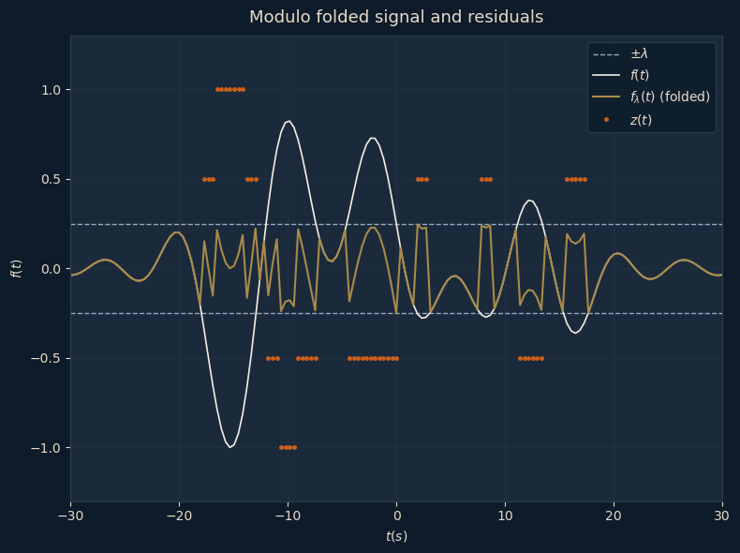
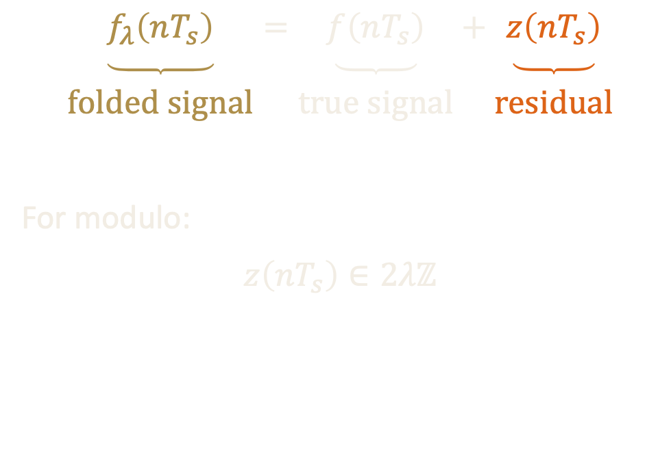
Solving for z gets you f
Whatever the non-linearity, the unknown is always z
$$\underset{\begin{aligned} \\ \text{folded signal}\end{aligned}}{\underbrace{f_{λ}\left(nT_{s}\right)}}=\underset{\begin{aligned} \\ \text{true signal}\end{aligned}}{\underbrace{f\left(nT_{s}\right)}}+\underset{\begin{aligned} \\ \text{residual}\end{aligned}}{\underbrace{z\left(nT_{s}\right)}}$$
For modulo:
$$z\left(nT_{s}\right)∈2λℤ$$
Notes:
Here's the central idea.
We fold samples and collect those values
In the case of modulo, it has a structure 2_lambda times an integer
So we don’t have to directly recover the true signal. If getting the residual is easier, then the true signal itself is solved.

Slide 5
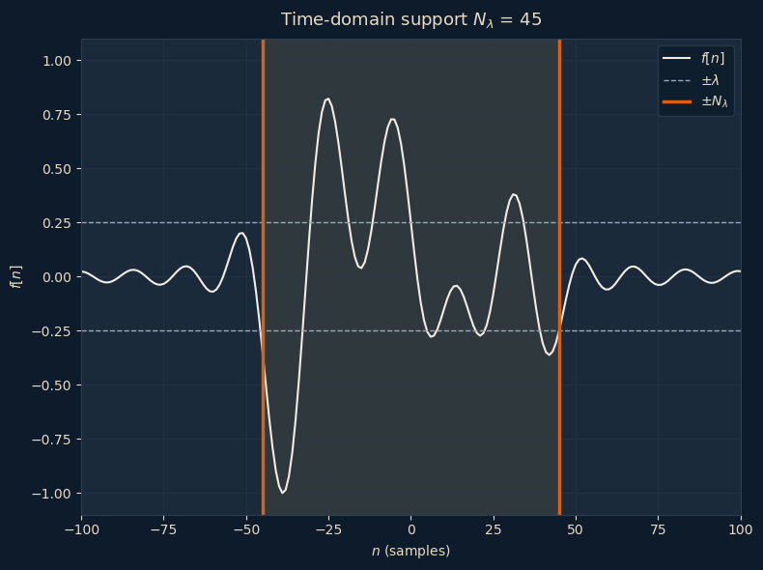
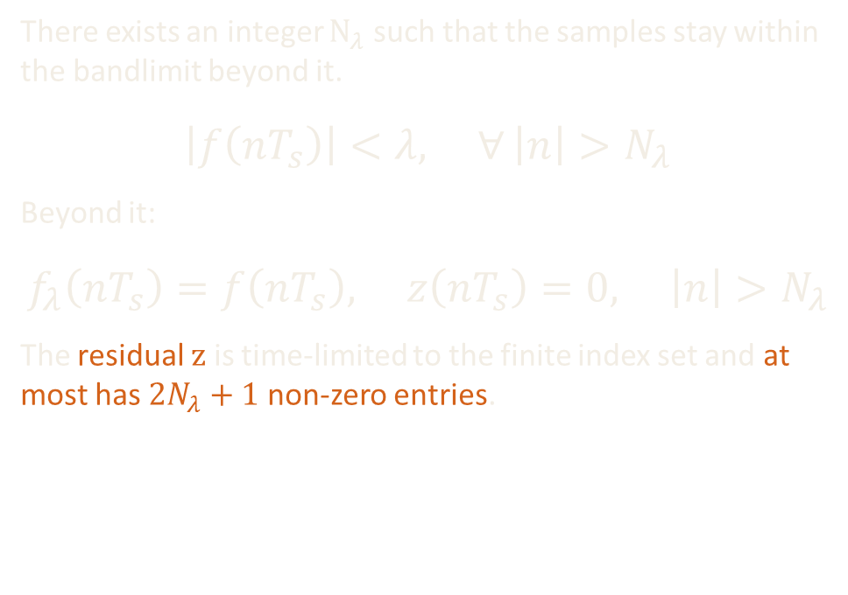
Time-Domain Separation
Bandlimited finite-energy signals decay
There exists an integer $N_{λ}$ such that the samples stay within the bandlimit beyond it.
$$\left|f\left(nT_{s}\right)\right|<λ, ∀ \left|n\right|>N_{λ}$$
Beyond it:
$$f_{λ}\left(nT_{s}\right)=f\left(nT_{s}\right), z\left(nT_{s}\right)=0, \left|n\right|>N_{λ}$$
The residual $z$ is time-limited to the finite index set and at most has $2N_{λ}+1$ non-zero entries.
Notes:
So how do we pin down $z$? It comes from two properties that let us separate it from the true signal — one in time, one in frequency. This is the first
.
A bandlimited, finite-energy signal decays — by the Riemann–Lebesgue lemma, it has to go to zero as you move out in time. So for any threshold $λ$, there's some index $N_{λ}$beyond which the signal never exceeds the dynamic range again.
And if the signal stays inside $±λ$, there's nothing to fold. So beyond $N_{λ}$, the folded samples equal the true samples, and the residual is exactly zero — that's the shaded region versus the tails in the plot.
The payoff: $z$isn't some arbitrary infinite sequence. It's time-limited — at most $2N_{λ}+1$nonzero entries, all bunched in the middle where the signal was large. We've turned an infinite unknown into a finite one.
Next we'll use the frequency domain to actually solve for those entries.

Slide 6
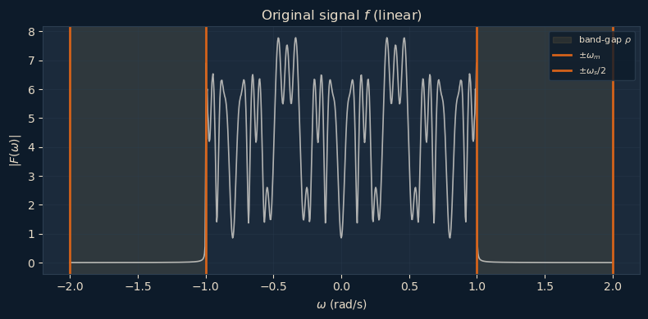
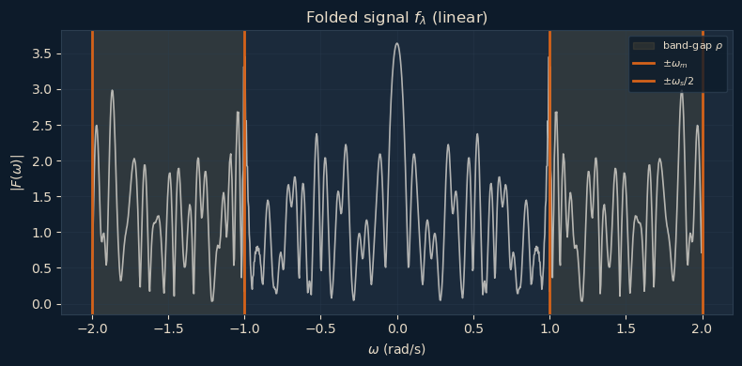
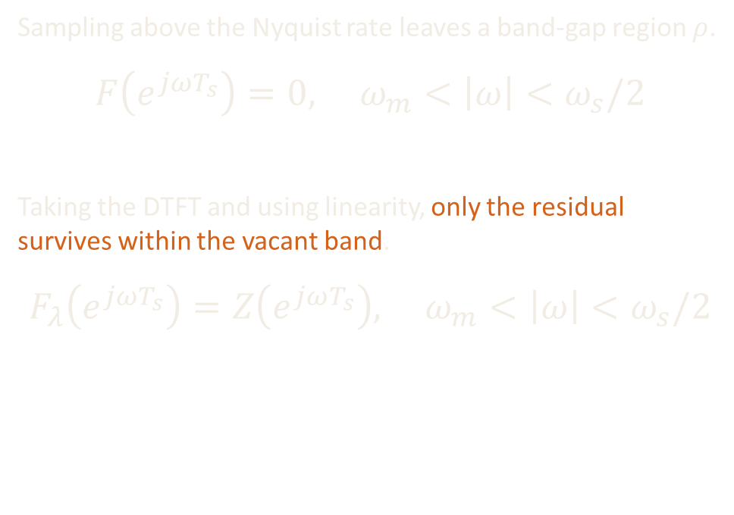
Fourier-Domain Separation
The spectral energy in the band-gap region is “purely” the residual
Sampling above the Nyquist rate leaves a band-gap region $ρ$.
$$F\left(e^{jωT_{s}}\right)=0, ω_{m}<\left|ω\right|<ω_{s}/2$$
Taking the DTFT and using linearity, only the residual survives within the vacant band.
$$F_{λ}\left(e^{jωT_{s}}\right)=Z\left(e^{jωT_{s}}\right), ω_{m}<\left|ω\right|<ω_{s}/2$$
Notes:
Fourier-Domain Separation
Next property → Fourier domain
DTFT of original (top): energy within omega_m band, bandlimited, zero above omega_m
Sampling above Nyquist → band-gap region rho (between omega_m and omega_s/2), spectrum empty
Folding = nonlinearity → generates new spectral content
DTFT of folded (bottom): no longer bandlimited → energy spills into band-gap
Key: original contributes nothing in band-gap → energy there is purely residual (folded minus original)
Linearity → folded spectrum equals residual spectrum in the vacant band
Band-gap = clean window onto residual → reconstruction exploits this

Slide 7

Combining the Two
Can we solve for z via matrix inversion?
$$F_{λ}\left(e^{jωT_{s}}\right)=\sum_{n=−N_{λ}}^{N_{λ}}{z\left(nT_{s}\right)} e^{−jnT_{s}ω}, ω_{m}<\left|ω\right|<ω_{s}/2$$
Sampling$M=2N_{λ}+1$ frequencies in the bandgap gives the linear system:
$$\underset{V}{\underbrace{{\left[e^{−jnT_{s}ω_{k}}\right]}_{{k=1,…,M \atop n=−N_{λ},…,N_{λ}}}}}\underset{z}{\underbrace{{\left[z\left(nT_{s}\right)\right]}_{n=−N_{λ}}^{N_{λ}}}}=\underset{b}{\underbrace{{\left[F_{λ}\left(e^{jω_{k}T_{s}}\right)\right]}_{k=1}^{M}}}$$
Solving for the residuals is a matter of inverting $V$:
$$Vz=b ⇒ z=V^{−1}b$$
Notes:
On the band-gap, the folded spectrum is just the DTFT of the residual z (finite sum over the residual samples)
Sample M frequencies in the band-gap (M = 2 N_lambda + 1) → gives a linear system
The system: V z = b
V = matrix of complex exponentials (the sampled frequencies)
- z = residual samples we want to recover
b = folded spectrum values measured in the band-gap
Solving for the residuals = inverting V → z equals V-inverse times b So in principle, recovering the residual is a direct matrix inversion

Slide 8
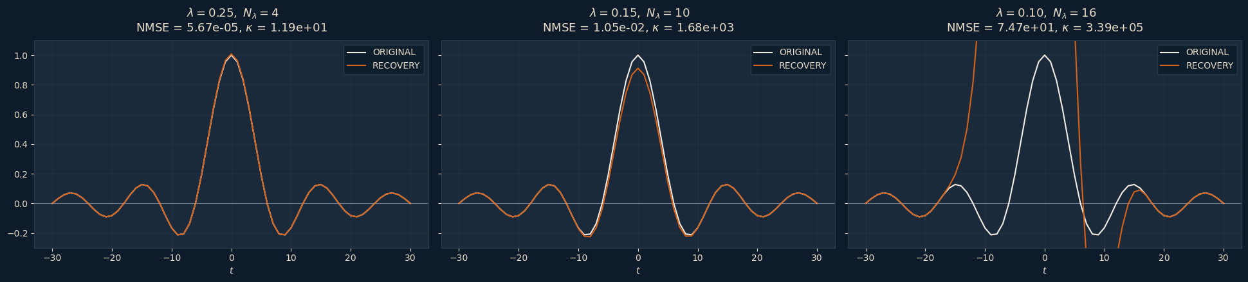

Matrix Inversion
Unstable for high $N_{λ}$
As $N_{λ}$ grows, $V$ becomes ill-conditioned
Notes:
Here's the catch. "Invertible in principle" and "stable in practice" are not the same thing.
As N_

Slide 9

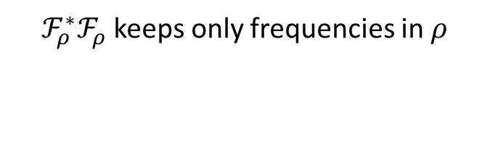

B²R² Algorithm – Inner Loop
Beyond Bandwidth Residual Reconstruction
PGD Inner Loop – repeat to convergence:
Gradient-step:
$$y^{k}=z^{k−1}−γ_{k} ∇C\left(z^{k−1}\right)$$
Project to support:
$$z^{k}=P_{𝒮_{N_{λ}}}\left(y^{k}\right)$$
Over the band-gap:
$$F_{λ}\left(e^{jωT_{s}}\right)=Z\left(e^{jωT_{s}}\right), ω_{m}<\left|ω\right|<ω_{s}/2$$
Objective:
$$\min_{z}{C\left(z\right)=\frac{1}{2}{\left\|ℱ_{ρ}f_{λ}−ℱ_{ρ}z\right\|}^{2} \text{s.t.} z∈𝒮_{N_{λ}}}$$
Gradient:
$$∇C\left(z\right)=ℱ_{ρ}^{∗}ℱ_{ρ}\left(z−f_{λ}\right)$$
THE HIGHPASS FILTER
$ℱ_{ρ}^{∗}ℱ_{ρ }$keeps only frequencies in $ρ$
Notes:
- Frame it as an optimization problem.
- folded spectrum = residual spectrum
- That means, instead of perfectly looking for the equality, we would want to minimize the difference of the DTFT of the two within rho.
- The gradient is then the highpass filter between these two.
- The highpass filter operator takes the DTFT of the difference, keeps only the frequencies in rho, then inverses that back to the time domain sample values.
- We can then use this gradient in an iterative way.

Slide 10
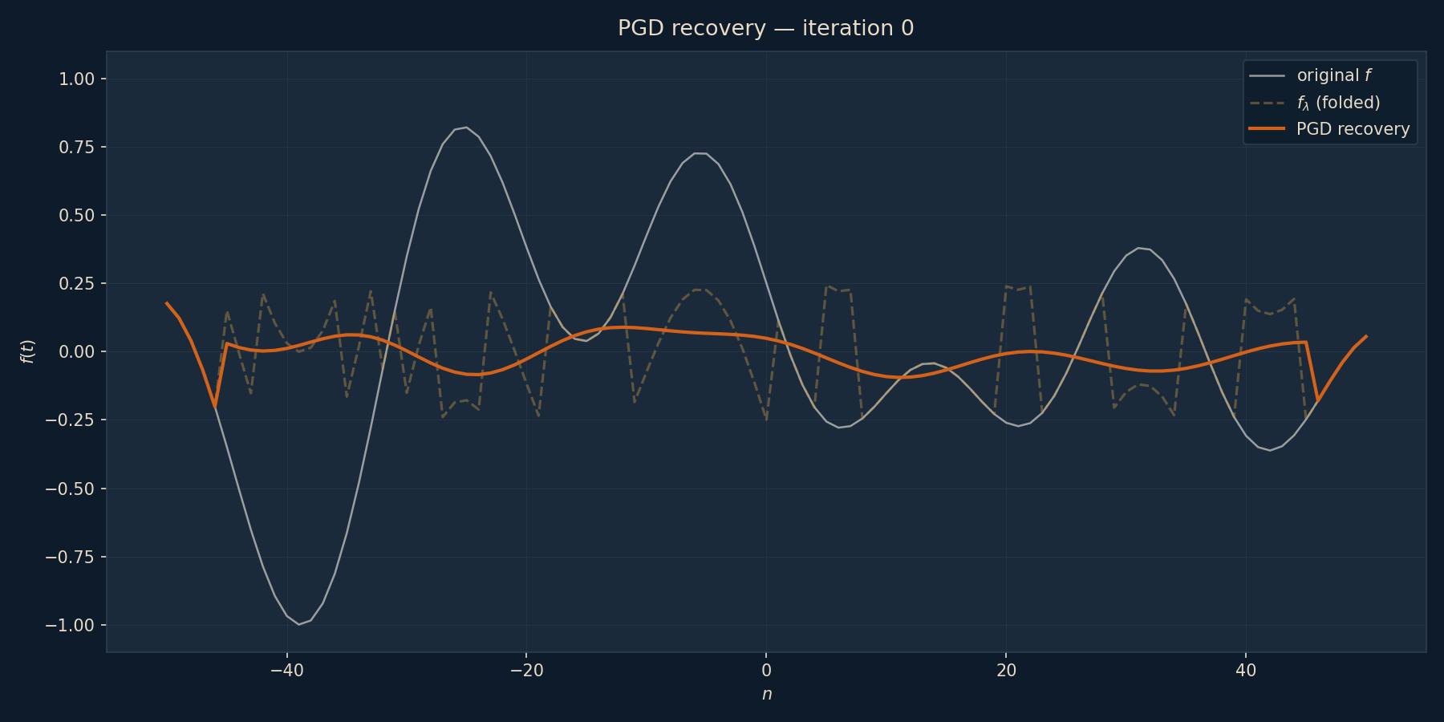
Inner PGD Loop
Set-up

Slide 11
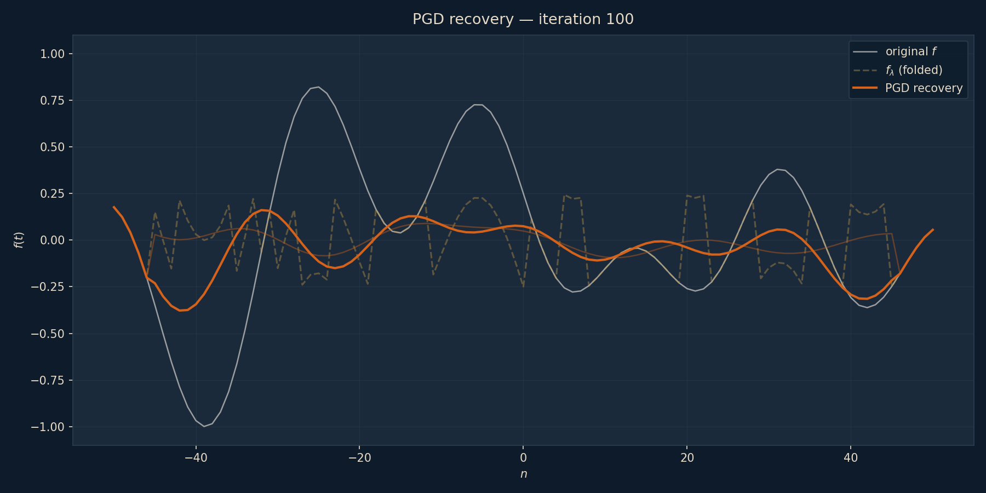
Inner PGD Loop
Set-up

Slide 12
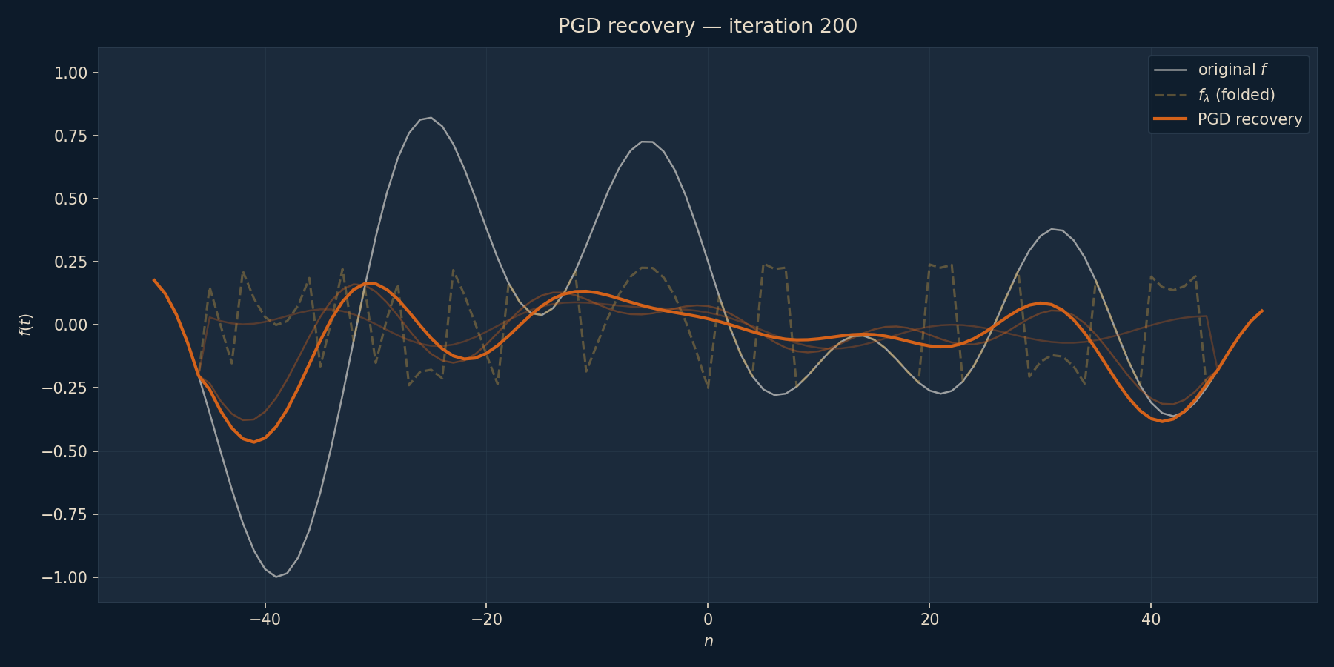
Inner PGD Loop
Set-up

Slide 13
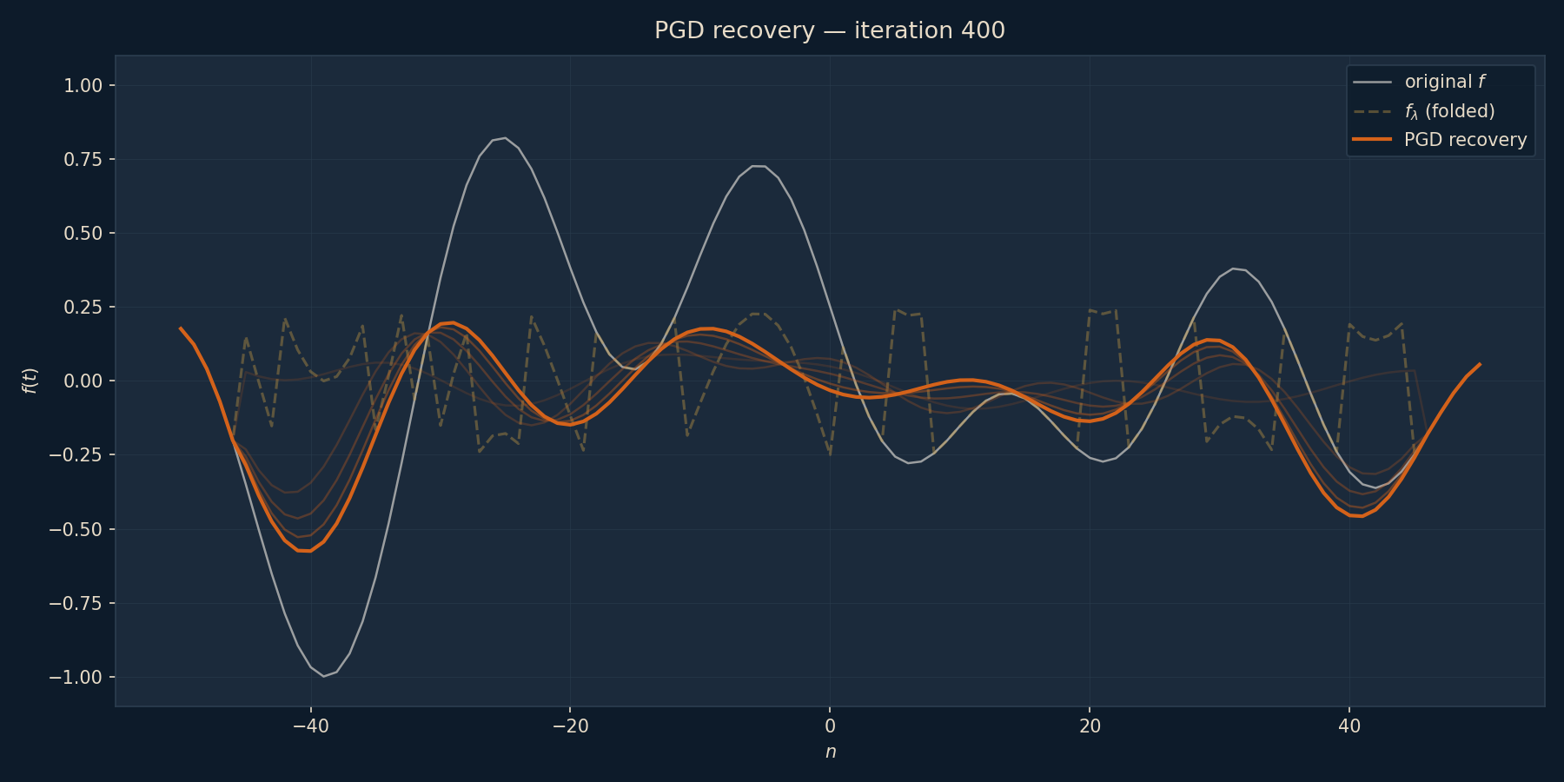
Inner PGD Loop
Set-up

Slide 14
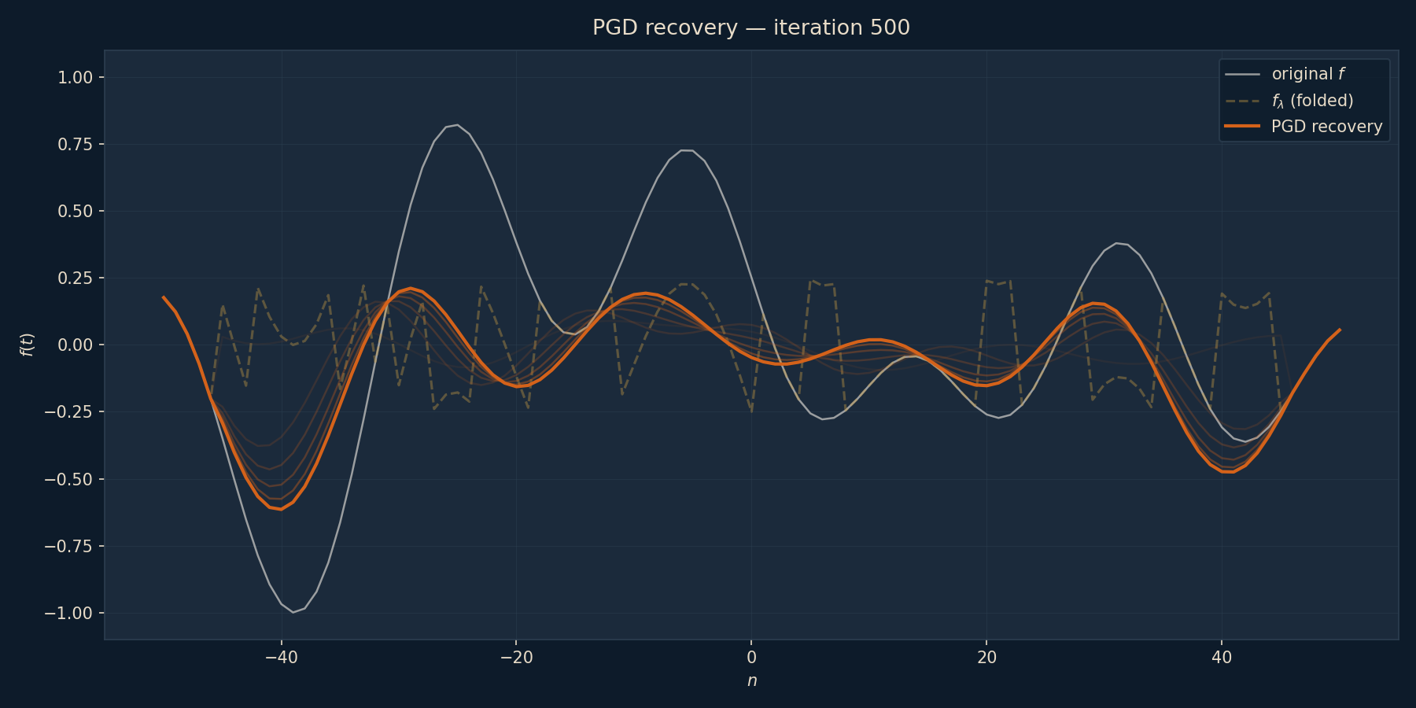
Inner PGD Loop
Set-up

Slide 15
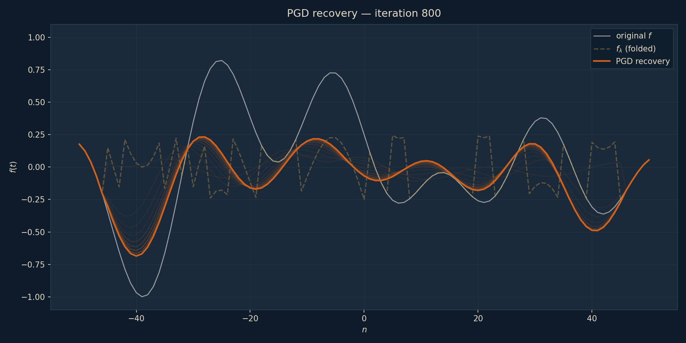
Inner PGD Loop
Set-up

Slide 16
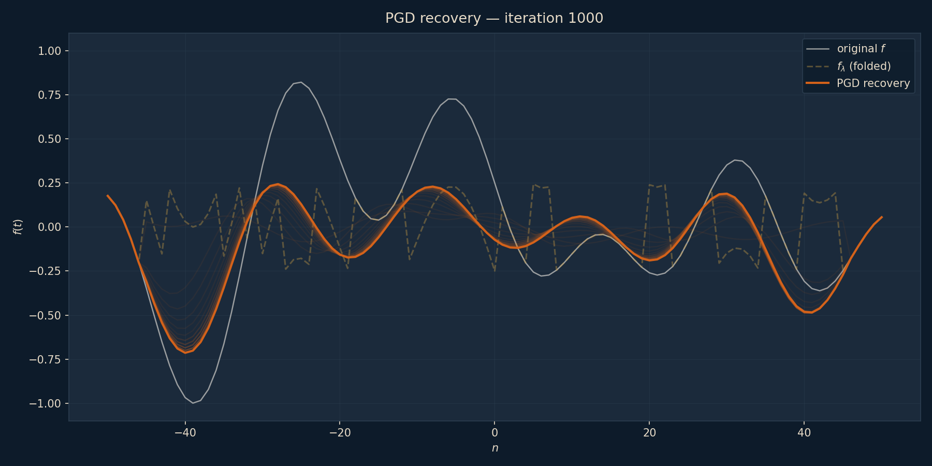
Inner PGD Loop
Set-up
Trust only the edges of the supports
Notes:
So we run the inner loop — a thousand iterations of filter-and-project. And here's what comes out.
Look closely. At the edges of the support, around $±40$, the recovery tracks the true signal beautifully. But toward the middle, where the signal swings hardest and the folds pile up, it falls short — the orange curve flattens out and never reaches those big peaks.
This is the catch with the inner loop on its own: it's accurate at the edges but unreliable in the interior. That's not a bug — it's actually a clue. The residual is easiest to nail down exactly where the signal is just barely crossing $λ$, which is at the edges of the active region.
So the strategy — "trust only the edges" — is exactly what the full algorithm exploits. Lock in the residual at the two outermost samples where we know it's right, peel them off, and shrink the problem. Then repeat on a smaller window.

Slide 17
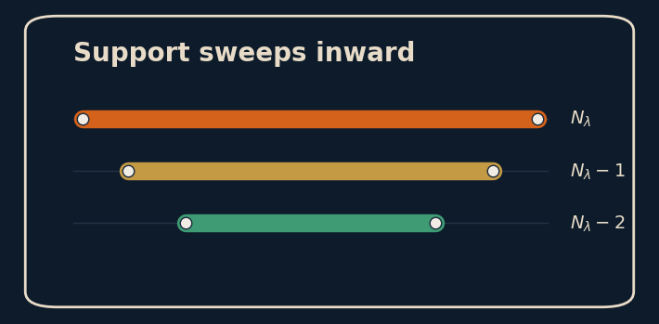
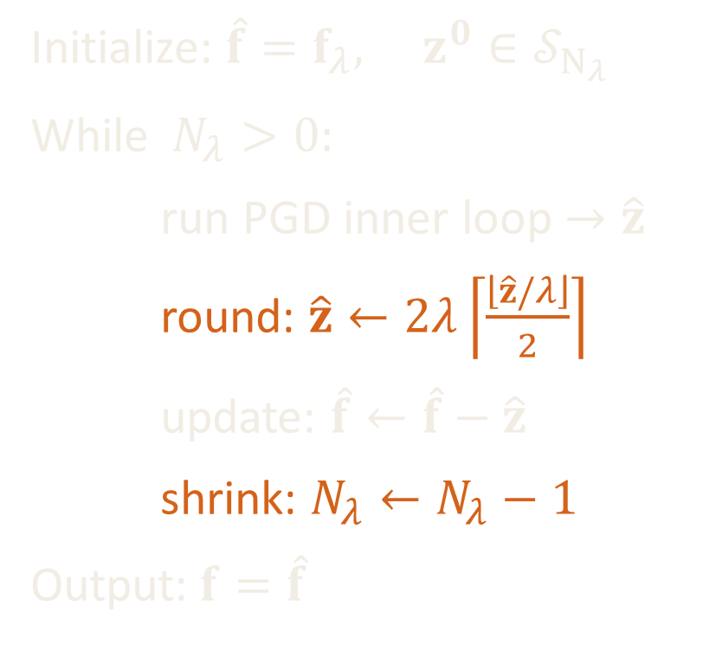
B²R² Algorithm – Full Loop
Beyond Bandwidth Residual Reconstruction
Initialize: $\hat{f}=f_{λ}, z^{0}∈𝒮_{N_{λ}}$
While $N_{λ}>0:$
run PGD inner loop $→\hat{z}$
round: $\hat{z}←2λ\left\lceil \frac{\left\lfloor \hat{z}/λ\right\rfloor }{2}\right\rceil$
update: $\hat{f}←\hat{f}−\hat{z}$
shrink: $N_{λ}←N_{λ}−1$
Output:$f=\hat{f}$
Notes:
The full loop
Exploit:
1. That the residual is structured (at least for the modulo case)
2. The inner PGD loop solves for the edges first
The

Slide 18
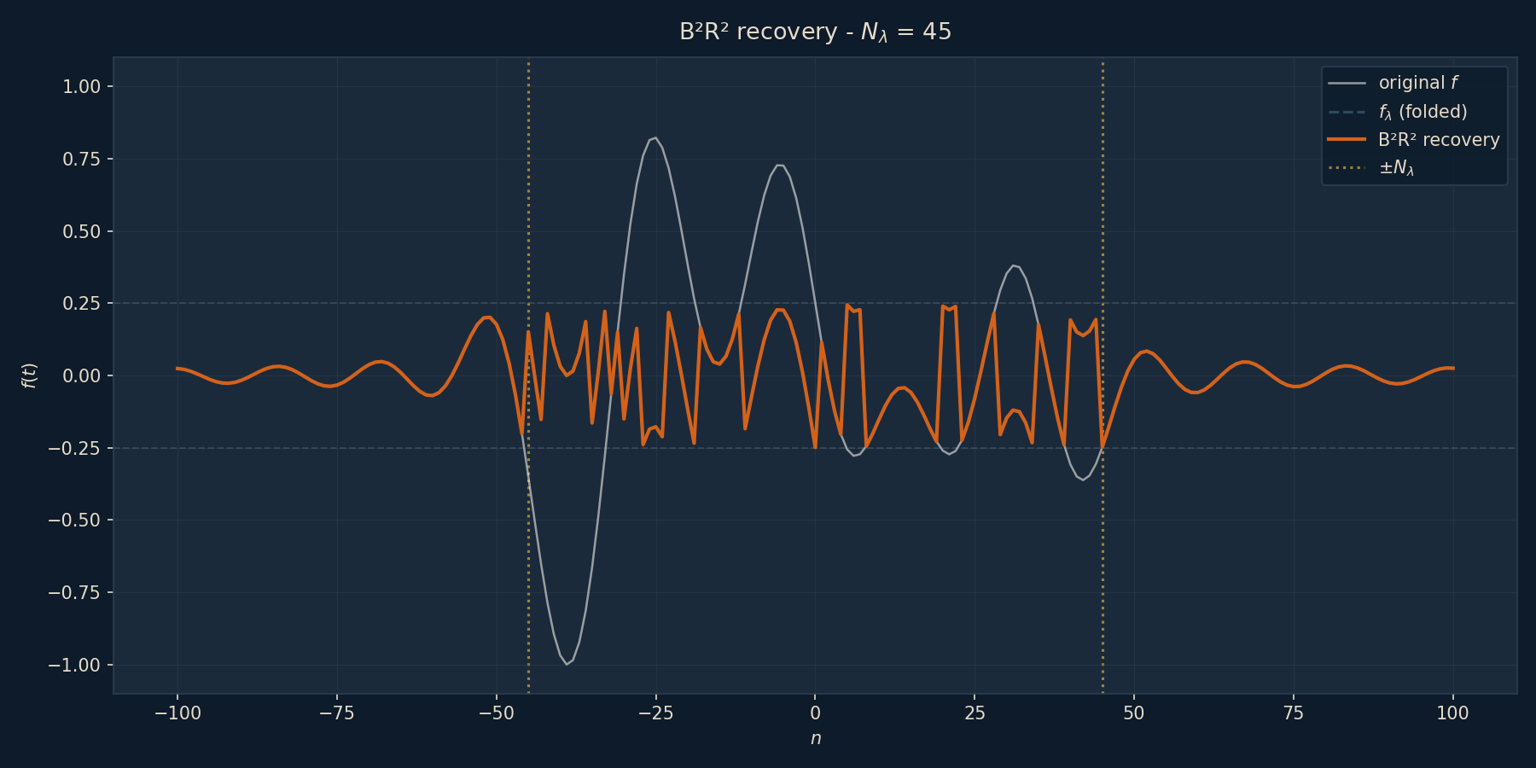
Full B2R2 Implementation
Set-up

Slide 19
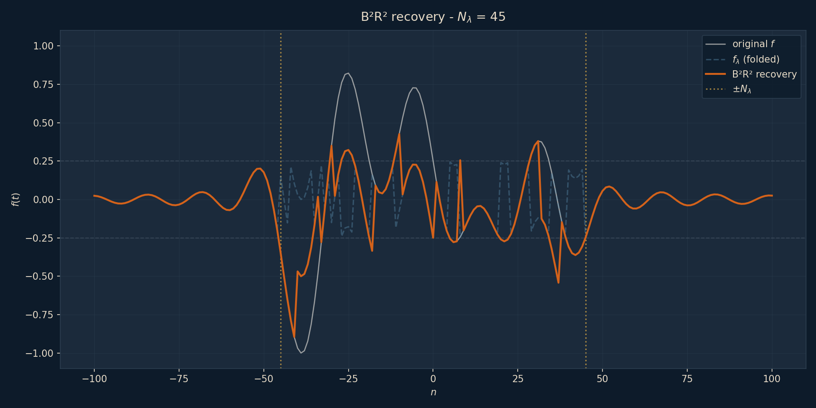
Full B2R2 Implementation
Set-up

Slide 20
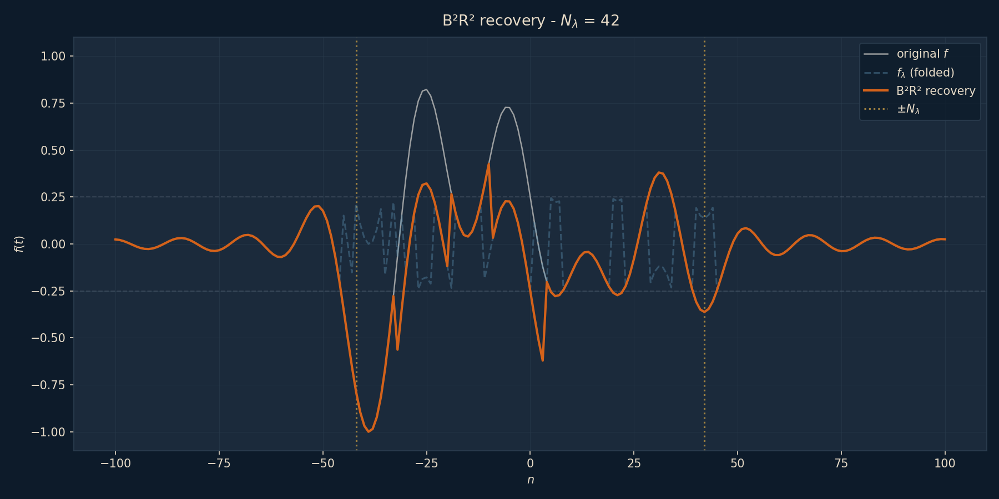
Full B2R2 Implementation
Set-up

Slide 21
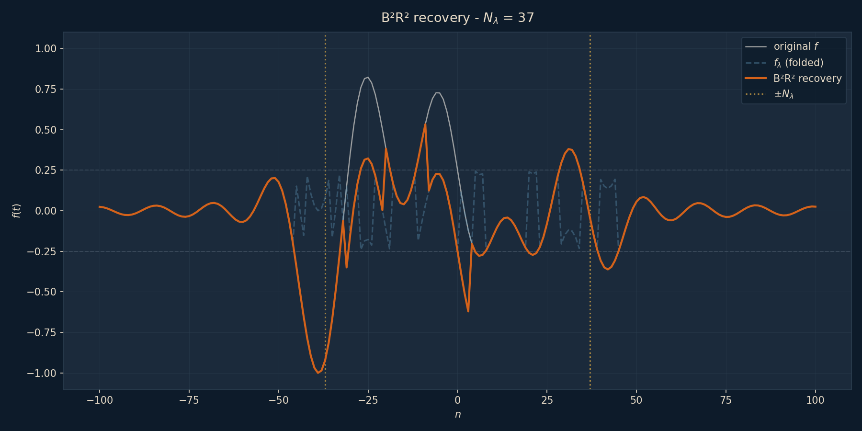
Full B2R2 Implementation
Set-up

Slide 22
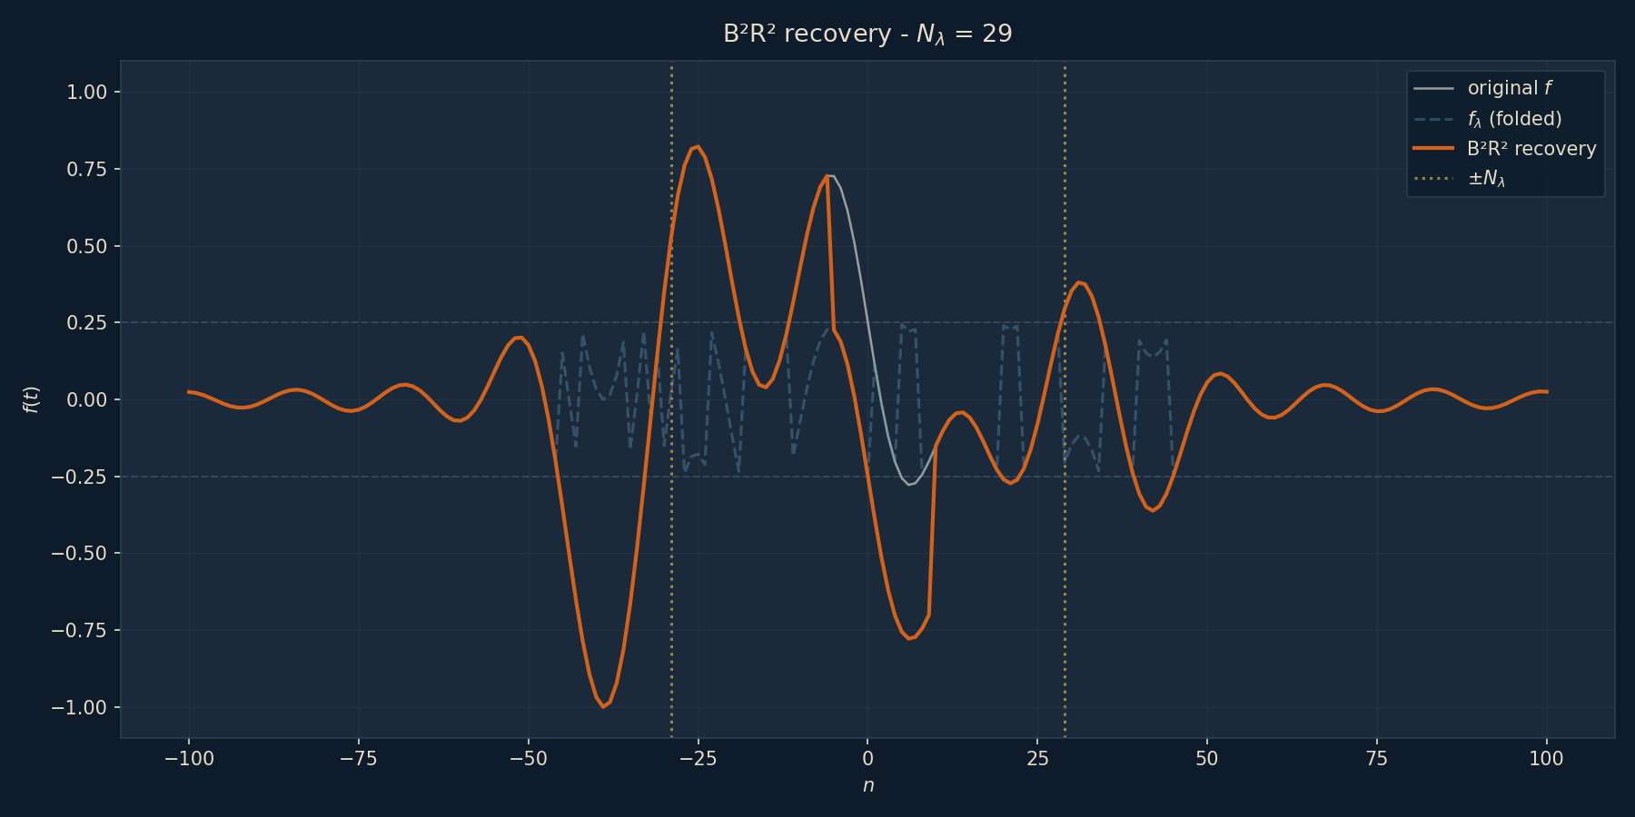
Full B2R2 Implementation
Set-up

Slide 23
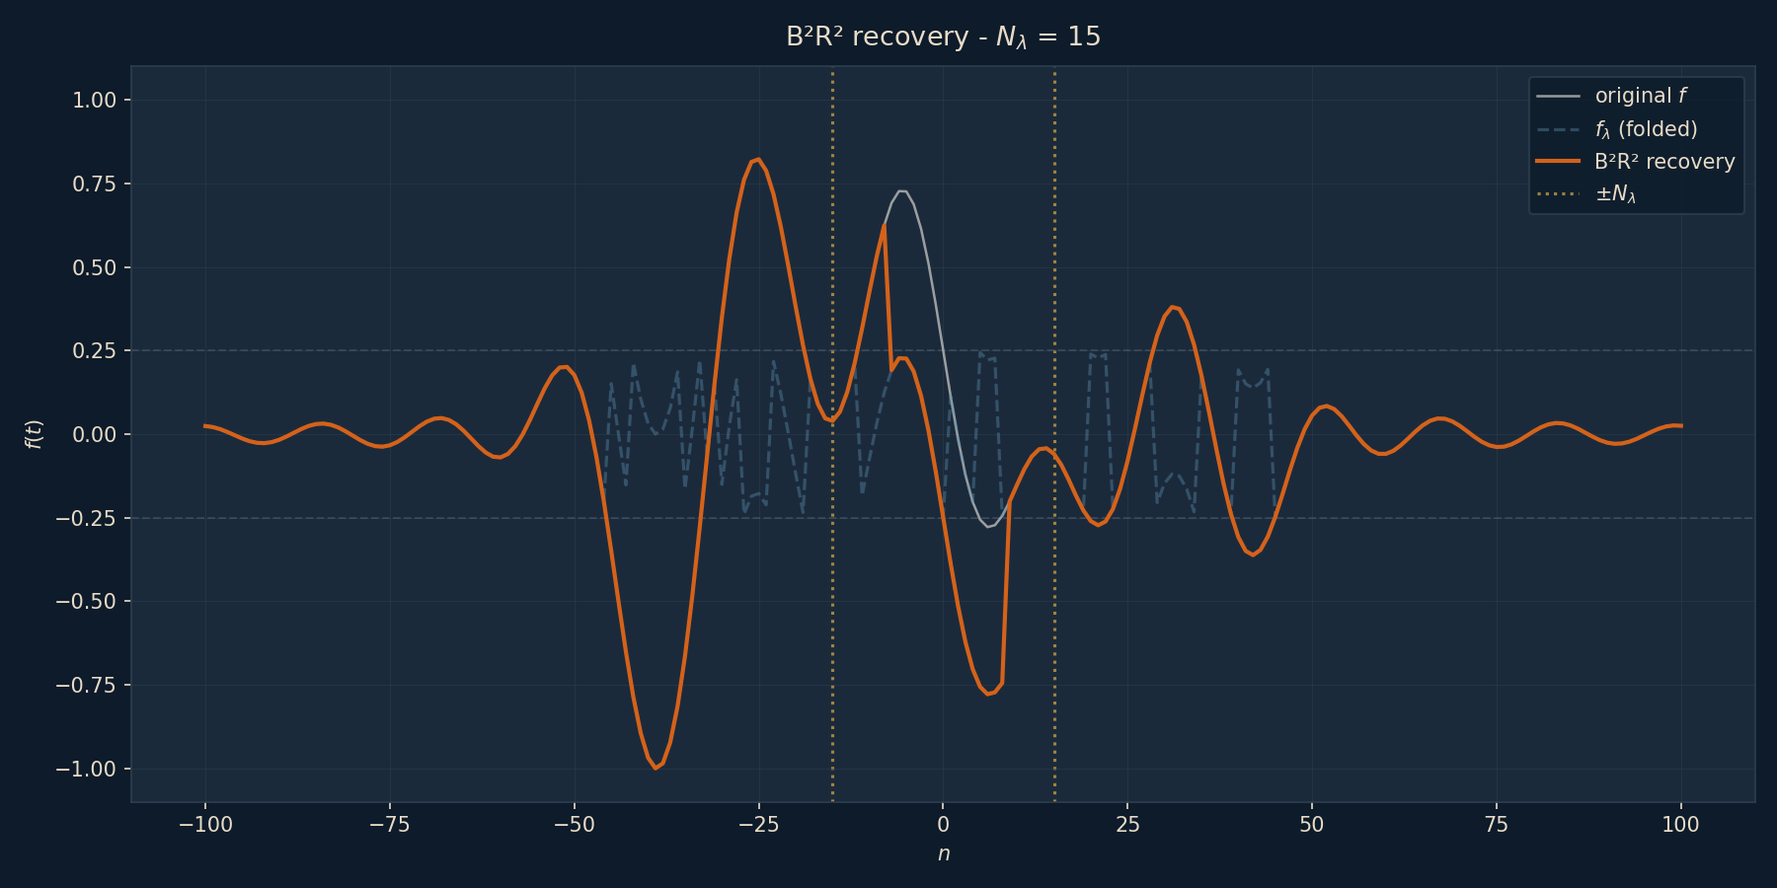
Full B2R2 Implementation
Set-up

Slide 24
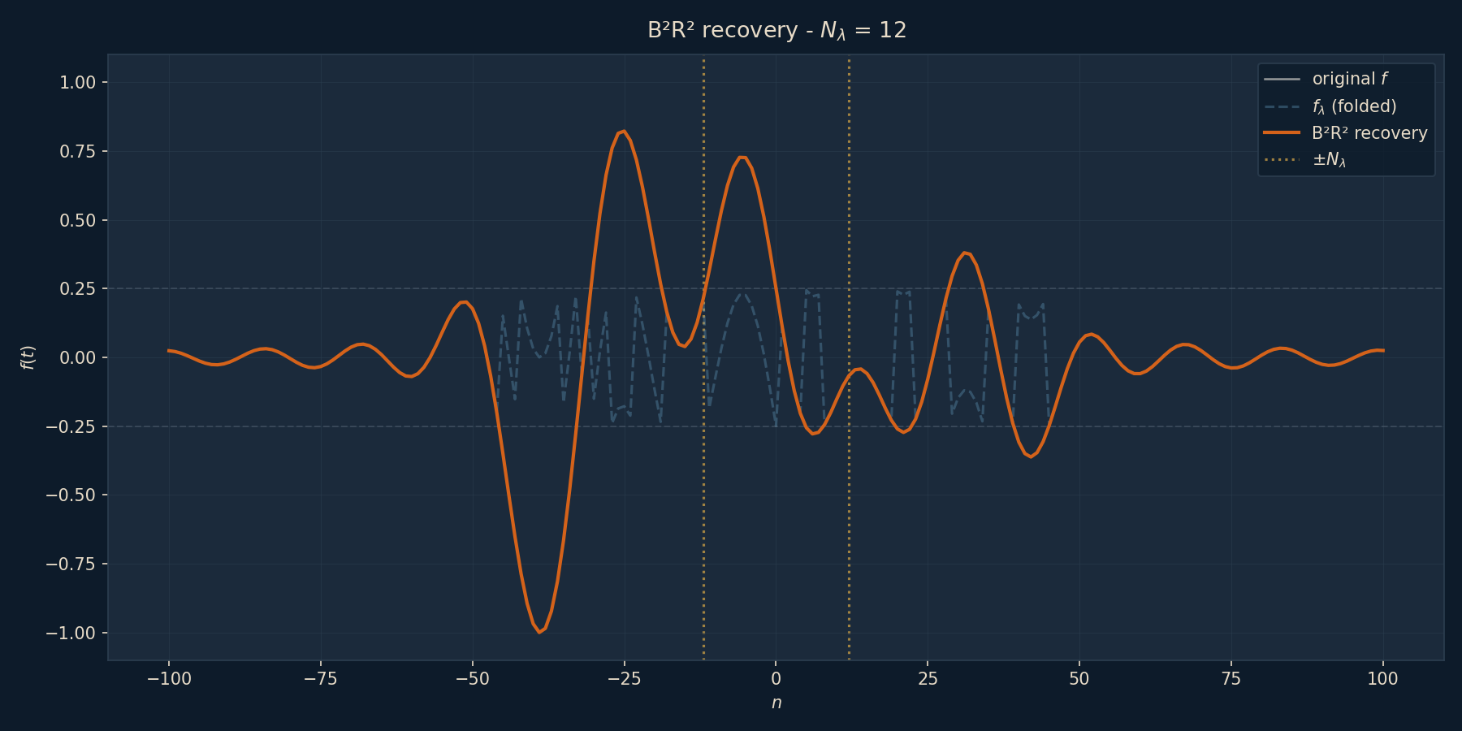
Full B2R2 Implementation
Set-up

Slide 25
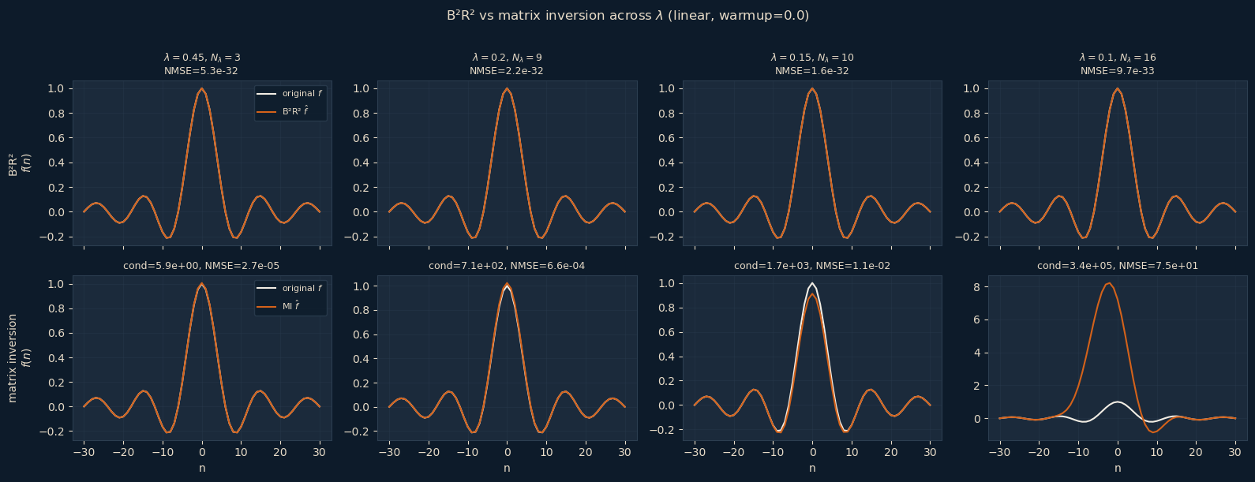
B2R2 vs Matrix Inversion

Slide 26
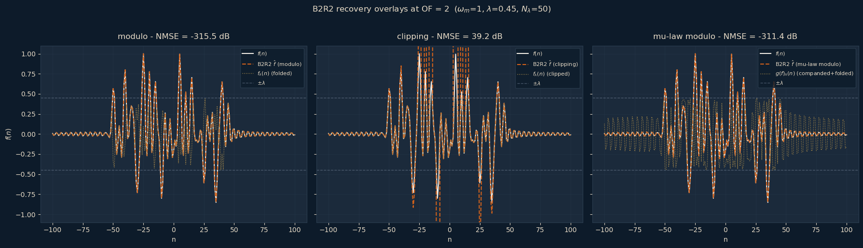
Comparison between Operators

Slide 27
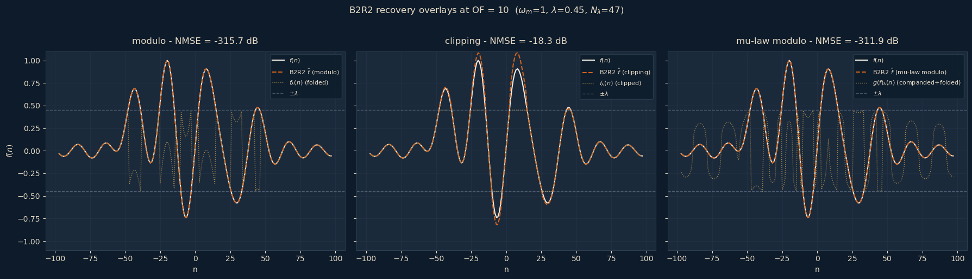
Comparison between Operators

Slide 28
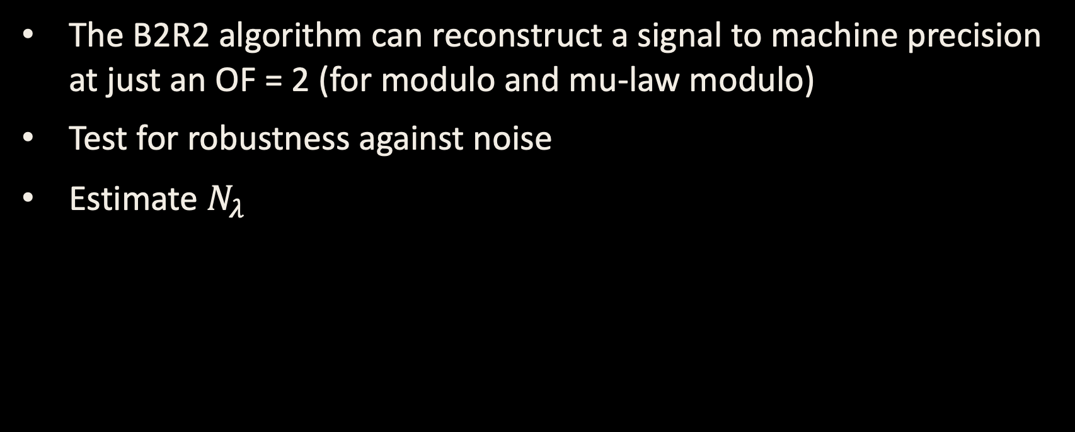
Conclusion and Next Steps
The B2R2 algorithm can reconstruct a signal to machine precision at just an OF = 2 (for modulo and mu-law modulo)
Test for robustness against noise
Estimate $N_{λ}$
Notes:
The full loop
Exploit:
1. That the residual is structured (at least for the modulo case)
2. The inner PGD loop solves for the edges first
The

Slide 29
Thank you

Slide 30
Deep Navy
Background
Dark Slate
Surface/card
Warm Sand
Light text
Burnt Orange
Highlight
Muted Gold
Subtle accent
Off-White
Body text
Deep Navy
Background
Dark Slate
Surface/card
Warm Sand
Light text
Burnt Orange
Highlight
Muted Gold
Subtle accent
Off-White
Body text
#0D1B2A
#1B2A3B
#E8DCC8
#D4621A
#C49A45
#F2EDE4

