Slide 1
Presentation Ninja
⚔with xaringan Yihui Xie

Slide 2
background-image: url(https://upload.wikimedia.org/wikipedia/commons/b/be/Sharingan_triple.svg)
???
Image credit: Wikimedia Commons
class: inverse, center, middle

Slide 3
Get Started

Slide 4
Hello World
Install the xaringan package from Github:
remotes::install_github("yihui/xaringan")
–
You are recommended to use the RStudio IDE, but you do not have to.
Create a new R Markdown document from the menu File -> New File -> R Markdown -> From Template -> Ninja Presentation;1
–
Click the Knit button to compile it;
–
or use the RStudio Addin2 “Infinite Moon Reader” to live preview the slides (every time you update and save the Rmd document, the slides will be automatically reloaded in RStudio Viewer.
.footnote[ [1] 中文用户请看这份教程
[2] See #2 if you do not see the template or addin in RStudio. ]

Slide 5
Hello Ninja
As a presentation ninja, you certainly should not be satisfied by the “Hello World” example. You need to understand more about two things:
The remark.js library;
The xaringan package;
Basically xaringan injected the chakra of R Markdown (minus Pandoc) into remark.js. The slides are rendered by remark.js in the web browser, and the Markdown source needed by remark.js is generated from R Markdown (knitr).

Slide 6
remark.js
You can see an introduction of remark.js from its homepage. You should read the remark.js Wiki at least once to know how to
create a new slide (Markdown syntax* and slide properties);
format a slide (e.g. text alignment);
configure the slideshow;
and use the presentation (keyboard shortcuts).
It is important to be familiar with remark.js before you can understand the options in xaringan.
.footnote[[*] It is different with Pandoc’s Markdown! It is limited but should be enough for presentation purposes. Come on… You do not need a slide for the Table of Contents! Well, the Markdown support in remark.js may be improved in the future.]
class: inverse, middle, center

Slide 7
Using xaringan

Slide 8
xaringan
Provides an R Markdown output format xaringan::moon_reader as a wrapper for remark.js, and you can use it in the YAML metadata, e.g.
--- title: "A Cool Presentation" output: xaringan::moon_reader: yolo: true nature: autoplay: 30000 ---
See the help page ?xaringan::moon_reader for all possible options that you can use.

Slide 9
remark.js vs xaringan
Some differences between using remark.js (left) and using xaringan (right):
.pull-left[ 1. Start with a boilerplate HTML file;
Plain Markdown;
Write JavaScript to autoplay slides;
Manually configure MathJax;
Highlight code with *;
Edit Markdown source and refresh browser to see updated slides; ]
.pull-right[ 1. Start with an R Markdown document;
R Markdown (can embed R/other code chunks);
Provide an option autoplay;
MathJax just works;*
Highlight code with {{}};
The RStudio addin “Infinite Moon Reader” automatically refreshes slides on changes; ]
.footnote[[*] Not really. See next page.]

Slide 10
Math Expressions
You can write LaTeX math expressions inside a pair of dollar signs, e.g. $+$ renders $α+β$. You can use the display style with double dollar signs:
$$\bar{X}=\frac{1}{n}\sum_{i=1}^nX_i$$
$$\overset{‾}{X}=\frac{1}{n}\sum_{i=1}^{n}{X_{i}}$$
Limitations:
The source code of a LaTeX math expression must be in one line, unless it is inside a pair of double dollar signs, in which case the starting $$ must appear in the very beginning of a line, followed immediately by a non-space character, and the ending $$ must be at the end of a line, led by a non-space character;
There should not be spaces after the opening $ or before the closing $.
Math does not work on the title slide (see #61 for a workaround).

Slide 11
R Code
# a boring regression fit = lm(dist ~ 1 + speed, data = cars) coef(summary(fit))
# Estimate Std. Error t value Pr(>|t|) # (Intercept) -17.579095 6.7584402 -2.601058 1.231882e-02 # speed 3.932409 0.4155128 9.463990 1.489836e-12
dojutsu = c('地爆天星', '天照', '加具土命', '神威', '須佐能乎', '無限月読') grep('天', dojutsu, value = TRUE)
# character(0)

Slide 12
R Plots
par(mar = c(4, 4, 1, .1)) plot(cars, pch = 19, col = 'darkgray', las = 1) abline(fit, lwd = 2)

Slide 14
Tables
If you want to generate a table, make sure it is in the HTML format (instead of Markdown or other formats), e.g.,
knitr::kable(head(iris), format = 'html')
Sepal.Length
Sepal.Width
Petal.Length
Petal.Width
Species
5.1
3.5
1.4
0.2
setosa
4.9
3.0
1.4
0.2
setosa
4.7
3.2
1.3
0.2
setosa
4.6
3.1
1.5
0.2
setosa
5.0
3.6
1.4
0.2
setosa
5.4
3.9
1.7
0.4
setosa

Slide 15
HTML Widgets
I have not thoroughly tested HTML widgets against xaringan. Some may work well, and some may not. It is a little tricky.
Similarly, the Shiny mode (runtime: shiny) does not work. I might get these issues fixed in the future, but these are not of high priority to me. I never turn my presentation into a Shiny app. When I need to demonstrate more complicated examples, I just launch them separately. It is convenient to share slides with other people when they are plain HTML/JS applications.
See the next page for two HTML widgets.

Slide 16
library(leaflet) leaflet() %>% addTiles() %>% setView(-93.65, 42.0285, zoom = 17)

Slide 17
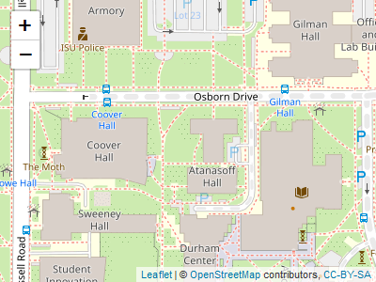

Slide 18
DT::datatable( head(iris, 10), fillContainer = FALSE, options = list(pageLength = 8) )

Slide 19
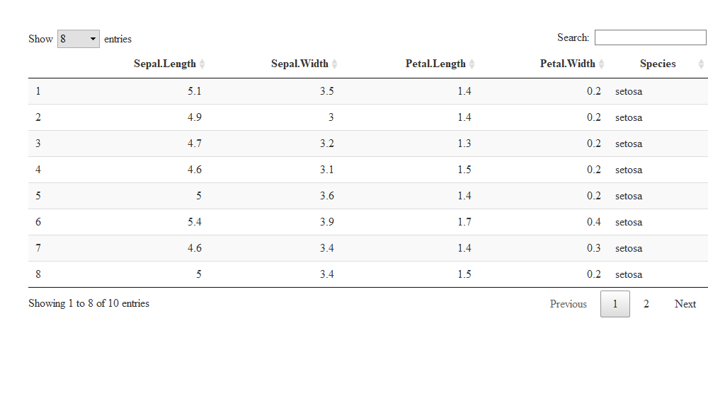

Slide 20
Some Tips
Do not forget to try the yolo option of xaringan::moon_reader.
output: xaringan::moon_reader: yolo: true

Slide 21
Some Tips
Slides can be automatically played if you set the autoplay option under nature, e.g. go to the next slide every 30 seconds in a lightning talk:
output: xaringan::moon_reader: nature: autoplay: 30000
If you want to restart the play after it reaches the last slide, you may set the sub-option loop to TRUE, e.g.,
output: xaringan::moon_reader: nature: autoplay: interval: 30000 loop: true

Slide 22
Some Tips
A countdown timer can be added to every page of the slides using the countdown option under nature, e.g. if you want to spend one minute on every page when you give the talk, you can set:
output: xaringan::moon_reader: nature: countdown: 60000
Then you will see a timer counting down from 01:00, to 00:59, 00:58, … When the time is out, the timer will continue but the time turns red.

Slide 23
Some Tips
The title slide is created automatically by xaringan, but it is just another remark.js slide added before your other slides.
The title slide is set to class: center, middle, inverse, title-slide by default. You can change the classes applied to the title slide with the titleSlideClass option of nature (title-slide is always applied).
output: xaringan::moon_reader: nature: titleSlideClass: [top, left, inverse]
–
If you’d like to create your own title slide, disable xaringan’s title slide with the seal = FALSE option of moon_reader.
output: xaringan::moon_reader: seal: false

Slide 24
Some Tips
There are several ways to build incremental slides. See this presentation for examples.
The option highlightLines: true of nature will highlight code lines that start with *, or are wrapped in {{ }}, or have trailing comments #<<;
output: xaringan::moon_reader: nature: highlightLines: true
See examples on the next page.

Slide 25
Some Tips
.pull-left[ An example using a leading *:
```r if (TRUE) { ** message("Very important!") } ```
Output:
if (TRUE) { * message("Very important!") }
This is invalid R code, so it is a plain fenced code block that is not executed. ]
.pull-right[ An example using {{}}:
```{r tidy=FALSE} if (TRUE) { *{{ message("Very important!") }} } ```
Output:
if (TRUE) { {{ message("Very important!") }} }
## Very important!
It is valid R code so you can run it. Note that {{}} can wrap an R expression of multiple lines. ]

Slide 26
Some Tips
An example of using the trailing comment #<< to highlight lines:
```{r tidy=FALSE} library(ggplot2) ggplot(mtcars) + aes(mpg, disp) + geom_point() + #<< geom_smooth() #<< ```
Output:
library(ggplot2) ggplot(mtcars) + aes(mpg, disp) + geom_point() + #<< geom_smooth() #<<

Slide 27
Some Tips
When you enable line-highlighting, you can also use the chunk option highlight.output to highlight specific lines of the text output from a code chunk. For example, highlight.output = TRUE means highlighting all lines, and highlight.output = c(1, 3) means highlighting the first and third line.
```{r, highlight.output=c(1, 3)} head(iris) ```
## Sepal.Length Sepal.Width Petal.Length Petal.Width Species ## 1 5.1 3.5 1.4 0.2 setosa ## 2 4.9 3.0 1.4 0.2 setosa ## 3 4.7 3.2 1.3 0.2 setosa ## 4 4.6 3.1 1.5 0.2 setosa ## 5 5.0 3.6 1.4 0.2 setosa ## 6 5.4 3.9 1.7 0.4 setosa
Question: what does highlight.output = c(TRUE, FALSE) mean? (Hint: think about R’s recycling of vectors)

Slide 28
Some Tips
To make slides work offline, you need to download a copy of remark.js in advance, because xaringan uses the online version by default (see the help page ?xaringan::moon_reader).
You can use xaringan::summon_remark() to download the latest or a specified version of remark.js. By default, it is downloaded to libs/remark-latest.min.js.
Then change the chakra option in YAML to point to this file, e.g.
output: xaringan::moon_reader: chakra: libs/remark-latest.min.js
If you used Google fonts in slides (the default theme uses Yanone Kaffeesatz, Droid Serif, and Source Code Pro), they won’t work offline unless you download or install them locally. The Heroku app google-webfonts-helper can help you download fonts and generate the necessary CSS.

Slide 29
Macros
remark.js allows users to define custom macros (JS functions) that can be applied to Markdown text using the syntax ![:macroName arg1, arg2, ...] or ![:macroName arg1, arg2, ...](this). For example, before remark.js initializes the slides, you can define a macro named scale:
remark.macros.scale = function (percentage) { var url = this; return '<img src="' + url + '" style="width: ' + percentage + '" />'; };
Then the Markdown text
![:scale 50%](image.jpg)
will be translated to
<img src="image.jpg" style="width: 50%" />

Slide 30
Macros (continued)
To insert macros in xaringan slides, you can use the option beforeInit under the option nature, e.g.,
output: xaringan::moon_reader: nature: beforeInit: "macros.js"
You save your remark.js macros in the file macros.js.
The beforeInit option can be used to insert arbitrary JS code before remark.create(). Inserting macros is just one of its possible applications.

Slide 31
CSS
Among all options in xaringan::moon_reader, the most challenging but perhaps also the most rewarding one is css, because it allows you to customize the appearance of your slides using any CSS rules or hacks you know.
You can see the default CSS file here. You can completely replace it with your own CSS files, or define new rules to override the default. See the help page ?xaringan::moon_reader for more information.

Slide 32
CSS
For example, suppose you want to change the font for code from the default “Source Code Pro” to “Ubuntu Mono”. You can create a CSS file named, say, ubuntu-mono.css:
@import url(https://fonts.googleapis.com/css?family=Ubuntu+Mono:400,700,400italic); .remark-code, .remark-inline-code { font-family: 'Ubuntu Mono'; }
Then set the css option in the YAML metadata:
output: xaringan::moon_reader: css: ["default", "ubuntu-mono.css"]
Here I assume ubuntu-mono.css is under the same directory as your Rmd.
See yihui/xaringan#83 for an example of using the Fira Code font, which supports ligatures in program code.

Slide 33
Themes
Don’t want to learn CSS? Okay, you can use some user-contributed themes. A theme typically consists of two CSS files foo.css and foo-fonts.css, where foo is the theme name. Below are some existing themes:
names(xaringan:::list_css())
## [1] "chocolate-fonts" "chocolate" "default-fonts" ## [4] "default" "duke-blue" "fc-fonts" ## [7] "fc" "hygge-duke" "hygge" ## [10] "ki-fonts" "ki" "kunoichi" ## [13] "lucy-fonts" "lucy" "metropolis-fonts" ## [16] "metropolis" "middlebury-fonts" "middlebury" ## [19] "nhsr-fonts" "nhsr" "ninjutsu" ## [22] "rladies-fonts" "rladies" "robot-fonts" ## [25] "robot" "rutgers-fonts" "rutgers" ## [28] "shinobi" "tamu-fonts" "tamu" ## [31] "uio-fonts" "uio" "uo-fonts" ## [34] "uo" "uol-fonts" "uol" ## [37] "useR-fonts" "useR"

Slide 34
Themes
To use a theme, you can specify the css option as an array of CSS filenames (without the .css extensions), e.g.,
output: xaringan::moon_reader: css: [default, metropolis, metropolis-fonts]
If you want to contribute a theme to xaringan, please read this blog post.
background-image: url(https://upload.wikimedia.org/wikipedia/commons/b/be/Sharingan_triple.svg) background-size: 100px background-position: 90% 8%

Slide 35
Sharingan
The R package name xaringan was derived1 from Sharingan, a dōjutsu in the Japanese anime Naruto with two abilities:
the “Eye of Insight”
the “Eye of Hypnotism”
I think a presentation is basically a way to communicate insights to the audience, and a great presentation may even “hypnotize” the audience.2,3
.footnote[ [1] In Chinese, the pronounciation of X is Sh /ʃ/ (as in shrimp). Now you should have a better idea of how to pronounce my last name Xie.
[2] By comparison, bad presentations only put the audience to sleep.
[3] Personally I find that setting background images for slides is a killer feature of remark.js. It is an effective way to bring visual impact into your presentations. ]

Slide 36
Naruto terminology
The xaringan package borrowed a few terms from Naruto, such as
Sharingan (写輪眼; the package name)
The moon reader (月読; an attractive R Markdown output format)
Chakra (查克拉; the path to the remark.js library, which is the power to drive the presentation)
Nature transformation (性質変化; transform the chakra by setting different options)
The infinite moon reader (無限月読; start a local web server to continuously serve your slides)
The summoning technique (download remark.js from the web)
You can click the links to know more about them if you want. The jutsu “Moon Reader” may seem a little evil, but that does not mean your slides are evil.

Slide 37
class: center

Slide 38
Hand seals (印)
Press h or ? to see the possible ninjutsu you can use in remark.js.

Slide 40
class: center, middle

Slide 41
Thanks!
Slides created via the R package xaringan.
The chakra comes from remark.js, knitr, and R Markdown.

