Slide 1

EMEA EXECUTIVES
Redefining Executive Outreach in the AI Era
Investor / Client Deck – 2025

Slide 2
The Problem
Traditional executive search is opaque, slow, and network‑bound.
Leaders lack live market intel across shifting EMEA hubs.
AI‑era roles require evidence‑based evaluation.

Slide 3
Our Solution
AI‑native sourcing with structured market maps and signal extraction.
Transparent match‑fit scoring, clear and auditable.
GDPR‑first data flows and consent handling.

Slide 4
Market Opportunity
Enterprise, scale‑ups, and PE/VC portfolio companies.
Key hubs: London, Barcelona, Berlin, Paris, Amsterdam, Dubai, Tel Aviv, Stockholm.
AI raises the bar for executive leadership fit.

Slide 5
How We Are Different
Transparent scoring vs. black‑box shortlists.
Persona and culture match for executive contexts.
Privacy‑first workflows with EU data residency options.
Always‑on intelligence from trusted public sources.

Slide 6
Traction
150+ direct employers mapped across EMEA.
5 priority sectors covered.
Ready for distributed C‑suites (remote).

Slide 7
Product Snapshot
Research hub: market maps, role scorecards, outreach sequences.
Match‑fit UI: capability, outcomes, culture, risk flags.
Compliance layer: audit trail, candidate consent, GDPR capture.

Slide 8
Business Model
Retained executive search fees (core).
Advisory for board and investor diligence (optional).
Intelligence dashboard (future SaaS).

Slide 9
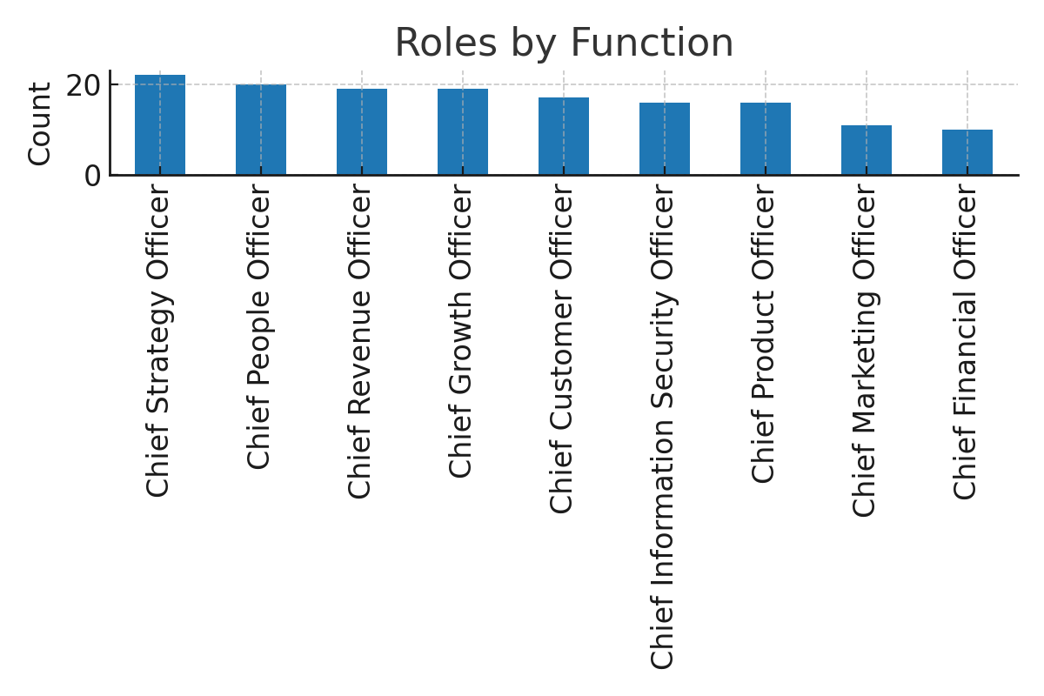
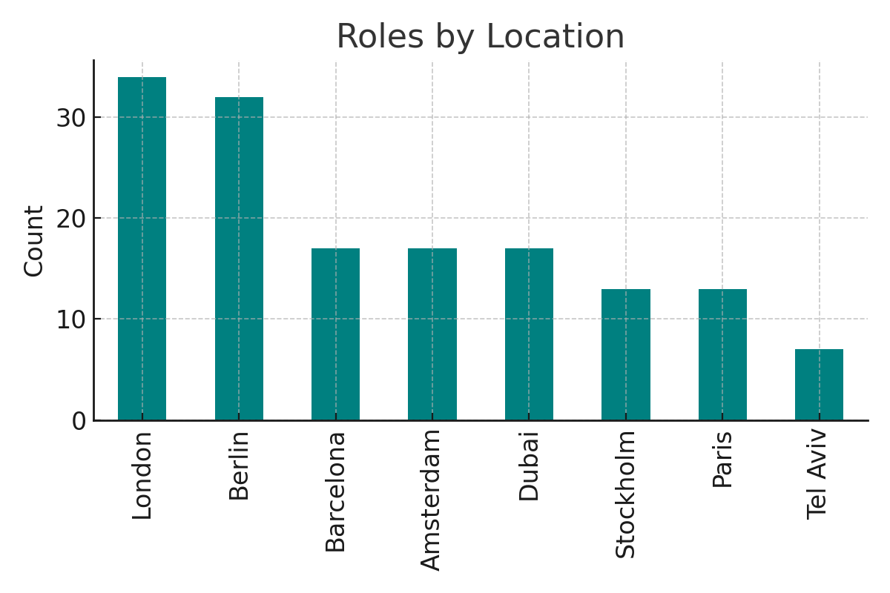
Market Map Snapshot — 150 Roles
Distribution of 150 mapped executive roles across EMEA hubs and functions.

Slide 10
Let's Build Your Leadership Bench
Priority roles: CPO, GTM/Sales, CMO, CFO, CISO, Chief People Officer.
Mobile / WhatsApp: +34 629 720 982 • +44 7541 640 352
Locations: London • Barcelona • Dubai • Berlin

