Slide 1
Labour
Dcm 11

Slide 2
Objectives
Anatomy of fetal skull and pelvis
Definition of labour
Stages of labour
Mechanism of normal labour and delivery

Slide 3
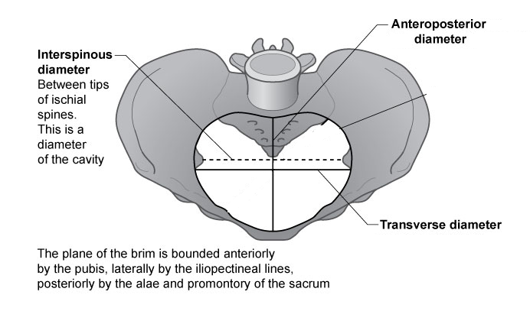
Anatomy – Pelvic Inlet/Brim
11cm
13.5cm
At the pelvic inlet the transverse diameter is wider than the AP diameter

Slide 4
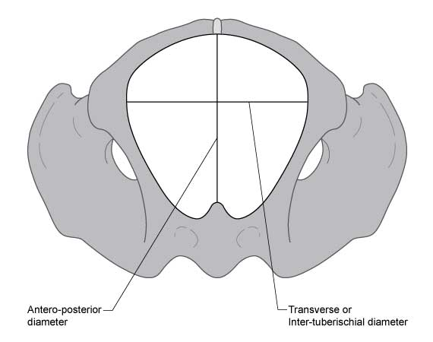
Anatomy: Pelvic Outlet
Pelvic Outlet:
Anterior: lower margin of pubic symphysis
Lateral: pubic rami, ischial tuberosity and sacrotuberous ligaments
Posterior: last part of sacrum
AP diameter: 13.5cm
Transverse diameter: 11cm
At the pelvic outlet, the AP diameter is greater than the transverse diameter

Slide 5
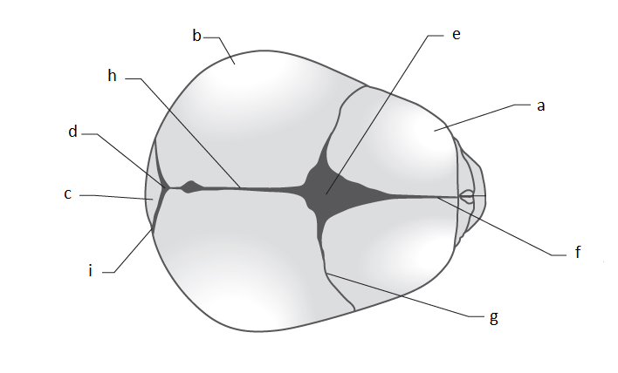
Anatomy – Fetal Skull
Bones:
Fontanelle:
Sutures:
A: Frontal
B: Parietal
C: Occipital
D: Posterior
E: Anterior / Bregma
F: Frontal
G: Coronal
H: Sagittal
I: Lambdoidal
Notes:
Suture lines: Where bones meet, soft unossified membranes
Fontanelle: where sutures meet. Allow for movement and bone overlap in labour
Parietal bones tend to slide over the frontal and occipital bones
All these characteristics allow for moulding which reduces diameter of fetal skull and encourages progress through bony pelvis
Vertex: area bound by two parietal eminences and ant and post fontanelle.

Slide 6
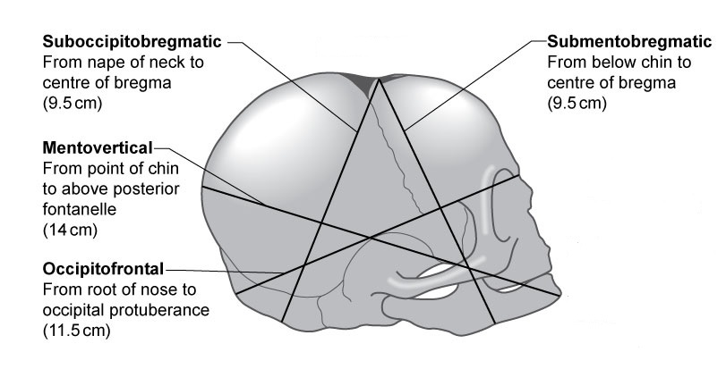
Fetal Skull – Longitudinal Diameters
Notes:
The longitudinal diameter of the presenting part is dependent on the attitude of the fetal head.
Most common attitude: well flexed/vertex presentation: suboccipitobregmatic
Partially extended head/deflexed head: occipitofrontal
Extended head: mentovertical/brow
Hyperextended: submentobregmatic/face

Slide 7
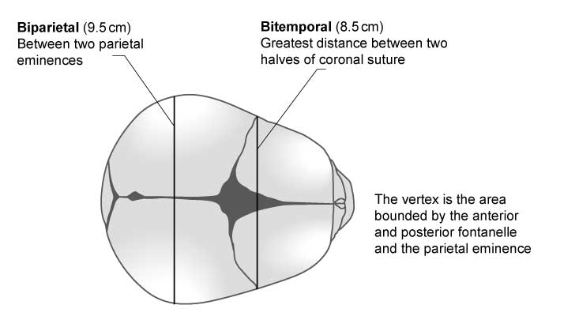
Fetal Skull - Diameters

Slide 8
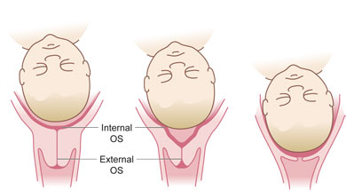
Definition of labour
The onset of regular uterine activity
associated with effacement and dilatation of the cervix, and
descent of the presenting part through the cervix

Slide 9
Stages of labour
First stage: cervical ripening
Latent phase: From onset of labour and 3-4cm dilatation with effacement
Active phase: From 3-4cm until 10cm (fully dilated)
Second stage: from 10cm until delivery
Passive phase: no urge to push as head high
Active phase: active pushing
Third stage: from delivery of fetus until delivery of placenta
Notes:
Effacement is a process whereby the cervix shortens and becomes included into the lower segment of the uterus
Can begin any time in the weeks preceding onset of labour and will be complete bu the end of the latent phase
In primps: effacement precedes dilatation
In multips: can occur simultaneously

Slide 10
Mechanism of normal labour
Engagement
Descent
Flexion
Internal Rotation
Extension
Restitution
External rotation
Delivery of shoulders and body

Slide 11
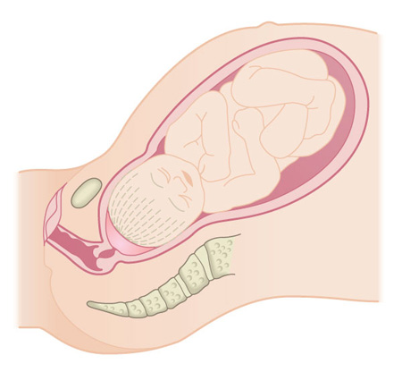
Engagement/descent/flexion
Head enters pelvic brim in a transverse/occipitolateral position (largest diameter of fetal head in line with largest diameter of pelvis)
Progressive uterine activity aids descent and flexion of the fetal head
Fetal head usually well flexed so presenting diameter is suboccipito-bregmatic (9.5cm)

Slide 12
Internal Rotation
Once the head reaches the V-shaped pelvic floor, the fetal head rotates 90° to an occipito–anterior position.
(This brings the longitudinal diameter of the fetal head in line with the larger AP diameter of the pelvic outlet)
Less commonly, the head rotates to an occipito–posterior position, and this may result in a prolonged or obstructed labour.

Slide 13
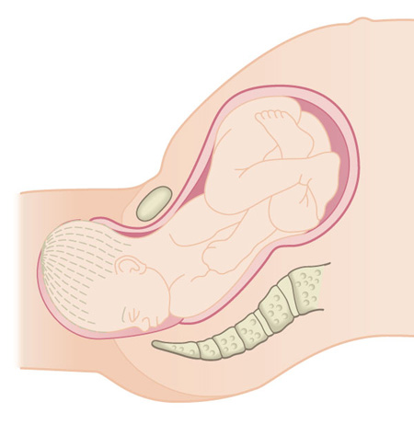
Extension
The head continues its descent beyond the ischial spines
Crowning: The occiput passes beyond the pubic symphysis and no longer recedes following contractions
The head extends and distends the vulva and delivers

Slide 14
Restitution and external rotation
As soon as the head is delivered it realigns itself with the shoulders by turning back to the transverse position - RESTITUTION
The shoulders entered the pelvic inlet in a transverse position and also rotate to an AP position on reaching the pelvic floor – EXTERNAL ROTATION

Slide 15
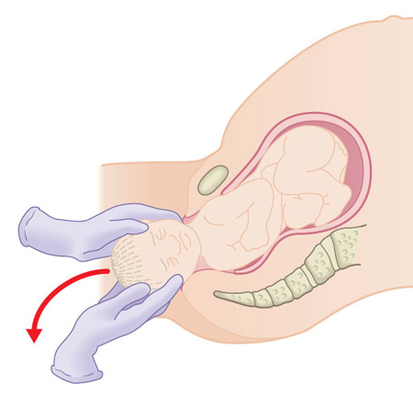
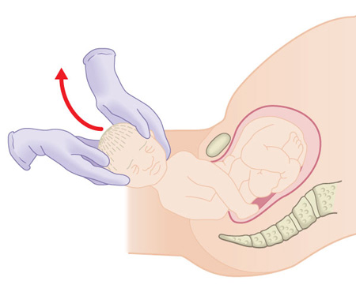
Delivery of shoulders and body
The anterior shoulder is delivered by downward traction of the head
The posterior shoulder is delivered with upward lateral traction
Body follows

Slide 16
Third Stage of labour
This is the time between delivery of fetus until delivery of the placenta
Uterus contracts and placenta separates
Physiological management
Controlled cord traction
Usually a few minutes but should not take more than 30 minutes

Slide 17
Complications
Presentation:
Breech
Transverse
First stage:
Failed induction
Fetal Distress
Delay
Second stage:
Delay
Fetal Distress
Malposition
Maternal Exhaustion
Third Stage:
PPH
Retained Placenta

Slide 18
Thank you Any Questions?

