Slide 1
EPILEPSY
BY MUKISA ERIC
DCM III

Slide 2
DEFINITION
Is a chronic neurological disorder x-terized by recurring seizures. This is due to recurrent abnormality in electrical activity in the brain resulting in behavioural, motor, consciousness or sensory changes.

Slide 3
Seizures
Aseizureistheclinicalmanifestationofanabnormal,excessiveexcitationandsynchronizationofapopulationofcorticalneurons.OrAsudden,briefdisruptionofthenormalfunctioningofneuronsinthebrain.
Asingleseizureisnotepilepsybutanindicationforinvestigation

Slide 4
Types of seizures
Idiopathic-this means there is no apparent cause.
Cryptogenic-this means the doctor thinks there is most probably a cause, but cannot pinpoint it.
Symptomatic-this means that the doctor knows what the cause is.

Slide 5
pathophysiology
Same as the one in status epilepticus !!!!!!!!! discussed below

Slide 6
International Classification of epileptic Seizures
1. Partial/focal; localized to a particular part of one hemisphere. It is further classified as;
Simple partial (no impairment of consciousness) usually lasts less than a min.
Complex plartial (TLE)(with impairment of consciousness)
Many of this type of seizure begin with ; chewing, walking around, mumbling. Can last 2-3 secs, person may not remember anythinhg abt the seizure on recovery.
Secondarily generalised
2. Generalised; involve the whole brain. It is further classified into;
Myoclonic
Absence (petit mal)
Tonic-clonic (grand mal)
Clonic
Tonic
Atonic

Slide 7
Generalized tonic clonic seizures
Loss of consciousness
Mental confusion after regaining consciousness
Foaming at the mouth
Associated with autonomic dysfunction
Loss of sphincter control (urination, passing flatus and defecation)
Associated with an aura

Slide 8
Petit Mal/ Absence seizures
Characterized by sudden cessation of motor activity or speech with blank facial expression (stares)
Absence of senses without collapse
Many seizures in a day
Common in children
Usually on for < 30 sec. but can persist for more
No post ictal state
Self limiting ( Usually disappear at 5-8 years)

Slide 9
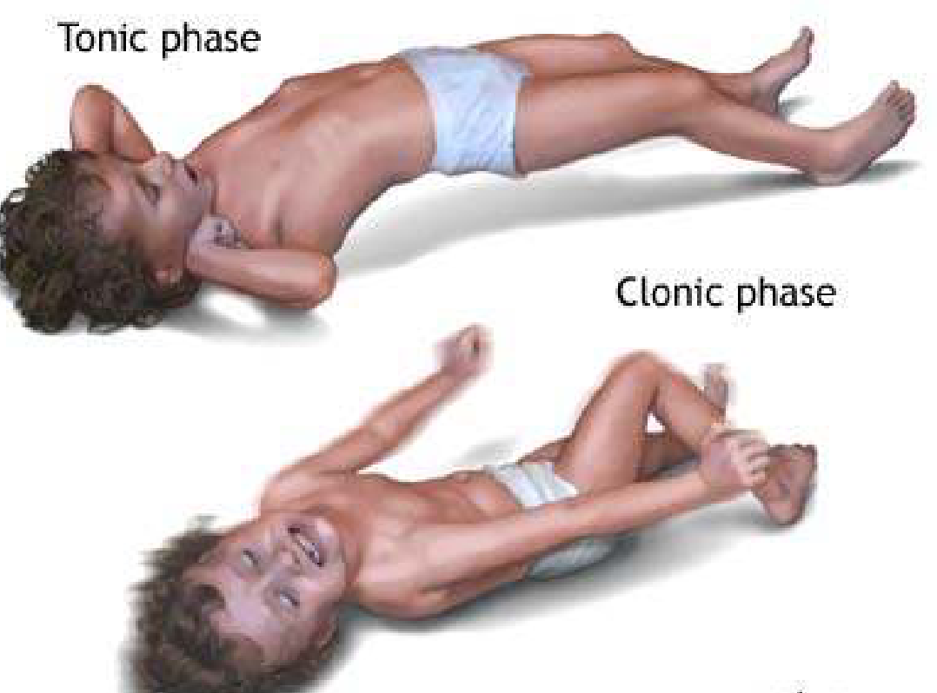
Tonic Clonic Seizure

Slide 10
Tonic
•There is stiffening of the muscles of the back, arms and legs and may cause to fall to the ground.
•Recovery is swift, but injuries can be sustained. Tonic seizures can also occur in sleep.

Slide 11
Atonic
Also known as drop seizures, cause a loss of muscle control (tone),which may cause sudden collapse or fall down.
•The person will become limp and collapse, usually head first, so facial and head injuries are common.
•There is no noticeable loss of consciousness and recovery is swift unless the person is injured

Slide 12
Clonic
Seizures are associated with repeated or rhythmic, jerking muscle movements. These seizures usually affect the neck, face and arms

Slide 13
Myoclonic
Usually appear as sudden brief jerks or twitches of the arms and legs.
•These seizures are very brief but intense muscle jerks usually involving the upper body.
•Many people mistake them for clumsiness as they often occur after awakening resulting in dropping or spilling things. Although consciousness is not impaired, the person may feel confused or drowsy if several seizures occur over a short period. They can sometimes lead to atonic clonic seizure

Slide 14
Tonic-clonicseizures
Previously known as grand mal seizures, are the most dramatic type of epileptic seizure and can cause an abrupt loss of consciousness, body stiffening and shaking, and sometimes loss of bladder control or biting your tongue. These are the most recognized seizures
They begin with a sudden loss of consciousness and often the person will cry out. If standing, the person will fall, the body stiffens (tonic) followed by jerking of the muscles (clonic).
•Breathing is shallow or temporarily suspended causing the lips and complexion to look grey/ bluish
STATUS EPILEPTICUS- the convulsive one (grand mal)

Slide 15
3. UNCLASSIFIED(Neonatal seizures /Infantile spasms)
•Epileptic spasm (which include infantile spasms) consist of a sudden forward flexion of the upper body followed by stiffening. Often the arms are flung out as the knees are pulled up and the body bends forward. Less often, the head can be thrown back as the body and legs stiffen in a straight out position, or movements can be more subtle and limited to the neck or other body parts. Each seizure lasts only asecond or two but they usually occur in clusters

Slide 16
Aetiology
Idiopathic
Hypoxemic ischaemic encephalopathy (birth asphyxia)
Intracranial infections; meningitis, encephalitis
Metabolic disorders ie . Hypoglycaemia
Electrolyte anormalities; hyper/hypo Na, low Mg
Poisoning; Phenothiazine
Narcotic drug withdrawal
Heavy metal poisoning; Lead, gold
Brain tumors
Increased Intracranial Pressure
Trauma
Congenital CNS abnormalities

Slide 17
Differential diagnosis
Syncope
•Psychiatric disorders esp. Conversion disorder, Anxiety
•Metabolic disturbance
•Migraine
•Movement disorders
•Sleep disorders
•Malingering

Slide 18
NB; Brain damage occurs if the seizures remain for 60 minutes. Cell death results from excessively increased metabolic demands by continuously discharging neurons.
Areas of brain ,which are most vulnerable to damage, are hippocampus,amygdala,cerebellum,middlecortical area, and thalamus.

Slide 19
Diagnosis
Hx –precipitating (alcohol, infection drugs) and predisposing factors (febrile seizure, genetic, trauma)
Examination –best after seizure (4 injury, incontinence), mental exam (perceptual, cognitive, affective disorders and ictal, postictal psychosisP)
Investigations ie RBS,RFTS, LFTS, HIV,TPHA,Urinalysis,EEG-in all pts with seizure disorders, imaging ie,skull X-ray, CT-scan,MRI.
MGT

Slide 20
MANAGEMENT
FIRST AID/SUPPORTIVE
DEFINITIVE
DRABCDE
Anticonvulsant
Glucose
AEDs

Slide 21
AEDs
Carbamazepine
Simple & complex focal seizures (TLE)
Secondarily generalized
10-30mg/kg/day
Ethosuximide
Absence seizures (P.Mal)
Complex partial status
Myoclonic (rare)
15-40mg/kg/day
Gabapentin/Pregabalin
Focal seizures ± secondary generalization
30-100mg/kg/day
Lamotrigine
Focal
GTC
Typical absence seizures
1-15mg/kg/day

Slide 22
AEDs
Phenobarbital
All forms of epilepsy except absence seizures
2-6mg/kg/day
Phenytoin
All forms mostly grand mal
4-8mg/kg/day
Sodium valproate
All forms of epilepsy
20-60mg/kg/day
Vigabatrin
Focal seizures
West syndrome
40-150mg/kg/day

Slide 23
Discontinuation of Rx
AEDS should be continued until the patient is free of seizures for at least 1–2 years.
In about 75% of patients, seizures may not recur after discontinuation
Variables which carry a good prognosis include;
Younger age at onset
normal EEG
idiopathic etiology
ease of controlling seizures

Slide 24
Poor prognosis with high risk of recurrence;
symptomatic etiology
later onset
continued epileptiform EEG
difficulty in establishing initial control of the seizures
polytherapy
generalized tonic-clonic or myoclonic seizures
abnormal neurologic examination

Slide 25
Most AEDs (with the exception of barbiturates and clonazepam) can be withdrawn over 6–8 weeks.
Recurrent seizures affect up to 25% of children who attempt withdrawal from medications.
Recurrence of seizures is most likely within 6–12 months of discontinuing medications.
If seizures recur during or after withdrawal, AED therapy should be reinstituted and maintained for at least another 1–2 years.

Slide 26
Psychlogical Rx
H.E on;-signs and symptoms of the condition,what to do when they begin, on precipitations and predisposing factors.
Demystify abt the held culture (beliefs)
Adhere to Rx
Accept illness and good care 4 it

Slide 27
Alternative Rx
1. ACTH & Corticosteroids
Indications
Adrenocorticotropic hormone is indicated for Rx of West syndrome
ACTH is given upto 6 months before attempting withdrawal
if seizures have ceased, tapered over a variable length of time, usually several weeks.
If seizures recur, the dosage is increased to the last effective level
Oral corticosteroids and intravenous immune globulin (IVIG) are occasionally used for pharmacoresistant epilepsy

Slide 28
Dosages
For ACTH (Acthar Gel), start with 40–80 U/d, upto 150 U/m2 IM in a single morning dose.
For prednisone, start with 2–4 mg/kg/d orally in 2-3 divided doses.
Precautions
Guard against infections
Give additional potassium
Watch out for Cushing
Watch out for possible HTN

Slide 29
4. Surgery
Medically intractable partial epilepsy
Video-EEG monitoring, PET, can be used to identify lesions such as cortical dysplasias
Resection
Hemispherectomy
Corpus callostomy
Lobectomy

