Slide 1
Haematinics
By okumu peter

Slide 2
Haematinics
The finite life span of most mature blood cells requires their continuous replacement, a process termed hematopoiesis.
The hematopoietic machinery resides primarily in the bone marrow in adults and requires a constant supply of three essential nutrients:
Iron
Vitamin B12
Folic acid
Hematopoietic growth factors which are proteins that regulate the proliferation and differentiation of hematopoietic cells must also be present.

Slide 3
Haematinics cont’d
Inadequate supplies of either the essential nutrients or the growth factors result in deficiency of functional blood cells of which anemia is the commonest manifestation.
The blood cells begin their lives in the bone marrow from a single type of cell called the pluripotential hematopoietic stem cell.
All cells of the circulating blood are eventually derived from this type of cell.

Slide 4
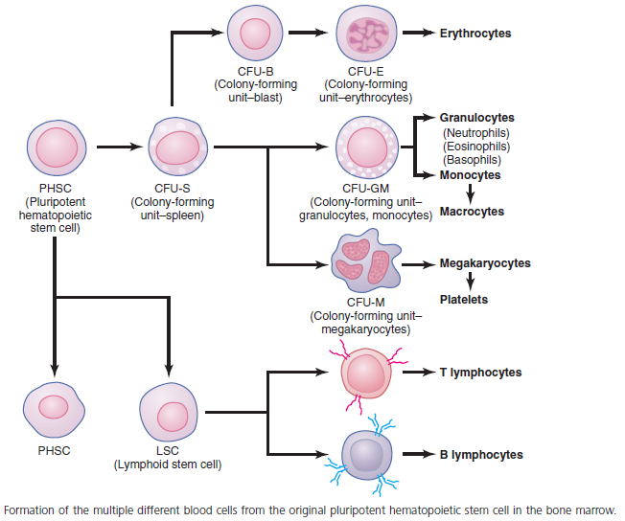
Haematinics cont’d
Hematopoietic system

Slide 5
Haematinics cont’d
Anemia means deficiency of hemoglobin in the blood, which can be caused by either too few RBCs or too little hemoglobin in the cells.
Types of anemia
Blood Loss Anemia
Chronic blood loss leads to iron shortage hence smaller RBCs are formed (microcytic, hypochromic anemia).
Aplastic Anemia Due to Bone Marrow Dysfunction
Lack of adequately functioning bone marrow. Can be caused by chemotherapy, radiation, autoimmune disorder and unknown causes.

Slide 6
Haematinics cont’d
Megaloblastic Anemia
Here RBCs grow too large, with odd shapes, and are called megaloblasts. They have fragile membranes that can rupture easily.
Mainly occurs in patients where folic acid, vitamin B12, and other vitamin B compounds are poorly absorbed.
Hemolytic Anemia
Different abnormalities of the RBCs, many of which are hereditarily acquired, make the cells fragile, so they rupture easily.

Slide 7
Haematinics cont’d
Erythropoietin
Erythropoietin is the most important regulator of the proliferation of committed erythroid progenitors (CFU-E) and is synthesized in the kidney.
Preparations of recombinant human erythropoietin include epoetin alfa, epoetin beta, epoetin omega, and epoetin zeta.
Epoetin alfa has a half life of about 4–13 hrs while darbepoetin alfa has a twofold to threefold longer half-life than epoetin alfa.
Often patients with anemia have elevated levels of erythropoietin unless the anemia has been cause by renal disease.
These usually respond to erythropoietin therapy.

Slide 8
Haematinics cont’d
Clinical uses
Used to reduce the need for red blood cell transfusion in some cancer patients.
Patients who have disproportionately low serum erythropoietin levels for their degree of anemia.
Anemia in Patients With AIDS especially those on zidovudine therapy
Anemia due to kidney disease
Epoetin alfa has been used for the treatment of the anemia of prematurity.
Erythropoietin is one of the drugs commonly used illegally by endurance athletes to enhance performance.

Slide 9
Haematinics cont’d
Toxicity
Commonest adverse effects: hypertension and thrombotic complications.
Iron
Iron deficiency is the most common cause of chronic anemia.
In the absence of adequate iron, small erythrocytes with insufficient hemoglobin are formed, giving rise to microcytic hypochromic anemia.
Free inorganic iron is extremely toxic and hence the body has an elaborate system for regulating iron absorption, transport, and storage.

Slide 10
Haematinics cont’d
Iron absorption increases in response to low iron stores or increased iron requirements.
Hepcidin, produced primarily by liver cells, serves as a key central regulator of the system.
Clinical indications
Iron preparations are indicated for the treatment or prevention of iron deficiency anemia.
Formulations could either be oral or parenteral.

Slide 11
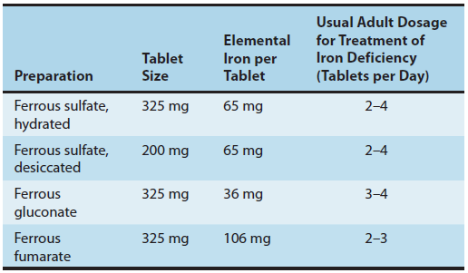
Haematinics cont’d
Oral
formulations
Intravenous formulations:
Iron dextran, sodium ferric gluconate complex, iron sucrose, ferric carboxymaltose and Ferumoxytol

Slide 12
Haematinics cont’d
Acute Toxicity
*Heartburn *Nausea
*Upper gastric discomfort *Bloody diarrhea
*Necrotizing gastroenteritis *Constipation
*Severe metabolic acidosis *Coma
*Shock
Whole bowel irrigation should be performed to flush out unabsorbed pills.
Deferoxamine, a potent iron-chelating compound can be given by IV route to bind absorbed iron.
Supportive therapy for GI bleeding metabolic acidosis and shock should be given.

Slide 13
Haematinics cont’d
Chronic Toxicity (Iron overload)
Also known as hemochromatosis results when excess iron is deposited in the heart, liver, pancreas, and other organs leading to organ failure
It most commonly occurs in patients with inherited hemochromatosis, a disorder characterized by excessive iron absorption and in patients who receive many red cell transfusions over a long period.
Chronic iron overload in the absence of anemia is most efficiently treated by intermittent phlebotomy.
Iron chelation therapy administered parenterally is less efficient and only administered when there is no other option.

Slide 14
Haematinics cont’d
Vitamin B12
Deficiency of vitamin B12 leads to megaloblastic anemia.
Cyanocobalamin and hydroxocobalamin are the available pharmaceutical preparations of vitamin B12.
Vitamin B12 is absorbed after it complexes with intrinsic factor, a glycoprotein secreted by the parietal cells of the gastric mucosa.
Vitamin B12 deficiency in humans most often results from malabsorption due either to lack of intrinsic factor or to loss or malfunction of the absorptive mechanism in the distal ileum.

Slide 15
Haematinics cont’d
Nutritional deficiency is rare but may be seen in strict vegetarians after many years without meat, eggs, or dairy products.
Vitamin B12 is an important component in the formation of methionine with homocysteine formed as an intermediate.
There is evidence that disruption of the methionine synthesis pathway is a cause of neurologic problems.
Without vitamin B12, there is depletion of tetrahydrofolate that prevents synthesis of adequate supplies of the deoxythymidylate (dTMP) and purines required for DNA synthesis in rapidly dividing cells.

Slide 16
Haematinics cont’d
The main clinical indication of vitamin B12 is to treat or prevent its deficiency that can result in megaloblastic anemia.
Hydroxocobalamin is preferred because it is more highly protein-bound and therefore remains longer in the circulation.
Formulations for include; IV, oral, intranasal sprays as well as gels.
Folic acid
Just like vitamin B12, folic acid is required for the synthesis of amino acids, purines, and DNA.
The consequences of folate deficiency go beyond the problem of anemia.

Slide 17
Haematinics cont’d
Folate deficiency is implicated as a cause of congenital malformations in newborns and may play a role in vascular disease.
The richest sources of folic acid include; yeast, liver, kidney, and green vegetables.
Folates are excreted in the urine and stool and are also destroyed by catabolism hence levels may fall within a few days after intake is diminished.
Folic acid is converted into tetrahydrofolate in a reaction that requires vitamin B12.
Folate deficiency also results in a megaloblastic anemia

Slide 18
Haematinics cont’d
Folic acid deficiency is often caused by inadequate dietary intake of folates.
Patients with alcohol dependence as well as those with liver disease can develop folic acid deficiency because of poor diet and diminished hepatic storage.
Pregnant women and patients with hemolytic anemia have increased folate requirements and may become folic acid-deficient, if their diets are marginal.
Patients who require renal dialysis are at risk of folic acid deficiency because folates are removed from the plasma during the procedure.
Drugs can also cause deficiency e.g. Methotrexate and, to a lesser extent, trimethoprim and pyrimethamine.

Slide 19
Haematinics cont’d
Parenteral administration of folic acid is rarely necessary, since oral folic acid is well absorbed.
Folic acid supplementation should be considered in high-risk patients, including pregnant women, hemolytic anemia, liver disease, and patients on renal dialysis.
Other haemopoietic growth factors
Megakaryocyte growth factors (filgastrim, sargramostim, Pegfilgrastim and Lenograstim) used for neutropenias.
Myeloid growth factors (IL-11, romiplostim and eltrombopag) used for thrombocytopenias.

Slide 20
The end
Thank you

