Slide 1
Highly Active Antiretroviral Therapy (HAART)
MANAGEMENT OF HIV/aids

Slide 2
HAART may be defined as therapy which is potent enough to suppress HIV viraemia to undetectable levels (<50 copies/mL), as measured by the most sensitive assay available, and which is durable in its virologic effect.
HAART conventionally includes three or more drugs from at least two classes.
However, as long as there is full and durable suppression of viral load, any regimen should be regarded as HAART.
On the other hand, known sub optimal regimens, e.g. monotherpy, double nucleoside, or certain triple nucleoside combinations are not HAART and are contraindicated in HIV disease.
HAART is the global standard of care in the treatment of HIV infection. Although not a cure for HIV infection, HAART usually results in near-complete suppression of HIV replication.
Treatment has to be lifelong.

Slide 3
Goals of HAART
Reduce HIV-related morbidity and prolong survival
Improve quality of life
Restore and preserve immunologic function
Maximally and durably suppress viral load, and
Prevent vertical transmission of HIV
Promotion of growth and neurological development (in children)

Slide 4
Tools to achieve the goals of therapy
• Maximization of adherence to ART.
This may require getting a treatment buddy who will support the patient to adhere to his treatment.
• Disclosure of HIV sero status reinforces patient adherence to ART.
• Rational sequencing of drugs so as to preserve future treatment options
• Use ARV drug resistance testing when appropriate and available
• Use of viral load estimates for monitoring if available

Slide 5
Principles of ART
Antiretroviral therapy is part of comprehensive HIV care. The guiding principles of good ART include:
• Efficacy of the chosen drug regimens
• Freedom from serious adverse effects
• Ease of administration including no food restrictions.
• Affordability and availability of drugs and drug combinations
• Ongoing support of the patient to maintain adherence
Organised sequencing – spares other available
formulations for use in second line while allowing for
harmonisation of regimens across age and population

Slide 6
Limitations of ART
• Drug interactions and drug resistance may decrease the potency of these drugs
• Patients on ART may develop adverse drug reactions
• The HIV drugs are still relatively expensive even though their prices have significantly reduced
• Patients have to take at least 95% of their pills in order to respond well (adherence is key to successful therapy)
• The medications have to be taken for life. At present, eradication of HIV in the body is not possible
• Some patients may not respond (benefit) to treatment and continue to progress with their HIV disease in spite of doing everything right.
• Children are dependent on adults for adherence to ART
Notes:
Antiretroviral drugs are not a cure for HIV. However, when properly used by both patients and health care providers they are associated with excellent quality of life. They are relatively expensive, require an adequate infrastructure and knowledgeable health care workers. Training of health care personnel in the use of ARVs is critical to safe and effective use of these drugs. Even when all these are in place, ART has its own
limitations in several ways;

Slide 7
initiation of HAART
It is recommended to initiate ART at the earliest opportunity in all documented HIV-infected adults, adolescents and children regardless of CD4 count and WHO clinical staging (Test and Treat)
Notes:
Old guidlines
It is recommended to initiate Antiretroviral Therapy in
Adults and Adolescents with documented HIV infection
CD4 cell count of 250 cells/mm3 and below
CD4 cell count above 250 but below 350 cells/mm 3in those:
¾ Who are co-infected with tuberculosis (TB), or WHO Stage III disease
¾ Women who are pregnant
WHO Stage IV disease irrespective of CD4 cell count
WHO stage I or II with CD4 cell counts ≤250/mm3
Should be based on level of immune suppression
Use clinical criteria and/or laboratory monitoring (CD4)
CD4 count <350 cells/mm³ irrespective of clinical symptoms
Stage III and IV irrespective of CD4
Stage I and II if CD4 <350
Others:
All HIV patients with active TB irrespective of CD4
For all HBV/HIV co-infected individuals requiring treatment for their HBV infection irrespective of CD4 or WHO stage
All pregnant women with CD4 <350 irrespective of clinical symptoms

Slide 8
Recommended First Line Regimens in Adults,
Adolescents, Pregnant Women and Children

Slide 13
Triple NRTI Regimens
A triple NRTI regimen should be considered as an alternative for first-line ART in situations where NNRTI options provide additional complications and to preserve the PI class for second- line treatment e.g.:
• In pregnant women with CD4 counts of 250−350 cells/mm3);
• Patients co-infection with viral hepatitis or tuberculosis;
• Patients with severe adverse reactions to NVP or EFV).
Recommended triple NRTI combinations are:
• zidovudine + lamivudine + abacavir
• and zidovudine + lamivudine + tenofovir.
Notes:
A 3-NRTI combination containing TDF+ABC+3TC or TDF+ddI+3TC should not be
used as triple NRTI regimen at any time becauseof very high virological failure rates.

Slide 14
Recommended second line of ART regimens in adults and adolescents
Back bone is a boosted PI
Plus 2 NRTIs
Preferred PIs are ATV/r and LPV/r
Simplification is required
The entire regimen needs to be changed, so choice depends on first line regimen
ABC+ddI+LPV/r or TDF+3TC+LPV/r
If first line was AZT+3TC+NVP/EFV
AZT+ddI+LPV/r or ABC+ddI+LPV/r or AZT+3TC+LPV/r
If first line was TDF+3TC+NVP/EFV

Slide 15
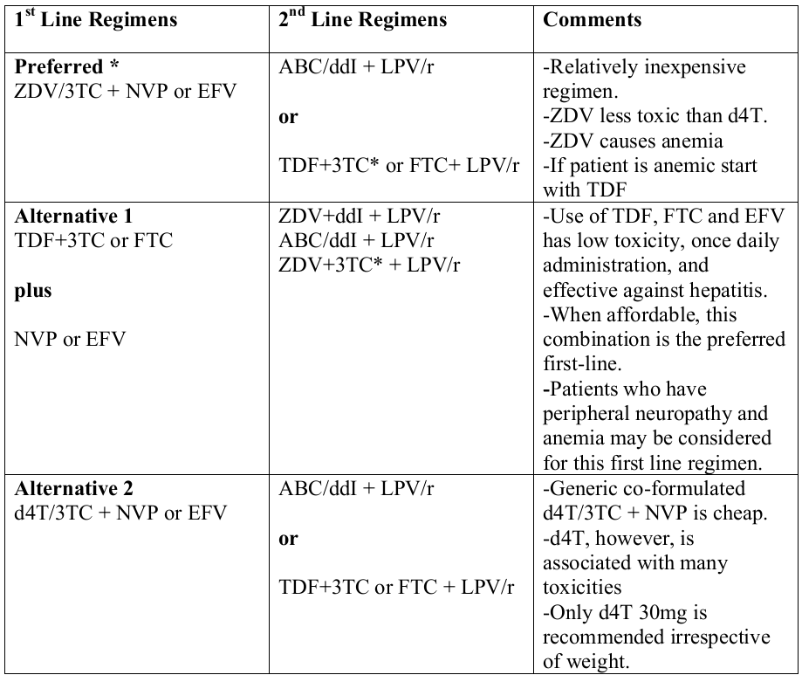
Notes:
Recommended First and Second Line Regimens in Adults and A
Dolescents
Adapted and modified from World Health Organization. Antiretroviral Therapy for HIV
infection in adults and adolescents: Recommendations for a Public Health Approach (2006 revision)
*3TC can be considered to be maintained in 2nd
line regimens to reduce the viral fitness

Slide 18
What to do after 2nd Line Treatment Failure
Salvage regimens are not readily available on the public free ART program
Decisions to continue a failing 2ndline regimen should be made on a case by case basis and in consultation with experts in ART.
when the patient can afford the costs of salvage therapy,
here are options of new :
PIs like darunavir,
NNRTIs like etravirine,
Integrase inhibitors like raltegravir and
chemokine receptor (CCR5) blockers like maraviroc.
Notes:
Because a failing ARV regimen that contains nucleoside analogues and a protease inhibitor may still have a beneficial effect on the immune status of the patient, there is reason to continue with it if no other treatment option is available.

Slide 19
People co-infected with TB and HIV infections
Is complicated because of:
Drug interactions between Rifampicin and NNRTI and Pis
IRIS
Pill burden
Overlapping toxicities
Adherence

Slide 25
post-exposure prophylaxis
The exposure should be classified as “low risk” or “high risk” for HIV infection as below:
Low risk:
• Solid needle, superficial exposure on intact skin
• Small volume (drops of blood) on mucous membrane or non-intact skin exposure
• Source is asymptomatic or VL <1500 c/mL
High Risk:
• Large bore needle, deep injury, visible blood on device, needle in patient artery/vein
• Large volume (major blood splash on mucous membrane or non-intact skin exposures
• Source symptomatic, acute seroconversion, high viral load

Slide 32
When to change therapy
Indications for changing regimens
• Treatment failure
• Drug adverse effects
• Occurrence of active tuberculosis and/or pregnancy
• Inconvenient regimens such as dosing/number of pills that may compromise adherence
• Children dozing to meet their growth requirements
• Economic constraints for those buying their own drugs

Slide 33
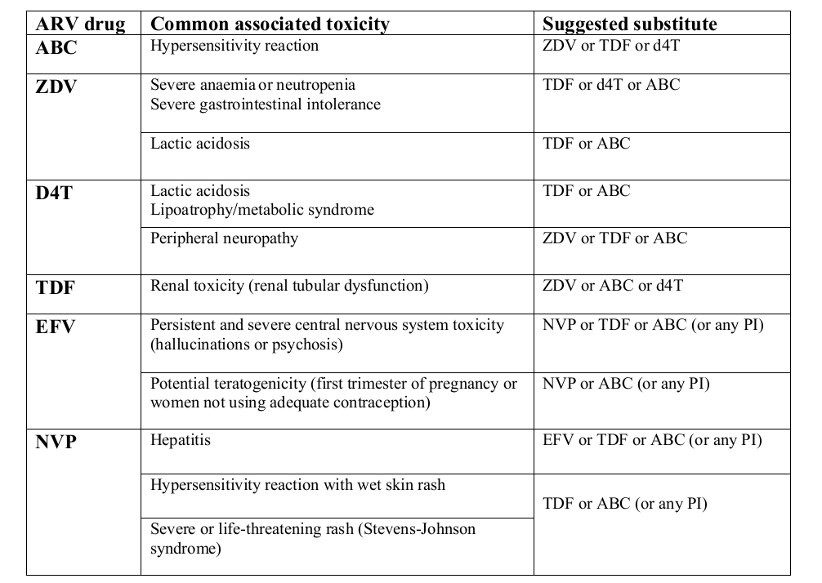
Notes:
Drug specific indications for changing regimens

Slide 34
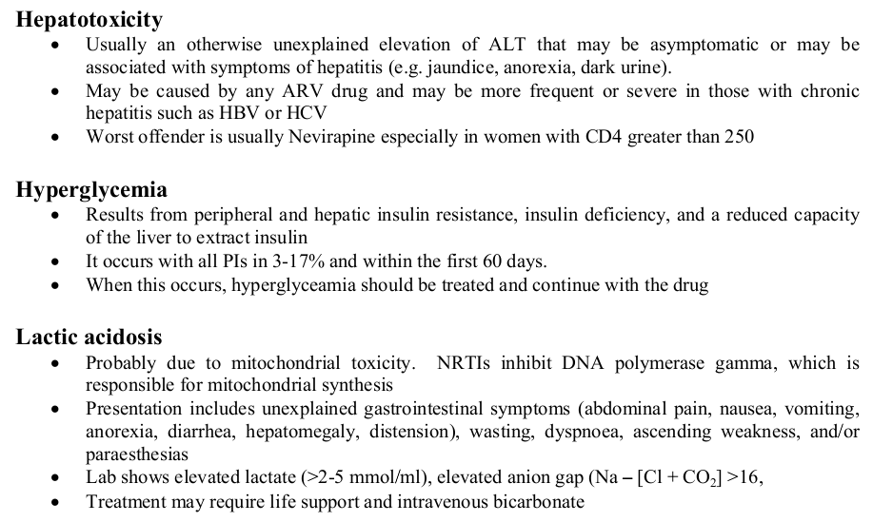

Slide 35
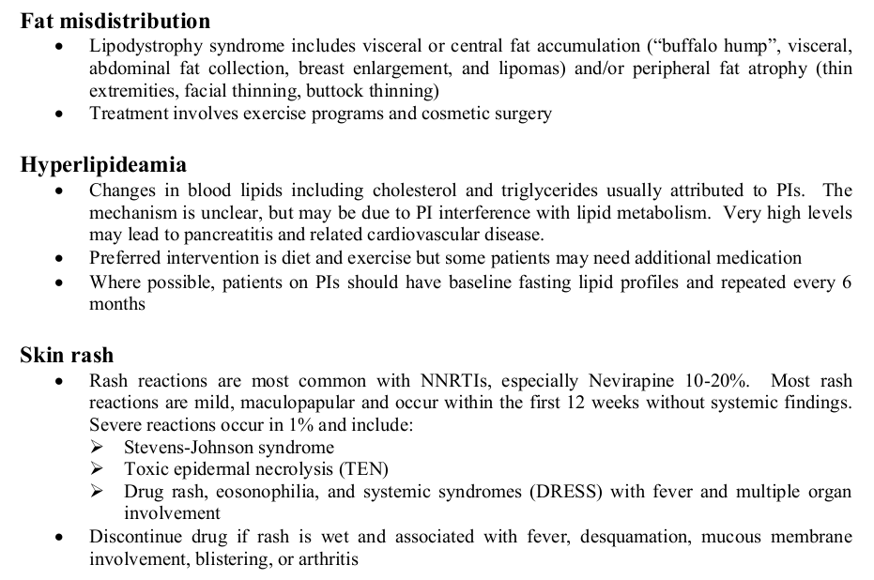

Slide 36

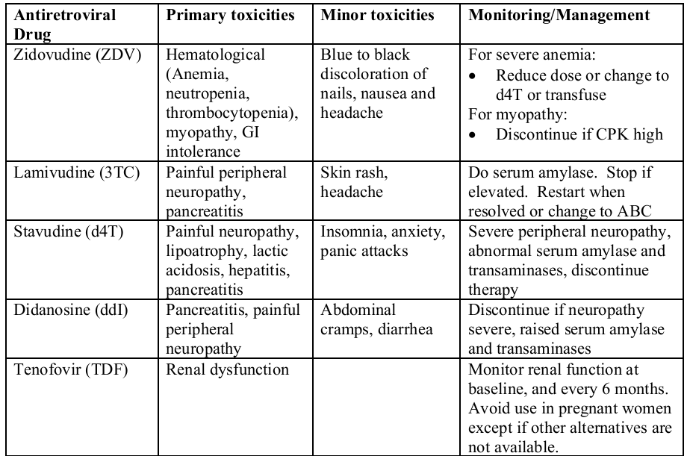

Slide 37
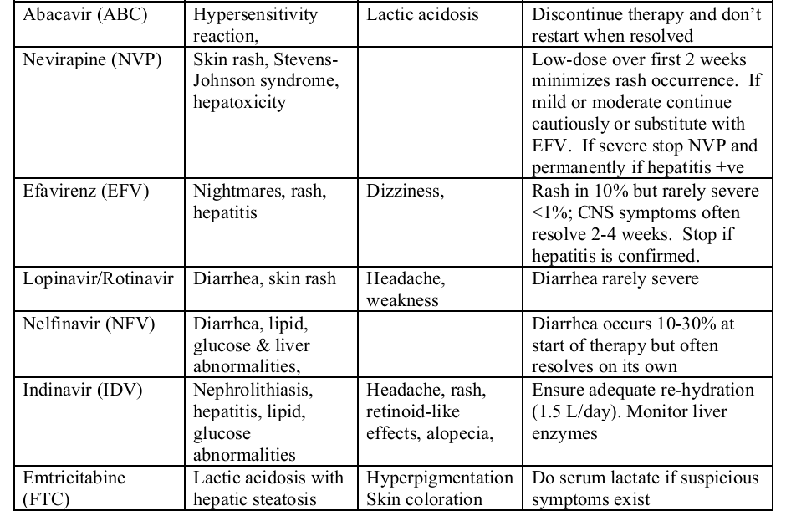

Slide 38
summary

