Slide 1

Antidepressants
Minyeto Daniel, MPS

Slide 2
Definition of Depression
“An affective disorder characterized by loss of interest or pleasure in almost all a person’s usual activities or pastimes.”
A mental condition characterized by severe feelings of hopelessness and inadequacy, typically accompanied by a lack of energy and interest in life

Slide 3
Types of depression
Major depression
Chronic depression (Dysthymia)
Atypical depression
Bipolar disorder/Manic depression
Seasonal depression (SAD)

Slide 4
Types of depression
Major depression – recurring and disabling. Symptoms must last for at least two weeks and impair one’s ability to interfere with a person's ability to work, sleep, study, eat, and enjoy once-pleasurable activities
Chronic depression – less disabling than major depression, but symptoms can last longer, sometimes being unhappy for two years. More common in women, affects 10.9 million peopled
Atypical depression, rather than the other two, is characterized less by pervasive sadness and more by overeating, oversleeping, sensitivity to rejection
Bipolar/manic depression oscillates between major depression and episodes of mania (extreme elation), Bipolar I – episode of mania with or without depression. Bipolar II – episode of depression with episode of hypomania or mania
Seasonal depression (SAD) – often occurs where winters are short or there is a big change in the amount of sunlgiht, and often treated with light therapy

Slide 5
Symptoms Associated With Depression
persistently sad, anxious, or empty moods
loss of pleasure in usual activities (anhedonia)
feelings of helplessness, guilt, or worthlessness
crying, hopelessness, or persistent pessimism
fatigue or decreased energy
loss of memory, concentration, or decision-making capability
restlessness, irritability
sleep disturbances
change in appetite or weight
physical symptoms that defy diagnosis and do not respond to treatment (especially pain and gastrointestinal complaints)
thoughts of suicide or death, or suicide attempts
poor self-image or self-esteem (as illustrated, for example, by verbal self-reproach)

Slide 6
Diagnosis
Extensive patient and family history
Blood test for hypothyroidism
Current medication
DSM-IV (1994) now DSM-IV (2000), DSM-5, currently DSM-IV-TR
  (Diagnostic and Statistical Manual of Mental Disorders)
  One of the first two symptoms
  Five other symptoms

Slide 7
Diagnosis
Physicians will ask many questions about personal mood, new behaviors, changes in routine
Check blood and current drugs to rule out other factors (hypothyroidism, drug side effects)
Drugs like antihypertensives, oral contraceptives, and Accutane for acne can cause depression

Slide 8
Causes
Genetics
Death/Abuse
Medications
  antihypertensives, oral contraceptives, and Accutane for acne

Slide 9
Treatment of Depression
Antidepressant Pharmacology
  First introduced 40 years ago
  Also used for treatment of other disorders including:
  -Anxiety disorders, dysthymia, chronic pain and behavioral problems
Notes:
Dysthymis = persistent mild depression

Slide 10
Treatment (con’t)
Evolution of drug therapy
  Antidepressants discovered accidentally while investigating antipsychotic efficacy of modifications of phenothiazines
  Imipramine - first antidepressant discovered
  Around the same time, monoamine oxidase inhibitors were identified
  Second generation antidepressants identified to address problems with first generation antidepressants
  Late 1980’s- SSRI’s were developed
  Now working on other antidepressant treatments

Slide 11

Treatment (con’t)
Psychotherapy
ECT (Electroconvulsive therapy)
Natural alternatives
Medication
    TCAs
    SSRIs
    MAOs
    SNRIS
    NDRIS
    COMT St. Jone’s wort
Notes:
Psychotherapy = tx of mental disorders by psychological means rather that medical
ECT = put a patient under anesthesia, pass small electric currents into brain to trigger brief seizures. ECT seems to cause brain chemical changes that reverse symptoms of certain mental illnesses

Slide 12
Treatment (con’t)
Psycotherapy/talk therapy – especially useful when combined with meds. Goal is to teach good coping skills for every day stressors
ECT – electric shock is applied to scalp through electrodes, results in seizure in the brain. Fast and effecitve in patients with depression or suicidal thoughts (good for suicide bc doesn’t have the same delayed onset as meds). Usually given up to three times a week for two to four weeks
Natural alternatives – St. John’s wort (sold in teas and tablets, and in diet pills) not good for severe depression but can help mild depression

Slide 13
Tricyclic Antidepressants (TCAs)
Effectively relieve depression with anxiolytic and analgesic action* (eg neuropathic pain)
First choice for treatment of depression
Pharmacological properties: REUPTAKE
  Block presynaptic NE reuptake transporter
  Block presynaptic 5-HT reuptake transporter
  Block postsynaptic histamine receptors
  Block postsynaptic ACh receptors

Slide 14
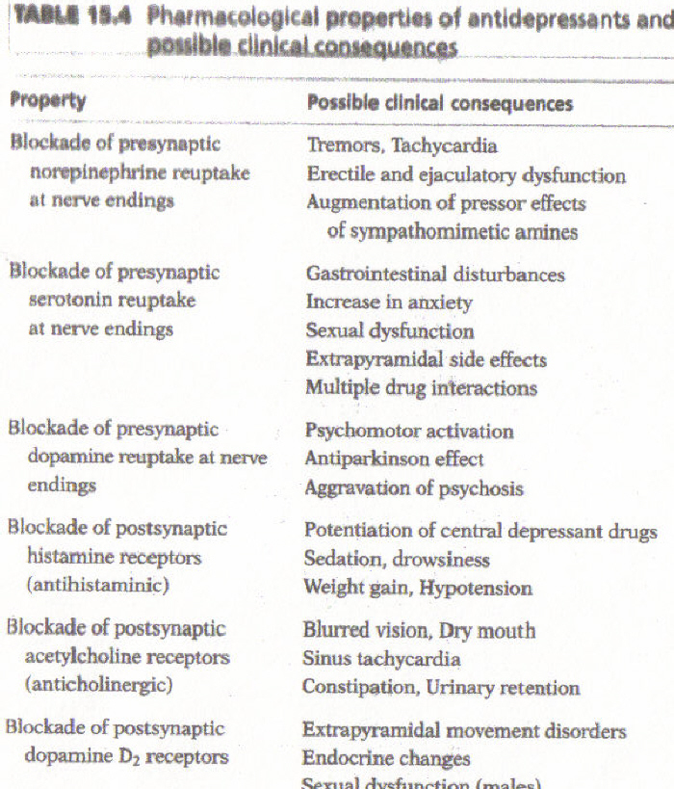


Slide 15
Imipramine and Amitriptyline
Prototypical TCAs
Desipramine (Norpramin) – pharmacologically active intermediate metabolite of imipramine (tofranil)
Nortriptyline (Pamelor) – an active intermediate metabolite of amitriptyline (elavil)

Slide 16
Clinical Limitations of TCA’s
Slow onset of action
Wide variety of effects on CNS (adverse side effects):
  Can directly impair attention, motor speed, dexterity, and memory
Cardiotoxic and potentially fatal in overdoses

Slide 17
Pharmacokinetics
Well absorbed upon oral administration
Relatively long half-lives
Metabolized in the liver
Converted into intermediates that are later detoxified
Readily cross the placenta (teratogenic)

Slide 18
Pharmacological Effects of TCA’s
In CNS: blocks presynaptic 5-HT, DA and NE receptors
Blocking of ACh receptors leads to dry mouth, confusion, blurry vision and mental confusion
Blocking of histamine receptors leads to drowsiness and sedation
Effects on the PNS include: cardiac depression, increased electrical irritability, can be life threatening with overdose

Slide 19
Second Generation (Atypical) Antidepressants
Developed in the late 1970’s and 1980’s
Maprotiline – one of the first clinically available antidepressants, has a long half life and blocks NE reuptake
Amoxapine – primarily a NE reuptake inhibitor
Trazodone – not a potent blocker of NE or 5-HT, its active metabolite blocks a subclass of 5-HT receptors
Bupropion – selectively inhibits DA reuptake, used for ADHD, side effects include: anxiety, restlessness, tremors, and insomnia

Slide 20
Cont’d
Clomipramine – structurally a TCA but exerts inhibitory effects on 5-HT reuptake
  Desmethyclomipramine – active metabolite; classified as a mixed 5-HT and NE reuptake inhibitor
    Used to treat OCD, depression, panic disorder and phobic disorders
Venlafaxine – also a mixed 5-HT and NE reuptake inhibitor
  Also inhibits the reuptake of DA
  Produces improvements in psychomotor and cognitive function

Slide 21
Serotonin - Specific Reuptake Inhibitors (SSRI’s)
Available for the past 15 years
Allows for more serotonin to be available to stimulate postsynaptic receptors
Available to treat depression, anxiety disorders, ADHD, obesity, alcohol abuse, childhood anxiety, etc.

Slide 22
SSRI’s
Fluoxetine (Prozac) – first SSRI available, long half life, slow onset of action, can cause sexual dysfunction, anxiety, insomnia and agitation
Sertraline (Zoloft) – second SSRI approved, low risk of toxicity, few interactions, more selective and potent than Prozac
Paroxetine (Paxil) – third SSRI available, more selective than Prozac, highly effective in reducing anxiety and posttraumatic stress disorder (PTSD) as well as OCD, panic disorder, social phobia, premenstrual dysphoric disorder, and chronic headache

Slide 23
SSRI’s
Fluvoxamine (Luvox) – structural derivative of Prozac, became available for OCD, also treats PTSD, dysphoria, panic disorder, and social phobia
Citalopram (Celexa) – well absorbed orally, few drug interactions, treats major depression, social phobia, panic disorder and OCD

Slide 24
SSRIs
Serotonin syndrome
  At high doses or combined with other drugs an exaggerated response can occur
    This is due to increased amounts of serotonin
    Alters cognitive function, autonomic function and neuromuscular function (somatic effects)
    Its mechanism is not well understood
    Potentially fatal
Serotonin withdrawal syndrome
  With discontinuation of any SSRI onset of withdrawal symptoms occur within a few days and can persist 3-4 weeks
  Symptoms: disequilibrium, gastrointestinal problems, flu-like symptoms, sensory disturbances, sleep disturbances

Slide 25
Dual Action Antidepressants
Nefazodone – a unique antidepressant, resembles a TCA as an inhibitor of 5-HT and NE reuptake, no therapeutic superiority over TCA’s and SSRI’s
Mirtazapine – increases noradrenergic and serotonergic neurotransmission by blocking the central alpha autoreceptors and heteroreceptors, a potent antagonist, rapidly absorbed orally

Slide 26
Monoamine Oxidase Inhibitors (MAOI’s)
Long acting, irreversible inhibitors of monoamine oxidase
Have been used since the 1950’s but have a controversial past
Has potential for serious side effects and potentially fatal interactions with other drugs and food
MAO is one of two enzymes that break down neurotransmitters 5-HT and NE
  Two types
    MAO-A: inhibition causes antidepressant activity
    MAO-B: inhibition causes side effects

Slide 27
Irreversible MAOI’s
Nonselective: block both A and B types
Form a permanent chemical bond with part of the MAO enzyme (enzyme function returns only as new enzyme is biosynthesized)
Have a rapid rate of elimination, excess drug is rapidly metabolized
Inhibition occurs slowly
  Ex: phenelzine (Nardil), tranylcypomine (Parnate), isocarboxazid (Marplan)

Slide 28
Reversible MAOI’s
not available in the U.S. yet
Highly selective in inhibiting MAO-A
Much safer than irreversible MAOI’s
Side effects are minimal
  Ex: Brofaromine, Pirlindole, Toloxatone, and Moclobemide

Slide 29
Serotonin-Norepinephrine Reuptake Inhibitors (SNRIS)
Slightly greater efficacy than SSRIs
Slightly fewer adverse effects than SSRIs
Current drugs
  Venlafaxine (Effexor)
  Duloxetine (Cymbalta)
Mechanism of Action
  Very similar to SSRIs
  Works on both neurotransmitters
Side effects
  Similar to SSRIs
  Suicide
Notes:
Venlafaxine is a racemix mixture
While SSRIs are less potent than the other classes of drugs, they have more manageable side effects so they’re considered better
The mechanism is similar to SSRIs, as are the side effects. However, the rate of suicide for SNRIs has been debateable, especially venlafaxine.
Finnish study showed Ven increased suicide risk 1.6 times compared to no treatment while Fluoxetine halved it.
FDA study showed 5-fold increase in <25 so it is contraindicated in adolescents.

Slide 30
Norepinephrine-Dopamine Reuptake Inhibitors (NDRIS)
Current drugs
  Bupropion (Wellbutrin)
Mechanims of Action
  Similar to SSRIs and SNRIs
  More potent in inhibiting dopamine
  Also anα3-β4 nicotinic antagonist (used to stop smoking)
Adverse effects
  Lowers seizure threshold
  Suicide
  Does not cause weight gain or sexual dysfunction (even used to treat the two)
Notes:
Bupropion is a racemic mixture

Slide 31
New Drug Treatments
Catechol –O- Methyltransferase inhibitors (COMT inhibitors) – second of two enzymes that catalyze the inactivation of DA and NE by decreasing neurotransmitter levels
  Tolcapone – specific inhibitor of COMT used in treatment of Parkinson’s
SNRI – soon to be available for clinical use
  Reboxetine – first of its kind to block NE reuptake without also blocking DA or 5-HT reuptake
Serotonin 5-HT₁ Agonists – appear to be responsible for acute antidepressant effects

Slide 32
END
Thank you for listening

