Slide 1
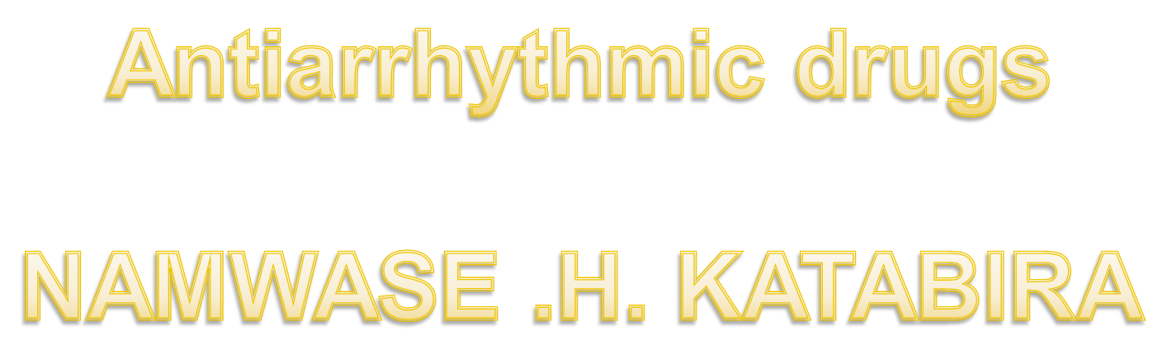


Slide 2

LECTURE’S OUTLINE:
Electrophysiology of the heart
Arrhythmia: definition, mechanisms, types
Drugs :class I, II, III, IV
Guide to treat some types of arrhythmia
Questions

Slide 3

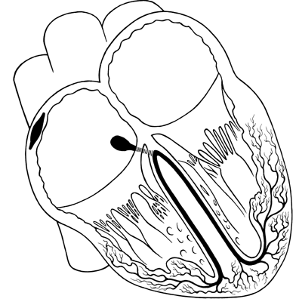
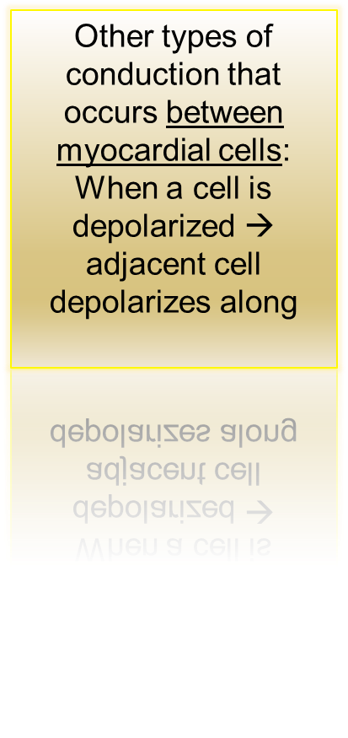
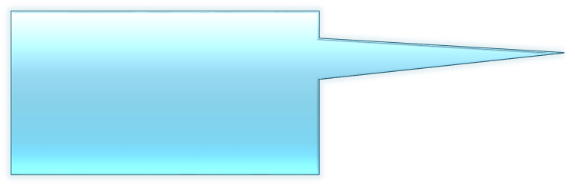
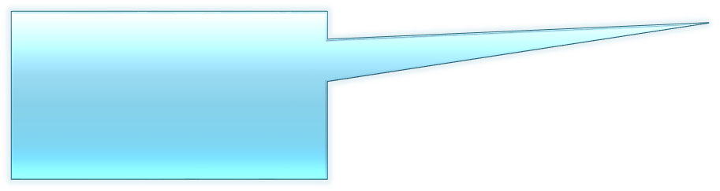
Normal conduction pathway:
1- SA node generates action potential and delivers it to the atria and the AV node
2- The AV node delivers the impulse to purkinje fibers
3- purkinje fibers conduct the impulse to the ventricles

Slide 4


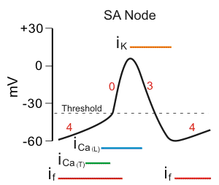
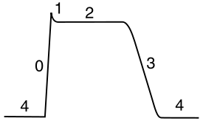
Action potential of the heart:
In the atria, purkinje, and ventricles the AP curve consists of 5 phases
In the SA node and AV node, AP curve consists of 3 phases

Slide 5
Non-pacemaker action potential
Phase 1: partial repolarization
Due to rapid efflux of K⁺
Phase 2: plateu
Due to Ca⁺⁺ influx
Phase 0: fast upstroke
Due to Na⁺ influx
Phase 3: repolarization
Due to K⁺ efflux
Phase 4: resting membrane potential
N.B. The slope of phase 0 = conduction velocity
Also the peak of phase 0 = V_{max}

Slide 6



Pacemaker AP
Phase 0: upstroke:
Due to Ca⁺⁺ influx
Phase 3: repolarization:
Due to K⁺ efflux
Phase 4: pacemaker potential
Na influx and K efflux and Ca influx until the cell reaches threshold and then turns into phase 0
Pacemaker cells (automatic cells) have unstable membrane potential so they can generate AP spontaneously

Slide 7
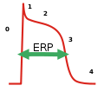
Effective refractory period (ERP)
It is also called absolute refractory period (ARP) :
In this period the cell can’t be excited
Takes place between phase 0 and 3

Slide 8
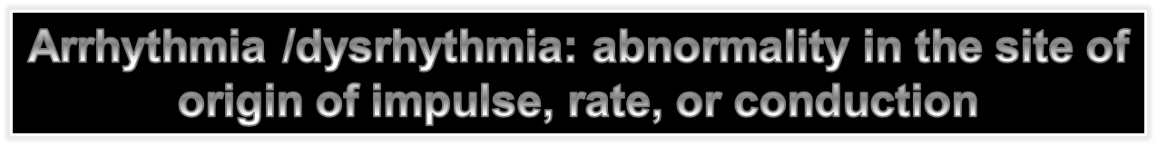
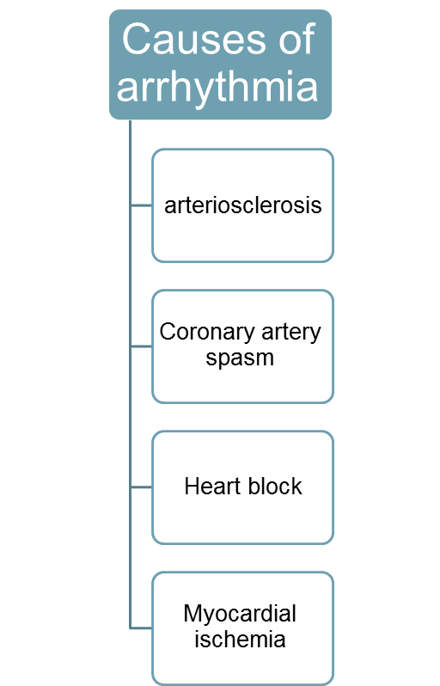
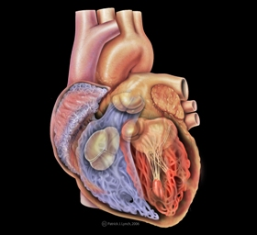
Arrhythmia
If the arrhythmia arises from atria, SA node, or AV node it is called supraventricular arrhythmia
If the arrhythmia arises from the ventricles it is called ventricular arrhythmia

Slide 9
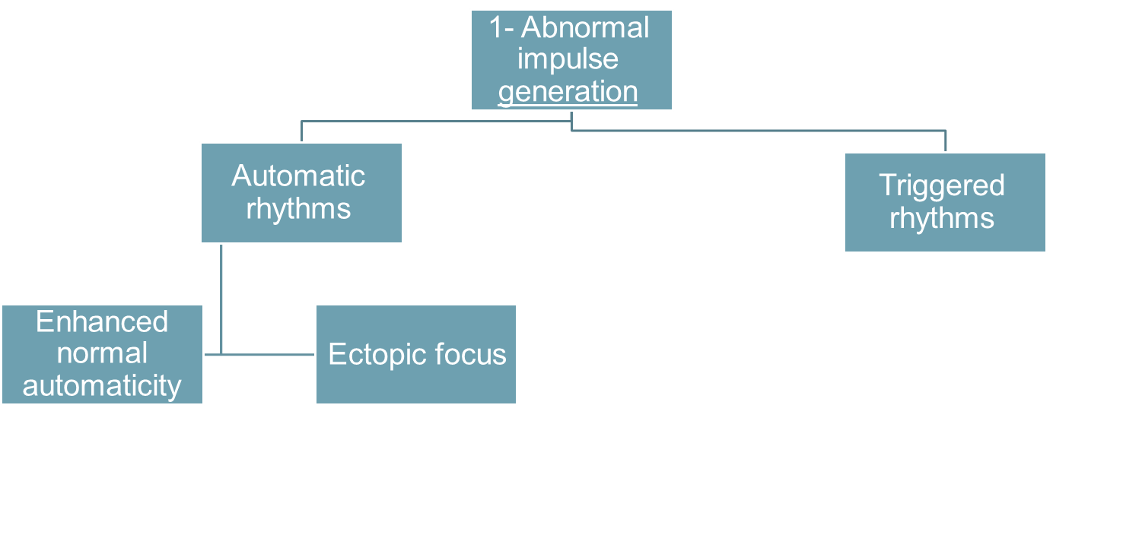
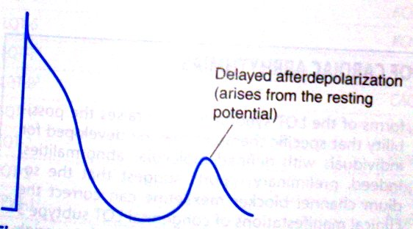
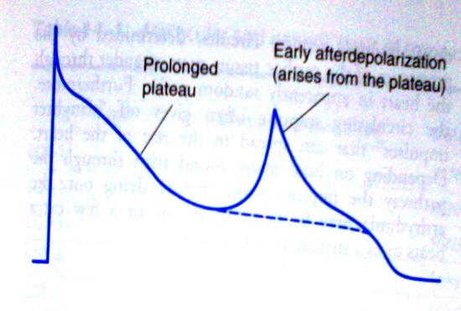


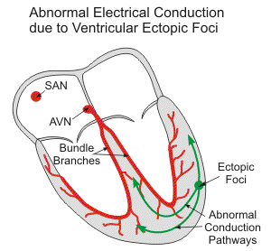


Mechanisms of Arrhythmogenesis
Delayed afterdepolarization
Early afterdepolarization
AP arises from sites other than SA node
↑AP from SA node

Slide 10
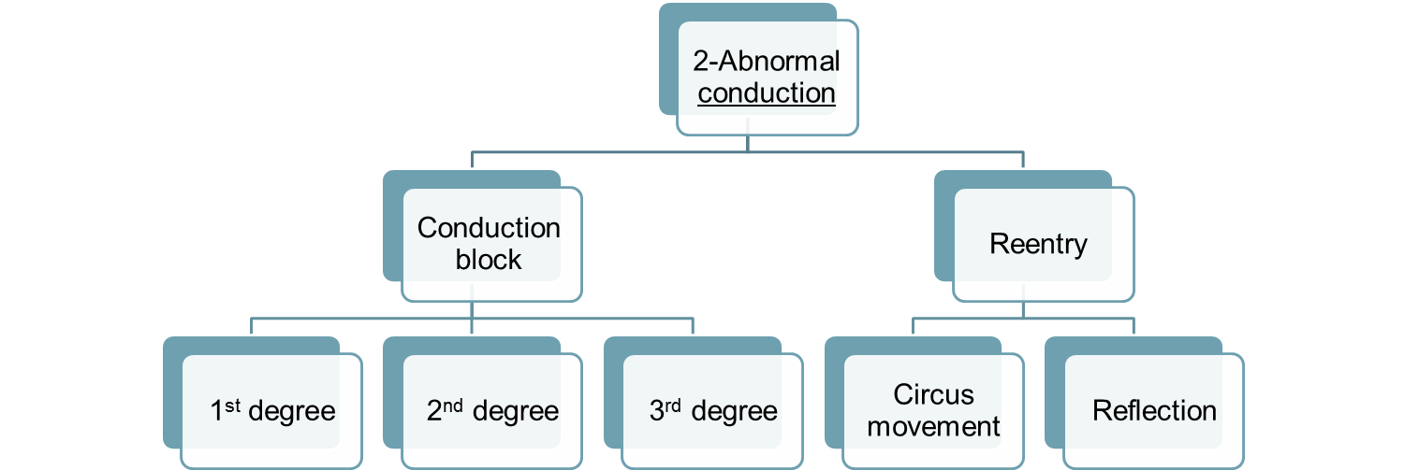

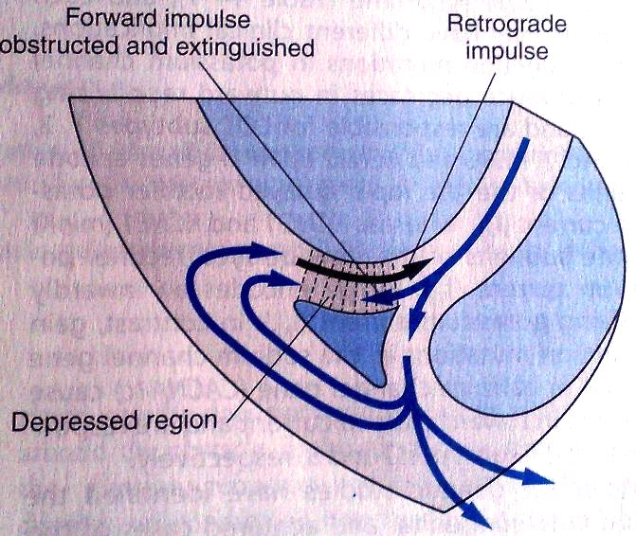
This is when the impulse is not conducted from the atria to the ventricles
1-This pathway is blocked
3-So the cells here will be reexcited (first by the original pathway and the other from the retrograde)
2-The impulse from this pathway travels in a retrograde fashion (backward)

Slide 11
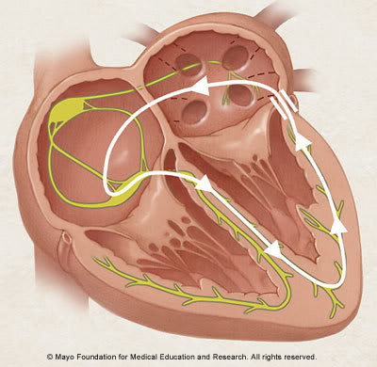
Abnormal anatomic conduction
Here is an accessory pathway in the heart called Bundle of Kent
Present only in small populations
Lead to reexcitation → Wolf-Parkinson-White Syndrome (WPW)

Slide 12
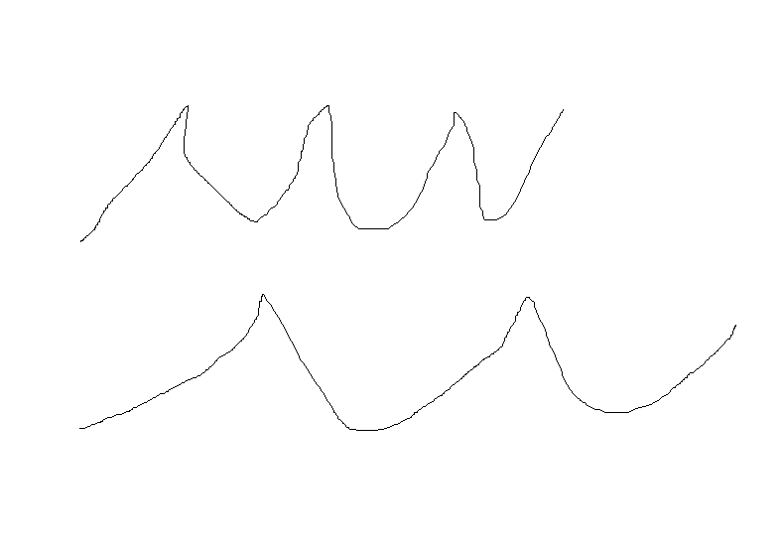
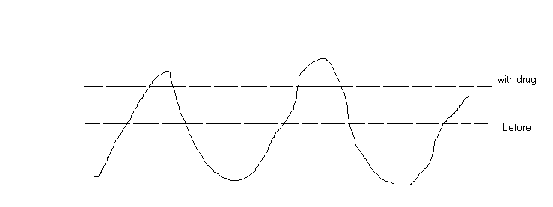
Action of drugs
In case of abnormal generation:
In case of abnormal conduction:
Decrease of phase 4 slope (in pacemaker cells)
↑ERP
(so the cell won’t be reexcited again)
↓conduction velocity (remember phase 0)
Before drug
Raises the threshold
after
phase4

Slide 13
Types of Arrhythmia
Supraventricular Arrhythmias
Sinus Tachycardia: high sinus rate of 100-180 beats/min, occurs during exercise or other conditions that lead to increased SA nodal firing rate
Atrial Tachycardia: a series of 3 or more consecutive atrial premature beats occurring at a frequency >100/min
Paroxysmal Atrial Tachycardia (PAT): tachycardia which begins and ends in acute manner
Atrial Flutter: sinus rate of 250-350 beats/min.
Atrial Fibrillation: uncoordinated atrial depolarizations.
AV blocks
A conduction block within the AV node , occasionally in the bundle of His, that impairs impulse conduction from the atria to the ventricles.

Slide 14
ventricular Arrhythmias
Ventricular Premature Beats (VPBs): caused by ectopic ventricular foci; characterized by widened QRS.
Ventricular Tachycardia (VT): high ventricular rate caused by abnormal ventricular automaticity or by intraventricular reentry; can be sustained or non-sustained (paroxysmal); characterized by widened QRS; rates of 100 to 200 beats/min; life-threatening.
Ventricular Flutter - ventricular depolarizations >200/min.
Ventricular Fibrillation - uncoordinated ventricular depolarizations

Slide 15
Pharmacologic Rationale & Goals
The ultimate goal of antiarrhythmic drug therapy:
Restore normal sinus rhythm and conduction
Prevent more serious and possibly lethal arrhythmias from occurring.
Antiarrhythmic drugs are used to:
decrease conduction velocity
change the duration of the effective refractory period (ERP)
suppress abnormal automaticity

Slide 16
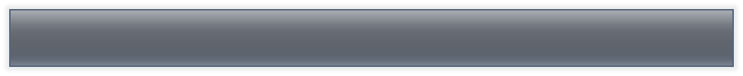
Antyarrhythmic drugs
Most antiarrhythmic drugs are pro-arrhythmic (promote arrhythmia)
They are classified according to Vaughan William into four classes according to their effects on the cardiac action potential
class | mechanism | action | notes
I | Na⁺ channel blocker | Change the slope of phase 0 | Can abolish tachyarrhythmia caused by reentry circuit
II | β blocker | ↓heart rate and conduction velocity | Can indirectly alter K and Ca conductance
III | K⁺ channel blocker | ↑action potential duration (APD) or effective refractory period (ERP). Delay repolarization. | Inhibit reentry tachycardia
IV | Ca⁺⁺ channel blocker | Slowing the rate of rise in phase 4 of SA node(slide 12) | ↓conduction velocity in SA and AV node

Slide 17
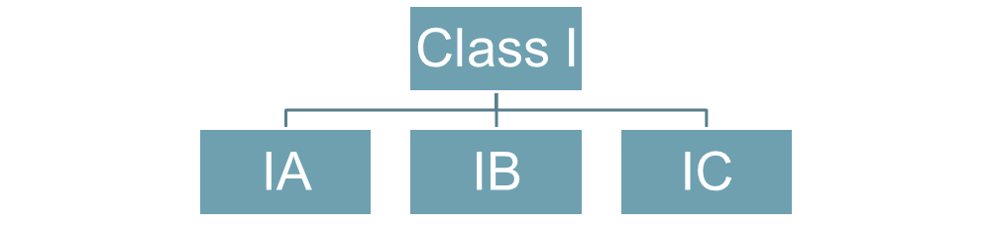



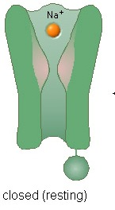
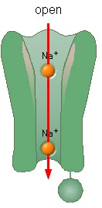
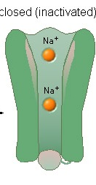
Class I drugs
Have moderate K⁺ channel blockade
They ↓ conduction velocity in non-nodal tissues (atria, ventricles, and purkinje fibers)
They act on open Na⁺ channels or inactivated only
So they are used when many Na⁺ channels are opened or inactivated (in tachycardia only) because in normal rhythm the channels will be at rest state so the drugs won’t work

Slide 18


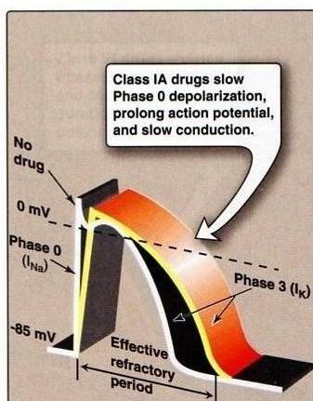
Slowing of the rate of rise in phase 0 → ↓conduction velocity
↓of V_{max} of the cardiac action potential
They prolong muscle action potential & ventricular (ERP)
They ↓ the slope of Phase 4 spontaneous depolarization (SA node) → decrease enhanced normal automaticity
They make the slope more horizontal

Slide 19
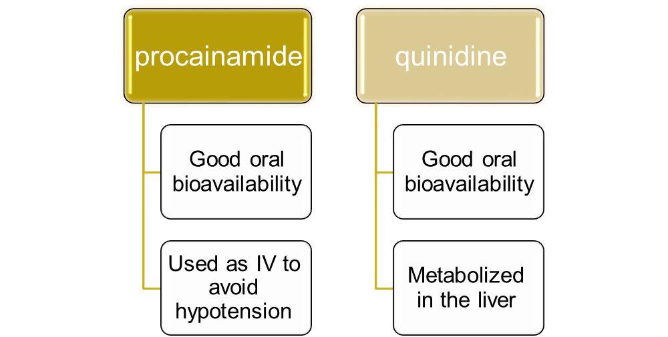
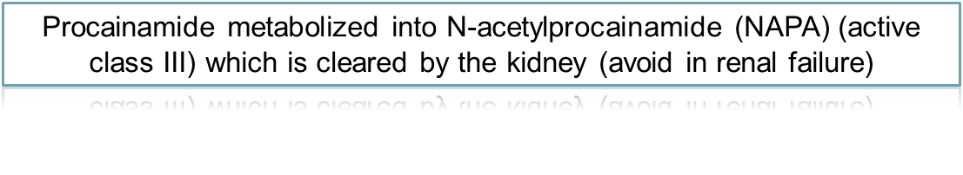
Class IA Drugs
They possess intermediate rate of association and dissociation (moderate effect) with sodium channels.
Pharmacokinetics:

Slide 20
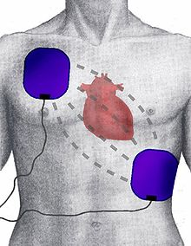
Class IA Drugs Uses
Supraventricular and ventricular arrhythmias
Quinidine is rarely used for supraventricular arrhythmias
Oral quinidine/procainamide are used with class III drugs in refractory ventricular tachycardia patients with implantable defibrillator
IV procainamide used for hemodynamically stable ventricular tachycardia
IV procainamide is used for acute conversion of atrial fibrillation including Wolff-Parkinson-White Syndrome (WPWS)
defibrillator

Slide 21
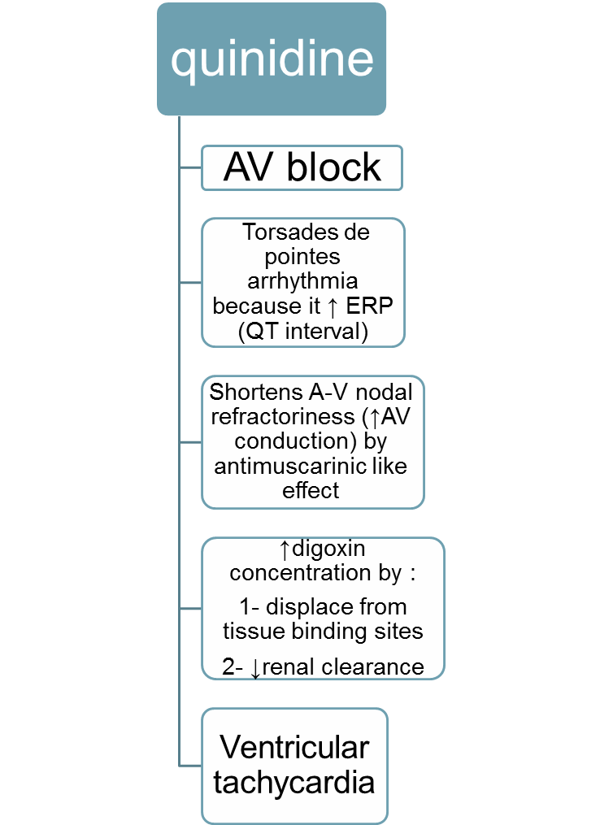
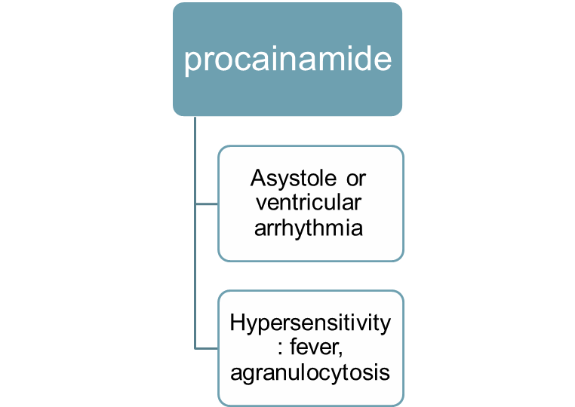

Class IA Drugs Toxicity
Systemic lupus erythromatosus (SLE)-like symptoms: arthralgia, fever, pleural-pericardial inflammation.
Symptoms are dose and time dependent
Common in patients with slow hepatic acetylation

Slide 22
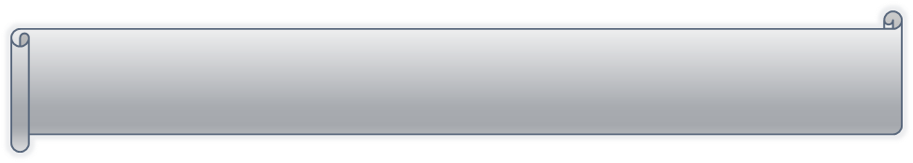

Notes:
Torsades de pointes: twisting of the point . Type of tachycardia that gives special characteristics on ECG
At large dosesof quinidine → cinchonism occurs:blurred vision, tinnitus, headache, psychosis and gastrointestinal upset
Digoxin is administered before quinidine to prevent the conversion of atrial fibrillation or flutter into paradoxical ventricular tachycardia

Slide 23
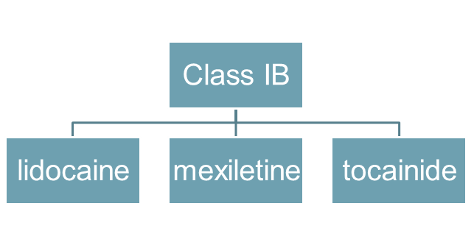
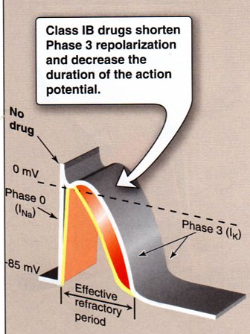
Class IB Drugs
They shorten Phase 3 repolarization
↓ the duration of the cardiac action potential
They suppress arrhythmias caused by abnormal automaticity
They show rapid association & dissociation (weak effect) with Na⁺ channels with appreciable degree of use-dependence
No effect on conduction velocity

Slide 24


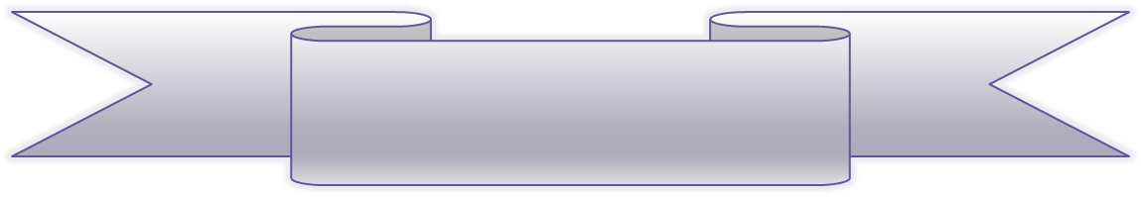
Agents of Class IB
Lidocaine
Used IV because of extensive 1st pass metabolism
Lidocaine is the drug of choice in emergency treatment of ventricular arrhythmias
Has CNS effects: drowsiness, numbness, convulstion, and nystagmus
Mexiletine
These are the oral analogs of lidocaine
Mexiletine is used for chronic treatment of ventricular arrhythmias associated with previous myocardial infarction
Adverse effects:
1- neurological effects
2- negative inotropic activity
Uses
They are used in the treatment of ventricular arrhythmias arising during myocardial ischemia or due to digoxin toxicity
They have little effect on atrial or AV junction arrhythmias (because they don’t act on conduction velocity)

Slide 25
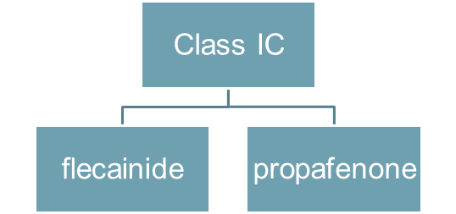
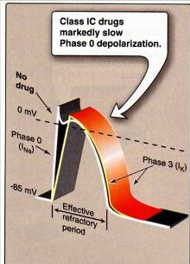
Class IC Drugs
They markedly slow Phase 0 fast depolarization
They markedly slow conduction in the myocardial tissue
They possess slow rate of association and dissociation (strong effect) with sodium channels
They only have minor effects on the duration of action potential and refractoriness
They reduce automaticity by increasing the threshold potential rather than decreasing the slope of Phase 4 spontaneous depolarization.

Slide 26
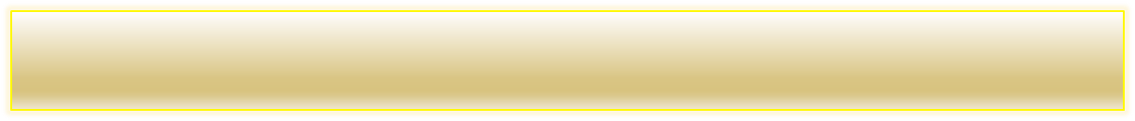
Uses:
Refractory ventricular arrhythmias.
Flecainide is a particularly potent suppressant of premature ventricular contractions (beats)
Toxicity and Cautions for Class IC Drugs:
They are severe proarrhythmogenic drugs causing:
severe worsening of a preexisting arrhythmia
de novo occurrence of life-threatening ventricular tachycardia
In patients with frequent premature ventricular contraction (PVC) following MI, flecainide increased mortality compared to placebo.
Notice: Class 1C drugs are particularly of low safety and have shown even increase mortality when used chronically after MI

Slide 27

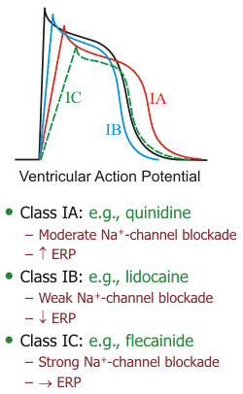
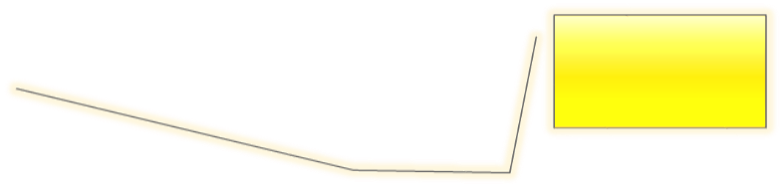
Compare between class IA, IB, and IC drugs as regards effect on Na⁺ channel & ERP
Sodium channel blockade:
IC > IA > IB
Increasing the ERP:
IA>IC>IB (lowered)
Because of K⁺ blockade

Slide 28
Class II ANTIARRHYTHMIC DRUGS
(β-adrenergic blockers)
Uses
Treatment of increased sympathetic activity-induced arrhythmias such as stress- and exercise-induced arrhythmias
Atrial flutter and fibrillation.
AV nodal tachycardia.
Reduce mortality in post-myocardial infarction patients
Protection against sudden cardiac death
Mechanism of action
Negative inotropic and chronotropic action.
Prolong AV conduction (delay)
Diminish phase 4 depolarization → suppressing automaticity(of ectopic focus)

Slide 29
Class II ANTIARRHYTHMIC DRUGS
Propranolol (nonselective): was proved to reduce the incidence of sudden arrhythmatic death after myocardial infarction
Metoprolol
reduce the risk of bronchospasm
Esmolol:
Esmolol is a very short-acting β₁-adrenergic blocker that is used by intravenous route in acute arrhythmias occurring during surgery or emergencies
selective

Slide 30
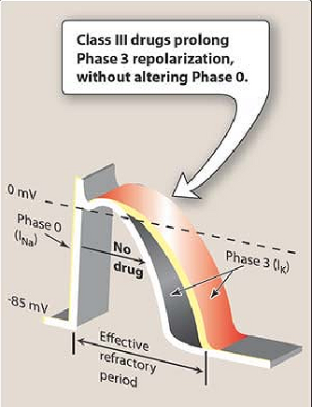
Class III ANTIARRHYTHMIC DRUGS
K⁺ blockers
Prolongation of phase 3 repolarization without altering phase 0 upstroke or the resting membrane potential
They prolong both the duration of the action potential and ERP
Their mechanism of action is still not clear but it is thought that they block potassium channels

Slide 31
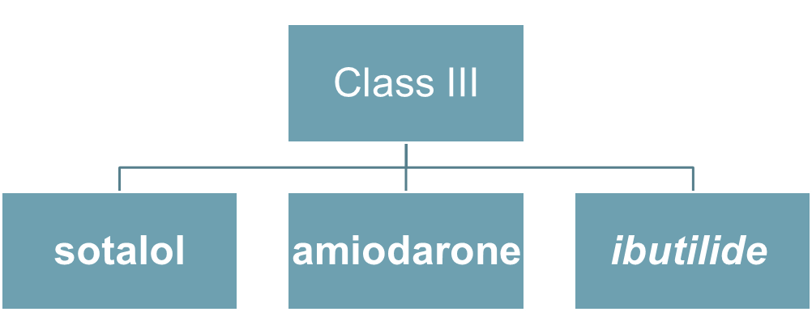
Uses:
Ventricular arrhythmias, especially ventricular fibrillation or tachycardia
Supra-ventricular tachycardia
Amiodarone usage is limited due to its wide range of side effects

Slide 32
Sotalol (Sotacor)
Sotalol also prolongs the duration of action potential and refractoriness in all cardiac tissues (by action of K⁺ blockade)
Sotalol suppresses Phase 4 spontaneous depolarization and possibly producing severe sinus bradycardia (by β blockade action)
The β-adrenergic blockade combined with prolonged action potential duration may be of special efficacy in prevention of sustained ventricular tachycardia
It may induce the polymorphic torsades de pointes ventricular tachycardia (because it increases ERP)
Ibutilide
Used in atrial fibrillation or flutter
IV administration
May lead to torsade de pointes
Only drug in class three that possess pure K⁺ blockade

Slide 33
Amiodarone (Cordarone)
Amiodarone is a drug of multiple actions and is still not well understood
It is extensively taken up by tissues, especially fatty tissues (extensive distribution)
t_{1/2} = 60 days
Potent P450 inhibitor
Amiodarone antiarrhythmic effect is complex comprising class I, II, III, and IV actions
Dominant effect: Prolongation of action potential duration and refractoriness
It slows cardiac conduction, works as Ca²⁺ channel blocker, and as a weak β-adrenergic blocker
Toxicity
Most common include GI intolerance, tremors, ataxia, dizziness, and hyper-or hypothyrodism
Corneal microdeposits may be accompanied with disturbed night vision
Others: liver toxicity, photosensitivity, gray facial discoloration, neuropathy, muscle weakness, and weight loss
The most dangerous side effect is pulmonary fibrosis which occurs in 2-5% of the patients

Slide 34
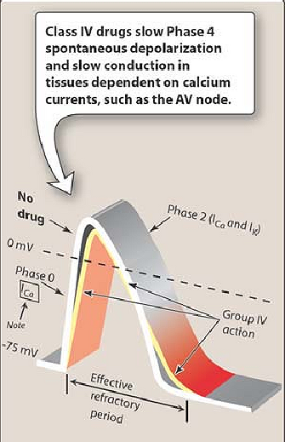
Class IV ANTIARRHYTHMIC DRUGS
(Calcium Channel Blockers)
Calcium channel blockers decrease inward Ca²⁺ currents resulting in a decrease of phase 4 spontaneous depolarization (SA node)
They slow conductance in Ca²⁺ current-dependent tissues like AV node.
Examples: verapamil & diltiazem
Because they act on the heart only and not on blood vessels.
Dihydropyridine family are not used because they only act on blood vessels

Slide 35
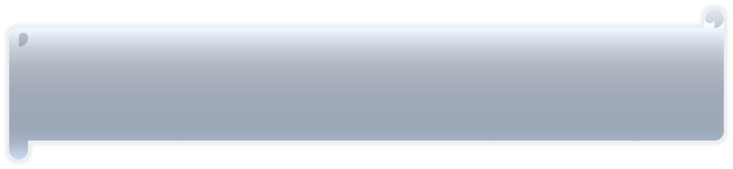
Mechanism of action
They bind only to depolarized (open) channels → prevention of repolarization
They prolong ERP of AV node → ↓conduction of impulses from the atria to the ventricles
So they act only in cases of arrhythmia because many Ca²⁺ channels are depolarized while in normal rhythm many of them are at rest
Uses
More effective in treatment of atrial than ventricular arrhythmias.
Treatment of supra-ventricular tachycardia preventing the occurrence of ventricular arrhythmias
Treatment of atrial flutter and fibrillation

Slide 36
contraindication
Contraindicated in patients with pre-existing depressed heart function because of their negative inotropic activity
Adverse effects
Cause bradycardia, and asystole especially when given in combination with β-adrenergic blockers

Slide 37
Miscellaneous Antiarrhythmic Drugs
Adenosine
Adenosine activates A₁-purinergic receptors decreasing the SA nodal firing and automaticity, reducing conduction velocity, prolonging effective refractory period, and depressing AV nodal conductivity
It is the drug of choice in the treatment of paroxysmal supra-ventricular tachycardia
It is used only by slow intravenous bolus
It only has a low-profile toxicity (lead to bronchospasm) being extremly short acting for 15 seconds only

Slide 38
class | ECG QT | Conduction velocity | Refractory period
IA | ++ | ↓ | ↑
IB | 0 | no | ↓
IC | + | ↓ | no
II | 0 | ↓In SAN and AVN | ↑ in SAN and AVN
III | ++ | No | ↑
IV | 0 | ↓ in SAN and AVN | ↑ in SAN and AVN

Slide 39

1st: Reduce thrombus formation by using anticoagulant warfarin
2nd: Prevent the arrhythmia from converting to ventricular arrhythmia:
First choice: class II drugs:
After MI or surgery
Avoid in case of heart failure
Second choice: class IV
Third choice: digoxin
Only in heart failure of left ventricular dysfunction
3rd: Conversion of the arrhythmia into normal sinus rhythm:
Class III:
IV ibutilide, IV/oral amiodarone, or oral sotalol
Class IA:
Oral quinidine + digoxin (or any drug from the 2nd step)
Class IC:
Oral propaphenone or IV/oral flecainide
Use direct current in case of unstable hemodynamic patient

Slide 40


Premature ventricular beat (PVB)
First choice: class II
IV followed by oral
Early after MI
Second choice: amiodarone
Avoid using class IC after MI → ↑ mortality
First choice: Lidocaine IV
Repeat injection
Second choice: procainamide IV
Adjust the dose in case of renal failure
Third choice: class III drugs
Especially amiodarone and sotalol

