Slide 1
Drugs for diarrhoea and constipation
Dr. Rishi Pal
Asstt. Professor

Slide 2
Anti-diarrhoeal agents
Diarrhoea: frequent passage of liquid or semisolid stools is called diarrhoea.
Causes: enteric infection, food toxins, malnutrition, inflammation, drugs like reserpine, prostaglandins, metoclopramide, domperidome, cholinergic drugs, quinidine and purgatives.
Dysentery: abdominal pain and passage of bloody stools and mucous due to infection or inflammation.

Slide 3
Agents can cause diarrhoea
Non specific agents:
Fear
Anxiety or apprehension
Ingestion
Traveling
Acute diarrhoea
Chronic diarrhoea

Slide 4
Management of diarrhoea
1. Non-specific therapy:
a) Oral and parenteral rehydration
b) Anti-motility and anti-secretory agents:
i) Opioids: codeine, diphenoxylate, loperaminde
ii) α-adrenergic receptor agonist: clonidine
iii) Octreotide.
2. Specific therapy: Antimicrobial agents
3. Antispasmodics: Atropine & oxyphenonium (antrenyl)
4. Adsorbants: Kaolin, pectin and chalk, bismuth subsalicylate

Slide 5
Non-specific therapy
Oral rehydration solution (ORS):
2.6 g NaCl, 1.5 g KCl, 2.9 g sodium citrate, 13.5 g glucose dissolved in 1 liter of water.
Super ORS:
(boiled rice powder used instead of glucose)-also decreases frequency of diarrhoea along with rehydration.

Slide 6
Antimotility and antisecretory agents
Codeine: opium alkaloid, reduces GI motility, also have antisecretory effects.
Diphenoxylate: structurally related to pethidine, combined with small doses with atropine, side effects are constipation, paralytic ileus, banned in many countries.
Loperamide: opiate analogue and importantant antidiarroeal than morphine.
Interact with µ-receptor in the gut, reduces GI motility and increase anal sphincter tone.

Slide 7
Antimotility and antisecretory….
loperamide poorly penetrates BBB and has no abuse potential. Can use in acute and chronic and traveller’s diarrhoea.
Adverse reactions:
Skin rashes, headache, and paralytic ileus, should not be used in children <4 years of age. Should be avoided in infectious diarrhoeas, avoided in IBD.

Slide 8
Antimotility and antisecretory…
Clonidine: it has antimotility and antisecretory activities, used in diabetics with autonomic neuropathy,
Octreotide: analogue of somatostatin, inhibits 5-HT & VIP, gastrin, used in refractory diarrhoea in patients with AIDS.
Racecadotril: inhibits degradation of enkephalins, used in acute secretory diarrhoeas.
Side effects: nausea, vomiting, drowsiness.

Slide 9
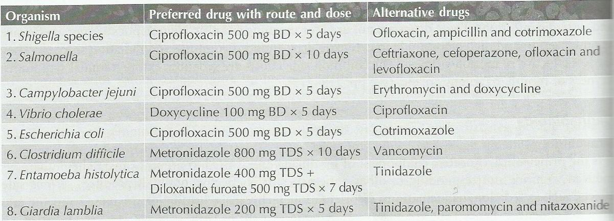
Infective antidiarrhoeal drugs

Slide 10
Pharmacotherapy of IBD
IBD includes crohn’s disease and ulcerative colitis , characterized by diarrhoea, bleeding, abdominal discomfort, anaemia and weight loss.
Aminosalicylates: sulphasalazine, mesalamine, olsalazine, balsalazide.
Antibiotics: metronidazole, ciprofloxacin, clarithromycin.
Glucocorticoids: prednisolone, methylprednisolone, hydrocortisone, budesonide.
Immunomodulators: azathioprine, 6-mercaptopurine, methotrexate.
Biological response modifiers: infliximab.

Slide 11
Pharmacotherapy of IBD…
Sulphasalazine: prodrug composed of sulphapyridine and 5- aminosalicylic acid (5-ASA), acts locally by inhibiting production of inflammatory mediators.
Sulphapyridine get absorbed and causes side effects like nausea, vomiting, skin rashes, headache, fever, pancreatitis, pneumonitis, etc.

Slide 12
Pharmacotherapy of IBD…
Mesalamine: 5-ASA, can administerd as suppository and enema.
Osalazine: 2 molecule of 5-ASA with azo linkage, poorly absorbed after oral administration; in colon it cleaved into 2 molecules of 5-ASA by colonic bacteria.
Basalazide: split into 5-ASA and metabolized in colon.

Slide 13
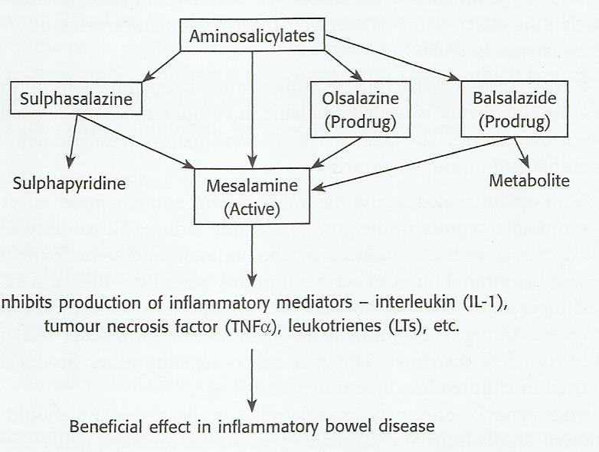
Mechanism of Drugs for IBD

Slide 14
Pharmacotherapy of IBD…
Glucocorticoids: used in moderate to severe IBD, prolong use can leads to adrenal suppression and numerous systemic side effects.
Antibiotics: metranidazole, ciprofloxacin, clarithromycin.
Immunosuppressants:
Biological response modefier:

Slide 15
Laxatives (purgatives, cathartics)
Classification
1. Bulk laxatives: dietary fiber- bran, methgylcellulose, isapagula.
2. Stool softeners: docusates, liquid paraffin
3. Stimulants (irritant): bisacodyl, sodium picosulphate, phenophthelein
Anthraquinone derivatives- senna, cascara sagrada.
4. Osmotic laxatives: MgSO₄⁻, MgOH, NaPO4⁻, NaSO₄, sodium potasium tartarate, lectulose, PEG.
5. 5-HT4 agonist: Prucalopride

Slide 16
Bulk forming laxatives
Indigestible, hydrophilic substances like bran, agar, methylcellulose, ispaghula etc.
Absorb water, swell up and increase the bulk of stools.
Cause mechanical distension so stimulate peristalsis and promote defaecation.
Large amount of water should be taken with bulk laxatives to avoid intestinal obstruction.

Slide 17
Stool softeners
Docusates: dioctyl sodium sulphosuccinate, dioctyl calcium sulphosuccinate and dioctyl potassium sulphosuccinate.
Anionic detergents, lower surface tension of stool, accumulates fluids and fatty substance thus softening the stool.
Administered orally or as retention enema.
Should not be given with liquid paraffin, because increase absorption of it.

Slide 18
Stool softeners
Liquid paraffin is a mineral oil, administered orally.
Soften stools.
Has lubricant effects.
Useful in patients with cardiac disease, because it prevent straining.
Adverse effects: lipid pneumonia, so avoided at bed time and in laying position.
Long term use cause malabsorption of vitamins.

Slide 19
Stimulant laxatives
Phenophtaelein, bisacodyl, sodium picosulfate, anthraquinone derivatives,
These agents have direct action on enteric neurons and GI mucosa.
Increase prostaglandin and cAMP levels, inhibit Na⁺, K⁺-ATPase activity in intestinal mucosa.
Increase secretion of water and electrolytes by intestinal (colon) mucosa thus stimulating peristalsis.
Contraindicated in pregnancy.

Slide 20
Osmotic/saline laxatives
Most powerful and rapid acting laxatives.
Salts of magnesium, sodium or potassium.
Given orally, not absorbed from gut, remain in lumen and exert osmotic effect, draw water in lumen, distend the bowel, stimulates peristalsis.
Sodium phosphate used in enema before surgery.
Should be avoided in cardiac patients.

Slide 21
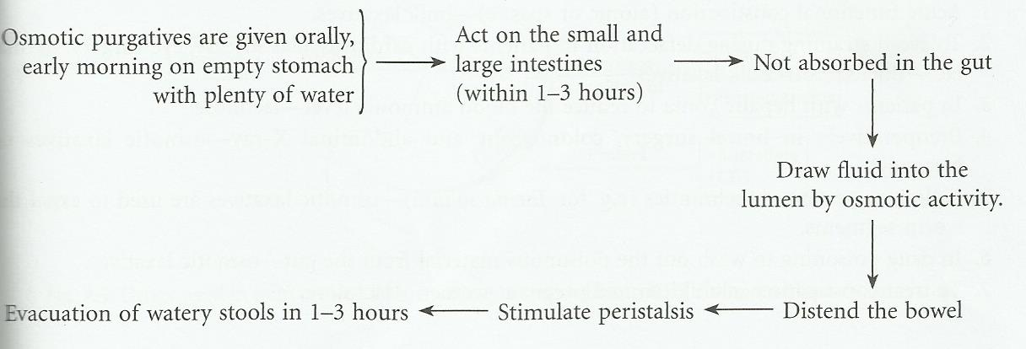
Osmotic laxatives/purgatives mechanism

Slide 22
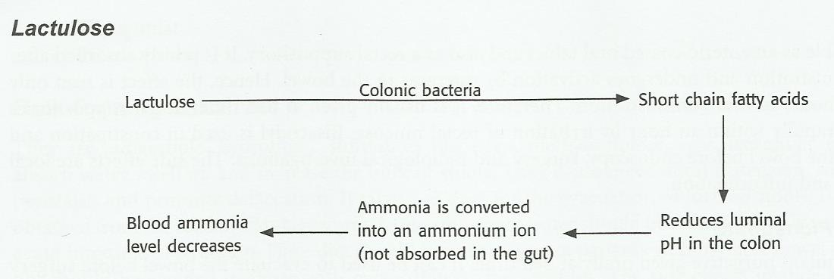
Mechanism of lactulose

Slide 23
Uses of laxatives
Acute functional constipation-bulk laxatives
To avoid straining during defecation-bulk laxatives
Hepatic comma, to reduce NH₃ levels-lactulose
Surgery/x-ray, colonoscopy-osmotic laxatives
Anthelmintics-osmotic laxatives
Drug poisoning-osmotic laxatives
Pregnant women/ children-lactulose.

Slide 24
Uses of laxatives
Constipation, surgery, hernia.
Hepatic coma
Preoperatively in bowel surgery, colonoscopy, abdominal x-ray
Drug poisoning

