Slide 1
A 68-year-old man with late stage prostate cancer is admitted to A & E with mental obtundation. An electrolyte panel shows a serum calcium of 16.5 (normal 8.5–10.5 mg/dL).
Which of the following therapies would be most useful in the management of severe hypercalcemia?
(A) Acetazolamide plus saline infusion
(B) Furosemide plus saline infusion
(C) Hydrochlorothiazide plus saline infusion
(D) Mannitol plus saline infusion
(E) Spironolactone plus saline infusion

Slide 2
Diuretics I
AND OTHER RENAL AGENTS
MBcHB II 17/18
May 18 2018
Dr. Sauba Nakazibwe

Slide 3
Overview
Classification
Overview of clinical use of diuretics agents
Specific diuretics
Assignment

Slide 4
A. OVERVIEW
Definitions
Diuretics: drugs that increase the rate of urine flow.
      ? Natriuretic
      ? Aquaretic
      ? Saluretic
With the exception of osmotic diuretics, they act primarily by decreasing the renal tubular reabsorption of Na+, which in turn decreases the reabsorption of water H2O and Cl.

Slide 5
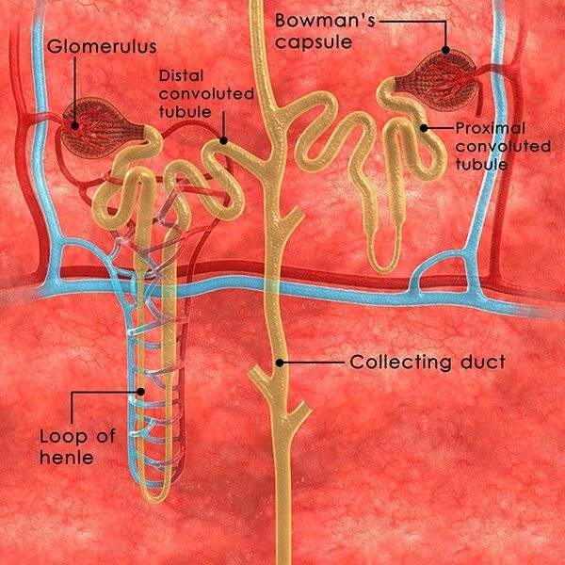
Renal tubule mechanisms: brief review
Proximal Tubule (PCT)
Loop of Henle (LOP)- Thick Ascending Limb (TAL)
Distal Convoluted Tubule (DCT)
Collecting Duct (CD)

Slide 6
Proximal Convoluted Tubule (PCT)
Highly permeable to H2O. Reabsorbs > 60% of filtrate (Na+, NaHCO3, K+,H2O, all glucose & amino acids)
Relevant to diuretic action: NaHCO3 and NaCl
Primary transporter: Na+/H+ exchanger (NHE3) - allows entry of Na+ into cell from the tubular lumen in exchange for a proton (H+).
Carbonic anhydrase (CA) catalyzes the reversible reaction, H2CO3 H2O+ CO2 i. e. dehydration of carbonic acid to form the diffusible CO2 (lumen) and hydration of CO2 to form carbonic acid (in the cell)
On dissociation of H2CO3, the H+ is available for transport by the Na+/H+ exchanger.

Slide 7
PCT contd
Thus, CA promotes reabsorption of NaHCO3 & secretion of H+ because:
  the luminal CA permits reabsorption of -HCO3 by dehydrating H2CO3 to diffusible CO2 the intracellular CA permits H+ secretion and Na+ reabsorption by providing H+ for the Na+/H+ exchanger.
Proximal tubule (straight segments)
Secretion & reabsorption of organic acids &bases, incl. uric acid & most diuretics. No diuretic target
Thin descending limb of Henle’s loop:
Passive reabsorption of water. No diuretic target

Slide 8
Thick Ascending Limb of Henle’s loop (TAL)
Highly impermeable to H2O
Active reabsorption: 15–25% of filtered Na+;
Secondary reabsorption: Ca2+ and Mg2+
Primary transporter: Na/K/2Cl (NKCC2)
Na+ K+ 2Cl- symporter moves 1 Na+, 1 K+ and 2 Cl- from lumen into tubular cells. Ions are then exported into interstitium via transporters/channels in basolateral memb. K+ largely returned into cells by Na+K+-ATPase; back diffusion into lumen. Process has two consequences:
    Hypertonic interstitium (ions not followed by H2O) which drives the reabsorption of H2O by extracting H2O from the leaky descending limb of the loop.
    An interstitium-negative transepithelial potential difference which drives the reabs. of Ca2+ and Mg2+.

Slide 9
Distal convoluted tubule (DCT)
Active reabsorption of 4–8% of filtered Na+ and Cl−
Ca2+ reabsorption under parathyroid hormone control. Na+/Ca2+ exchanger exports Ca2+ into interstitium
K+ not returned into cells by the Na+K+-ATPase
Relatively impermeable to H2O. NaCl reabsorption further dilutes tubular fluid.
Primary transporter: Na+/Cl− cotransporter (NCC)
DCT (distal segment) and CD
Transporter: Epithelial Na+ channel (ENaC). Reabsorbs 1-2% of filtered Na+ in exchange for K+ & H+ (excreted into urine).
Activity of ENaC
  Depends on Na+ concentration: high Na+ conc = > Na+ reabsorbed and > K+ & H+ excreted
  Regulated by aldosterone. Increased aldosterone stimulates reabsorbtion of Na+ (& increased K+, H+ loss)

Slide 10
Role of Antidiuretic hormone (ADH/Vasopressin) in CD
ADH regulates the insertion of preformed H2O channels (AQUAPORINS) into apical memb. of principal cells. Increase H2O permeability.
Thus, ADH markedly increases H2O permeability, leading to formation of a more concentrated urine and reduced urine outflow.
Finally 1-2% of initially filtered Na+ remains in final urine

Slide 11
B. CLASSIFICATION
Based on the intensity of the diuretic effect:
High efficacy
      Loop diuretics (furosemide, torsemide, bumetanide, ethacrynic acid)
Medium efficacy
      Thiazides ( hydrochlorothiazide, chlorothiazide)
      Thiazide-like drugs (clopamide, indapamide, chlorthalidone)
Weak or adjunctive diuretics
    Carbonic anhydrase inhibitors (acetazolamide)
    K+ sparing diuretics
        Aldosterone antagonist (spironolactone, eplerenone, canrenoate)
        Na+ channel inhibitors/Directly acting (triamterene, amiloride)
    Osmotic diuretics (mannitol, glycerol)
    Xanthines (theophylline)

Slide 12
II. Based on effect on K+ excretion: K+ (and H+)-losing and K+ (and H+)-sparing diuretics
Diuretics may differentially alter K+ excretion (Effect unwanted)
K+ losing drugs (incidentally also increase H+ excretion). Can induce hypokalemia and alkalosis
K+ sparing diuretics (are also H+ sparing drugs). May cause hyperkalemia and acidosis.
These opposite types of diuretics may be combined in order to mutually minimize their unwanted effects (e.g. fixed combinations of HCTZ and amiloride are available), OR the K+ losing diuretics should be coadministered with K+ supplement to avoid hypokalemia.

Slide 13
K+ (and H+) losing diuretics
Loop diuretics (furosemide, bumetanide, torasemide, ethacrynic acid)
Thiazides (chlorothiazide, hydrochlorothiazide)
Thiazide-like drugs (clopamide, indapamide, chlorthalidone)
K+ (and H+) sparing diuretics
Aldosterone antagonists (spironolactone, canrenoate, eplerenone)
Na+ channel inhibitors (amiloride, triamterene)
Note: Carbonic anhydrase inhibitors cannot be listed into either of these two groups, as they are weak K+ losing diuretics, but cause H+ sparing” effect, because they decrease the tubular secretion of H+

Slide 14
III. Based on the site and mechanism of diuretic action
Diuretics may act at various segments of the nephron (see table & fig II).
Osmotic diuretics -partly before the kidney (systemic circulation) and partly all along the nephron
Carbonic anhydrase inhibitors- PCT
Loop diuretics-LOP (within TAL)
Thiazide diuretics-DCT
Na+-channel antagonists & aldosterone antagonists (or mineralocorticoid receptor antagonists, MRA)- CD
All diuretics except spironolactone reach these luminal transport sites thru’ the tubular fluid. SPL competitively binds receptors at the aldosterone-dependent- Na+-K+ exchange site in the DCT
Table following lists diuretics according to their site of action in a descending order.

Slide 15
Diuretics | Drugs | Site of action | Target molecule | Effects
OSMOTIC | Mannitol Urea Glycerin Isosorbide | Systemic: EC space Renal: leaky segments | None | -Decrease IC H20 space Increase EC H20 space -Decrease H20 reabsorption
CA INHIBITORS | Acetazolamide Brinzolamide* Dichlorphenamide* Methazolamide* | Proximal Convoluted Tubule (PCT) | Carbonic anhydrase (luminal and intracellular) | -Decrease Na+–H+ exchange -Decrease NaHCO3 reabsorption (forming alkaline urine) -Decrease H+ secretion (can cause systemic acidosis)
LOOP | Furosemide Bumetanide Torasemide Ethacrynic acid | Loop of Henle (TAL) | Na+ K+ 2Cl symporter | -Decrease Na+, Cl- reabsorption -Decrease Ca2+, Mg2+ reabsorption -Increase K+, H+ secretion in the DCT (can cause hypokalemia, alkalosis, hypocalcemia hypomagnesemia)
* Used for topical treatment of glaucoma, not as a diuretic.

Slide 16
Table I contd
Diuretics | Drugs | Site of action | Target molecule | Effects
THIAZIDES, THIAZIDE-LIKE DIURETICS | (Chlorothiazide) Hydrochlorothiazide Clopamide Indapamide Chlorthalidone | Distal Convoluted Tubule (DCT) | Na+ Cl- symporter | -Decrease Na+, Cl- reabsorption -Decrease Mg2+, -Increase Ca2+ reabsorption -Increase K+, H+ secretion in the DCT (can cause hypokalemia, alkalosis, hypercalcemia hypomagnesemia)
Na+ CHANNEL ANTAGONISTS | Amiloride Triamterene | Collecting duct, CD (principal cells) | Epithelial Na+-channel | -Decrease Na+ reabsorption -Decrease K+, H+ secretion in the CD (can cause hyperkalemia, acidosis)
ALDOSTERONE ANTAGONISTS (MRA) | Spironolactone Canrenoate Eplerenone | Collecting duct, CD (principal cells) | Mineralocorticoid receptor | -Decrease Na+ reabsorption -Decrease K+, H+ secretion in the CD (can cause hyperkalemia, acidosis)

Slide 17
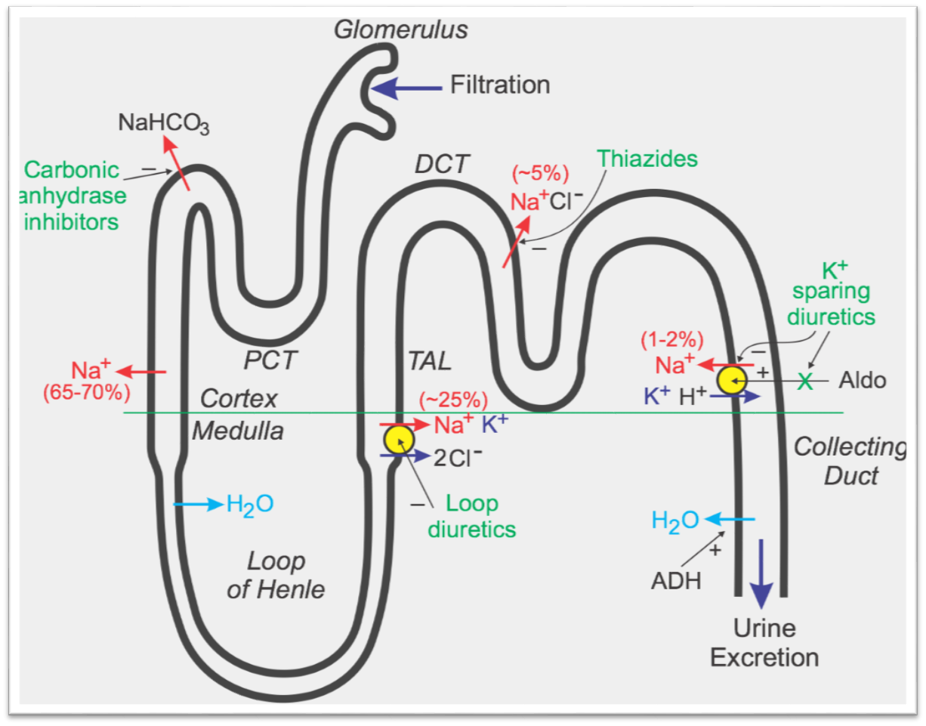
Fig. II Sites of action of diuretics

Slide 18
OVERVIEW OF CLINICAL USE
1. To decrease expanded ECF (edema)
a. Systemic edemas (thiazides, loop diuretics):
  Cardiac edema: CHF ( aldosterone antagonists)
  Hepatic edema: liver cirrhosis ( aldosterone antagonists)
  Renal edema: chronic renal disease, nephrosis
b. Localized edemas (acute and dangerous conditions):
  Cranial edema (mannitol infusion)
  Pulmonary edema (furosemide i.v.)
  Glaucoma (acute: mannitol or urea infusion, or isosorbide per os. chronic: acetazolamide per os/i.v.; dorzolamide or brinzolamide topically)
2. Lower Blood Pressure (Bp)
  Chronic hypertension: thiazides (e.g. HCTZ) + amiloride, aldosterone antagonists (eplerenone)
  Acute hypertensive crisis: furosemide IV

Slide 19
3. To increase urinary excretion of inorganic ions, eg
  Ca2+ in acute hypercalcemia: furosemide
  K+ in acute hyperkalaemia: furosemide
  Li+ in lithium intoxication: amiloride
  Br- in bromide intoxication: thiazides
4. To prevent anuria in acute renal failure:
  Furosemide i.v.
  Mannitol infusion (only if it produces diuresis)
5. Other indications:
    Dialysis disequilibrium syndrome (mannitol inf. to correct hyposmolarity of the blood)
    Ca2+ nephrolithiasis (thiazides to Ca2+ excretion into urine)
    Osteoporosis (thiazides to Ca2+ excretion into urine)

Slide 20
Other indications contd
Nephrogenic diabetes insipidus, i.e. ADH refractoriness (thiazides)*
Epilepsy (CA inhibitors to CO2 concentration in brain)
Metabolic alkalosis (CA inhibitors to NaHCO3 excretion)
Altitude sickness (CA inhibitors)
Cystic fibrosis (inhalation of Na+ channel inhibitor solution or of mannitol powder to dilute the bronchial secretion and thus promote the mucociliary clearance)
Cardiovascular diseases, e.g. CHF, MI, hypertension (aldosterone antagonists: spironolactone, eplerenone)

