Slide 1
Detection of Poison Ivy With Password Specific Snort Rules Mario R. De Tore

Slide 2
Intro
Lead IR dude at SLAC
Before SLAC was a lead IH at Mandiant
Prior Navy, .mil/.gov monitoring tours and other “stuff”

Slide 3
Agenda
Some basic PI info
Generate some traffic with a PI implant
Analyze and decrypt the traffic
Generate and validate some signatures
New tool - pivysnort demo
Questions/discussion (time permitting)

Slide 4
Poison Ivy Overview
Very capable, easy to deploy & use implant
Freely available
Source code leaked?
Lots of variants in the wild
Still used, but being replaced by Sogu/PlugX
Utilizes camellia for encryption
256 bit key with 16-byte blocks (remember this!)

Slide 5
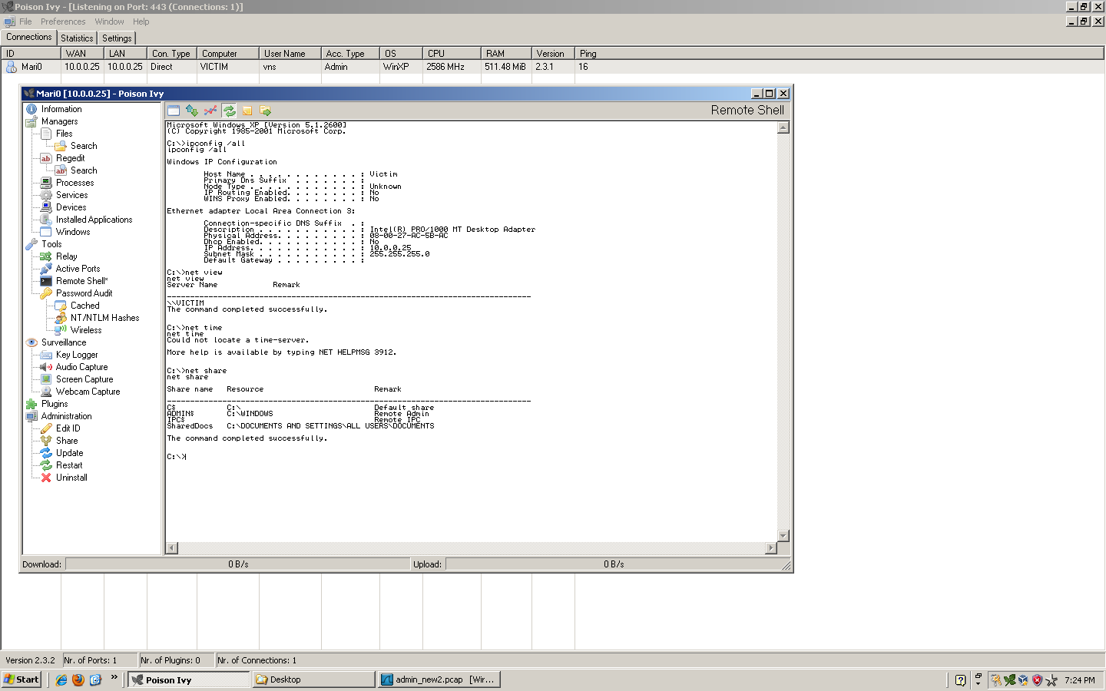
Poison Ivy Live

Slide 6
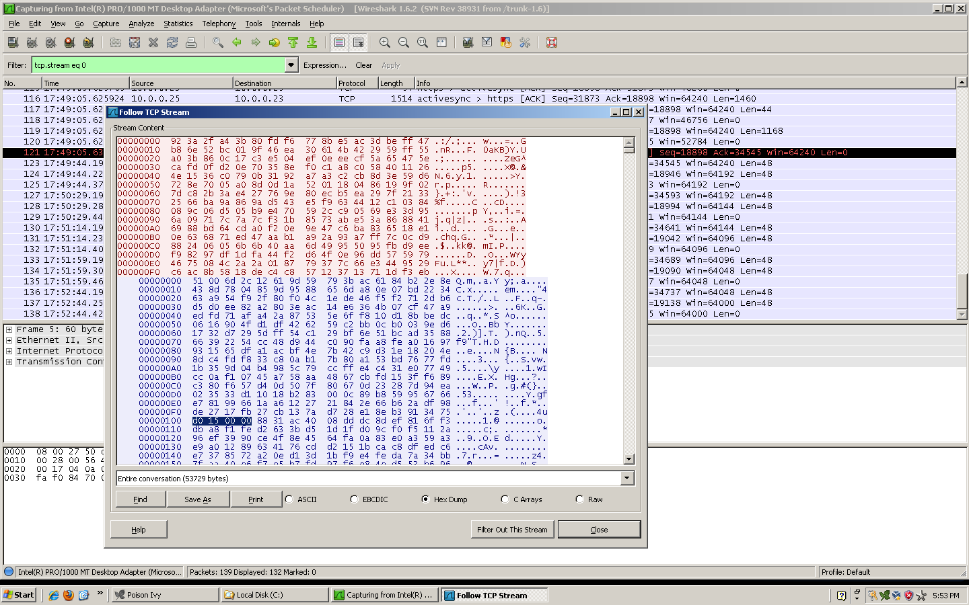
Reviewing Traffic

Slide 7
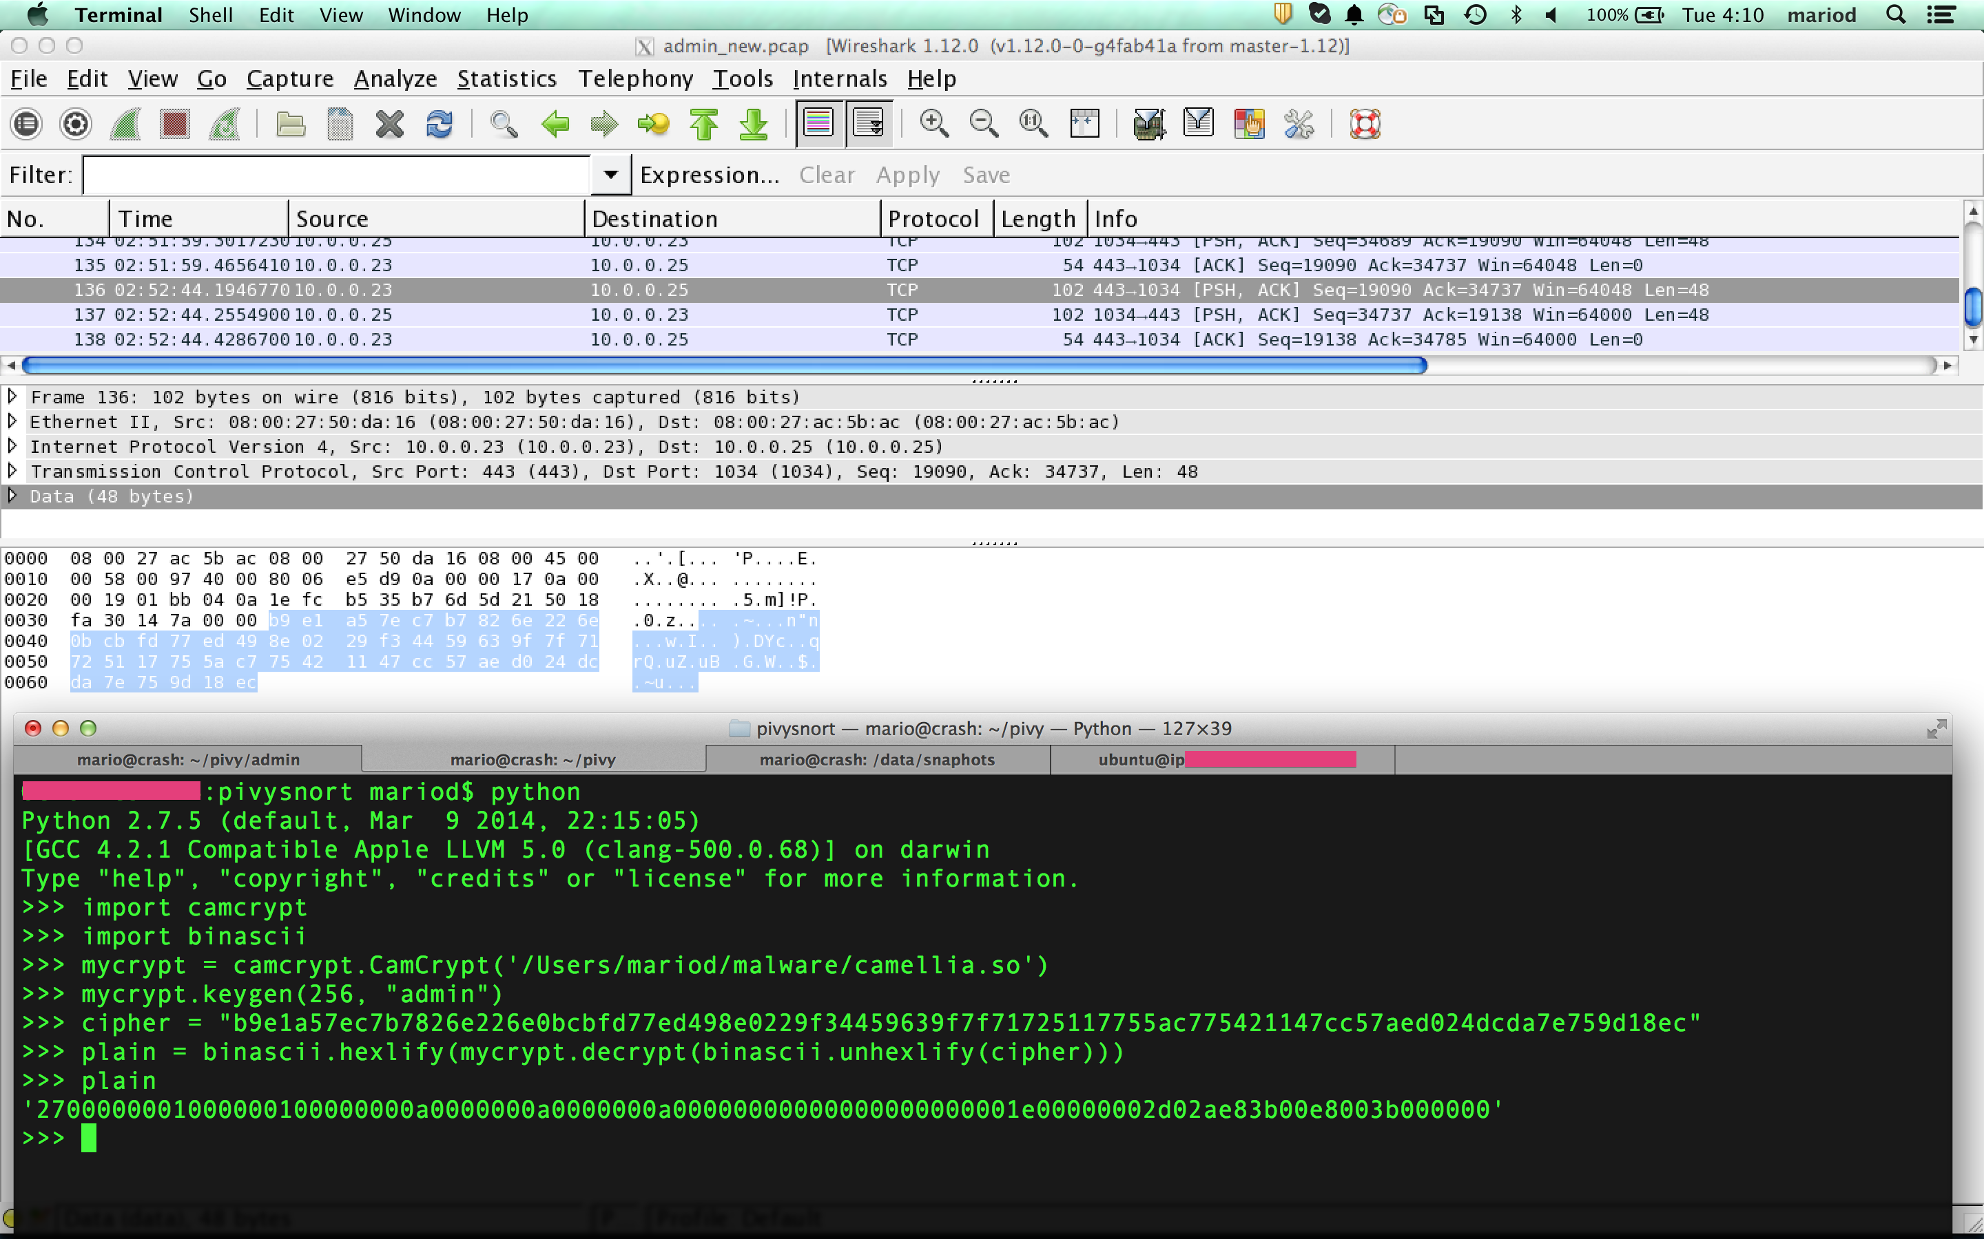
Decrypting Traffic

Slide 8
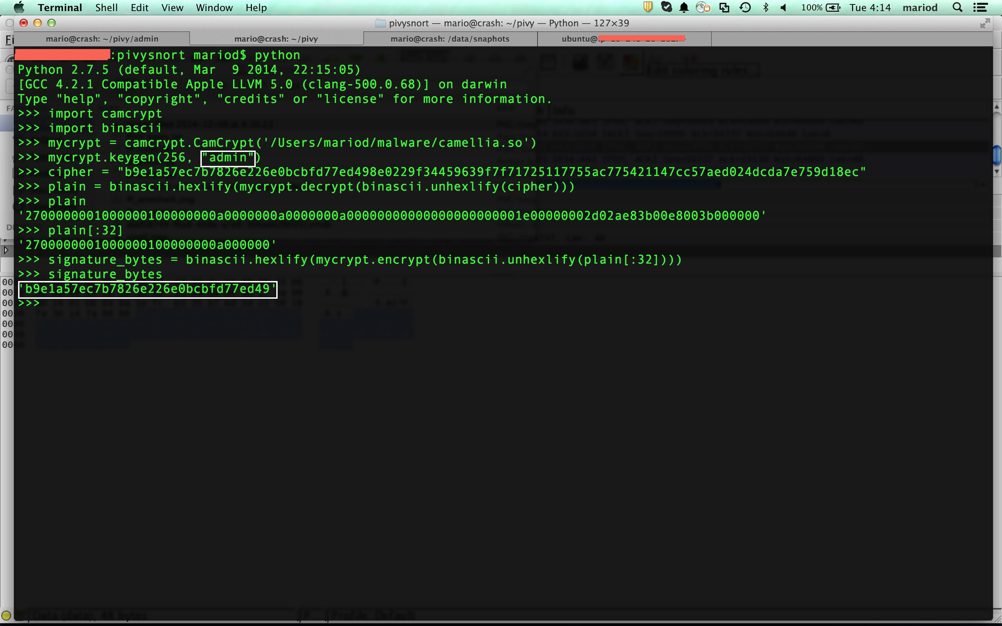
Building Signatures

Slide 9
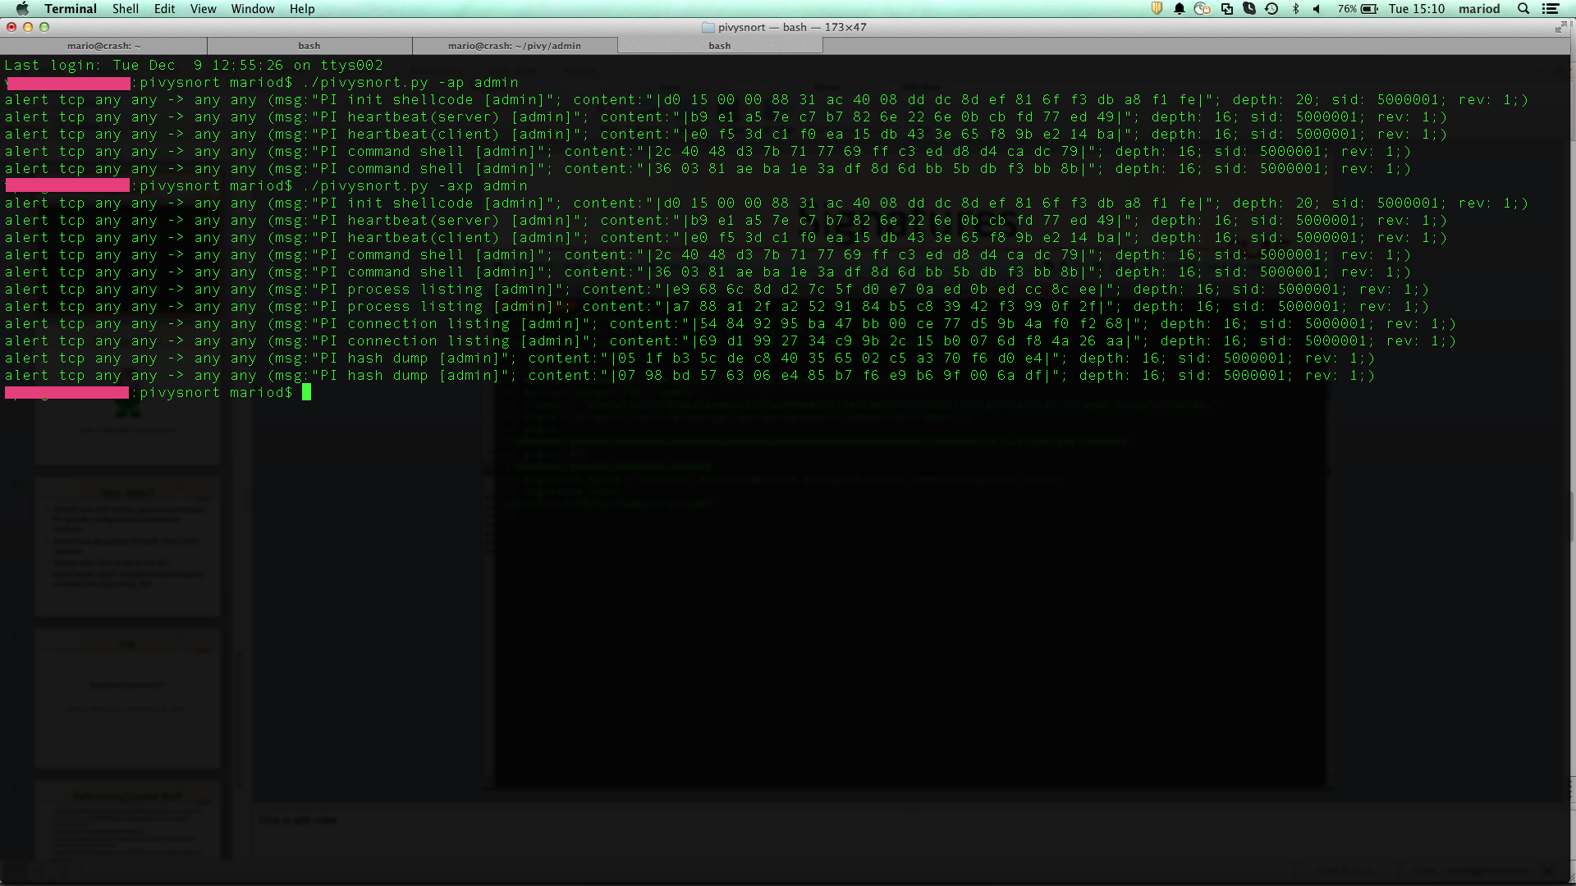
Finished signatures
alert tcp any any -> any any (msg:"PI heartbeat(server) [admin]"; content:"|b9 e1 a5 7e c7 b7 82 6e 22 6e 0b cb fd 77 ed 49|"; depth: 16; sid: 5000001; rev: 1;)

Slide 10

Code or GTFO!
https://code.google.com/p/pivysnort

Slide 11
Next Steps?
Identify and add reliable signature prototypes for specific configurations of deployed implants
Brute force decryption for traffic from UNID implants
Maybe with a Bro script on the fly?
http://www.rapid7.com/db/modules/exploit/windows/misc/poisonivy_bof

Slide 12
FIN
Questions/comments?
mariod@slac.stanford.edu

Slide 13
References/Useful Stuff
https://www.fireeye.com/resources/pdfs/fireeye-poison-ivy-report.pdf
https://github.com/MITRECND/chopshop/blob/master/modules/poisonivy_23x.py
https://github.com/knowmalware/camcrypt
https://code.google.com/p/volatility/source/browse/trunk/contrib/plugins/malware/poisonivy.py
http://volatility-labs.blogspot.com/2012/10/reverse-engineering-poison-ivys.html

