Slide 1
Design a Parking Lot using OOP
Team 4
Hyeonho, Ewarn,
Nyi, Emil

Slide 2
Table of contents
1
System Requirements
2
Use Case Diagram
3
Class Diagram
4
Code
+Page Flow Diagram
+Output

Slide 3
1
System Requirements
12 System Requirements

Slide 4
System Requirements
Multi-level structure
Entry-Exit
Ticket
2 Payment Options
Display Board
Diverse Parking Spots
Facility with several parking floors
Numerous entry and exit points
Obtaining parking ticket upon entering parking lot
Accept both cash and credit card
Shows all the data related to parking lot
Compact, Large, Handicapped, Motorcycle

Slide 5
System Requirements
Diverse vehicle types
Capacity Limit
Fare Calculation
Find My Car
Membership Plan
Priority for disabled people
Facility with several parking floors
Notify customers if the capacity reaches its limit
Fare based on vehicle type, duration
Locate parked car easily
Special plans for frequent visitors
Exclusive reservation for individuals with disabilities

Slide 6
2
Use Case Diagram

Slide 7
Use Case Diagram
Actors: Admin, Customer, System, Parking Attendant
Top Use Cases:
Add/Remove parking floor
Add/Remove parking spot
Add/Remove parking attendant
Create/Modify Account
Take Ticket
Scan Ticket
Calculate/Modify Parking Rate
Find My Car

Slide 8
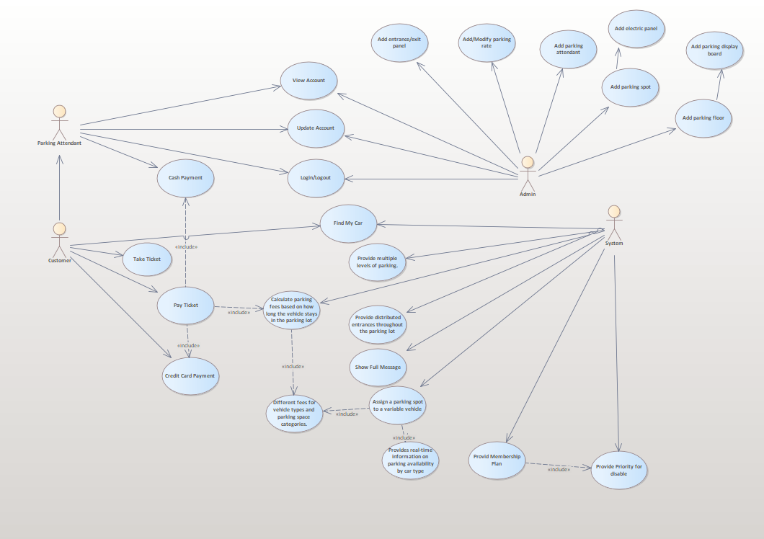

Slide 9
3
Class Diagram

Slide 10
Class Diagram
Main Classes:
Parking Lot
Parking Floor
Parking Spot
Account
Parking Ticket
Vehicle
Entrance and Exit Panels
Payment
Parking Rate
Parking Display Board

Slide 11
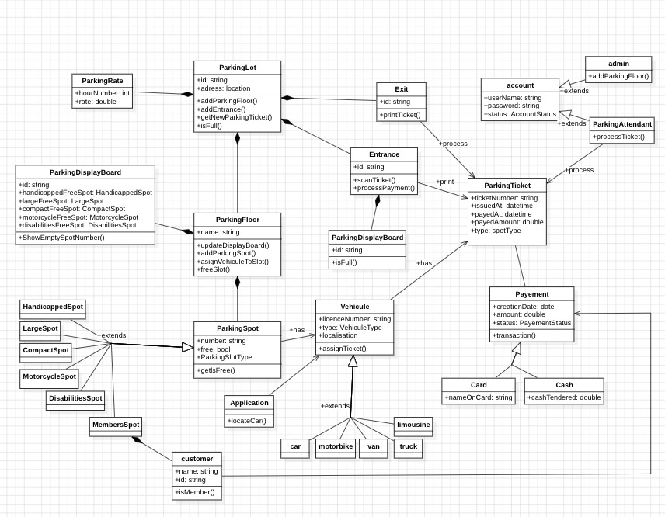

Slide 12
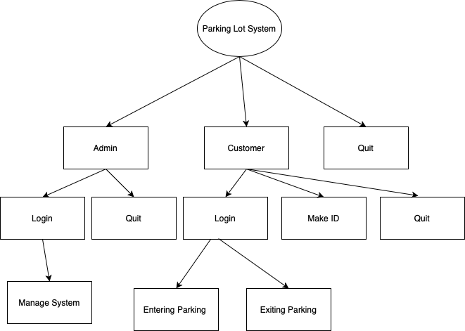
Page Flow Diagram

Slide 13
4
Code

Slide 14
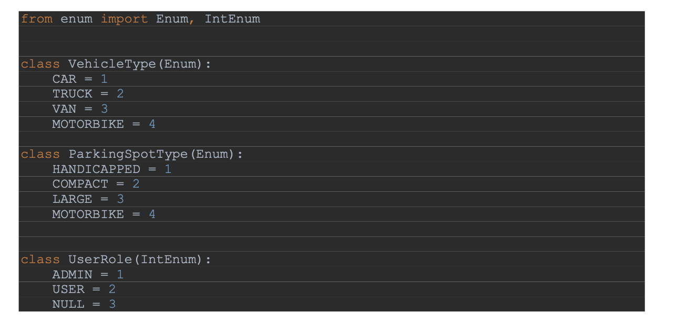
constants.py

Slide 15
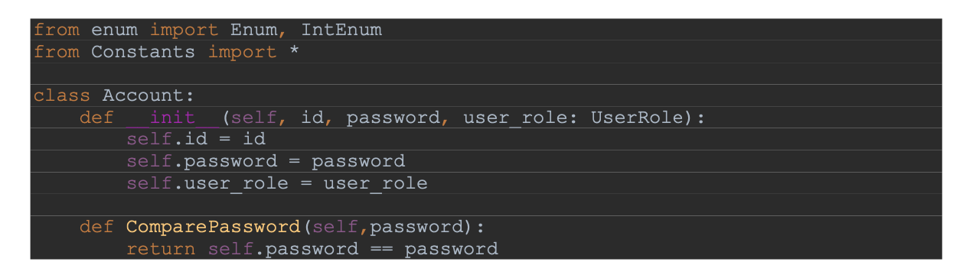
account.py

Slide 16
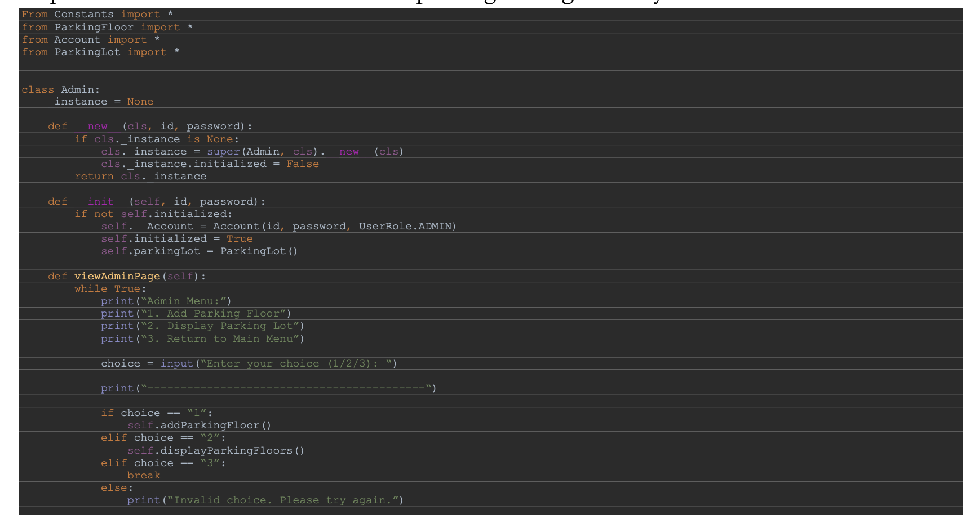
admin.py

Slide 17
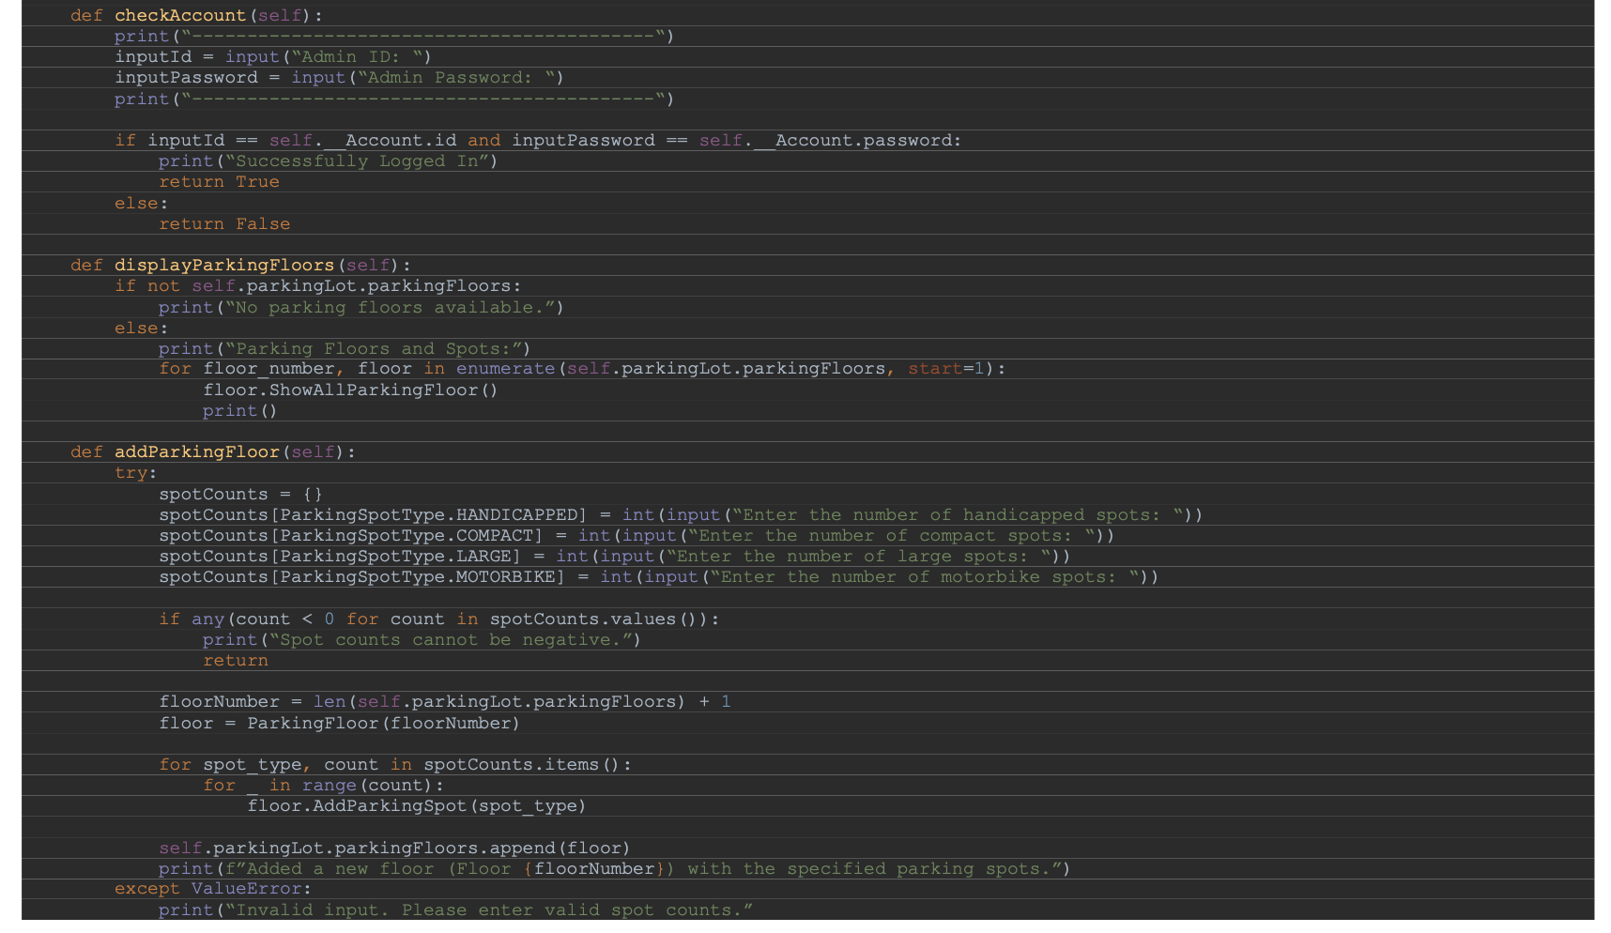
admin.py (cont’d)

Slide 18
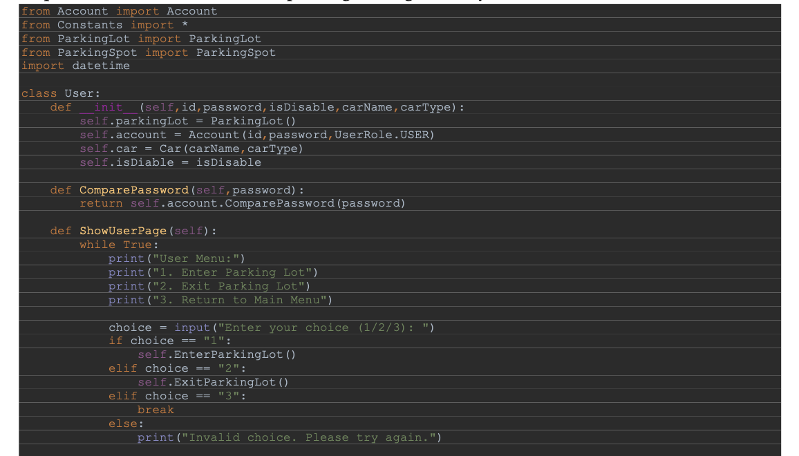
user.py

Slide 19
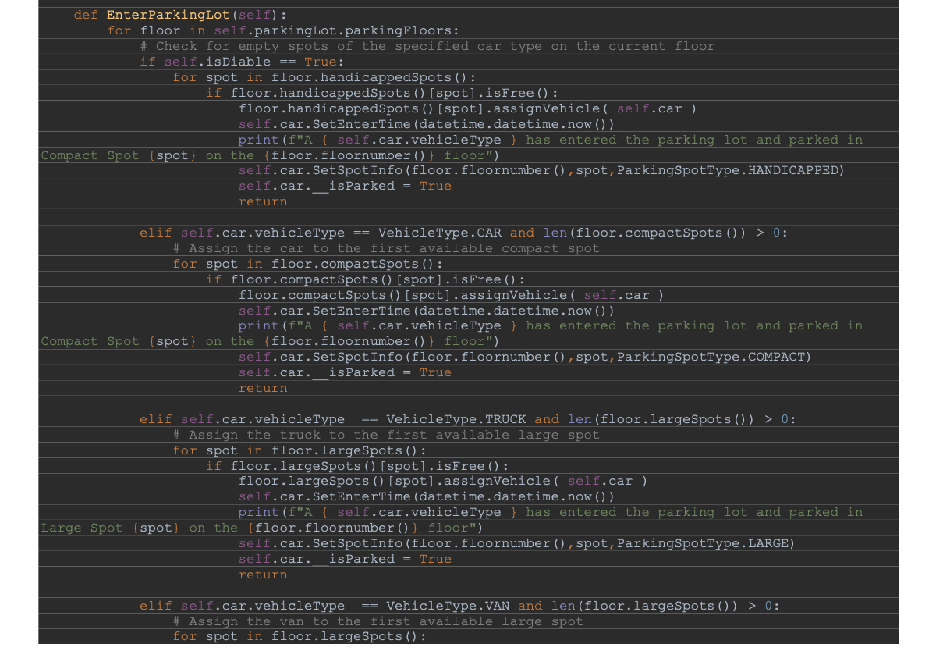
user.py (cont’d)

Slide 20
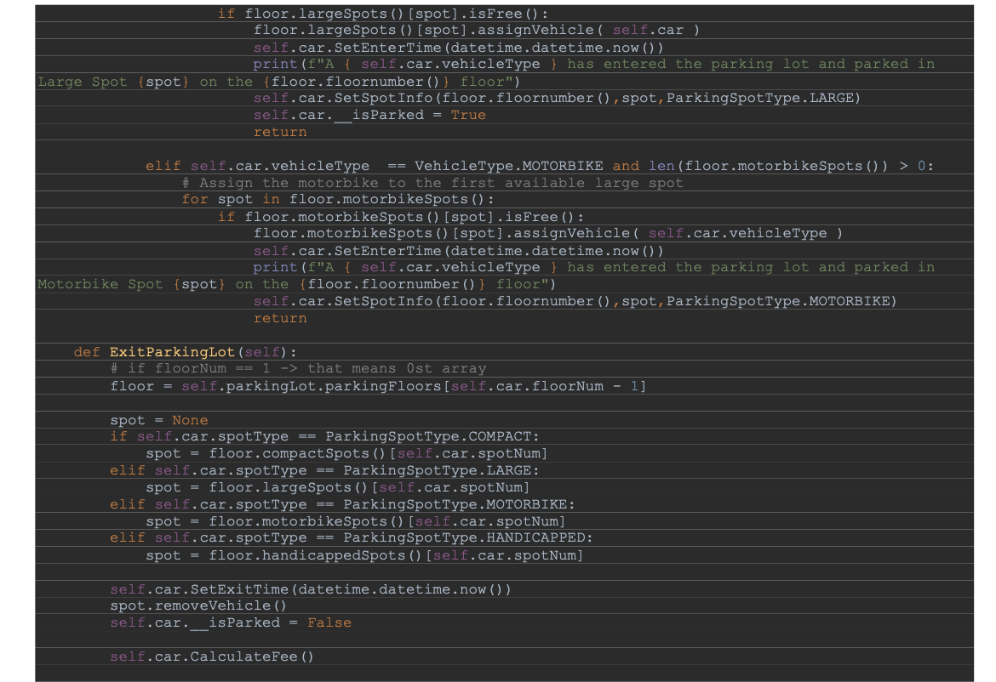
user.py (cont’d)

Slide 21
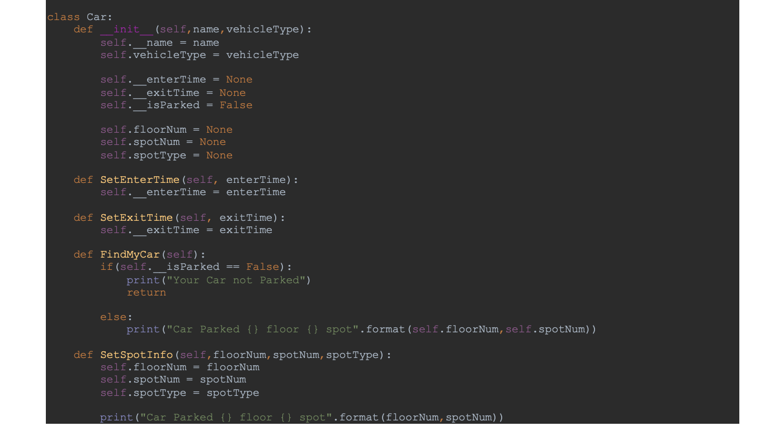
user.py (cont’d)

Slide 22
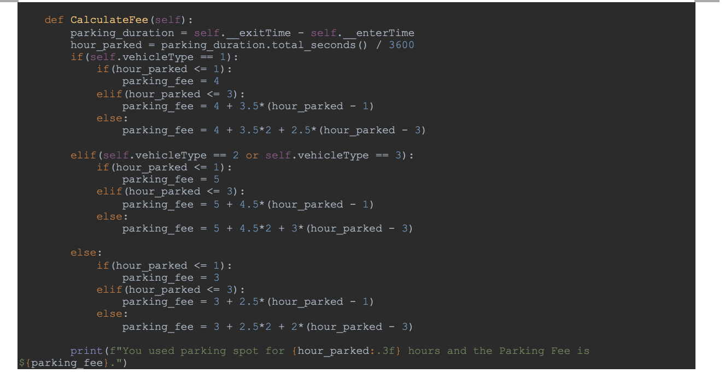
user.py (cont’d)

Slide 23
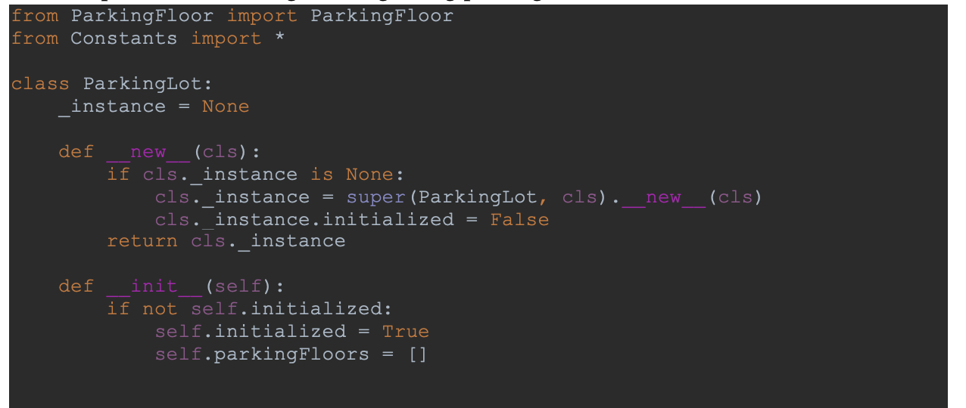
parkinglot.py

Slide 24
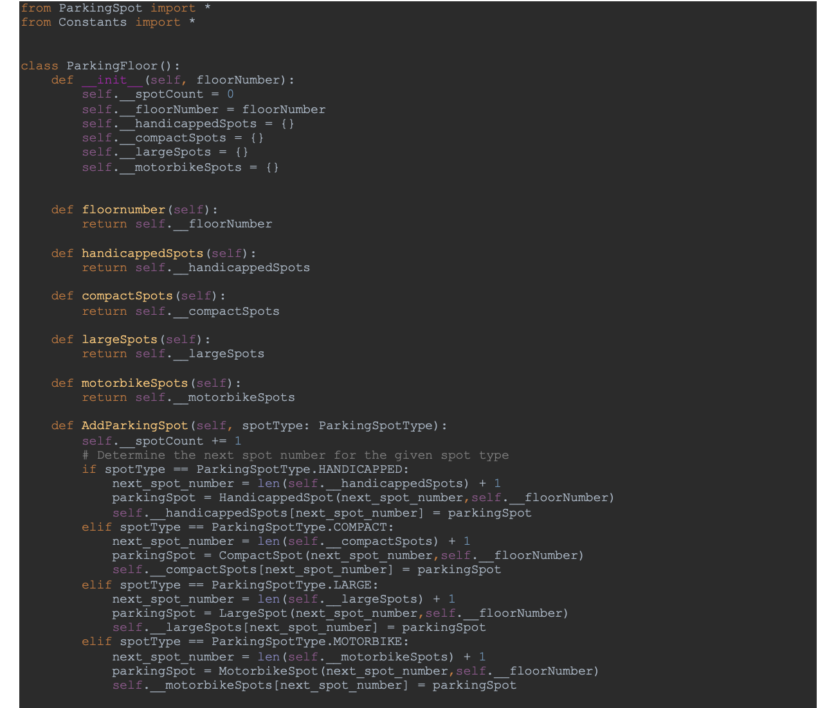
parkingfloor.py

Slide 25
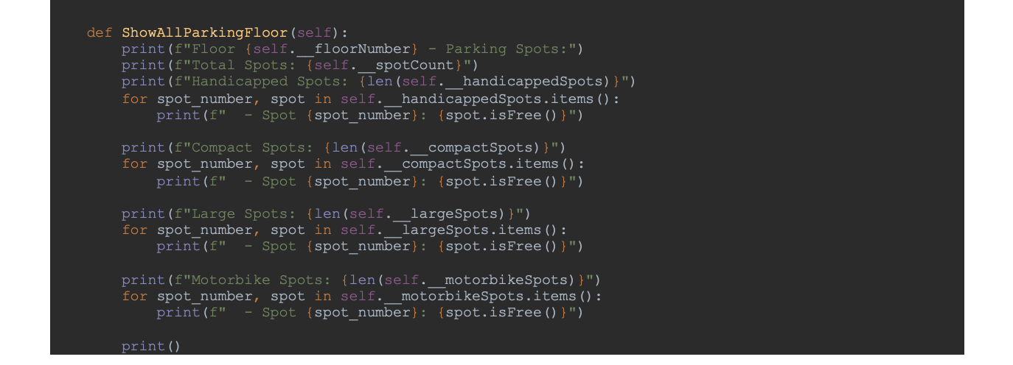
parkingfloor.py (cont’d)

Slide 26
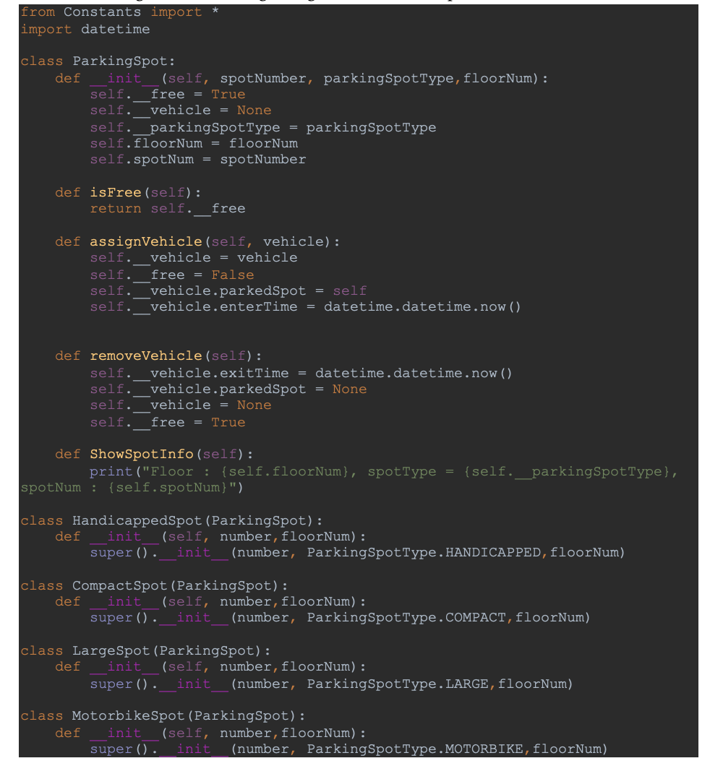
parkingspot.py

Slide 27
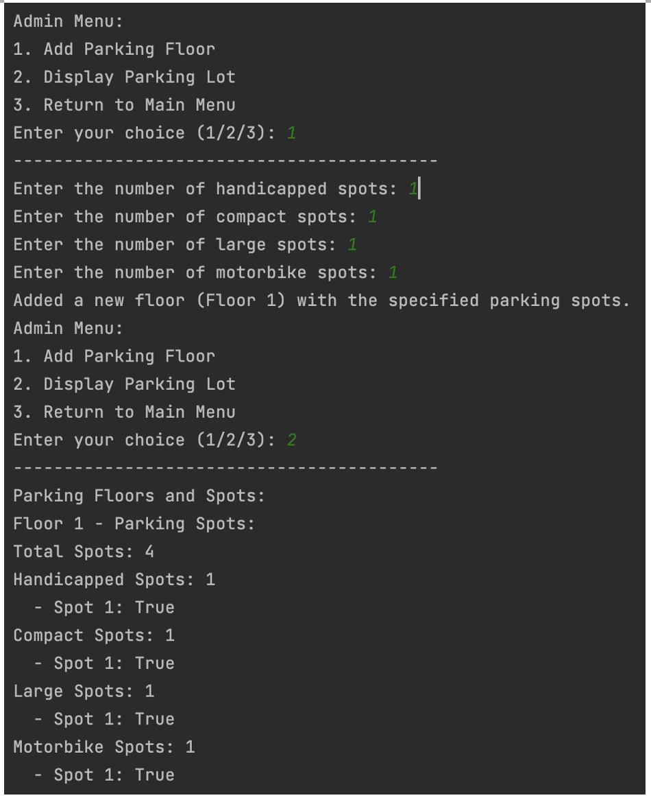
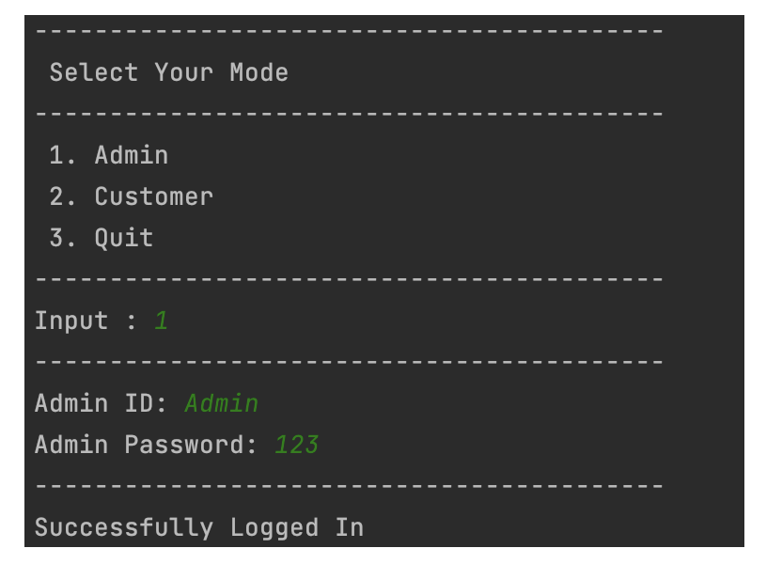
Output

Slide 28
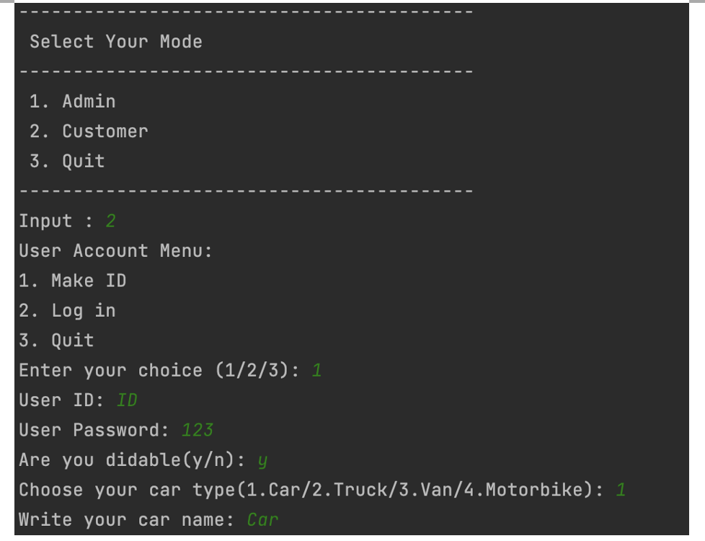
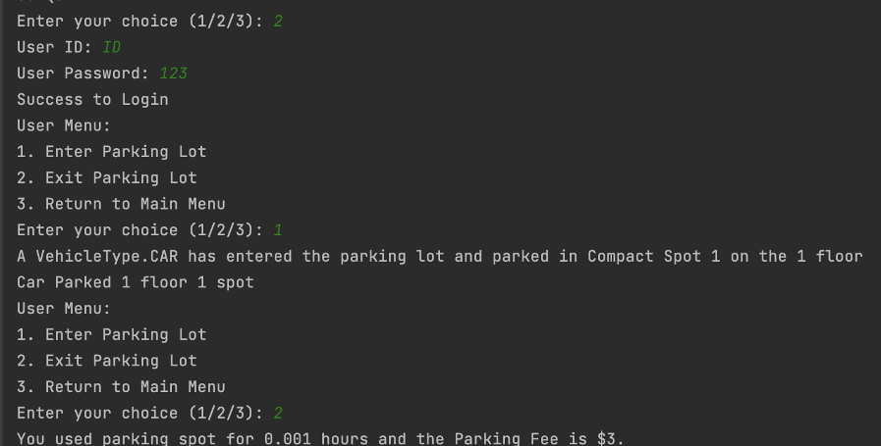
Output

