Slide 1
Root of a Quadratic equation
Step 1: Start
Step 2: Input variables a, b, c, D, x1, x2, rp and ip;
Step 3: Calculate discriminant - D = b2-4ac
Step 4: If D ≥ 0
x1 = (-b+√D)/2a
x2 = (-b-√D)/2a
Display x1 and x2.
Else
Calculate real part and imaginary part
rp = -b/2a
ip = √(-D)/2a
Display rp+j(ip) and rp-j(ip) as roots
Step 5: Stop

Slide 2
Finding the largest of three numbers
Step 1: Start
Step 2: Declare variables a,b and c.
Step 3: Read variables a,b and c.
Step 4: If a > b
If a > c
Print a is the largest number.
Else,
Print c is the largest number.
Else
If b > c
Print b is the largest number.
Else
Print c is the greatest number.
Step 5: Stop

Slide 3
Finding the factorial of number n
Step 1: Start
Step 2: Input variable n
Step 3: Read n, factorial and i
Step 4: factorial = 1
i = 1
Step 5: Repeat the steps until i = n
5.1: factorial = factorial*i
5.2: i = i+1
Step 6: Print factorial
Step 7: Stop

Slide 4
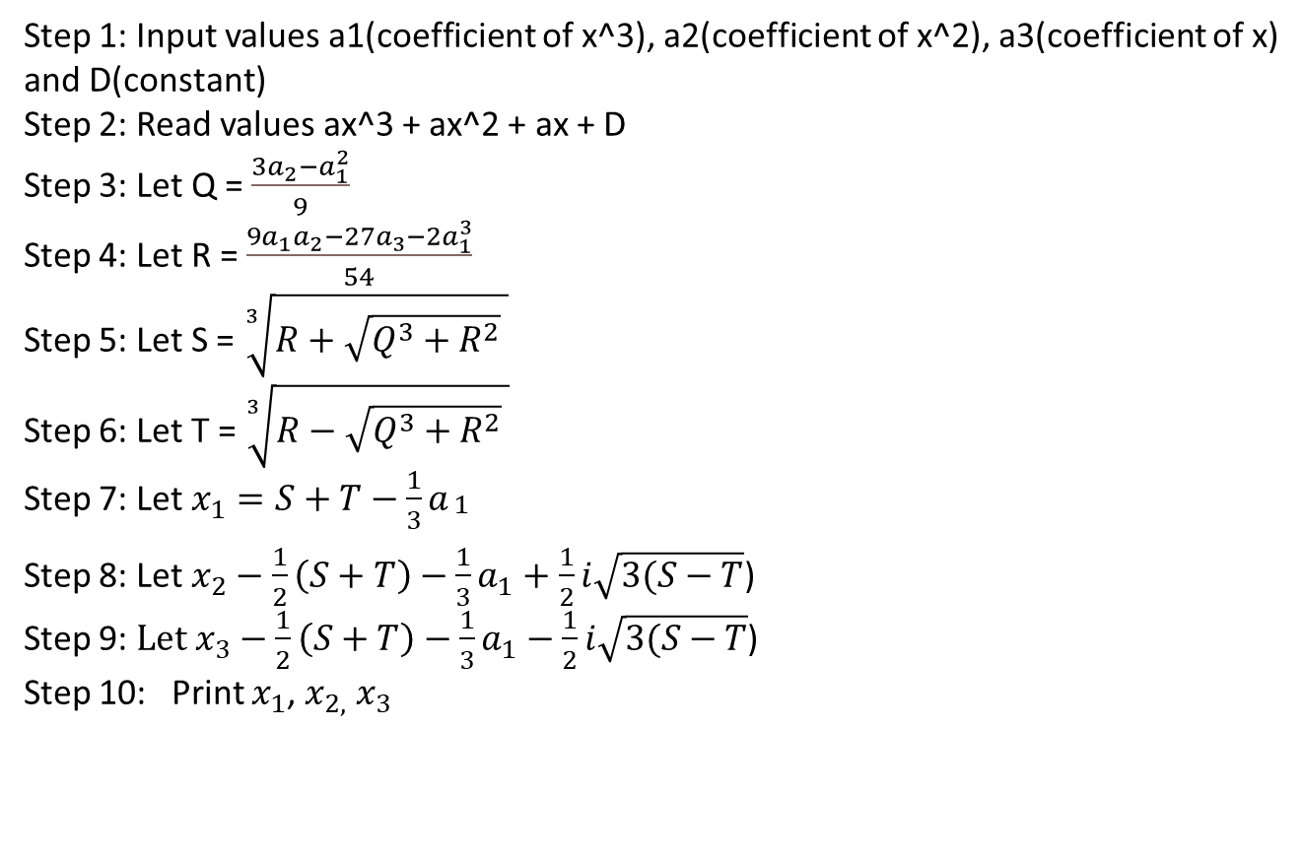
Root of a cubic equation
Step 1: Input values a1(coefficient of x^3), a2(coefficient of x^2), a3(coefficient of x)
and D(constant)
Step 2: Read values ax^3 + ax^2 + ax + D
Step 3: Let Q = $\frac{3a_{2}−a_{1}^{2}}{9}$
Step 4: Let R = $\frac{9a_{1}a_{2}−27a_{3}−2a_{1}^{3}}{54}$
Step 5: Let S = $\sqrt[3]{R+\sqrt{Q^{3}+R^{2}} }$
Step 6: Let T = $\sqrt[3]{R−\sqrt{Q^{3}+R^{2}} }$
Step 7: Let $x_{1}=S+T−\frac{1}{3}a_{\begin{aligned}1 \\ \end{aligned}}$
Step 8: Let $x_{2}−\frac{1}{2}\left(S+T\right)−\frac{1}{3}a_{1}+\frac{1}{2}i\sqrt{3(S−T}$)
Step 9: $Let x_{3}−\frac{1}{2}\left(S+T\right)−\frac{1}{3}a_{1}−\frac{1}{2}i\sqrt{3(S−T}$)
Step 10: Print $x_{1}$, $x_{2, }$ $x_{3}$

Slide 5
Begin lcm := a i := 2 while lcm mod b ≠ 0, do lcm := a * i i := i + 1 done return lcm End
GCD and LCM of two numbers
GCD
Step 1: Start
Step 2: Input n1 and n2
Step 3: gcd = 1, I = 1
Step 4: If n1%i = 0 and n2%i = 0:
gcd = I
Step 5: Print gcd
Step 6: Stop
LCM
Step 1: Start
Step 2: lcm = a, i = 2
Step 3: while lcm mod b != 0
Step 4: lcm = a * i
Step 5: i = i + 1
Step 6: return lcm
Step 7: Stop

