Slide 1
supporting fractional investment & tokenized real estate: multiple regression analysis
presented by: marvin lee

Slide 2
final model
00
background
01
data + eda
02
modeling
03
conclusion
04

Slide 3
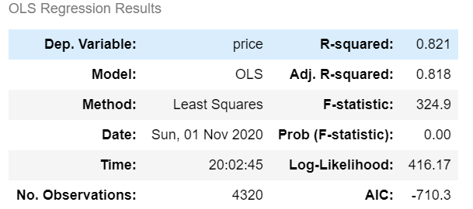
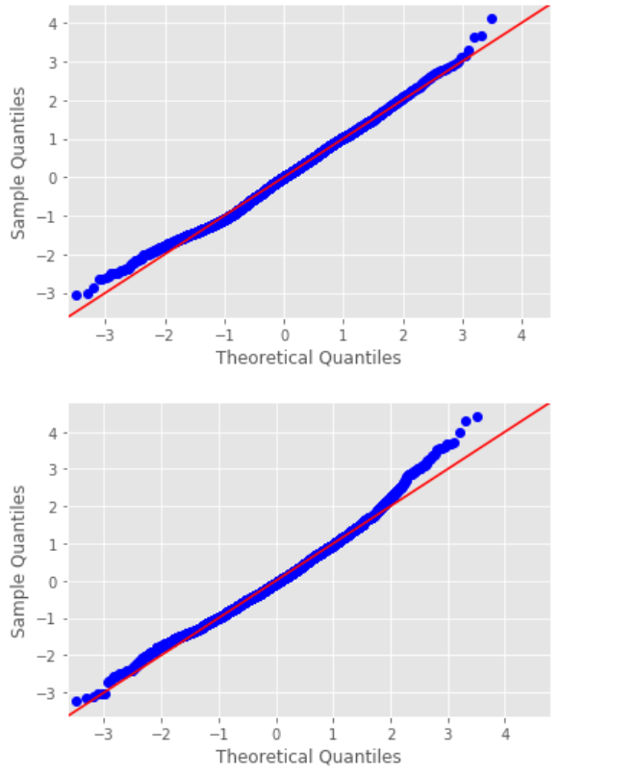
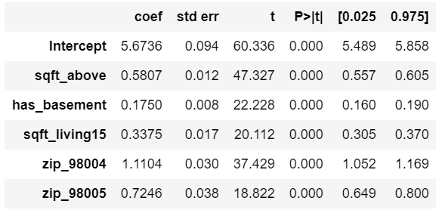
Keys: log-transformed price, zip code dominance, log+scale of sqft_above
final model:

Slide 4

background: decentralized, trustless systems for real estate asset management need accurate price predictions
collateral
home upgrades
[insert need here]

Slide 5
data
home_age, living_lot_ratio, baths_with_reno
KC house data set (21,000+ items)
Output “cleaned” data set to a CSV file
Most variables were turned into categorical variables
Primary goal: improve R2 / Secondary goal: a trustless model
Used stepwise method for initial “automatic” add/drop statistical analysis
Log-transformed + scaled continuous variables / Log-transformed target
Created the following features:

Slide 6
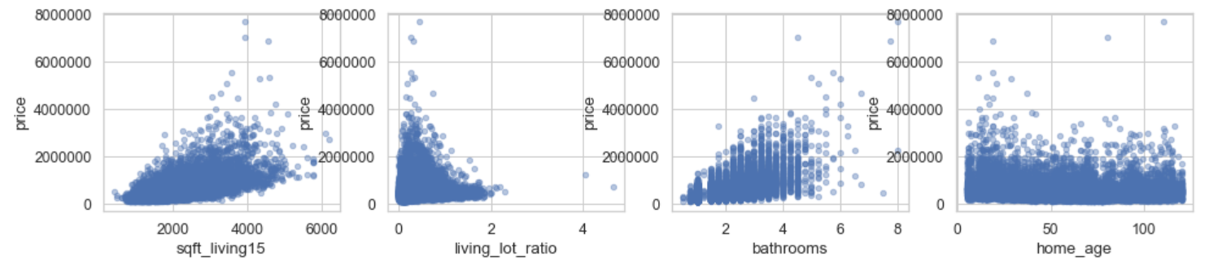
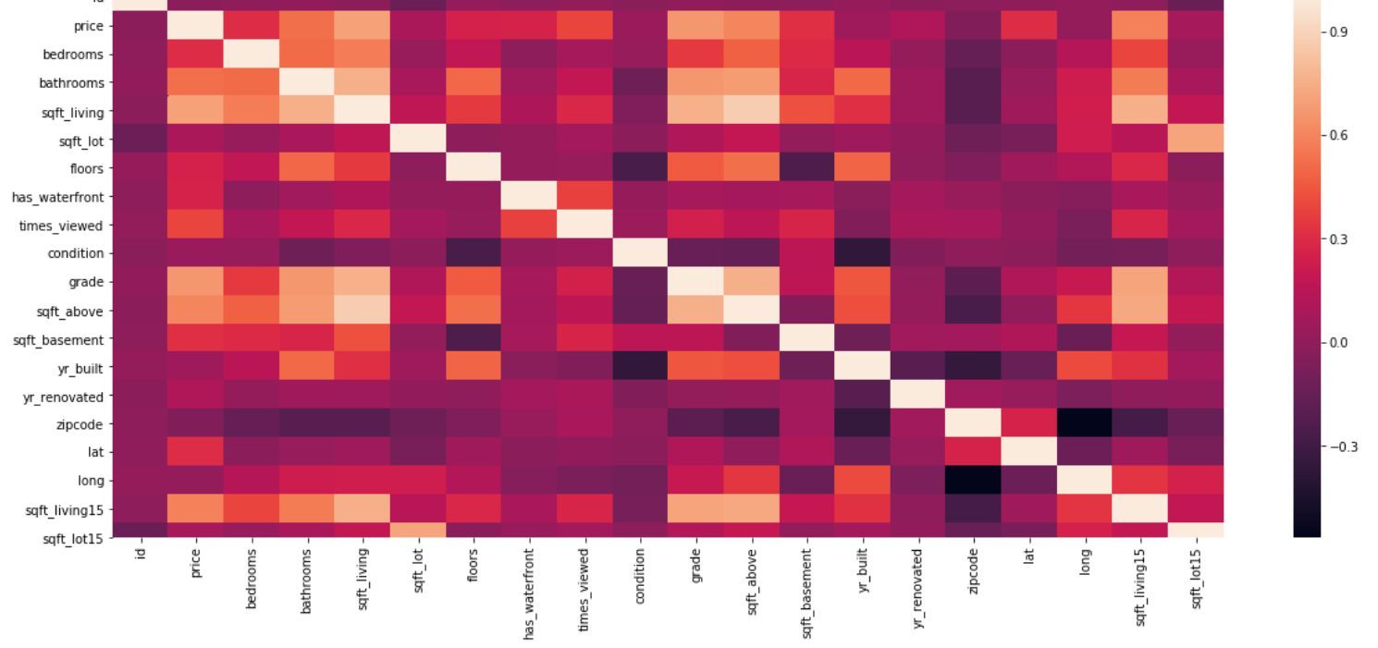
eda
checked for:
multicollinearity
subjectivity
redundancy
mostly categoricals

Slide 7
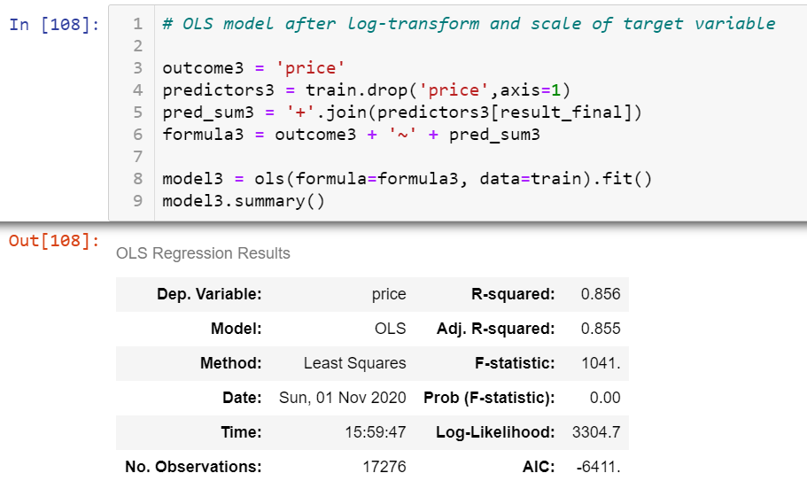
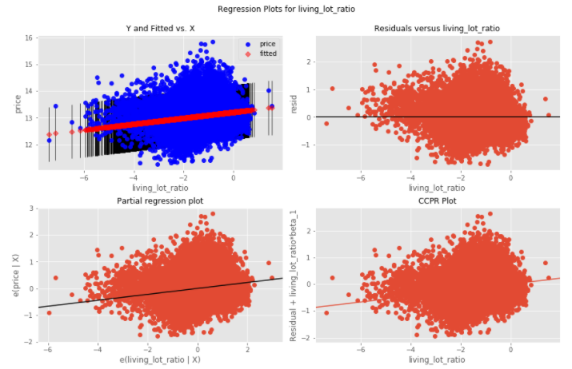
modeling
Living lot ratio proved to have homoscedasticity and was therefore unfit to be included in the final model.
Log-transformation of the target variable + stepwise addition led to the best R-squared value
features
stepwise

Slide 8
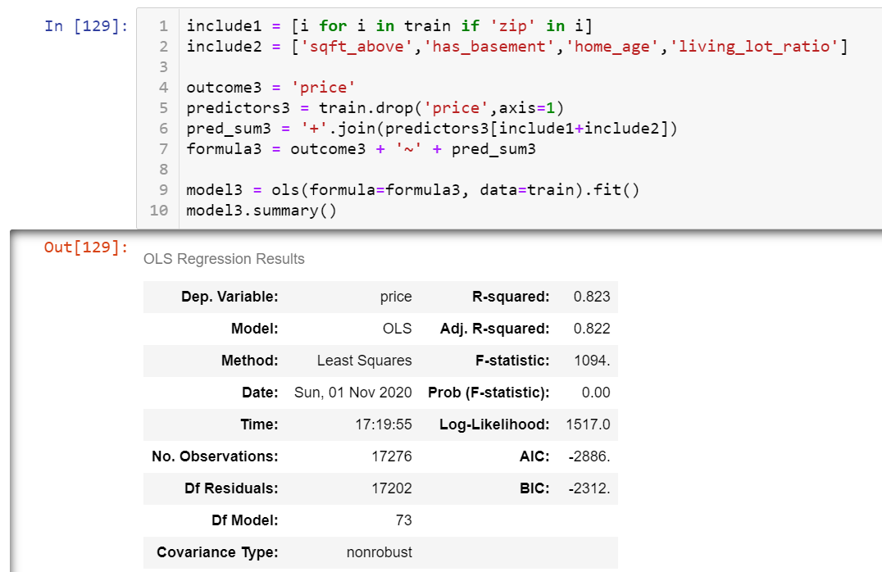
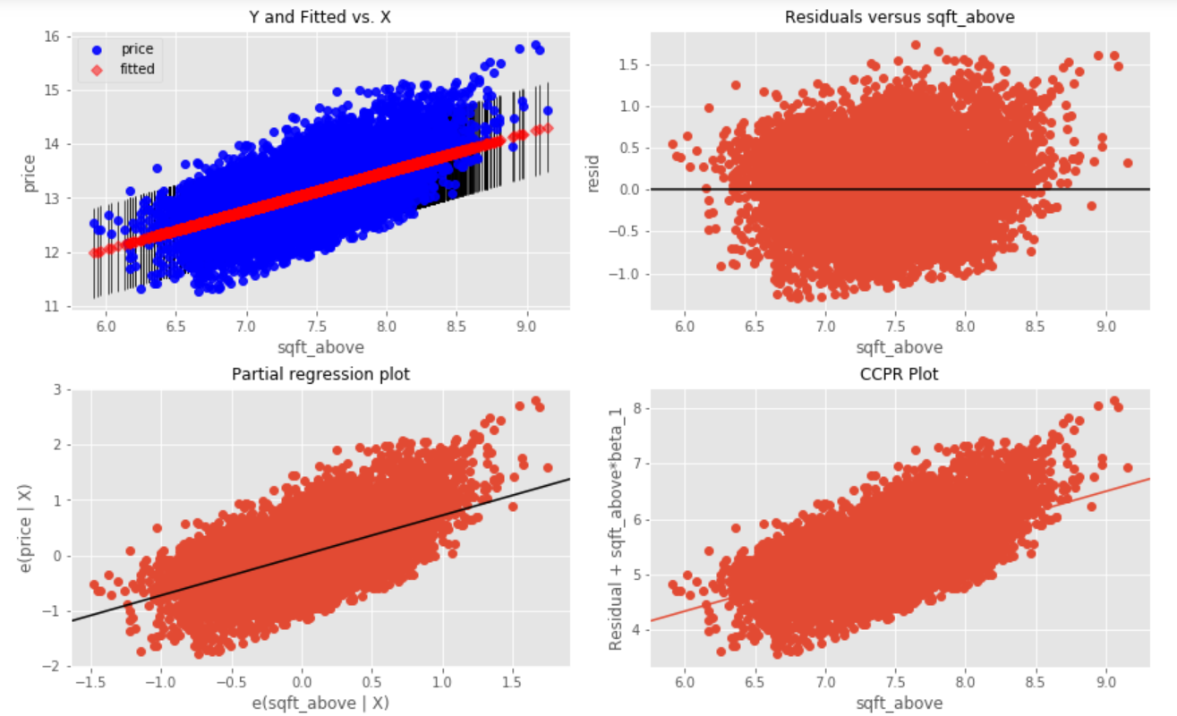
zips + minimum other features
R-squared of 0.823
2 variables with p-value > 0.05

Slide 9
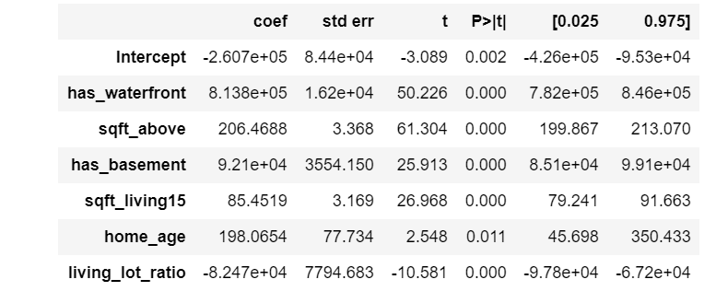
conclusion + the future
base collateral levels on:
segmented modeling
study grading
location + sqft_above
high prices vs. lower prices
subjective variables
features didn’t pass
but may still hold insights

Slide 10

04
thank you
www.github.com/emel333

