Slide 1
Emma Moore Human-Centered Research & Strategy Portfolio Snapshot
Turning complex, regulated systems into clear, predictable experiences.
Mixed-methods research | Multi-team alignment | System modernization
Winter 2025

Slide 2
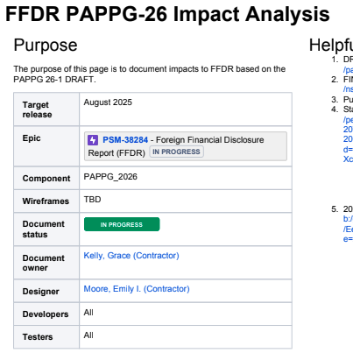
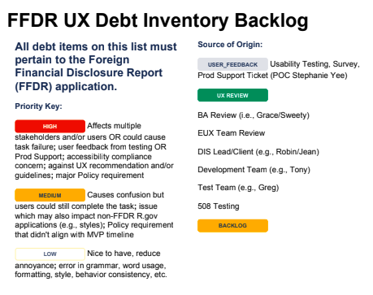
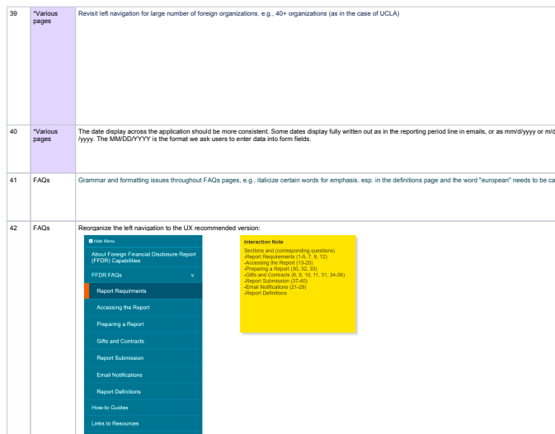
Designing for Large, Regulated Ecosystems
Across NSF, NIH, and FDA, I worked in environments where complexity, policy constraints, and legacy systems made clarity difficult for both users and internal teams. My work focuses on uncovering what truly matters, removing friction, and guiding stakeholders toward aligned, user-centered decisions.
Winter 2025

Slide 3
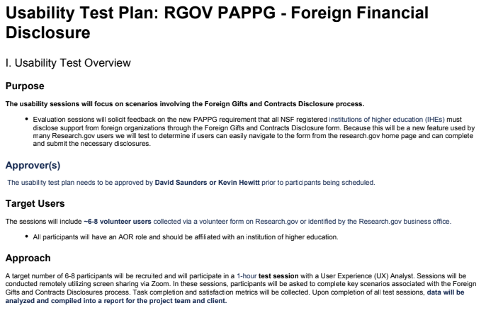
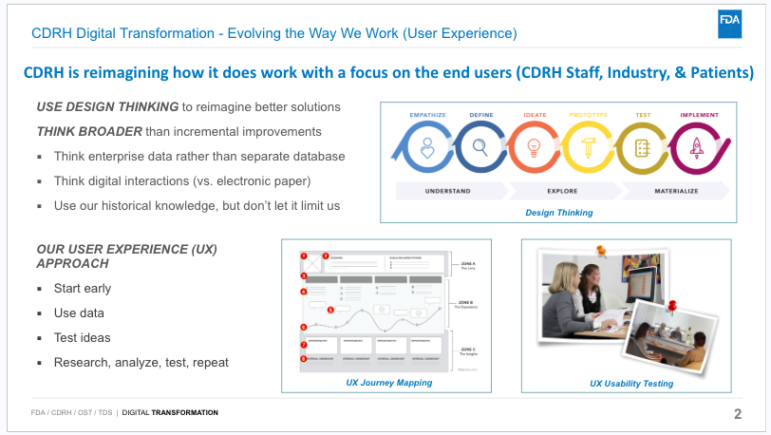
How I Bring Clarity to Complexity
Uncover needs through mixed-methods research
Align stakeholders through actionable insights
Translate policy + workflow constraints into clear requirements
Build repeatable systems (ops, onboarding, templates)
Support leadership with concise, decision-ready recommendations
Winter 2025

Slide 4
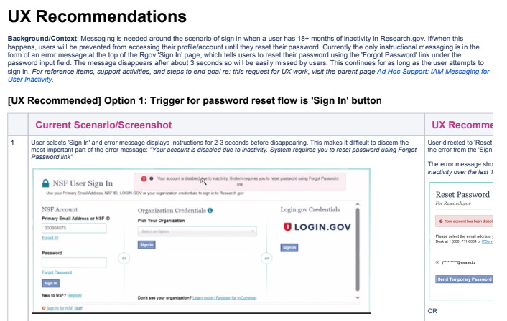
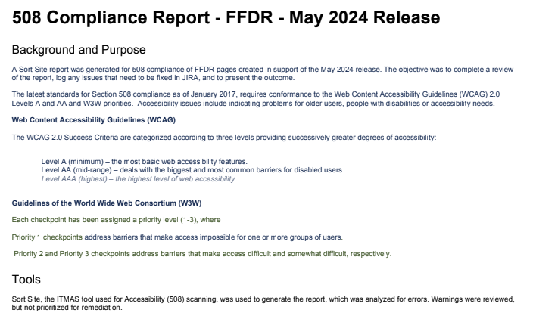
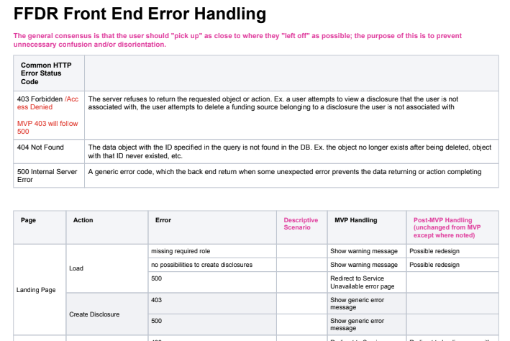
Transforming User Insights Into Direction
I led research that surfaced critical workflow gaps, compliance risks, and unmet needs. The synthesis clarified which changes would deliver the greatest impact with the least disruption. Impact:
Reduced rework
Informed product priorities
Supported compliance-aligned decisions
Winter 2025

Slide 5
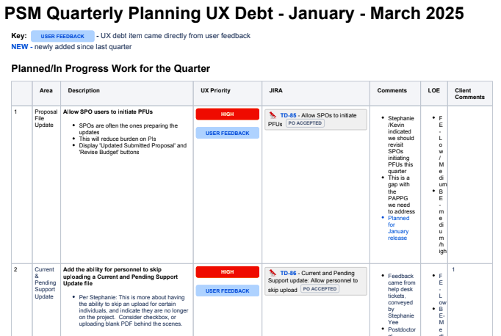
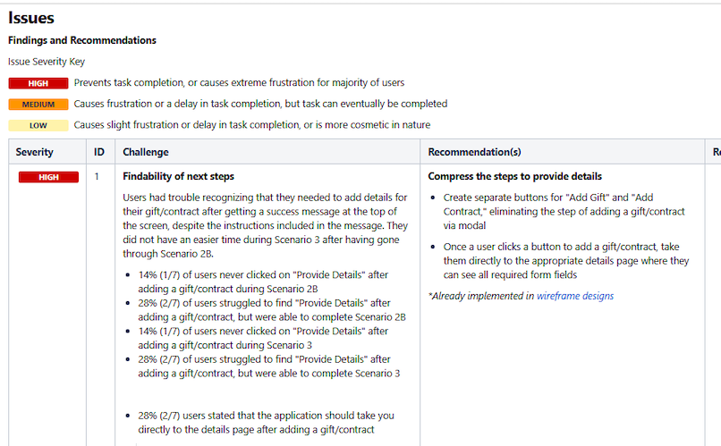
Guiding Stakeholders with Decision-Ready Findings
I distilled research into clear, prioritized actions that balanced user needs, technical constraints, and policy requirements. These recommendations directly influenced quarterly planning and reduced ambiguity for engineering. Impact:
Avoided wasted engineering cycles
Accelerated delivery
Boosted cross-team alignment
Winter 2025

Slide 6
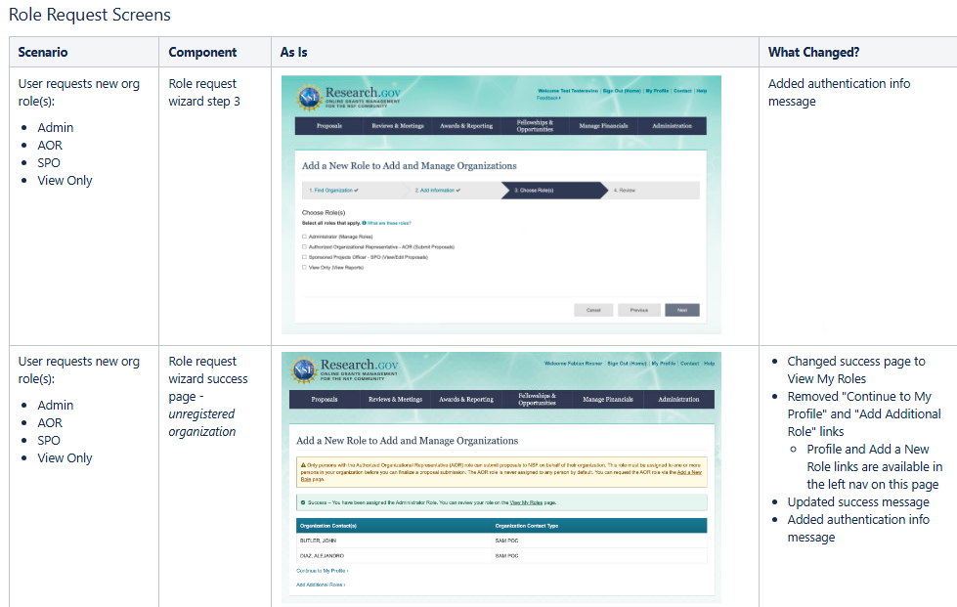
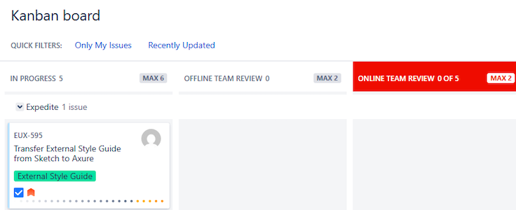
Clarifying End-to-End Workflows Across Multi-Team Systems
I mapped complex workflows to identify disconnects and unify cross-functional teams around the same operational picture. These artifacts became a source of truth for design, policy, and engineering teams. Impact:
Reduced confusion
Improved consistency
Enabled cross-team decision making
Winter 2025

Slide 7
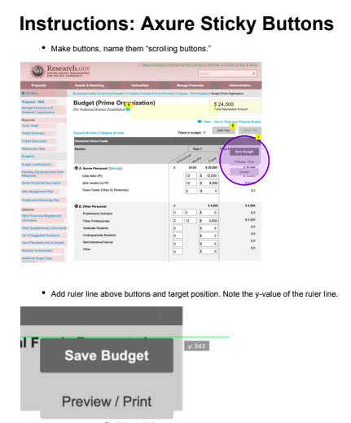
Building Research & UX Operational Infrastructure
I built templates, onboarding materials, and governance guidelines to support consistent, scalable UX practice. This infrastructure reduced onboarding time and improved quality across teams. Impact:
Standardized processes/designs
Faster onboarding
Reduced knowledge loss
Winter 2025

Slide 8
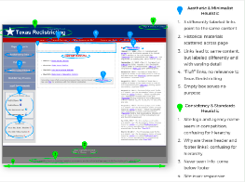
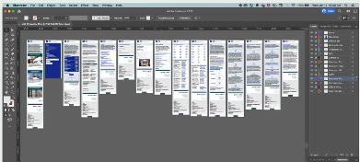
Turning Insights Into Clear, Usable Designs
I converted insights into low-fidelity prototypes that helped teams visualize solutions, uncover edge cases, and define requirements earlier in the process.
Winter 2025

Slide 9
Impact Across Federal Clients
Aligned multi-vendor teams around shared priorities
Reduced rework by clarifying requirements early
Delivered insights that shaped high-stakes, policy-driven decisions
Improved consistency across systems through UX governance
Supported leadership with concise, accessible executive briefings
Winter 2025

Slide 10
What I Bring to Design Research and Strategy Roles
Breadth across research, analysis, design, and storytelling
Depth in systems thinking, policy translation, and multi-team alignment
Strong communication with senior leadership
Ability to turn messy complexity into clear, confident decision-making
Love of mission-driven, public-serving work
Winter 2025

