Slide 1


NORTHEASTERN UNIVERSITY PARKING LOT MANAGEMENT SYSTEM
2
+
2
+
2
+
Alex Pavlukov, Douglas Aldridge, Emely Andrade
INFO 5100

Slide 2

FUNCTIONAL GOAL OF THE APPLICATION
2
+
The aim of this project was to develop a user-friendly vehicle parking management system which would:
Determine the compatibility between different vehicle attributes and available parking spots
Allow user to add and remove vehicles to and from various lots
Record and display current status of each parking spot and details of the vehicles parked
Validate user data inputs and interact back by printing common error and success messages to the console
2
+

Slide 3
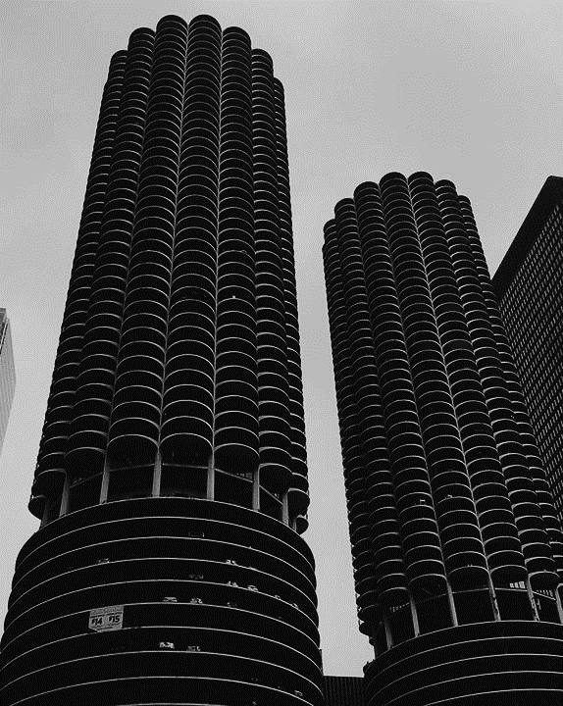
IMPLEMENTATION
2
+
Steps followed
Evaluating the Requirements
Technical Research
Functional Analysis
System Design Initial Development and Iterative Approach
UML Diagram
Testing and Code Refactoring
Documentation and Presentation

Slide 4
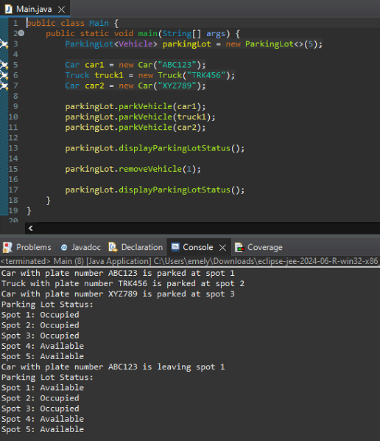
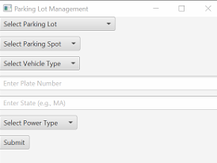
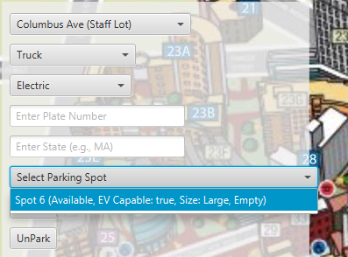
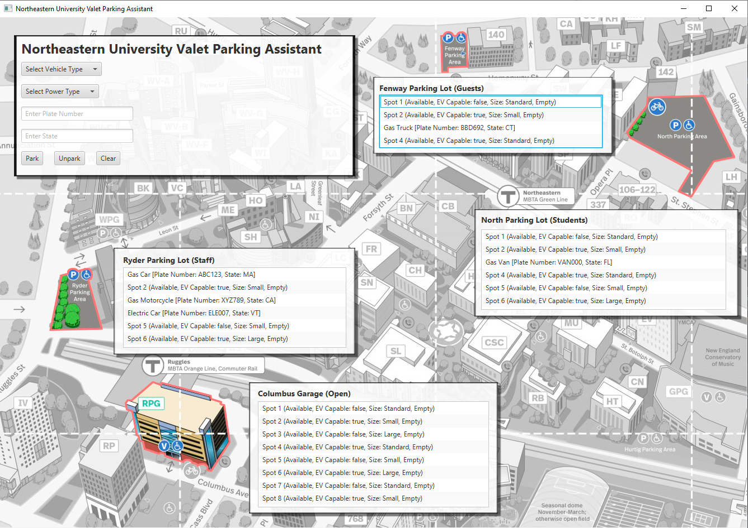
Version 1 - Initial Program Development - Testing
2
+
ITERATIVE APPROACH
Road to success
Version 2 - User Interface Integration Enhanced
- Functionality
Version 3 - Interactive Filtering
- Enhanced Validation
- Unparking Functionality
Version 4 - Comprehensive Integration
- User Interface Enhancements

Slide 5
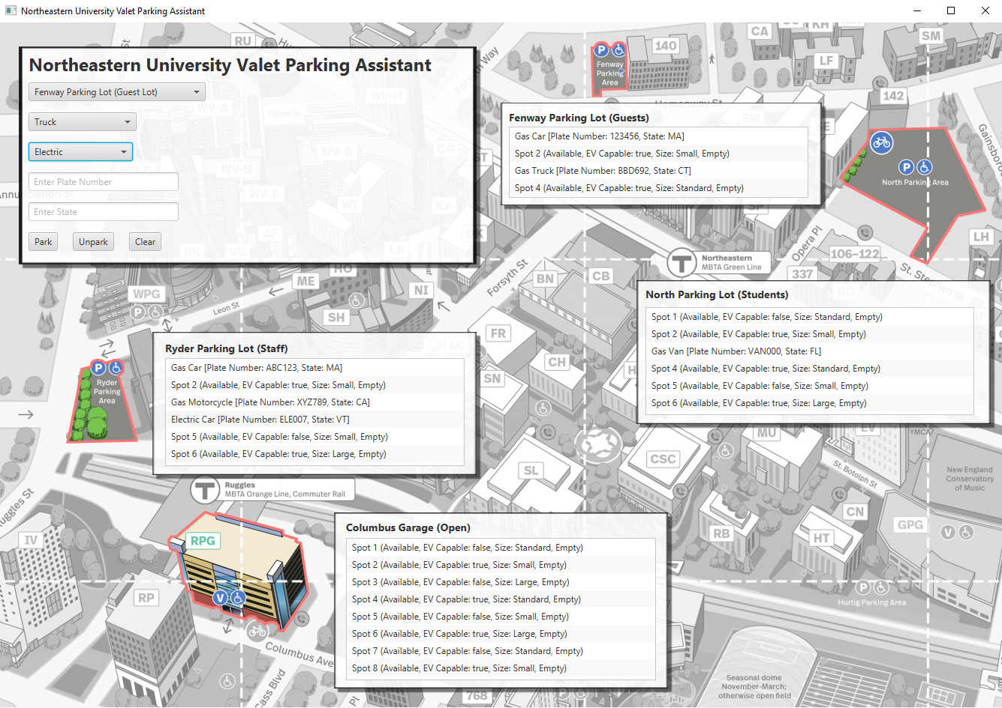
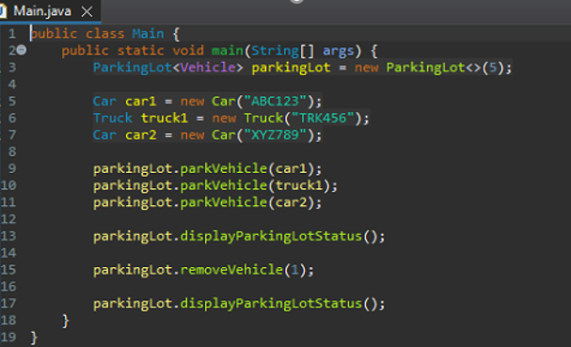
2
+
ITERATIVE APPROACH
Start
Final Version

Slide 6
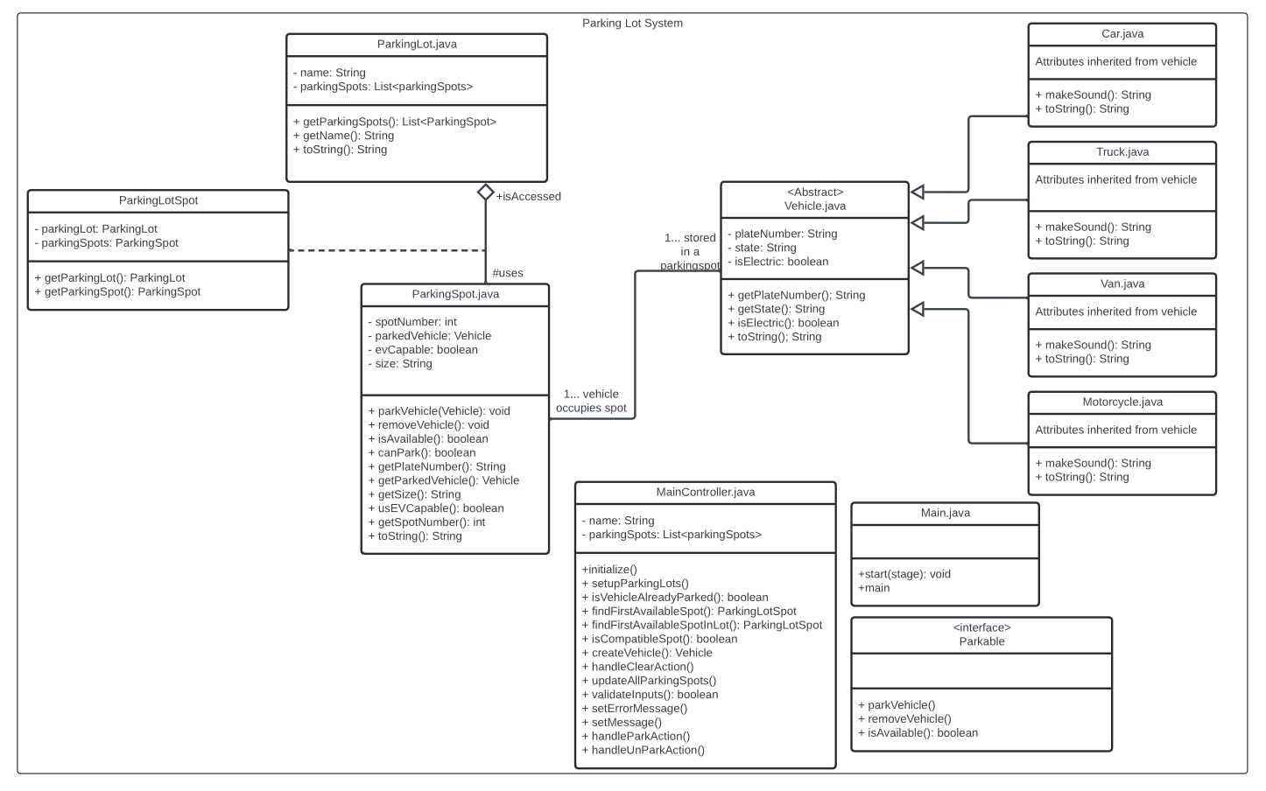
SYSTEM DESIGN AND UML DIAGRAM
2
+
2
+

Slide 7

JAVA TOPICS EMPLOYED
2
+
Final program incorporates the following
Class definition
Inheritance and polymorphism
Lists
Sets
Iterators
Abstract class
Interface

Slide 8

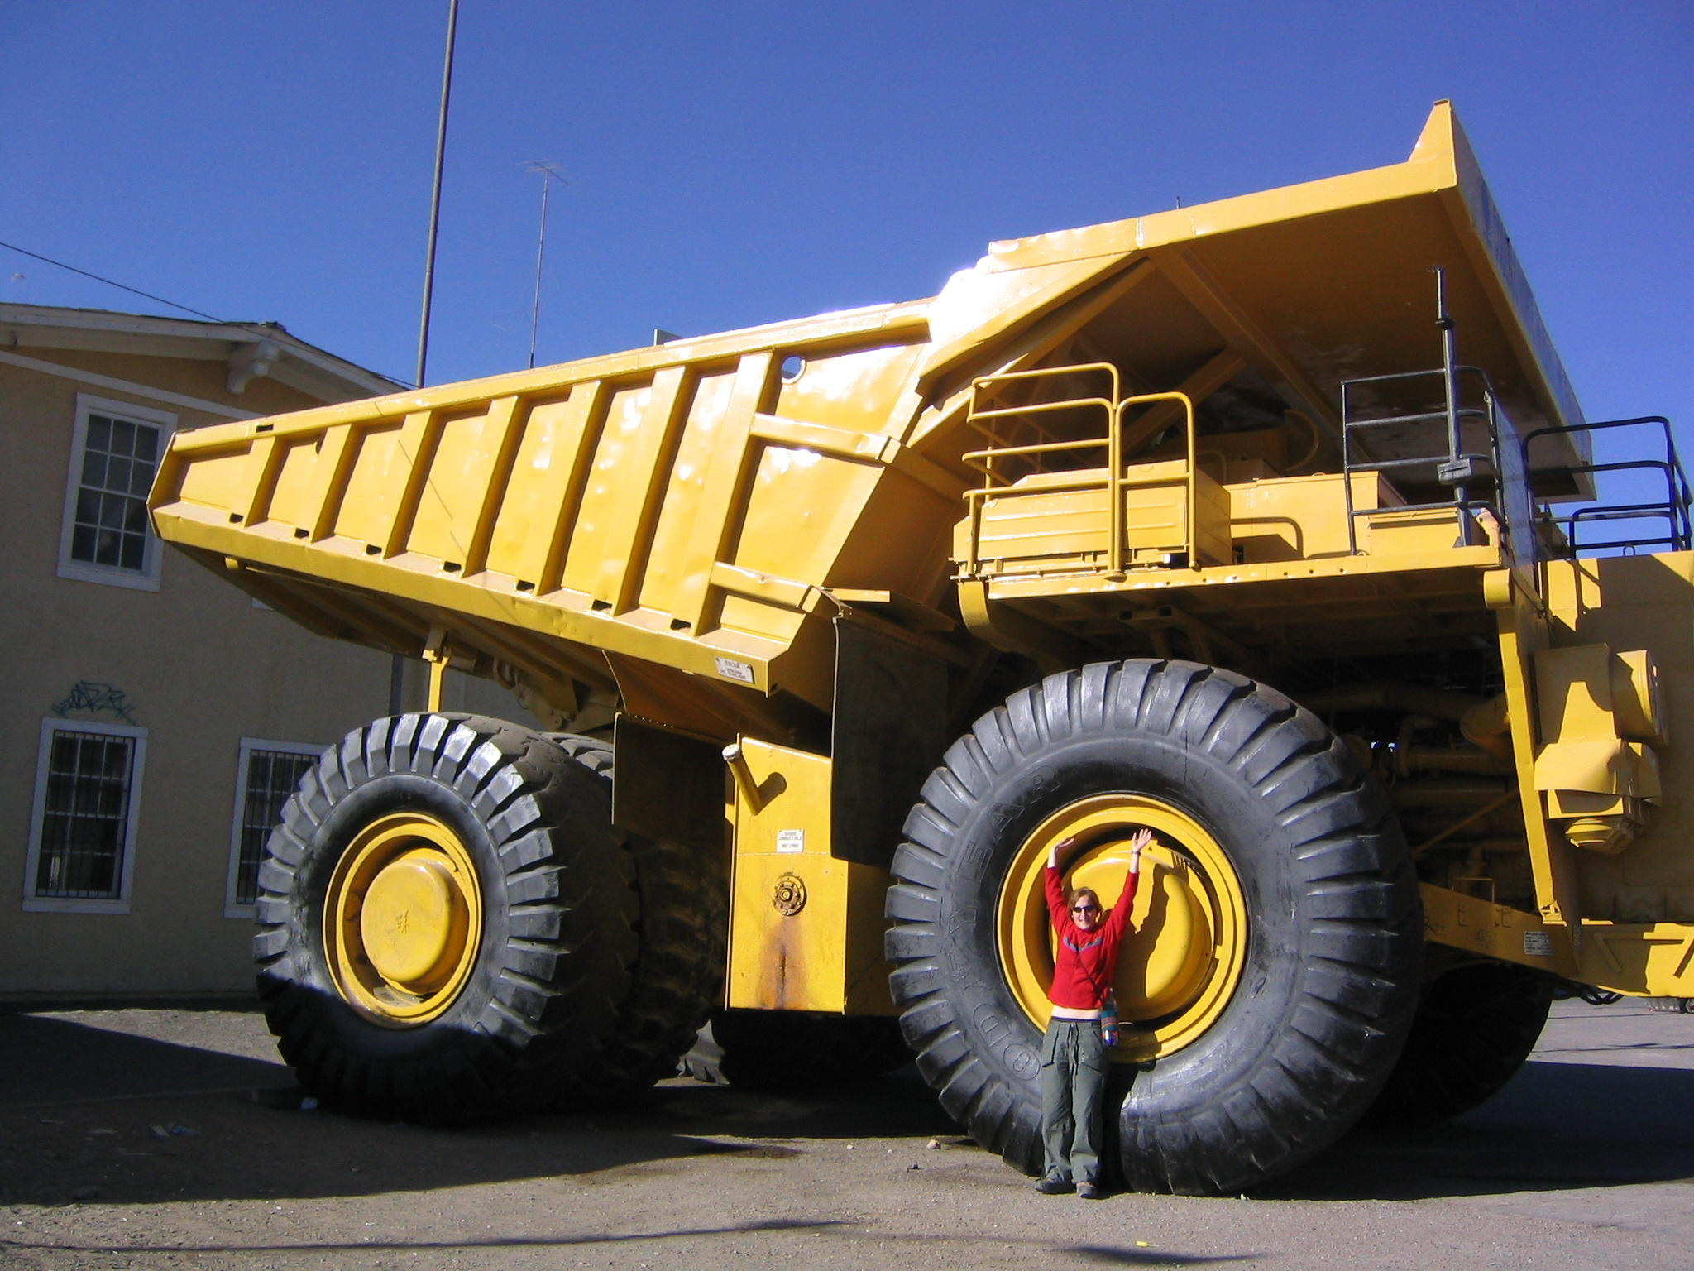
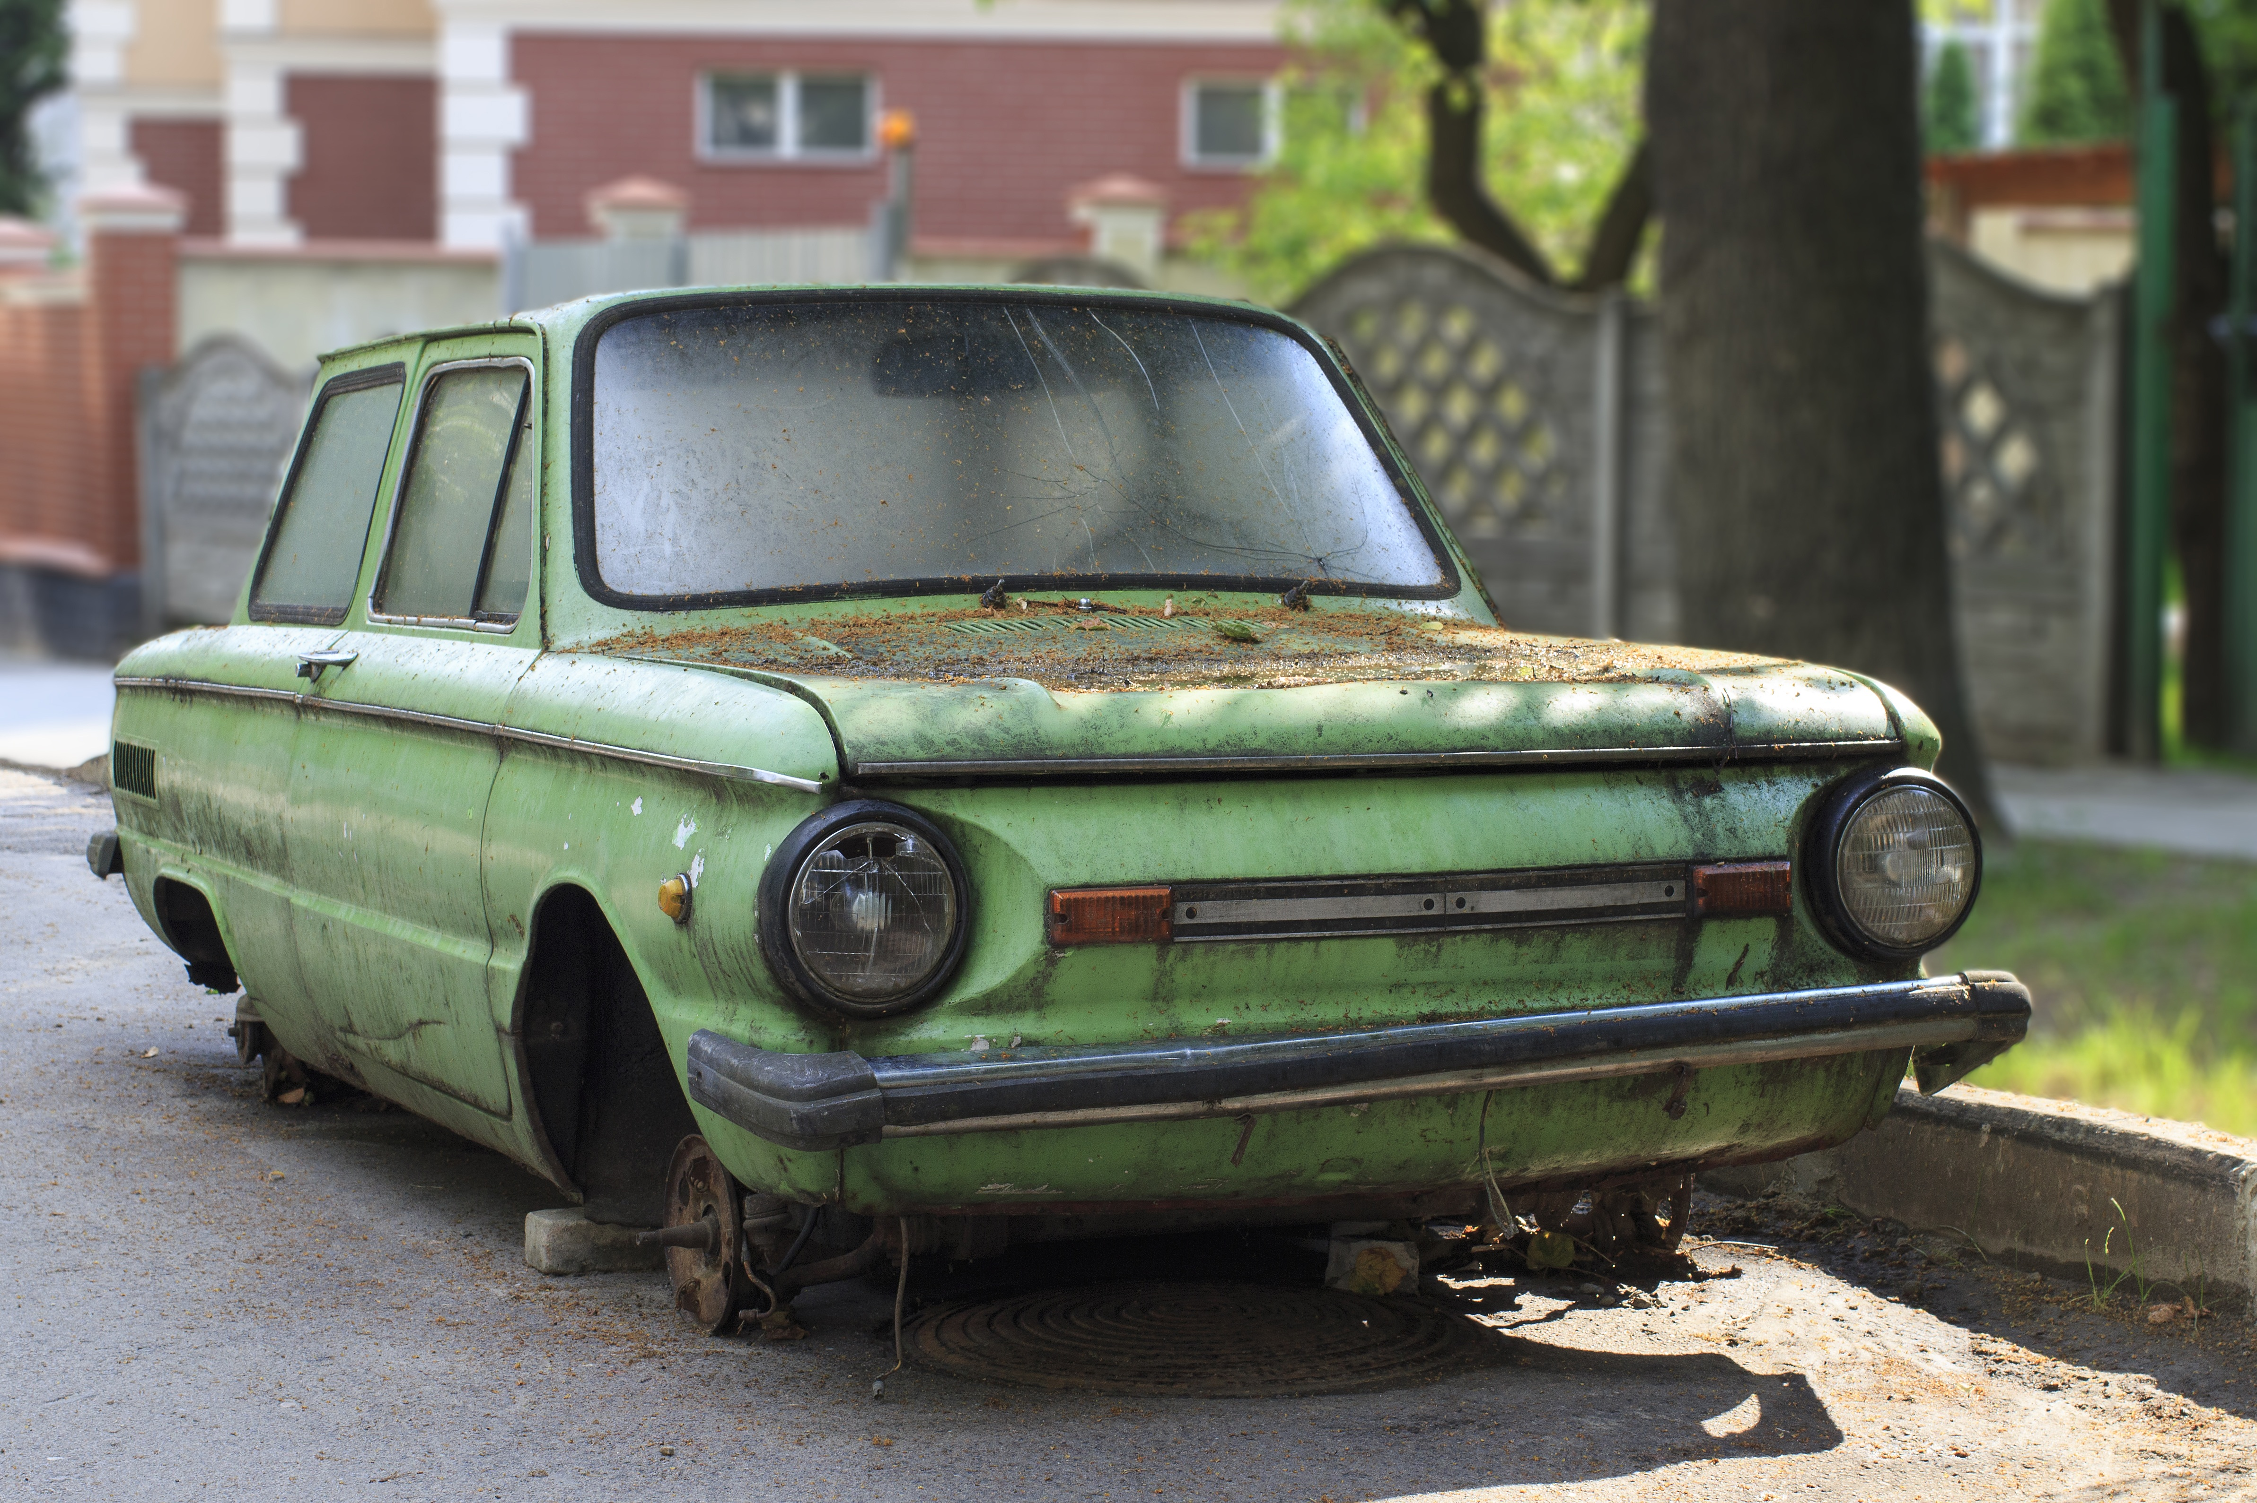
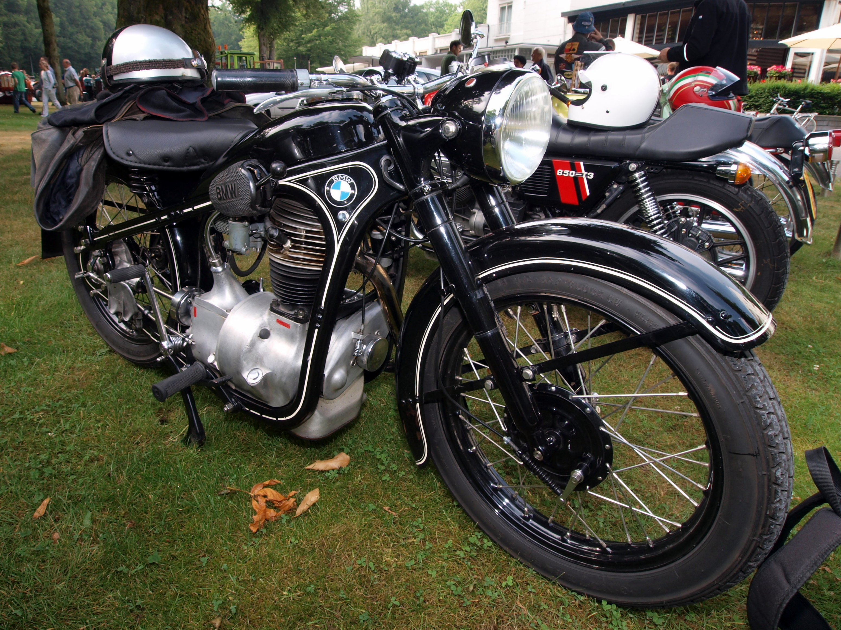
JAVA TECHNIQUES EMPLOYED
Grrrr-Grroom!!!
Inheritance and polymorphism
Inheritance: Vehicle Class VS Car, Truck, Van and Motorcycle Class
Polymorhism: vehicle.makeSound() implementation is overridden by subclass’s versions, so depending on the vehicle type, makeSound() method will produce different results.
Beep - Beep!!!
Weeeeee!!!

Slide 9
JAVA TECHNIQUES EMPLOYED
Lists and Sets
Iterators
Lists: Our application uses lists to store and dynamically update collections of ParkingSpots and Vehicles. Examples include adding/removing parked vehicles and managing parking spots.
Sets: Used to ensure the uniqueness of parked vehicles by validating the vehicle’s license plate.
Value: Lists and sets keep the user interface synced with application data
Implementation: Used to safely and efficiently loop through parking spot collections without directly managing indexes.
Flexibility: Combining lists and iterators allows easy scaling, enabling the addition of new spots or lots without altering core logic.
Future Expansion: This approach provides a foundation for future features, such as advanced parking algorithms or handling larger collections.

Slide 10
JAVA TECHNIQUES EMPLOYED
Abstraction
Interface
Abstract Vehicle Class: Acts as a blueprint with shared attributes like plateNumber, state, and isElectric, and an abstract makeSound method.
Subclass Specific Behavior: Subclasses like Car and Motorcycle implement their own version of makeSound, ensuring unique behavior while maintaining a common structure.
Scalability: Abstraction allows easy addition of new vehicle types (e.g., Bus, RV) by creating subclasses and implementing necessary methods, ensuring flexibility for future growth.
Parkable Interface: Defines key behaviors like parkVehicle(), removeVehicle(), and isAvailable() to standardize parking spot operations.
Flexibility: Allows different types of parking spots (e.g., street parking) to implement the same interface, ensuring consistent behavior across spot types.
Scalability: Supports easy expansion, enabling new features (like valet parking or dynamic pricing) through new classes that implement Parkable without affecting existing functionality.

Slide 11

Final Thoughts
2
+

