Slide 1
Mind the Gap:
How Proximity to Metro Stops Relates to Gentrification of Local Neighborhoods
UCLA MASDS STATS 405 Final Project
Jon Darius, Mercy Eme, Judith Mendoz, Layla Rainosek, Daniel Rocha
06092026
Notes:
Focus on findings first (without background), then go back through exec summary report. Distance devay plot and boxplots

Slide 2
Table of Contents
UCLA MASDS STATS 405 Final Project
Jon Darius, Mercy Eme, Judith Mendoz, Layla Rainosek, Daniel Rocha
06092026
Key Findings
Slide 3
A
Background
Slide 4
B
Approach
Slide 5
C
Results
Slides 6-7
D
Discussion
Slide 8
E
Notes:
Key Findings: Daniel
Background: Judith
Approach: Approach
Discussion: Layla
Plots: Mercy

Slide 3
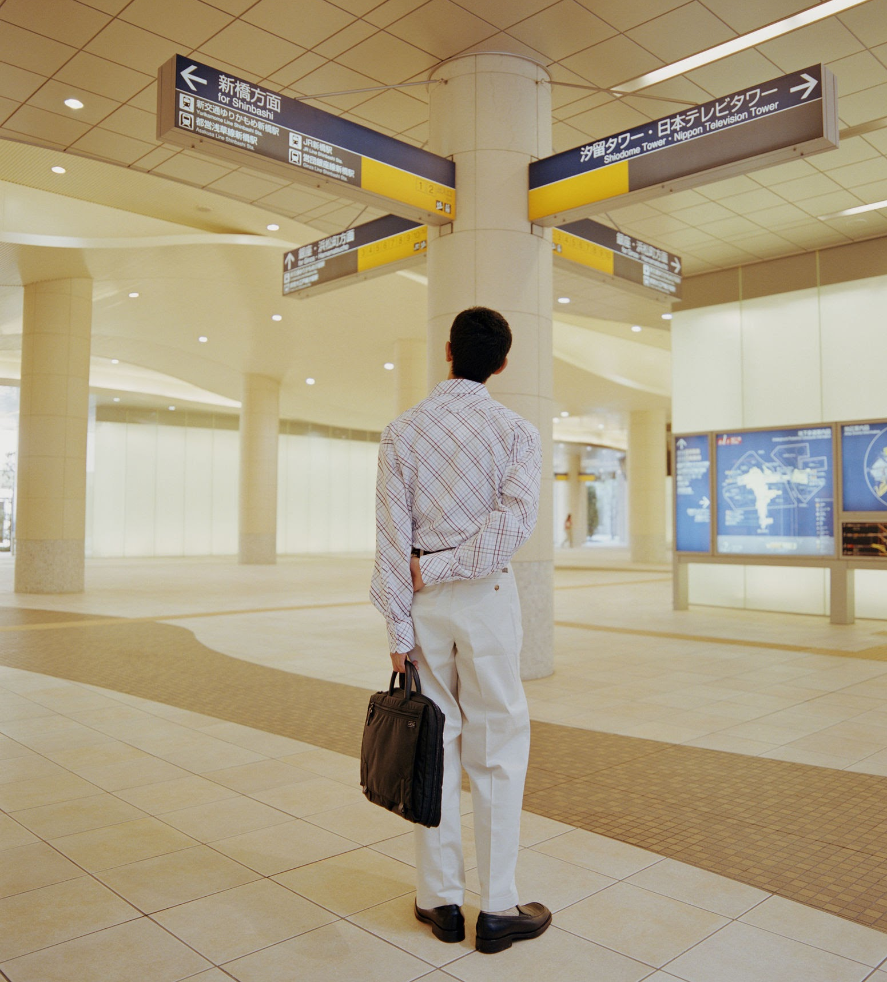
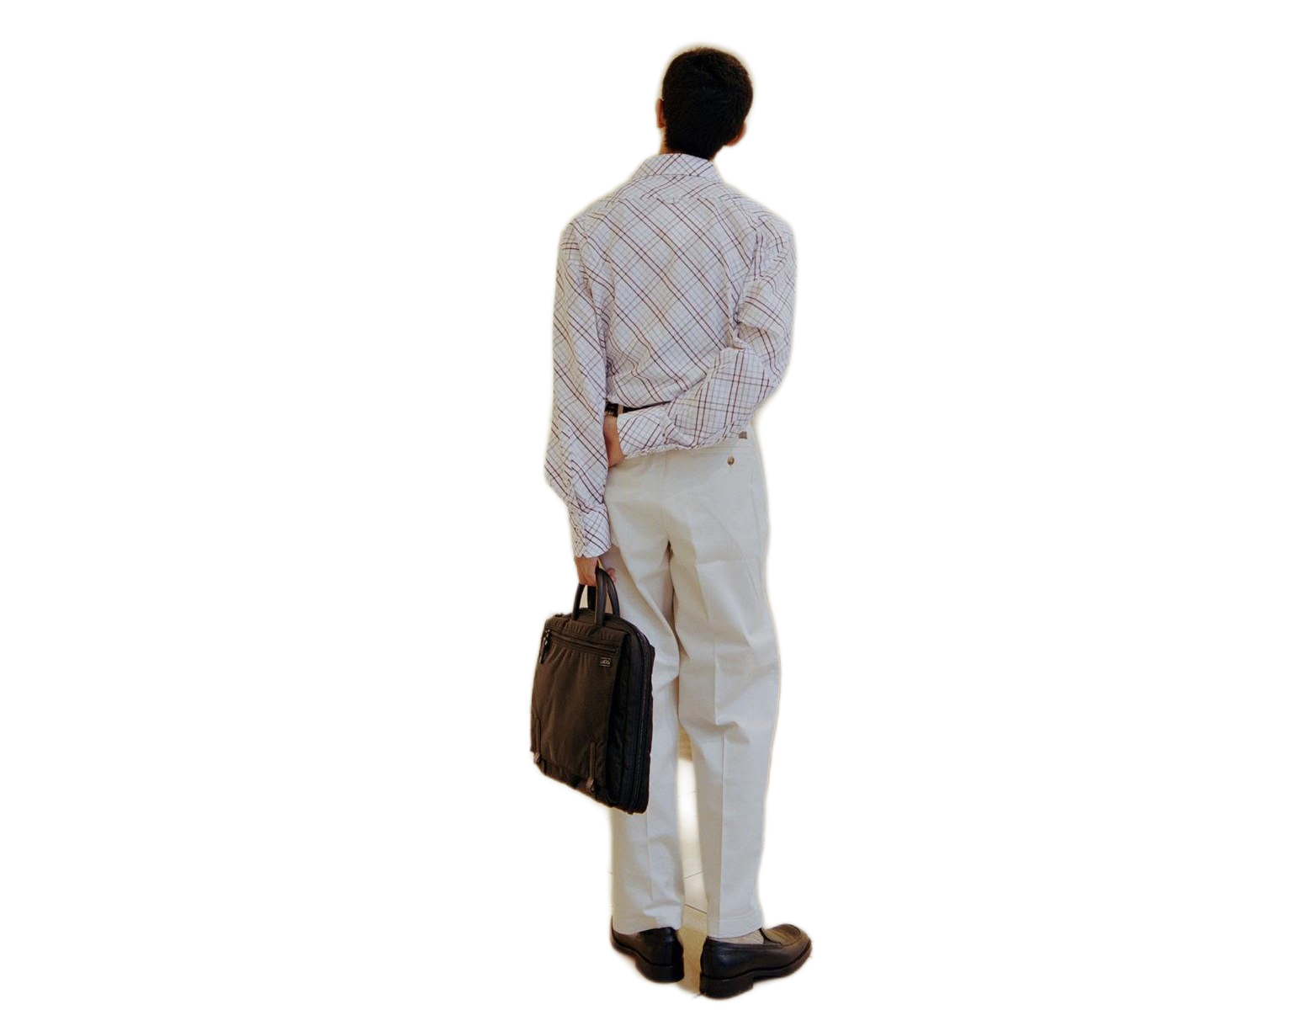
UCLA MASDS STATS 405 Final Project
Jon Darius, Mercy Eme, Judith Mendoz, Layla Rainosek, Daniel Rocha
06092026
Key Findings:
Gentrification Risk
01
Gentrification is negatively related to Metro proximity
Gentrification risk increases steadily as distance to the nearest station decreases across the sample.
Risk levels differ sharply from one Metro line to the next as well (Kruskal-Wallis p < 0.001), which is why the forecast trains on the corridors most like the D Line rather than the full network.
Our analysis predicts little to no added pressure in the Westwood and UCLA corridor, since rents there have already topped out, with little room left to climb. Pressure shifts to still-affordable areas like Koreatown, Palms, and Mar Vista, which carry the highest composite gentrification risk along the line.
02
Risk levels differ by Metro Line
03
Pressure shifts to Koreatown, Palms, and Mar Vista
Notes:
Abstract

Slide 4

Background
UCLA MASDS STATS 405 Final Project
Jon Darius, Mercy Eme, Judith Mendoz, Layla Rainosek, Daniel Rocha
06092026
01
02
03
Los Angeles is extending its metro rail with the D Line, and transit proximity is routinely marketed as a neighborhood amenity.
That same amenity has coincided with rising rents and displacement along earlier rail expansions across LA, and the same trend has been documented in other cities as well.
With 63% of Angelenos renting, a shift in housing costs reaches most of the population, not a narrow slice of it. The question this analysis takes up is where, along the new corridor, that pressure is most likely to land.
Notes:
Introduction

Slide 5
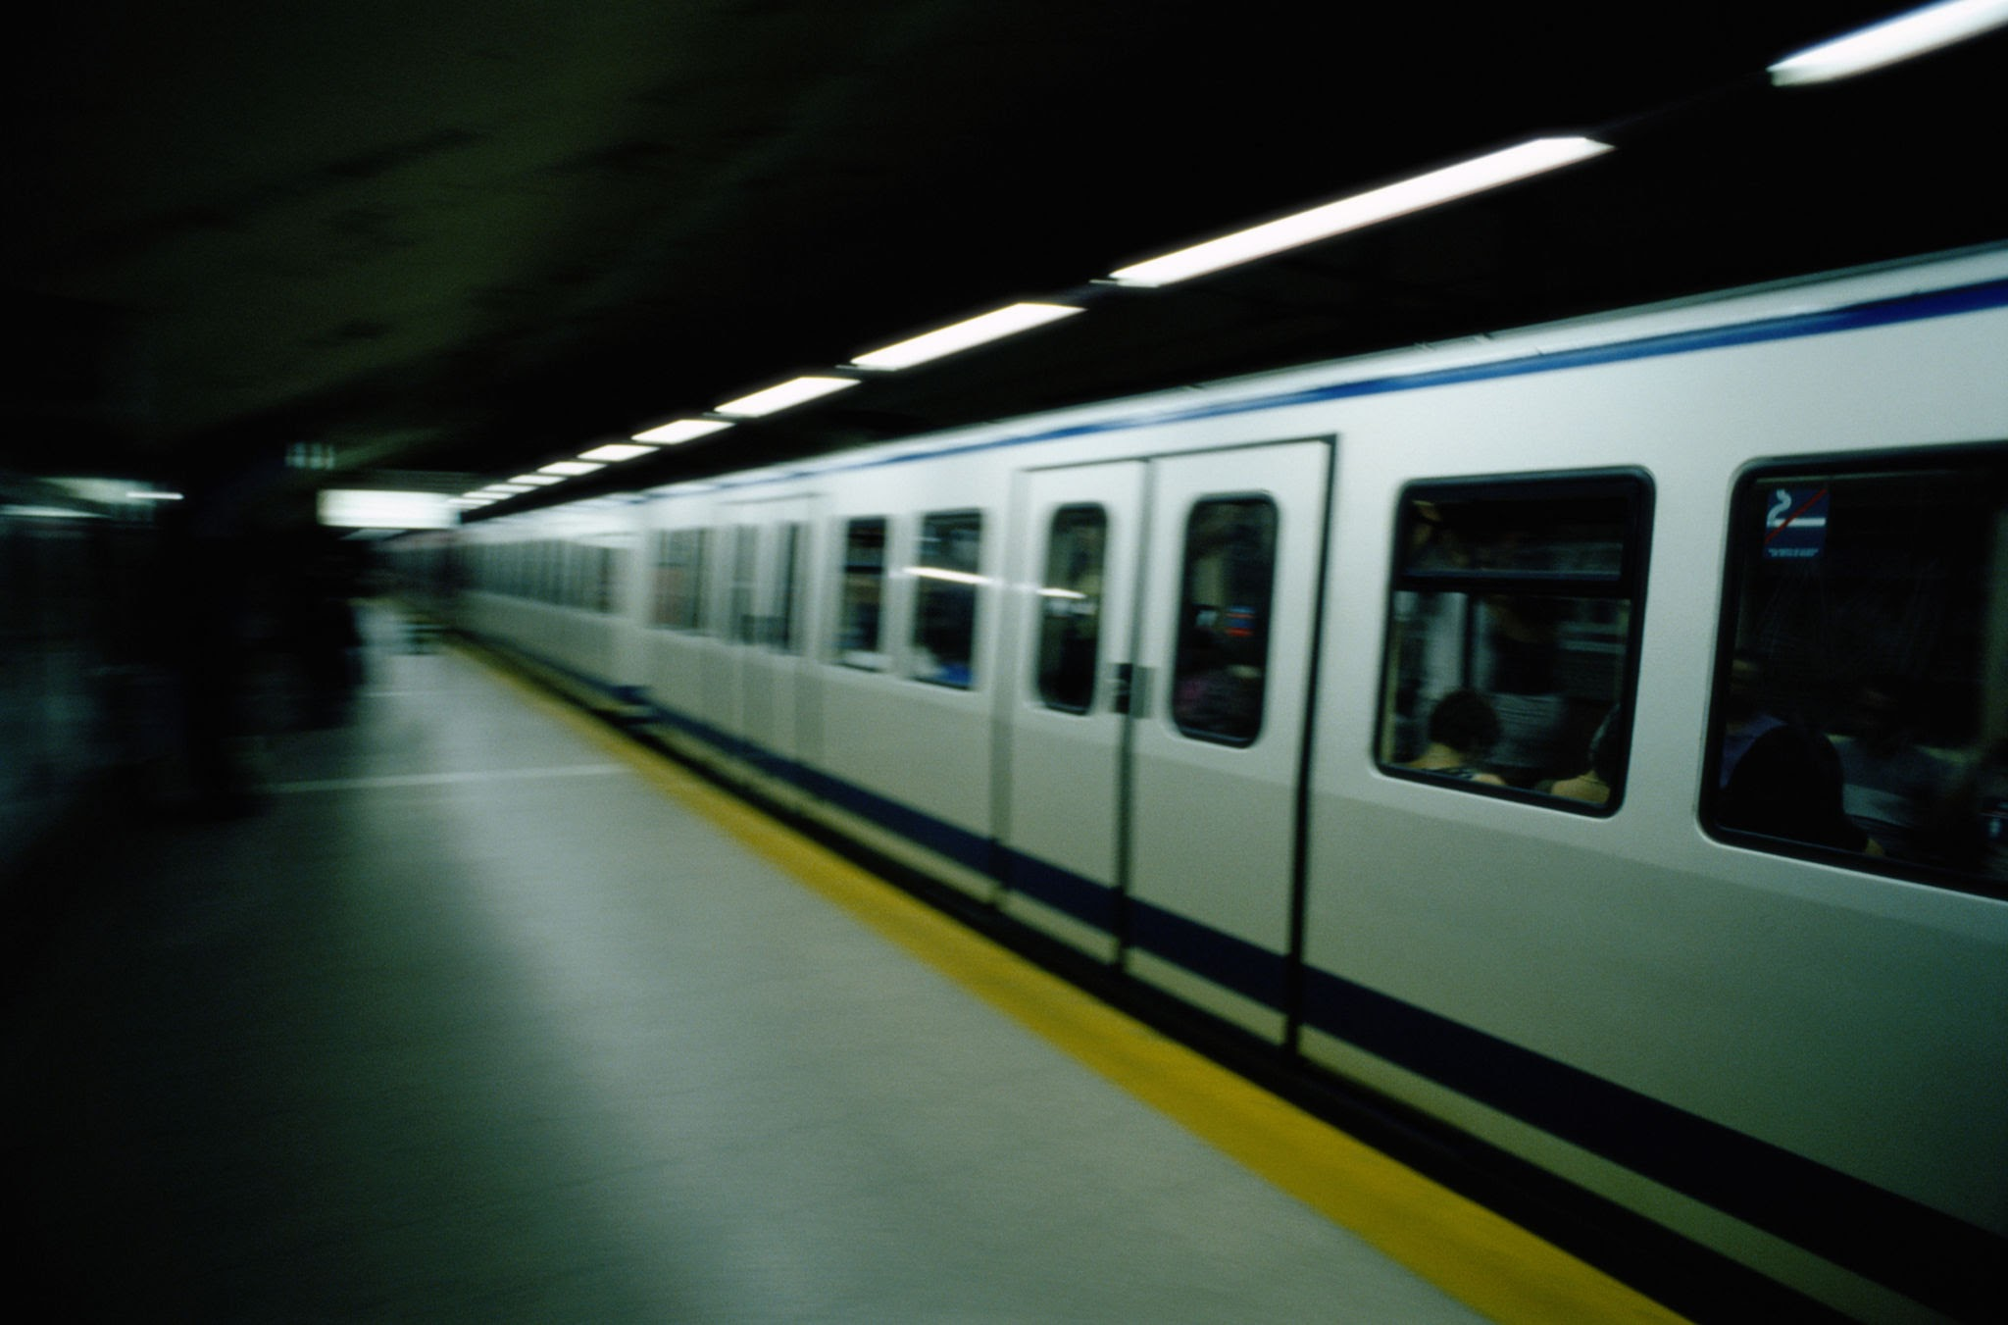
UCLA MASDS STATS 405 Final Project
Jon Darius, Mercy Eme, Judith Mendoz, Layla Rainosek, Daniel Rocha
06092026
Approach
A
B
C
D
E
K
Outcome
Five-fold cross-validated model performance
We computed a Composite Gentrification Risk Score (CGRS) that captures:
  rent premium,
  rent burden,
  spatial rent appreciation,
  price per square foot premium,
  & education change.
Each component is z-scored and averaged with equal weight, so the final CGRS places every listing on a common scale
CV-RMSE
CV-MAE
CV-R²
Applicable Lines
OLS/Ridge
0.376
0.286
0.453
A
E
Random Forest
0.201
0.144
0.844
A
E
Gradient-Boosted Trees
(best performer)
0.173
0.121
0.885
A
E
Notes:
Results

Slide 6
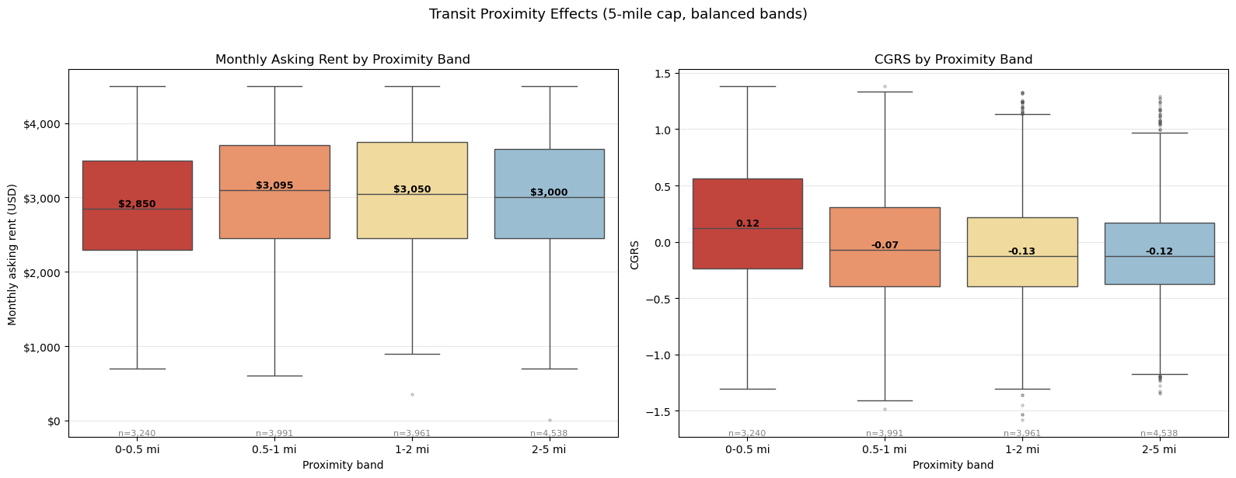
Results:
Graphs
UCLA MASDS STATS 405 Final Project
Jon Darius, Mercy Eme, Judith Mendoz, Layla Rainosek, Daniel Rocha
06092026
01
Transit Proximity Effects
Figure 1. Rent (left) and CGRS (right), grouped by proximity band, with sample sizes annotated for each band (5-mile cap, balanced bands).
Notes:
Results (graphs)

Slide 7
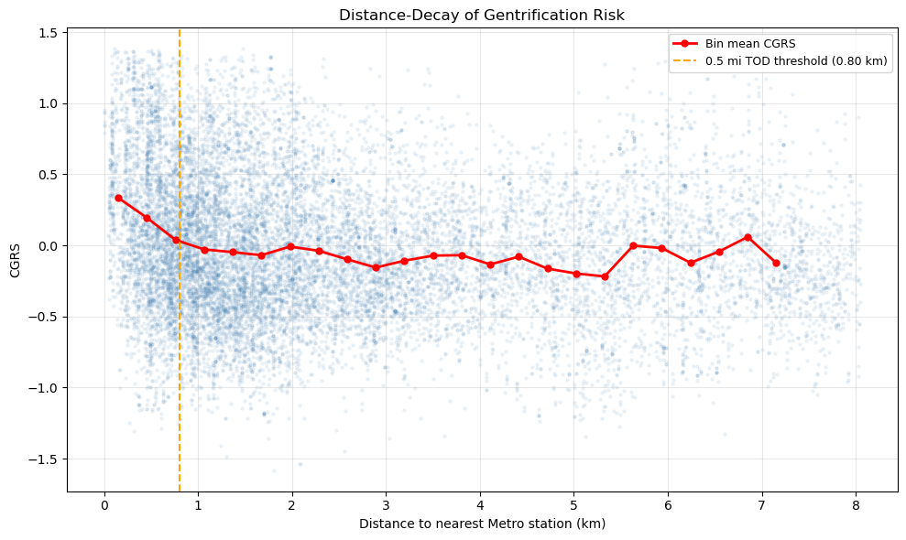
Results:
Graphs
UCLA MASDS STATS 405 Final Project
Jon Darius, Mercy Eme, Judith Mendoz, Layla Rainosek, Daniel Rocha
06092026
02
Distance-Decay Plot
Distance-decay of mean CGRS, binned by distance to the nearest Metro station (25 equal-width bins from 0 to the 97th percentile of distance), with the 0.5-mile TOD threshold marked.
Notes:
Results (graphs)

Slide 8
Implications From This Study
UCLA MASDS STATS 405 Final Project
Jon Darius, Mercy Eme, Judith Mendoz, Layla Rainosek, Daniel Rocha
06092026
01
These findings are not causal. The analysis is cross-sectional, so it captures a single moment and cannot show how risk will shift as transit access expands.
02
It also cannot separate the Metro's influence from the fact that LA's rail already runs through some of the city's most established corridors.
03
Proximity may reflect where high-value neighborhoods already sit, or it may be an early signal of pressure that has not yet surfaced.
Notes:
Implications
These findings should be read more as an association, not as cause and effect, because the analysis is cross-sectional. It’s capturing a single moment due to the housing data coming from just a 1 year period, and so the analysis cannot show a true mediation effect of how risk will shift as transit access expands over time.
As such, it also can’t separate which came first between the Metro's influence on an area and the area’s influence on the decision to build a metro line there, since many rails, and particularly the D line expansion, already run through some of the city's most established corridors.
So, proximity may reflect where high-value neighborhoods already sit, or it may be an early signal of pressure that has not yet surfaced. Ultimately, the results point to a pattern that’s worth watching though and studies like these can be helpful in advocating for rent control and used in city planning efforts to offset potential gentrification in the planning of future metro expansions.

Slide 9
UCLA MASDS STATS 405 Final Project
Jon Darius, Mercy Eme, Judith Mendoz, Layla Rainosek, Daniel Rocha
06092026
Q&A
Any questions?
Ask away!
This presentation looked at the relationship between LA Metro Rail Stop Proximity and Risk of Gentrification.

Slide 10
UCLA MASDS STATS 405 Final Project
Jon Darius, Mercy Eme, Judith Mendoz, Layla Rainosek, Daniel Rocha
06092026
Project Overview:
Scope and Findings
01
Abstract
The planned D Line (Purple Line) extension to Westwood/UCLA, scheduled to open ahead of the 2028 Los Angeles Olympic Games, raises the question of whether new transit access will accelerate gentrification in the surrounding Olympic Corridor.
We compute a CGRS to address this question and isolate the predicted effect of new transit accessibility from existing neighborhood conditions.
While listings within 0.5 miles of existing Metro stations had significantly higher CGRS, this study points to a potential "ceiling effect" where additional transit access produces limited further change.
Notes:
Abstract

Slide 11
Project Objectives
UCLA MASDS STATS 405 Final Project
Jon Darius, Mercy Eme, Judith Mendoz, Layla Rainosek, Daniel Rocha
06092026
01
02
03
Measure Gentrification Risk
Create a Composite Gentrification
Risk Score using rent, rent appreciation, price per square foot, and education change.
Compare Metro Proximity
Compare rent listings near Metro stations with listing farther away to see whether closer areas show higher gentrification risk.
Forecast D Line Impact
Use predictive models to estimate whether the future D line Extension could add gentrification pressure to the Olympic Corridor.
Notes:
Introduction

