Slide 1


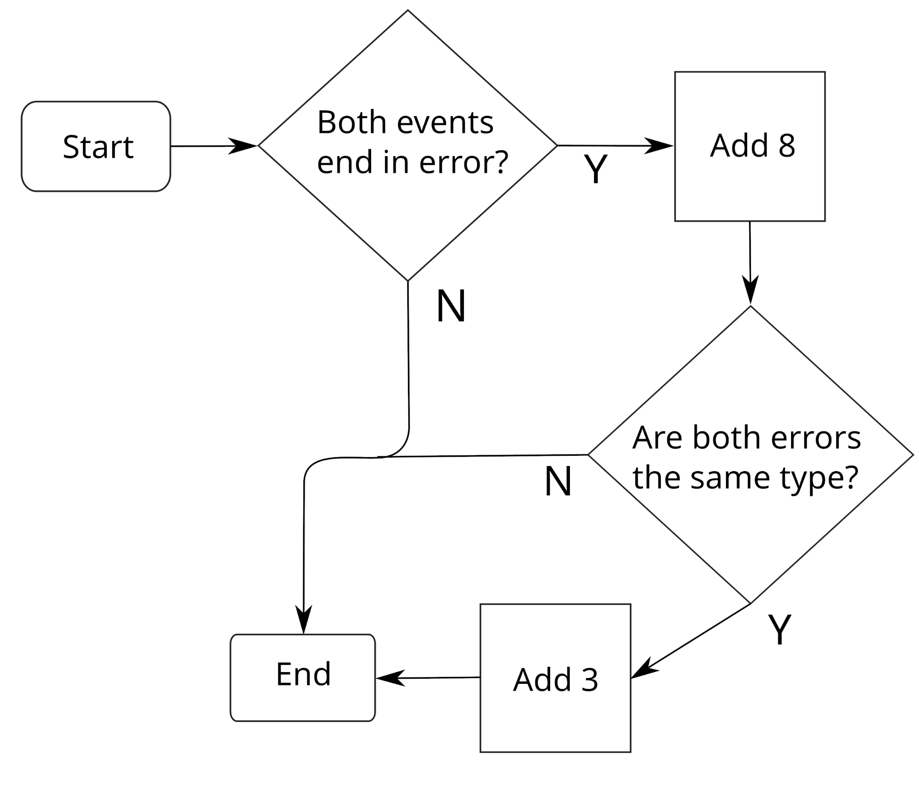
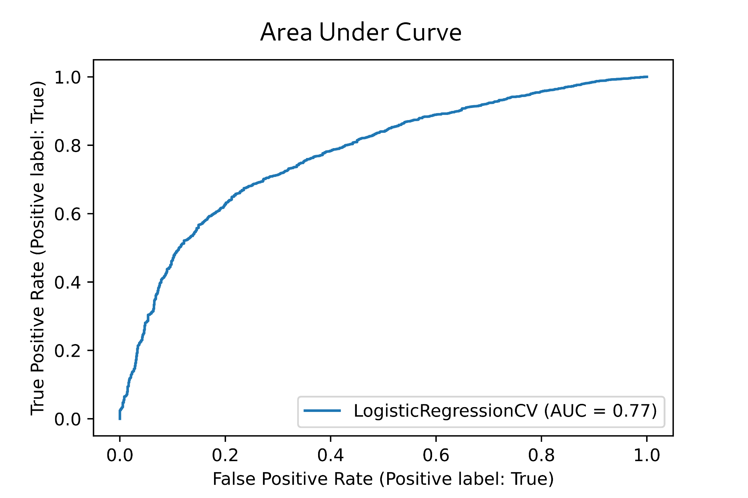
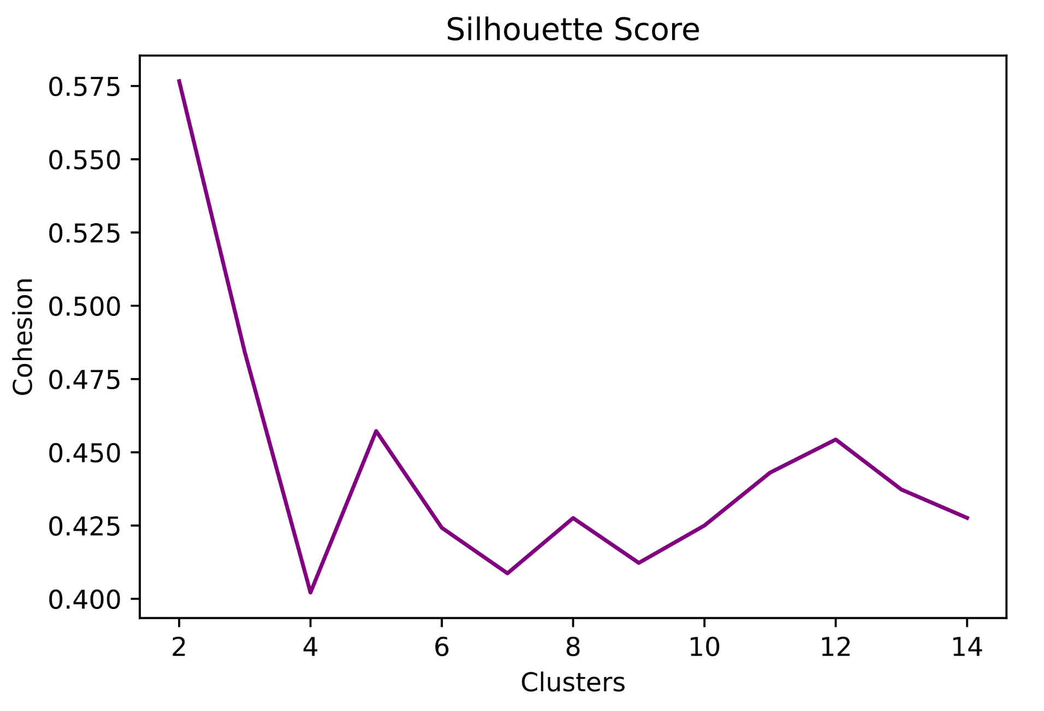
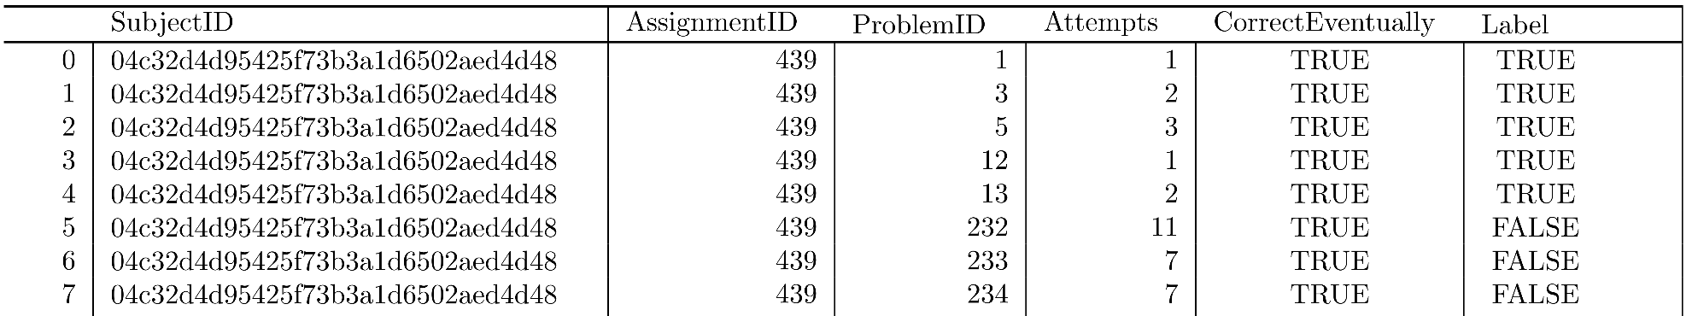
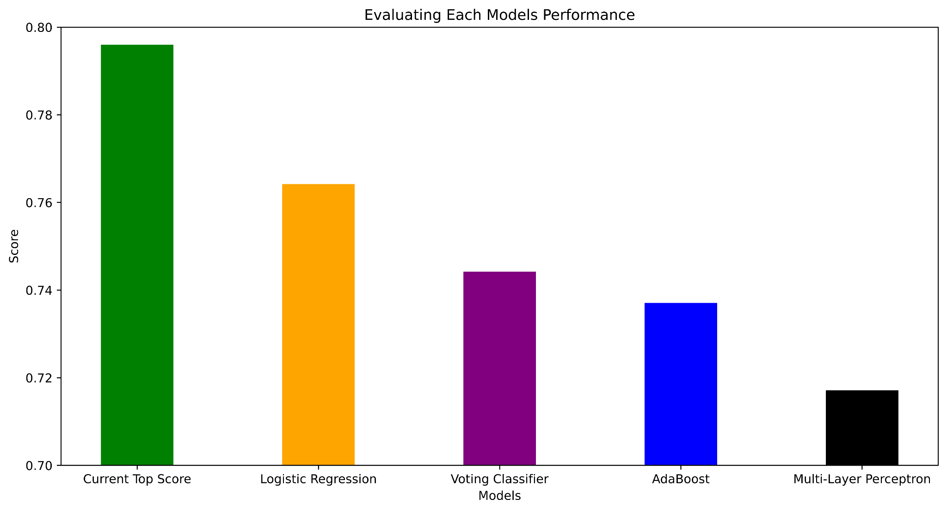
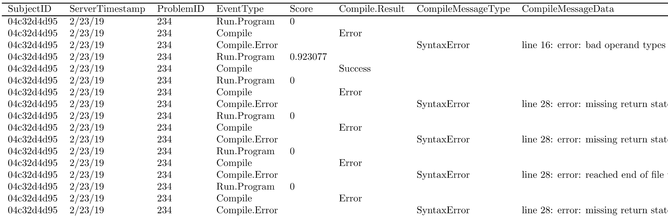
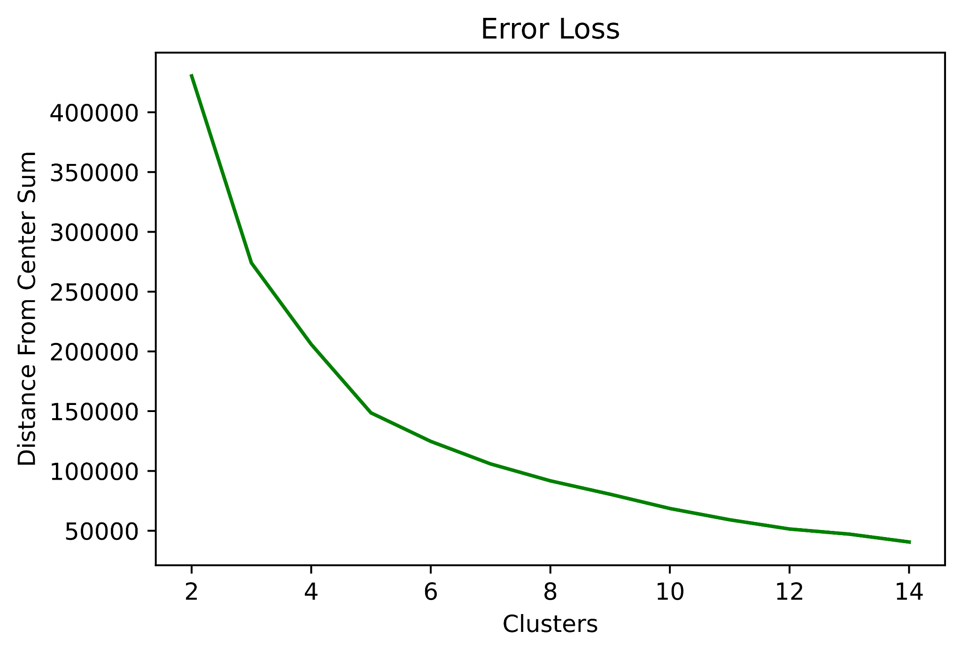
Machine Learning for CS Education:
Predicting Student Grades from Early Performance (Group 2)
Jacques Sarraffe, Evan Hatton, Erika Mendoza, Dr. Suzanne Rivoire
Department of Computer Science
Abstract
With growing interest in both Computer Science (CS) and online education, predicting students' learning outcomes in courses is increasingly important. We are competing in the CS Education Data Mining Challenge, which is part of the International Education Data Mining Conference. Split into two submission tracks, knowledge tracing (Track 1) and final grade prediction (Track 2), the goal is to code models that identify students at risk of failure early in a course.
The contest uses CodeWorkout, a public dataset of student code submissions (Spring and Fall 2019), encoded in the ProgSnap2 format, that captures each interaction between a student and the Java compiler on every problem assigned in a given semester.
Our model augments the original dataset features with handcrafted metrics of student compilation errors from the CS education research literature. Our results are already competitive with last year’s contest winners.
Features We Engineered
Results
The Error Quotient (Jadud [3]) characterizes how much or how little a student struggled with syntax errors while programming. A perfect EQ for a given session is 0.0. –see diagram, right.
We also added features to categorize time between compilations.
The Area Under the Curve (AUC) measures the ability of a classifier to distinguish between classes. This is the metric used to rank people participating in the competition. The higher the AUC, the better the performance of the model at distinguishing between whether a student struggled or not.
Using KMeans, we grouped the multidimensional data into clusters and added the cluster IDs as features into the dataset. The Silhouette Score measures the homogeneity of the clusters.
Dataset
*Represents early training data of one student
The Error Loss shows the data on average getting closer to the center of each cluster as the number of predicted clusters increases.
Anonymized 246 students’ data from instrumented development environment that logs every compilation. Total of 50 lab assignments per semester (30 train, 20 test), each requiring 10-26 lines of code.
Current Top Score: the highest scoring submission as of 4/23/22 (a PhD student)
Logistic Regression: similar to linear regression but predicts probabilities of a binary choice
Voting Classifier: combined AdaBoost, MLP, and Logistic Regression in one model
AdaBoost: Decision Tree that uses more decision trees on edge cases
MLP: a neural network with backpropagation
Basic Model Features
Problems Attempted - Number of attempted problems out of 30
Percent Correct Eventually - Percent of correct problems (had to modify to take into account unsubmitted attempts)
Median Attempts Per Problem
Categorical Problem IDs - the differing coding problems
Future Work
Tune model’s (hyper)parameters (Neural, Voting)
Build features which track student performance across multiple assignments
  current features look at each lab assignment independently or all 30
Acknowledgments
This work is funded by the Koret Scholar Foundation program.
References
“CSEDM Data Challenge.” https://sites.google.com/ncsu.edu/csedm-dc-2021/home.
Price, Thomas W., et al. “Progsnap2: A Flexible Format for Programming Process Data” in Proceedings of the 2020 ACM Conference on Innovation and Technology in Computer Science Education (ITiCSE).
Jadud, Matthew C. “Methods and Tools for Exploring Novice Compilation Behaviour” in Proceedings of the 2006 International Workshop on Computing Education Research (ICER).

