Slide 1
Pokemon Data Analysis
2021
Eduardo Mendoza
Notes:
My name is Ed
GOAL: Primarily looking to increase net revenue from mortgage-backed securities

Slide 2

Objective
Is the game fair and inviting to players of all types and preferences?

Slide 3

Strategy
Understand with common sense approach
Verify with statistical testing
Use insights gained to make prudent deductions about the state of Pokemon games
Use the improvement of game quality to increase revenue from game sales

Slide 4

Introduction
Are the variables normally distributed?
Does the data contain bias?
Gather key factors to formulate hypothesis.
Notes:
The negative net revenue on some cars could be attributed to the model of the car being unpopular We can average the profit lost or gained for each model to determine which ones to remove
44 Car models are losing money, the number 1 loss being in the 2018 Daewoo Nubira

Slide 5
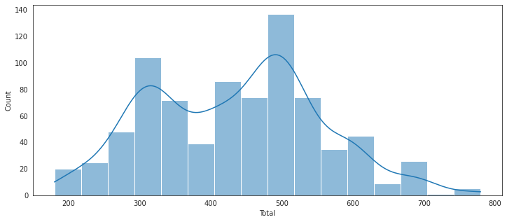
Data Pre-Check
count 800
mean 435
std 119
min 180
25% 330
50% 450
75% 515
max 780
Total Score is normally distributed
*A/A T-test found no significant difference in the two test groups

Slide 6
Hypothesis
These distinct element types are not very influential to the Total Score of Pokemon, to a statistically significant degree, and should not be the deciding factor of Pokemon choice.

Slide 7

Elemental Type Breakdown
Water 112
Normal 98
Grass 70
Bug 69
Psychic 57
Fire 52
Rock 44
Electric 44
Dragon 32
Ghost 32
Ground 32
Dark 31
Poison 28
Steel 27
Fighting 27
Ice 24
Fairy 17
Flying 4

Slide 8
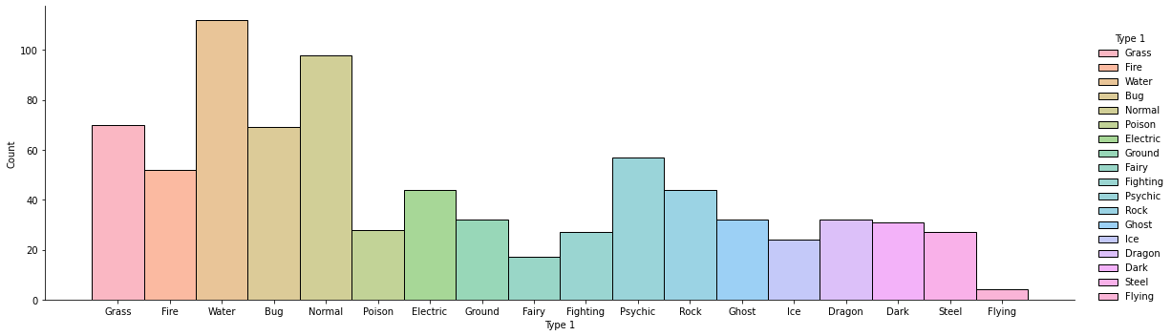
Elemental Type Breakdown

Slide 9
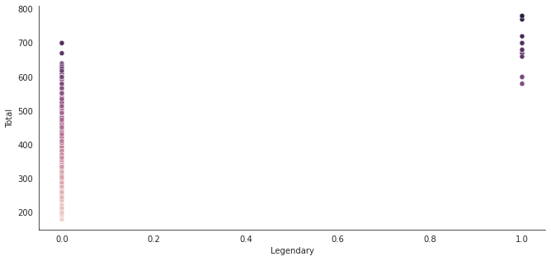
Legendary Pokemon
With a Pearson Correlation coefficient of over 0.5, we know that the Legendary status of a Pokemon has a large and statistically significant influence on its 'Total' score
Correlation Coefficient:
(0.5017583833882712, 3.0952457469647346e-52)
Notes:
Details:
1) Discontinue all the car models that are losing money, as a whole (44 Models)
2) Only remove the 212 individual cars that are not making a profit (All cars with <1% Profit Margin)
3) Transfer sales of removed cars to sales of new cars using average profit margin of top 10 (70%)
4) Use existing average branch revenue for the new branches ($ 1,056,604.14)

Slide 10
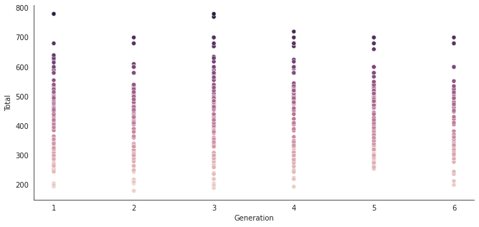
Generations of Pokemon
With a Pearson Correlation coeficcient of close to 0, we know that the Generation of a Pokemon has very little influence on its 'Total' score
Correlation Coefficient:
(0.04838402403489613, 0.17157271591500375)
Notes:
Details:
1) Discontinue all the car models that are losing money, as a whole (44 Models)
2) Only remove the 212 individual cars that are not making a profit (All cars with <1% Profit Margin)
3) Transfer sales of removed cars to sales of new cars using average profit margin of top 10 (70%)
4) Use existing average branch revenue for the new branches ($ 1,056,604.14)

Slide 11

Water
T-test: Fail to Reject the Null
Being a water type Pokemon does not give you an inherent advantage against other Pokemon types
The difference in means at the 95% confidence interval (two-tail) is between -17.428614529544888 and 28.235923499644485.
Notes:
Details:
1) Discontinue all the car models that are losing money, as a whole (44 Models)
2) Only remove the 212 individual cars that are not making a profit (All cars with <1% Profit Margin)
3) Transfer sales of removed cars to sales of new cars using average profit margin of top 10 (70%)
4) Use existing average branch revenue for the new branches ($ 1,056,604.14)

Slide 12
Conclusion
Notes:
Details:
1) Discontinue all the car models that are losing money, as a whole (44 Models)
2) Only remove the 212 individual cars that are not making a profit (All cars with <1% Profit Margin)
3) Transfer sales of removed cars to sales of new cars using average profit margin of top 10 (70%)
4) Use existing average branch revenue for the new branches ($ 1,056,604.14)

Slide 13
Key Indicators
Psychic
Ground
Bug
Normal
Dark
These element types of Pokemon are correlated with higher Total scores. (5 out of 12)

Slide 14

Summary
Goal
Even out the breakdown of elemental types so that players feel they have more choices of Pokemon.
This should be a key factor in the increase of sales of this type of game
Notes:
Summarize, Hope this presentation made our goals clear
Thank you

