Slide 2
Computer Vision in Airplane Mode
A camera, a local model and an agent, with nothing leaving the laptop
Javier Carnero · Plain Concepts
Notes:
NOTES
Azure Tour Sevilla 2026. Javier Carnero, Plain Concepts.
Laptop on stage, camera on, work cell on the desk.

Slide 3

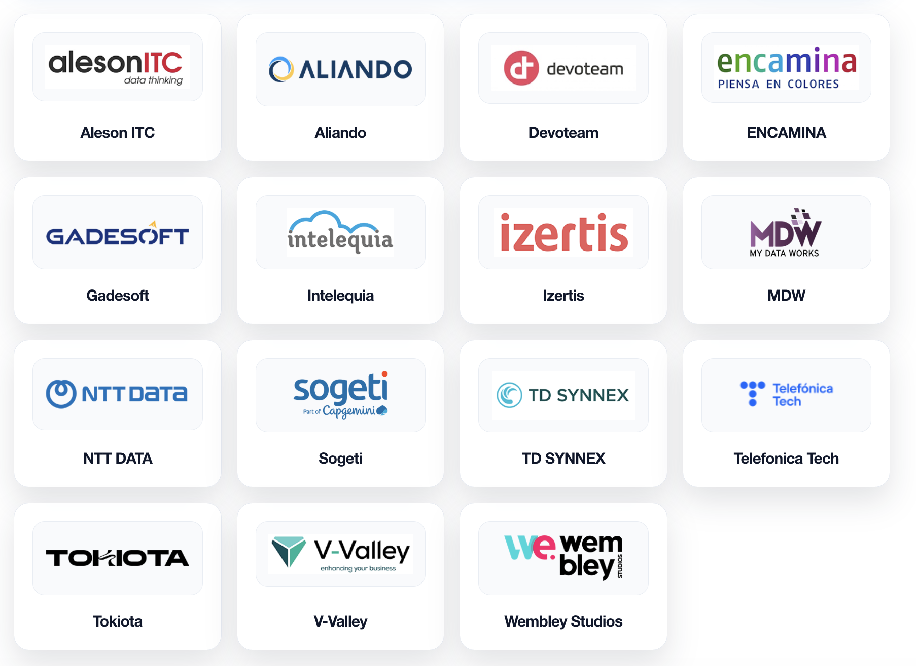



Slide 4

Airplane mode: on
and it stays on until the last slide
Notes:
SCRIPT
Before anything else, I am switching this laptop to airplane mode.
No Wi-Fi, no cable, no cloud. It stays like this for the whole talk.
NOTES
Switch it on in full view. Leave the airplane icon visible on the projected screen.

Slide 5
One look

Live demo
Notes:
NOTES
D1. `uv run observe --camera 0 --variant qwen3-vl-2b-instruct-generic-cpu:2`. Read the sentence it writes aloud.

Slide 6
README.md
$ uv run observe
Model qwen3-vl-2b-instruct-generic-cpu:2 (CPU / CPUExecutionProvider)
Frame 640x480 jpeg, from camera 0
Inference 1.201 s
A man with a beard is sitting in a room in front of a wooden bookshelf
filled with books and model rockets.
Notes:
NOTES
Backup of D1: a real run from the repo's README, abridged. Show it only if the live run fails.

Slide 7
It wrote a sentence about me
and the picture never left this laptop
Notes:
SCRIPT
That sentence is the whole talk. A model looked at me and wrote about what it saw.
The image went nowhere. What came out was a sentence, and a sentence can travel.
Keep an eye on that sentence. It comes back every few minutes.

Slide 8
“
Local AI is a chat toy. Real AI lives in the cloud.
Notes:
SCRIPT
You have just seen an agent in production on Microsoft Foundry. Good. Now we unplug the cable.
Most local AI demos end up as a text chat on a laptop. So we assume serious work lives in the cloud.
And we assume the choice is binary: everything in Azure, or everything on your own box.
NOTES
The room's belief, said as theirs. Bridge from the 11:35 talk.

Slide 9

What crosses the wire?
Notes:
NOTES
Plant the question. It closes every section of the body. Do not answer it yet.

Slide 10
A workstation on a production line

Slide 11
Three facts about this plant

The camera films workers
The plant network is cut off by design
The camera watches all shift, every shift
Notes:
NOTES
Residency was covered at 10:25. One sentence on GDPR and the works council, then move on.
The third fact is the one that matters for cost later.

Slide 12
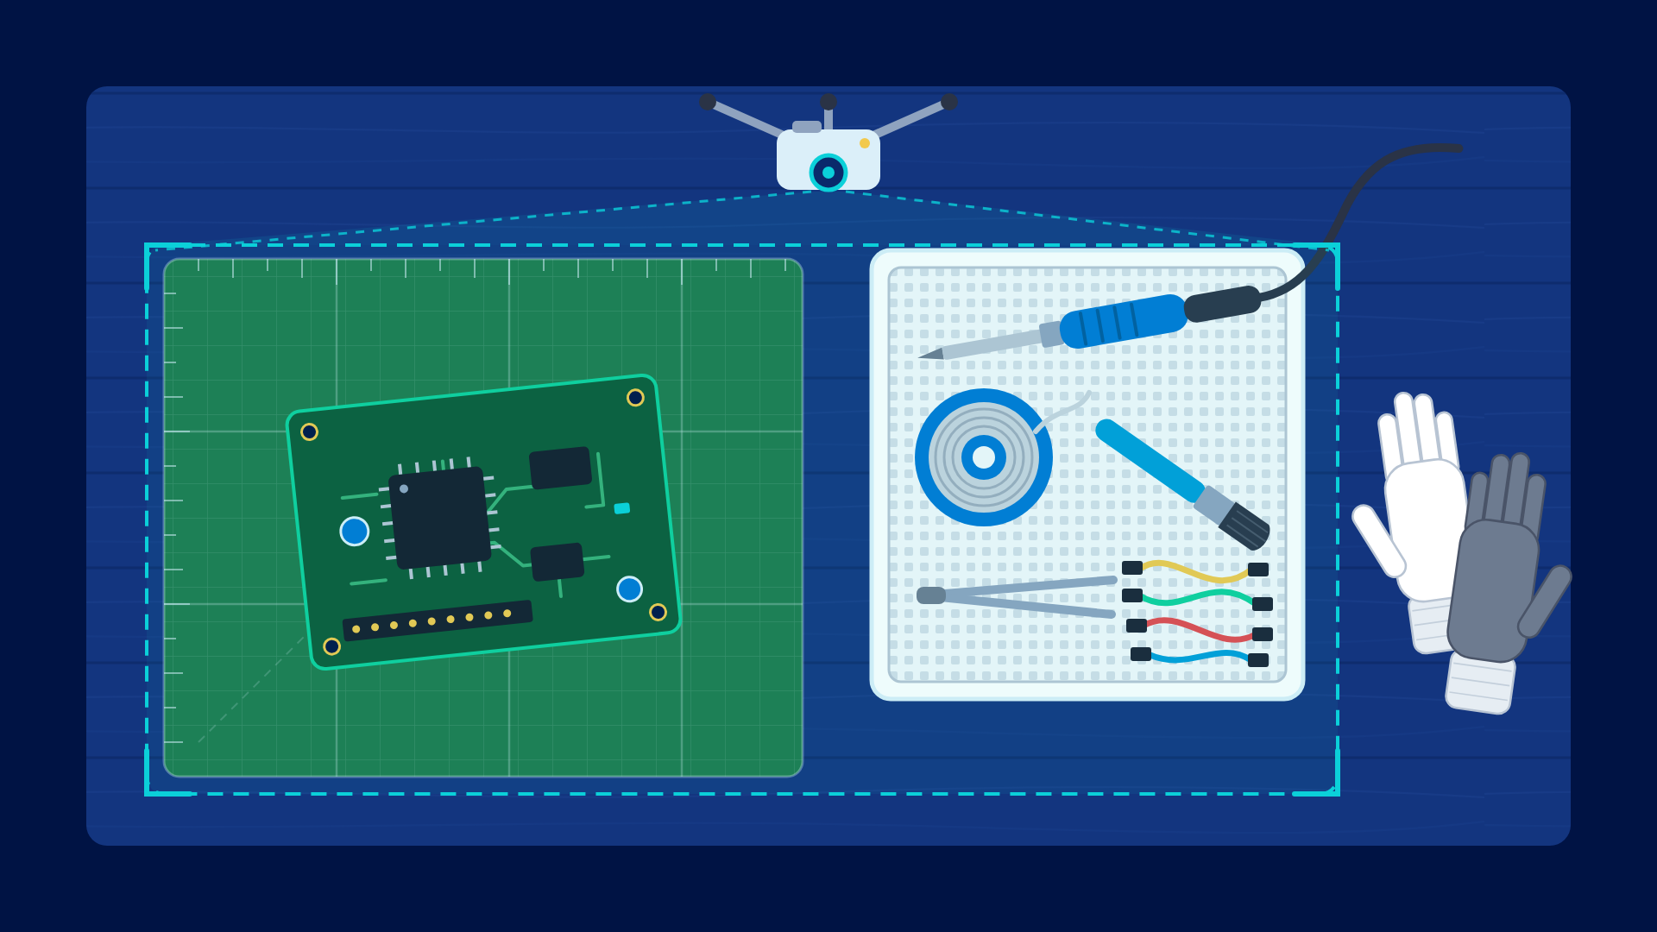
the work cell, at desk scale
Notes:
NOTES
The green mat is the Zone, the white tray holds the six parts.
The supervisor wants to know three things: a part goes missing, someone works without gloves, something is left on the mat.
Only gloves are live today. The spike, later, says why.

Slide 13
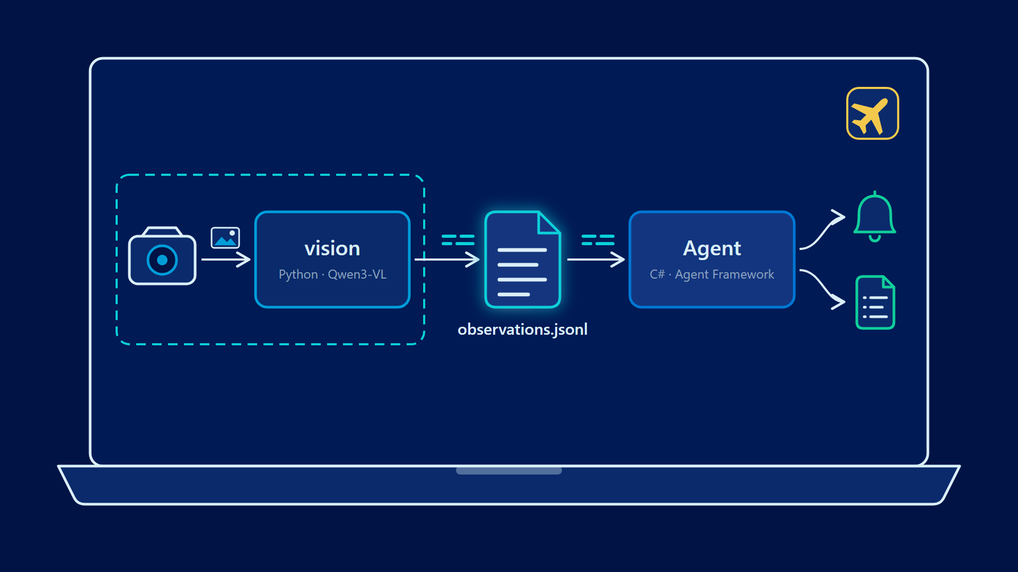
the whole system, on one laptop
Notes:
SCRIPT
This is the whole system. Two processes on one laptop.
The first one sees: it turns a camera frame into text. The second one decides and acts.
Between them there is a file. Remember where the dashed line is: the image never crosses it.

Slide 14
The stack

Qwen3-VL, 2B and 4B, the model that sees
Foundry Local 2.0.1, in-process
OpenVINO GenAI 2026.3, for the GPU and the NPU
Microsoft Agent Framework 1.22, on .NET 10
Python for vision, C# for the Agent
Notes:
NOTES
Every piece is a released version, nothing preview. Agent Framework is on its stable 1.x line.
Qwen3-VL, not Phi-4-multimodal: ADR-0001. Two runtimes: ADR-0012.

Slide 15
The frame
1

Slide 16
terminal
This is an invalid model.
Error: Duplicate definition of name (pad_CUDAExecutionProvider).
Notes:
SCRIPT
I asked for a model by its alias, and Foundry Local chose the build for my hardware.
It chose one that cannot load, and nothing I could do as a caller fixed it.
The model you ask for is not the model you get. So name the exact Variant. The whole demo rests on that.
NOTES
qwen3.5-0.8b-cuda-gpu:3 on my desktop. The defect is in the published artifact, not in the caller.
Reported as microsoft/foundry-local#1075. If asked: fixed by the publisher five days later, as a new version (:4). Nothing the caller did fixed it.

Slide 17
Foundry Local 2.0, in-process

no service, no HTTP hop
the image as a typed item, not base64 smuggled in
one package, no -winml split
telemetry you can switch off
a pinned Variant starts with no network
Notes:
SCRIPT
Most of what you will find online is Foundry Local 1.x. This is 2.0, and it changes the shape.
It runs inside my process. The image is a typed object, not a string hidden in a field.
And the last line is the one that matters today: pin the Variant, and it starts in airplane mode.
NOTES
2.0.1 shipped on 1 September. In 1.x the image went as untyped base64 inside extra_body; now it is an ImageItem, bytes plus a codec hint, in every SDK including C#.
Learn still documents 1.2.x, and no first-party sample combines ChatSession with ImageItem. ADR-0004.
Trap if asked: a ChatSession accumulates turns, so we rebuild it for every request.

Slide 18

What crosses the wire?
A sentence

Slide 19
The question
2

Slide 20
Ask the watch

Live demo
Notes:
NOTES
D2. `uv run watch --camera 2 --variant qwen3-vl-4b-instruct-int4-sym-gpu`. This is the 4B on the iGPU: "you will see why".
Type "Is there a phone or a cup on the green mat? Answer in one or two sentences." Cup beside the mat first: the "no" says where the cup is, which is the reasoning moment. Then onto the mat.
Then "What is the person doing? Answer in one sentence."
A question takes effect at the next Cadence. Say so rather than waiting in silence.

Slide 21
A detector
A vision-language model
a fixed list of classes
retrained when the list changes
a list anyone changes by typing
an accuracy you have to measure
Notes:
SCRIPT
Production today runs detectors, trained for a fixed list and retrained when it changes.
Here I typed a new question, with no new model and no data scientist.
That flexibility is the reason to run a VLM at all. It is also why its accuracy must be measured.

Slide 22
“
Answer in one sentence.
Notes:
SCRIPT
Every question I type ends the same way. Without that bound, a small model keeps talking.
It truncates, it loops, it invents. Bound the answer, and it stays on the photo.
NOTES
The cup question: 13 of 13 photos right, 1.3 to 2.3 s per answer on the 4B iGPU. docs/research/2026-09-24-d2-scene-questions.md.
Discarded, notes only: "Is it safe to solder like this?" answers "No" to every photo, with a lecture on eye protection.

Slide 23

What crosses the wire?
A question in, a sentence out

Slide 24
The model
3

Slide 25
What the catalogue offers this laptop

qwen3-vl on the CPU
no GPU build
no NPU build
Notes:
SCRIPT
This laptop has a GPU and an NPU. The catalogue offers this model for the CPU only.
So if you want the accelerators, you build the model yourself.
NOTES
Verified with `foundry model list` on this machine. The catalogue is filtered per device.
The laptop has an Arc 140V iGPU and an Intel AI Boost NPU. Foundry Local's NPU builds here are all chat models, none with vision.

Slide 26
vision/tools/convert/convert.py
optimum-cli export openvino \
--model Qwen/Qwen3-VL-2B-Instruct \
--weight-format int4 --sym --ratio=1.0 --group-size=-1 \
qwen3-vl-2b-instruct-int4-sym
Notes:
NOTES
The recipe verified on this laptop, not a general rule. Two exports with the same recipe: the 2B and the 4B.
It runs once, on the CPU, and needs no NPU. OpenVINO is told its device, so one IR serves CPU, GPU and NPU.
If asked: transformers must stay >=4.57,<5.0; convert.py scrubs a system-wide OpenVINO install that shadows the right one; provenance.json records the recipe beside the IR; CACHE_DIR takes the NPU's first compile from ~32 s to ~2 s.

Slide 27
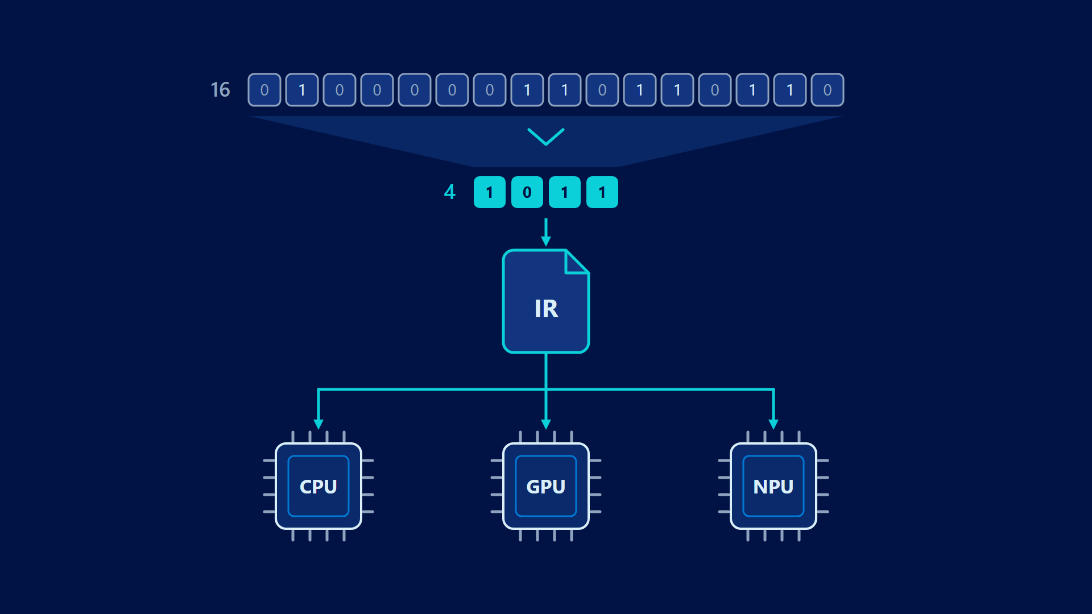
sixteen bits to four, one file for three engines
Notes:
SCRIPT
Each weight goes from sixteen bits to four.
One exported file serves the CPU, the GPU and the NPU through OpenVINO.

Slide 28
Foundry Local, CPU
OpenVINO, INT4
This is a dimly lit room with a tall wooden bookshelf filled with books and various items on the shelves. A blue and gray office chair is in the foreground.
A bookshelf is on the left, and a white door is in the center. A white door is in the center. A white door is in the center. A white door is in the center.
Notes:
NOTES
Same image, same prompt, from the Benchmark of 2026-09-22. Every OpenVINO row repeats like this, on every engine.
Greedy decoding is the setting most prone to loops. On the spike's checklist prompt, 16 of 32 OpenVINO replies looped against 2 of 32 on Foundry Local.

Slide 29
The recipe sets the price
not INT4
Notes:
SCRIPT
Both of these are four bits per weight. So four bits is not the problem. The recipe is.
Ours is the coarsest there is, because the NPU asks for that shape.
And one file serves all three engines, so the GPU and the CPU pay a price only the NPU demands.
NOTES
Foundry Local's build is INT4 too: 1.34 GB for the 2B, block-wise, one scale per 32 weights. docs/research/2026-09-25-int4-quantisation.md.
Ours is the coarsest INT4 there is: channel-wise (group-size -1), symmetric, and no INT8 layers (ratio 1.0; optimum keeps 20% by default). ~1.7 GB, larger and still worse.

Slide 30
Quantising better

one IR per engine, not one for all
group-wise INT4 or INT8 for the GPU and the CPU
group-wise, or AWQ and scale estimation, for the NPU
a repetition penalty at decode time
count the loops, not only the tokens per second
Notes:
NOTES
Each one is a ticket in the repo: #72 (GPU and CPU IR), #73 (NPU recipe), #74 (repetition penalty). #75 looks at reaching the iGPU through Foundry Local's own GPU builds.
How AWQ and scale estimation work stays out of the talk.

Slide 31

What crosses the wire?
The model, once, while you prepare the machine
Notes:
SCRIPT
The weights came down once, while I prepared this laptop. Since then, nothing.
Preparing may use the network. Operating may not.

Slide 32
The hardware
4

Slide 33
terminal
uv run watch --variant qwen3-vl-2b-instruct-generic-cpu:2
uv run watch --variant qwen3-vl-2b-instruct-int4-sym-gpu
uv run watch --variant qwen3-vl-2b-instruct-int4-sym-npu
Notes:
NOTES
D3, on the 2B and the webcam, each with --ask "What is the person doing? Answer in one sentence."
Same watch, three engines. Only the Variant name changes. Point at the timings as they come in.

Slide 34
Same image, same prompt, tokens per second
Notes:
NOTES
Benchmark of 2026-09-22 on this laptop, five runs each. Tokens per second, because the INT4 rows did more work.
The two CPU rows are the same silicon reached two ways.

Slide 35
I measured the NPU with the GPU's ruler
Notes:
SCRIPT
I came in expecting the NPU to win. By tokens per second, it does not, on this model.
That was my mistake. I only found out after building a second runtime to reach it.
I was asking the wrong question of the wrong engine.

Slide 36
Which engine is fastest?
Which engine suits a station that watches all shift?
Notes:
SCRIPT
A station does not sprint. It watches the same cell for eight hours, then does it again.
For that job, peak speed is not the whole story.

Slide 37
What the NPU showed on this laptop

loads fastest of the four: 2.3 s
no cold-start penalty: 5.8 s first run, 5.9 s warm
the exported model ran on it at the first attempt
leaves the CPU and the GPU free for the rest of the station
Notes:
NOTES
All from the Benchmark record. For contrast: the OpenVINO CPU row goes from 9.1 s cold to 4.6 s warm; the iGPU loads in 6.2 s.
Earlier spike, a different model (Qwen2.5-VL-3B INT4, issue #38): NPU 6.0 s to first token against 23.7 s on the CPU.

Slide 38
2.8x
performance per watt of the NPU over the GPU, measured by Intel on Panther Lake
Notes:
SCRIPT
Intel has measured where this is going. On Panther Lake, the next generation, the NPU does 2.8 times the work per watt of the GPU.
Different chip, different model, not my app. But that is the direction.
I did not measure energy for this app. Last year, in a talk with Intel, we measured it on this very laptop.
Then a driver update made that impossible, and it still is. So you get Intel's figure, labelled as Intel's.
NOTES
Intel's own lab: Gemma 4 E2B on Core Ultra 7 355, power measured with SocWatch. There the NPU was also faster than the GPU.
Next generation, different model, not this app. Say all three.
For this chip generation Intel's claim is qualitative: sustained AI workloads while remaining energy-efficient.

Slide 39

What crosses the wire?
Nothing. Changing engines is changing a name.

Slide 40
The seam
5

Slide 41
0 of 11
forced tool calls with an image that the model honoured
Notes:
SCRIPT
The Agent needs more than prose. It needs a shape it can test.
I first asked the vision model to call a tool with that shape. It never did, not once in eleven.
So I stopped forcing it. I ask for the shape in the prompt, and parse what comes back.
NOTES
Spike of 2026-09-15. The model never honoured a forced tool call when the request carried an image.
ADR-0011 records the mechanism that did not survive.

Slide 42
vision/src/vision/inference.py
This is a work bench seen from above. The work zone is the green
cutting mat. The tray is the white mesh tray beside it.
List every distinct object you can see, and where it is:
"tray", "zone", "hand" or "elsewhere".
Name each visible hand "bare hand" (skin showing) or "gloved hand".
Reply with ONLY a JSON array of {"name", "count", "where"}.
Notes:
NOTES
The `described` prompt, cut to its key sentences. The full text carries a worked example and "If nothing is there, reply with []".
It names this mat and this tray. That is a debt, recorded in ADR-0016; a --scene flag is the way out.
Structured output gets 256 tokens, prose 128, temperature 0. At 128, only 12 of 32 4B lists fitted.

Slide 43
Asked in prose
Asked for a shape
"Is each visible hand bare or gloved?"
"bare" on 4 of 6 photos with no hands at all
a list of objects and where each one is
0 false Triggers on 17 photos with no bare hand
Notes:
SCRIPT
A question is flexible, and you saw that in the demo. But a Trigger cannot rest on it.
Asked in prose about hands, the model found bare hands in photos that had no hands.
Asked for a list, it made no false Trigger at all. Asking is for people. A Trigger needs the shape.
NOTES
Both on the 4B iGPU, the same photos. Prose: 7 of 13 right overall. docs/research/2026-09-24-d2-scene-questions.md.

Slide 44
docs/fixtures/watch-emit-contract.jsonl
{"type": "cadence", "cadence": 1,
"time": "2026-09-24T10:30:02+02:00",
"variant": "qwen3-vl-2b-instruct-cuda-gpu:2",
"outcome": "objects",
"objects": [
{"name": "soldering iron", "count": 1, "where": "tray"},
{"name": "bare hand", "count": 1, "where": "hand"}],
"truncated": false, "shortfall": null}
Notes:
SCRIPT
This is everything that crosses from vision to the Agent. One line of JSON per Cadence, in a file.
No socket, no shared endpoint. Each process loads its own model.
You can open this file and read everything the Agent ever received. I will, in the demo.
NOTES
One line of the contract fixture, wrapped for the slide. Both sides test against this file. ADR-0014.
Outcome is exactly one of: objects, no_shape with its reason, failed with its error. The first line of each file describes the Watch.
The file is recreated at every Watch start. Never a Frame, never a path to one, even under --keep-frames.

Slide 45
agent/work-cell.json
"hands": {
"bare": ["bare hand"],
"gloved": ["gloved hand", "white glove", "glove"],
"plain": ["hand"]
},
"triggers": {
"no_gloves": { "n": 2 }
}
Notes:
SCRIPT
The scenario lives in a text file. What the tray holds, what may lie on the mat, the names the model uses for each.
And which Triggers are on. Today, one: working without gloves, confirmed twice.
Change the scenario, and you edit this file. You do not touch the code.
NOTES
Excerpt. The file also lists the six parts of the Tray and the Zone, each with the synonyms the model uses: "solder spool", "spool", "solder wire".
A plain "hand" counts as bare unless a gloved hand is named in the same Observation: live, the 4B says "hand", almost never "bare hand".
missing_part is off (refuted), foreign_object deferred (#70). An unknown Trigger or an N below one is refused at start.

Slide 46
When a Trigger fires

its condition holds on N Observations in a row
it re-arms after N in a row without it
an Observation with no shape counts neither way
each firing is one Incident
Notes:
NOTES
A small model is wrong on single Frames. N consecutive is what keeps its noise off a worker's record.
A failed inference or a reply in prose is never read as evidence either way.

Slide 47

What crosses the wire?
One line of JSON

Slide 48
The action
6

Slide 49
I measured it before I promised it
Notes:
SCRIPT
This is why the demo runs the 4B. The 2B could not see the work cell.
And I planned the demo on a part going missing from the tray. No local model this size sees that.
So the Trigger is working without gloves. I measured it before I promised it on this stage.
NOTES
Spike #58: 32 photos, three Variants, four prompts. docs/research/2026-09-24-work-cell-spike.md.
The 2B never says "bare hand" on OpenVINO. The 4B, with the described prompt: 8 of 9 bare hands, 5 of 5 mixed, 0 false.
A missing part: at best 2 of 6 caught, with 9 to 16 false "missing" on 16 photos. The brush and the tweezers are missed systematically.

Slide 50
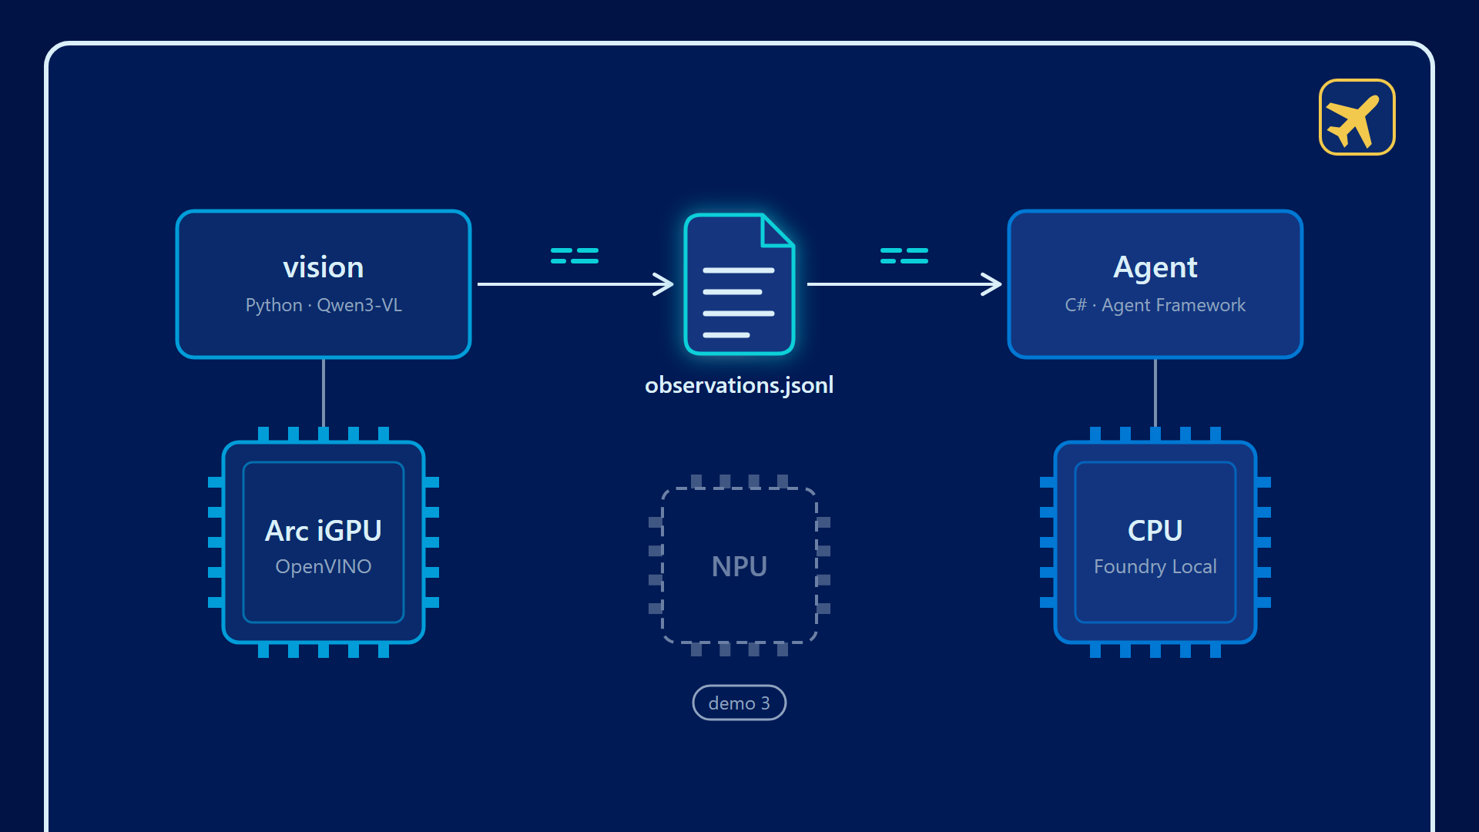
two processes, two engines
Notes:
NOTES
The Watch and the Agent never share an Execution Provider by default. The Watch: 4B on the iGPU, ~8 s per structured Frame, a 10 s Cadence.
The Agent: qwen2.5-1.5b-instruct-generic-cpu:4. It is consulted only when a Trigger fires, never per Observation.

Slide 51
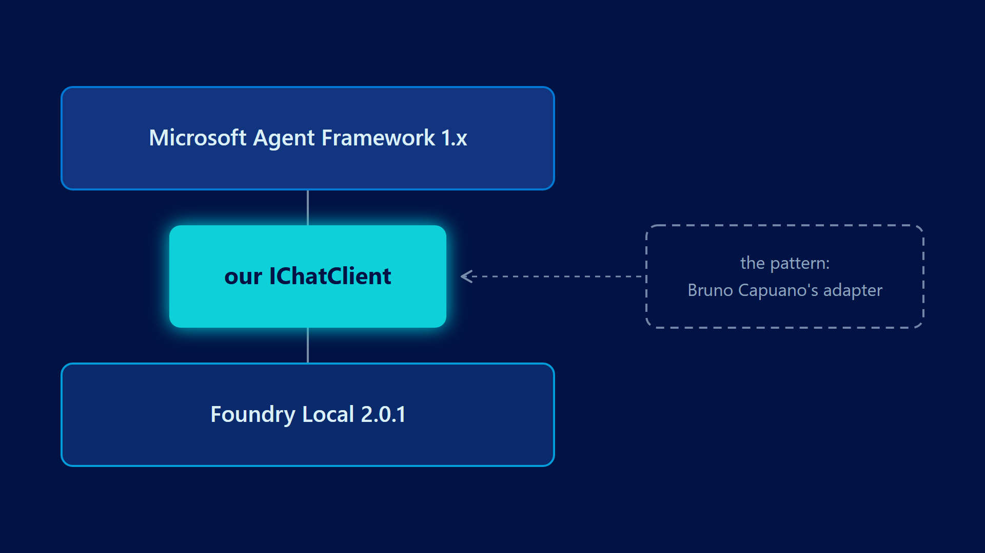
Agent Framework, on Foundry Local 2.0.1
Notes:
SCRIPT
Agent Framework speaks IChatClient. Foundry Local 2.0 does not give you one in .NET.
Bruno Capuano solved this for 1.x with an adapter, and I followed his pattern.
But 1.x sends telemetry you cannot switch off, and it loses tool calls. So I wrote the same bridge for 2.0.1.
NOTES
ADR-0015. Bruno's ElBruno.MAF.FoundryLocal set the pattern: an IChatClient bridge where no first-party one exists. Credit him.
Why we wrote our own: his pins Foundry Local 1.2.1, has no telemetry switch, and drops tool calls when streaming.
Ours: tools map to Foundry Local's tool definitions and back to function-call contents, a fresh ChatSession per call, telemetry off. It is the only class that knows Foundry Local.
In 2.0.1, GetChatClientAsync returns an OpenAI client that implements no IChatClient.

Slide 52
10 of 10
Incidents where the 1.5B model called both tools, on the CPU. On the GPU and the NPU: 0 of 10.
Notes:
SCRIPT
The model that sees is not the model that acts.
The vision model runs on the GPU. The model that calls tools reliably only did it on the CPU.
So each one runs where it works, and the laptop uses two engines at once.
NOTES
docs/benchmarks/tool-call-reliability-zenbook-20260925-114415.md. The GPU build called only log_incident, the NPU build only notify_supervisor.
qwen3-1.7b on the CPU: empty replies. qwen3-4b: prose reasoning, 50 to 100 s. ~15 to 25 s per Incident on the winner.

Slide 53
No system prompt scored best
Notes:
SCRIPT
I wrote the Agent careful instructions. Every version made it worse.
With no system prompt at all, it called both tools every time. Measure before you polish a prompt.
NOTES
Every system prompt tried scored 0 to 8 of 10. No instructions at all: 10 of 10. The tool descriptions carry the intent.

Slide 54
Gloves off

Live demo
Notes:
NOTES
D5, three panes: the Agent, the Watch with --structured --emit, and the emitted file.
Gloves off, bare hands on the mat. no gloves 1/2, then the Incident, the toast and the log. ~40 s: narrate over the file, never wait in silence.
Fallback: the recording.

Slide 55
The incident log

the Trigger that fired
the Observation that fired it
the model's sentence and the time
whether the model acted
never a Frame
Notes:
NOTES
Point at agent_acted. If the model does not call both tools, throws or takes over 60 s, a template sentence goes through the same two Actions: agent_acted false, with the reason.
An Incident is never lost, and the model's failure is visible, not hidden. Gloves back on: two Cadences, then "Incident cleared", no model turn.

Slide 56

What crosses the wire?
Text. The Agent never sees an image.
Notes:
SCRIPT
The Agent cannot leak a picture it was never given. That is not a promise. It is the architecture.

Slide 57
What this laptop taught me

pin the Variant
measure the NPU with its own ruler
the recipe sets the price
bound every answer
a Trigger needs a shape, not a question
the model that sees is not the model that acts
Notes:
SCRIPT
Six things I did not know when I started, all measured on this machine.
None of them is on a spec sheet. Each one cost me a wrong assumption first.

Slide 58
What stays at the edge

Slide 59
Three questions

May the image leave the site?
Is the load continuous?
Is the network there when the decision is due?
Notes:
SCRIPT
Three questions. If any answer pushes you local, the image stays where it was taken.
And only text leaves.

Slide 60
4 cameras
at most, on this laptop's iGPU, with the 2B at one Observation every 10 seconds
Notes:
NOTES
10 s divided by a 2.3 s median, rounded down. An upper bound, one model serving the Feeds in series, for this Hardware Profile only.
With the 4B the demo runs, ~8 s per structured Frame: one camera.

Slide 61
Where it runs, and what it costs

the PC already at the station, an edge box, an on-premises server
at the edge: ~$2.50 per camera per month
rented cloud GPU: ~$29
per-minute video API: ~$4,320
Notes:
NOTES
Costs: order-of-magnitude model by Fora Soft on AWS list prices, for a continuously watched camera. Not an invoice.
Continuous load is the shape a per-call API bills worst. For bursty load, the cloud is cheaper and simpler.
Edge boxes from Advantech, OnLogic, ASRock Industrial, Lenovo, Neousys, Vecow run OpenVINO GenAI. Their Series 1 and 2 NPUs are 11 to 13 TOPS against this laptop's 48; Series 3 edge parts reach 50. Laptop figures do not transfer. Measure the box.

Slide 62
The image stays.
The conclusion may leave.
Notes:
SCRIPT
So the question was never local or cloud. It was what crosses the wire.

Slide 63
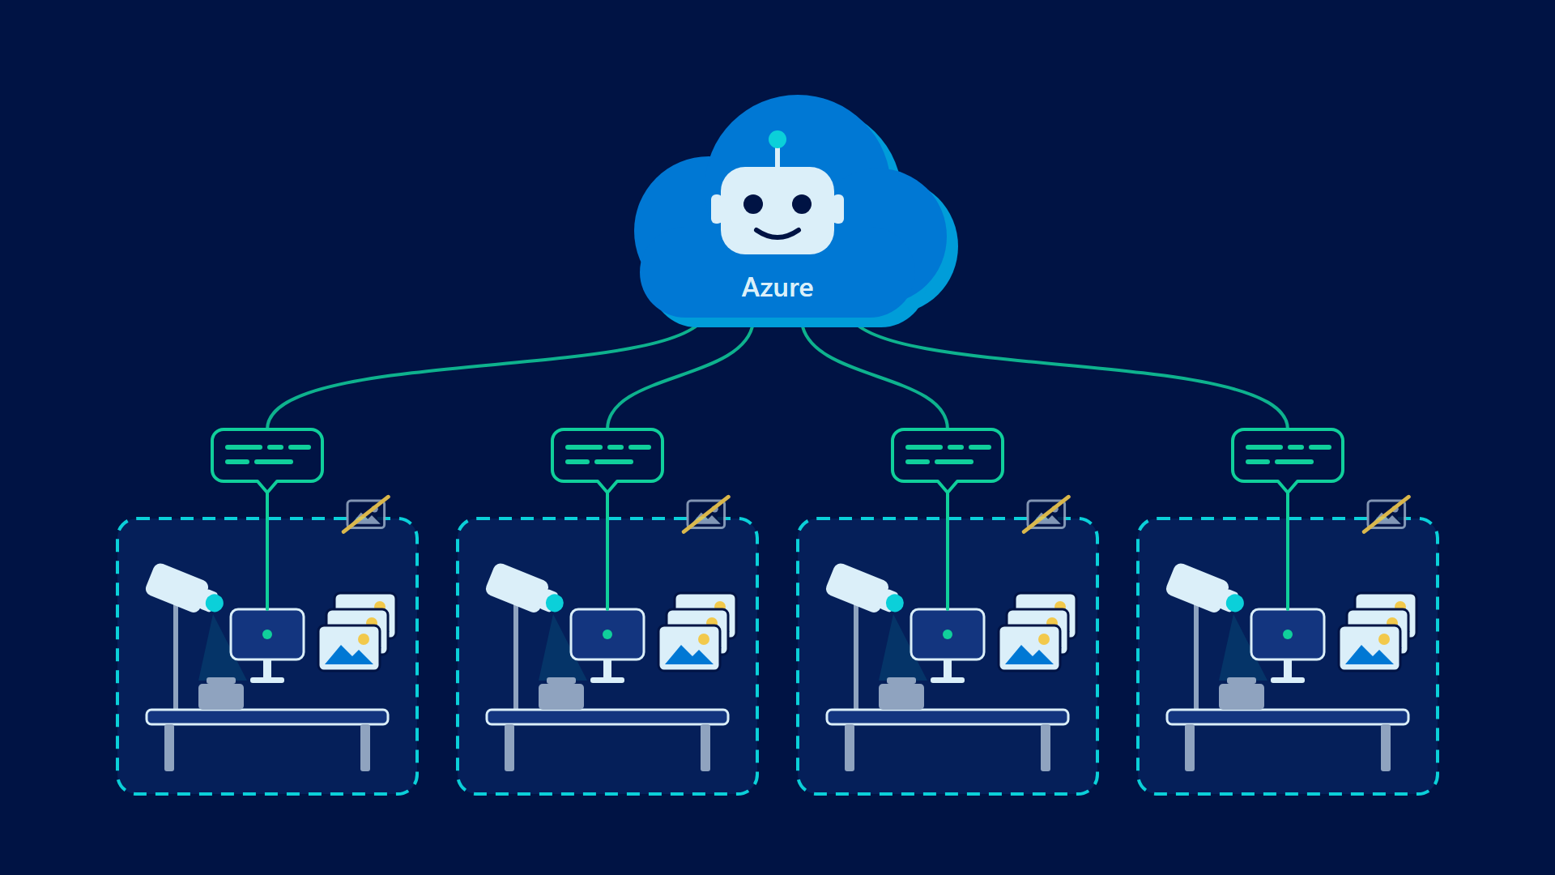
the agent you saw at 11:35, fed sentences, never frames
Notes:
SCRIPT
Want to see all your stations from head office? Send the sentences to a Foundry agent.
Every frame stays on the machine that took it. Nothing in this design has to change.

Slide 64
This is not about switching off the Wi‑Fi
It is about deciding what leaves the machine

Slide 65

Airplane mode has been on the whole time
Notes:
NOTES
Payoff. Point at the icon that has been on screen since the second slide.

Slide 66
What is kept is a sentence
never a face

Slide 67
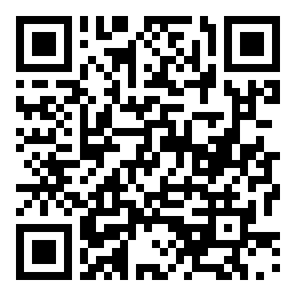
Clone it. Measure your own machine.
github.com/emepetres/local-vision-playground
Notes:
NOTES
Everything shown is in the repo, with the benchmarks and the decisions behind them.

Slide 68
Questions

Slide 69


