Slide 1
UML Case Diagram Presentation
Group 14

Slide 2
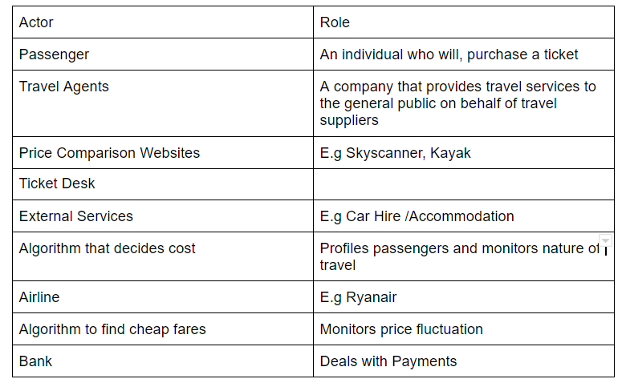
Table Of Actors

Slide 3
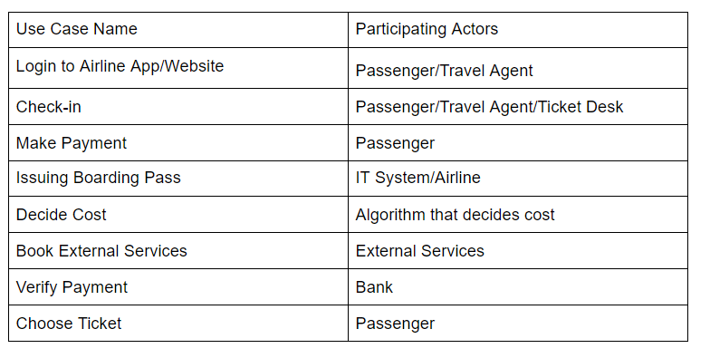
Use-Case / Actor Table

Slide 4
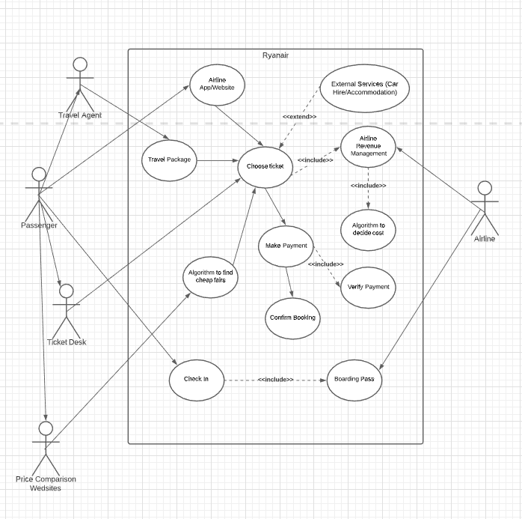
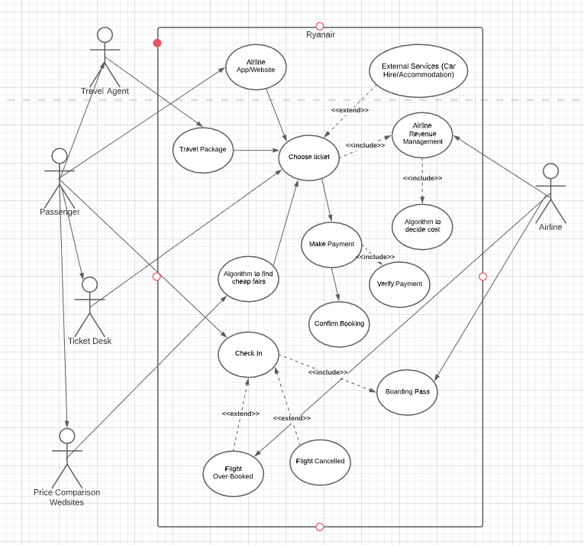
Progress of UML Diagram

Slide 5
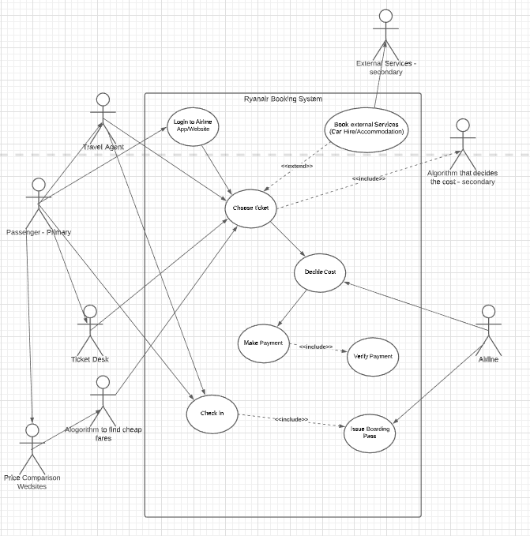
Current Version
Old Version

Slide 6
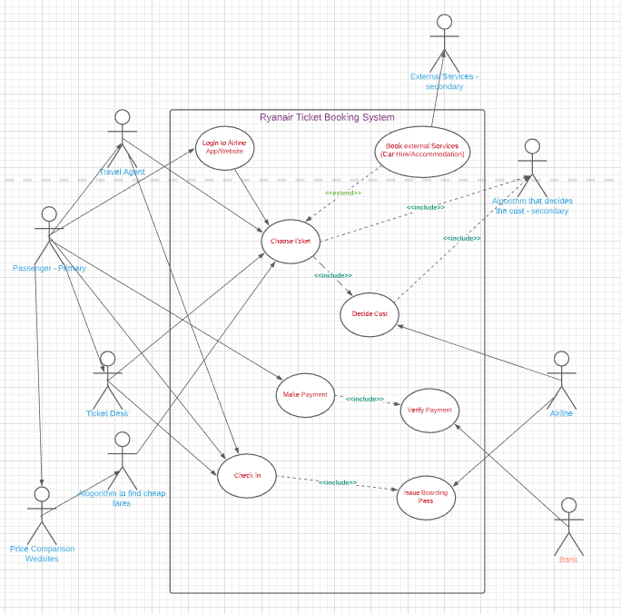
Current Version

Slide 7
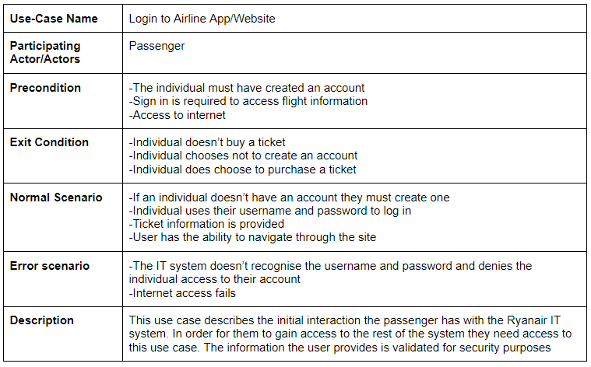
UML Cases we thought were most important

Slide 8
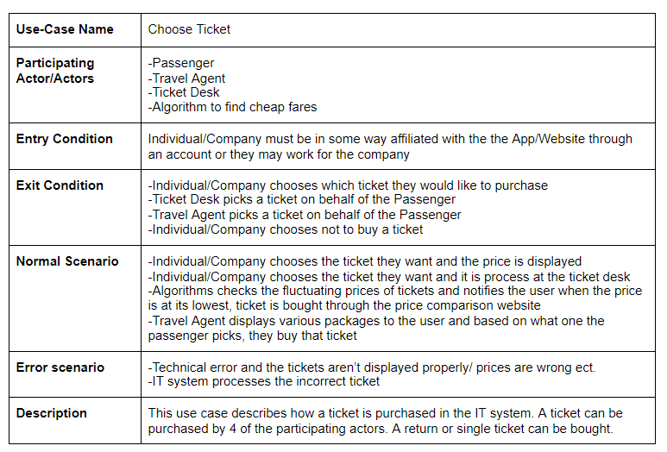
UML Cases we thought were most important

Slide 9
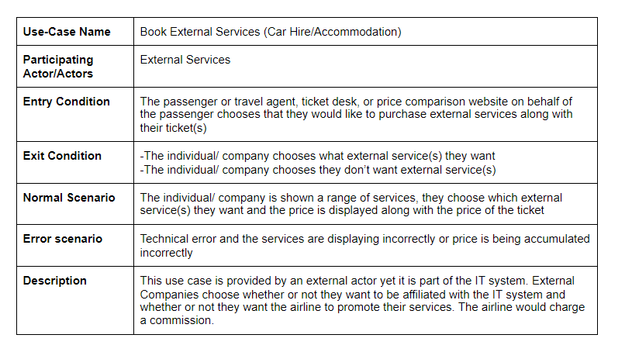
UML Cases we thought were most important

Slide 10
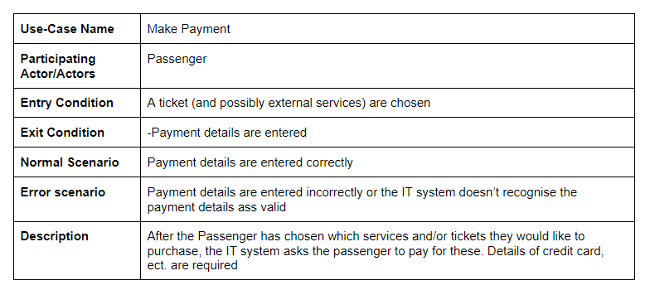
UML Cases we thought were most important

Slide 11
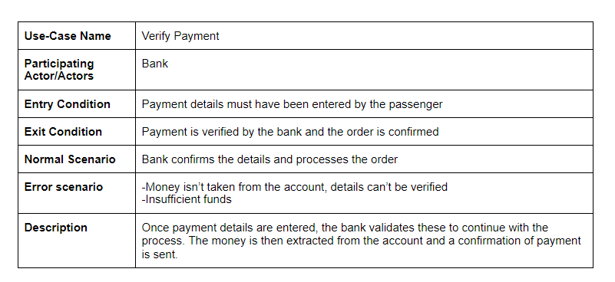
UML Cases we thought were most important

Slide 12
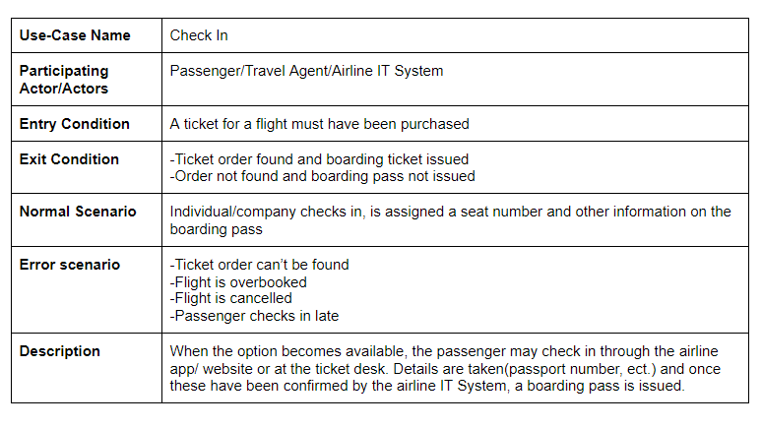
UML Case we thought were most important

Slide 13
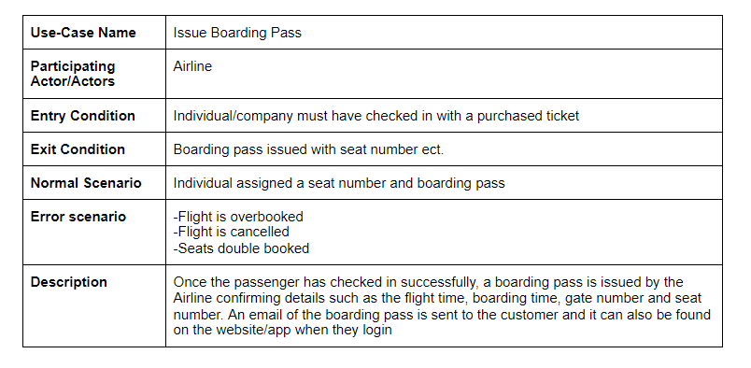
UML Cases we thought were important

Slide 14
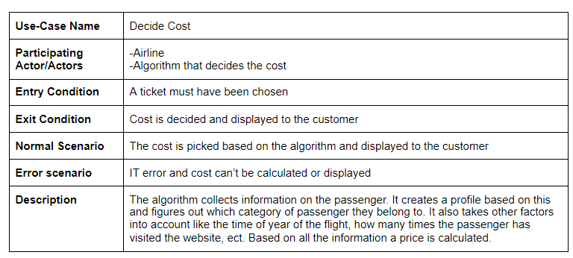
UML Cases we thought were important

