Slide 1


CBU Methods Day 2020
Using deep neural networks as a modelling framework to understand ventral stream computations
Emer Jones
PhD student
MRC Cognition and Brain Sciences Unit,
University of Cambridge
Notes:
Emer Jones
BBSRC
Supervised by

Slide 2
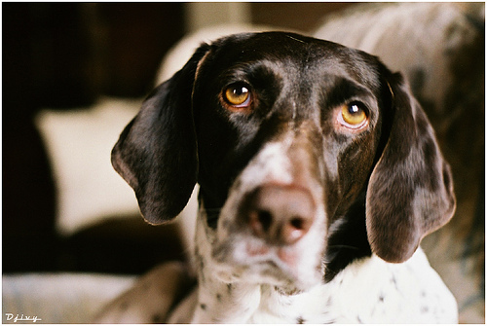
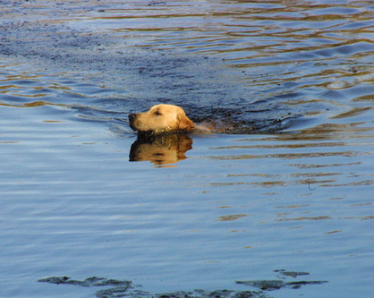

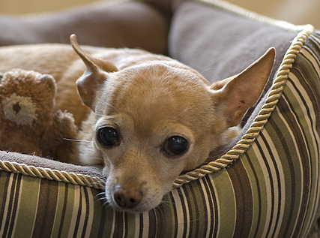
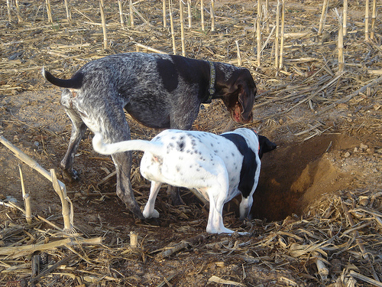
Images from ecoset and 3Blue1Brown

Slide 3
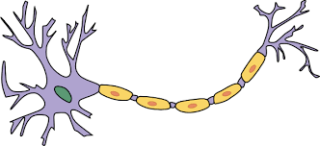
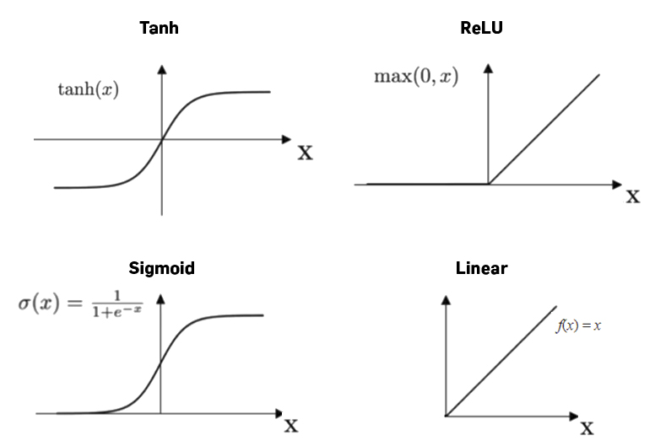
Input signal
Neuron
Input signal
Output signal
Input signal
Threshold
Node
Images: https://docs.paperspace.com/machine-learning/wiki/activation-function
https://en.wikipedia.org/wiki/Neuron
W
Input
signals
W
b
Output
signal
W
Activation function

Slide 4
0.4
“Cat”
Input Layer:
Pixels of an image
Output Layer: Probability that the image belongs to each category
0.1
“Violin”
0.5
“Dog”
Hidden Layer

Slide 5
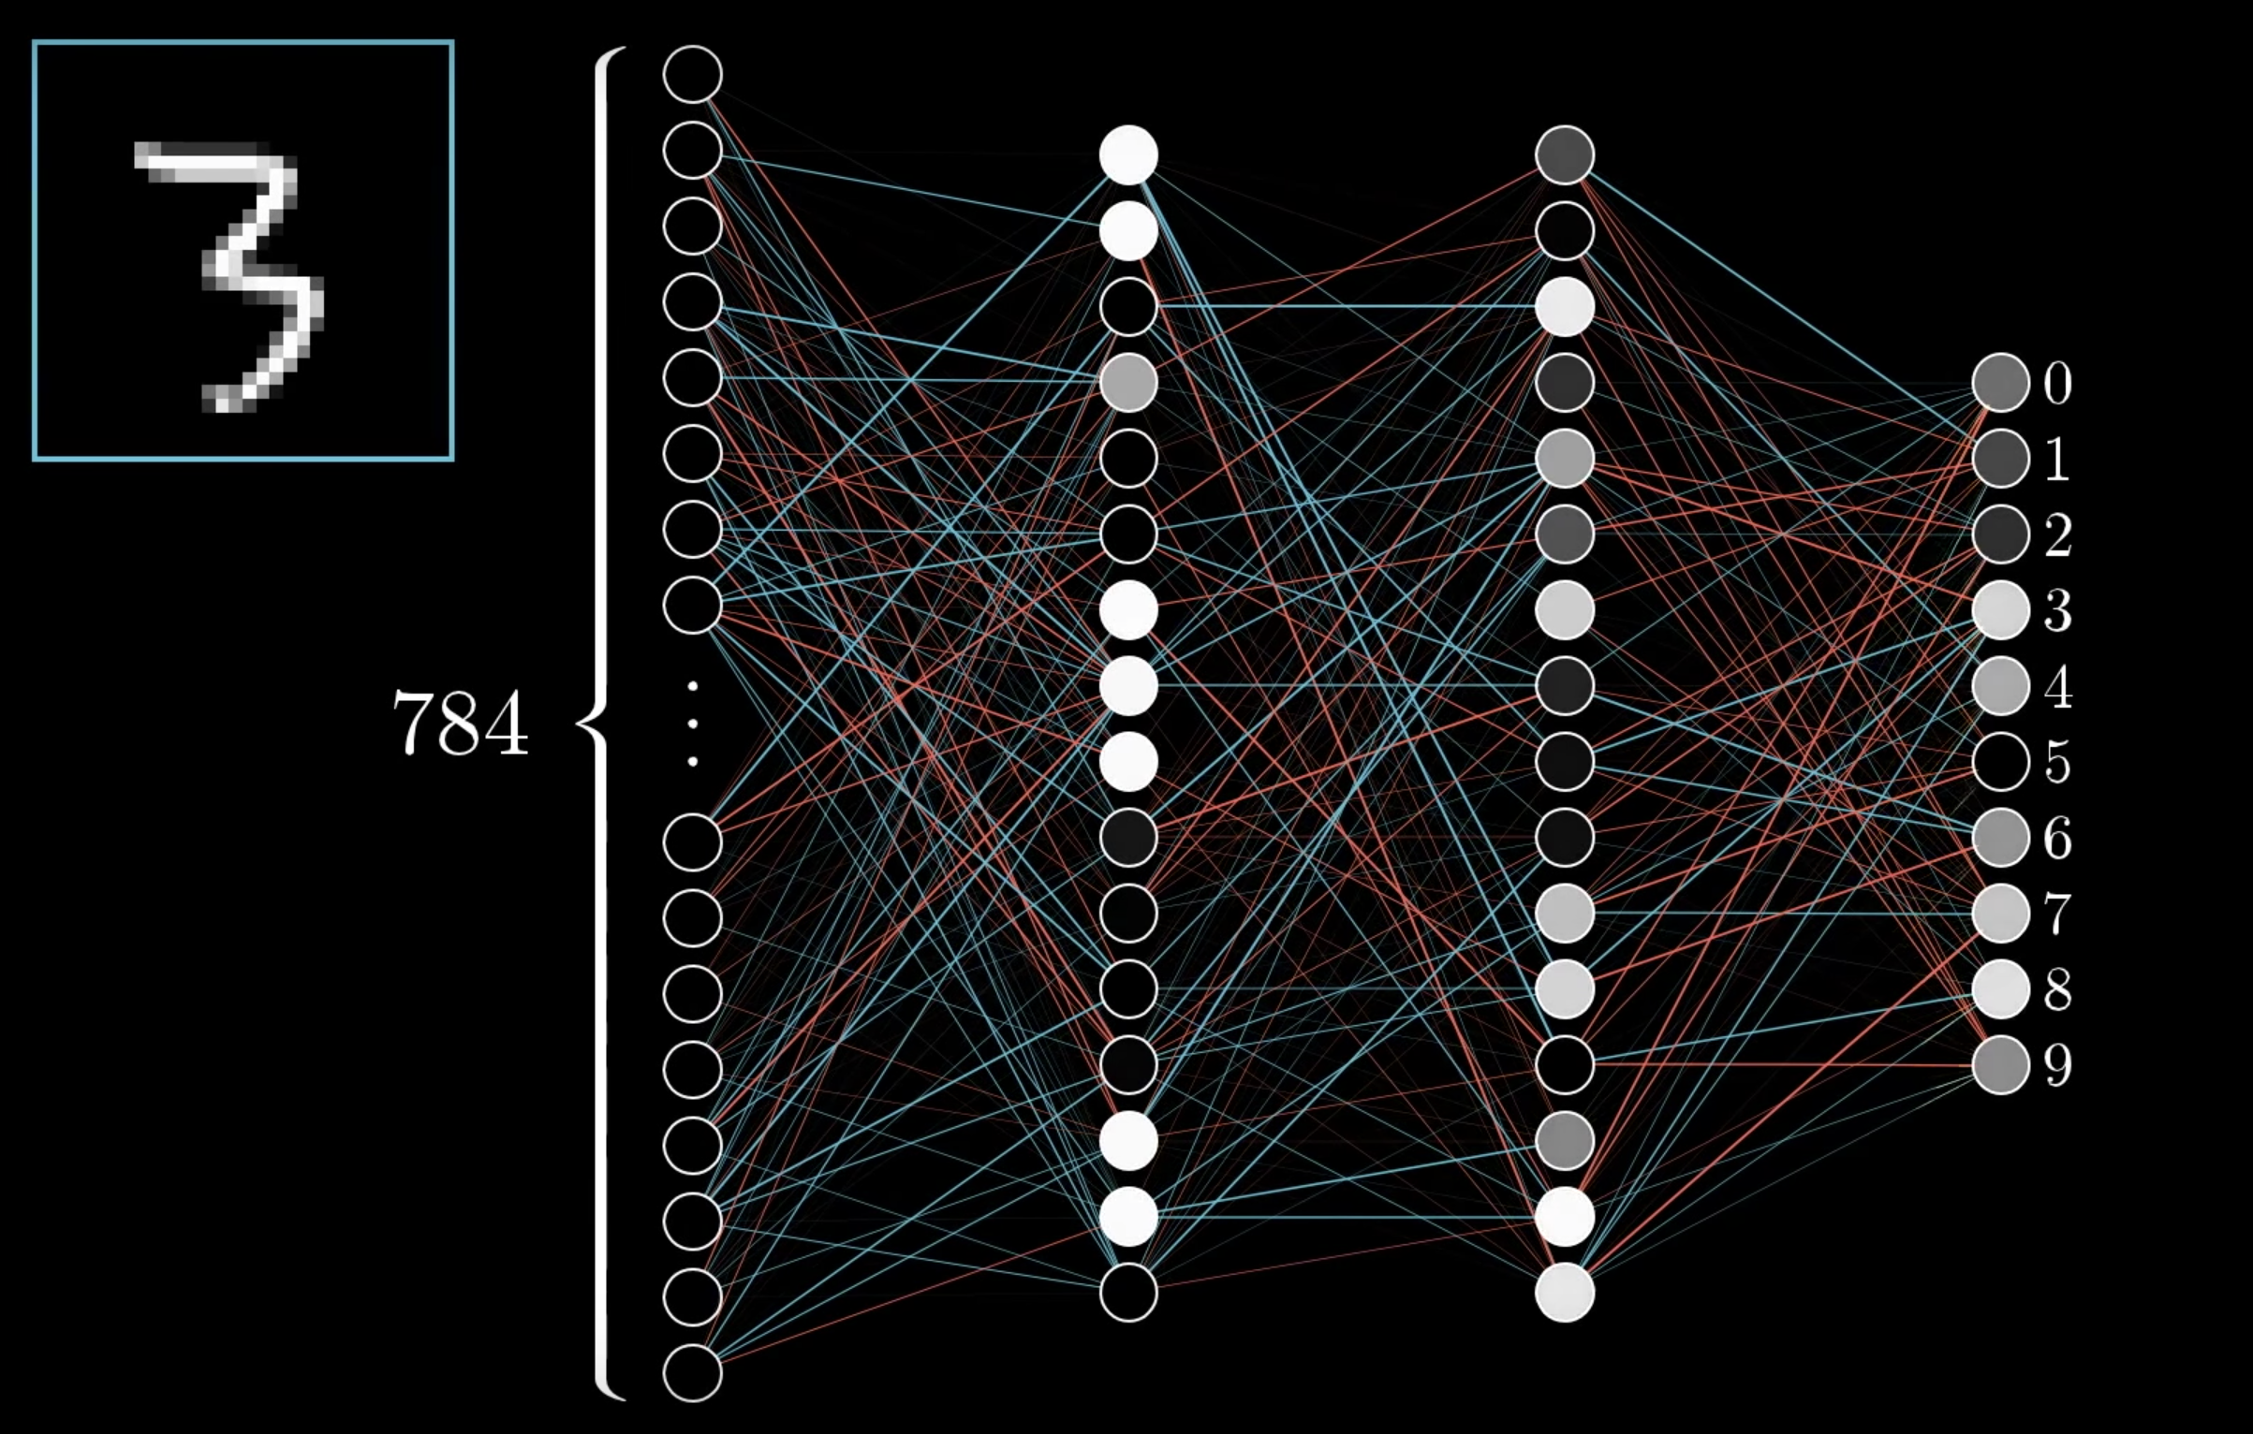
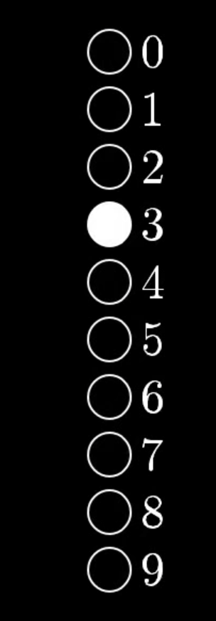

Target
With thanks to Tim Kietzmann

Slide 6
Target
With thanks to Tim Kietzmann
With thanks to Tim Kietzmann

Slide 7


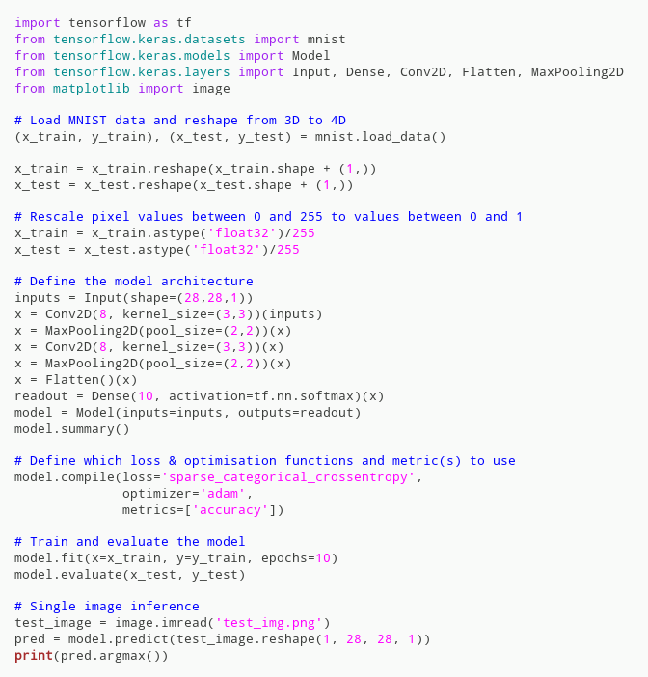

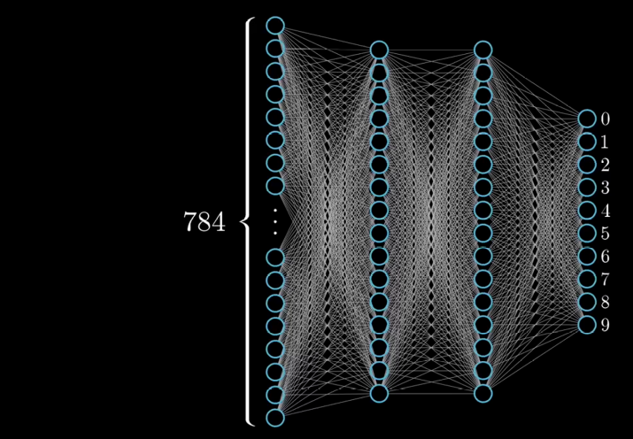

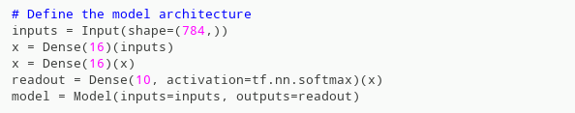
x_train: (60000, 28, 28)
y_train: (60000)
x_test: (10000, 28, 28)
y_test: (10000)
x_train: (60000, 784)
y_train: (60000)
x_test: (10000, 784)
y_test: (10000)
Number of parameters: 13,002
Accuracy: 87%

Slide 8
x_train: (60000, 784)
y_train: (60000)
x_test: (10000, 784)
y_test: (10000)
Number of parameters: 13,002
Accuracy: 93%

Slide 9
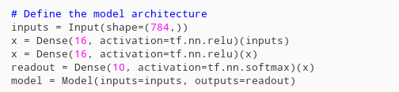
x_train: (60000, 784)
y_train: (60000)
x_test: (10000, 784)
y_test: (10000)
Number of parameters: 13,002
Accuracy: 96%

Slide 10
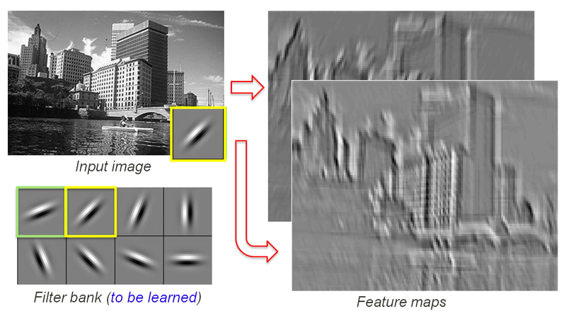
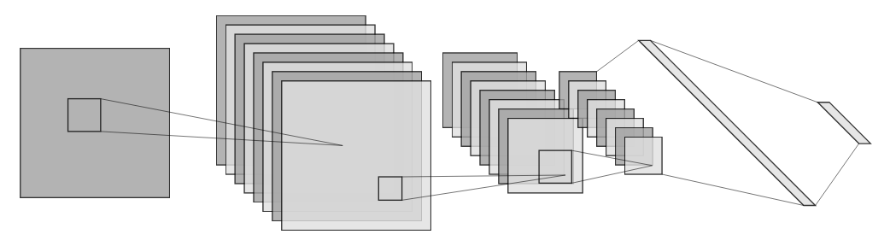
x_train: (60000, 28, 28)
x_train: (60000, 28, 28, 1)
Images: S Lazebnik
10
Diagram: http://alexlenail.me/NN-SVG/LeNet.html
Number of parameters: 2,674
Accuracy: 98%

Slide 11
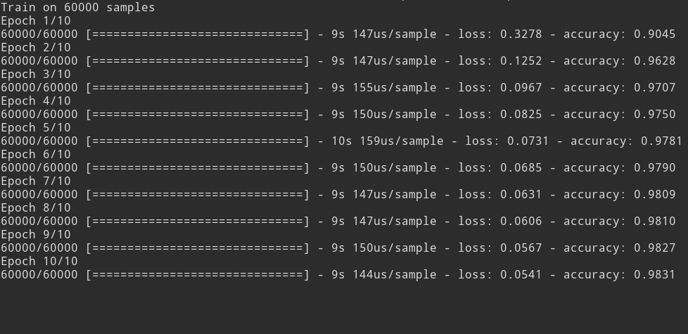
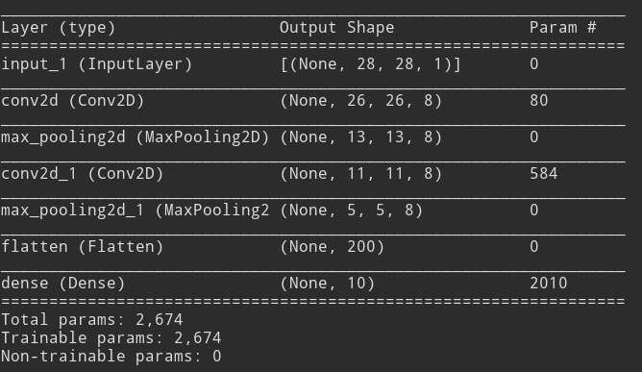

Slide 12
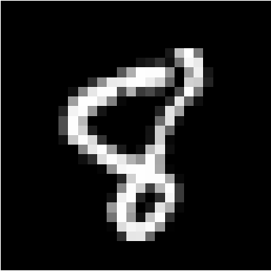


Slide 13


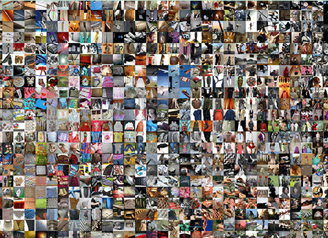
Data preprocessing (& augmentation)
Validation set
Saving checkpoints during training
Bigger models (10-100 million parameters)
Normalisation, regularisation
Lateral/top-down/skip connections
Computational resources
Image sources: MNIST, ecoset, https://www.centreforthestudyof.net/?p=3428
60,000
>1 million
10 classes
100s/1000s of classes

Slide 14
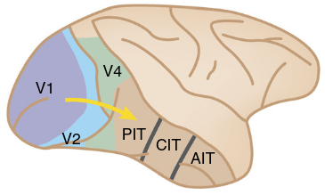
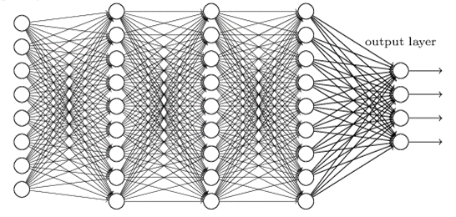
“Dog”
Images: Yamins & DiCarlo Nat Neurosci (2016); https://www.rsipvision.com/exploring-deep-learning/
“Dog”

Slide 15
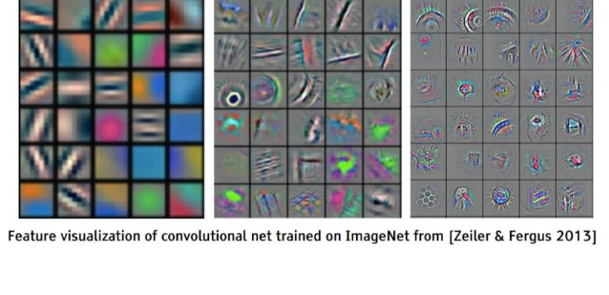
S Lazebnik
?

Slide 16
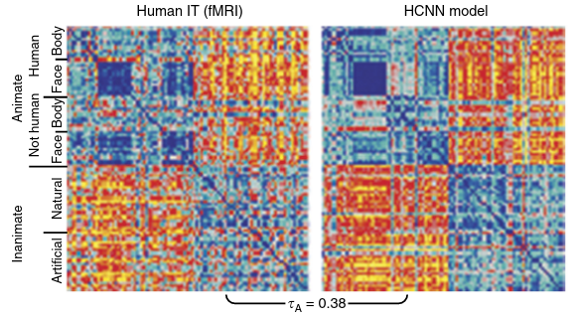
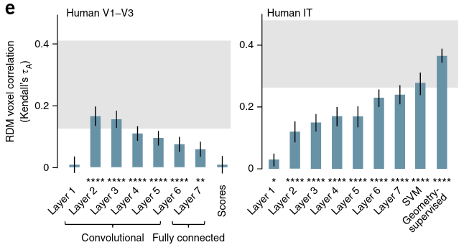
Yamins & DiCarlo, Nat Neurosci (2016), adapted from Khaligh-Razavi & Kriegeskorte, PloS Comput Biol (2014)

Slide 17
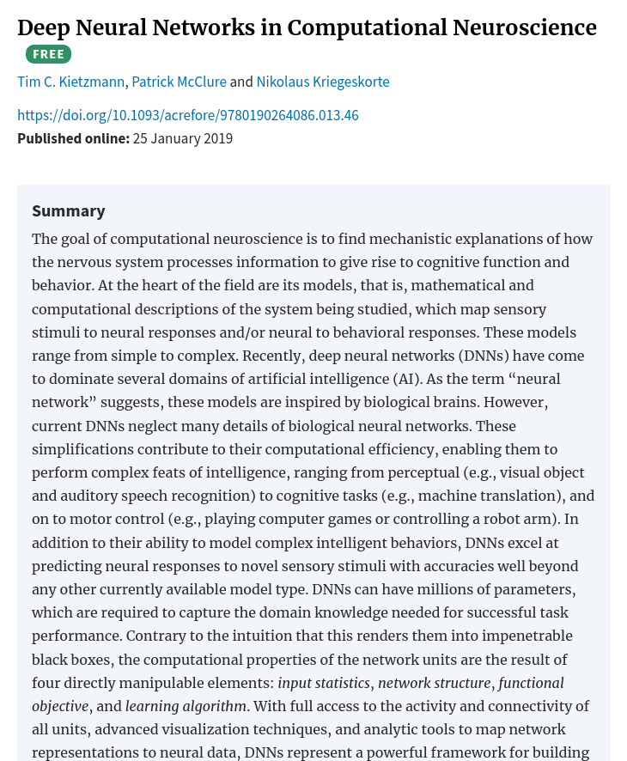
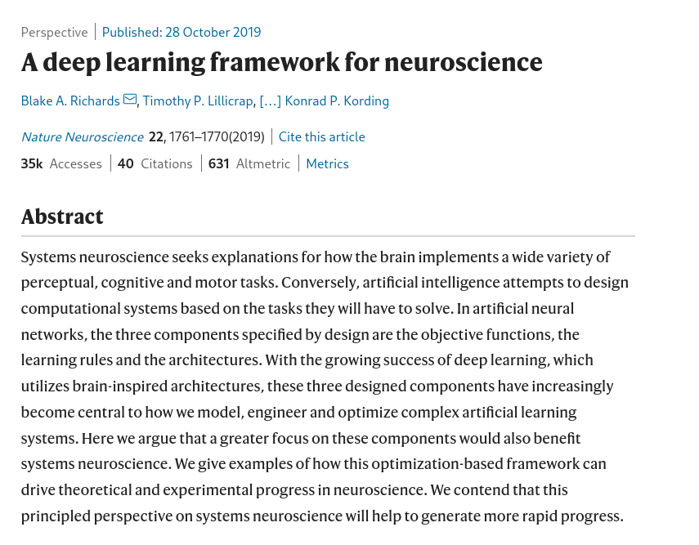
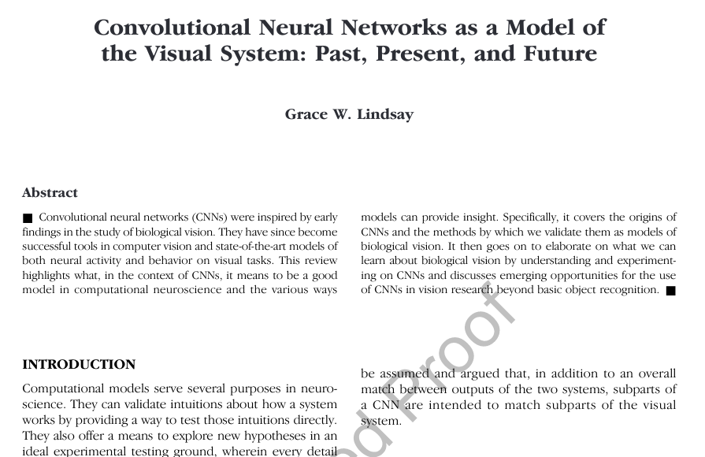
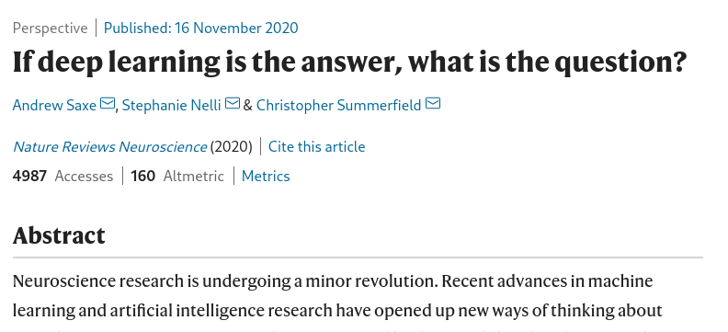

Slide 18
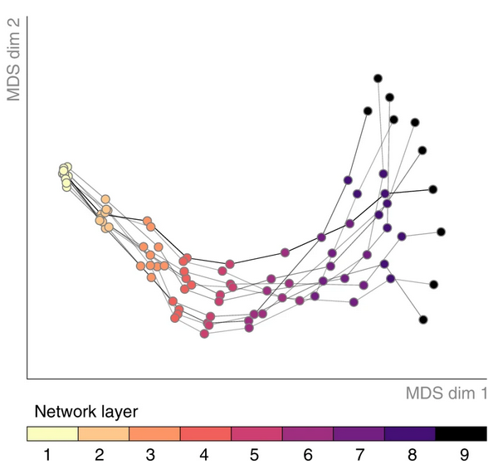
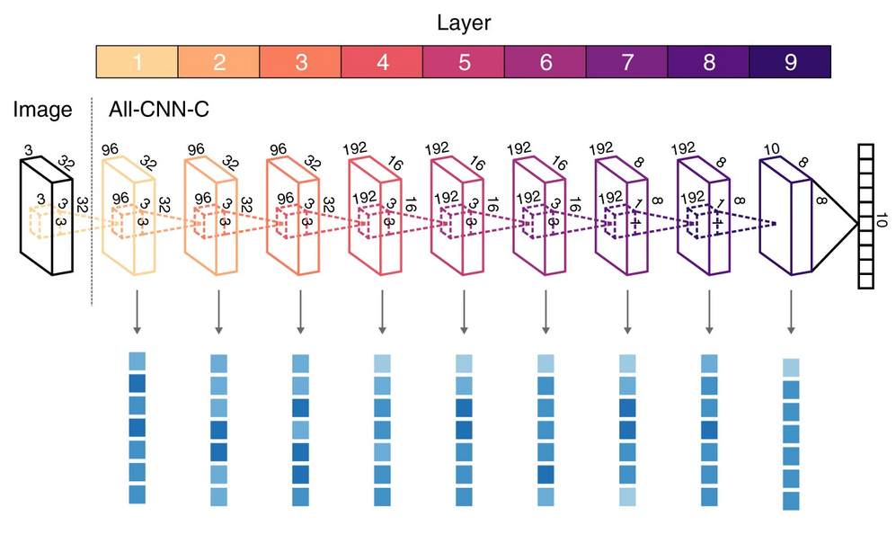
Models should be treated as participants
Mehrer, J. et al. Individual differences among deep neural network models. Nat Commun (2020)

Slide 19


ecj35@cam.ac.uk
emercjones
github.com/emercjones/dnn-examples

Slide 20
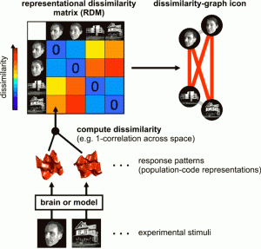
Kriegeskorte, N et al. Front Syst Neurosci (2008)

