Slide 1
📊 Sales Data Analysis using Python & Power BI
Data-Driven Insights for Business Decisions
CYIZERE SIBORUREMA Elie | ID 27492

Slide 2
🔍 Introduction
This project analyzes sample sales data using Python and Power BI.
Goals:
- Discover trends and sales patterns
- Visualize key performance indicators
- Provide data-driven business recommendations.

Slide 3
🧪 Methodology
1. Data Cleaning (missing values, data types)
2. Exploratory Data Analysis (EDA)
3. Feature Engineering (time-based features, encodings)
4. Power BI Dashboard Creation (interactive visuals)

Slide 4
Methodology 1. Data Cleaning
Loaded dataset from Excel
Handled missing values by:
Removing or imputing nulls in critical fields (like Date, Amount).
Converted data types appropriately (e.g., Date column to datetime).
Standardized currency and number formats.

Slide 5
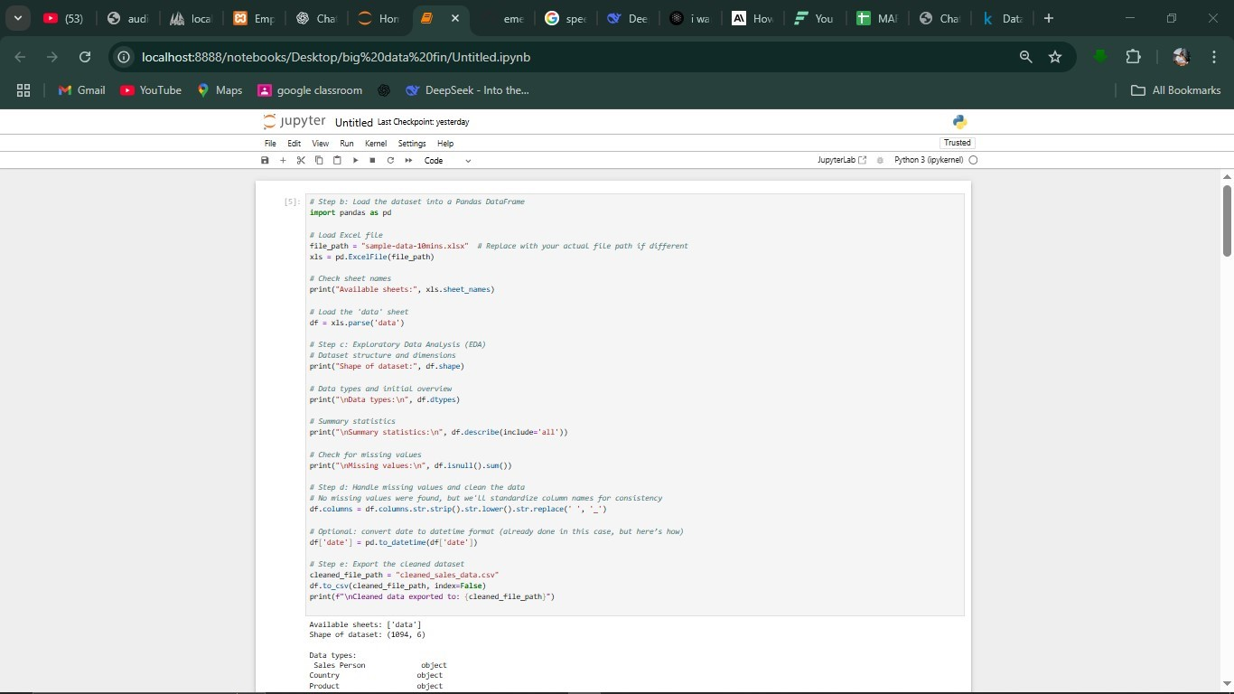
Screenshoots
cleaning

Slide 6
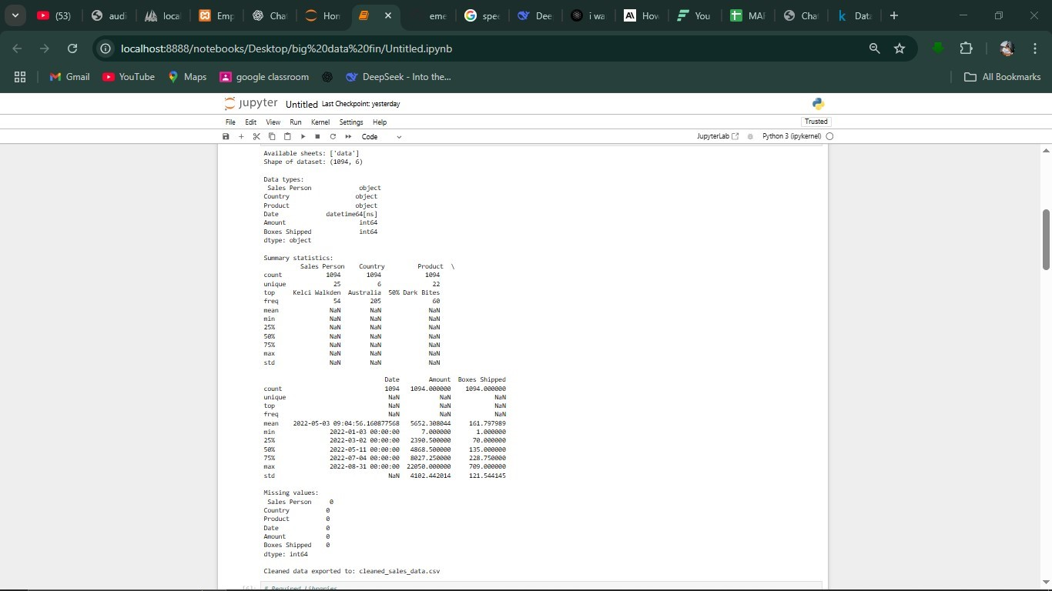
Cleaning cont

Slide 7
2. Exploratory Data Analysis (EDA)
Generated summary statistics: mean, median, standard deviation, quartiles.
Identified outliers using IQR and boxplots.
Explored variable distributions and relationships using: histogram,scatter plots

Slide 8
📊 Exploratory Data Analysis (EDA)
- Descriptive statistics (mean, median, std)
- Distribution plots and box plots
- Outlier detection
- Correlation matrix between variables

Slide 9
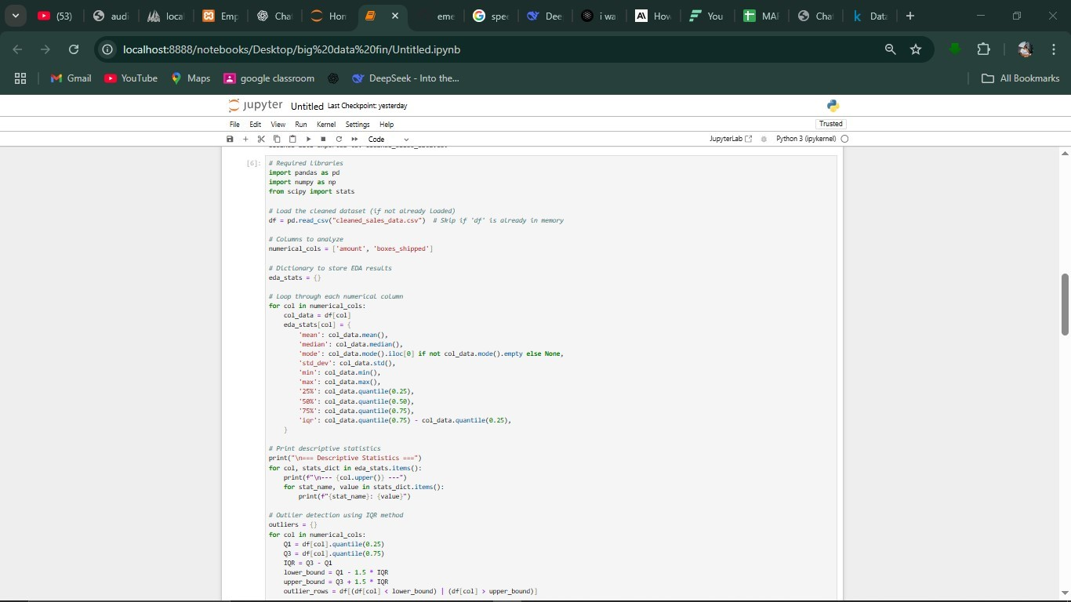
screenshoot

Slide 10
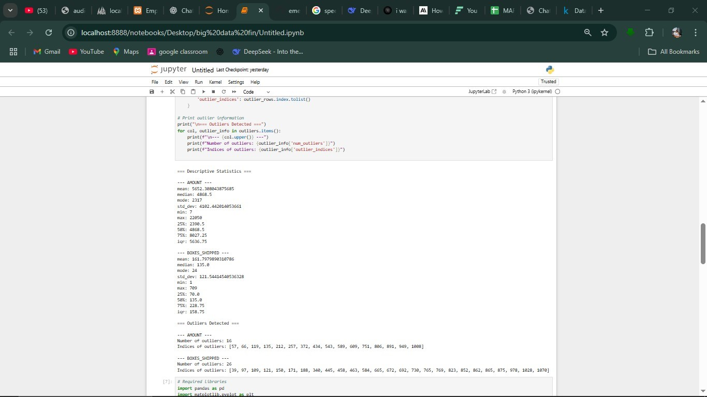

Slide 11
3. Feature Engineering
Extracted date-related features:
Hour, Day, Month, Day of Week
Created new fields:
Peak vs Off-Peak time indicators
Weekday vs Weekend classification
Encoded categorical columns for Power BI compatibility

Slide 12
4. Data Export for Power BI
Saved cleaned and enhanced dataset to CSV (enhanced_sales_data.csv).
Imported into Power BI for visual analytics.

Slide 13
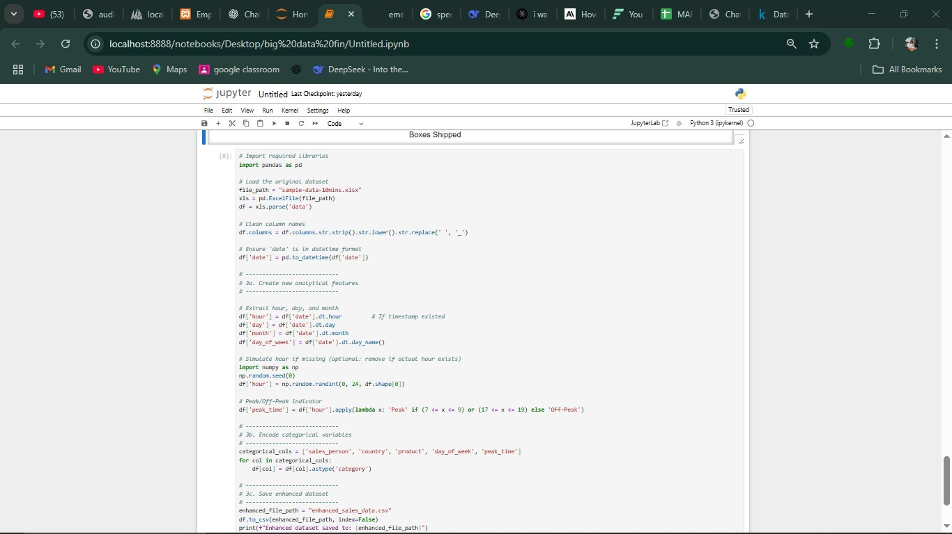
screenshoot

Slide 14
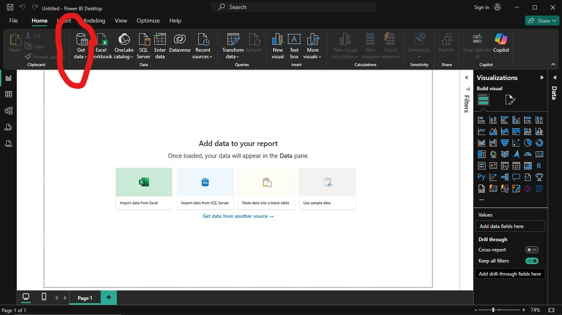
Importing data into power BI

Slide 15
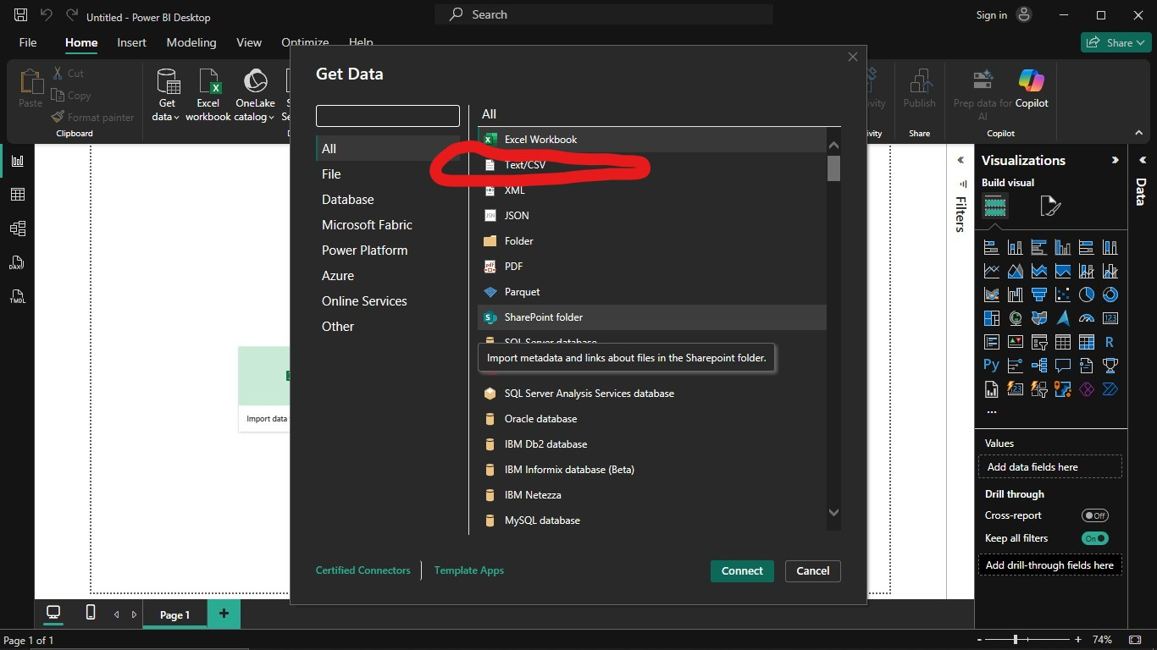

Slide 16
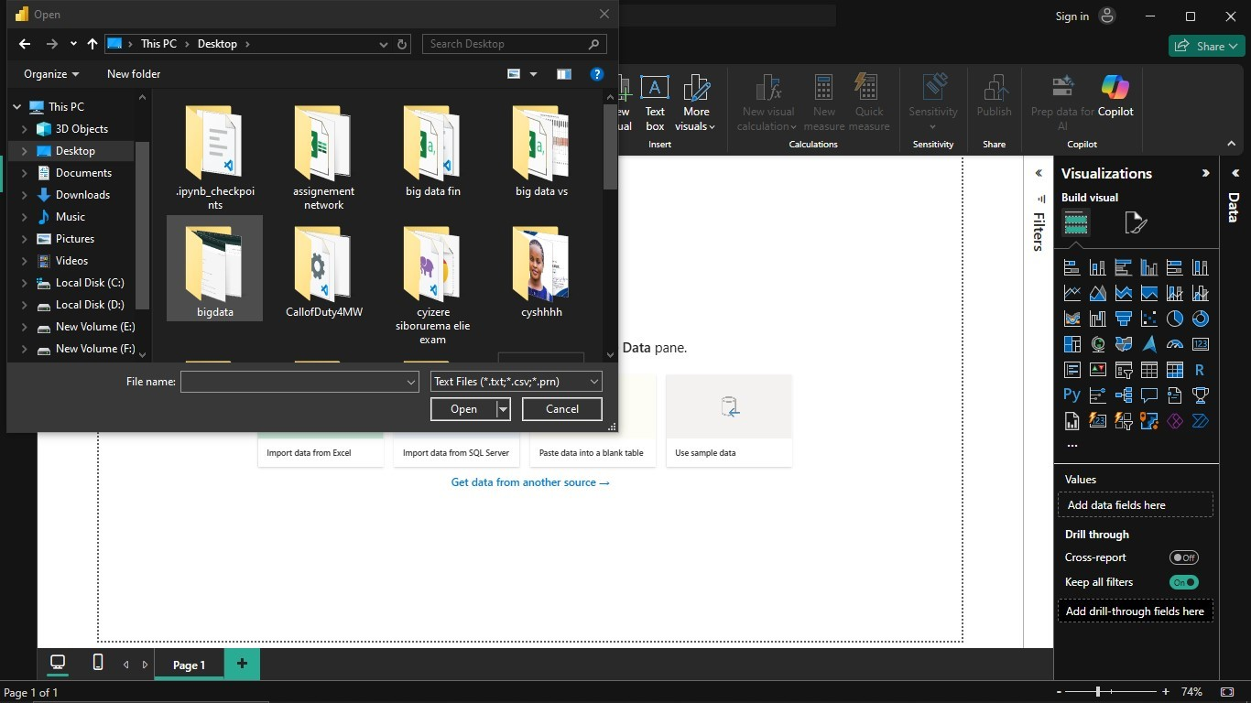

Slide 17
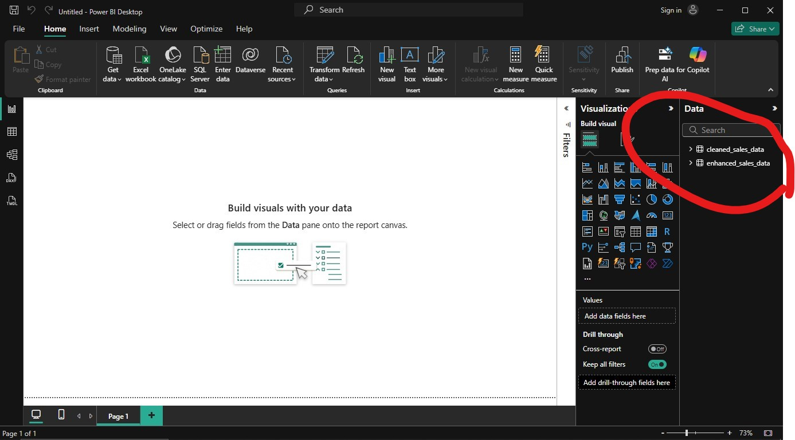

Slide 18
5. Power BI Dashboard Development
Designed interactive visuals: funnel, pie chart, maps, line charts.
Added filters and slicers for drill-downs.
Applied consistent formatting for professional presentation.
- Sales by country, product, and salesperson
- Monthly, daily, and hourly analysis
- Interactive visuals: pie chart, funnel, map
- Slicers and drill-down filters for exploration

Slide 19
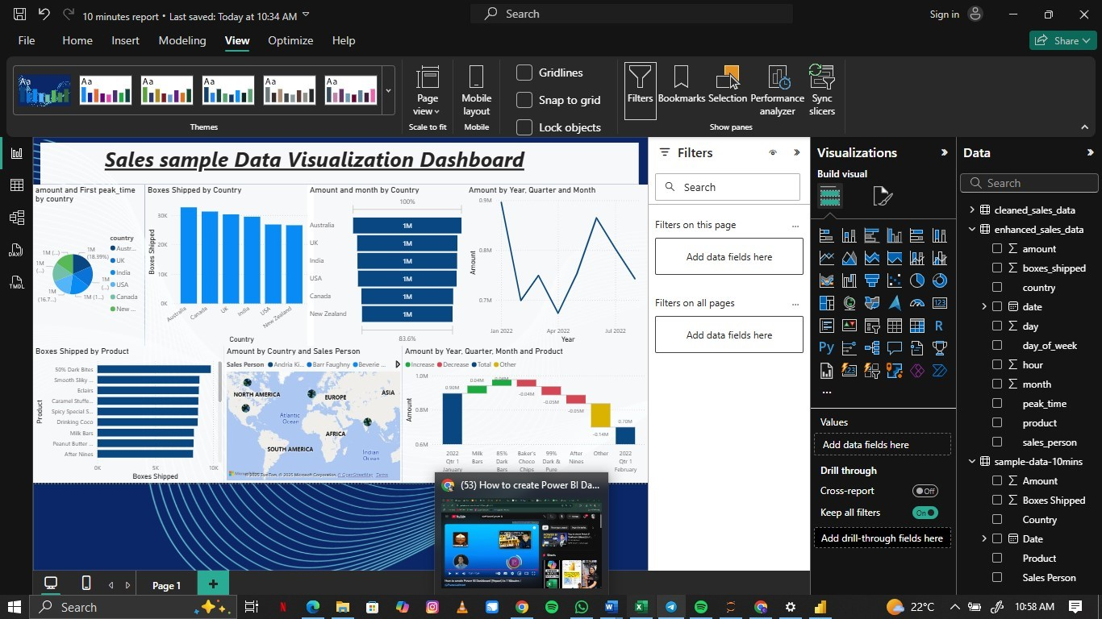
screenshoot

Slide 20
📁 Dataset Overview
Source: sample-data-10mins.xlsx
Features:
- Sales Person
- Country
- Product
- Date
- Amount
- Boxes Shipped
Time range: Various dates across multiple countries.

Slide 21
🔍 Key Insights
- Top countries: UK, India, Australia
- Best-selling products: Peanut Butter Cubes, 99% Dark & Pure
- Monthly and seasonal sales fluctuations
- Top salespeople drive higher revenue

Slide 22
📝 Business Recommendations
- Focus on marketing best-selling products
- Replicate strategies of top-performing salespeople
- Optimize inventory around peak months
- Leverage Power BI dashboard for continuous insights

Slide 23
✅ Conclusion
- Python streamlined data analysis and feature creation
- Power BI delivered insightful visual storytelling
- Dashboard empowers smarter sales and marketing decisions

Slide 24
📬 Contact & Questions
Thank you for your attention!
Questions?
GitHub: https://github.com/emerick149/sales-data-analysis
Email: eliesiborurema@gmail.com

