Slide 1

Ansible On Windows
emerson.candido@live.com
https://github.com/emerson-candido

Slide 2
Git first steps
emerson.candido@live.com
https://github.com/emerson-candido

Slide 3
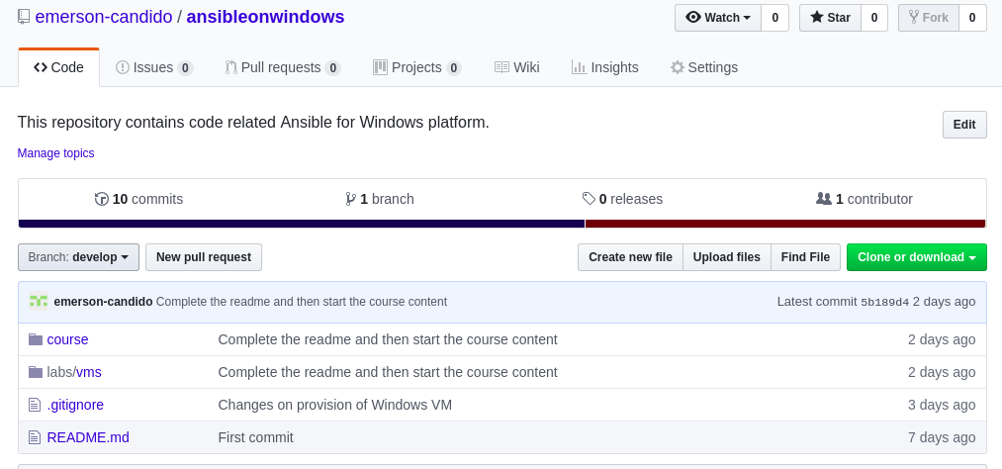
Github
emerson.candido@live.com
https://github.com/emerson-candido/ansibleonwindows

Slide 4

Git First Steps
Understand repositories
Understand branches
Code workflow
  Commit
  Push
  Pull
emerson.candido@live.com
https://github.com/emerson-candido/ansibleonwindows

Slide 5
Se you soon!
emerson.candido@live.com
https://github.com/emerson-candido/ansibleonwindows

