Slide 1

Ansible On Windows
emerson.candido@live.com
https://github.com/emerson-candido

Slide 2
Lab environment
emerson.candido@live.com
https://github.com/emerson-candido

Slide 3
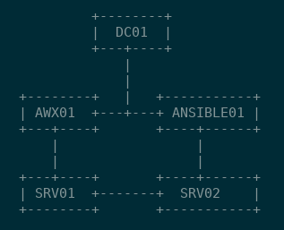
Lab environment
emerson.candido@live.com
https://github.com/emerson-candido/ansibleonwindows

Slide 4
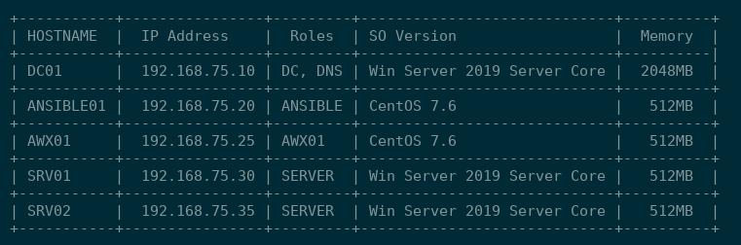
Lab environment
emerson.candido@live.com
https://github.com/emerson-candido/ansibleonwindows

Slide 5
Se you soon!
emerson.candido@live.com
https://github.com/emerson-candido/ansibleonwindows

